Slide 1
Dog DFE Meeting
7/14/2020 feat. Kirk and Eduardo

Slide 2
Summary from last week
I think I figured out the truly neutral inference, i.e., inferring a DFE based purely on demographic info.
As a spot check, the proportional (simulated) empirical synonymous sfs matches the proportional inferred nonsynonymous sfs.
However, optimizing around highly constrained parameter space results in the same solution regardless of how many iterations and guesses, so when I spit out the top 5 best guesses, they were all the same – here I am only reporting one.

Slide 3
Simulation summary
As a reminder, the simulations were performed as follows:
An ancestral population of 80,000 wolves existed some time in the past.
Their evolution was “burnt in” for 80,000 * 10 generations, i.e., 800,000 generations.
24,251 generations ago, the ancestral population was subject to a bottleneck to 19,000 individuals, i.e., a Labrador demography
10,000 generations ago, we shifted ALL new mutations to s=0, i.e., all new mutations became neutral
Today, we sample 8 individuals, or 16 chromosomes.

Slide 4
Seed 1
 | Gamma
 | Likelihood | Alpha | Beta
1st | -37.03836514753061 | 0.52218345 | 24.12967973
2nd | -37.049454227536444 | 0.51824542 | 24.57352965
3rd | -37.05172348908468 | 0.5178686 | 24.60263265
4th | -37.05283117527006 | 0.51724331 | 24.69234263
5th | -37.05337365397099 | 0.51702315 | 24.72539149
 | Neugamma
 | Likelihood | Proportion | Alpha | Beta
1st | -37.02622174959947 | 0.07137269 | 0.67459489 | 19.0715012
2nd | -37.0298378098546 | 0.11362355 | 0.81176614 | 16.16062565
3rd | -37.03034517304923 | 0.11515994 | 0.81978776 | 15.98178463
4th | -37.05283117527006 | 0.12217263 | 0.8471402 | 15.56531733
5th | -37.032484712146015 | 0.12558326 | 0.86278551 | 15.29135375
 | Neutral
 | Likelihood | Proportion | Alpha | Beta
1st | -54.4911494809 | 0.99999999 | 6.05813971e-02 | 1.91695839e+04

Slide 5
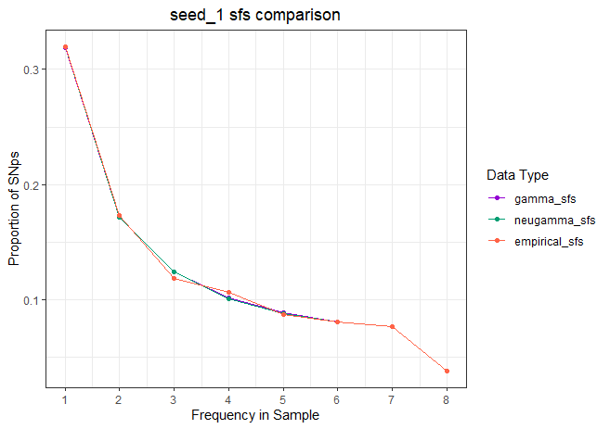
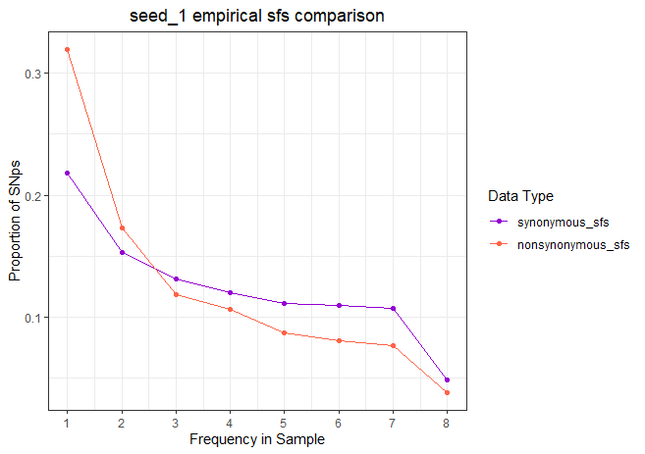
On the left is an sfs comparison between the inferred sfs using a gamma distribution or a neutral-gamma distribution, as well as the “empirical” nonsynonymous sfs spit out by SLiM.
Gamma and neugamma sfs match each other well, but slightly worse matching with empirical
On the right is an sfs comparison between the “empirical” synonymous and nonsynonymous sfs’s spit out by SLiM.
Synonymous and nonsynonymous sfs do not match very well.
This suggests that the current simulations do not have a truly neutral DFE (which makes sense due to setup, as only the last 10,000 generations were shifted to a truly neutral DFE, whereas all previous generations were under an Arctic wolf DFE.)

Slide 6
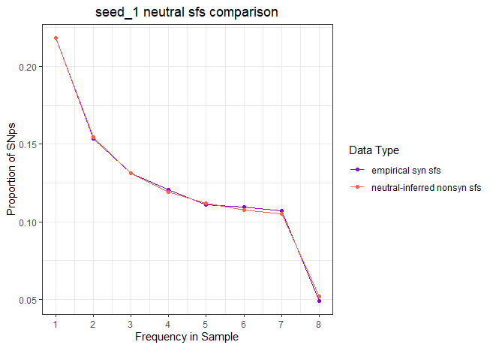
This is comparing the (simulated) empirical synonymous sfs and the nonsynonymous sfs produced when inferring the DFE based purely on demography, i.e., a purely neutral model.

Slide 7
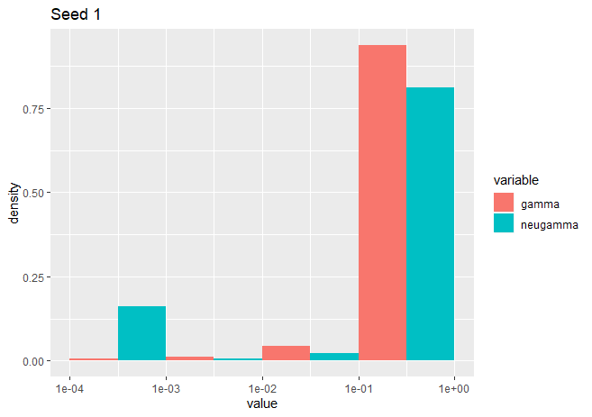
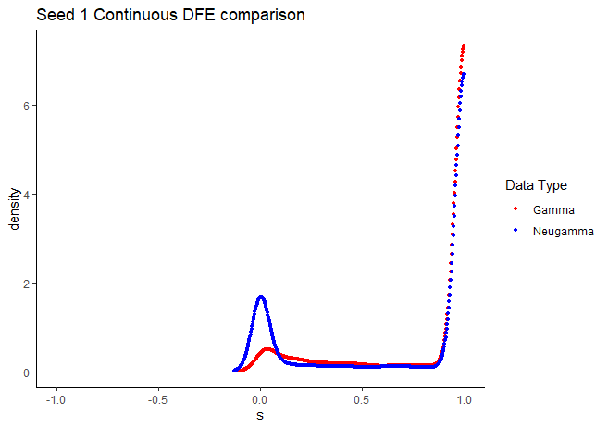
A DFE inferred under a neutral-gamma assumption has a point-mass at s=0, as expected.
When shown either binned or continuous, the DFE inferred under either a gamma or neutral gamma model differ.
This makes sense (through the lens of statistics) because different assumptions result in inferences
This doesn’t make sense (through the lens of biology) because the SFS’s match super close to each other, so the true underlying DFE’s should be similar or identical.
Big takeaway is that the underlying assumption of what form the DFE takes affects our inferred DFE, which is kind of worrying. Not sure which inferred DFE is “correct”.

Slide 8
Seed 2
The population-scaled best-fit parameters: [-37.91140720271733 array([ 0.42616827, 82.97655387])].
The population-scaled best-fit parameters: [-37.933275721346035 array([ 0.41815093, 87.34678929])].
The population-scaled best-fit parameters: [-37.93457382288716 array([ 0.41754515, 87.80641927])].
The population-scaled best-fit parameters: [-37.93472132248462 array([ 0.41753396, 87.80113349])].
The population-scaled best-fit parameters: [-37.9351083160218 array([ 0.41740083, 87.91552924])].
The population-scaled best-fit parameters: [-37.91343543225207 array([ 0.0861595 , 0.56581974, 65.54497081])].
The population-scaled best-fit parameters: [-37.9143875851114 array([ 0.12388146, 0.66492325, 56.87671786])].
The population-scaled best-fit parameters: [-37.9152873172186 array([ 0.13110814, 0.68872322, 55.15147521])].
The population-scaled best-fit parameters: [-37.91582999705952 array([ 0.12805149, 0.67634901, 56.33555846])].
The population-scaled best-fit parameters: [-37.916041961289466 array([ 0.13807284, 0.71379824, 53.37138283])].
The population-scaled best-fit parameters: [-53.7533563669array([0.99999999, 5.25045079e-02, 5.01122255e+04])].

Slide 9
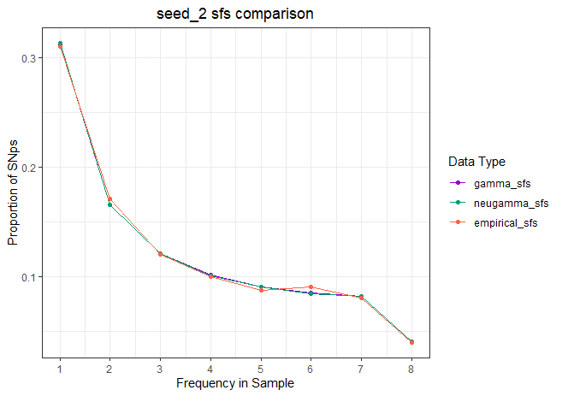
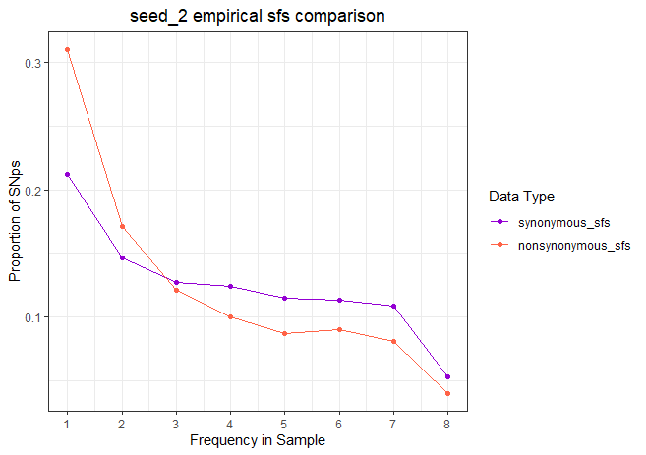
On the left is an sfs comparison between the inferred sfs using a gamma distribution or a neutral-gamma distribution, as well as the “empirical” nonsynonymous sfs spit out by SLiM.
Gamma and neugamma sfs match each other well, but very slightly worse matching with empirical
On the right is an sfs comparison between the “empirical” synonymous and nonsynonymous sfs’s spit out by SLiM.
Similar story as seed 1

Slide 10
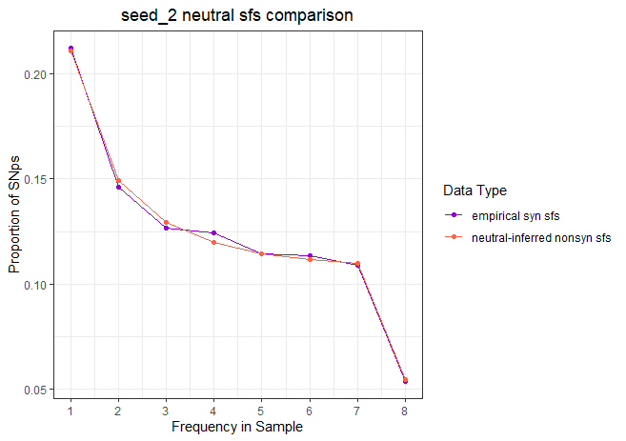
This is comparing the (simulated) empirical synonymous sfs and the nonsynonymous sfs produced when inferring the DFE based purely on demography, i.e., a purely neutral model.

Slide 11
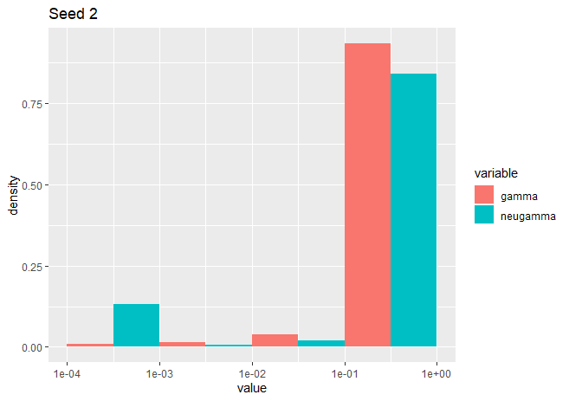
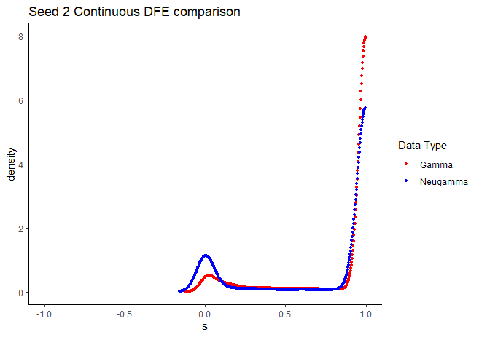
A DFE inferred under a neutral-gamma assumption has a point-mass at s=0, as expected.
As a side-note, the continuous DFE / density plot has values below 0, but those are just plotting artifacts from R.
When shown either binned or continuous, the DFE inferred under either a gamma or neutral gamma model differ.
This makes sense (through the lens of statistics) because different assumptions result in inferences
This doesn’t make sense (through the lens of biology) because the SFS’s match super close to each other, so the true underlying DFE’s should be similar or identical.
Big takeaway is that the underlying assumption of what form the DFE takes affects our inferred DFE, which is kind of worrying. Not sure which inferred DFE is “correct”.

Slide 12
Seed 3
The population-scaled best-fit parameters: [-35.86036371889577 array([ 0.47562804, 64.7016557 ])].
The population-scaled best-fit parameters: [-35.86323807045346 array([ 0.47453927, 65.13021638])].
The population-scaled best-fit parameters: [-35.863489858975754 array([ 0.4743693 , 65.22424747])].
The population-scaled best-fit parameters: [-35.86368425184219 array([ 0.4743141 , 65.24637038])].
The population-scaled best-fit parameters: [-35.86368034553175 array([ 0.47431541, 65.24574088])].
The population-scaled best-fit parameters: [-35.80557252696144 array([ 0.16382066, 0.99456779, 33.42607545])].
The population-scaled best-fit parameters: [-35.80807717872949 array([ 0.15880418, 0.96084792, 34.40328342])].
The population-scaled best-fit parameters: [-35.810768383263394 array([ 0.14972956, 0.90373204, 36.46252821])].
The population-scaled best-fit parameters: [-35.81348710953739 array([ 0.14197972, 0.86232906, 38.0037647 ])].
The population-scaled best-fit parameters: [-35.8136301853699 array([ 0.14128116, 0.85797647, 38.2021284 ])].
The population-scaled best-fit parameters: [-46.0166809706 array([0.99999999, 5.21275728e-02, 1.55425852e+04])].

Slide 13
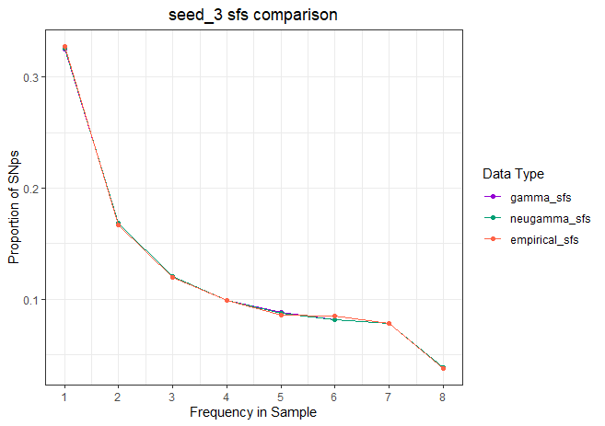
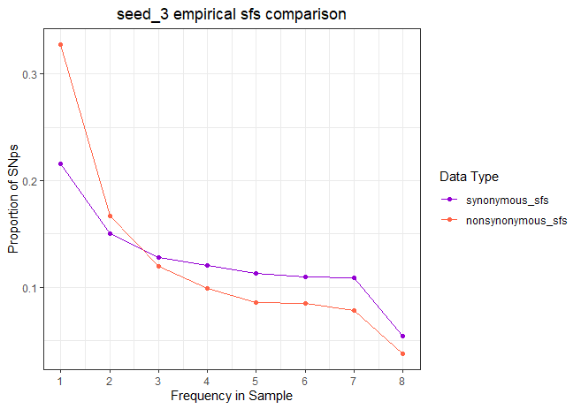
On the left is an sfs comparison between the inferred sfs using a gamma distribution or a neutral-gamma distribution, as well as the “empirical” nonsynonymous sfs spit out by SLiM.
All three match pretty well
On the right is an sfs comparison between the “empirical” synonymous and nonsynonymous sfs’s spit out by SLiM.
Similar story as seed 1

Slide 14
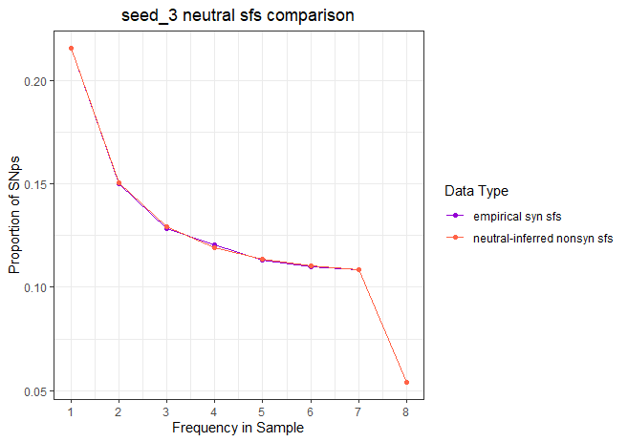
This is comparing the (simulated) empirical synonymous sfs and the nonsynonymous sfs produced when inferring the DFE based purely on demography, i.e., a purely neutral model.

Slide 15
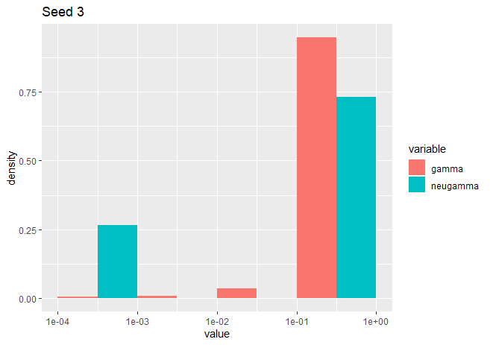
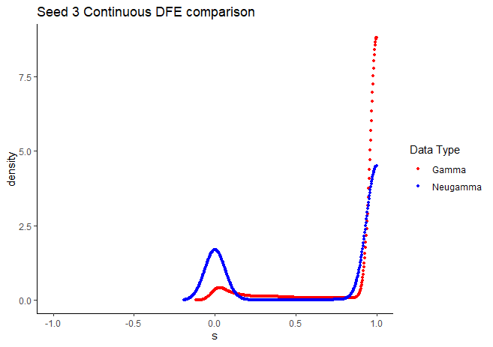
A DFE inferred under a neutral-gamma assumption has a point-mass at s=0, as expected.
As a side-note, the continuous DFE / density plot has values below 0, but those are just plotting artifacts from R.
When shown either binned or continuous, the DFE inferred under either a gamma or neutral gamma model differ.
This makes sense (through the lens of statistics) because different assumptions result in inferences
This doesn’t make sense (through the lens of biology) because the SFS’s match super close to each other, so the true underlying DFE’s should be similar or identical.
Big takeaway is that the underlying assumption of what form the DFE takes affects our inferred DFE, which is kind of worrying. Not sure which inferred DFE is “correct”.

Slide 16
Seed 4
The population-scaled best-fit parameters: [-38.74844208191689 array([ 0.39553438, 62.81749496])].
The population-scaled best-fit parameters: [-38.74884830318183 array([ 0.39541822, 62.88766437])].
The population-scaled best-fit parameters: [-38.74886628602758 array([ 0.39541916, 62.88489728])].
The population-scaled best-fit parameters: [-38.74913920115978 array([ 0.39536176, 62.91430469])].
The population-scaled best-fit parameters: [-38.74984761720202 array([ 0.39521526, 62.99153585])].
The population-scaled best-fit parameters: [-38.47589613095738 array([ 0.20848412, 0.96321807, 26.79482919])].
The population-scaled best-fit parameters: [-38.47710668460468 array([ 0.21531336, 0.99693284, 26.30979454])].
The population-scaled best-fit parameters: [-38.48420680245022 array([ 0.20460114, 0.93568218, 27.57623833])].
The population-scaled best-fit parameters: [-38.49574542472237 array([ 0.1991047 , 0.89871485, 28.72799608])].
The population-scaled best-fit parameters: [-38.503241299855745 array([ 0.1952837 , 0.87630218, 29.40933897])].
The population-scaled best-fit parameters: [-52.6253057832 array([0.99999999, 1.40510334e-01, 1.32043682e+04])].

Slide 17
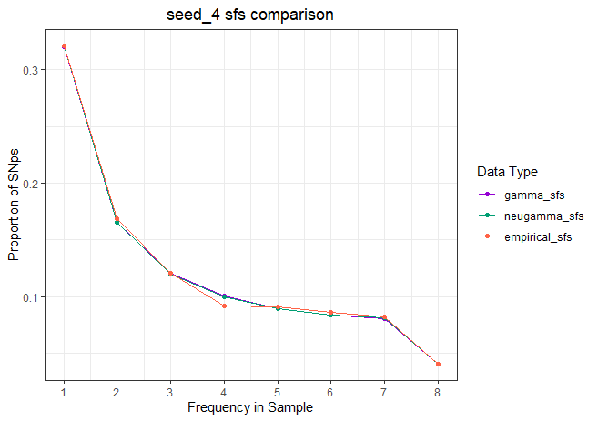
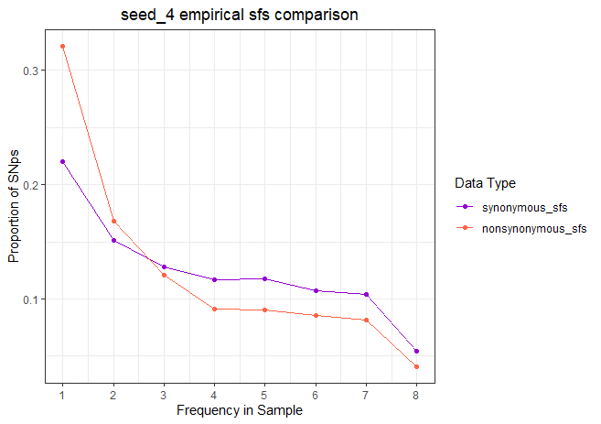
On the left is an sfs comparison between the inferred sfs using a gamma distribution or a neutral-gamma distribution, as well as the “empirical” nonsynonymous sfs spit out by SLiM.
Gamma and neugamma sfs match each other well, but very slightly worse matching with empirical
On the right is an sfs comparison between the “empirical” synonymous and nonsynonymous sfs’s spit out by SLiM.
Similar story as seed 1

Slide 18
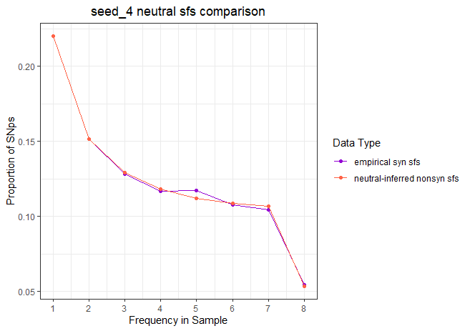
This is comparing the (simulated) empirical synonymous sfs and the nonsynonymous sfs produced when inferring the DFE based purely on demography, i.e., a purely neutral model.

Slide 19
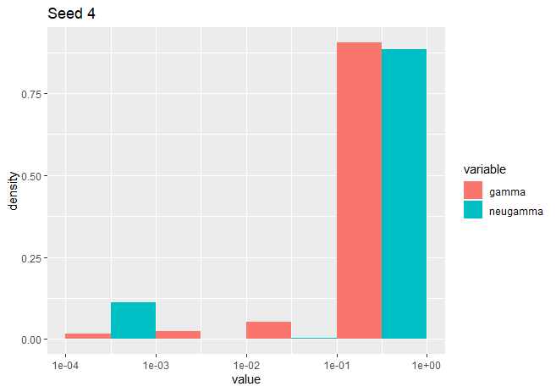
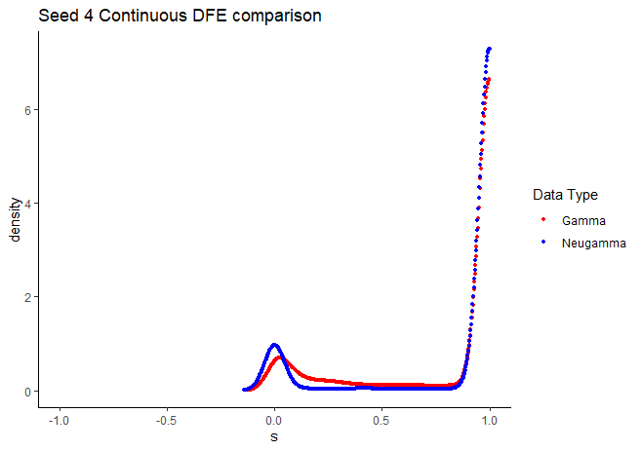
A DFE inferred under a neutral-gamma assumption has a point-mass at s=0, as expected.
As a side-note, the continuous DFE / density plot has values below 0, but those are just plotting artifacts from R.
When shown either binned or continuous, the DFE inferred under either a gamma or neutral gamma model differ.
This makes sense (through the lens of statistics) because different assumptions result in inferences
This doesn’t make sense (through the lens of biology) because the SFS’s match super close to each other, so the true underlying DFE’s should be similar or identical.
Big takeaway is that the underlying assumption of what form the DFE takes affects our inferred DFE, which is kind of worrying. Not sure which inferred DFE is “correct”.

Slide 20
Seed 5
The population-scaled best-fit parameters: [-41.18736659210276 array([ 0.47250698, 28.53572553])].
The population-scaled best-fit parameters: [-41.197702138380464 array([ 0.46769026, 29.31877681])].
The population-scaled best-fit parameters: [-41.19883822089696 array([ 0.46700085, 29.46730036])].
The population-scaled best-fit parameters: [-41.19883973259152 array([ 0.46700076, 29.46725743])].
The population-scaled best-fit parameters: [-41.19893973989497 array([ 0.46697561, 29.47171607])].
The population-scaled best-fit parameters: [-40.57924850629888 array([ 0.17848647, 0.99190092, 14.82176145])].
The population-scaled best-fit parameters: [-40.583878945695915 array([ 0.18344173, 0.99849742, 15.0951423 ])].
The population-scaled best-fit parameters: [-40.58519878928291 array([ 0.17749106, 0.98318778, 14.9808741 ])].
The population-scaled best-fit parameters: [-40.608597607257025 array([ 0.17257341, 0.95335154, 15.40841799])].
The population-scaled best-fit parameters: [-40.64645580871979 array([ 0.16472813, 0.90630135, 16.20490918])].
The population-scaled best-fit parameters: [-48.2744538697 array([0.99999999, 7.80034765e-02, 1.98261051e+04])].

Slide 21
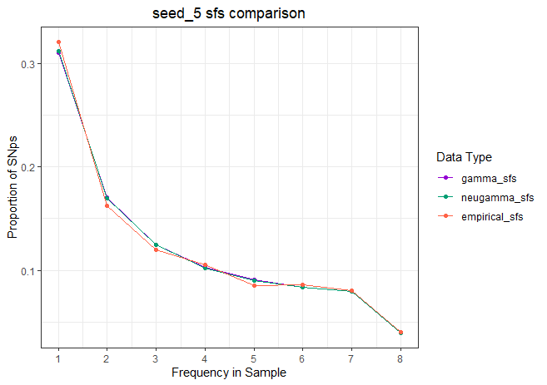
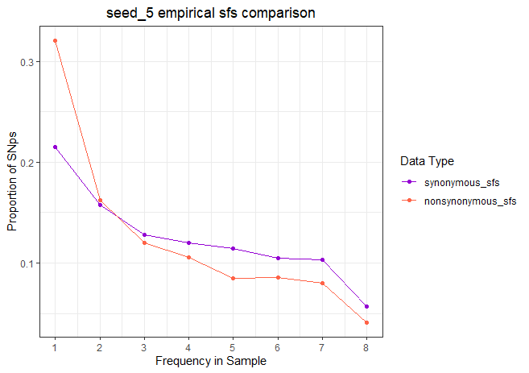
On the left is an sfs comparison between the inferred sfs using a gamma distribution or a neutral-gamma distribution, as well as the “empirical” nonsynonymous sfs spit out by SLiM.
Gamma and neugamma sfs match each other well, but slightly worse matching with empirical
On the right is an sfs comparison between the “empirical” synonymous and nonsynonymous sfs’s spit out by SLiM.
Similar story as seed 1

Slide 22
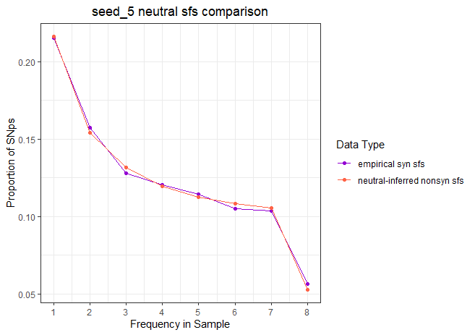
This is comparing the (simulated) empirical synonymous sfs and the nonsynonymous sfs produced when inferring the DFE based purely on demography, i.e., a purely neutral model.

Slide 23
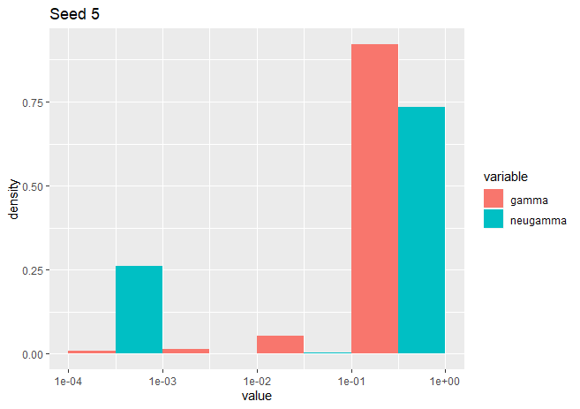
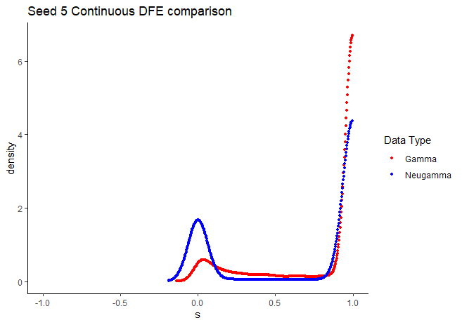
A DFE inferred under a neutral-gamma assumption has a point-mass at s=0, as expected.
As a side-note, the continuous DFE / density plot has values below 0, but those are just plotting artifacts from R.
When shown either binned or continuous, the DFE inferred under either a gamma or neutral gamma model differ.
This makes sense (through the lens of statistics) because different assumptions result in inferences
This doesn’t make sense (through the lens of biology) because the SFS’s match super close to each other, so the true underlying DFE’s should be similar or identical.
Big takeaway is that the underlying assumption of what form the DFE takes affects our inferred DFE, which is kind of worrying. Not sure which inferred DFE is “correct”.

