Slide 1
Dog DFE Meeting
7/28/2020 feat. Kirk and Eduardo

Slide 2
Summary from last week
Fixed plotting errors
Revisited “recapitulated” data from last year (i.e., to simulate AW DFE)

Slide 3
“Recap” Simulation summary
As a reminder, the simulations were performed as follows:
An ancestral population of 80,000 wolves existed some time in the past.
Their evolution was “burnt in” for 80,000 * 10 generations, i.e., 800,000 generations.
24,251 generations ago, the ancestral population was subject to a bottleneck to 19,000 individuals, i.e., a Labrador demography.
At this time, the DFE was set to match that of ancestral Arctic Wolves
Today, we sample 8 individuals, or 16 chromosomes.

Slide 4
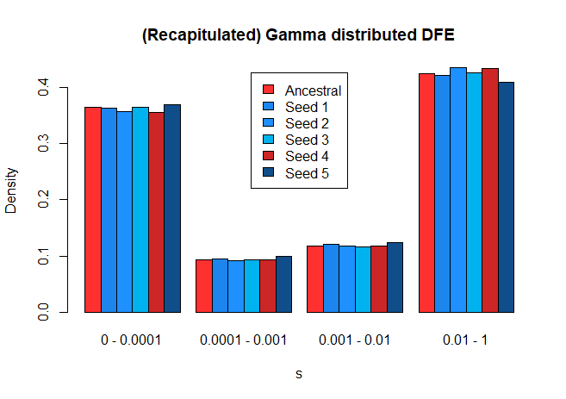
Recapitulated DFE (with new pipeline)
Using simulations, we can recapitulate
the inferred DFE.

Slide 5
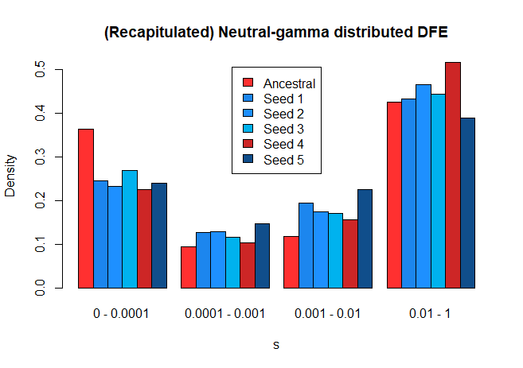
Recapitulated DFE (with new pipeline)
This doesn’t match as well, but I suspect this is because the true underlying (simulated) distribution, is gamma-distributed

Slide 6
“Shifted” Simulation summary
As a reminder, the simulations were performed as follows:
An ancestral population of 80,000 wolves existed some time in the past.
Their evolution was “burnt in” for 80,000 * 10 generations, i.e., 800,000 generations.
24,251 generations ago, the ancestral population was subject to a bottleneck to 19,000 individuals, i.e., a Labrador demography
10,000 generations ago, we shifted ALL new mutations to s=0, i.e., all new mutations became neutral
Today, we sample 8 individuals, or 16 chromosomes.

Slide 7
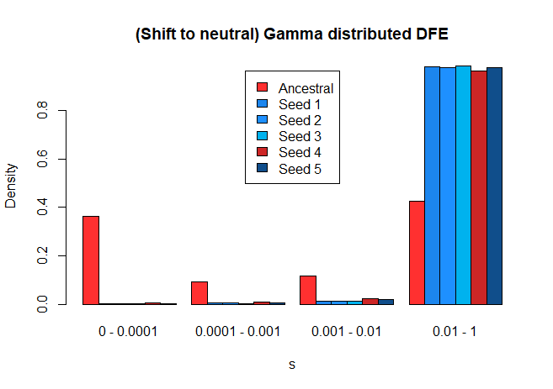
“Shifted” DFE (with new pipeline)
I believe the original justification for these simulations was to introduce a very drastic shift in DFE and see if we can detect it. There is certainly a difference in the inferred DFE, but the actual results of the inference differ from our expectation, i.e., s values went to 1 instead of 0.

Slide 8
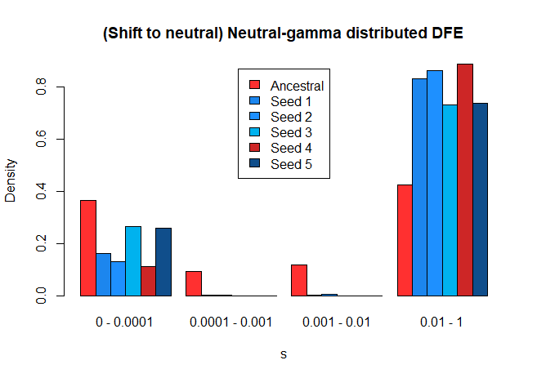
“Shifted” Neutral-gamma DFE

Slide 9
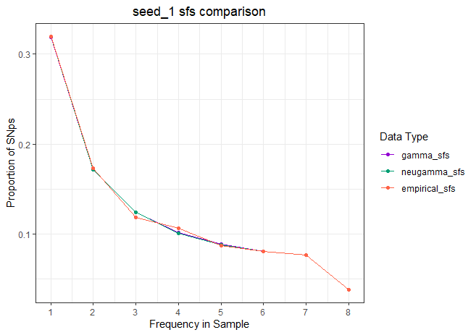
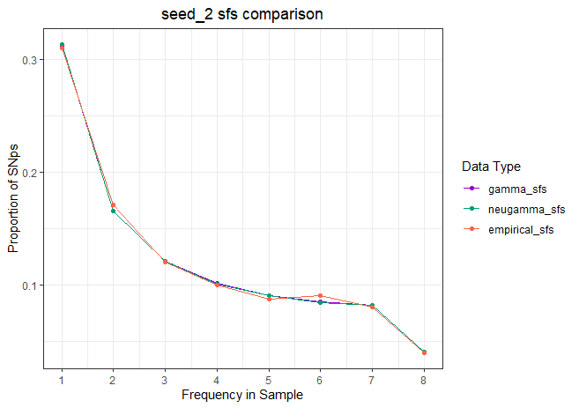
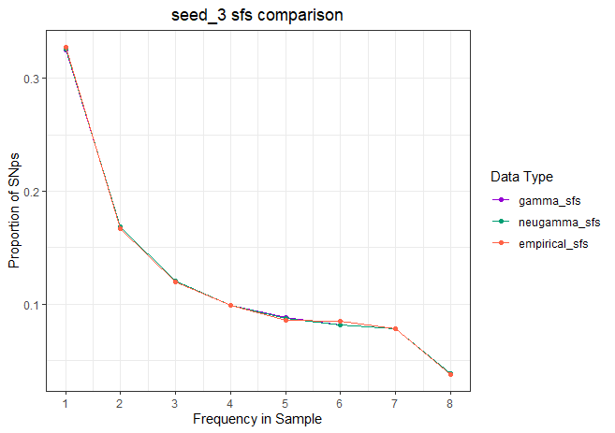
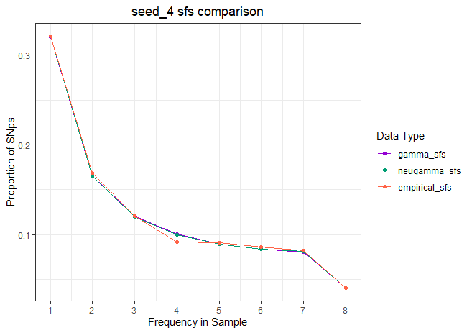
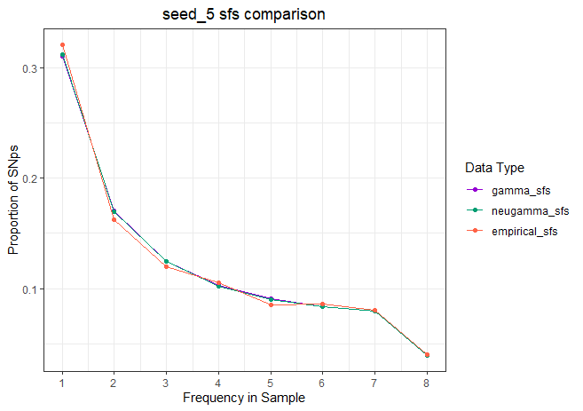
These all tell us that
Simulations match simulations

Slide 10
//TODO
I’m moving next week, and probably won’t be able to meet on 8/4
I should be set up and settled in by 8/11
Plot out sfs comparing recap data and shifted data
Compare all simulated sfs (how much variation within simulations, and between simulation types, i.e., shifted vs recap)
Separate plots for count and proportional sfs

