Slide 1
Dog DFE Meeting
8/11/2020 feat. Kirk and Eduardo

Slide 2
Summary from 2 weeks ago
Plot out sfs comparing recap data and shifted data
Compare all simulated sfs (how much variation within simulations, and between simulation types, i.e., shifted vs recap)
Separate plots for count and proportional sfs

Slide 3
“Recap” Simulation summary
As a reminder, the simulations were performed as follows:
An ancestral population of 80,000 wolves existed some time in the past.
Their evolution was “burnt in” for 80,000 * 10 generations, i.e., 800,000 generations.
24,251 generations ago, the ancestral population was subject to a bottleneck to 19,000 individuals, i.e., a Labrador demography.
At this time, the DFE was set to match that of ancestral Arctic Wolves
Today, we sample 8 individuals, or 16 chromosomes.

Slide 4
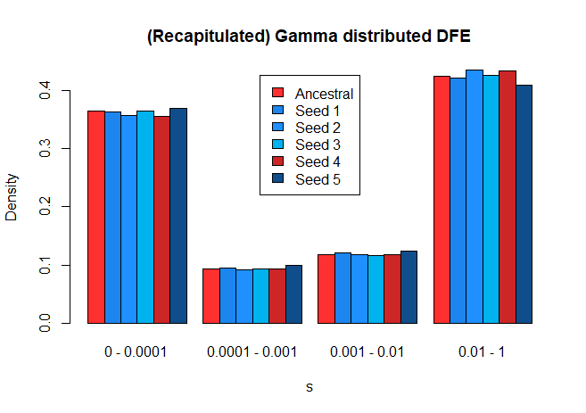
Recapitulated DFE (with new pipeline)
Using simulations, we can recapitulate
the inferred DFE.

Slide 5
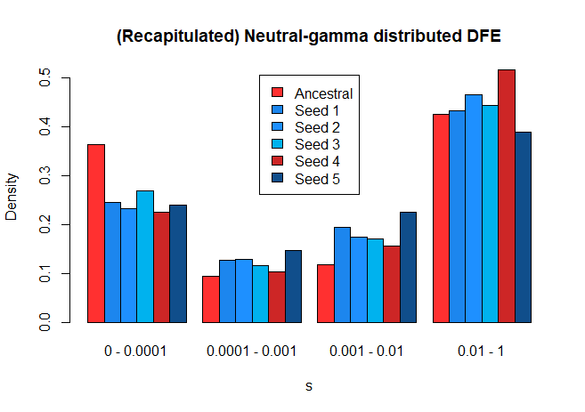
Recapitulated DFE (with new pipeline)
This doesn’t match as well, but I suspect this is because the true underlying (simulated) distribution, is gamma-distributed

Slide 6
“Shifted” Simulation summary
As a reminder, the simulations were performed as follows:
An ancestral population of 80,000 wolves existed some time in the past.
Their evolution was “burnt in” for 80,000 * 10 generations, i.e., 800,000 generations.
24,251 generations ago, the ancestral population was subject to a bottleneck to 19,000 individuals, i.e., a Labrador demography
10,000 generations ago, we shifted ALL new mutations to s=0, i.e., all new mutations became neutral
Today, we sample 8 individuals, or 16 chromosomes.

Slide 7
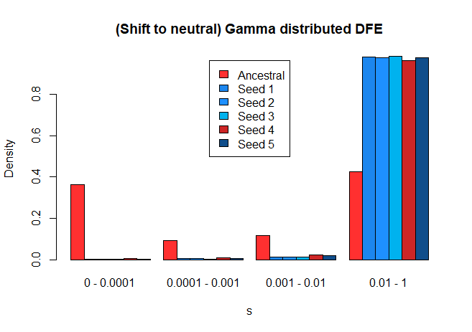
“Shifted” DFE (with new pipeline)
I believe the original justification for these simulations was to introduce a very drastic shift in DFE and see if we can detect it. There is certainly a difference in the inferred DFE, but the actual results of the inference differ from our expectation, i.e., s values went to 1 instead of 0.

Slide 8
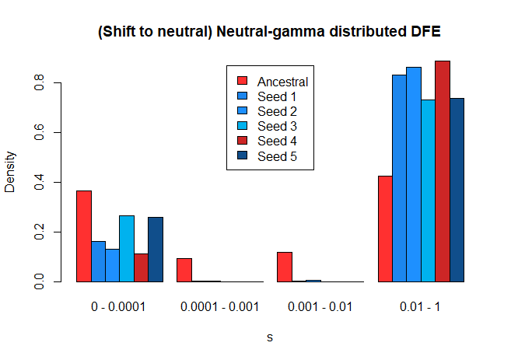
“Shifted” Neutral-gamma DFE

Slide 9
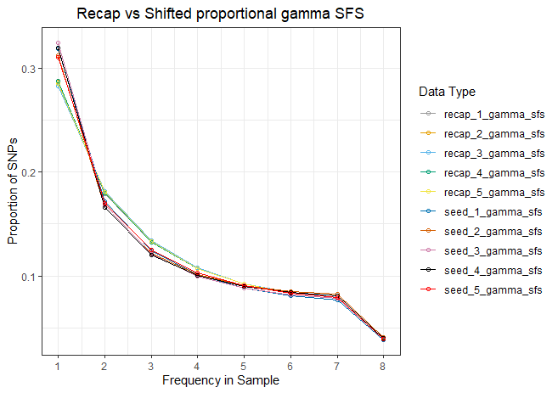
Recap and shifted gamma sfs (proportional)
Lighter colors = recap
Darker colors = shifted

Slide 10
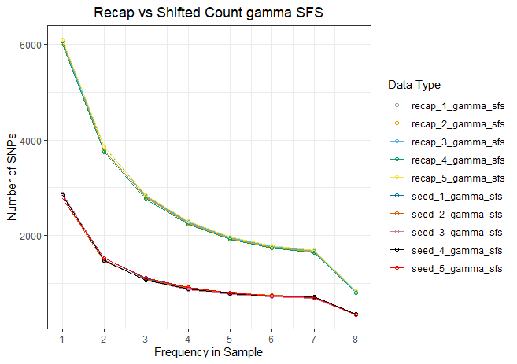
Recap and shifted gamma sfs (count)
Lighter colors = recap
Darker colors = shifted

Slide 11
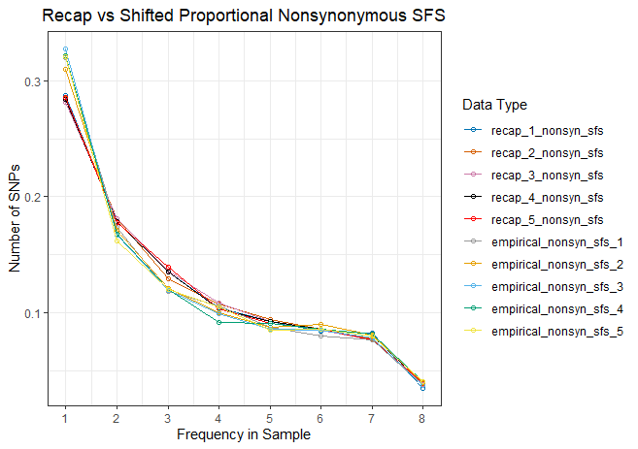
Recap and shifted nonsyn sfs (proportional)
Lighter colors = recap
Darker colors = shifted

Slide 12
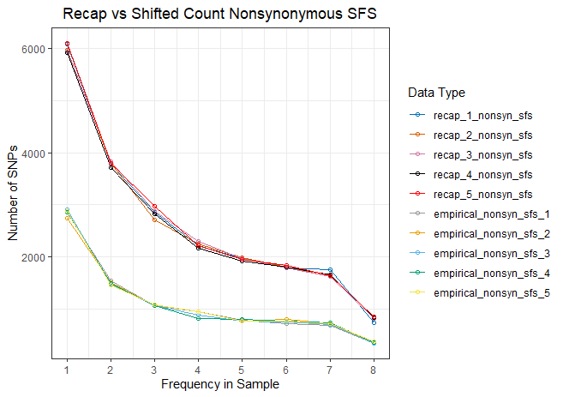
Recap and shifted nonsyn sfs (count)
Lighter colors = recap
Darker colors = shifted

Slide 13
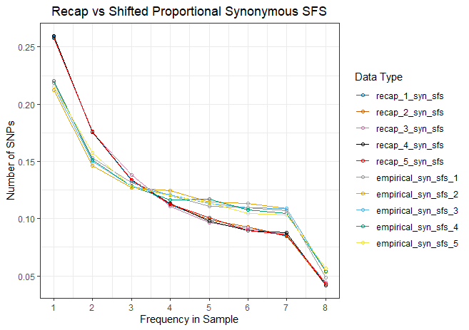
Recap and shifted syn sfs (proportional)
Lighter colors = recap
Darker colors = shifted

Slide 14
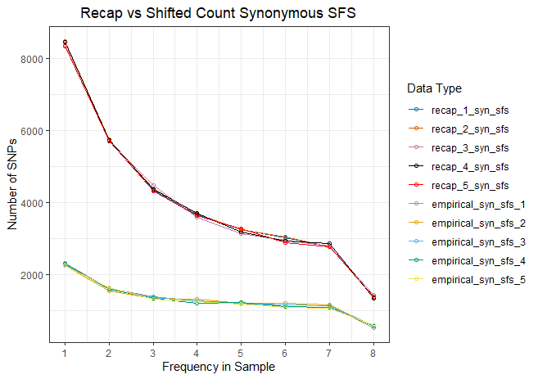
Recap and shifted syn sfs (count)
Lighter colors = recap
Darker colors = shifted

Slide 15
//TODO
Revisit SLiM, look at model we’re working with.
Shift and recap
Look at number of mutations which are segregating over time
Look at mutations over time between two separate simulations
Why are there fewer mutations in the smaller population???

