Slide 1


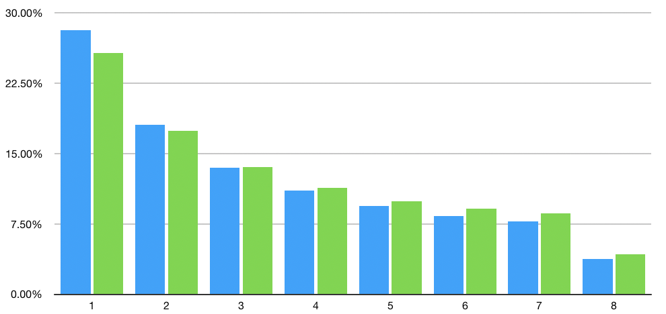
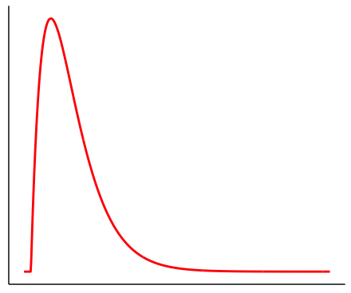




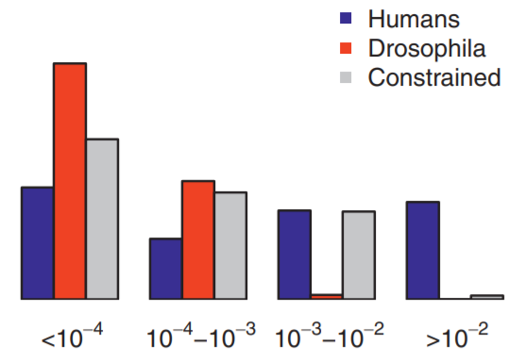
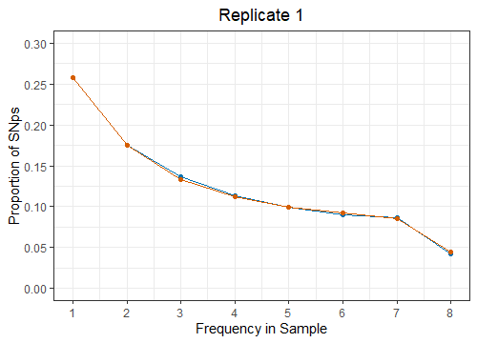
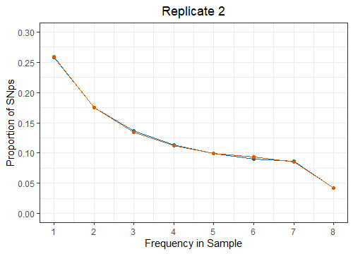
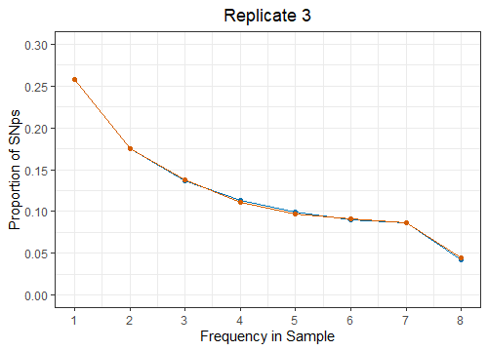
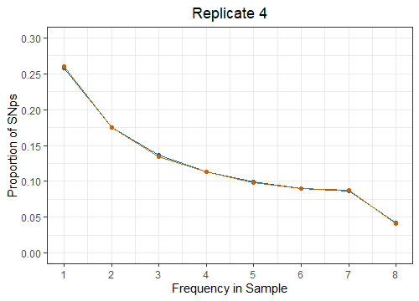
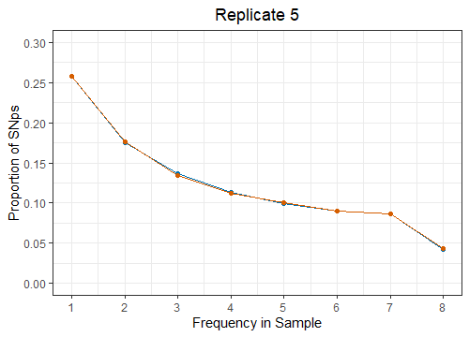

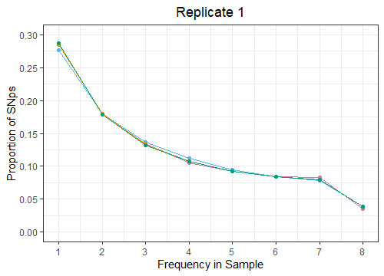
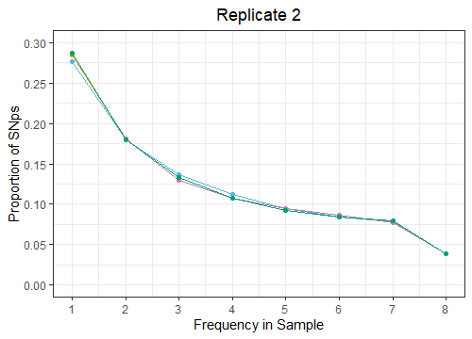
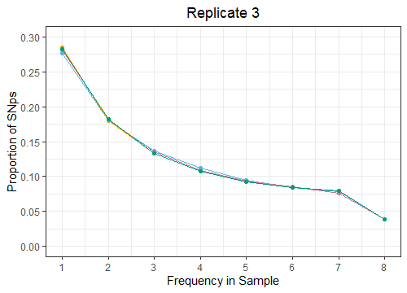
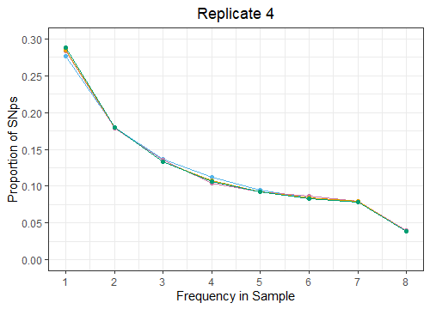
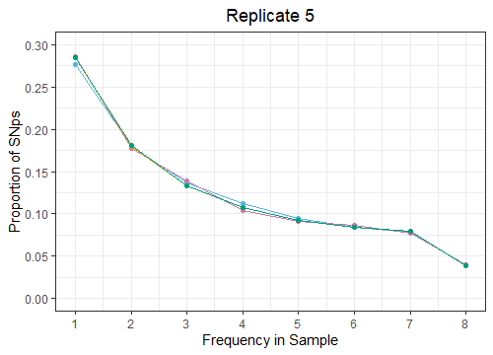
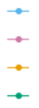
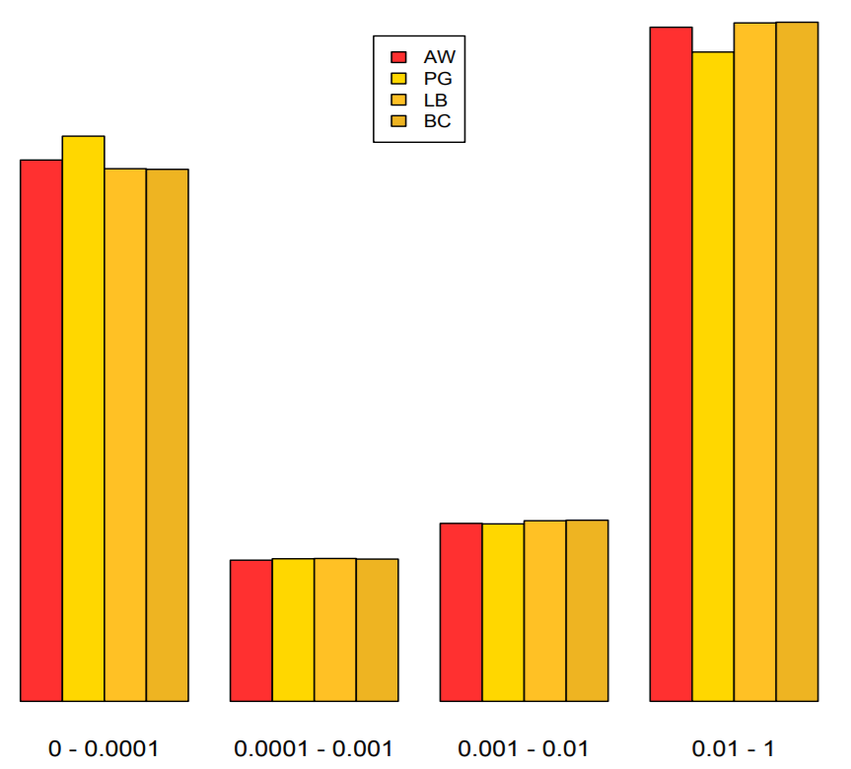
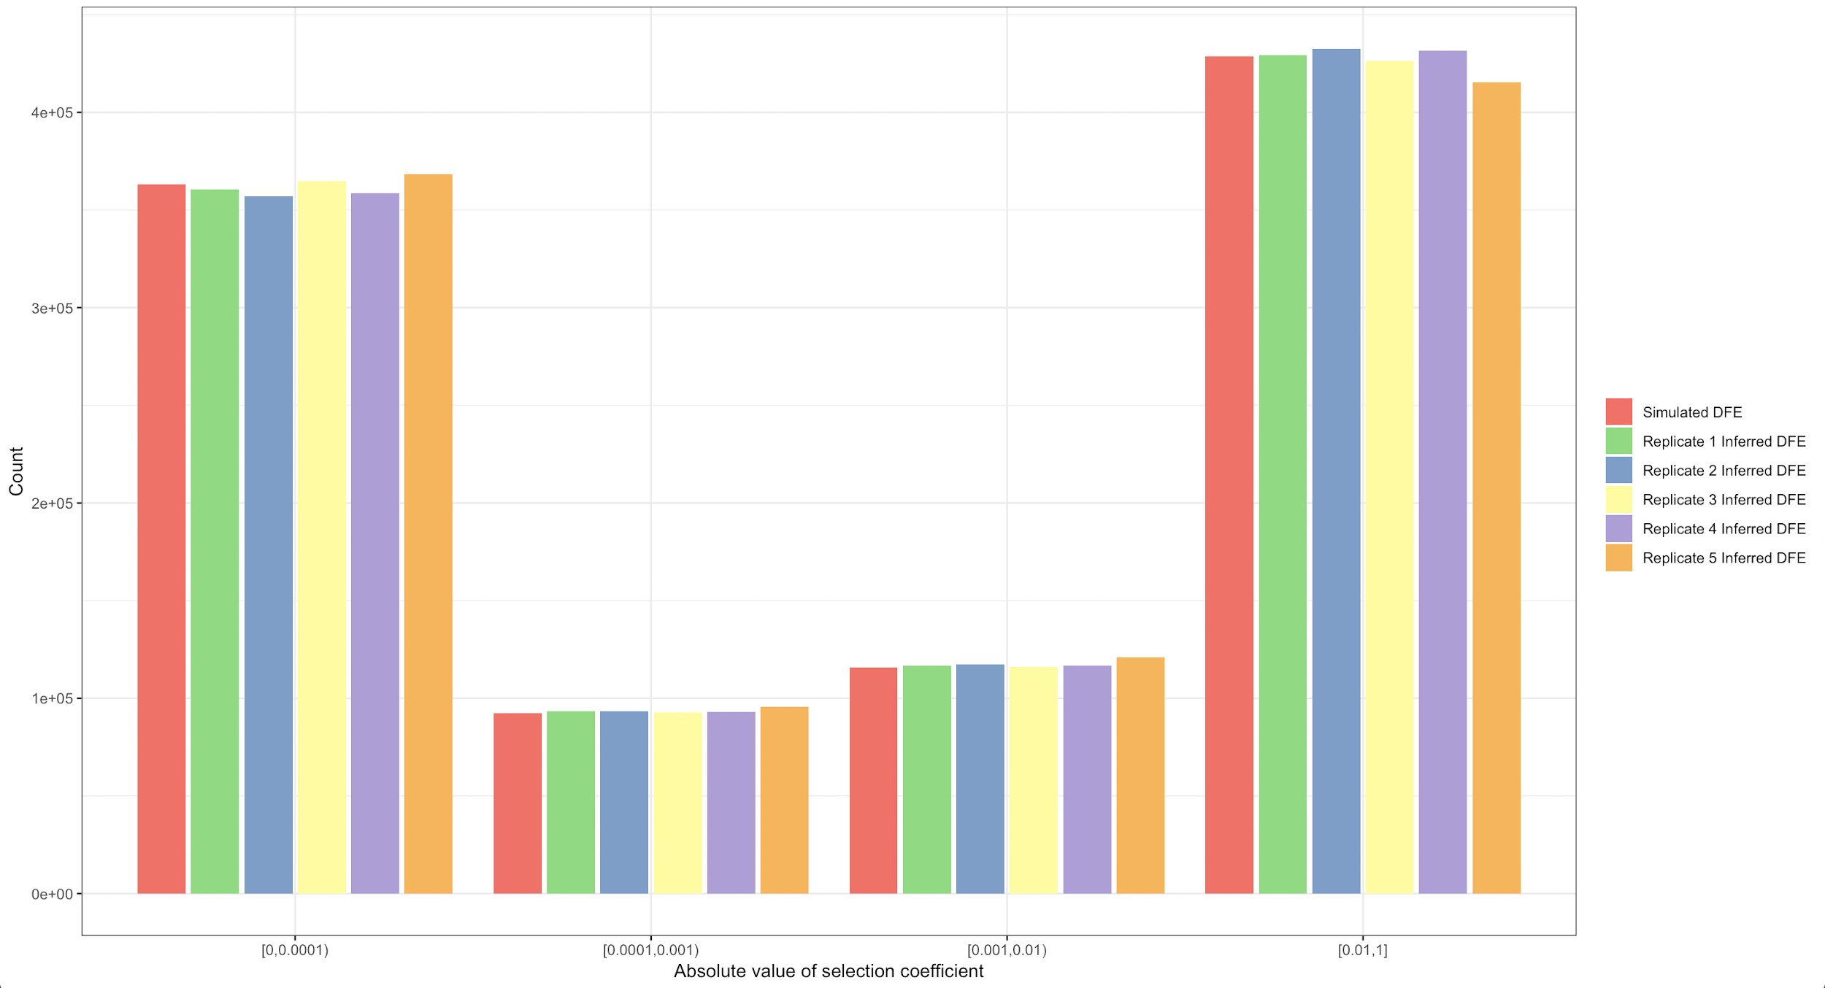
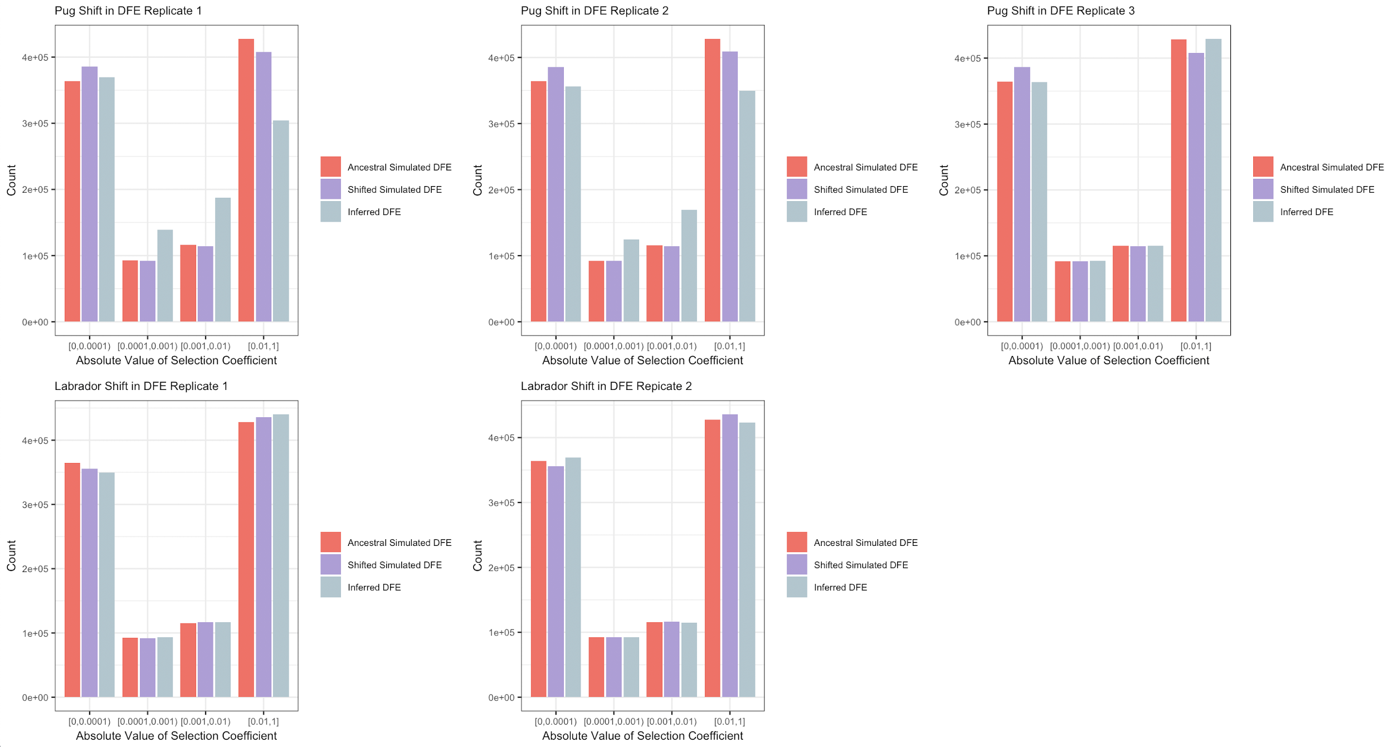
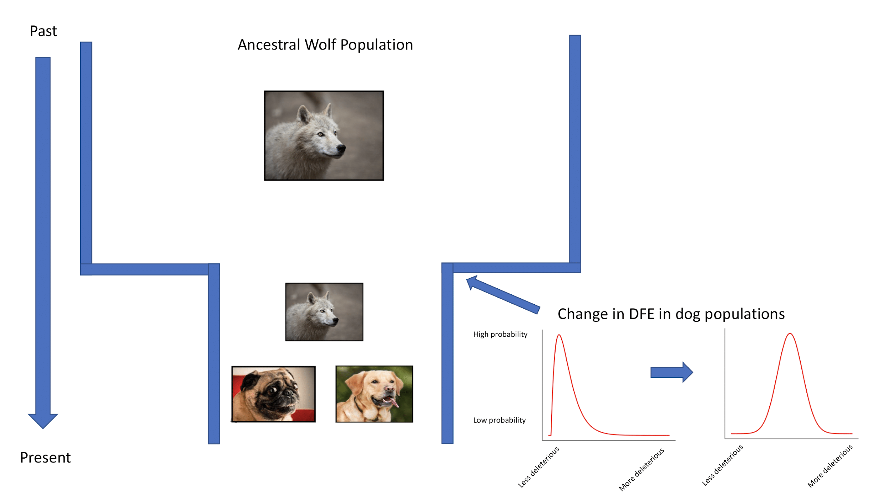
Quantifying the Statistical Power in the Inference of the Evolution of the
Distribution of Fitness Effects in Canine Lineages
Miguel Guardado¹, Jonathan Mah¹, Jesse Garcia², Eduardo Amorim³, Kirk Lohmueller^{2, 3, 4}
1. B.I.G. Summer Program, Institute for Quantitative Biosciences, 2. Bioinformatics Interdepartmental Graduate Program, UCLA,
3. Department of Ecology and Evolutionary Biology, UCLA, 4. Department of Human Genetics, UCLA
Introduction
Methods and Models
The distribution of fitness effects (DFE), which describes the impact and effect of all new mutations in a population, plays a fundamental role in shaping evolutionary genetics¹. Previous work on inferring the DFE has shown that distantly related species have distinct DFEs². However, the timescales and conditions under which the DFE evolves remain unclear.
Domestic dogs and wolves provide a system in which to understand how the DFE evolves over recent timescales, as these populations have recently diverged. However, using genomic resequencing data from arctic wolves and breed dogs, no detectable difference in the inferred DFE was found.
We sought to determine if current state-of-the-art methods for DFE inference had sufficient statistical power to detect a change in the DFE between wolf and dog populations.
We performed forward population genetics simulations modeling wolf and dog evolution, and compared the inferred DFE and demographic parameters of simulated and empirical data.
Simulate canine evolution though `SLiM`, generate Variant Call Format (VCF) data.
Given VCF data, use `easySFS` to generate nonsynonymous and synonymous site frequency spectra.
Given site frequency spectra, use `dadi` to infer population demographic parameters, and `fitdadi` to infer the gamma-distributed DFE from demographic parameters.
Compare the inferred DFE from simulated and empirical data.
Gamma-distributed DFE for Humans, Drosophila, and both sets of data combined.
Source: Huber et al., 2017, PNAS
Results
Comparison of Simulated and Empirical Synonymous Proportional Site Frequency Spectra
Data Type
Empirical Observation
Simulated Observation
Comparison of Simulated and Empirical Nonsynonymous Proportional Site Frequency Spectra
The inferred DFE does not differ between Dogs and Wolves.
Source: Amorim, C.E.G., 2019, Evolution, Providence, RI. Oral Presentation.
Data Type
Empirical Observation
Simulated Observation
Empirical Estimation
Simulated Estimation
Comparison of Simulated and Inferred Arctic Wolf DFE
Conclusions and Future Directions
Our simulations successfully replicated Arctic Wolf nonsynonymous and synonymous site frequency spectra.
From these spectra, we accurately inferred the ancestral Arctic Wolf DFE.
When simulating a shift in DFE, we find that it is easier to detect the changes present from Wolf to Pug than from Wolf to Labrador.
Our findings reflect that the DFE in Pug populations are more diverged from the ancestral DFE than the DFE of Labrador populations.
Next, we seek to develop a statistical framework to test changes in DFE.
Comparison of Simulated and Inferred Breed Dog DFE
Demographic Model
Acknowledgements
This work was supported through the Bruins-In-Genomics Summer Program for Undergraduate Research.
References
Loewe L, Hill WG (2010) The population genetics of mutations: Good, bad and indifferent. Philos Trans R Soc Lond B Biol Sci 365:1153–1167.
Huber, C. D., B. Y. Kim, C. D. Marsden, and K. E. Lohmueller, (2016) Determining the factors driving selective effects of new nonsynonymous mutations. Proceedings of the National Academy of Sciences 114(17), 4465-4470.
New mutations in breed dog populations are more likely to be deleterious.

