Slide 1
Dog DFE Meeting
8/11/2020 feat. Kirk and Eduardo

Slide 2
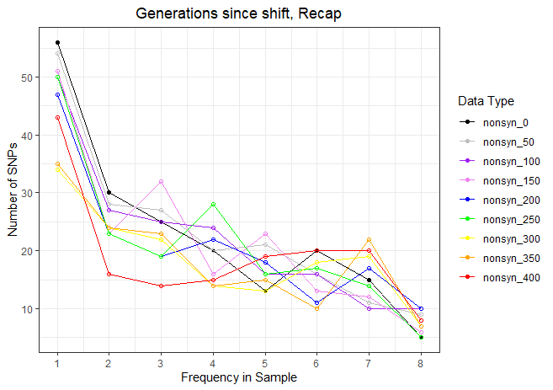
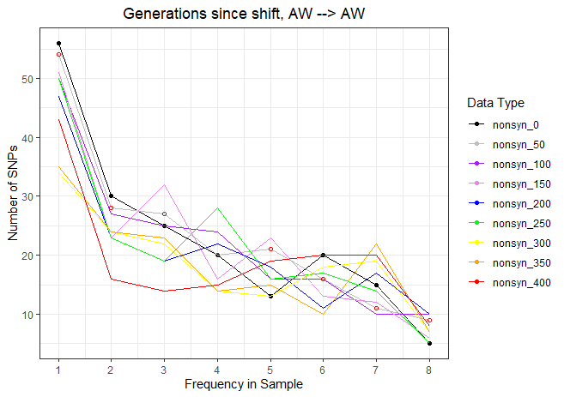
Recap from last week
Simulating a neutral simulation results in no significant difference between the proportional SYN and NS SFS.
Recapitulating the Arctic Wolf DFE results in the same SFS as shifting from Arctic Wolf to Arctic Wolf, i.e., not changing the DFE is consistent.

Slide 3
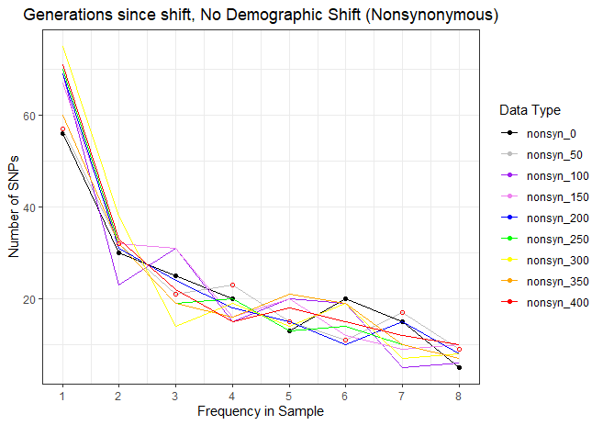
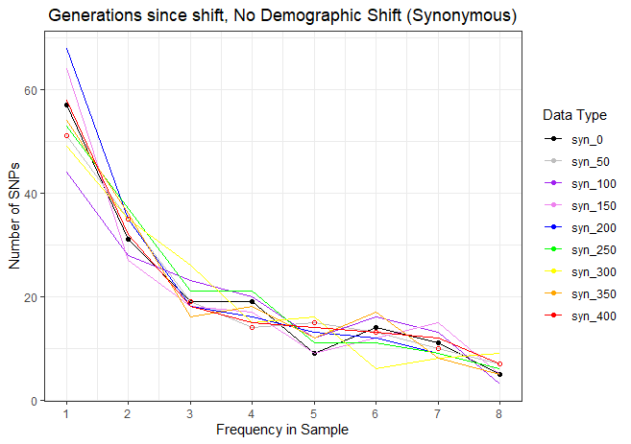
Shifting DFE without Demographics

Slide 4
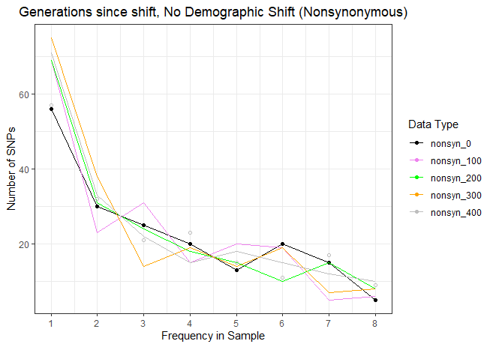
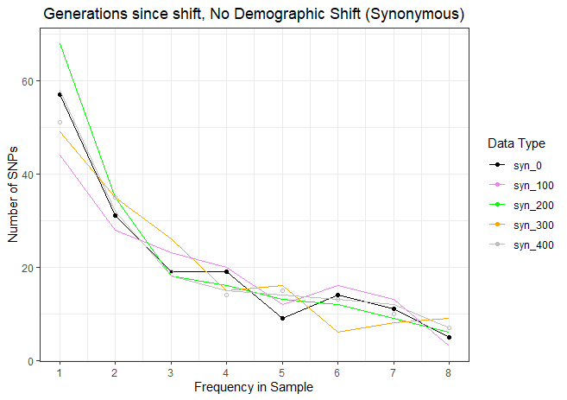
Shifting DFE without Demographics

Slide 5
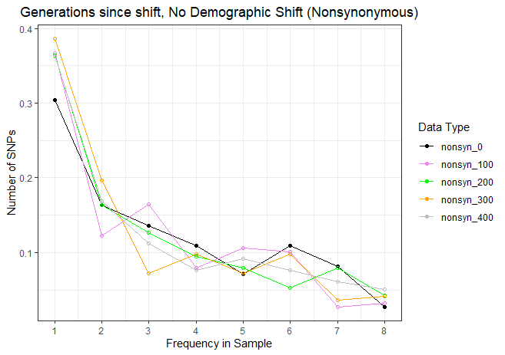
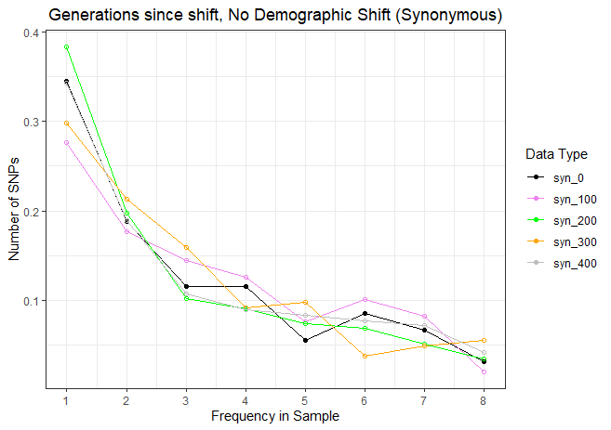
Shifting DFE without Demographics

Slide 6
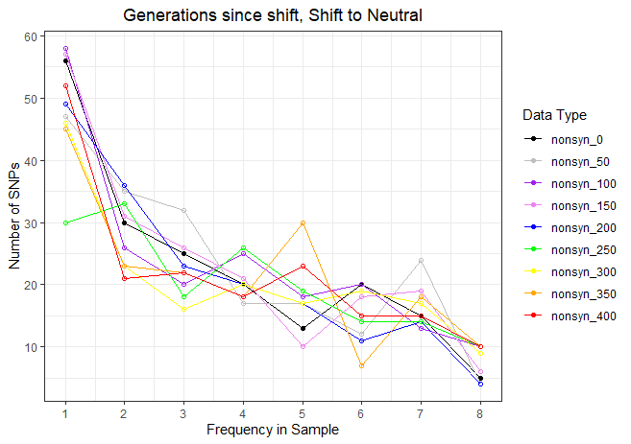
Shift of DFE to truly neutral results in more singletons
Demographic contraction results in reduction of singletons
Demographic contraction and shift to DFE,
Contraction dominates shape of SFS.

Slide 7
“Recap” Simulation summary
As a reminder, the simulations were performed as follows:
An ancestral population of 80,000 wolves existed some time in the past.
Their evolution was “burnt in” for 80,000 * 10 generations, i.e., 800,000 generations.
24,251 generations ago, the ancestral population was subject to a bottleneck to 19,000 individuals, i.e., a Labrador demography.
At this time, the DFE was set to match that of ancestral Arctic Wolves
Today, we sample 8 individuals, or 16 chromosomes.

Slide 8
“Shifted” Simulation summary
As a reminder, the simulations were performed as follows:
An ancestral population of 80,000 wolves existed some time in the past.
Their evolution was “burnt in” for 80,000 * 10 generations, i.e., 800,000 generations.
24,251 generations ago, the ancestral population was subject to a bottleneck to 19,000 individuals, i.e., a Labrador demography
10,000 generations ago, we shifted ALL new mutations to s=0, i.e., all new mutations became neutral
Today, we sample 8 individuals, or 16 chromosomes.

Slide 9
//TODO
Why is diversity reduced when shifting DFE, but not changing demographics?
Where did all of these variants go?
Still looking into changing DFE of singular mutations – make existing mutations neutral.
Can shifting the DFE change the mutation rate?
Try constant population size and shift to neutral
What happens to mutations that are lost.
Try constant population size and no shift.
Does shifting the DFE to neutral introduce a sweep? I.e., neutral nonsynonymous mutations are less bad, therefore more advantageous, and reduce variation due to a sweep?
What if we made a less dramatic shift in the DFE?
Or a different type of shift?
Look at synonymous mutations
If there is a sweep, there should also be a decrease in synonymous variation.

Slide 10
//TODO
Simulation without demographic change or DFE shift (under a AW DFE)
Run 350 generations through fitdadi (for all of these)
Fit Demographic Model to synonymous sfs
Infer DFE
Look at simulations with and without DFE shift
(Recap and Shift to Neutral)
Consider large size simulation without demographic contraction
SFS from large size simulation (recap and shift)

