Slide 1
Lab Meeting 07/29
Miguel Guardado and Jon Mah

Slide 2
Overview
The DFE is different between highly divergent species (e.g., Drosophila and humans).
Our a priori expectation was that the DFE between dogs and wolves would differ.
This shift in DFE is not observed in empirical data.
We are simulating a shift in DFE, and seeing if we can infer that the shift occurs.
Does a shift in DFE occur during domestication events?
Can we detect this DFE -- are we inferring the DFE correctly in general.

Slide 3
Things we’ve tried
N_{a} = 2,000
We’re using a smaller ancestral population size to quickly simulate certain scenarios.
We wanted to check if we can give `SLiM` a DFE and then re-infer it.
We wanted to check if we could detect a shift in DFE, given that we simulate one in `SLiM`.
N_{a} = 80,000 [currently running!]
Arctic wolves → Arctic wolves

Slide 4
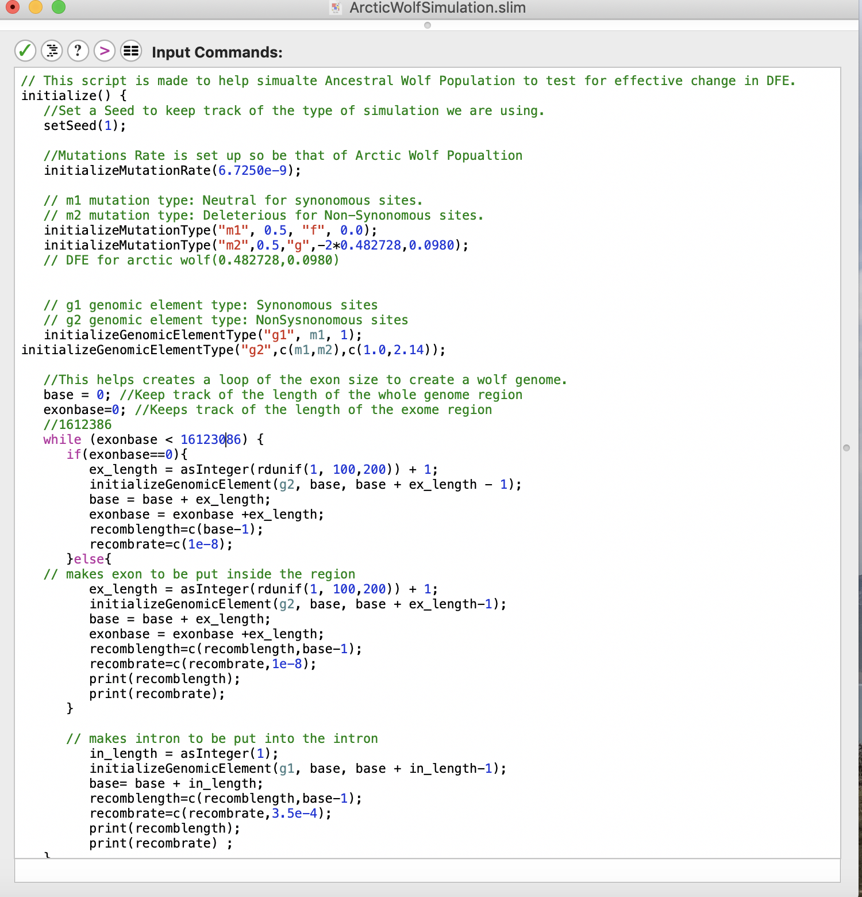
Simulation set-up
Ancestral Population
Burn in period for Ancestral population
Bottleneck + change in DFE
100/1000/
1786/2000 generations from current time

Slide 5
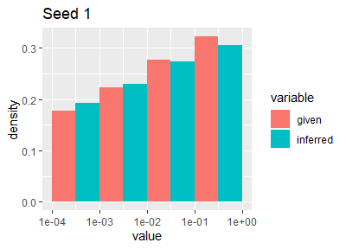

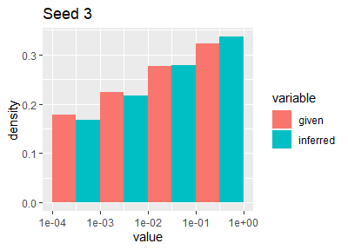
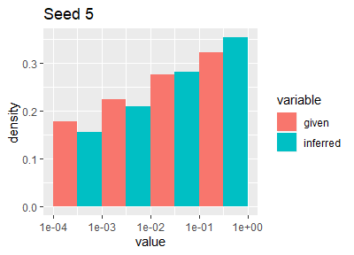

Comparing Distributions
[N_{a} = 2000, checking DFE inference]
Given Shape | 0.0980
Avg. Inferred Shape | 0.100822
Given Scale | 4.9260
Avg. Inferred Scale | 4.895863
Notes:
Seed=1 → Theta = 64.3
Seed=2 → Theta = 58.9
Seed=3 → Theta = 57.9
Seed=5 → Theta = 88.5
Seed=50 → Theta = 587.4

Slide 6
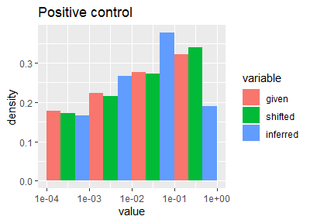
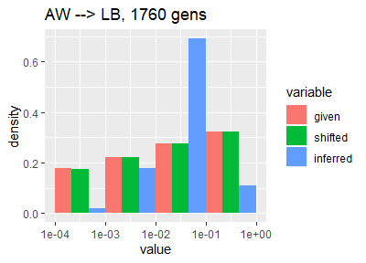
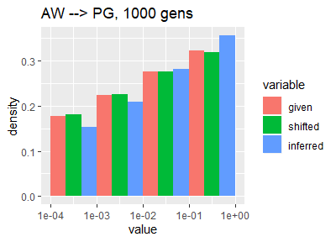
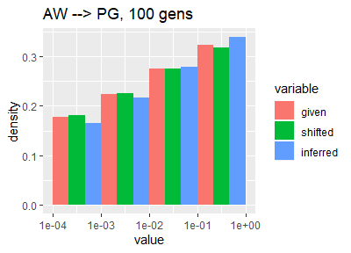
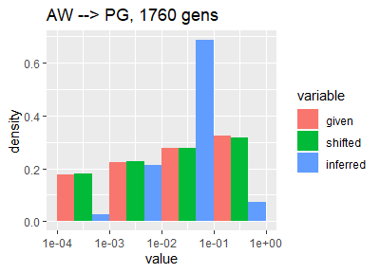
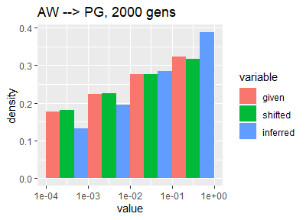
Comparing Distributions
[N_{a} = 2000, observing DFE shift]

Slide 7
Questions / Uncertainty
Likelihood surface appears to be flat, which makes accurate inference of parameters difficult.
Methods to test how close our DFE inference is to the given parameters
Increase number of initial guesses used in MLE.
Current state is ok.

Slide 8
Next Steps
Figure out how to statistically test DFE comparison. [Jesse mentioned Mann Whitney u test/KS test?]
Run full size and generational wolf simulation to match up with Eduardo’s [in progress!]
Run full size simulations where we look at dogs and implement change in DFE inside them
Increase number of initial guesses in `fitdadi` portion
Look at using N_{a} = 10,000 or N_{a} = 20,000, scale by `\theta`.

