Slide 1
Dog DFE Meeting
8/11/2020 feat. Kirk and Eduardo

Slide 2
Summary from 2 weeks ago
Look at recap simulation before and after demographic shift
We expect simulation at 0 past shift to be identical
At later times we expect there to be a contraction
Look at neutral simulations.
Look into a shift from AW to AW
Look into method for shifting the s of an existing mutation
WIP

Slide 3
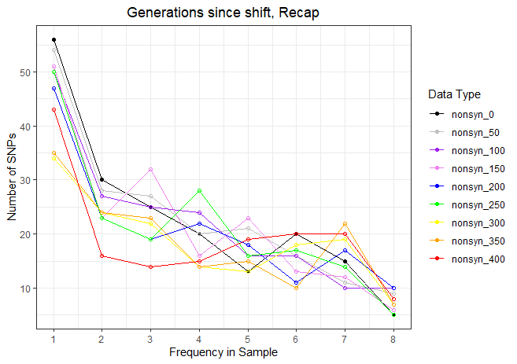
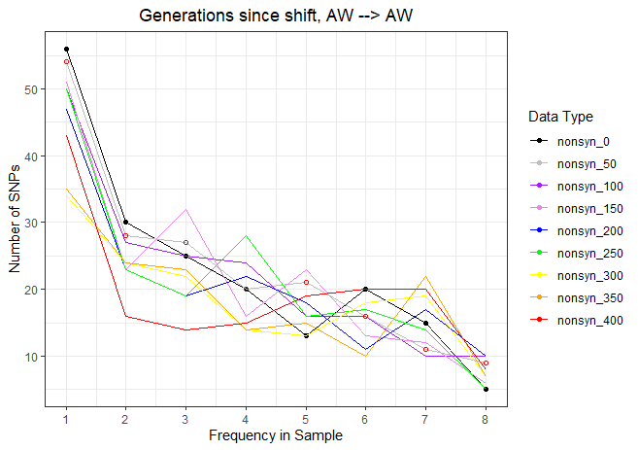
Keeping an Arctic Wolf DFE the whole time results in loss of SNP’s due to demographic change.

Slide 4
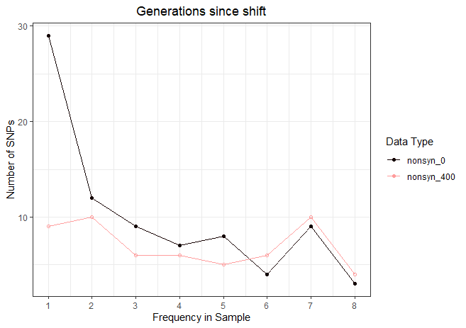
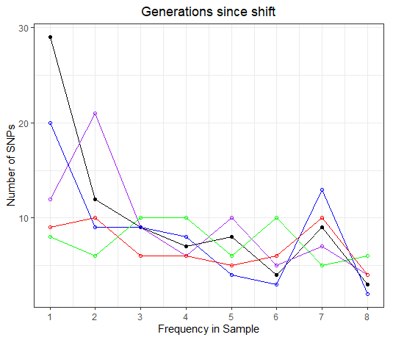
Shifting from Arctic wolves to a truly neutral DFE results in massive loss of SNPs

Slide 5
“Recap” Simulation summary
As a reminder, the simulations were performed as follows:
An ancestral population of 80,000 wolves existed some time in the past.
Their evolution was “burnt in” for 80,000 * 10 generations, i.e., 800,000 generations.
24,251 generations ago, the ancestral population was subject to a bottleneck to 19,000 individuals, i.e., a Labrador demography.
At this time, the DFE was set to match that of ancestral Arctic Wolves
Today, we sample 8 individuals, or 16 chromosomes.

Slide 6
“Shifted” Simulation summary
As a reminder, the simulations were performed as follows:
An ancestral population of 80,000 wolves existed some time in the past.
Their evolution was “burnt in” for 80,000 * 10 generations, i.e., 800,000 generations.
24,251 generations ago, the ancestral population was subject to a bottleneck to 19,000 individuals, i.e., a Labrador demography
10,000 generations ago, we shifted ALL new mutations to s=0, i.e., all new mutations became neutral
Today, we sample 8 individuals, or 16 chromosomes.

Slide 7
//TODO
Why is diversity reduced when shifting DFE, but not changing demographics?
Where did all of these variants go?
Still looking into changing DFE of singular mutations – make existing mutations neutral.
Can shifting the DFE change the mutation rate?
Try constant population size and shift to neutral
What happens to mutations that are lost.
Try constant population size and no shift.
Does shifting the DFE to neutral introduce a sweep? I.e., neutral nonsynonymous mutations are less bad, therefore more advantageous, and reduce variation due to a sweep?
What if we made a less dramatic shift in the DFE?
Or a different type of shift?
Look at synonymous mutations
If there is a sweep, there should also be a decrease in synonymous variation.

