Slide 1
Dog DFE Meeting
8/11/2020 feat. Kirk and Eduardo

Slide 2
Summary from 2 weeks ago
DFE inference is internally consistent
Slim simulations are resulting in less variation than expected
Given a truly neutral DFE, i.e., everything mutation has s=0, we expect there to be more variation as there are no deleterious mutations

Slide 3
“Recap” Simulation summary
As a reminder, the simulations were performed as follows:
An ancestral population of 80,000 wolves existed some time in the past.
Their evolution was “burnt in” for 80,000 * 10 generations, i.e., 800,000 generations.
24,251 generations ago, the ancestral population was subject to a bottleneck to 19,000 individuals, i.e., a Labrador demography.
At this time, the DFE was set to match that of ancestral Arctic Wolves
Today, we sample 8 individuals, or 16 chromosomes.

Slide 4
“Shifted” Simulation summary
As a reminder, the simulations were performed as follows:
An ancestral population of 80,000 wolves existed some time in the past.
Their evolution was “burnt in” for 80,000 * 10 generations, i.e., 800,000 generations.
24,251 generations ago, the ancestral population was subject to a bottleneck to 19,000 individuals, i.e., a Labrador demography
10,000 generations ago, we shifted ALL new mutations to s=0, i.e., all new mutations became neutral
Today, we sample 8 individuals, or 16 chromosomes.

Slide 5
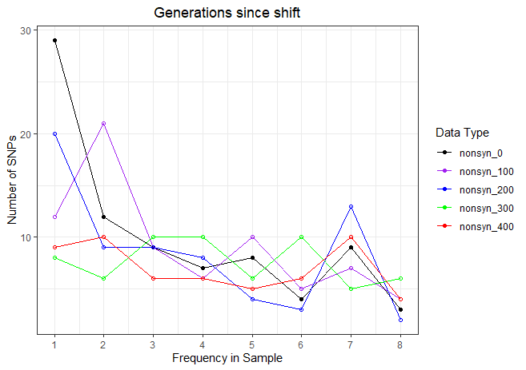
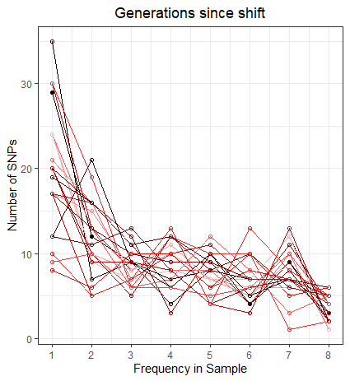
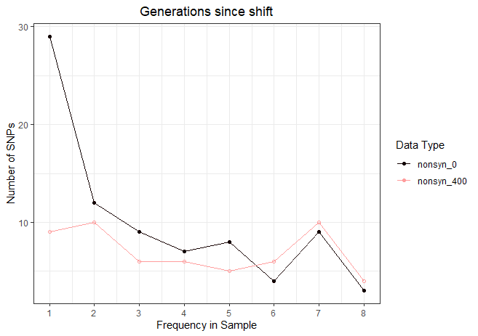

Slide 6
What I think actually happened
The function we used: setDistribution()
When updated, only new mutations are adjusted
Old mutations, prior to DFE shift remain deleterious and are removed over time
Is it possible new mutations are not being called as variants?

Slide 7
//TODO
Look at recap simulation before and after demographic shift
We expect simulation at 0 past shift to be identical
At later times we expect there to be a contraction
Look at neutral simulations.
Look into method for shifting the s of an existing mutation
Look into a shift from AW to AW

