Slide 1





How does the number of individuals studied influence the evolutionary stories we infer from population genetic data?
Jonathan Mah
Lohmueller and Garud Labs
November 1st, 2025
@jonmah_compbio
jonmah@g.ucla.edu
Notes:
How’s it going guys, gals, and non-binary pals, my name is Jonathan Mah, I’m a Bioinformatics Doctoral candidate here at UCLA co-advised by Professor Kirk Lohmueller and Professor Nandita Garud, and time permitted, today I’ll be talking about my #soon to be submitted work investigating how the number of individuals in a data set can influence the evolutionary stories that we infer from population genetic data.

Slide 2
How does the number of individuals studied influence the evolutionary stories we infer from population genetic data?
Jonathan Mah
Lohmueller and Garud Labs
November 1st, 2025
@jonmah_compbio
jonmah@g.ucla.edu
Notes:
How’s it going guys, gals, and non-binary pals, my name is Jonathan Mah, I’m a Bioinformatics Doctoral candidate here at UCLA co-advised by Professor Kirk Lohmueller and Professor Nandita Garud, and time permitted, today I’ll be talking about my #soon to be submitted work investigating how the number of individuals in a data set can influence the evolutionary stories that we infer from population genetic data.

Slide 3
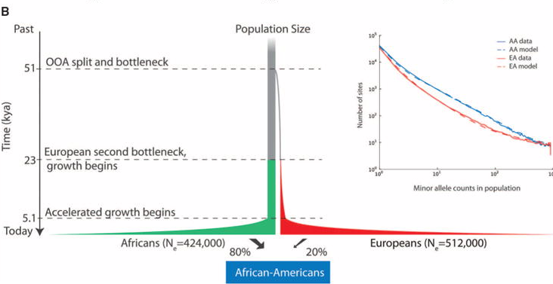
Inferred demographic models may depend on the number of individuals analyzed
Tennessen et al. 2012., Science
Notes:
This is of particular interest in the case of complex demographic histories, such as the story of modern human populations. Here on the top I show the classic Tennessen demographic model for human demographic history, which consists of two bottleneck events and then a population demographic expansion.

Slide 4
Inferred demographic models may depend on the number of individuals analyzed
Three-epoch
Two-epoch
Ancestral
Time
Current
Tennessen et al. 2012., Science
Notes:
However, in part due to a need for computational feasibility, the standard approach in population genetics is to fit simpler demographic models which capture the most important evolutionary signals. As an example, here on the top right I show a three-epoch model, which consists of two instantaneous size changes, and a two-epoch demographic model which consists of a single instantaneous size change. Neither of these models will ever fully capture the intricacies of true history, but as we like to say in statistics: all models are wrong, but some useful.

Slide 5

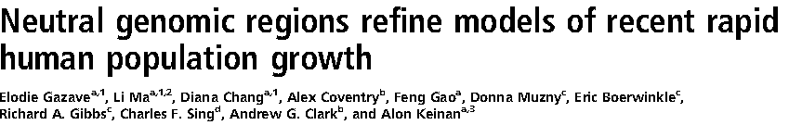
Inferred demographic models may depend on the number of individuals analyzed
Three-epoch
Two-epoch
Ancestral
Time
Current
Tennessen et al. 2012., Science
Notes:
The motivation for our study comes from work by Kryukov et al. 2008 and Gazave et al. 2014 in which these studies essentially found that when analyzing either empirical or simulated human data sets, different evolutionary signals are inferred from a two-epoch model depending on the number of individuals. We sought to investigate this further by more closely evaluating the outcomes of two-epoch demographic model inference while varying the number of individuals analyzed.

Slide 6
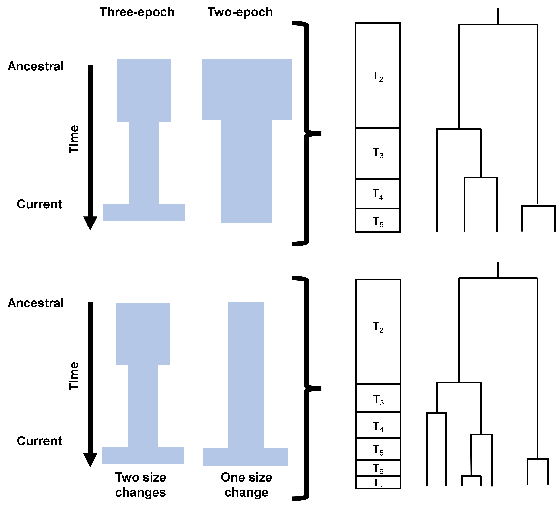
How can we translate that into a figure?
Notes:
Maybe let’s put this in the Discussion section (specifically the coalescent part)
Change the label on the three-epoch schematic to “true” demography or something like that
Change the label on the two-epoch schematic to “assumed” two epoch per model
Emma suggestion for legibility: Workflow diagram from three-epoch to two two-epoch models
On the right we can put N=5 and N=100 or something, e.g., small and large population size
Sneha suggestion for intro figure: can we do a 2x2 table for like true/false positive signal – what signal are we trying to pick up on?
Time interval vs. branch length illustrations
Cute thing with branch lengths summation

Slide 7
Demographic inference of simulated data is sensitive to the number of individuals
Ground Truth
Three-epoch
Ancestral
Time
Current
Simple Two-epoch Inference
Notes:
We started by simulating a three-epoch bottleneck scenario consisting of an ancient contraction and a recent expansion, generally matching the pattern of human demographic history. We simulated this scenario using two different software packages: Dadi shown in blue and MSPrime shown in yellow. As is standard in population genetics, we then fit a simple two-epoch model to determine whether the ancient contraction or the recent expansion was the dominant evolutionary signal.
Here I show on the x-axis the number of individuals analyzed in the dataset, while on the y-axis I respectively show the ratio of current to ancestral population size, the timing of the inferred instantaneous size change given in units of generations per 2NAncestral, and Tajima’s D.

Slide 8
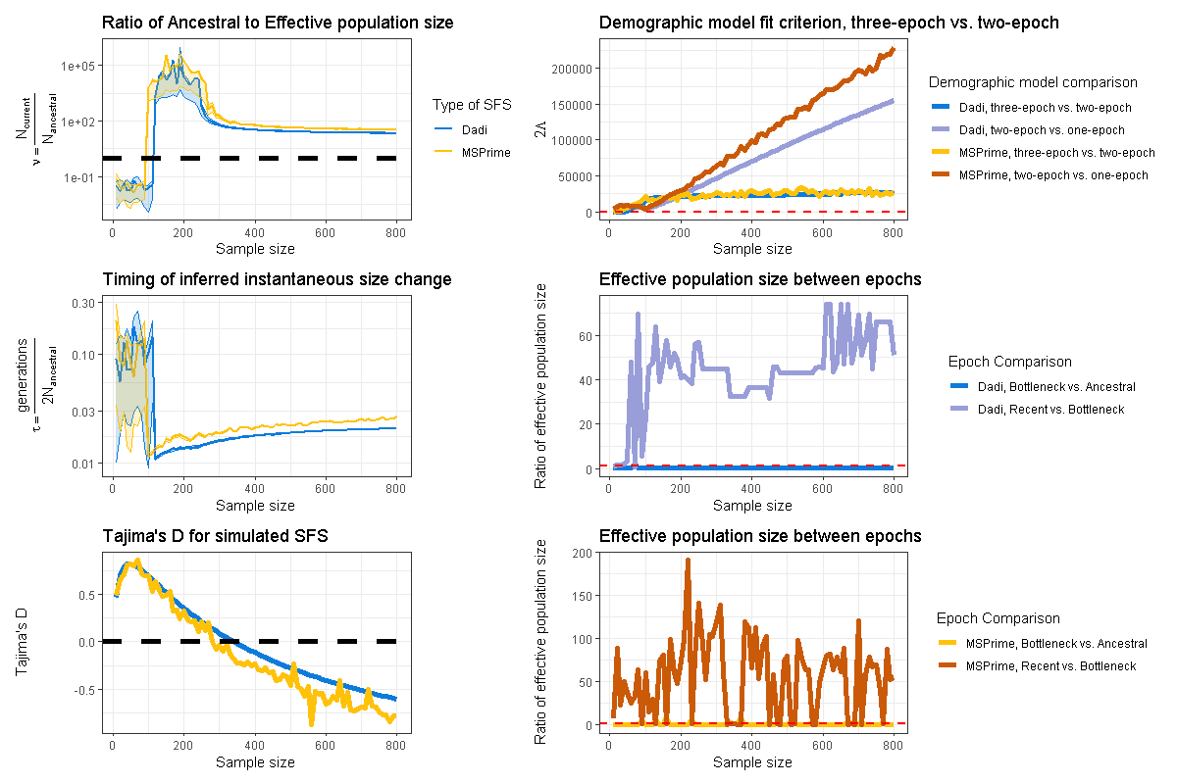
Demographic inference of simulated data is sensitive to the number of individuals
Ground Truth
Three-epoch
Ancestral
Time
Current
Simple Two-epoch Inference
Notes:
Here I show on the x-axis the number of individuals analyzed in the dataset, while on the y-axis I respectively show the ratio of current to ancestral population size, the timing of the inferred instantaneous size change, and Tajima’s D.

Slide 9
Demographic inference of simulated data is sensitive to the number of individuals
Ground Truth
Three-epoch
Ancestral
Time
Current
Simple Two-epoch Inference
Notes:
First I want to draw your attention to this top left panel. The dotted black line indicates a ratio of 1; thus, data below the line indicates a population contraction, while data above the line indicates a population expansion. Notably, the dominant inferred signal for both simulations does indeed change from a contraction to an expansion.
Swetha suggestion: simplify description
Kirk: only show MSPrime data

Slide 10
Demographic inference of simulated data is sensitive to the number of individuals
Ground Truth
Three-epoch
Ancestral
Time
Current
Simple Two-epoch Inference
Notes:
Furthermore, this middle panel on the left also tells a story about how the timing of the inferred population size change is ancient for a lower number of individuals analyzed and more generally more recent for a higher number of individuals analyzed

Slide 11
Demographic inference of simulated data is sensitive to the number of individuals
Ground Truth
Three-epoch
Ancestral
Time
Current
Simple Two-epoch Inference
Notes:
Lastly, this bottom left panel indicates that Tajima’s D generally decreases as the number of individuals increases. As a friendly refresher, a positive Tajima’s D would indicate an excess of common variants, potentially suggestive of a contraction, while a negative Tajima’s D would indicate an excess of rare variants, potentially suggestive of an expansion.
Kirk suggestion: plot SNM Tajima’s D
Supplemental figure: demography plots vs. ground truth (polished)

Slide 12
Demographic inference of simulated data is sensitive to the number of individuals
Ground Truth
Three-epoch
Ancestral
Time
Current
Simple Two-epoch Inference
Notes:
Taken together these points all indicate that when analyzing a low number of individuals, two-epoch inference of this scenario captures an ancient contraction, while when analyzing a high number of individuals, two-epoch inference instead captures a recent expansion.

Slide 13
Demographic inference of simulated data is sensitive to the number of individuals
Notes:
Taken together these points all indicate that when analyzing a low number of individuals, two-epoch inference of this scenario captures an ancient contraction, while when analyzing a high number of individuals, two-epoch inference instead captures a recent expansion.
Current to Ancestral

Slide 14
Demographic inference of simulated data is sensitive to the number of individuals
Notes:
Taken together these points all indicate that when analyzing a low number of individuals, two-epoch inference of this scenario captures an ancient contraction, while when analyzing a high number of individuals, two-epoch inference instead captures a recent expansion.
Kirk suggestion: zoom in on 2Lambda small sample size
Emma suggestion: title change on top right

Slide 15
Coalescent tree analysis highlights the importance of branch length by epoch
Notes:
We sought to investigate further as to how and why this phenomenon of changing evolutionary signal arose based on the number of individuals. To do so, we considered the coalescent tree and its properties.

Slide 16
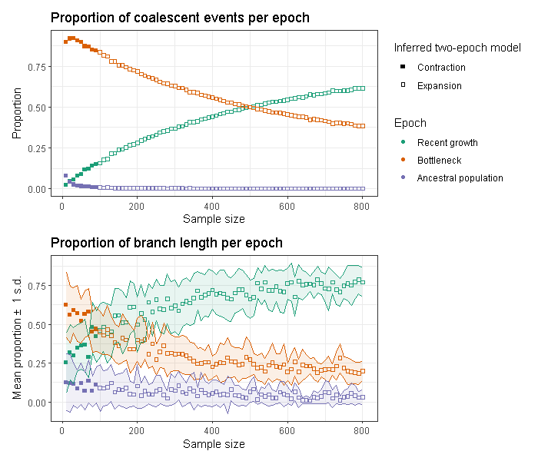
Coalescent tree analysis highlights the importance of branch length by epoch
Notes:
Quite nicely, because we used, MSPrime, which is a coalescent-based simulator, we knew the ground-truth of our simulated history, and calculated both the proportion of coalescent events per epoch, as well as the proportion of branch length per epoch.

Slide 17
Coalescent tree analysis highlights the importance of branch length by epoch
Notes:
Data points which are solid and filled in indicate the samples from which a two-epoch demographic model inferred a population contraction, while hollow points indicate a population expansion.

Slide 18
Coalescent tree analysis highlights the importance of branch length by epoch
Notes:
Additionally, data are color-coded by the ground truth epoch in which a coalescent event or branch proportion fell upon the coalescent tree.
Kirk suggestion: remove error bars
Kirk suggestion: maybe remove top figure
Swetha suggestion: description should summarize
Chen Lu comment: contraction vs. expansion confusion?
Kirk suggestion: colored-in diagram of three-epoch (orange, green, violet)

Slide 19
Coalescent tree analysis highlights the importance of branch length by epoch
Let’s dive deeper
into this
Notes:
Of extreme interest, we found that the highest mean proportion of branch lengths corresponded to the epoch whose evolutionary signal dominated the two-epoch model. As an example, here when the teal data points overtake the orange data points is when the dominant evolutionary signal changes from an ancient bottleneck to a recent expansion.

Slide 20
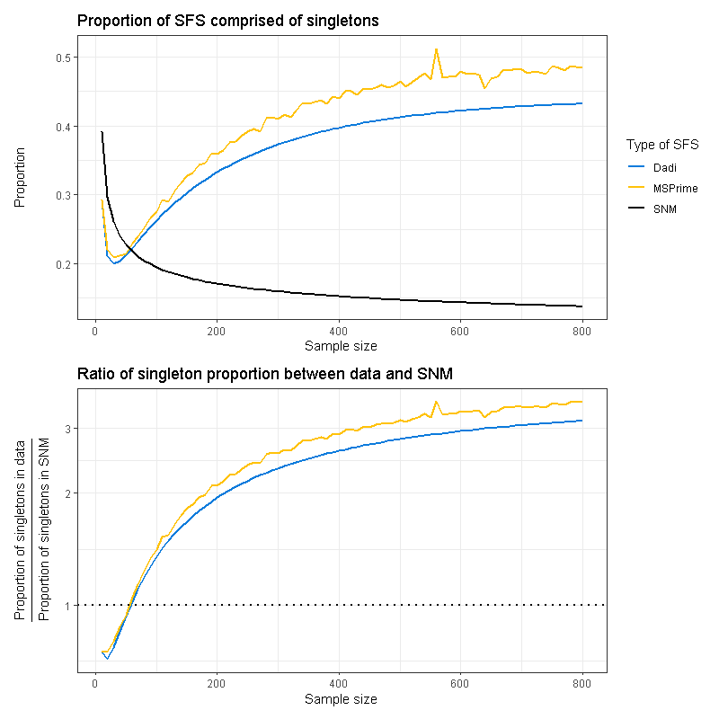
Singleton proportion changes with sample size
Notes:
Singletons don’t explain the whole story; but they are generally concordant with some of the story.
Maybe try for singletons and for doubletons and for singletons+doubletons

Slide 21
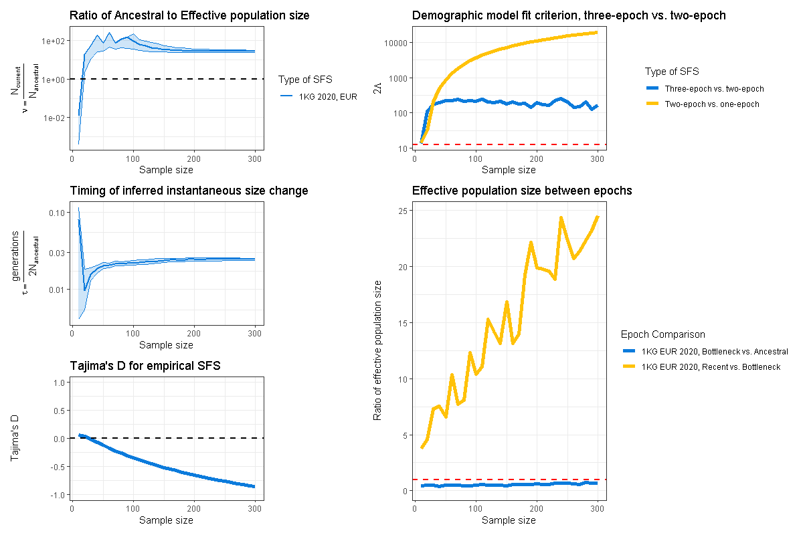
Demographic inference of empirical data is sensitive to the number of individuals
Simulated human data
Empirical human data
Notes:
Lastly, with what little time I have left, I just want to share that we did in fact also apply this analysis to empirical human data, shown, finding similarly that data sets with fewer individuals infer an ancient contraction while data sets with more individuals infer a recent expansion.
Aina comment: cut down on subfigures

Slide 22
Demographic inference of empirical data is sensitive to the number of individuals
Simulated human data
Empirical human data
Notes:
Lastly, with what little time I have left, I just want to share that we did in fact also apply this analysis to empirical human data, shown, finding similarly that data sets with fewer individuals infer an ancient contraction while data sets with more individuals infer a recent expansion.
Aina comment: cut down on subfigures

Slide 23
Demographic inference of empirical data is sensitive to the number of individuals
Simulated human data
Empirical human data
Notes:
Lastly, with what little time I have left, I just want to share that we did in fact also apply this analysis to empirical human data, shown, finding similarly that data sets with fewer individuals infer an ancient contraction while data sets with more individuals infer a recent expansion.
Aina comment: cut down on subfigures

Slide 24
Demographic inference of empirical data is sensitive to the number of individuals
Simulated human data
Empirical human data
Notes:
Lastly, with what little time I have left, I just want to share that we did in fact also apply this analysis to empirical human data, shown, finding similarly that data sets with fewer individuals infer an ancient contraction while data sets with more individuals infer a recent expansion.
Aina comment: cut down on subfigures

Slide 25
Demographic inference of empirical data is sensitive to the number of individuals
Simulated human data
Empirical human data
Notes:
Lastly, with what little time I have left, I just want to share that we did in fact also apply this analysis to empirical human data, shown, finding similarly that data sets with fewer individuals infer an ancient contraction while data sets with more individuals infer a recent expansion.
Aina comment: cut down on subfigures

Slide 26


Come check out my poster!
Takeaways
Population demographic inference is sensitive to the number of individuals.
Dominant evolutionary signals may reflect the distribution of coalescent branch lengths across time
Analyzing data sets consisting of differing numbers of individuals may reveal complementary facets of evolutionary history.
Contact Information
Jonathan Mah, University of California, Los Angeles
@jonmah_compbio
jonmah@g.ucla.edu
Notes:
To summarize my work, population genetics inference is sensitive to the number of individuals in the data set.
We suspect, and are testing, that the dominant evolutionary signal in a two-epoch model is determined by the epoch with the highest proportion of coalescent branch lengths
And lastly, this work has important implications for future population genetics studies which similarly infer demography – analyzing data sets of different sample sizes may yield complementary insights into the evolutionary history.
Happy to take questions but probably at my poster!

