Slide 1





How does the number of individuals studied influence the evolutionary stories we infer from population genetic data?
Jonathan Mah
Lohmueller and Garud Labs
November 1st, 2025
@jonmah_compbio
jonmah@g.ucla.edu
Notes:
How’s it going guys, gals, and non-binary pals, my name is Jonathan Mah, I’m a Bioinformatics Doctoral candidate here at UCLA co-advised by Professor Kirk Lohmueller and Professor Nandita Garud, and time permitted, today I’ll be talking about my #soon to be submitted work investigating how the number of individuals in a data set can influence the evolutionary stories that we infer from population genetic data.

Slide 2
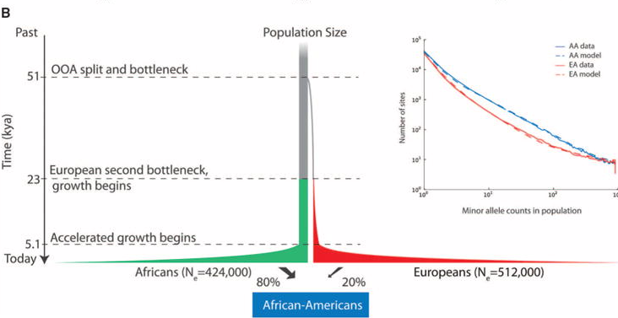
Inferred demographic models may depend on the number of individuals analyzed
Tennessen et al. 2012., Science
Notes:
This is of particular interest in the case of complex demographic histories, such as the story of modern human populations. Here on the top left I show the classic Tennessen demographic model for human population history, which consists of two bottleneck events and then a population demographic expansion.

Slide 3
Inferred demographic models may depend on the number of individuals analyzed
Three-epoch
Two-epoch
Ancestral
Time
Current
Tennessen et al. 2012., Science
Notes:
However, in part due to a need for computational feasibility, the standard approach in population genetics is to fit simpler demographic models which prioritize capture of the most important evolutionary signals. As an example, here on the top right I show a three-epoch model, which consists of two instantaneous size changes, and a two-epoch demographic model which consists of a single instantaneous size change. Neither of these models will ever fully capture the intricacies of true history; however as we like to say in statistics: all models are wrong, but some are useful.

Slide 4

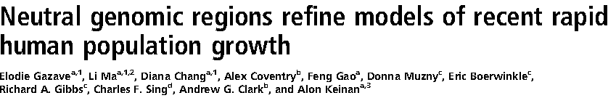
Inferred demographic models may depend on the number of individuals analyzed
Three-epoch
Two-epoch
Ancestral
Time
Current
Tennessen et al. 2012., Science
Notes:
The motivation for our study comes from work by Kryukov et al. 2008 and Gazave et al. 2014 in which these studies essentially found that when analyzing either empirical or simulated human data sets, different evolutionary signals are inferred from a two-epoch model depending on the number of individuals. We sought to investigate this further by more closely evaluating the outcomes of two-epoch demographic model inference while varying the number of individuals analyzed.

Slide 5
Demographic inference of simulated data is sensitive to the number of individuals
Ground Truth
Three-epoch
Ancestral
Time
Current
Simple Two-epoch Inference
Notes:
We started by simulating a three-epoch bottleneck scenario consisting of an ancient contraction and a recent expansion, generally matching the pattern of human demographic history. We simulated this scenario using MSPrime, which is a coalescent based simulation framework. As is standard in population genetics, we then fit a simple two-epoch model to determine whether the ancient contraction or the recent expansion was the dominant evolutionary signal.

Slide 6
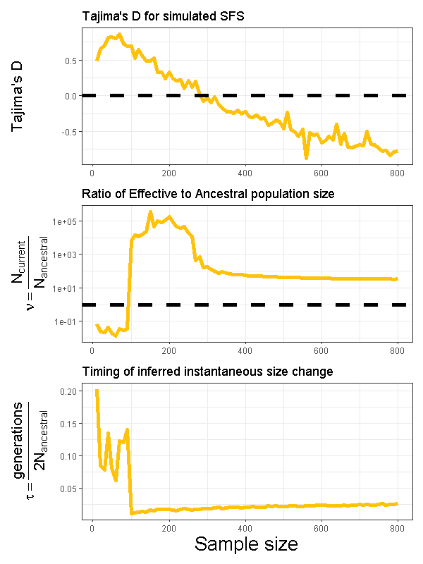
Demographic inference of simulated data is sensitive to the number of individuals
Ground Truth
Three-epoch
Ancestral
Time
Current
Simple Two-epoch Inference
Notes:
Here I show on the x-axis the number of individuals analyzed in the dataset, while on the y-axis I respectively show Tajima’s D, the inferred ratio of current to ancestral effective population size, and the inferred time since the instantaneous size change.

Slide 7
Demographic inference of simulated data is sensitive to the number of individuals
Ground Truth
Three-epoch
Ancestral
Time
Current
Simple Two-epoch Inference
Notes:
First I want to draw your attention to this top left panel, which depicts Tajima’s D vs. sample size. A positive Tajima’s D typically indicates an excess of intermediate frequency variants in the SFS, suggesting a population contraction. Conversely, a negative Tajima’s D indicates an excess of low frequency variants in the SFS, suggesting a population expansion.

Slide 8
Demographic inference of simulated data is sensitive to the number of individuals
Ground Truth
Three-epoch
Ancestral
Time
Current
Simple Two-epoch Inference
Notes:
Furthermore, this middle panel on the left depicts how the inferred ratio of current to ancestral population size changes with the number of individuals analyzed. The dotted black line indicates a ratio of 1; thus, data below the line indicates an inferred population contraction, while data above the line indicates an inferred population expansion. As with the story of Tajima’s D, we find that the evolutionary signal is sensitive to the number of individuals analyzed.

Slide 9
Demographic inference of simulated data is sensitive to the number of individuals
Ground Truth
Three-epoch
Ancestral
Time
Current
Simple Two-epoch Inference
Notes:
Lastly, this bottom left panel also tells a story about how the inferred timing of the inferred population size change is ancient for a lower number of individuals analyzed and more recent for a higher number of individuals analyzed

Slide 10
Demographic inference of simulated data is sensitive to the number of individuals
Ground Truth
Three-epoch
Ancestral
Time
Current
Simple Two-epoch Inference
Notes:
Taken together these points all indicate that when analyzing a small dataset, two-epoch inference of this scenario captures an ancient contraction, while when analyzing a large dataset, two-epoch inference instead captures a recent expansion.

Slide 11
Coalescent tree analysis highlights the importance of branch length by epoch
Notes:
We sought to investigate further as to how and why this phenomenon of changing evolutionary signal arose based on the number of individuals. To do so, we considered the coalescent tree and its properties.

Slide 12
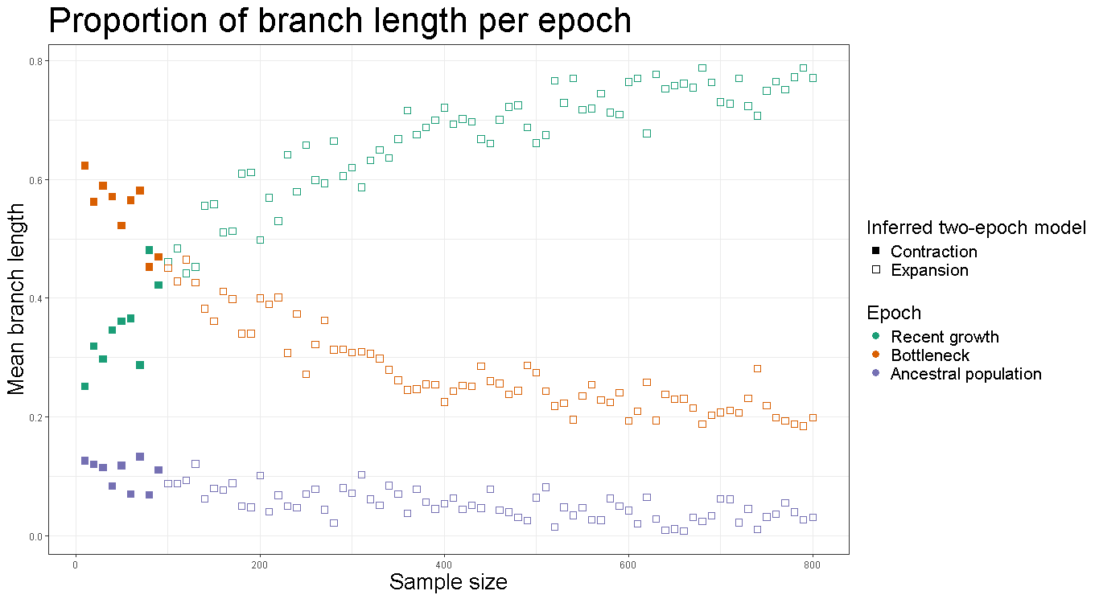
Coalescent tree analysis highlights the importance of branch length by epoch
Ancestral
Ancient
Recent
Notes:
Quite nicely, because we used, MSPrime, which is a coalescent-based simulator, we knew the ground-truth of our simulated history and calculated the proportion of branch length per epoch. To help with interpretation, I’ve provided a schematic for the simulated three-epoch demographic scenario on the right, color coded and labeled by epoch.

Slide 13
Coalescent tree analysis highlights the importance of branch length by epoch
Ancestral
Ancient
Recent
Notes:
Data points which are solid and filled in indicate the samples from which a two-epoch demographic model inferred a population contraction, while hollow points indicate a population expansion.

Slide 14
Coalescent tree analysis highlights the importance of branch length by epoch
Ancestral
Ancient
Recent
Notes:
Additionally, data are color-coded by the ground truth epoch in which the branch proportion fell upon the coalescent tree

Slide 15
Coalescent tree analysis highlights the importance of branch length by epoch
Ancestral
Ancient
Recent
Notes:
Of extreme interest, we found that the highest mean proportion of branch lengths corresponded to the epoch whose evolutionary signal was captured by the two-epoch model. As an example, here when the teal data points overtake the orange data points is when the inferred evolutionary signal changes from an ancient bottleneck to a recent expansion.

Slide 16
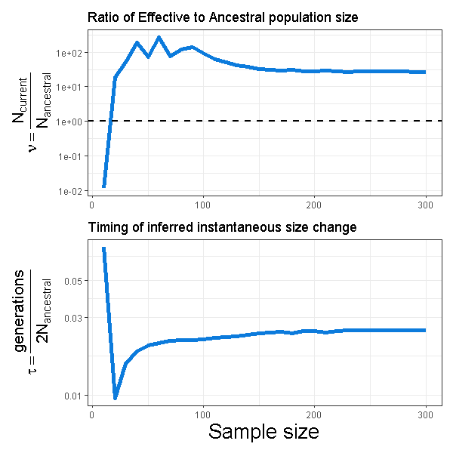
Demographic inference of empirical data is sensitive to the number of individuals
Simulated human data
Empirical human data
Notes:
Lastly, with what little time I have left, I just want to share that we did in fact also apply this analysis to empirical human data, shown here on the right in blue, finding similarly that data sets with fewer individuals infer an ancient contraction while data sets with more individuals infer a recent expansion

Slide 17


Come check out my poster!
Takeaways
Population demographic inference is sensitive to the number of individuals.
Dominant evolutionary signals may reflect the distribution of coalescent branch lengths across time
Analyzing data sets consisting of differing numbers of individuals may reveal complementary facets of evolutionary history.
Contact Information
Jonathan Mah, University of California, Los Angeles
@jonmah_compbio
jonmah@g.ucla.edu
Notes:
To summarize my work, population genetics inference is sensitive to the number of individuals in the data set.
We suspect, and are testing, that the dominant evolutionary signal in a two-epoch model is determined by the epoch with the highest proportion of coalescent branch lengths
And lastly, this work has important implications for future population genetics studies which similarly infer demography – analyzing data sets of different sample sizes may yield complementary insights into evolutionary history.
I’m happy to take any questions, but more realistically for time it’ll be at my poster.

