Slide 1
Lab Meeting
AKA
What has Jon been doing?
20250514
Jon Mah
Garud and Lohmueller Labs

Slide 2
Chapter 2 project summary
Question: How does sample size determine the strength of ancient vs. recent evolutionary signals?
Next Question: Can we find an optimal sample size to recover the ancient or recent evolutionary signals?
Approach:
  Simulate multiple demographic scenarios and downsample
  Compute expected SFS based on sample size using theory
  Apply to high quality empirical data

Slide 3
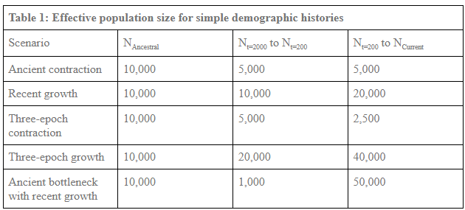
Simulation outline
L = 20,000,000 bp
r = 1E-8
mu = 1.5E-8
Downsample to sample size from 10 – 800, by 10 (i.e., 10, 20, 30, 40, 50)

Slide 4
Simulation outline
L = 20,000,000 bp
r = 1E-8
mu = 1.5E-8
Downsample to sample size from 10 – 800, by 10 (i.e., 10, 20, 30, 40, 50)

Slide 5
Simulation outline
L = 20,000,000 bp
r = 1E-8
mu = 1.5E-8
Downsample to sample size from 10 – 800, by 10 (i.e., 10, 20, 30, 40, 50)
We expect the bottleneck simulation to yield inferences resembling an ancient contraction at small sample sizes and a recent expansion at large sample sizes.

Slide 6
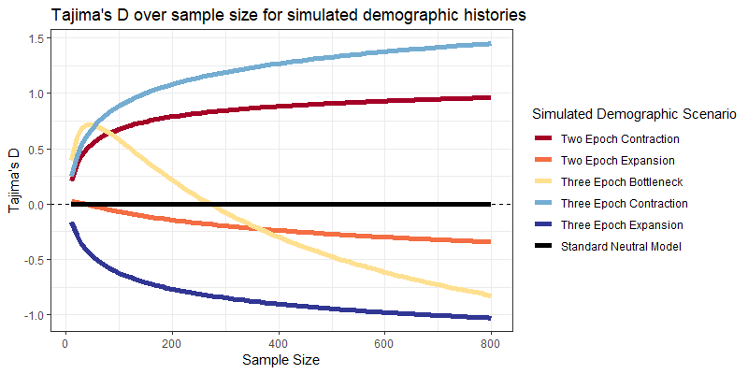
Simulation SFS summary statistics
Tajima’s D:
>0 → intermediate frequency
<0 → rare frequency
=0 → neutral

Slide 7
Simulation SFS summary statistics
Tajima’s D:
>0 → intermediate frequency
<0 → rare frequency
=0 → neutral

Slide 8
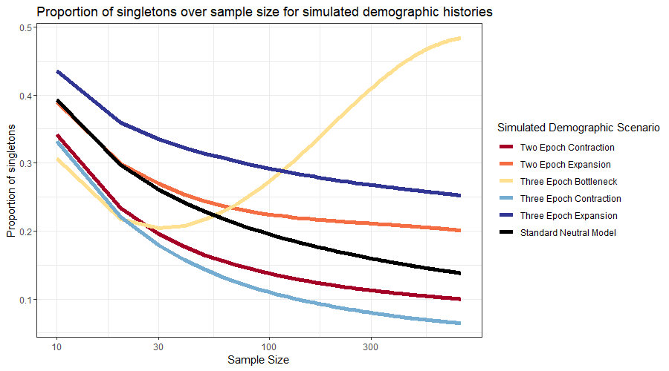
Simulation SFS summary statistics

Slide 9
Simulation SFS summary statistics

Slide 10
Simulation SFS summary statistics

Slide 11
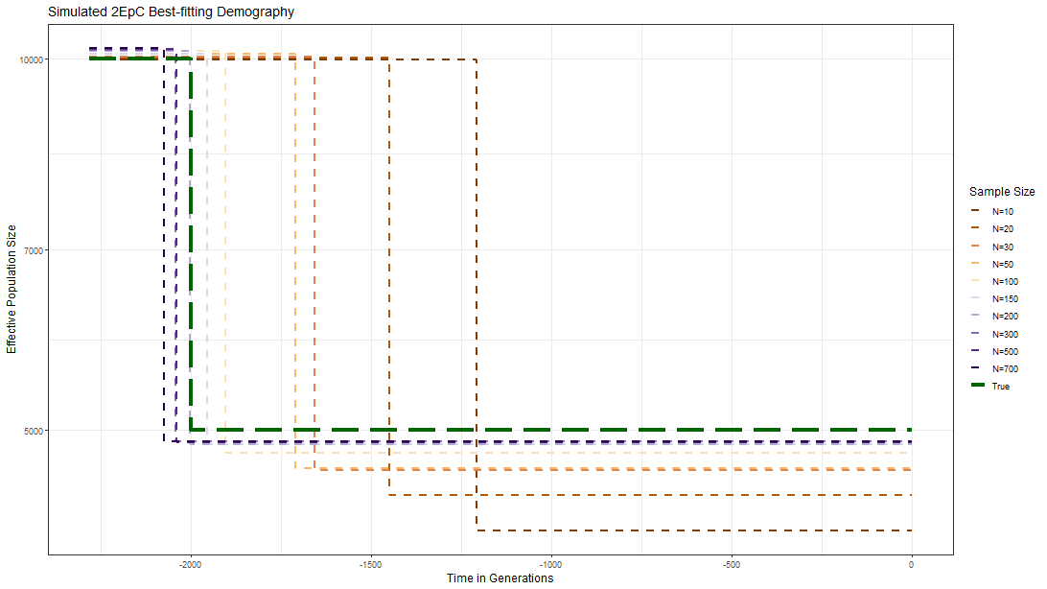
Inference from simulated SFSs reveals an “optimal” sample size for recovery

Slide 12
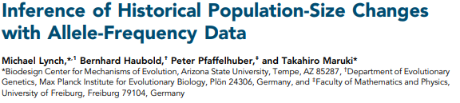

Lynch Theory: Expected count of SFS
Lynch et al. 2020

Slide 13
Lynch Theory: Expected count of SFS
Expected count of singletons
Arithmetic mean of population size…
Lynch et al. 2020

Slide 14
Lynch Theory: Expected count of SFS
Expected count of singletons
Arithmetic mean of population size…
as defined by intervals of coalescent time
Lynch et al. 2020

Slide 15
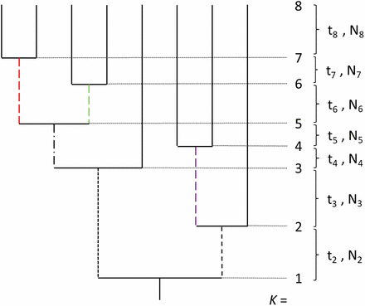
Lynch Theory: Time intervals
What matters is the arithmetic mean of N2 through N8. Note that the length of ti does not matter, just that there are intervals of time in between coalescent events.
Under coalescent theory, the expected time to coalesce k lineages is:
2N / (k choose 2)
Lynch et al. 2020

Slide 16
Lynch Theory: Does it work?
Let us simulate a bottleneck: 5,000 → 1,000 → 10,000, with k=5
Suppose the contraction occurs 3,100 generations prior
Suppose the expansion occurs 2,100 generations prior
Lynch et al. 2020

Slide 17
Lynch Theory: Does it work?
Let us simulate a bottleneck: 5,000 → 1,000 → 10,000, with k=5
Suppose the contraction occurs 3,100 generations prior
Suppose the expansion occurs 2,100 generations prior
  E[T_{5→4}] = 20,000 / (5 choose 2) = 2,000 generations
  E[T_{4→3}] = 2,000 / (4 choose 2) = 333.33 generations
  E[T_{3→2}] = 2,000 / (3 choose 2) = 666.67 generations
  E[T_{2→1}] = 10,000 / (2 choose 2) = 10,000 generations
Lynch et al. 2020

Slide 18
Lynch Theory: Does it work?
Let us simulate a bottleneck: 5,000 → 1,000 → 10,000, with k=5
Suppose the contraction occurs 3,100 generations prior
Suppose the expansion occurs 2,100 generations prior
  E[T_{5→4}] = 20,000 / (5 choose 2) = 2,000 generations
  E[T_{4→3}] = 2,000 / (4 choose 2) = 333.33 generations
  E[T_{3→2}] = 2,000 / (3 choose 2) = 666.67 generations
  E[T_{2→1}] = 10,000 / (2 choose 2) = 10,000 generations
Arithmetic mean of population size is 22,000 / 4 = 4250
We expect 4 * mu * L * 4250 = 255 singletons
Lynch et al. 2020

Slide 19
Lynch Theory: Does it work?
I set up simulations for a contraction and an expansion such that:
E[Bottleneck singletons] = 255
E[Contraction singletons] = 195
E[Expansion singletons] = 195
Lynch et al. 2020

Slide 20
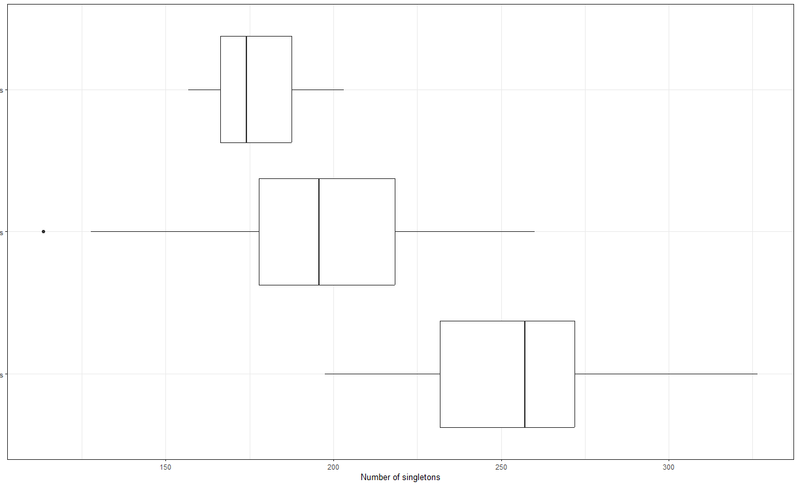

Lynch Theory: Does it work?
I set up simulations for a contraction and an expansion such that:
E[Bottleneck singletons] = 255
E[Contraction singletons] = 195
E[Expansion singletons] = 195
20 replicate simulations
Lynch et al. 2020

Slide 21
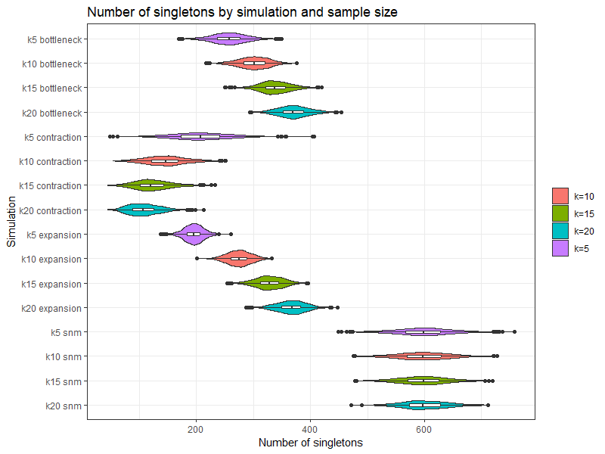
Lynch Theory: Scaled up
I repeated this with 1000 replicates for four different sample sizes (k = 5, 10, 15, 20), as well as for the standard neutral model.
Contractions lose singletons as sample size increase
Bottlenecks and expansions gain singletons as sample size increases.
The standard neutral model stays stable.
Lynch et al. 2020

Slide 22
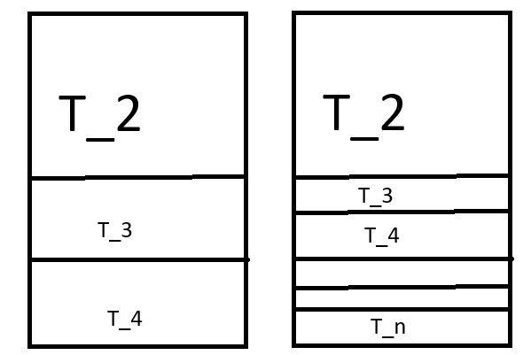
Lynch Theory: Explained
The Lynch Theory explains how singleton count is dependent on arithmetic mean of population size over coalescent time intervals. As sample size k increases, then the expected distribution of time intervals (and their associated N_{t}) becomes more and more dense in recent time, thereby biasing evolutionary inference towards recent events.

Slide 23
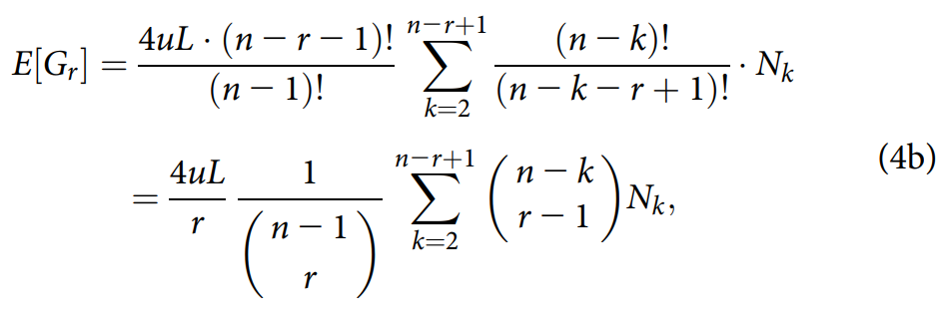
Lynch Theory: Scaled up (but in a different way)
I computed the expected number of doubletons from the previous round of simulations:
SNM E[doubletons] = 300
Expansion E[doubletons] = 15
Contraction E[doubletons] = 165
Bottleneck E[doubletons] = 90

Slide 24
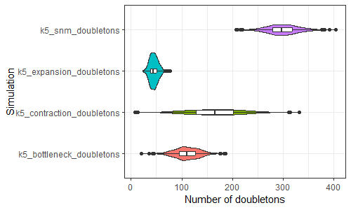
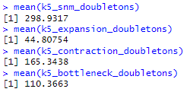
Lynch Theory: Scaled up (but in a different way)
I computed the expected number of doubletons from the previous round of simulations:
SNM E[doubletons] = 300
Expansion E[doubletons] = 15
Contraction E[doubletons] = 165
Bottleneck E[doubletons] = 90

