Slide 1





Statistical methods for inference of demography and selection within and across species
Jonathan Mah
Lohmueller and Garud Labs
November 20th, 2025
@jonmah_compbio
jonmah@g.ucla.edu
Notes:
Hi all and thanks for taking some time out of your schedules for what should my last committee meeting. The title of my thesis that I’m tentatively going with is “Statistical methods for inference of demography and selection within and across species”.

Slide 2
General updates and logistics
Notes:
I’ll start off with just a few quick check-ins and updates since I believe the last time we all met was quite a while ago.

Slide 3

I’m funded by the Dissertation Year Award
Notes:
I’m funded by the DYA.
My merit award, which covers the living stipend, is valid from July 1st 2024 to March 31st 2025
My tuition and fee coverage is for the entirety of the academic school year

Slide 4

I’m funded by the Dissertation Year Award
Notes:
Per the DYA timeline, I am required to file for my dissertation by the end of academic year, so I’ll be out of your hair sooner rather than soon

Slide 5
Thesis chapter overview
What is the population demographic history and distribution of fitness effects of human gut commensal bacteria?
How does the number of individuals studied influence the evolutionary stories we infer from population genetic data?
How do differences between population genetic datasets affect their distribution of fitness effects?

Slide 6
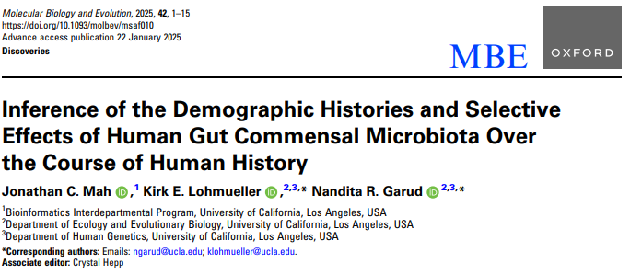
Thesis chapter 1 is published in Molecular Biology and Evolution
Notes:
My first chapter has been published in Molecular Biology and Evolution. Quick rant: the reviewers asked us to basically do the whole thing but with more species and with more analysis and it was a huge pain

Slide 7
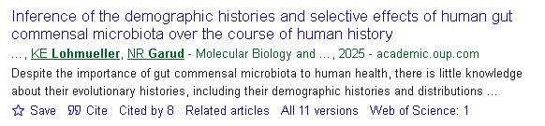
Thesis chapter 1 is published in Molecular Biology and Evolution
Notes:
People have been reading our work which is pretty neat-o

Slide 8
Thesis chapter overview
What is the population demographic history and distribution of selective effects of human gut commensal bacteria?
How does the number of individuals studied influence the evolutionary stories we infer from population genetic data?
How do differences between population genetic datasets affect their distribution of fitness effects?
Notes:
In my second chapter I have been investigating how the number of individuals in a data set can influence the evolutionary stories that we infer from population genetic data.
As a quick note, we do have a first draft of the manuscript, which Kirk and I have been passing back and forth. I’ve gotten a lot of helpful comments and questions that I’m working on addressing, and we’re wrapping up some final final analysis which I’ll get into greater detail later.

Slide 9
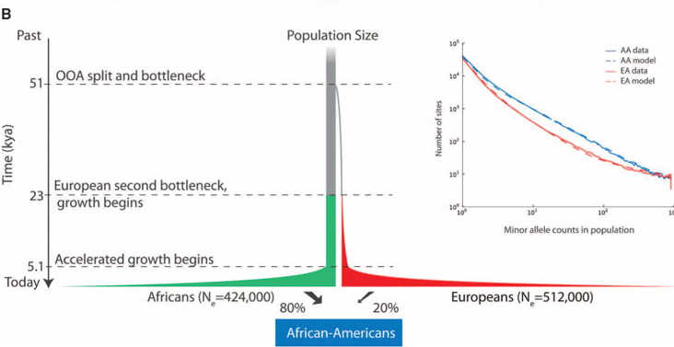
Inferred demographic models may depend on the number of individuals analyzed
Tennessen et al. 2012., Science
Notes:
This research question is of particular interest in the case of complex demographic histories, such as the story of modern human populations. Here on the top left I show the classic Tennessen demographic model for human population history, which consists of two bottleneck events and then a population demographic expansion.

Slide 10
Inferred demographic models may depend on the number of individuals analyzed
Three-epoch
Two-epoch
Ancestral
Time
Current
Tennessen et al. 2012., Science
Notes:
However, in part due to a need for computational feasibility, the standard approach in population genetics is to fit simpler demographic models which prioritize capture of the most important evolutionary signals. As an example, here on the top right I show a three-epoch model, which consists of two instantaneous size changes, and a two-epoch demographic model which consists of a single instantaneous size change. Neither of these models will ever fully capture the intricacies of true history; however as we like to say in statistics: all models are wrong, but some are useful.

Slide 11
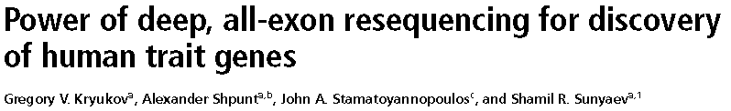
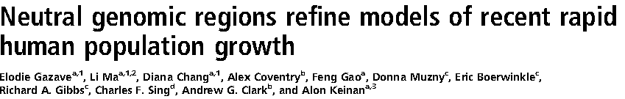
Inferred demographic models may depend on the number of individuals analyzed
Three-epoch
Two-epoch
Ancestral
Time
Current
Tennessen et al. 2012., Science
Notes:
The motivation for our study comes from work by Kryukov et al. 2008 and Gazave et al. 2014 in which these studies essentially found that when analyzing either empirical or simulated human data sets, different evolutionary signals are inferred from a two-epoch model depending on the number of individuals. We sought to investigate this further by more closely evaluating the outcomes of two-epoch demographic model inference while varying the number of individuals analyzed.
The underlying rationale to this approach is that most studies which infer demographic history do rely on these simplistic models. However, issues might arise in cases where scientists don’t necessarily have the luxury or the freedom to widely vary their sample size, e.g., working with rare mutation data, ancient data, or endangered species.

Slide 12
Demographic inference of simulated data is sensitive to the number of individuals
Ground Truth
Three-epoch
Ancestral
Time
Current
Simple Two-epoch Inference
Notes:
We started by simulating a three-epoch bottleneck scenario consisting of an ancient contraction and a recent expansion, generally matching the pattern of human demographic history. We simulated this scenario using MSPrime, which is a coalescent based simulation framework. As is standard in population genetics, we then fit a simple two-epoch model to determine whether the ancient contraction or the recent expansion was the dominant evolutionary signal.

Slide 13
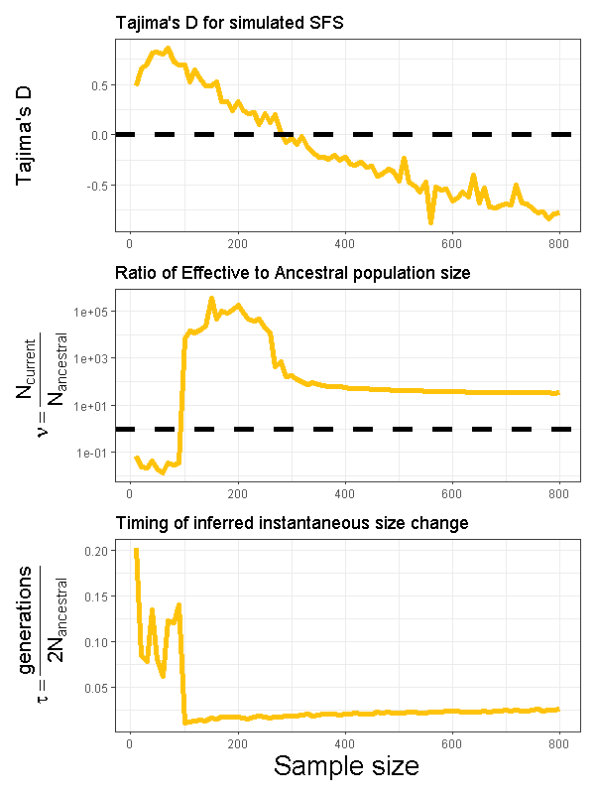
Demographic inference of simulated data is sensitive to the number of individuals
Ground Truth
Three-epoch
Ancestral
Time
Current
Simple Two-epoch Inference
Notes:
Here I show on the x-axis the number of individuals analyzed in the dataset, while on the y-axis I respectively show Tajima’s D, the inferred ratio of current to ancestral effective population size, and the inferred time since the instantaneous size change.

Slide 14
Demographic inference of simulated data is sensitive to the number of individuals
Ground Truth
Three-epoch
Ancestral
Time
Current
Simple Two-epoch Inference
Notes:
First I want to draw your attention to this top left panel, which depicts Tajima’s D vs. sample size.
These simulations were performed under neutrality, as in no selection.
A positive Tajima’s D typically indicates an excess of intermediate frequency variants in the SFS, suggesting a population contraction. Conversely, a negative Tajima’s D indicates an excess of low frequency variants in the SFS, suggesting a population expansion. The dashed black line indicates a Tajima’s D of 0.
Of note, at small sample sizes we have a positive Tajima’s D and at large sample sizes we have a negative Tajima’s D

Slide 15
Demographic inference of simulated data is sensitive to the number of individuals
Ground Truth
Three-epoch
Ancestral
Time
Current
Simple Two-epoch Inference
Notes:
Furthermore, this middle panel on the left depicts how the inferred ratio of current to ancestral population size changes with the number of individuals analyzed. The dashed black line indicates a ratio of 1; thus, data below the line indicates an inferred population contraction, while data above the line indicates an inferred population expansion. As with the story of Tajima’s D, we find that the evolutionary signal is sensitive to the number of individuals analyzed, shifting from a contraction to an expansion as the number of individuals increases.

Slide 16
Demographic inference of simulated data is sensitive to the number of individuals
Ground Truth
Three-epoch
Ancestral
Time
Current
Simple Two-epoch Inference
Notes:
Lastly, this bottom left panel also tells a story about how the inferred timing of the inferred population size change is ancient for a lower number of individuals analyzed and more recent for a higher number of individuals analyzed

Slide 17
Demographic inference of simulated data is sensitive to the number of individuals
Ground Truth
Three-epoch
Ancestral
Time
Current
Simple Two-epoch Inference
Notes:
Taken together these points all indicate that when analyzing a small dataset, two-epoch inference of this scenario captures an ancient contraction, while when analyzing a large dataset, two-epoch inference instead captures a recent expansion.

Slide 18
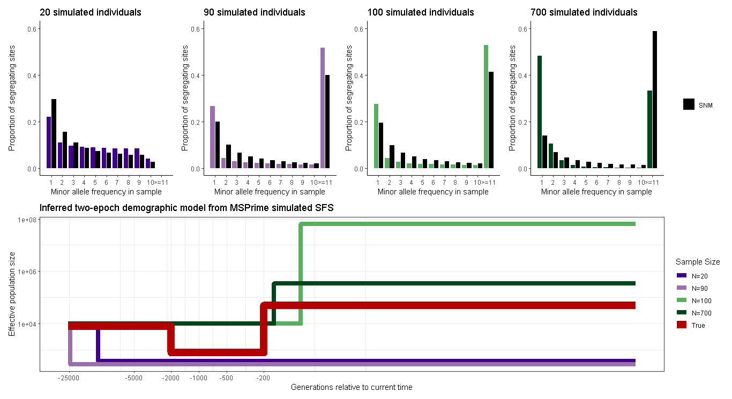
Inferred two-epoch demographic history is sensitive to the number of individuals
Notes:
Here’s an alternative way in which we can examine this phenomenon. On the top half of this figure I show the simulated SFS sampled at 20, 90, 100, and 700 individuals; all juxtaposed with the standard neutral model.

Slide 19
Inferred two-epoch demographic history is sensitive to the number of individuals
Notes:
On the bottom half of the figure I show the MLE two-epoch demographic history inferred from these same simulated SFSs. The x-axis depicts the number of generations going backwards in time, meaning that the right hand of the figure is current time, while the y-axis depicts the effective population size at a given time.
The red demography plot shows the true simulated demographic history.

Slide 20
Inferred two-epoch demographic history is sensitive to the number of individuals
Notes:
To help guide your eye, I have color coded both figures, the contractions (at n=20, n=90) as purple and the expansions (n=100, n=700) as green.

Slide 22
Inferred two-epoch demographic history is sensitive to the number of individuals
Notes:
As we saw before, at smaller sample sizes, we infer an ancient population contraction, consistent with the simulated ancient contraction

Slide 23
Inferred two-epoch demographic history is sensitive to the number of individuals
Notes:
while at larger sample sizes were instead infer a recent population expansion, consistent with the simulated recent expansion.

Slide 24
Inferred two-epoch demographic history is sensitive to the number of individuals
Notes:
One thing of interest to me is that our simulation sampling scheme was in increments of 10 individuals; however the change in inferred evolutionary history from 90 individuals to 100 individuals is quite drastic, even though visually their SFSs aren’t that different.

Slide 25
Coalescent tree analysis highlights the importance of branch length by epoch
Notes:
We sought to investigate further as to how and why this phenomenon of changing evolutionary signal arose based on the number of individuals. To do so, we considered the coalescent tree and its properties.

Slide 26
Coalescent tree analysis highlights the importance of branch length by epoch
Ancestral
Ancient
Recent
Notes:
Quite nicely, because we used, MSPrime, which is a coalescent-based simulator, we knew the ground-truth of our simulated history and calculated the proportion of branch length per epoch. To help with interpretation, I’ve provided a schematic for the simulated three-epoch demographic scenario on the right, color coded and labeled by epoch. For now I’ll refer to them as Ancestral, Ancient, and Recent

Slide 27
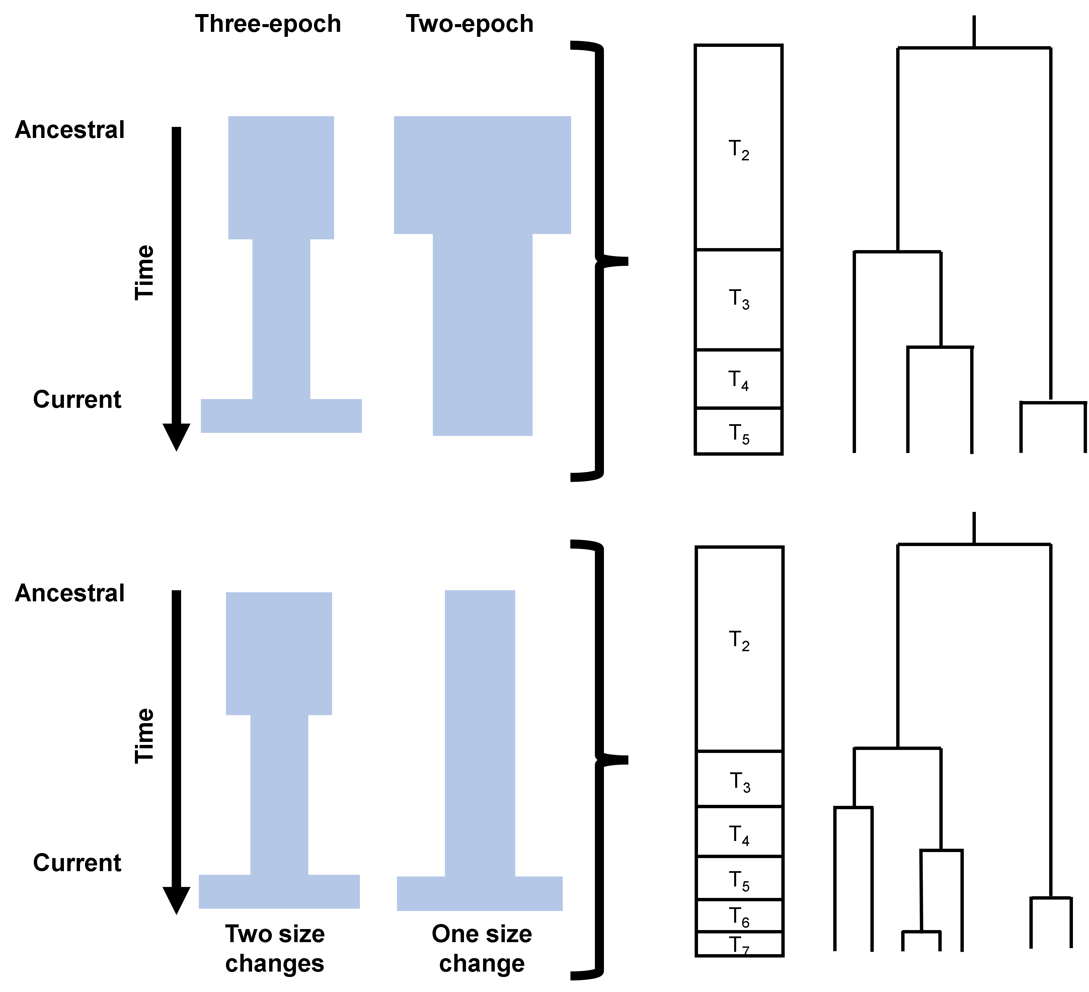
Coalescent tree analysis highlights the importance of branch length by epoch
Ancestral
Ancient
Recent
Notes:
I’ll start with a cartoon to help illustrate the process that went into making the next figure. Here I’m juxtaposing the distribution of coalescent event times on the left, a coalescent tree in the middle, and the demographic history schematic on the right.

Slide 28
Coalescent tree analysis highlights the importance of branch length by epoch
Ancestral
Ancient
Recent
Notes:
Again, because we know the ground truth, we can explicitly calculate the branch lengths and determine which epoch they fall into with respect to the coalescent tree, according to the schematic on the right and the coalescence times on the left.

Slide 29
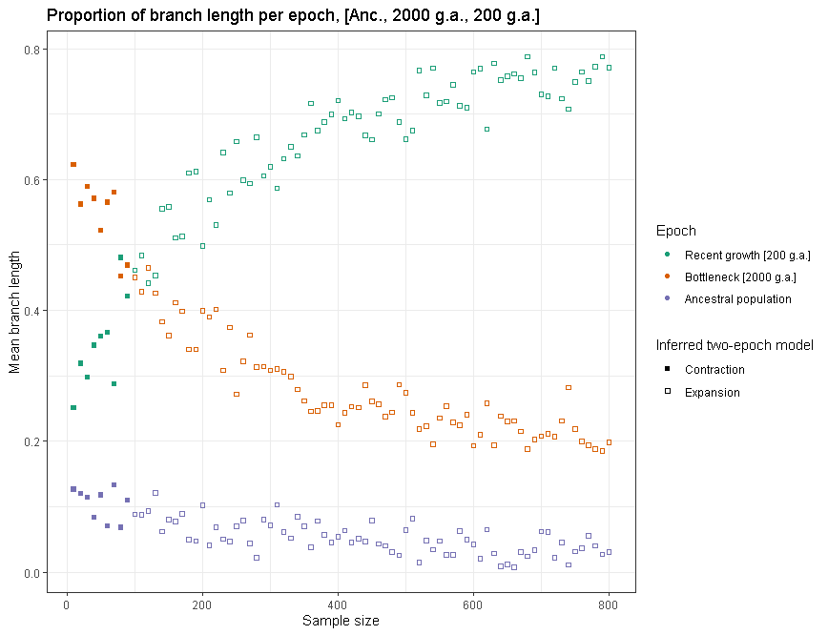
Coalescent tree analysis highlights the importance of branch length by epoch
Ancestral
Ancient
Recent
Notes:
Using this process, here I show the distribution of branch length per epoch.

Slide 30
Coalescent tree analysis highlights the importance of branch length by epoch
Ancestral
Ancient
Recent
Notes:
The notation system that I am using here indicates that the ancient contraction happened 2,000 generations ago and the recent growth happened 200 generations ago

Slide 31
Coalescent tree analysis highlights the importance of branch length by epoch
Ancestral
Ancient
Recent
Notes:
Data are color-coded by the ground truth epoch in which the branch proportion fell upon the coalescent tree

Slide 32
Coalescent tree analysis highlights the importance of branch length by epoch
Ancestral
Ancient
Recent
Notes:
Additionally, data points which are solid and filled in indicate the samples from which a two-epoch demographic model inferred a population contraction, while hollow points indicate an inferred population expansion.

Slide 33
Coalescent tree analysis highlights the importance of branch length by epoch
Ancestral
Ancient
Recent
Notes:
Of extreme interest, we found that the highest mean proportion of branch lengths corresponded to the epoch whose evolutionary signal was captured by the two-epoch model. As an example, here when the teal data points (the recent expansion epoch) overtake the orange data points (the ancient contraction epoch) is when the inferred evolutionary signal changes from an ancient contraction to a recent expansion.

Slide 34
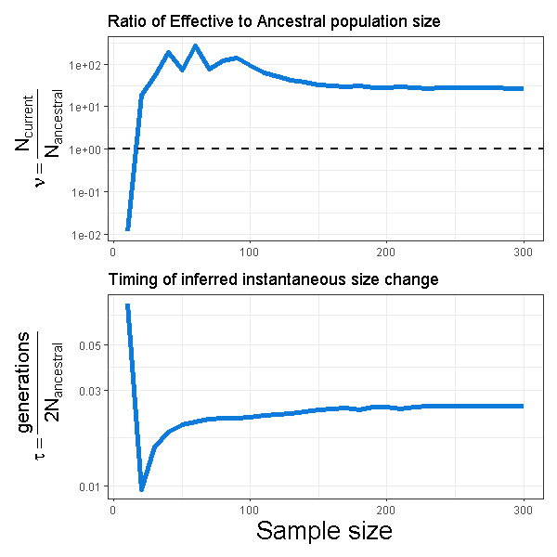
Demographic inference of empirical data is sensitive to the number of individuals
Simulated human data
Empirical human data
Notes:
Lastly, with what little time I have left, I just want to share that we did in fact also apply this analysis to empirical human data, shown here on the right in blue, finding similarly that data sets with fewer individuals infer an ancient contraction while data sets with more individuals infer a recent expansion

Slide 35
Current Takeaways
Population demographic inference is sensitive to the number of individuals.
Dominant evolutionary signals may reflect the distribution of coalescent branch lengths across time
Analyzing data sets consisting of differing numbers of individuals may reveal complementary facets of evolutionary history.
Further Analysis
Testing our hypothesis that the distribution of coalescent branch lengths is the primary determining factor for the dominant signal of two-epoch inference from a more complex demographic history
Notes:
To summarize my work, population genetics inference is sensitive to the number of individuals in the data set.
We suspect, and are testing, that the dominant evolutionary signal in a two-epoch model is determined by the epoch with the highest proportion of coalescent branch lengths
And lastly, this work has important implications for future population genetics studies which similarly infer demography – analyzing data sets of different sample sizes may yield complementary insights into evolutionary history.

Slide 36
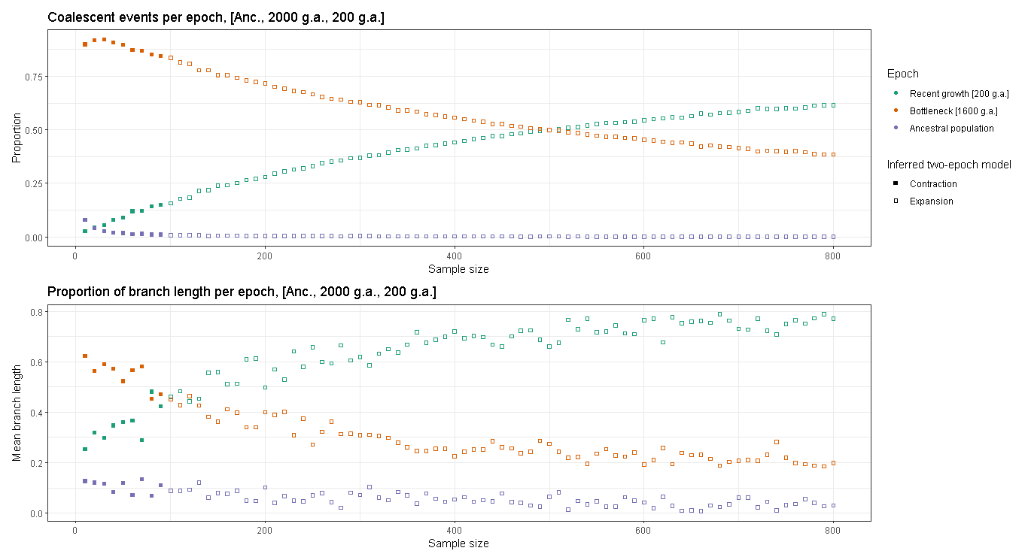
Additional coalescent tree analysis (I’m curious about your opinions!)

Slide 37
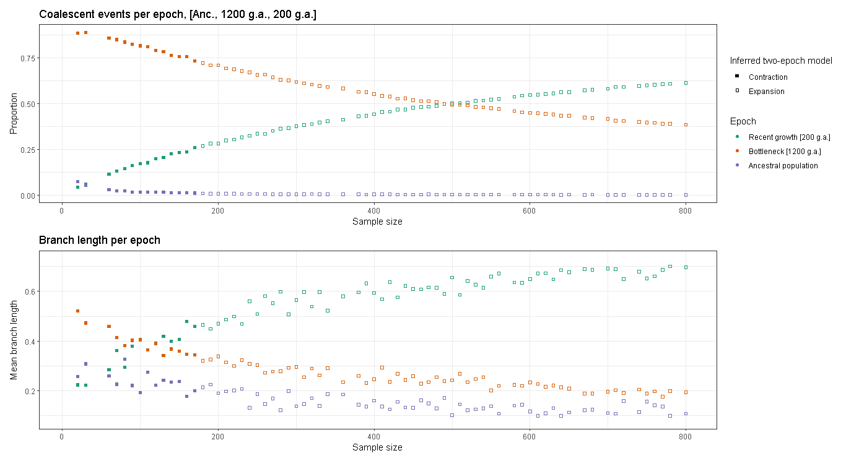
Additional coalescent tree analysis (I’m curious about your opinions!)

Slide 38
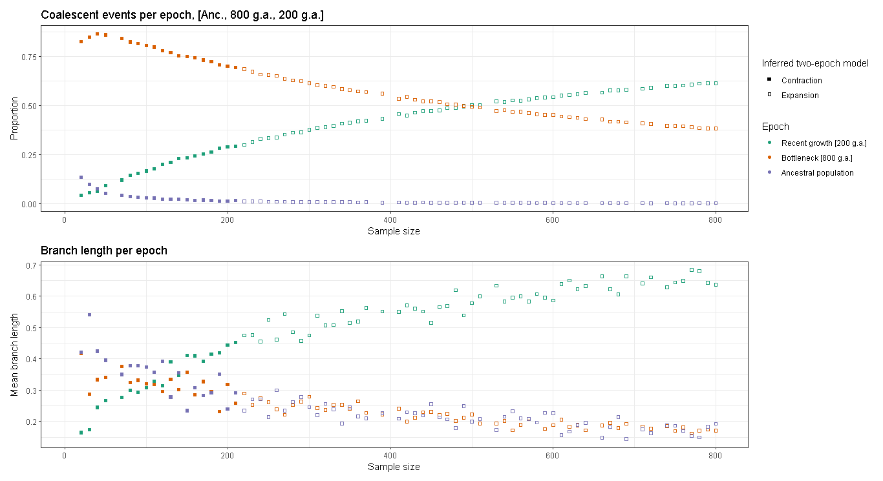
Additional coalescent tree analysis (I’m curious about your opinions!)
Notes:
Toy example: increase mutation rate such that increased number of mutations can tighten up the confidence intervals, decreasing statistical fluctuation

Slide 39
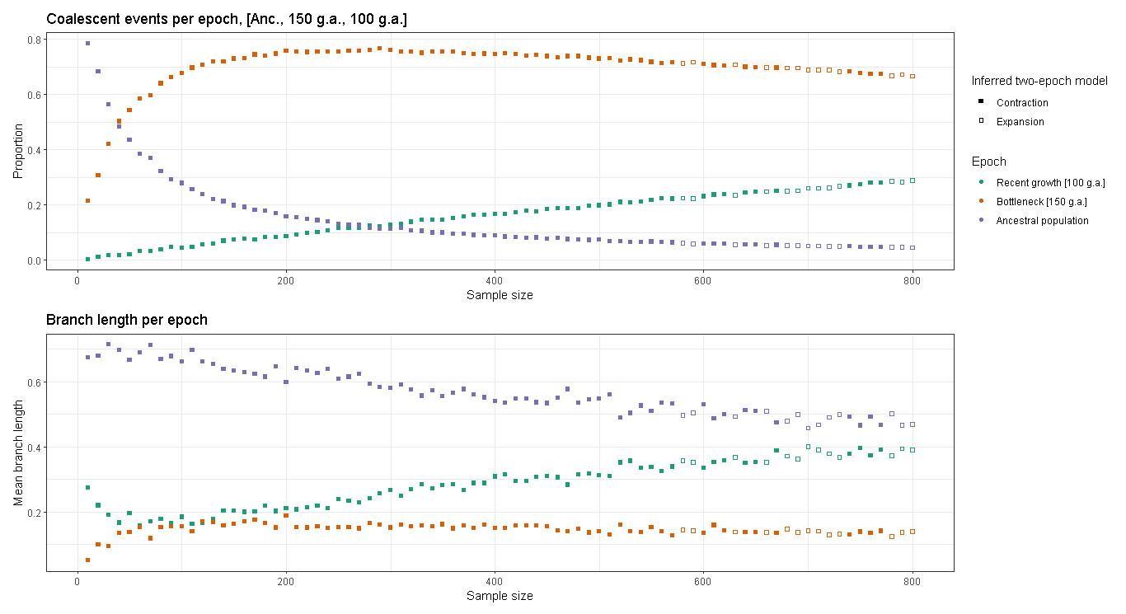
Additional coalescent tree analysis (I’m curious about your opinions!)
Notes:
In this case we’re not exactly sure what’s going on. The highest mean proportion of branch length corresponds to the Ancestral epoch, followed by the recent epoch, and then the bottleneck epoch. The only simulated contraction occurs going from the ancestral to the bottleneck epoch, yet the inferred demographic model is a contraction
At a given size change, how many lineages survive, distribution of lineages which survive

Slide 40
Additional coalescent tree analysis (I’m curious about your opinions!)
One-epoch model fit
Dummy-variable
Notes:
Here on the top I’m showing the model fits for a one-epoch model, which consists of no change in population size. It’s essentially the fit of data to a standard neutral model scaled to have the same underlying Theta

Slide 41
Additional coalescent tree analysis (I’m curious about your opinions!)
One-epoch model fit
Dummy-variable
Two-epoch model fit
Nu
Tau
Notes:
We can compare this to the numerical outputs of the two-epoch model fit, which has a substantially higher log likelihood. The model parameters are Nu and Tau respectively, denoting the change in effective population size relative to the ancestral population, and the inferred timing of the contraction.

Slide 42
Thesis chapter overview
What is the population demographic history and distribution of selective effects of human gut commensal bacteria?
How does the number of individuals studied influence the evolutionary stories we infer from population genetic data?
How do differences between population genetic datasets affect their distribution of fitness effects?
Notes:
In my second chapter I’ll be investigating how the number of individuals in a data set can influence the evolutionary stories that we infer from population genetic data.
As a quick note, we do have a first draft of the manuscript, I’ve gotten comments from Kirk that I’m working on addressing, and we’re wrapping up some final final analysis which I’ll get into greater detail later.

Slide 43
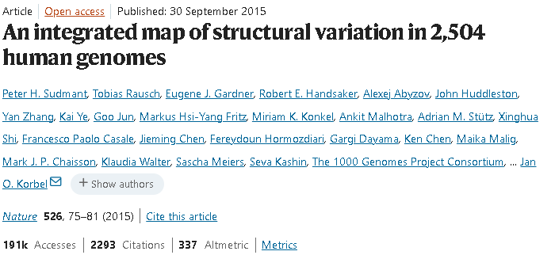
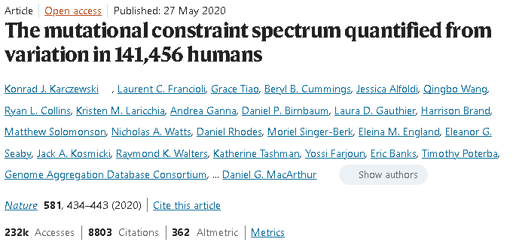
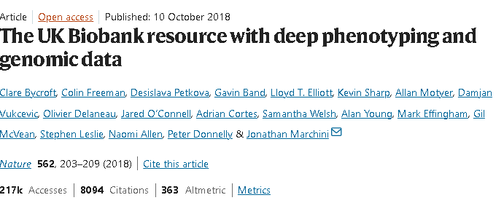
Human genomes are well-studied in terms of their genetic variation, yielding multiple huge datasets

Slide 44
I’m investigating two of these datasets (1KG sampled at two different times)

Slide 45
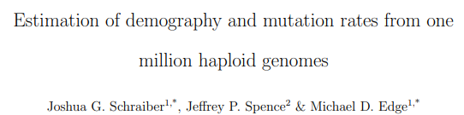
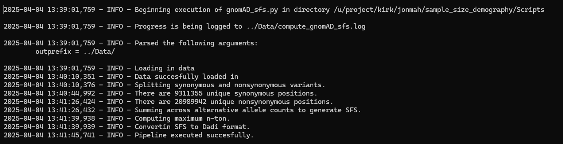
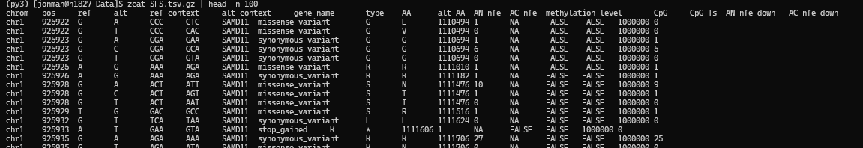
I got help from Josh Schraiber using DR EVIL to parse through the gnomAD data

Slide 46
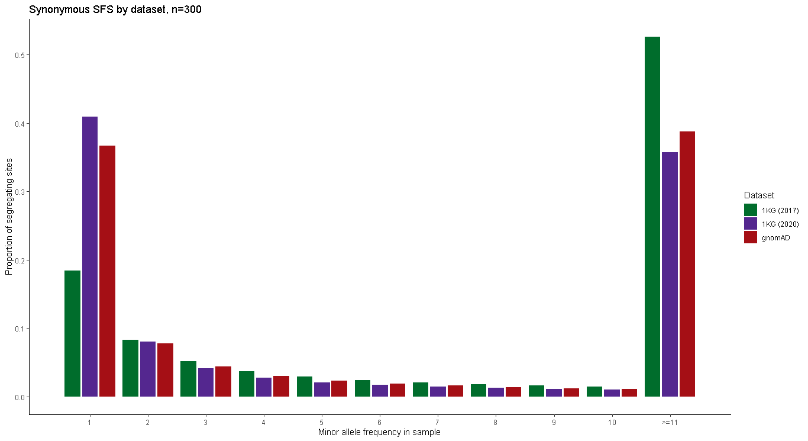
I am isolating “dataset-specific” factors by controlling for sample size and population structure (EUR)

Slide 47
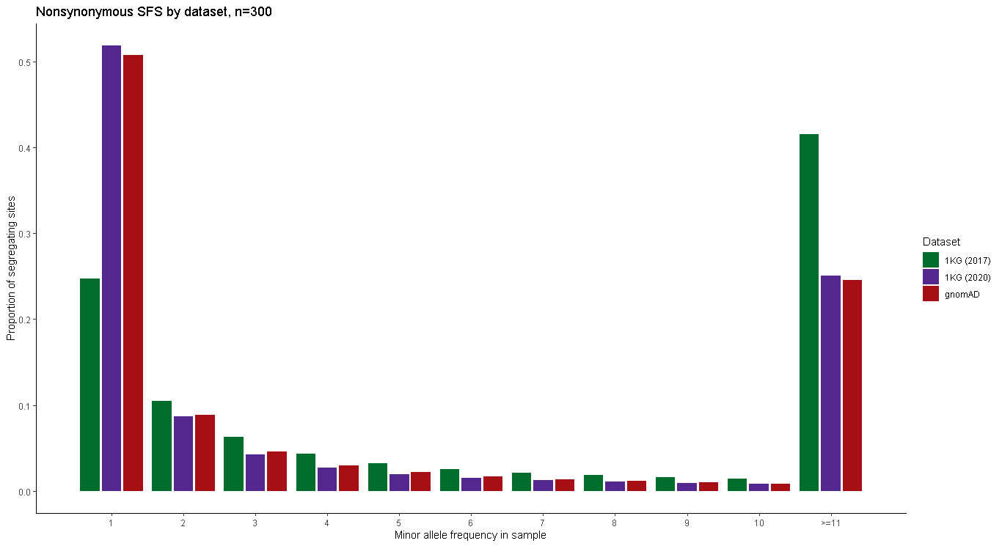
I am isolating “dataset-specific” factors by controlling for sample size and population structure (EUR)

Slide 48
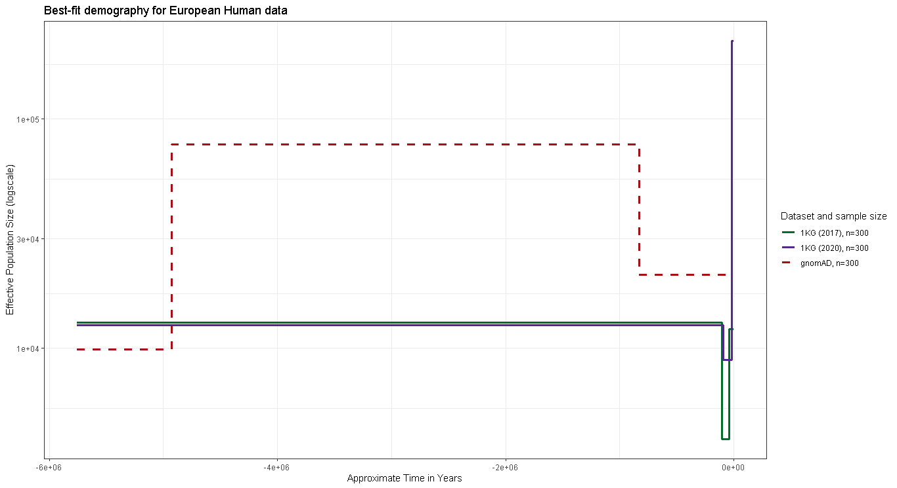
Dataset choice yields different inferred population demographic histories.

Slide 49
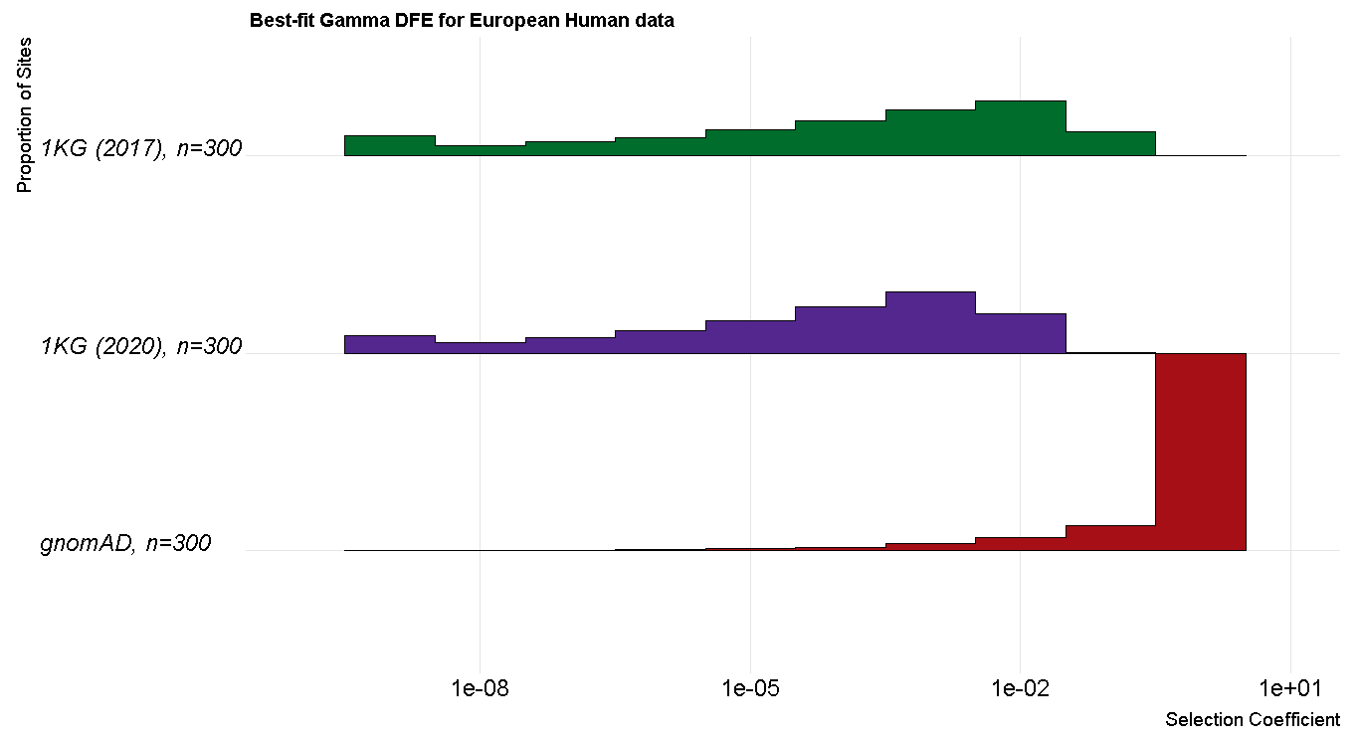
Dataset choice yields differently inferred gamma-distributed DFEs

Slide 50
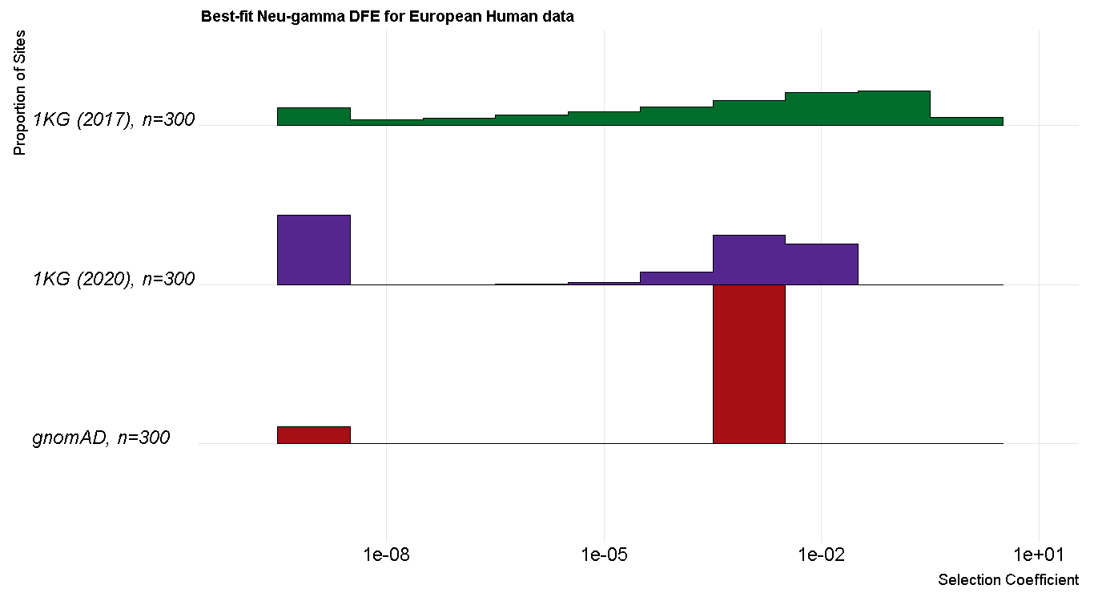
Dataset choice yields differently inferred neutral + gamma-distributed DFEs

Slide 51
Post-graduation Plans

Slide 52
Postgraduation Plans
I’ve done a lot of schmoozing (i.e., rubbing elbows) with politicians / staffers at the city and state level through some science policy work. I don’t want to do this full time as I dislike the people.
I’m looking at applying for government research and/or analysis jobs at the city / county / state level, with an emphasis on county jobs, based on my discussions with other scientists in these roles.
My dream career would be something like a covid (or other infectious disease) wastewater genomics analyst, incorporating population genetics, microbiology, and public health.
These jobs have a 6-month lockout for their minimum-qualification exam, so I plan to apply starting in December and land a job by June.
Notes:
Covered California Data Scientist, Anthropology Research. Reach out to Abby Bigham
Rachel, Bob Wayne, UC Santa Cruz
PI at UC Irvine
JGI
Sandio Labs (San Francisco)

Slide 53
Random extra slides

Slide 54
That’s a great question!

Slide 55
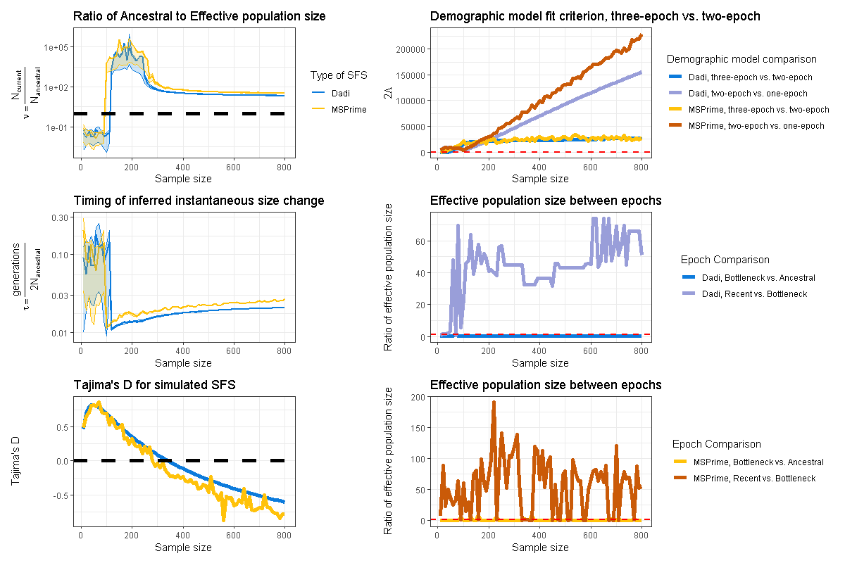
That’s a great question!

Slide 56
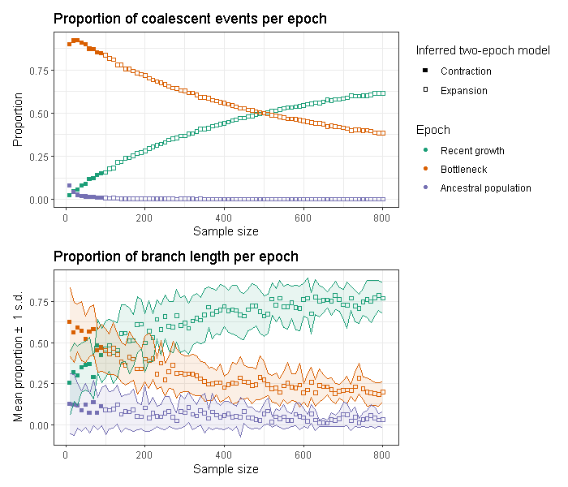
That’s a great question!

Slide 57
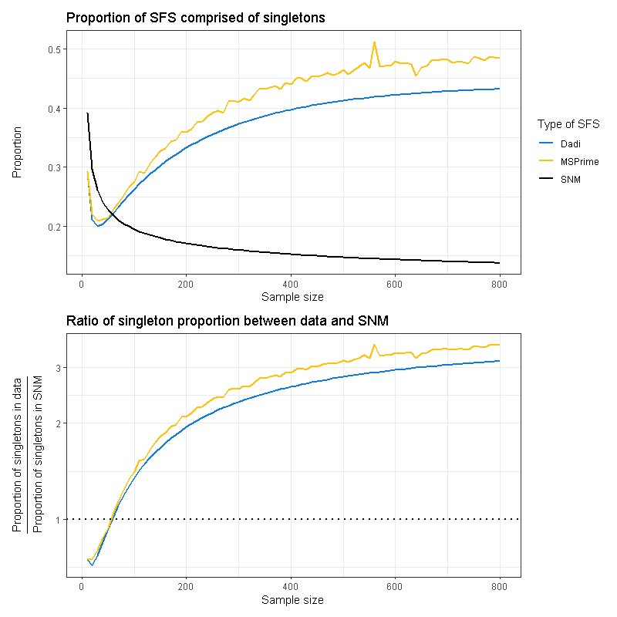
That’s a great question!

Slide 58
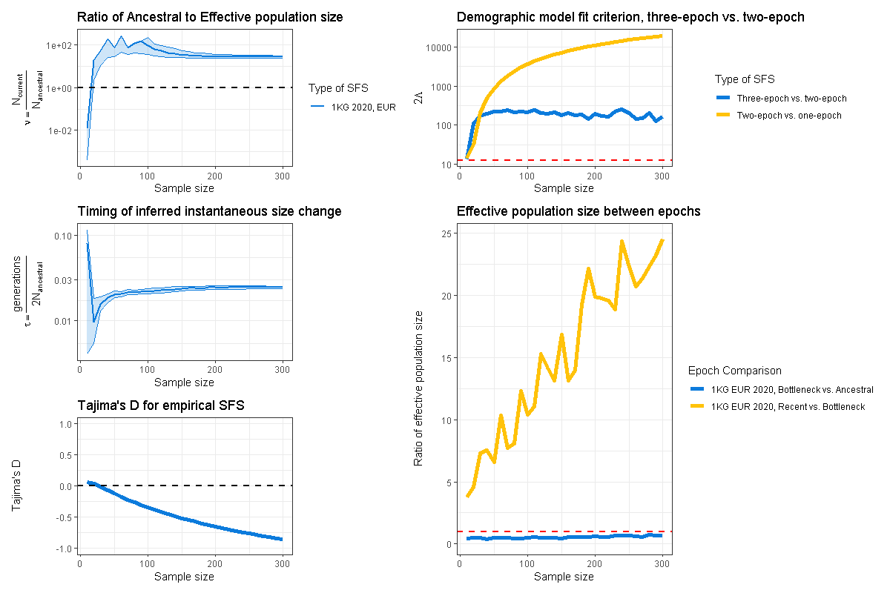
That’s a great question!

Slide 59
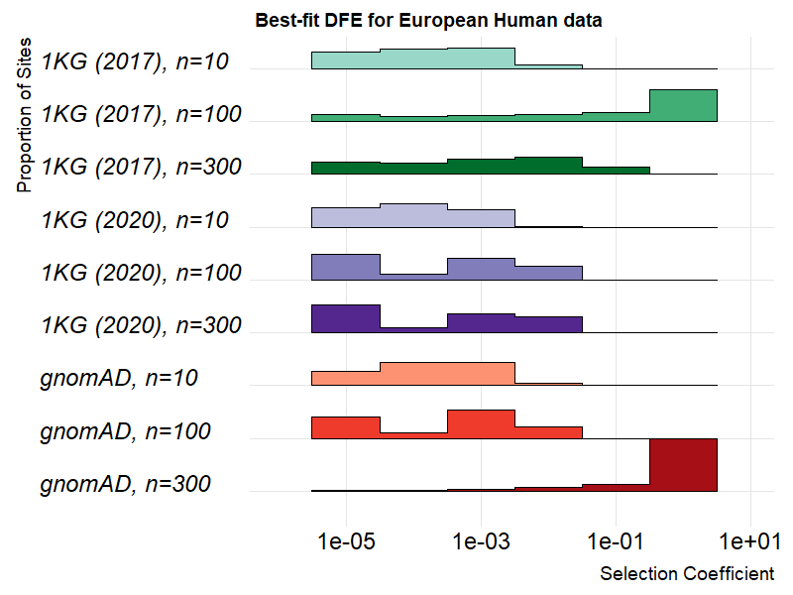
That’s a great question!

Slide 60
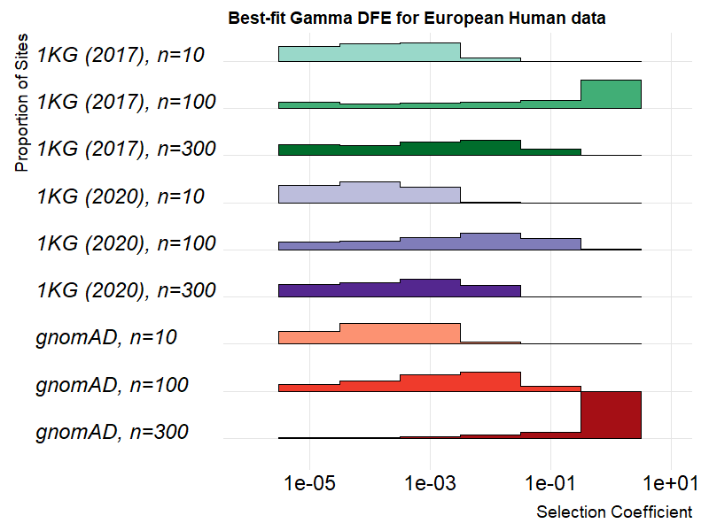
That’s a great question!

Slide 61
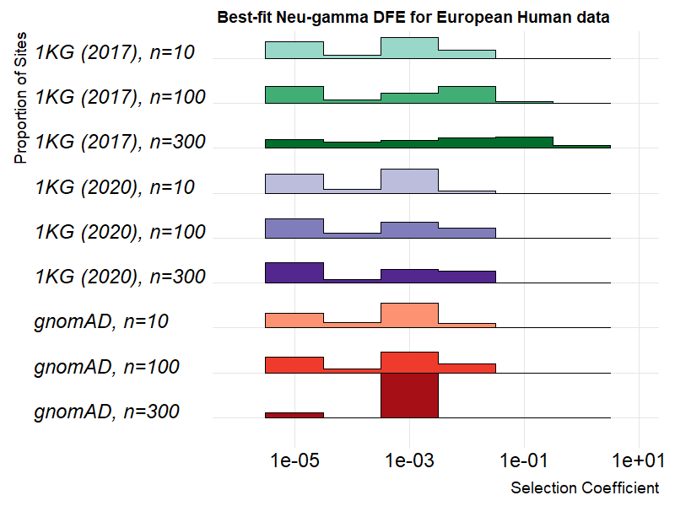
That’s a great question!

