Slide 1
Lab Meeting
AKA
What has Jon been doing?
20250626
Jon Mah
Garud and Lohmueller Labs

Slide 2
Chapter 2 project summary
Question: How does sample size determine the strength of ancient vs. recent evolutionary signals?
Next Question: Can we find an optimal sample size to recover the ancient or recent evolutionary signals?
Approach:
  Simulate multiple demographic scenarios and downsample
  Compute expected SFS based on sample size using theory
  Apply to high quality empirical data

Slide 3
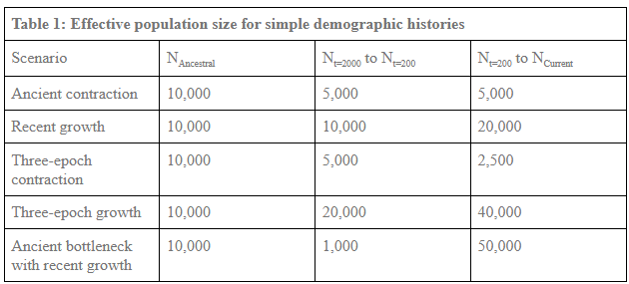
Simulation outline
L = 100,000,000 bp
r = 1E-8
mu = 1.5E-8
Downsample to sample size from 10 – 800, by 10 (i.e., 10, 20, 30, 40, 50)

Slide 4
Simulation outline
L = 20,000,000 bp
r = 1E-8
mu = 1.5E-8
Downsample to sample size from 10 – 800, by 10 (i.e., 10, 20, 30, 40, 50)

Slide 5
Simulation outline
L = 20,000,000 bp
r = 1E-8
mu = 1.5E-8
Downsample to sample size from 10 – 800, by 10 (i.e., 10, 20, 30, 40, 50)
We expect the bottleneck simulation to yield inferences resembling an ancient contraction at small sample sizes and a recent expansion at large sample sizes.

Slide 6
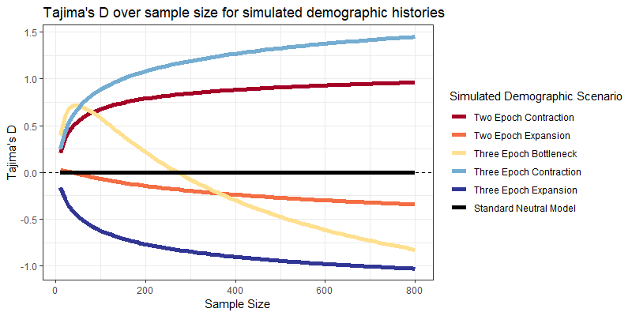
Simulation SFS summary statistics
Tajima’s D:
>0 → intermediate frequency
<0 → rare frequency
=0 → neutral

Slide 7
Simulation SFS summary statistics
Tajima’s D:
>0 → intermediate frequency
<0 → rare frequency
=0 → neutral
We can find an “inflection point” where Tajima’s D goes from positive to negative based only on sample size!

Slide 8
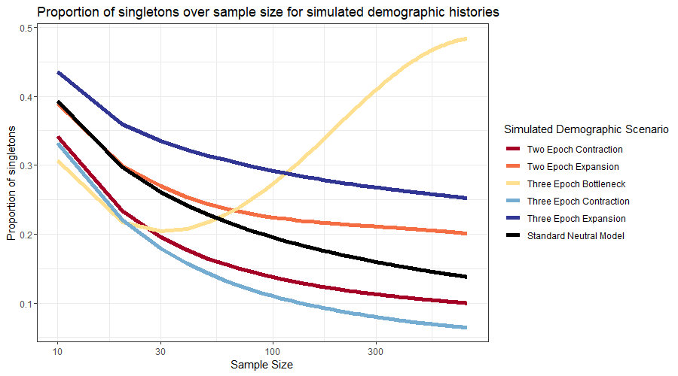
Simulation SFS summary statistics

Slide 9
Simulation SFS summary statistics
We can find an “inflection point” where the proportion of singletons changes behavior and exceeds that of the SNM!

Slide 10
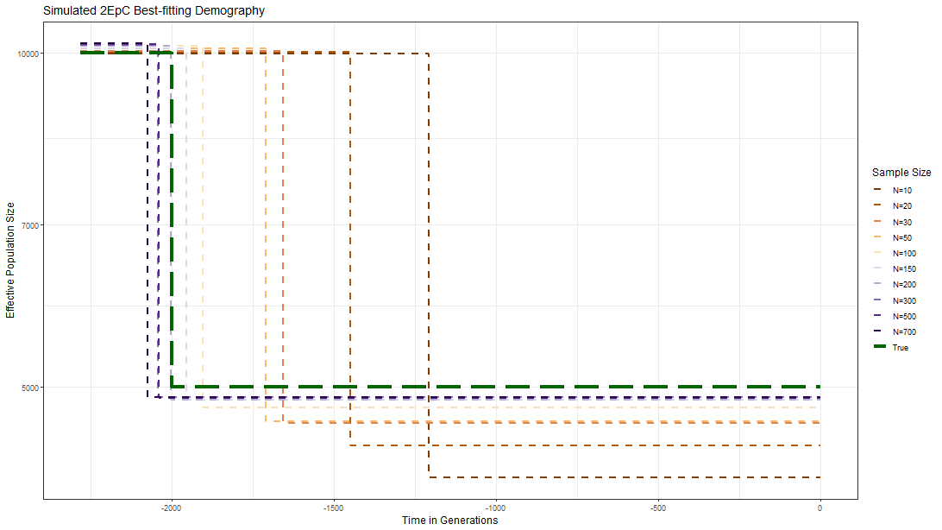
Inference from simulated SFSs reveals an “optimal” sample size for recovery

Slide 11
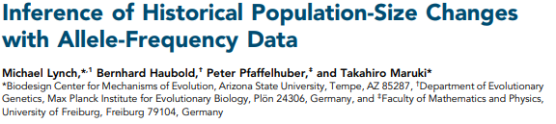

Lynch Theory: Expected count of SFS
Lynch et al. 2020

Slide 12
Lynch Theory: Expected count of SFS
Expected count of singletons
Arithmetic mean of population size…
Lynch et al. 2020

Slide 13
Lynch Theory: Expected count of SFS
Expected count of singletons
Arithmetic mean of population size…
as defined by intervals of coalescent time
Lynch et al. 2020

Slide 14
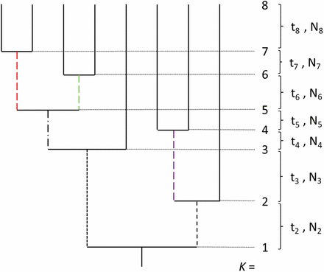
Lynch Theory: Time intervals
What matters is the arithmetic mean of N2 through N8. Note that the length of ti does not matter, just that there are intervals of time in between coalescent events.
Under coalescent theory, the expected time to coalesce k lineages is:
2N / (k choose 2)
Lynch et al. 2020

Slide 15
Lynch Theory: Does it work?
Let us simulate a bottleneck: 5,000 → 1,000 → 10,000, with k=5
Suppose the contraction occurs 3,100 generations prior
Suppose the expansion occurs 2,100 generations prior
Lynch et al. 2020

Slide 16
Lynch Theory: Does it work?
Let us simulate a bottleneck: 5,000 → 1,000 → 10,000, with k=5
Suppose the contraction occurs 3,100 generations prior
Suppose the expansion occurs 2,100 generations prior
  E[T_{5→4}] = 20,000 / (5 choose 2) = 2,000 generations
  E[T_{4→3}] = 2,000 / (4 choose 2) = 333.33 generations
  E[T_{3→2}] = 2,000 / (3 choose 2) = 666.67 generations
  E[T_{2→1}] = 10,000 / (2 choose 2) = 10,000 generations
Lynch et al. 2020

Slide 17
Lynch Theory: Does it work?
Let us simulate a bottleneck: 5,000 → 1,000 → 10,000, with k=5
Suppose the contraction occurs 3,100 generations prior
Suppose the expansion occurs 2,100 generations prior
  E[T_{5→4}] = 20,000 / (5 choose 2) = 2,000 generations
  E[T_{4→3}] = 2,000 / (4 choose 2) = 333.33 generations
  E[T_{3→2}] = 2,000 / (3 choose 2) = 666.67 generations
  E[T_{2→1}] = 10,000 / (2 choose 2) = 10,000 generations
Arithmetic mean of population size is 22,000 / 4 = 4250
We expect 4 * mu * L * 4250 = 255 singletons
Lynch et al. 2020

Slide 18
Lynch Theory: Does it work?
I set up simulations for a contraction and an expansion such that:
E[Bottleneck singletons] = 255
E[Contraction singletons] = 195
E[Expansion singletons] = 195
Lynch et al. 2020

Slide 19
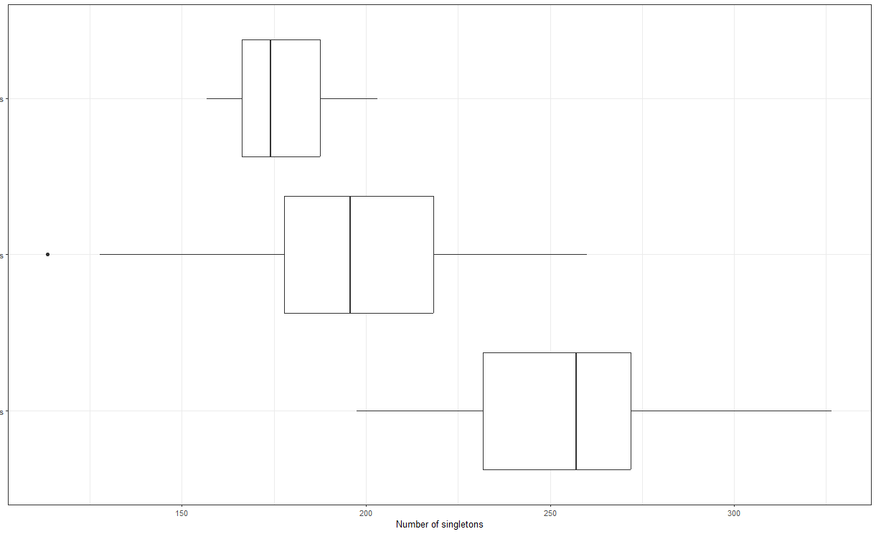

Lynch Theory: Does it work?
I set up simulations for a contraction and an expansion such that:
E[Bottleneck singletons] = 255
E[Contraction singletons] = 195
E[Expansion singletons] = 195
20 replicate simulations
Lynch et al. 2020

Slide 20
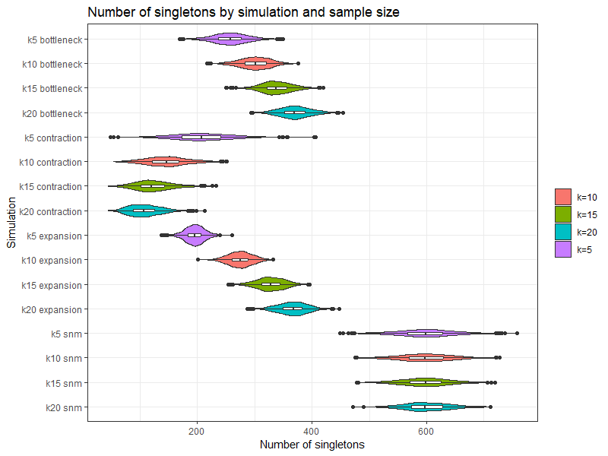
Lynch Theory: Scaled up
I repeated this with 1000 replicates for four different sample sizes (k = 5, 10, 15, 20), as well as for the standard neutral model.
Contractions lose singletons as sample size increase
Bottlenecks and expansions gain singletons as sample size increases.
The standard neutral model stays stable.
Lynch et al. 2020

Slide 21
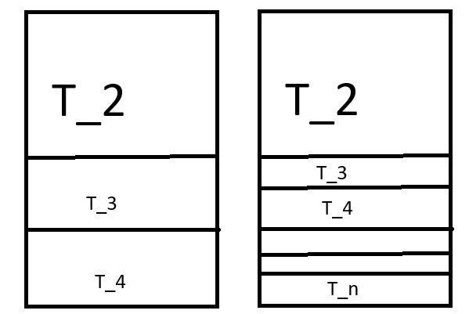
Lynch Theory: Explained
The Lynch Theory explains how singleton count is dependent on arithmetic mean of population size over coalescent time intervals. As sample size k increases, then the expected distribution of time intervals (and their associated N_{t}) becomes more and more dense in recent time, thereby biasing evolutionary inference towards recent events.
Small sample size → ancient
Big sample size → recent
*Not to scale, merely an illustration for the proportionality of time intervals

Slide 22
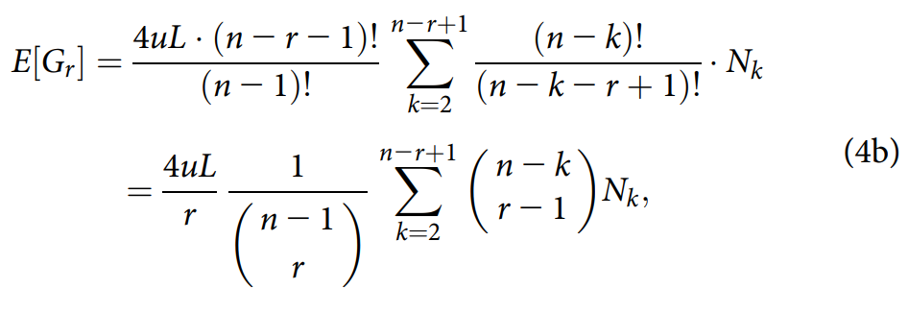
Lynch Theory: Scaled up (but in a different way)
We can compute not just the expected count or singletons, but also the expected count of r-tons, where r is the allele class, e.g., doubletons imply r=2, tripletons imply r=3, etc…

Slide 23
The Pipeline™: Computing expected SFS
Accepts `.csv` of generations and population size
Alternatively accepts list of `nu` and `tau` variables in Dadi format
Input demography

Slide 24
The Pipeline™ : Computing expected SFS
Input demography
Optional input flag
Accepts `--target_time`
Accepts `--target_sample_size`

Slide 25
The Pipeline™ : Computing expected SFS
Input demography
Optional input flag
Accepts `--target_time`
Accepts `--target_sample_size`
Iteratively search for target

Slide 26
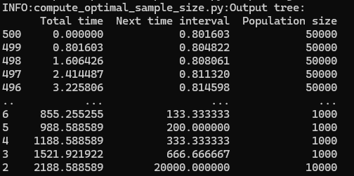
The Pipeline™ : Computing expected SFS
Input demography
Optional input flag
Accepts `--target_time`
Accepts `--target_sample_size`
Iteratively search for target
Calculate coalescent tree based on intervals

Slide 27
The Pipeline™ : Computing expected SFS
Input demography
Optional input flag
Accepts `--target_time`
Accepts `--target_sample_size`
Iteratively search for target
Calculate coalescent tree based on intervals
Output expected SFS

Slide 28
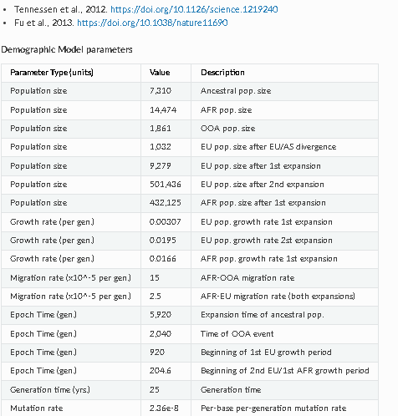

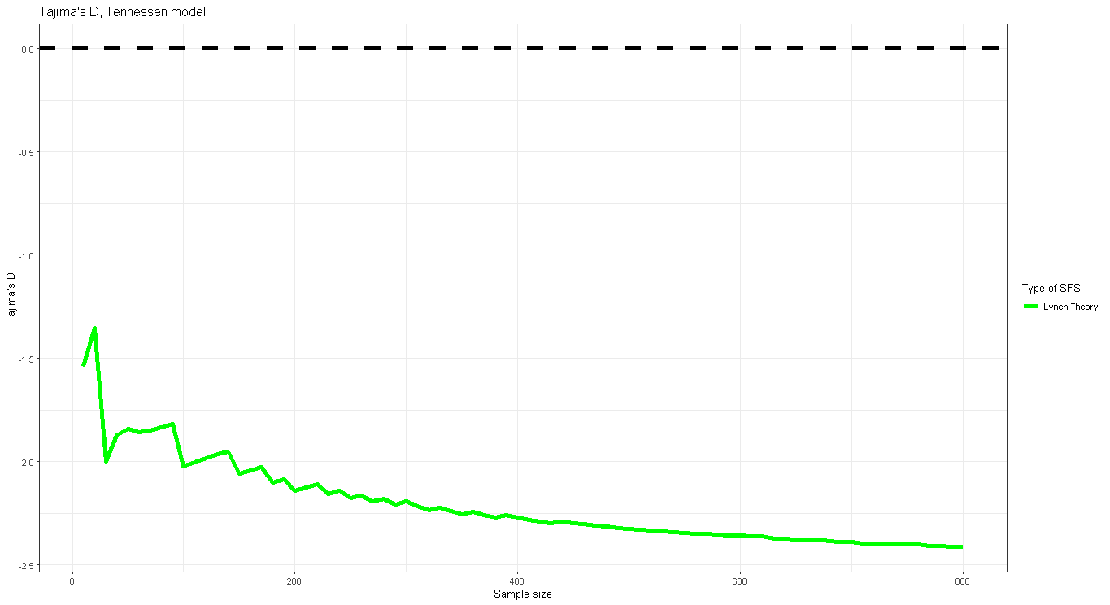
Sidenote: Complex Demographies

Slide 29
Three data sets to study at different sample sizes
MSPrime
Multiple demographic scenarios simulated using MSPrime, sampled at various sample sizes
Dadi
Lynch
Projection of the “full” simulated SFS from MSPrime, downsampled and projected using Dadi
Theoretical SFS computed at various sample sizes based on the same input demographic parameters as the MSPrime simulations

Slide 30
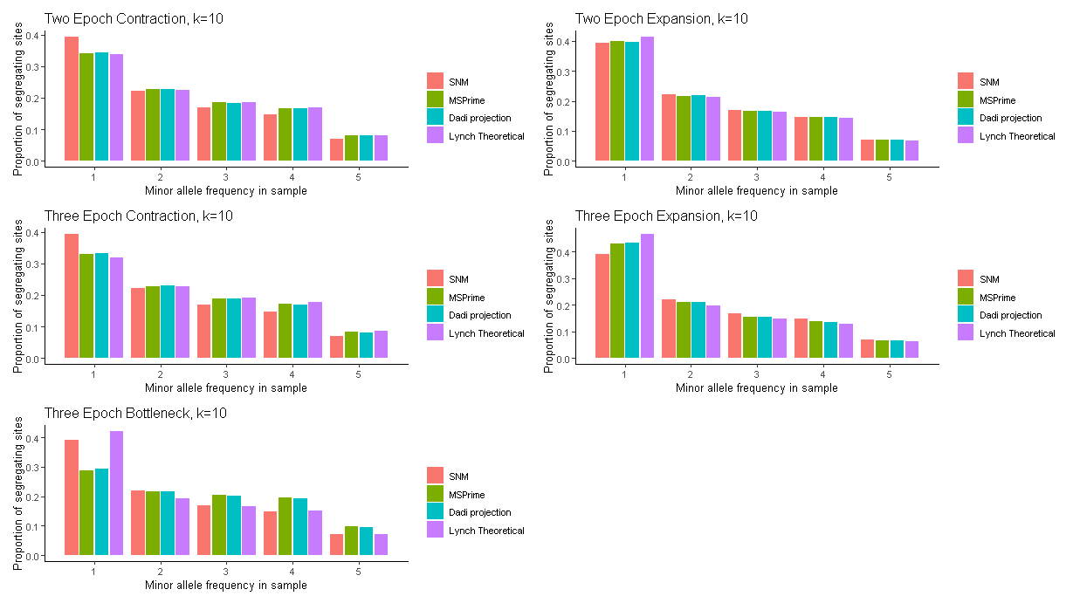
How well do these three data sets match?
The Lynch theoretical proportional SFS matches least well in the bottleneck + growth scenario

Slide 31
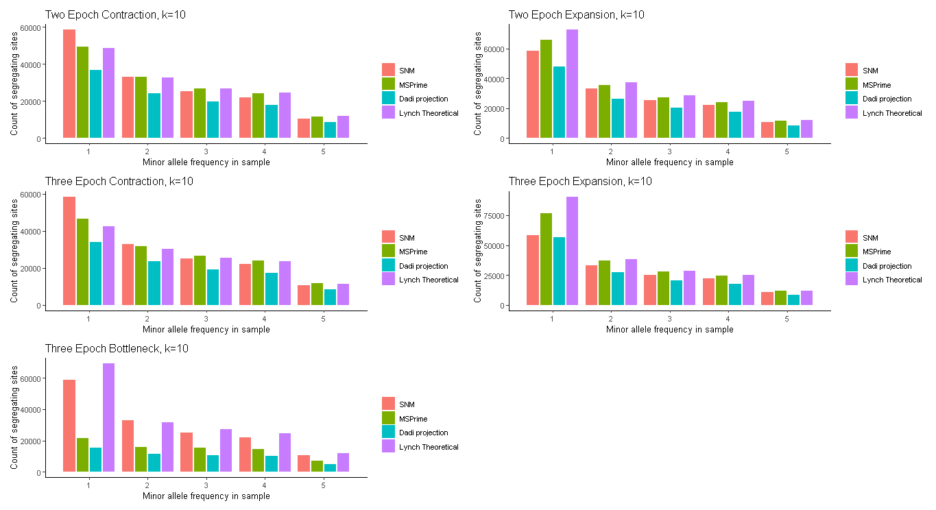
How well do these three data sets match?
The Lynch theoretical count SFS matches least well in the bottleneck + growth scenario

Slide 32
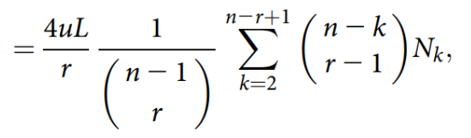
Side-bar: Theory on theoretical discrepancy

Slide 33
Side-bar: Theory on theoretical discrepancy
The expectation or E[G_r] involves a summation term from k=2 to n-r+1. As r increases, then the end condition (n – r + 1) decreases, and the corresponding N_k term is not included. Specifically, k=2 is the oldest lineage interval, and k=n is the most recent, thus, we “lose” information about recent intervals when considering higher order allele classes

Slide 34
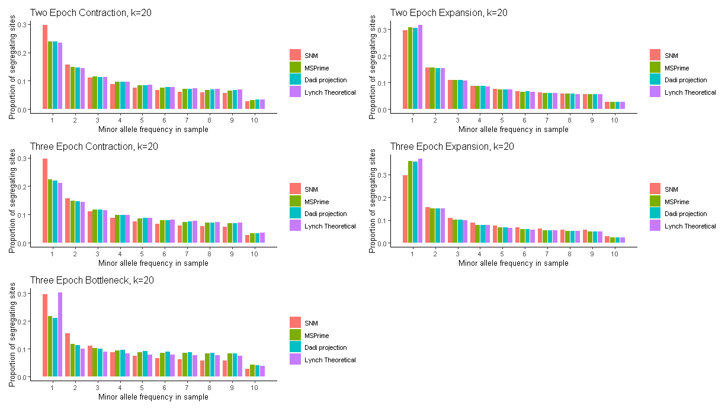
How well do these three data sets match?

Slide 35
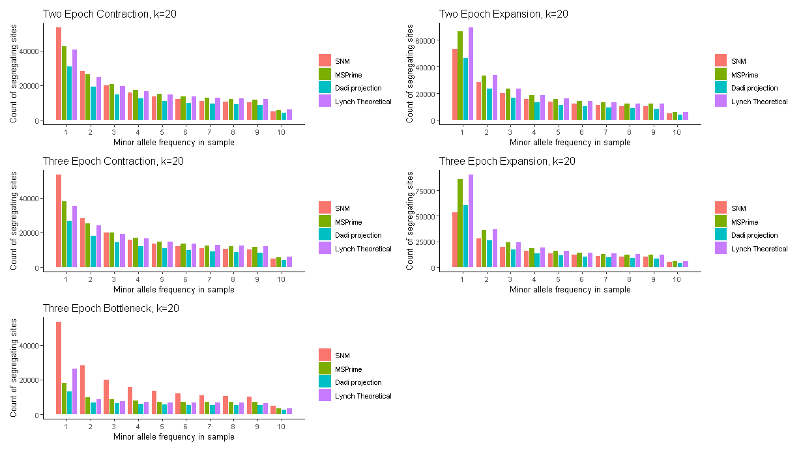
How well do these three data sets match?

Slide 36
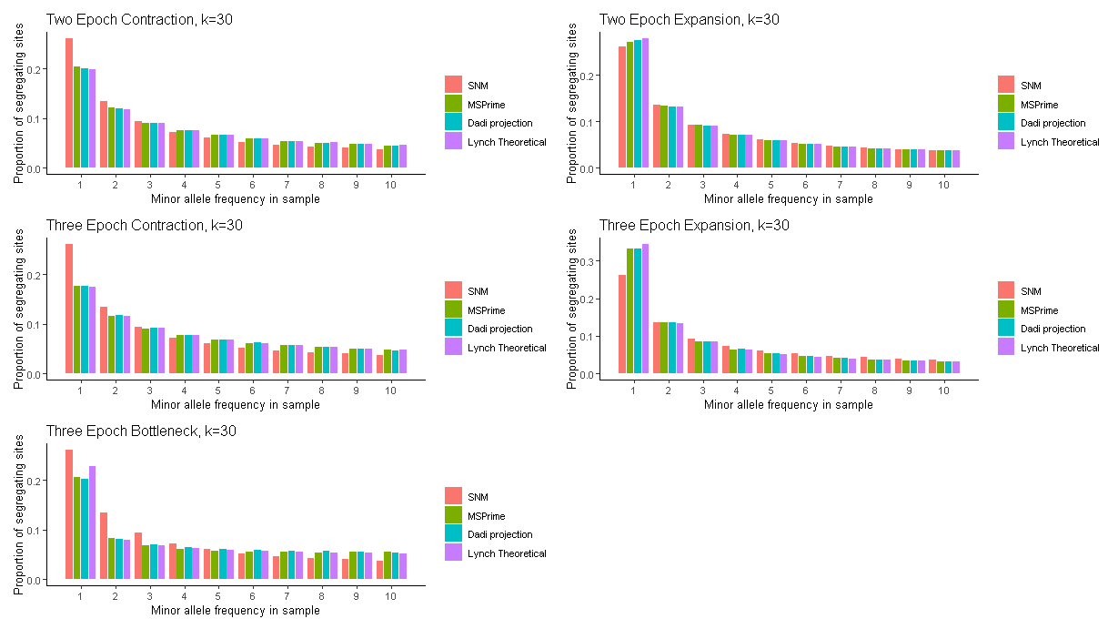
How well do these three data sets match?

Slide 37
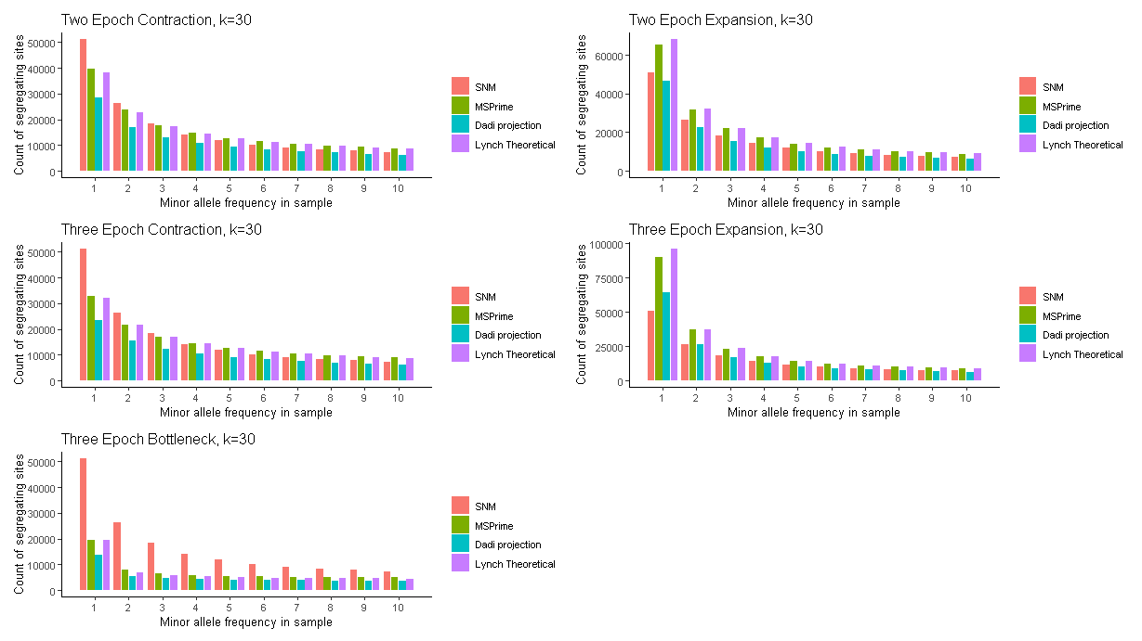
How well do these three data sets match?

Slide 38
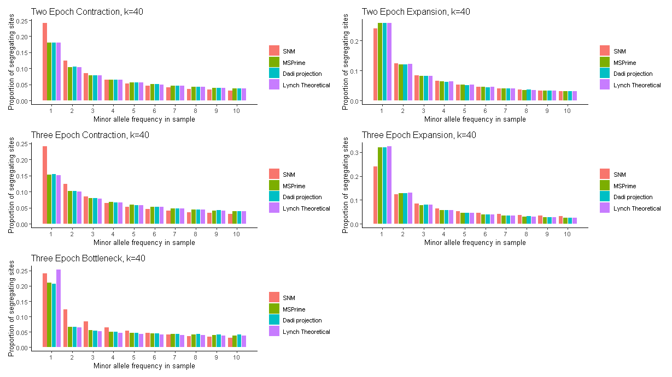
How well do these three data sets match?

Slide 39
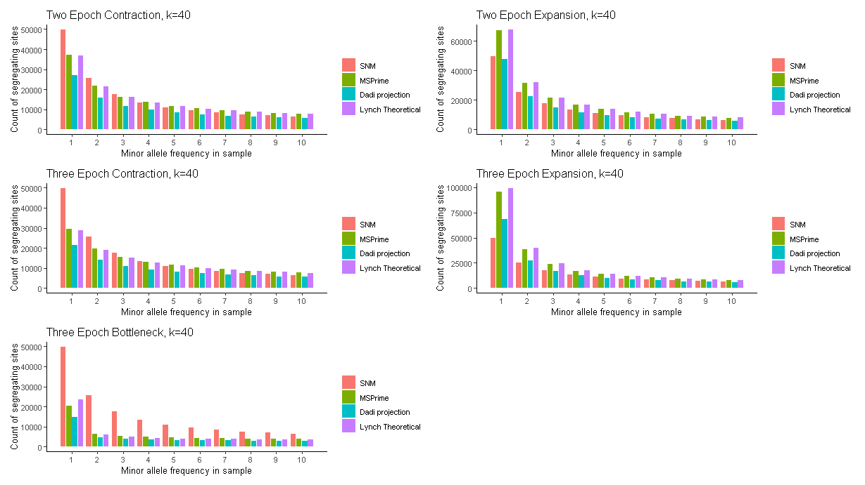
How well do these three data sets match?

Slide 40
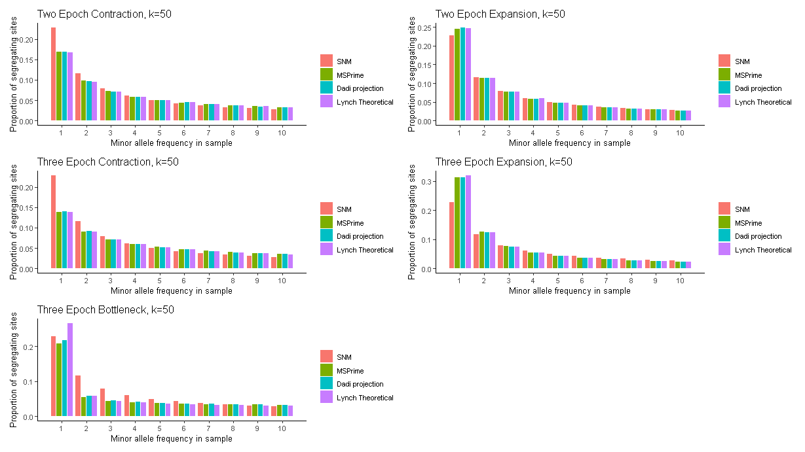
How well do these three data sets match?

Slide 41

How well do these three data sets match?

Slide 42
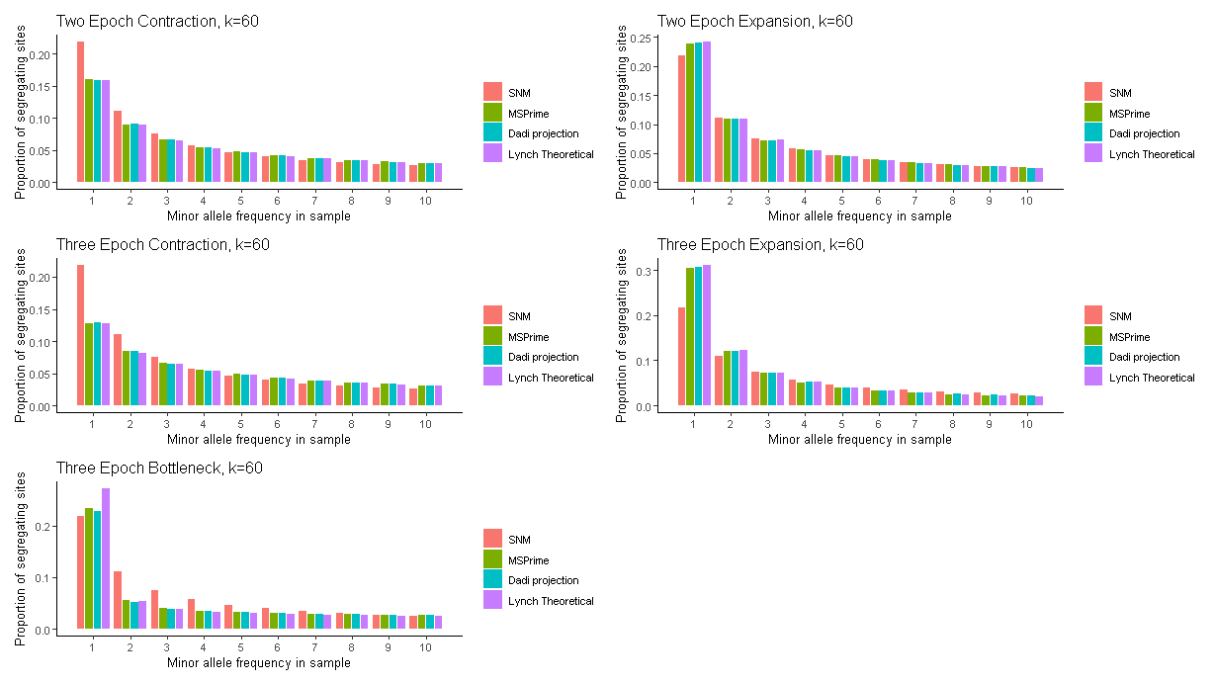
How well do these three data sets match?

Slide 43
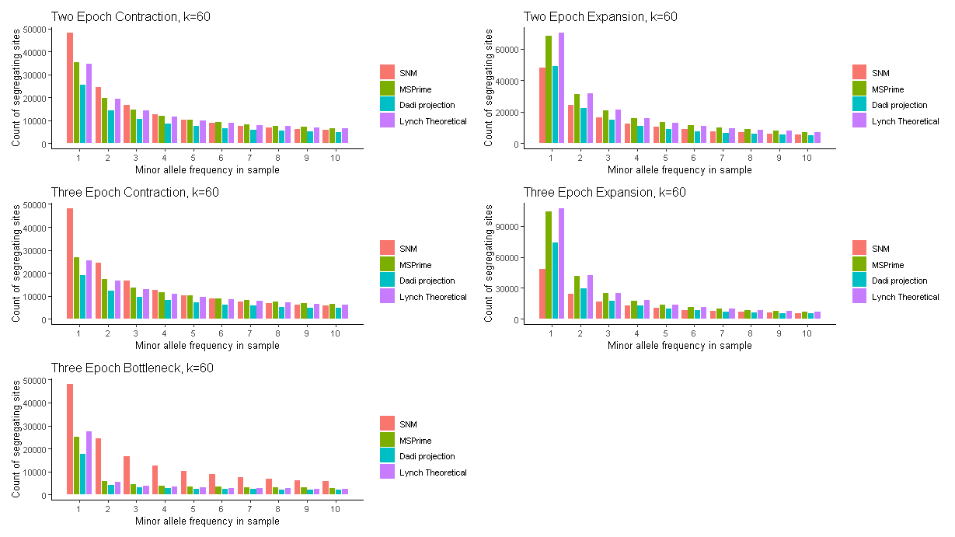
How well do these three data sets match?

Slide 44
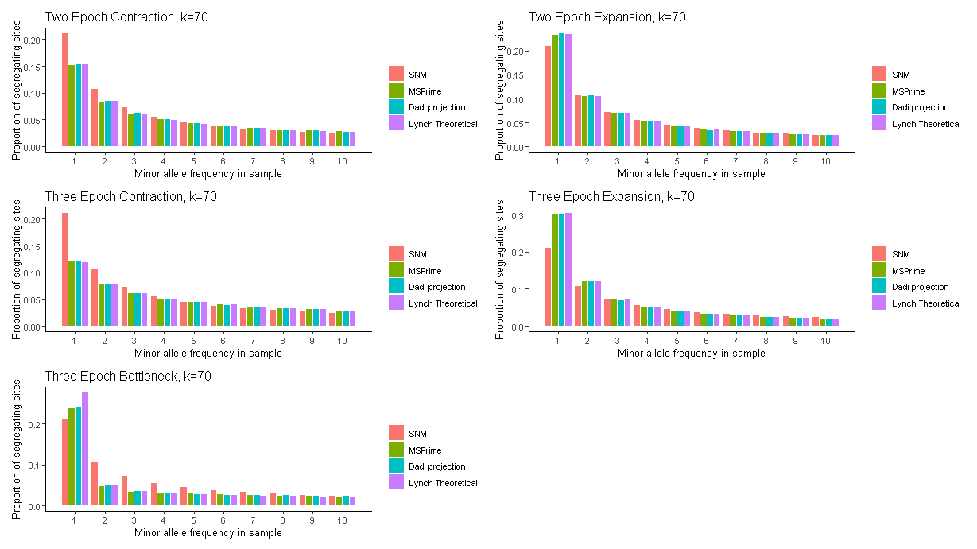
How well do these three data sets match?

Slide 45
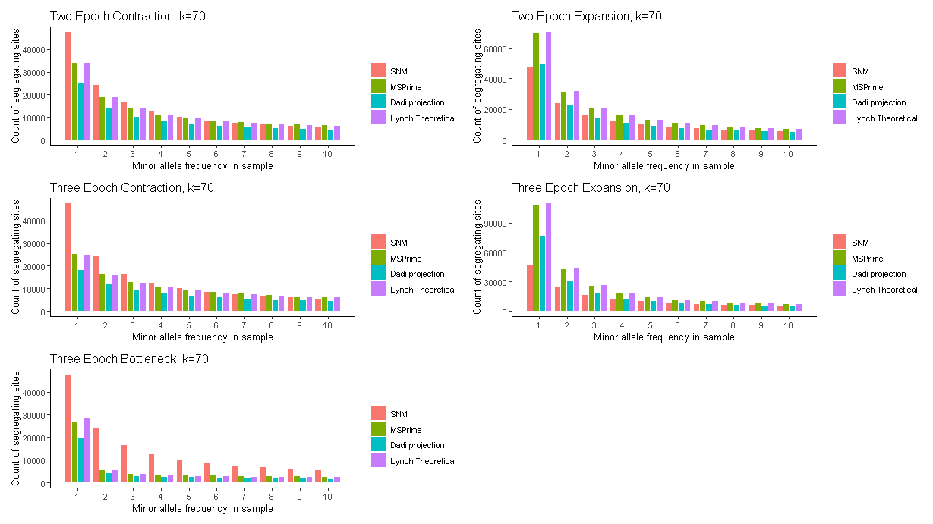
How well do these three data sets match?

Slide 46
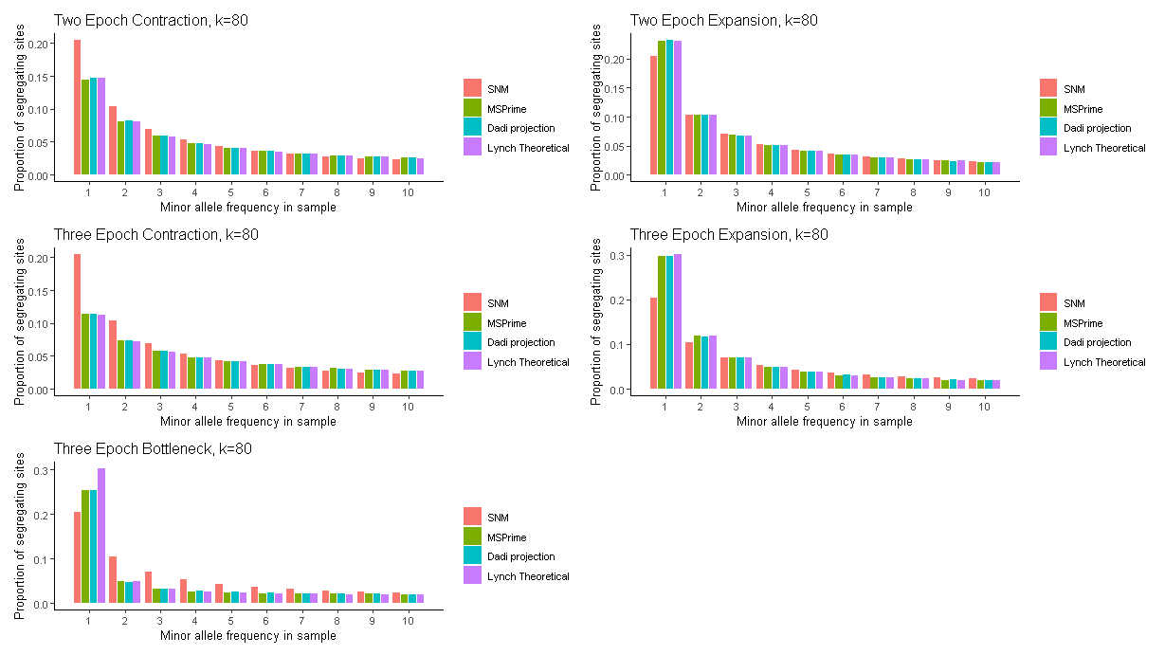
How well do these three data sets match?

Slide 47
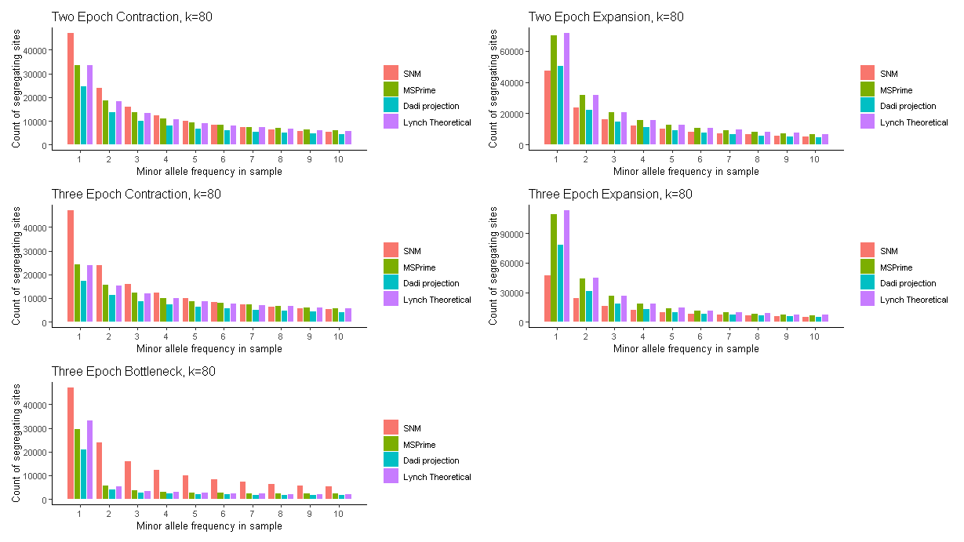
How well do these three data sets match?

Slide 48
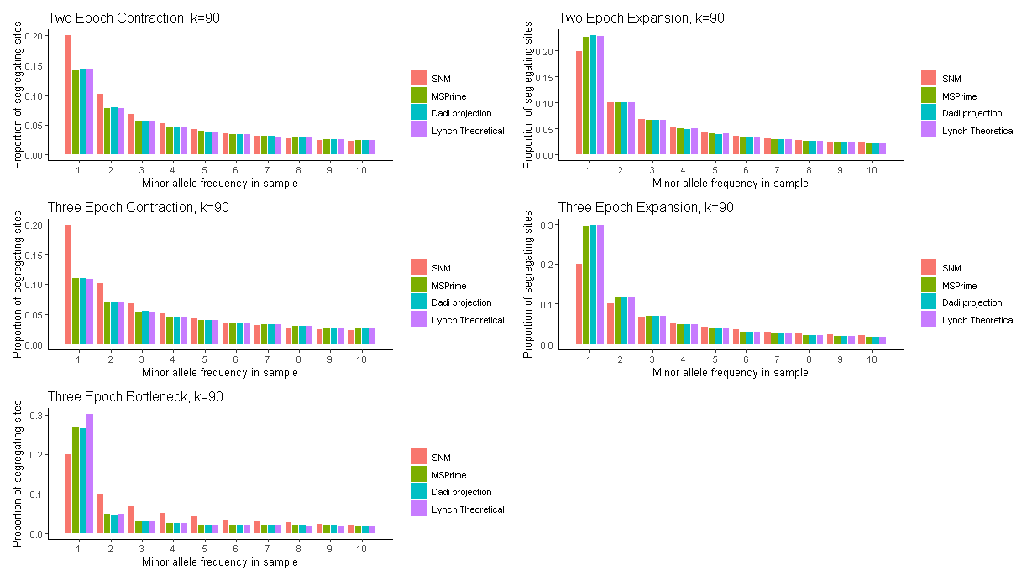
How well do these three data sets match?

Slide 49
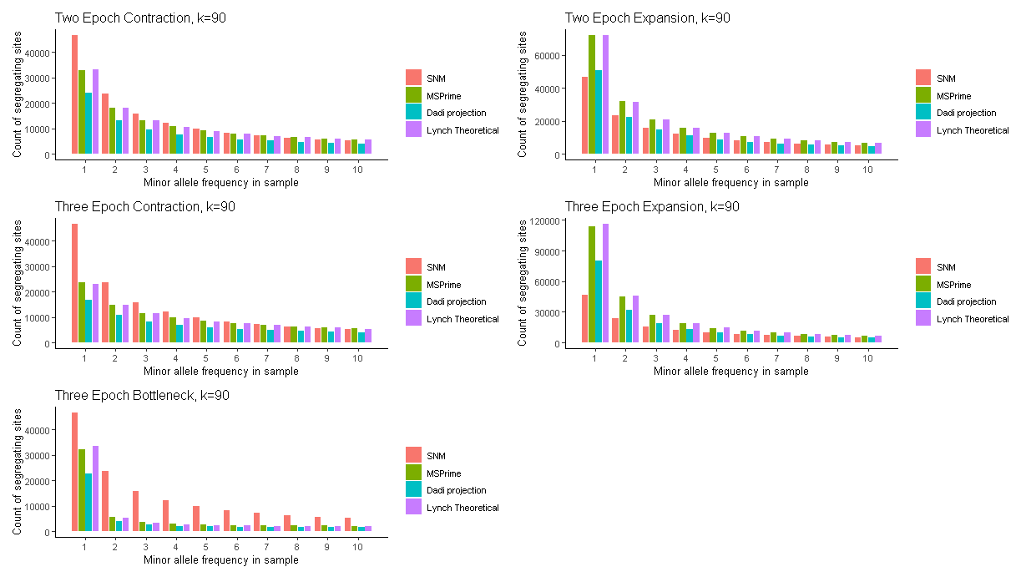
How well do these three data sets match?

Slide 50
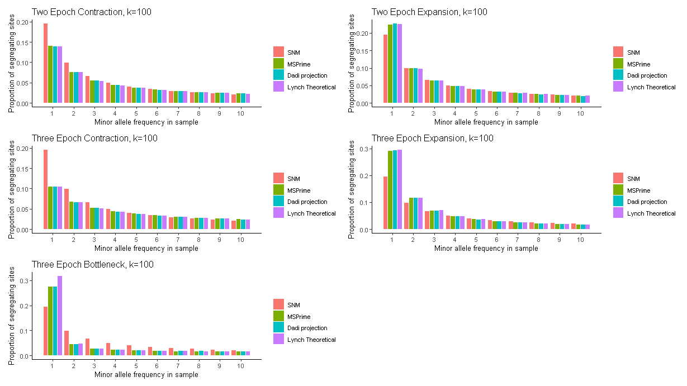
How well do these three data sets match?

Slide 51
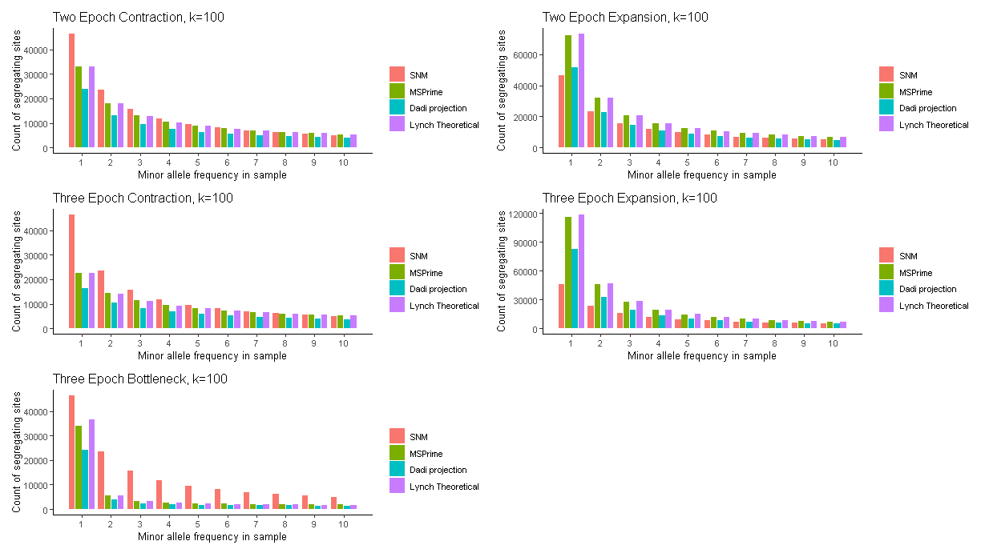
How well do these three data sets match?

Slide 52
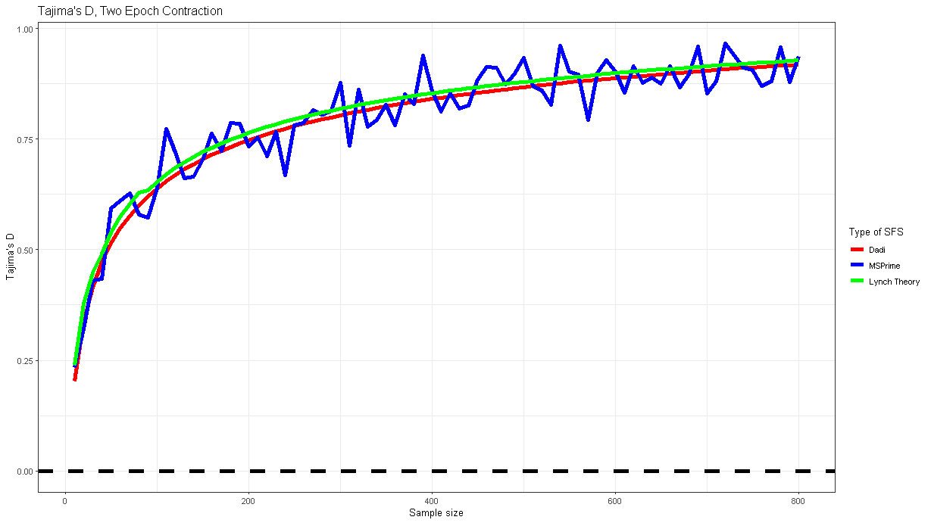
How well do these three data sets match?

Slide 53
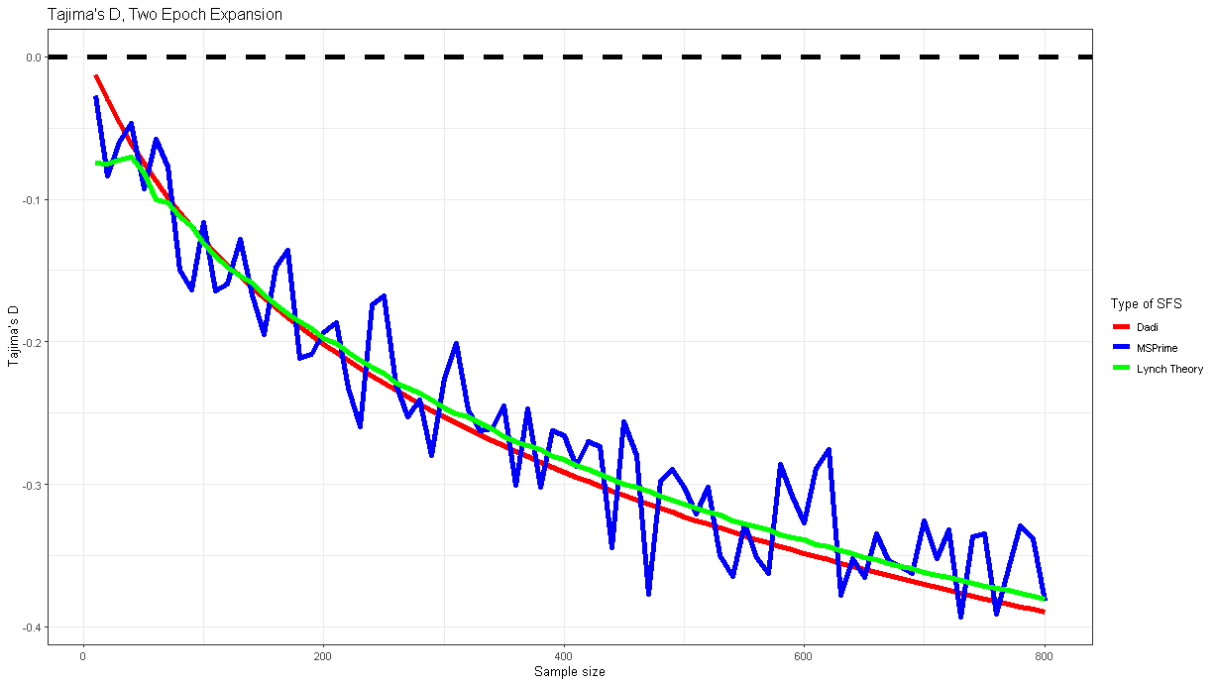
How well do these three data sets match?

Slide 54
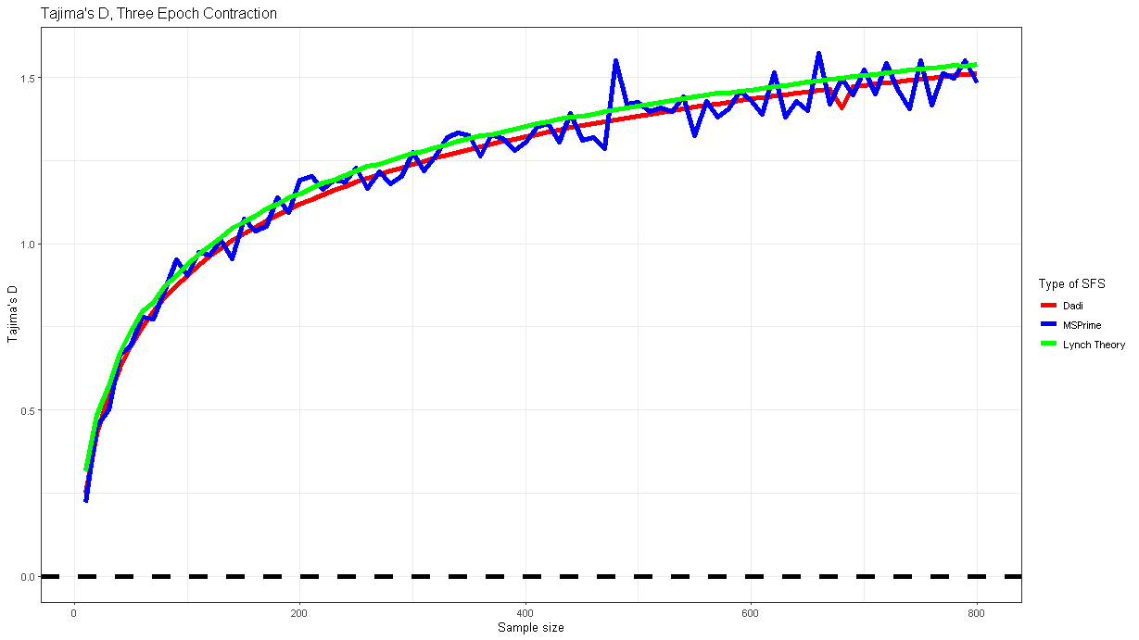
How well do these three data sets match?

Slide 55
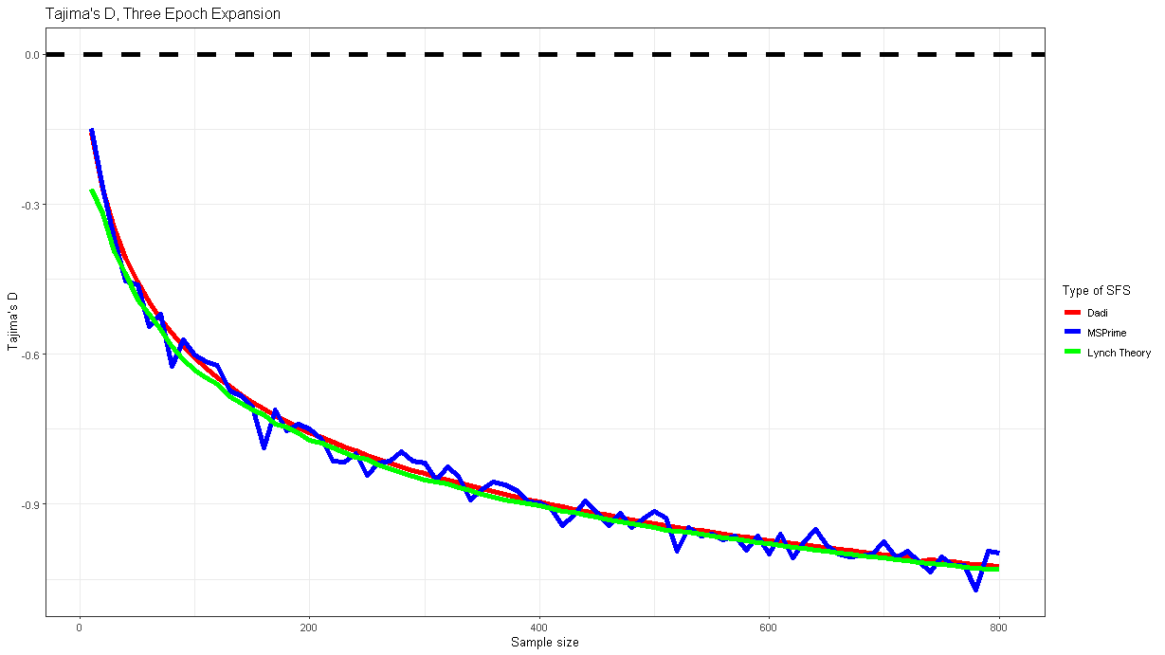
How well do these three data sets match?

Slide 56
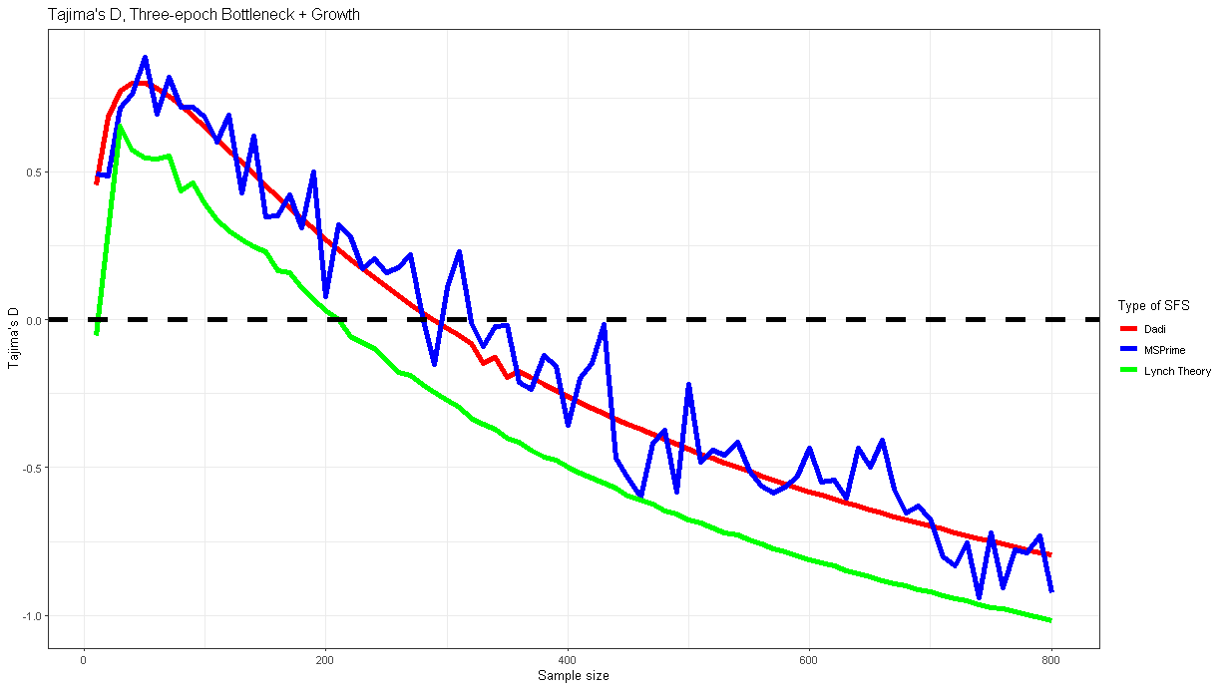
How well do these three data sets match?

Slide 57
Summary of findings
We have simulated simple demographic histories to study the effect of sample size on population genetics inference
From these simulations we also have theoretical expectations for SFS at different sample sizes.
We can observe that there are changes in the outcomes of certain summary statistics (like Tajima’s D) as sample size increases

Slide 58
What’s //TODO
Look into discrepancy between Lynch theory and MSPrime simulations for bottleneck + growth model (because that’s the one we mostly care about)
Apply to more complex demographic scenarios
Apply to high quality empirical data
Write!
Complain about Hoffman2

