Slide 1

R: The Basics

Slide 2
What is R?
A language
An environment

Slide 3
Learning R is like learning a language…
… except with more problem solving and troubleshooting
Coding can be fun!
treat it as a game
there are several ways to do a thing
Writing code is an investment
slow the first time, but easy to replicate
save your code!
copy-and-paste!

Slide 4


R is a higher order object-oriented programming language
Built as a statistical programming language
Graphing/Plotting
Statistics
Data management
RStudio is an interface for using R

Slide 5
and
R-Studio is an interface for using R
R is the language. R-Studio is your notebook, drawing pad, etc.

Slide 6
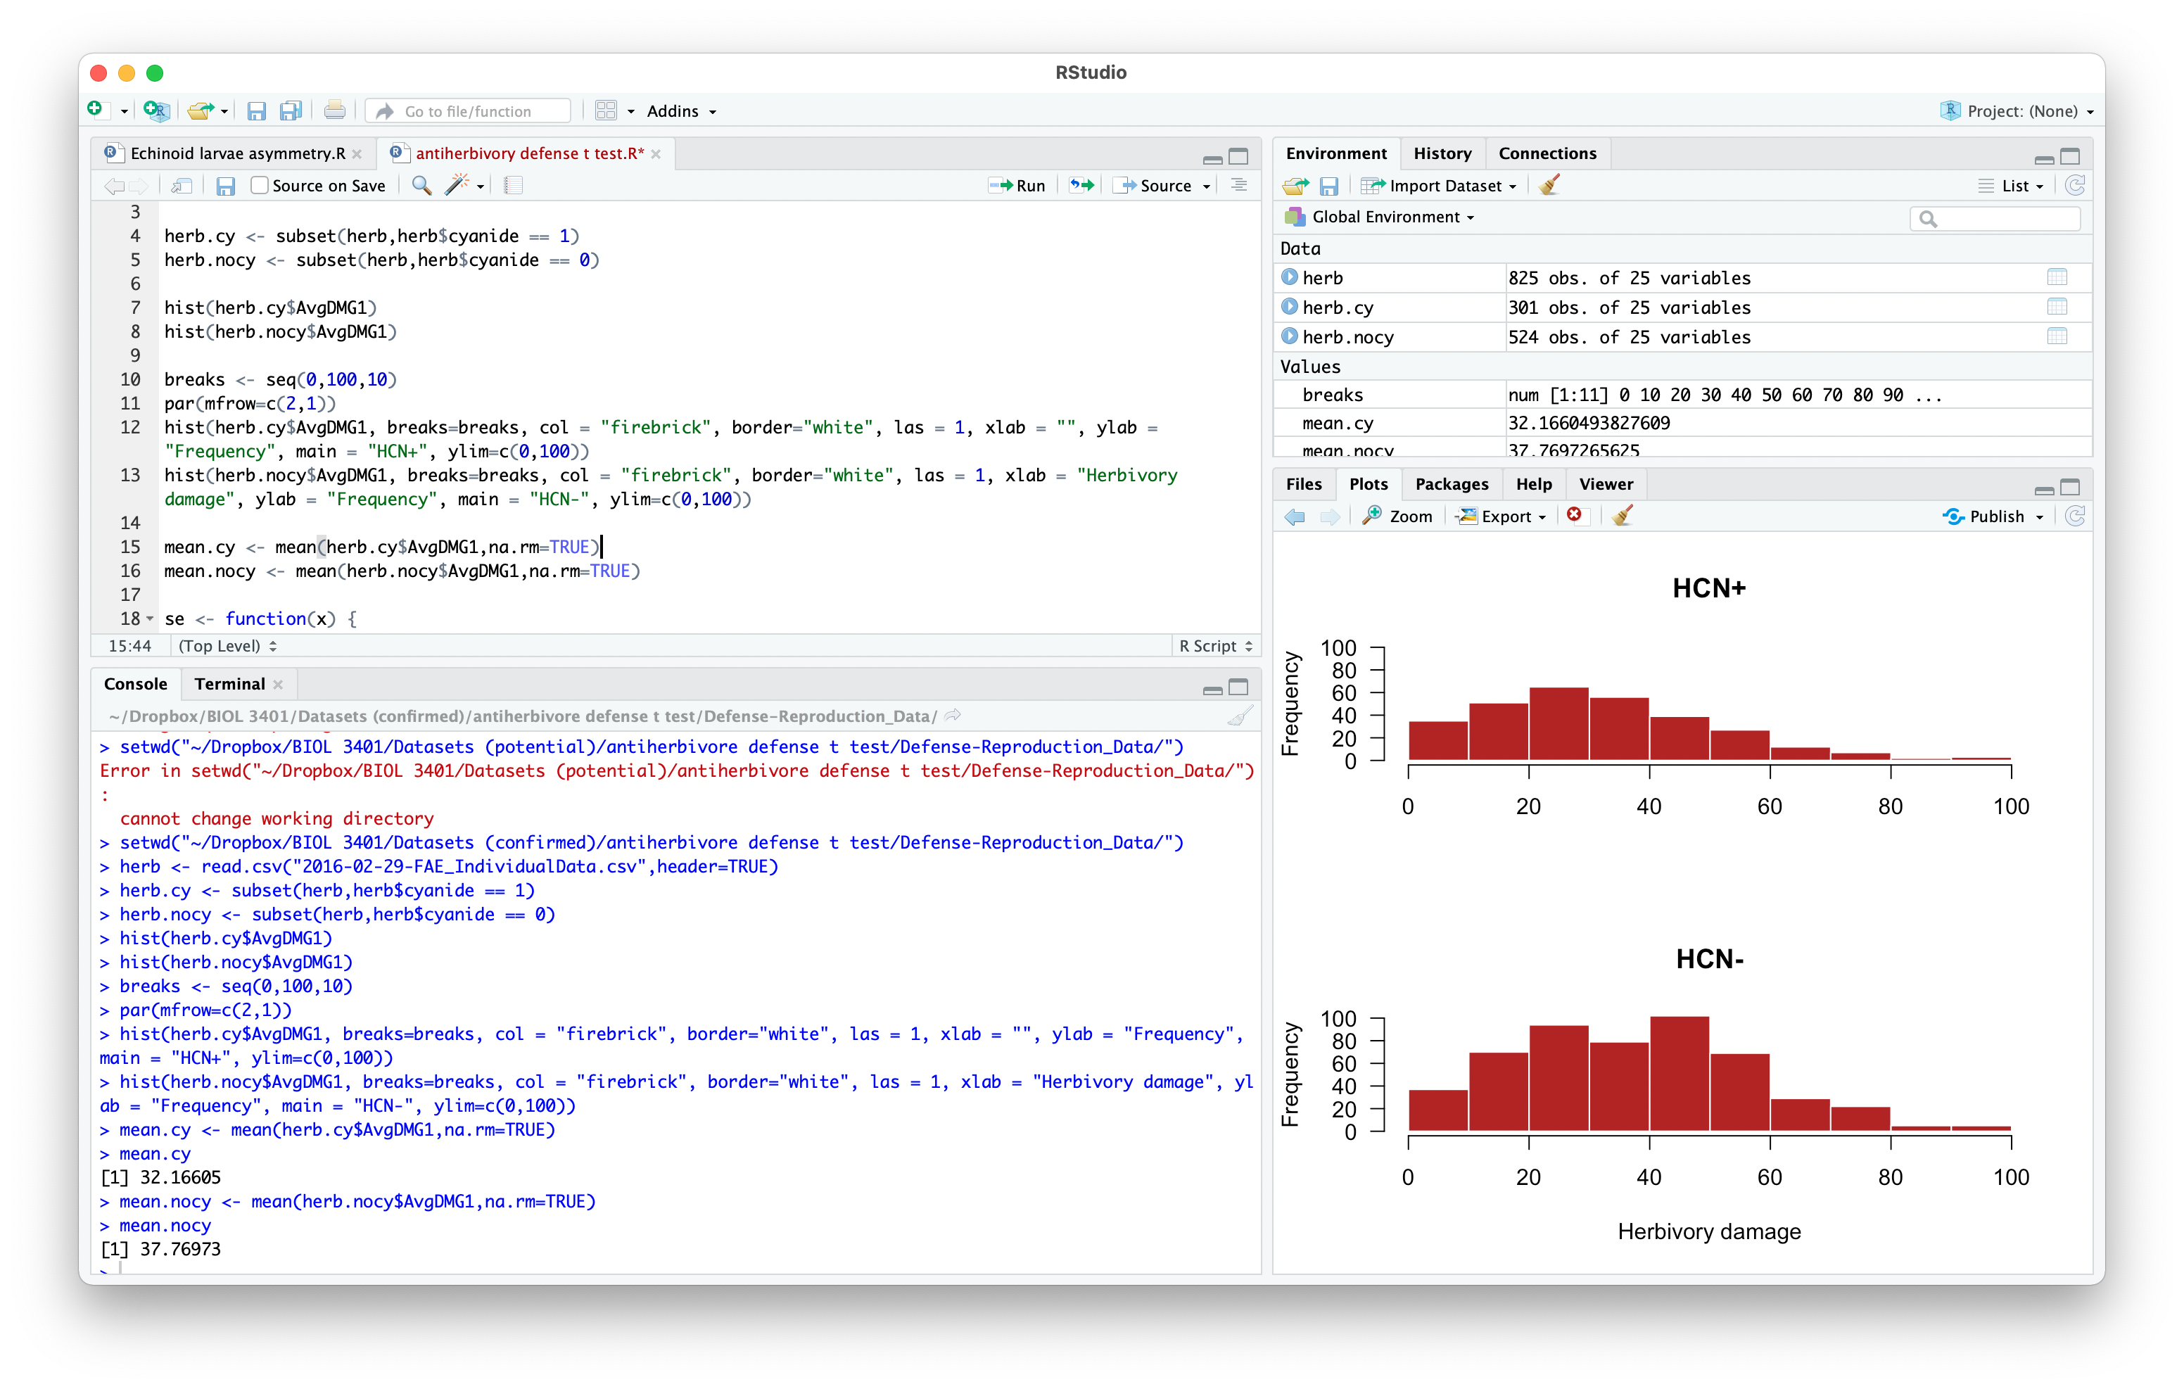
and

Slide 7
Common types of data in R (and in pretty much any other language)
Numeric
2, 0, -405, 178094980.564, Inf, -Inf, pi, 1e-2
Character
“A”, “Alberta”, “GCTTACG”, “Treatment 1”, “54”
Factors are a special way to store a character with a rank
“British Columbia”, “Alberta”, and “Saskatchewan” are recognized in alpha-numeric order:
“British Columbia” = 1
“Alberta” = 0
“Saskatchewan” = 2
Logical
TRUE, FALSE, NA

Slide 8
Everything in R is an object
An object can be a simple number or character
1, “Alberta”, pi
A data object has one of several structures:
vector
matrix
data frame
array
list

Slide 9
Everything in R is an object
Functions are another important type of object in R
They do things!
Examples:
c – creates a vector by concatenating a list of numbers
mean – calculates the mean of a numeric vector
sd – calculates the standard deviation of a numeric vector
plot – plots things!
Every function needs arguments:
mean(x)
mean(x, trim = 0, na.rm = FALSE, ...)
plot(x, y, xlab = NULL, ylab = NULL, …)

Slide 10
Data structures in R
vector: a sequence of at least one value
atomic vector: all values of the same type (e.g. all numeric)
list (see below)
matrix: a 2d form of a vector that can be indexed by rows and columns; all data must be of the same type
data frame: like a matrix, but columns (or rows) can vary in type, and columns can be named
array: a multi-dimensional (i.e. N-dimensional) form of a vector that can be indexed by rows, columns, depth, etc.
list: a vector in which elements need not be the same type; can be a list of lists! It’s lists all the way down!

Slide 11
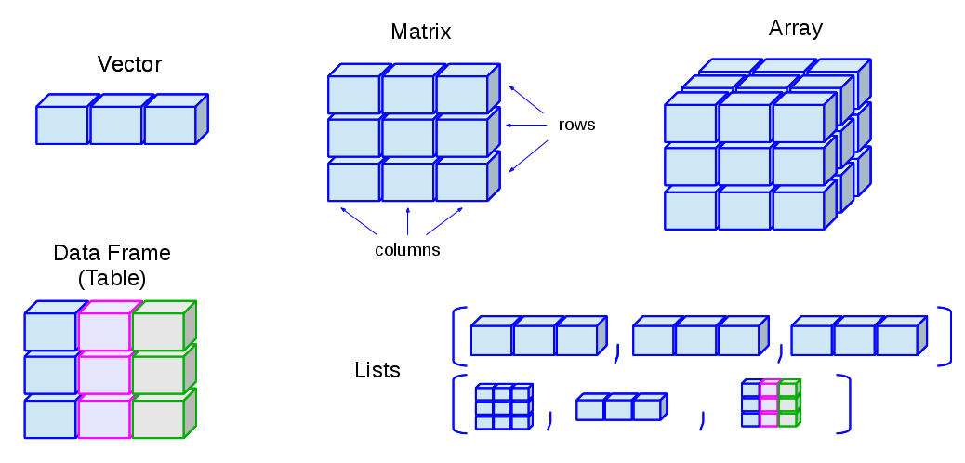
Data structures in R – visualized!
http://venus.ifca.unican.es/Rintro/dataStruct.html

Slide 12
How do we get data “into” R?
Read it in with a function:
read.csv(file, header = TRUE, ...)
read.table(file, header = FALSE, ...)
Create it in R:
c(4,5,9,8)
data.frame(treat = c(”high”,”high”,”low”,”low”), height=c(4,5,9,8))

Slide 13
“Base R” and packages
Base R refers to all the functions and defaults that are part of the base installation of your version of R
Packages add functions and capabilities beyond base R. Examples:
car: Companion to Applied Regression
lme4: Linear Mixed-Effects Models using 'Eigen' and S4
ggplot2: Create Elegant Data Visualisations Using the Grammar of Graphics
geomorph: Geometric Morphometric Analyses of 2D/3D Landmark Data
dada2: Fast and accurate sample inference from amplicon data with single-nucleotide resolution

Slide 14
Now, open R!

