Slide 1

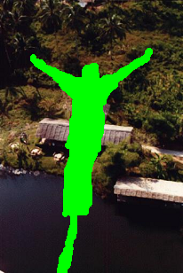




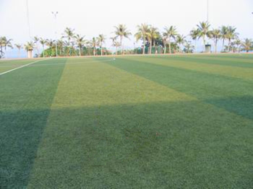
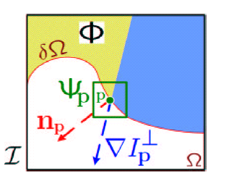
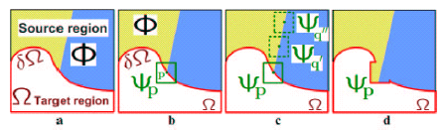
Object Removal by Exemplar-based Inpainting
Qiushuang Zhang
Original image
Target area
My result
Some more result
Filling priority:
Confidence term
Data term

