Slide 1
HERBERT Autonomous Rubik’s Cube Solver
Dylan Lytle
Li Lao
Matt Frandsen
Jon Whitaker

Slide 2
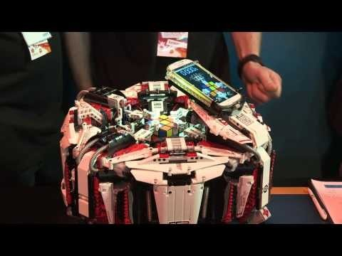
Background
CubeStormer 3 – Fastest robot to solve a Rubik’s Cube (3.253s) [1].

Slide 3
Introduction
GOAL: Create an autonomous robotic Rubik's Cube solver.
Integrates various technologies
Video cameras, stepper motors, mechanical actuators, single-board computer, FPGA
Take Guinness World Record (3.253s)
Optimize mechanical operations while maintaining the precision needed to rotate the cube.

Slide 4
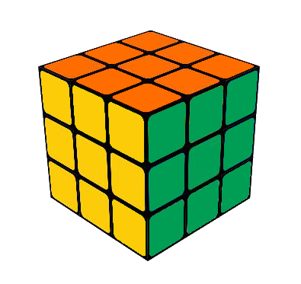
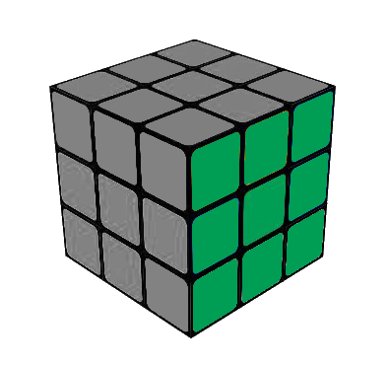
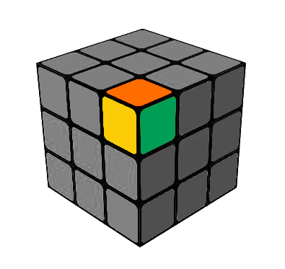
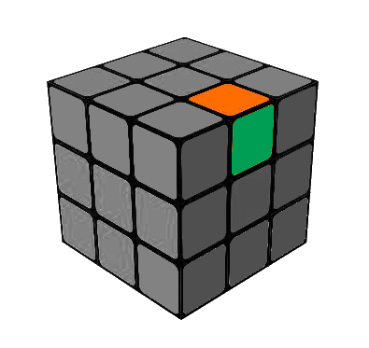
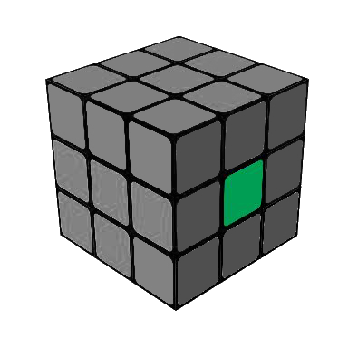
Cube Representation
Face
Corner
Cubies
Cubelet
Edge

Slide 5
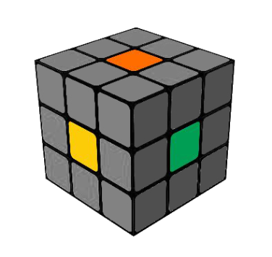
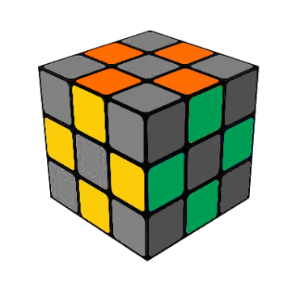
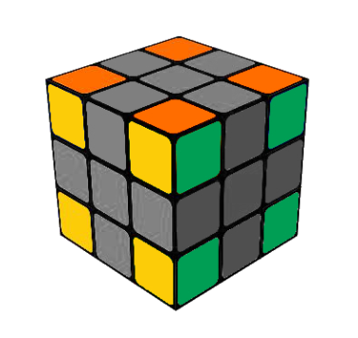
Middle Facelets Determine Face Color
(U = Orange, R = Green, F = Yellow, etc.)
12 Edge Cubies
8 Corner Cubies

Slide 6
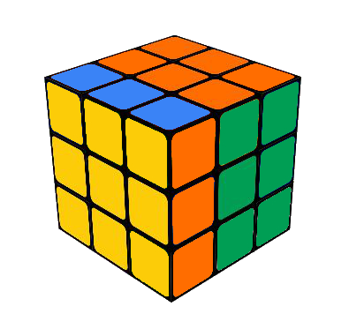
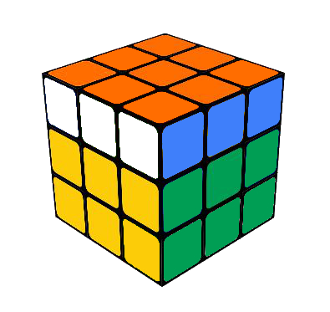
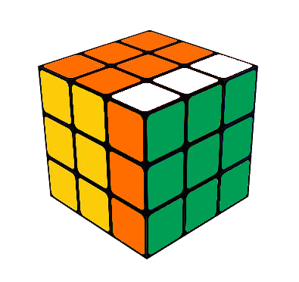
F
F Face Twisted Clockwise
U
L
F
R
B
D
R’
R Face Twisted Counterclockwise
U2
U Face Twisted 180 Degrees

Slide 7
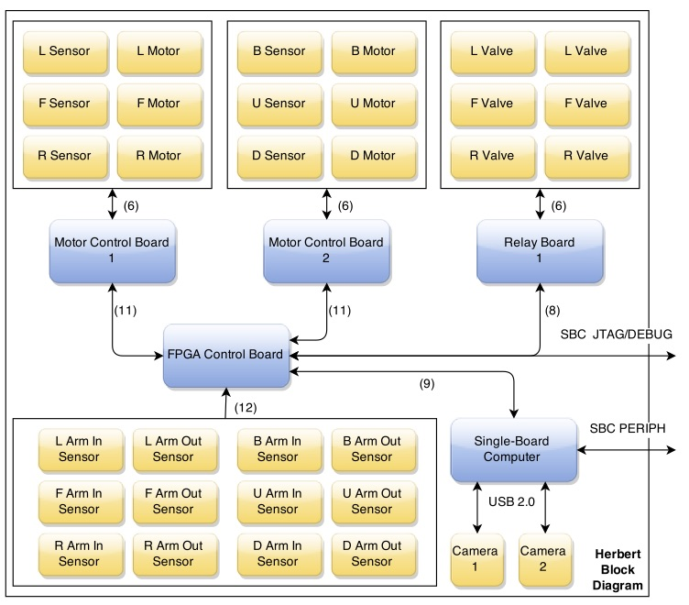
High level System Diagram

Slide 8
OpenCV & Image Processing
Two cameras, one for three of the six faces of the cube.
Grayscale conversion – Convert RGB to pixel intensity for feature filtration [2].
Canny edge detection - Identify the edges of the cube and the faces [3].
Contour filtering - Identify cubelets on each face [4].

Slide 9
Kcube & Solution Sequence
Cubelets represented with an ASCII character
‘W’, ‘R’, ‘B’, ‘G’, ‘O’, ‘Y’
Kcube application used to generate the solution sequence [5].
Created by Greg Schmidt
Utilizes Kociemba’s algorithm
Microsoft Windows [ Version X.X. XXX ]
Copyright (c) 2015 Microsoft Corporation . All rights reserved .
c:> kcube L: GGWWOWBRB F: GWGBGYWBO U: YOOOWYROY D: ORGWYYYRB R: OGBBRYWRR B: YBROBGWGR

Slide 10
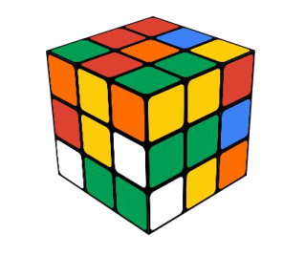
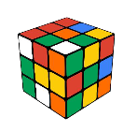
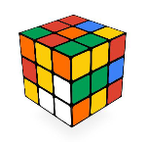

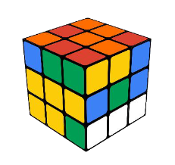
Kociemba Two-Phase
Algorithm
Phase 1
F
R
U
B
L
D
F’
R’
U’
B’
L’
D’
F2
R2
U2
B2
L2
D2
.
.
.
.
.
.
.
.
.
.
.
.
.
.
.
.
F
U
D2
F2
F
L2
U2
Phase 1
43,252,003,274,489,856,000 possible starting orientations
All 18 possible moves are used
Uses pruning and symmetries
2,217,093,120 possible phase 1 solutions
F
B2
L’
U
R2
F
B’
Phase 1 Solution: F, U, F2, L2, U2, B2, L’, U, R2, F, B’ (11 moves)

Slide 11

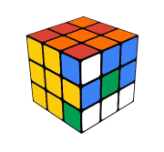
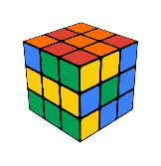

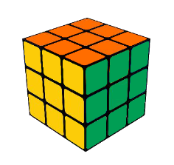
Kociemba Two-Phase
Algorithm
Phase 2
U
D
U’
D’
F2
R2
U2
B2
L2
D2
.
.
.
.
.
.
.
.
U
R2
D2
D’
U
R2
U’
Phase 2
2,217,093,120 possible starting orientations
A subset of 10 moves are used
Uses pruning and symmetries
1 possible phase 2 solution
U
F2
U
D
B2
Phase 2 Solution: U, R2, D’, R2, U’, F2, U, D, B2 (9 moves)
Final Solution: F, U, F2, L2, U2, B2, L’, U, R2, F, B’, U, R2, D’, R2, U’, F2, U, D, B2 (20 moves)

Slide 12
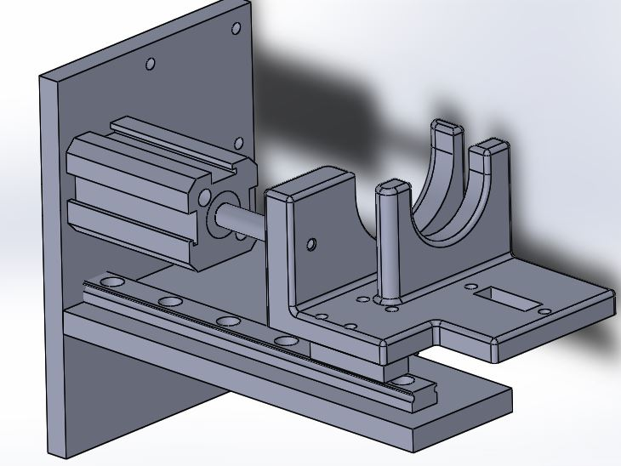
Mechanical Actuators
One arm for each face of the cube
Each arm must actuate, and avoid contact with the other arms
Very time critical component
Initial ideas included motors
Rotary motion to linear motion
Linear actuator motor
Solution: double action pneumatic air cylinder
High Speed
Affordable
Small footprint
Controlled by solenoid valve and a
Relay board
Simultaneous coaxial pair motion
Approximately 80-100psi

Slide 13
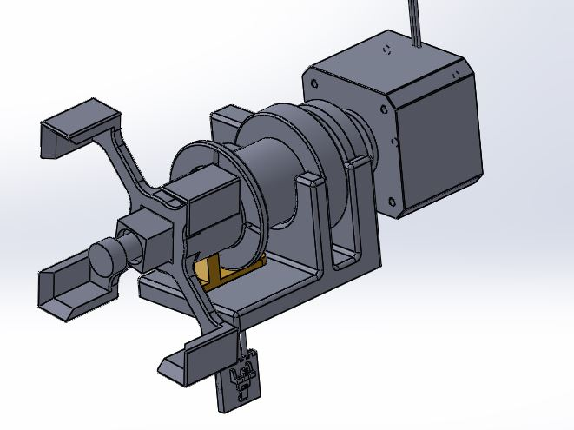
Electro-Mechanical Stepper Motors
Each actuating arm will have a stepper motor to control rotating each face of the cube
90 degree or 180 degree rotations
Clockwise or Counter-Clockwise rotations
Controlled by a FPGA and Motor control board, which contains a motor driver chip for each stepper
Full Steps, no micro-stepping
Break Sensor for 90 degree
alignment.

Slide 14
Summary
Integrates various technologies and domains of engineering.
Computer and Electrical engineering combined with mechatronics and robotics
Great application of system integration and teamwork.
Mechanical components pose the greatest limitations.

Slide 15



Acknowledgments
Point Grey Research
BioFire Defense
Futura Industries

Slide 16
REFERENCES
[1] Guinness World Records. Fastest robot to solve a Rubik's Cube [Online]. Available: http://www.guinnessworldrecords.com/world-records/fastest-robot-to-solve-a-rubiks-cub
[2] OpenCV Developers Team. Miscellaneous Image Transformations [Online].
Available: http://docs.opencv.org/modules/imgproc/doc/miscellaneous_transformations.html#cvtcolor
[3] OpenCV Developers Team. Feature Detection [Online]. Available: http://docs.opencv.org/modules/imgproc/doc/feature_detection.html?highlight=canny#canny
[4] OpenCV Developers Team. Structural Analysis and Shape Descriptors [Online]. Available: http://docs.opencv.org/modules/imgproc/doc/structural_analysis_and_shape_descriptors.html?highlight=findcontours#findcontours
[5] Herbert Kociemba. The Two-Phase Algorithm [Online]. Available: http://kociemba.org/cube.htm

