Slide 1
HERBERT Autonomous Rubik’s Cube Solver
Dylan Lytle
Li Lao
Matt Frandsen
Jon Whitaker

Slide 2
Background
CubeStormer 3
Embed Video

Slide 3
Introduction

Slide 4
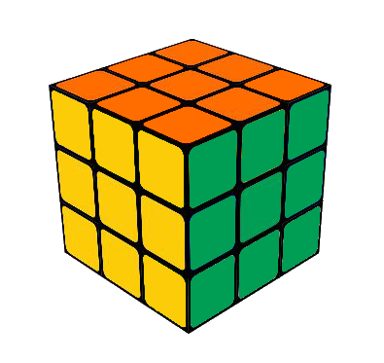
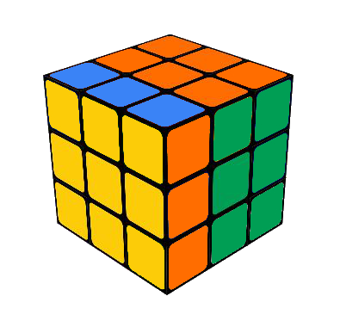
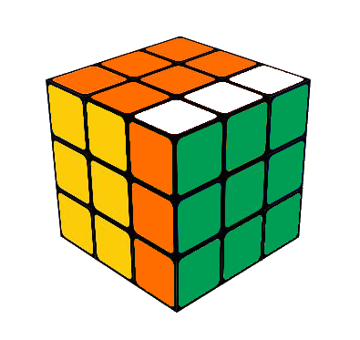
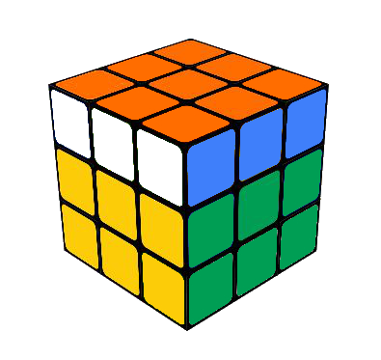
F
F Face Twisted Clockwise
U
L
F
R
B
D
R’
R Face Twisted Counterclockwise
U2
U Face Twisted 180 Degrees

Slide 5
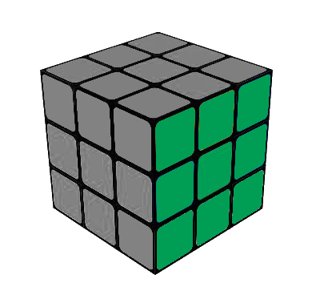
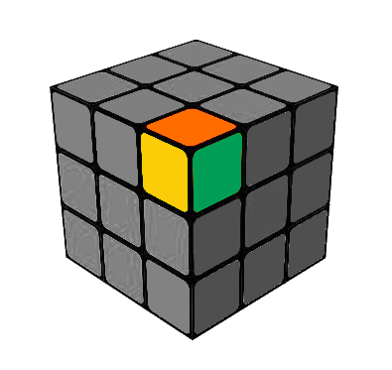
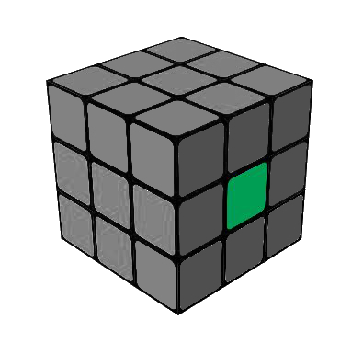
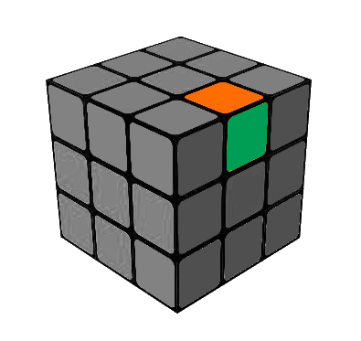
Cube
Face
Corner
Cubie
Cubelet
Edge

Slide 6
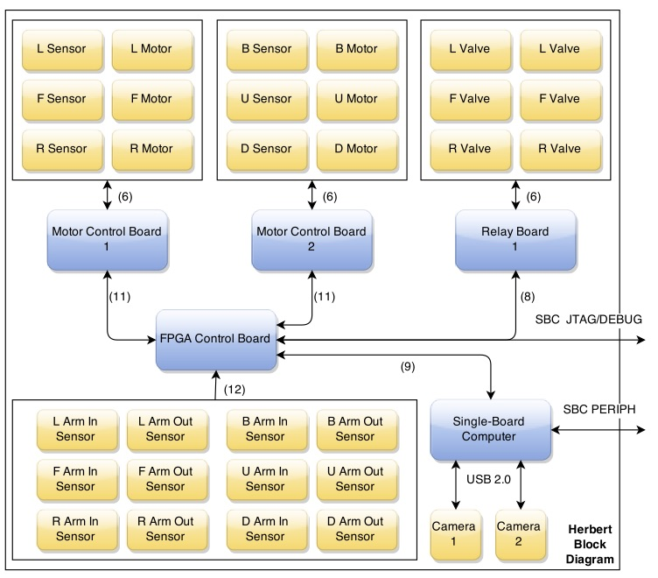
High level System Diagram

Slide 7
OpenCV & Image Processing

Slide 8
Kociemba’s Algorithm & Solution Sequence

Slide 9
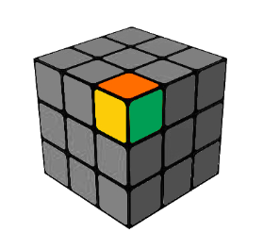
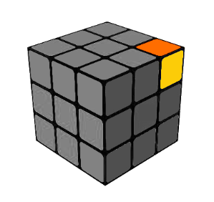
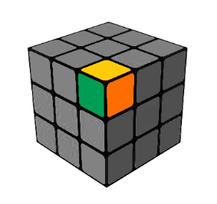
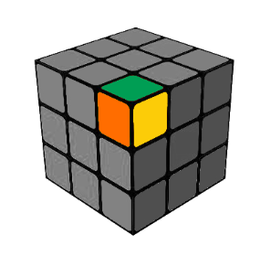
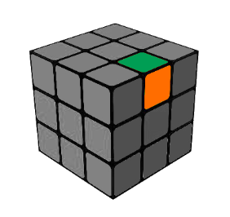
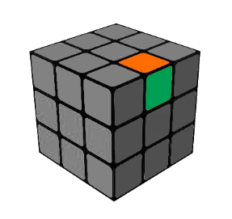
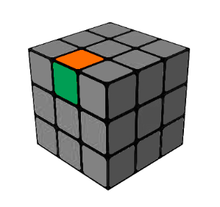
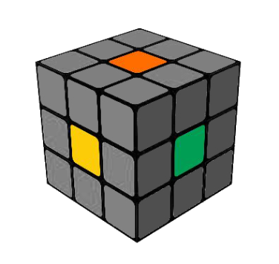
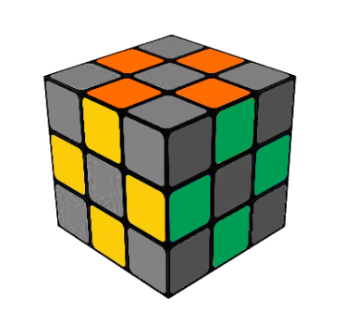
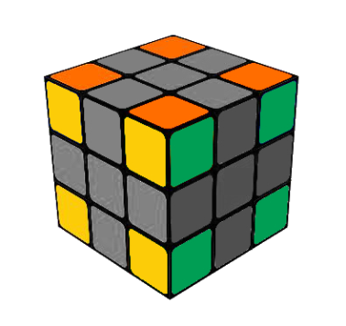
Cube Representation
Location
Orientation
Middle Facelets Determines Face Color
(U = Orange, R = Green, F = Yellow, etc.)
12 Corner Cubies Location and Orientation
8 Corner Cubies Location and Orientation

Slide 10
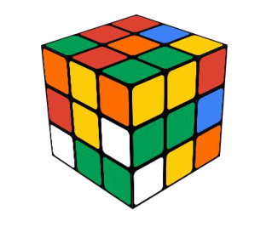
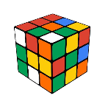
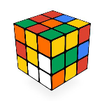

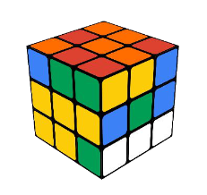
Kociemba Two-Phase
Algorithm
Phase 1
F
R
U
B
L
D
F’
R’
U’
B’
L’
D’
F2
R2
U2
B2
L2
D2
.
.
.
.
.
.
.
.
.
.
.
.
.
.
.
.
F
U
D2
F2
F
L2
U2
Phase 1
43,252,003,274,489,856,000 possible starting orientations
All 18 possible moves are used
Uses pruning and symmetries
2,217,093,120 possible phase 1 solutions
F
B2
L’
U
R2
F
B’
Phase 1 Solution: F, U, F2, L2, U2, B2, L’, U, R2, F, B’ (11 moves)

Slide 11

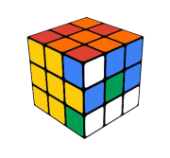
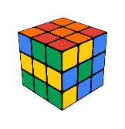

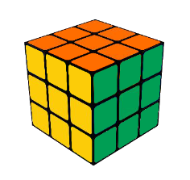
Kociemba Two-Phase
Algorithm
Phase 2
U
D
U’
D’
F2
R2
U2
B2
L2
D2
.
.
.
.
.
.
.
.
U
R2
D2
D’
U
R2
U’
Phase 2
2,217,093,120 possible starting orientations
A subset of 10 moves are used
Uses pruning and symmetries
1 possible phase 2 solution
U
F2
U
D
B2
Phase 2 Solution: U, R2, D’, R2, U’, F2, U, D, B2 (9 moves)
Final Solution: F, U, F2, L2, U2, B2, L’, U, R2, F, B’, U, R2, D’, R2, U’, F2, U, D, B2 (20 moves)

Slide 12
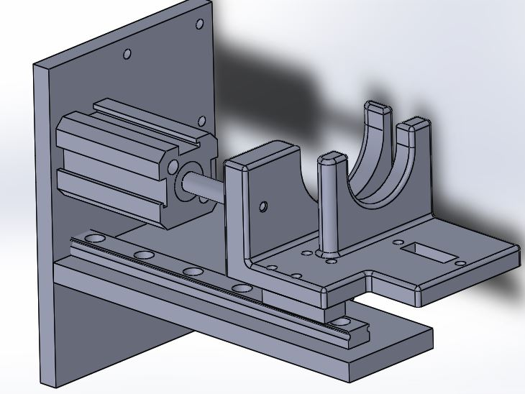
Mechanical Actuators

Slide 13
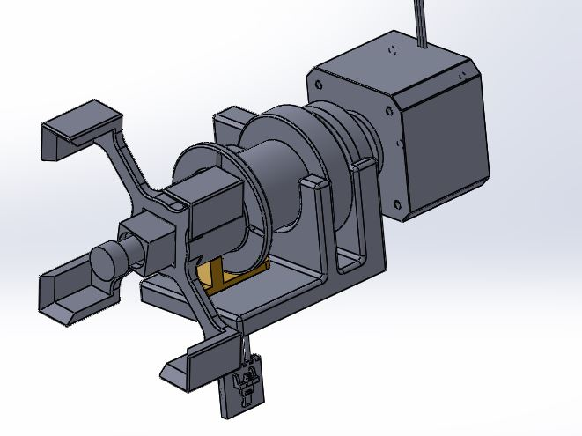
Electro-Mechanical Stepper Motors

Slide 14
Summary

Slide 15



Acknowledgments
Point Grey Research
BioFire Defense
Futura Industries

