Slide 1
databases
Prescott Software Developers Meetup Group
Gabriel Magaña –14-Mar-2013

Slide 2
What I’ll cover
Definition of a DB
Database usage scenarios
Major types of databases
Overview of each major type
Mention of existing databases of each type
Important aspects of all databases (Bare minimum must-know)

Slide 3
What is a database?
An organized collection of data
Data: Values of qualitative or quantitative variables, belonging to a set of items
The data is organized to model relevant aspects of reality (for example, the availability of rooms in hotels)
In a way that supports retrieving this information (for example, finding a hotel with vacancies).

Slide 4
Is it a database?
Database
Something else
Excel spreadsheet
Word list
List of files
List of book titles
Metadata about pictures
Tables of data
Log files
Book’s text
PDF file
Image of text
Printouts
Pictures
Graphs

Slide 5
Crossing the boundaries: Profit!
Database -> non-database: Making data and summarized data consumable
Making data human consumable, readable, and understandable
Translating information into words
Drawing conclusions
Graphs / visualizations
Non-databases -> Database: Making sense of disorganized data and information
Splunk for log files
OCR – Optical character recognition
AI image sorting and object identification

Slide 6
Database Usage Scenarios
Embedded/small scale
Read-only
High write/low read
Low write/high read
Short-term store
Long term analytic store
All levels of concurrency levels
Huge data stores distributed over farms of hosts (and possibly spread out over several continents)
High-uptime requirements

Slide 7
Types of Databases
Flat binary files
Delimited text files
Non-server SQL-enabled
Relational Client/Server
Key/Value stores (no-SQL)
Column-Oriented

Slide 8
Flat Files
First DBs to exist
As simple as a copy of a RAM region to disk
Could have variable-length records
Binary data manipulated directly by the programmer
Each file had different format and limitations
Very fast to read, very easy to corrupt
Wild west of databases
Very little code needed to read/write
Still makes sense for small embedded applications

Slide 9
Flat file DB access code sample
/* read opt */
_dos_lseek (handle, 0L);
if (_dos_read (handle, &opt, sizeof(opt), &read) || read != sizeof(opt)) {
error ("err %d ReadD %s", errno, fname);
set_badopt ();
return ;
}

Slide 10
Flat file drawbacks
No versioning
No fields
No easy content modification path
No programmer error detection
No security mechanism
UNLESS, this is all implemented in the system accessing the database
All data access methods (sorting, filtering, selection) implemented by hand in the system accessing the data

Slide 11
Delimited text files
Variable-length text files
Each “record” is a line of text
Each “column” is a delimited text element
Most popular format is CSV (Comma-delimited):
John,Smith,1/12/1979,654-488-1956
Michael,Lo,6/6/1996,156-884-2121
Data modified and accessed directly by the client program
Not built for concurrent access
Shares a great deal of drawbacks with flat files

Slide 12
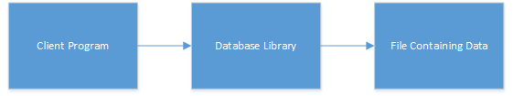
Non-Server SQL Enabled
Uses SQL – Server Query Language
Library between client program and data:
Common language for data access
Documented methods for data access
Data access method reusability
Some data stores are NOT SQL-enabled (ie, dBase, Clipper)

Slide 13
Non-Server SQL Enabled Systems
dBase
MS Access
SQLite
SQL Server CE

Slide 14
Non-Server SQL Enabled Drawbacks
Still in-process: A client system application crash also crashes the database access: Data corruption Russian roulette
Concurrent access limited synchronization
Trouble-prone if data resides on remote host
Limited concurrency
Higher chance of data corruption
Slow access: Data must be transferred before being filtered

Slide 15
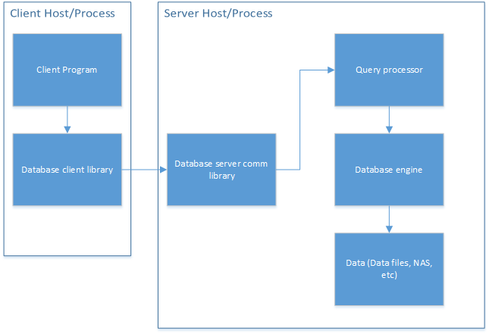
Relational Client/Server Databases
Dedicated process accesses data
Communication protocol used for data access
Can be on a remote host or in the same host
Uses SQL for interaction

Slide 16
Relational DB positives
Relational schema = data integrity
A TON of documented functionality implemented: Security, data manipulation methods, data access methods, and on and on
Security mechanism
Failure isolation from client
Failure isolation from server
Data and query caching
Replication / fault tolerance / load distribution
Backup facilities (hot/cold backups)
ACID compliance

Slide 17
Side Note: ACID
Atomicity – Transactions either succeed or fail as a whole
Consistency – Data is always consistent
Isolation – Concurrent operations are the same as sequential operations
Durability – Committed transactions are truly committed
What’s a “transaction”?

Slide 18
Relational DB Negatives
Large footprint
Larger resource needs (CPU/Disk/RAM)
Disk space is not top priority
Longer time to develop
Schema changes time consuming

Slide 19
Relational DB Systems
Oracle DB Server
Microsoft SQL Server
Oracle MySQL
Percona MySQL
IBM DB2
Informix
Teradata
Sybase
PostgreSQL

Slide 20
Key/Value Stores (noSQL DBs)
Aims to bring down complexity of SQL databases
No concept of tables or schemas
Also called “document stores”
Bottom line: They are key/value stores
Sample data:
Key: Gabriel
Value: [[1024 Main St]:[Prescott Valley, AZ 86314]]
Key: 18
Value: [[[1288]:[Wildwest Dr]]]
Does not use SQL language
No ACID compliance (for the vast majority of noSQL DBs out there)

Slide 21
Key/Value Store Advantages
Quick to implement
Easier to scale (up to a point)
Facilitates iterative experimentation
Strong use cases:
Tweets
FB postings
Fast-iteration prototyping

Slide 22
Key/Value Store Disadvantages
No ACID compliance only “eventual consistency”
No guarantees as to the structure of data
Not universally proven at large scale
Needs indices for searching for a non-key element
Potential re-inventing the wheel for the programmer
There are so many choices and paradigm variants, that you must do a lot of homework beforehand

Slide 23
Key/Value Store Systems
Cassandra
CouchDB
MongoDB
Oracle NoSQL
Project Voldemort
Google BigTable
Many, many others. There are several categories of NoSQL DBs: KV stores, hierarchical KV stores, ordered KV stores, multivalue DBs, tabular, etc…

Slide 24
Column-Oriented Databases
Very similar to SQL Relational Databases
Focuses on storing columns of data, not rows
ACID compliance
Large-scale purpose
Intended for data analytics and discovery, not general use
Analytics focus requires:
Compact storage
Very wide records
Huge number of records
A lot of inserts
Few (but much larger) queries

Slide 25
Column-Oriented DB Advantages
Did someone say “high-volume”?
“Column-oriented” means we focus on accessing a lot of values of the same column in different records optimally
Huge queries, not possible in other database systems (noSQL or Relational), and executed very fast
Data is inserted very fast

Slide 26
Column-Oriented DB Disadvantages
Tolerates very few incoming connections
Cannot be a line-of-business database

Slide 27
Column-Oriented Systems
Vertica
MonetDB
VectorWise
Sybase IQ
ParAccel
Infobright
C-Store

Slide 28
Must-know DB Principles and Terms
OLTP – Online Transaction Processing
OLAP – Online Analytical Processing
Clustering
Sharding
Replication
Backups and restores
Hot/Cold
Transaction logs
ACID compliance
DBMS – Database Management System
RDBMS – Relational Database Management System

Slide 29
The End
Questions?
Suggestions for topics?

