Slide 1



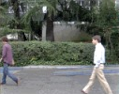

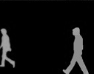

MLaaS Provider
Inference
Mallory
Eve
Encrypt
Decrypt
User

Slide 2
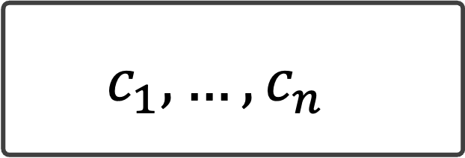
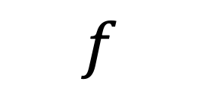
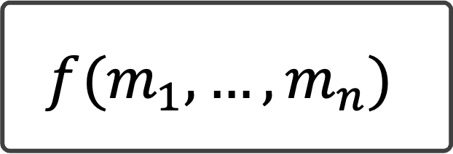
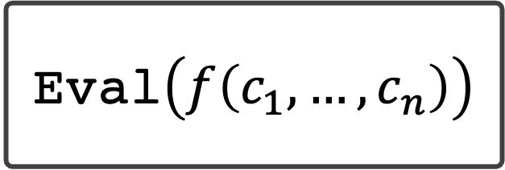
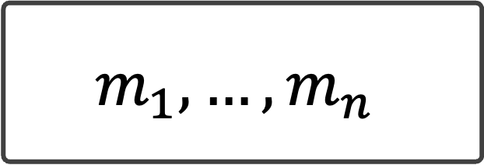
Eval
$$c_{1},…, c_{n}$$
Eval$\left(f\left(c_{1},…,c_{n}\right)\right)$
Enc
Dec
$$m_{1},…, m_{n}$$
$$f(m_{1},…, m_{n})$$
$$f$$

