Slide 1
Analysis of Heat Wave Trends in Illinois
Jonathan Kang and Zijun Yu
Supervised by Lelys Bravo De Guenni

Slide 2
Presentation Outline
Introduction
Data Description and Exploratory Analysis
Modelling Heat Index
Findings and Results
References

Slide 3
Introduction

Slide 4

What are Heat Waves
US EPA’s definition of heat waves.
A period of abnormally hot weather lasting at least 2 days.
Once the temperature reaches above the local 85th percentile threshold, a heatwave is declared.
Heat waves are determined by the local region, hence there is not a globally fixed temperature threshold.
Use a measure “Heat Index” to determine the occurrence of heat waves.
85th percentile
Formula developed by Lans P. Rothfusz in NWS ^{[2]}
Average Temperature and Relative Humidity
Weathermetrics
46/50 metropolitan areas experienced a significant increase in heat wave season.^{[1]}
[1] “Climate Change Indicators: Heat Waves.” United States Environmental Protection Agency. EPA, July 2022. https://www.epa.gov/climate-indicators/climate-change-indicators-heat-waves.
[2] “The Heat Index Equation.” Weather Prediction Center. National Weather Service, May 12, 2022. https://www.wpc.ncep.noaa.gov/html/heatindex_equation.shtml.
Notes:
JK

Slide 5
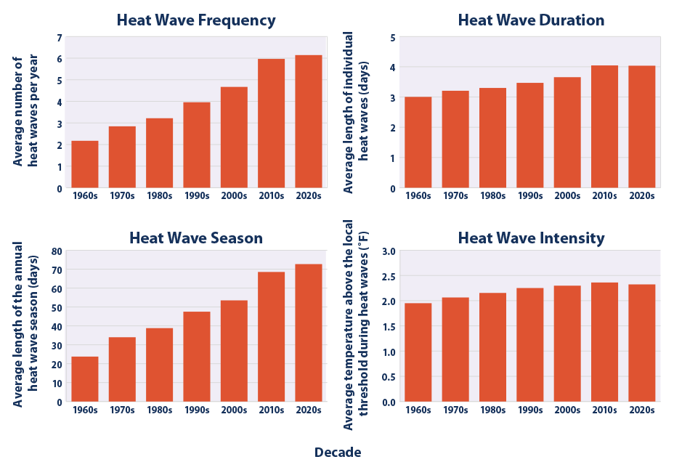
4 Aspects of Heat Waves
Four main characteristics of a heat wave:
Frequency - Number of heat waves.
Duration - How long a heat wave lasts.
Season Range - The number of days between the first and last heat wave of the season.
Intensity - How much hotter it is during the heat wave.
[1]
[1] “Climate Change Indicators: Heat Waves.” United States Environmental Protection Agency. EPA, July 2022. https://www.epa.gov/climate-indicators/climate-change-indicators-heat-waves.
Notes:
Zijun
In order to estimate the heat wave situation, we are gonna introduce 4 main characteristics t of heat wave.
The graphs show averages across all 50 metropolitan areas by decade. As you can see, all 4 aspects of heat wave are increasing with decades

Slide 6
Previous Works
Rodriguez-Iturbe’s et al. (1984) derived multiple models analyzing temporal rainfall data, with one of the models being the Rectangular Pulses Poisson Model.^{[1]}
Chulsang Yoo et al. (2008) have performed research on the quantification of drought using Rodriguez-Iturbe’s derived model, with the theoretical methodology of severity-duration-frequency analysis proposed to characterize spatial patterns of droughts in Seoul.^{[2]}
[1] Rodriguez‐Iturbe, Ignacio, Vijay K. Gupta, and Ed Waymire. "Scale considerations in the modeling of temporal rainfall." Water Resources Research 20.11 (1984): 1611-1619.
[2] Yoo, Chulsang, et al. "Quantification of drought using a rectangular pulses Poisson process model." Journal of Hydrology 355.1-4 (2008): 34-48.
Notes:
JK

Slide 7
Description and Exploratory Data Analysis

Slide 8
Dataset Description
Data is gathered from the Illinois Water and Atmospheric Resources Monitoring (WARM) network.^{[1]}
Variables have been aggregated daily, with the latest update on 12/31/2021.
Date, Temperature, Wind Speed, Precipitation, Relative Humidity, Soil Temperature and so on (54 variables).
Key Variables:
Date
Average Temperature (F)
Relative Humidity
[1] https://www.isws.illinois.edu/warm/datalist.asp
Notes:
JK
https://www.isws.illinois.edu/warm/datalist.asp

Slide 9
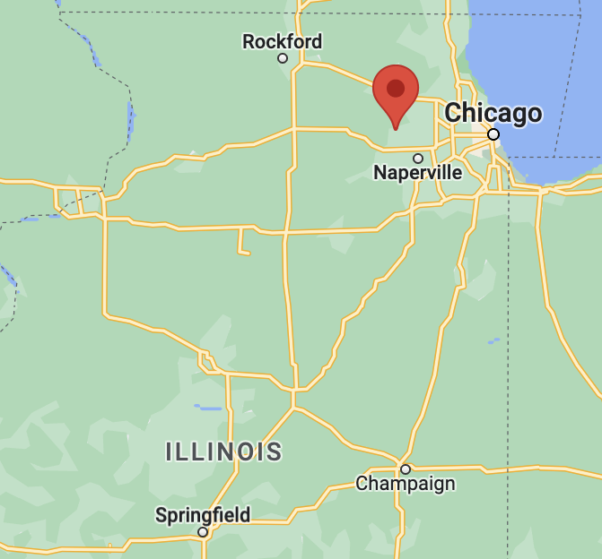
Descriptive Statistics
 | Champaign | St. Charles
Date period | 02/16/1989 - 12/31/2021 | 01/01/1988 - 12/31/2021
Highest Avg_Temperature (F) | 89.9 | 87.9
Lowest Avg_Temperature (F) | -14.8 | -21.8
Average Avg_Temperature (F) | 52.8463 | 49.0988
Average Relative Humidity (%) | 75.9687 | 76.7115
85th Percentile Heat Index | 83 | 78
Notes:
Zijun
We collect temperature and relative humidity data of two cities in Illinois. First one is Champaign and the second is St. Charles in the past 3 decades from Illinois Climate Network.
Highest, lowest and the average of avg temperature of Champaign are greater than St. Charles.
St. charles has greater average relative humidity then Champaign.
Champaign has higher 85th percentile heat index than St. charles

Slide 10
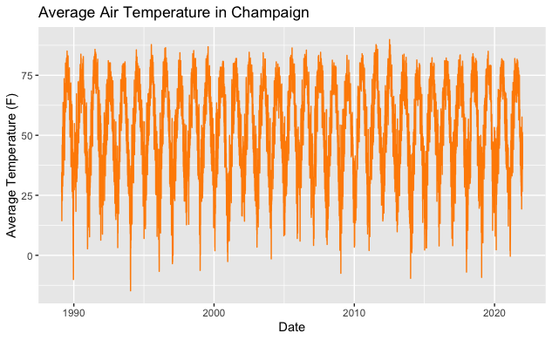
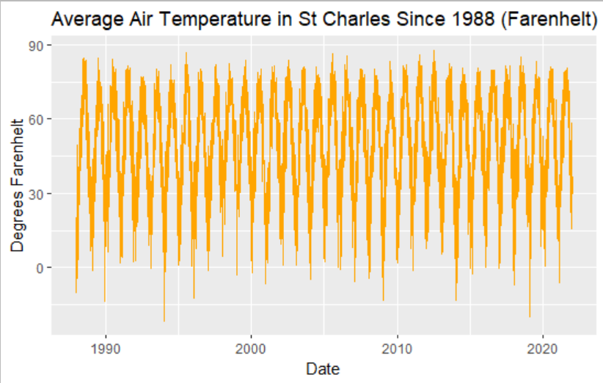
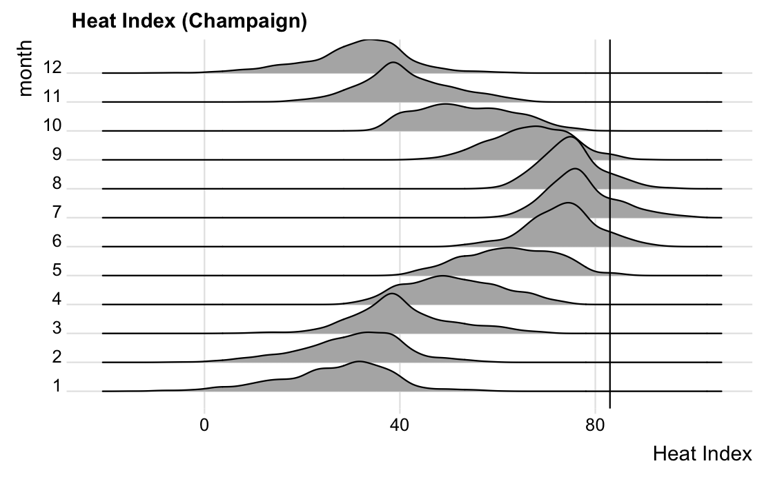
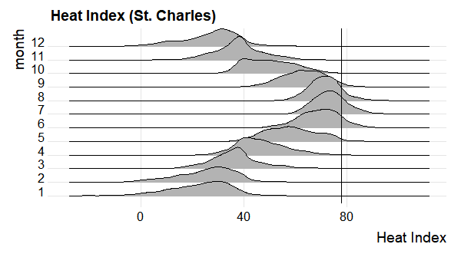
Time Series - Temperature & Heat Index
Notes:
JK

Slide 11
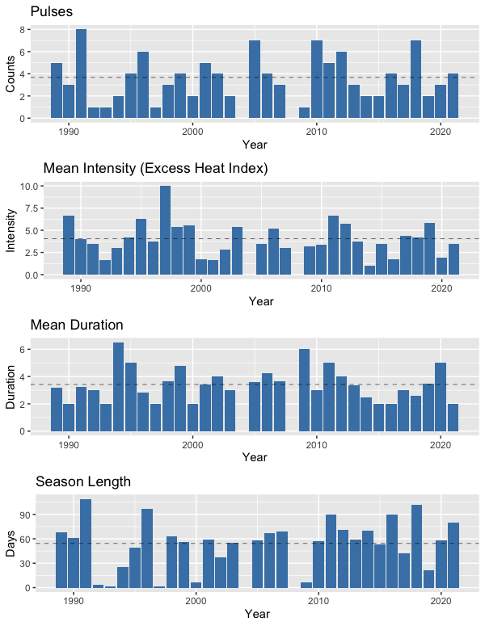
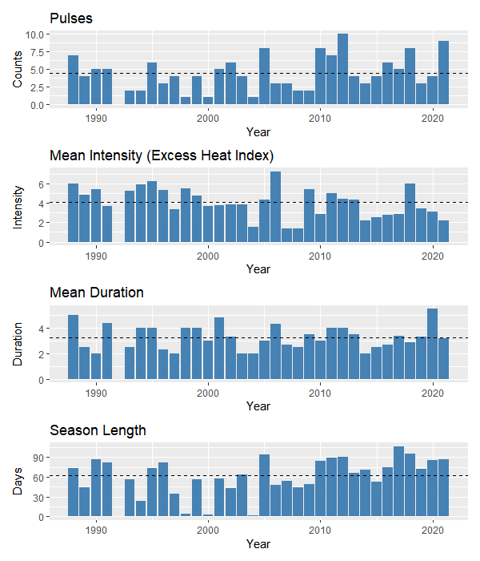
Champaign
St. Charles
Notes:
Zijun
Based on US EPA’s definition of heat waves we already introduced, we created graphs of 4 aspects of heat wave in Champaign and St. charles.As you can see, the heat wave didn’t happen every year. There is no heat wave in 1992 in St charles and 2004 in Champaign. Honestly, we can’t conclude a direct relationship between heat wave and time in those graph. Then we decided to conduct more statistical modeling to explore the heat wave situation.

Slide 12
Modelling Heat Index

Slide 13
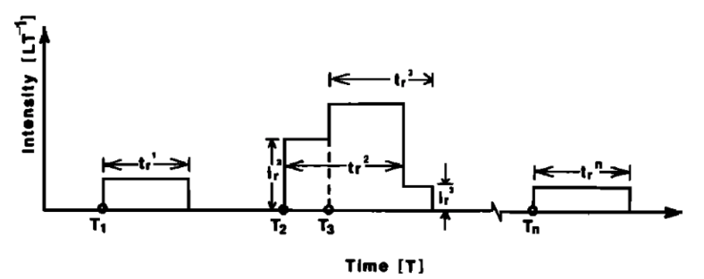
Rectangular Pulses Poisson Model
Use parameters to estimate the theoretical moments using method of moments
Mean
Variance
Lag-n Covariance
Model parameters we will be using in our system of equations
λ, θ, and μ
We are interested in estimating these parameters by using the RPPM method
Model assumes independence between duration and intensity of rectangular pulses
Continuous process in Time
[1]
Rectangular Pulses Poisson Model
Intensity (I) ~ Exponential(μ);
Duration (t) ~ Exponential(θ);
Time (T) is a Poisson Point Process with parameter λ.
[1] Rodriguez‐Iturbe, Ignacio, Vijay K. Gupta, and Ed Waymire. "Scale considerations in the modeling of temporal rainfall." Water Resources Research 20.11 (1984): 1611-1619.
Notes:
JK
Include slide (above) with figure (dissect by components – Intensity ~ exp, Duration ~ exp, Pulses ~ Poiss) with: CHECK
Graphic. Describte how Continuous process in time & CHECK
Rectangular pulses have height, width, and occurrence (Refer to the graph) -> Each variable has a distribution
Poisson Dist != Poisson Process CHECK
Explain how we are estimating the model params CHECK
Variables are the theoretical moments (Mean, Var, and Covar) – Using *Method of Moments* CHECK
Moments include Mean, Var, lag1 covar CHECK
Mention how estimations are made, put less focus on SDF analysis term CHECK

Slide 14


RPPM - Equations
[1]
To estimate the model parameters λ, θ, and μ, we will equate the samples heat index moments (mean, variance, and lag-n covariance) to the theoretical moments given by the system of nonlinear equations above.
These variables will be useful in later steps when determining the accuracy of our model to the observed samples.
[1] Rodriguez‐Iturbe, Ignacio, Vijay K. Gupta, and Ed Waymire. "Scale considerations in the modeling of temporal rainfall." Water Resources Research 20.11 (1984): 1611-1619.
Notes:
JK
We find the parameters lambda, theta and mu from the RPPM by equating the sample heat index moments (mean, variance and lag-1 covariance) to the theoretical moments given by these system of non-linear equations.

Slide 15
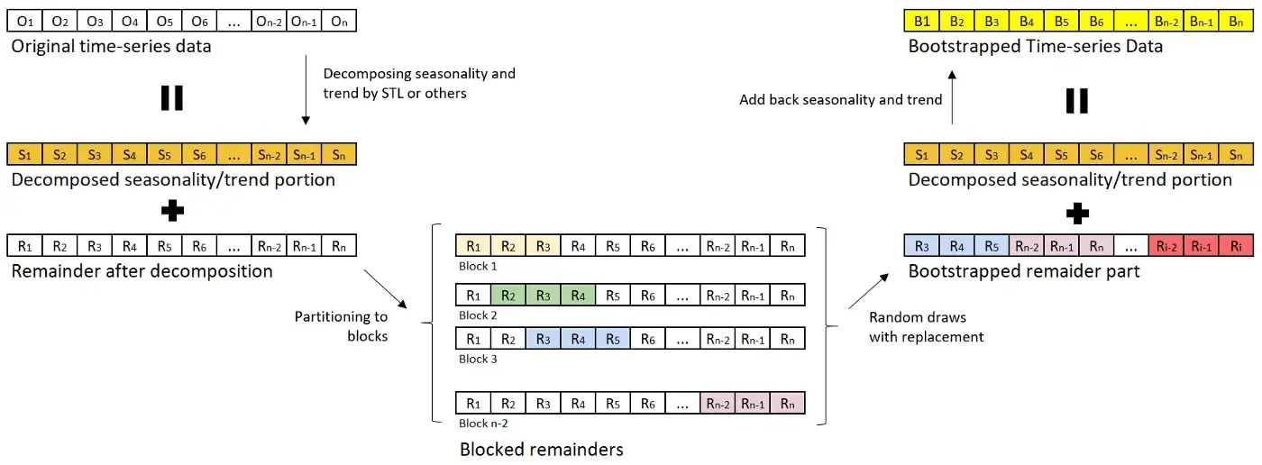
Moving Block Bootstrap Method
In “Moving Block Bootstrap (MBB)”, the random data draws are done over the ‘blocked sets’ of consecutive data (or more accurately, the remainder of data noise after removing trend and seasonality), instead of over individual data rows.
[1]
[1] DEI, Moto. “Bootstrapping on Time Series Data - ‘Moving Block Bootstrap.’” Medium. Medium, March 14, 2022. https://medium.com/@daydreamersjp/bootstrapping-on-time-series-data-moving-block-bootstrap-79aaf6648aec.
Notes:
Zijun
To obtain an estimate of the standard error of the model parameters, we will reference Moto DEI’s article regarding bootstrapping of time-series data.
Bootstrapping is a statistical procedure that resamples a single dataset to create many simulated samples.Although the bootstrapping is very useful, it is not applicable to time series data as it is; because the time series data is assumed to have the autocorrelation within the noises between the neighboring time points
Effectively simulate for large time-series data sample while taking autocorrelations into account

Slide 16
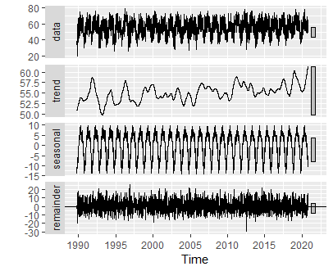
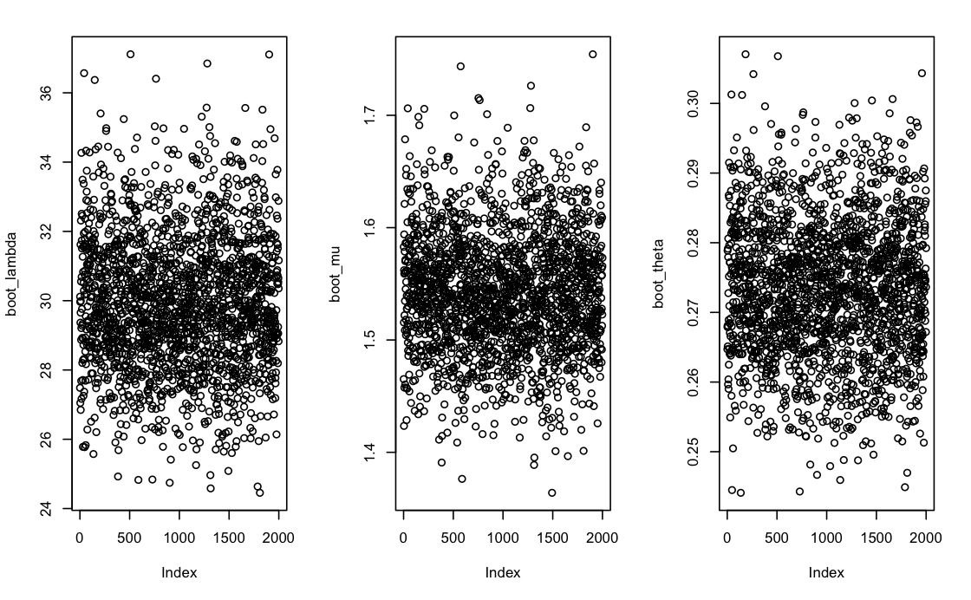
Results for STL Decompositions and Bootstraps
Notes:
JK

Slide 17
Findings and Results

Slide 18
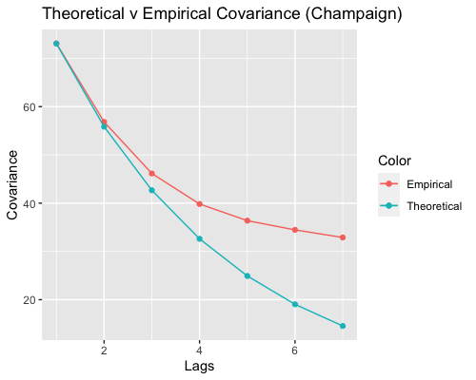
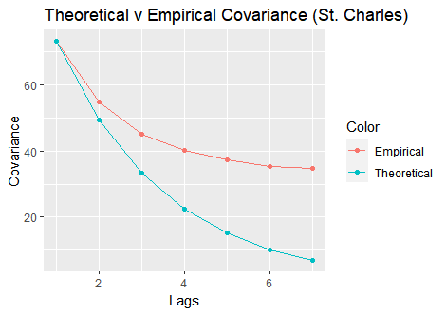
Sample and Theoretical Covariances
Multiple Lags
Notes:
Zijun
Here is graph comparing the observed covariance and the theoretical covariance using rectangular pulses poisson process model
Lags are in units of day. Champaign and St charles have overall similar covariance range. Also, Both covariance decrease as the lag increase. The difference between observed and theoretical covariance become larger as the lag increase.
Model is only suitable for reproducing sample covariances at lag 1 and 2.

Slide 19
Empirical and Theoretical Results
Multiple Decades
STL Bootstrap Results |  | CMI |  |  |  | StC
 |  | 1990s | 2000s | 2010s | Overall | 1990s | 2000s | 2010s | Overall
λ | Mean | 27.13499 | 33.70805 | 32.74380 | 29.93524 | 20.623609 | 24.060994 | 24.878698 | 22.164663
 | SD | 2.19280 | 4.65652 | 3.95800 | 1.91105 | 1.3849243 | 1.9186951 | 2.0326298 | 0.9827960
θ | Mean | 0.26779 | 0.28655 | 0.28547 | 0.2734007 | 0.3793452 | 0.4011538 | 0.3936024 | 0.3799253
 | SD | 0.01393 | 0.02518 | 0.01366 | 0.00980 | 0.0201299 | 0.0297646 | 0.0261246 | 0.0136194
μ | Mean | 1.440533 | 1.659132 | 1.588661 | 1.54191 | 1.0025513 | 1.0957227 | 1.1193433 | 1.0592301
 | SD | 0.05414 | 0.10416 | 0.12236 | 0.05230 | 0.0417478 | 0.0373864 | 0.0439848 | 0.0232571
Notes:
Z
After conducting moving back bootstrap and STL time series, we got this numerical table recording the mean and standard deviation of overall and each decade’s parameter lambda, Mu, and theta of rectangular pulses poisson process model. Average Intensity = 1 / theta
Average Duration = 1 / mu
Average Frequency = lambda

Slide 20
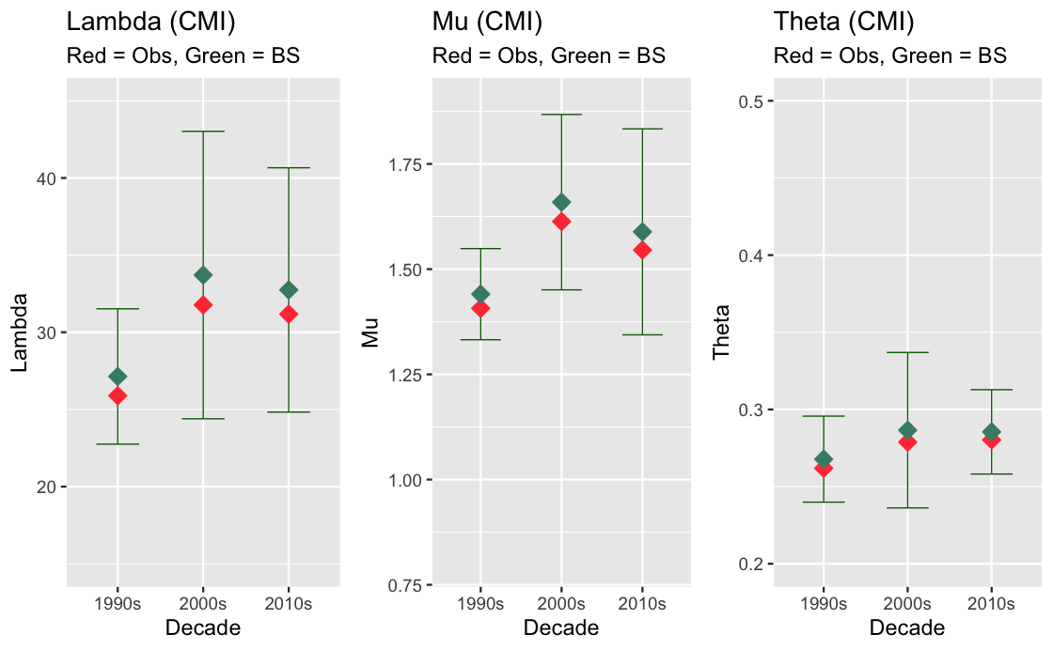
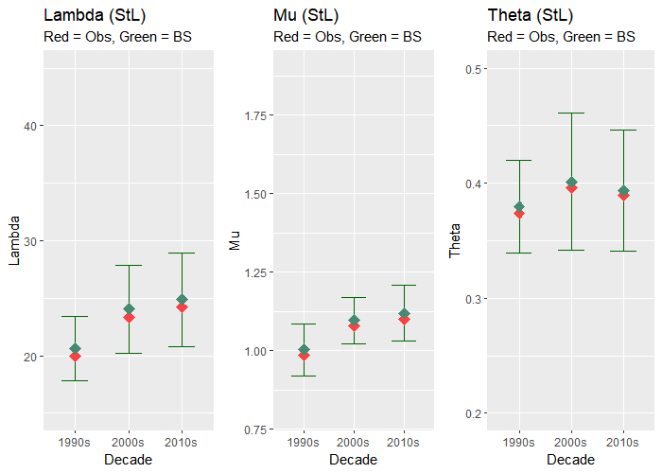
Champaign
St. Charles
Decade Results
Notes:
Z
Here is the graph showing how parameters lambda, Mu and Theta change with decade in Champaign and St. Charles
Red: mean of parameters calculated by RPPM formula, Green: mean of those parameter after bootstrapping 2000 times. We also indicate the 95% confidence interval of parameter value after bootstrapping.
Values of observed parameters are all lower than those after bootstraping, but those red points(observed) are still in 95% confidence interval, which are acceptable result for our research.
Champaign has higher lambda and mu than St.charle, (meaning more frequency and less duration)
Lower theta tham St.charles (meaning higher intensity )

Slide 21
Conclusions
Sample Covariance and Theoretical Covariance Comparison
Champaign sample covariances are similar to St. Charles, but have less drastic drops compared to St. Charles.
Both Champaign and St. Charles have distant correlations after 3 lag days.
RPPM preserves the sample moments for Lag 1 and Lag 2 covariances.
Decadal Analysis of Parameters
All parameters for both areas showed an increase between the first and second decade.
The 95% confidence interval perfectly captures the observed samples.
Slight variation, but no evident increasing or decreasing trends.
Champaign has larger variation for λ and μ, while St. Charles has a larger variance for θ
Notes:
JK
Summarize descriptive statistics
Graphics of Covariance – RPPM model is able to preserve the sample moments (Lag 1 and Lag2 covars). Does not preserver covar for larger lags
How parameters changed from decade to decade
StC and CMI comparison
See if SE captured in

Slide 22
Limitations and Future Work
The RPPM methodology assumes the random variables Intensity and Duration to be independent
Assumption can be relaxed by using other extensions or derivations of the RPPM
Investigate other definitions of Heat Waves
E.g Different heat index formula or threshold
Fit the RPPM for other locations to evaluate the spatial variability of the RPPM parameters
Global situation
Use the RPPM for simulation of synthetic heat waves time series
Use future projections of climate data to evaluate future changes of the RPPM parameters
Notes:
Z
- The RPPM assumes the random variables intensity ad duration are independent. This assumption can be relaxed by using other extensions of the RPPM.
- Several definitions of Heat Waves are available in the literature. Other definitions can be explored
- Fit the RPPM for other locations to evaluate the spatial variability of the RPPM parameters
- Use the RPPM for simulation of synthetic heat waves time series
- Use future projections of climate data to evaluate future changes of the RPPM parameters

Slide 23
Works Referenced
[1] “Climate Change Indicators: Heat Waves.” United States Environmental Protection Agency. EPA, July 2022. https://www.epa.gov/climate-indicators/climate-change-indicators-heat-waves.
[2] “The Heat Index Equation.” Weather Prediction Center. National Weather Service, May 12, 2022. https://www.wpc.ncep.noaa.gov/html/heatindex_equation.shtml.
[3] Yoo, Chulsang, et al. "Quantification of drought using a rectangular pulses Poisson process model." Journal of Hydrology 355.1-4 (2008): 34-48.
[4] Rodriguez‐Iturbe, Ignacio, Vijay K. Gupta, and Ed Waymire. "Scale considerations in the modeling of temporal rainfall." Water Resources Research 20.11 (1984): 1611-1619.
[5] DEI, Moto. “Bootstrapping on Time Series Data - ‘Moving Block Bootstrap.’” Medium. Medium, March 14, 2022. https://medium.com/@daydreamersjp/bootstrapping-on-time-series-data-moving-block-bootstrap-79aaf6648aec.
[6] Rodriguez-Iturbe, Ignacio, David Roxbee Cox, and Valerie Isham. "Some models for rainfall based on stochastic point processes." Proceedings of the Royal Society of London. A. Mathematical and Physical Sciences 410.1839 (1987): 269-288.
Notes:
Dosio, Alessandro, et al. "Extreme heat waves under 1.5 C and 2 C global warming." Environmental Research Letters 13.5 (2018): 054006.

Slide 24
Thank you for listening

