Slide 1
Cryptography
From then to now, and protecting the future.
Notes:
I’m going to provide you with a super light introduction to cryptography and then we’ll go on a hunt for it.
We’ll look for it in our every day apps and services, and we’ll look for it in our development tools and infrastructure.

Slide 2
Greetings
I am Jon

Slide 3
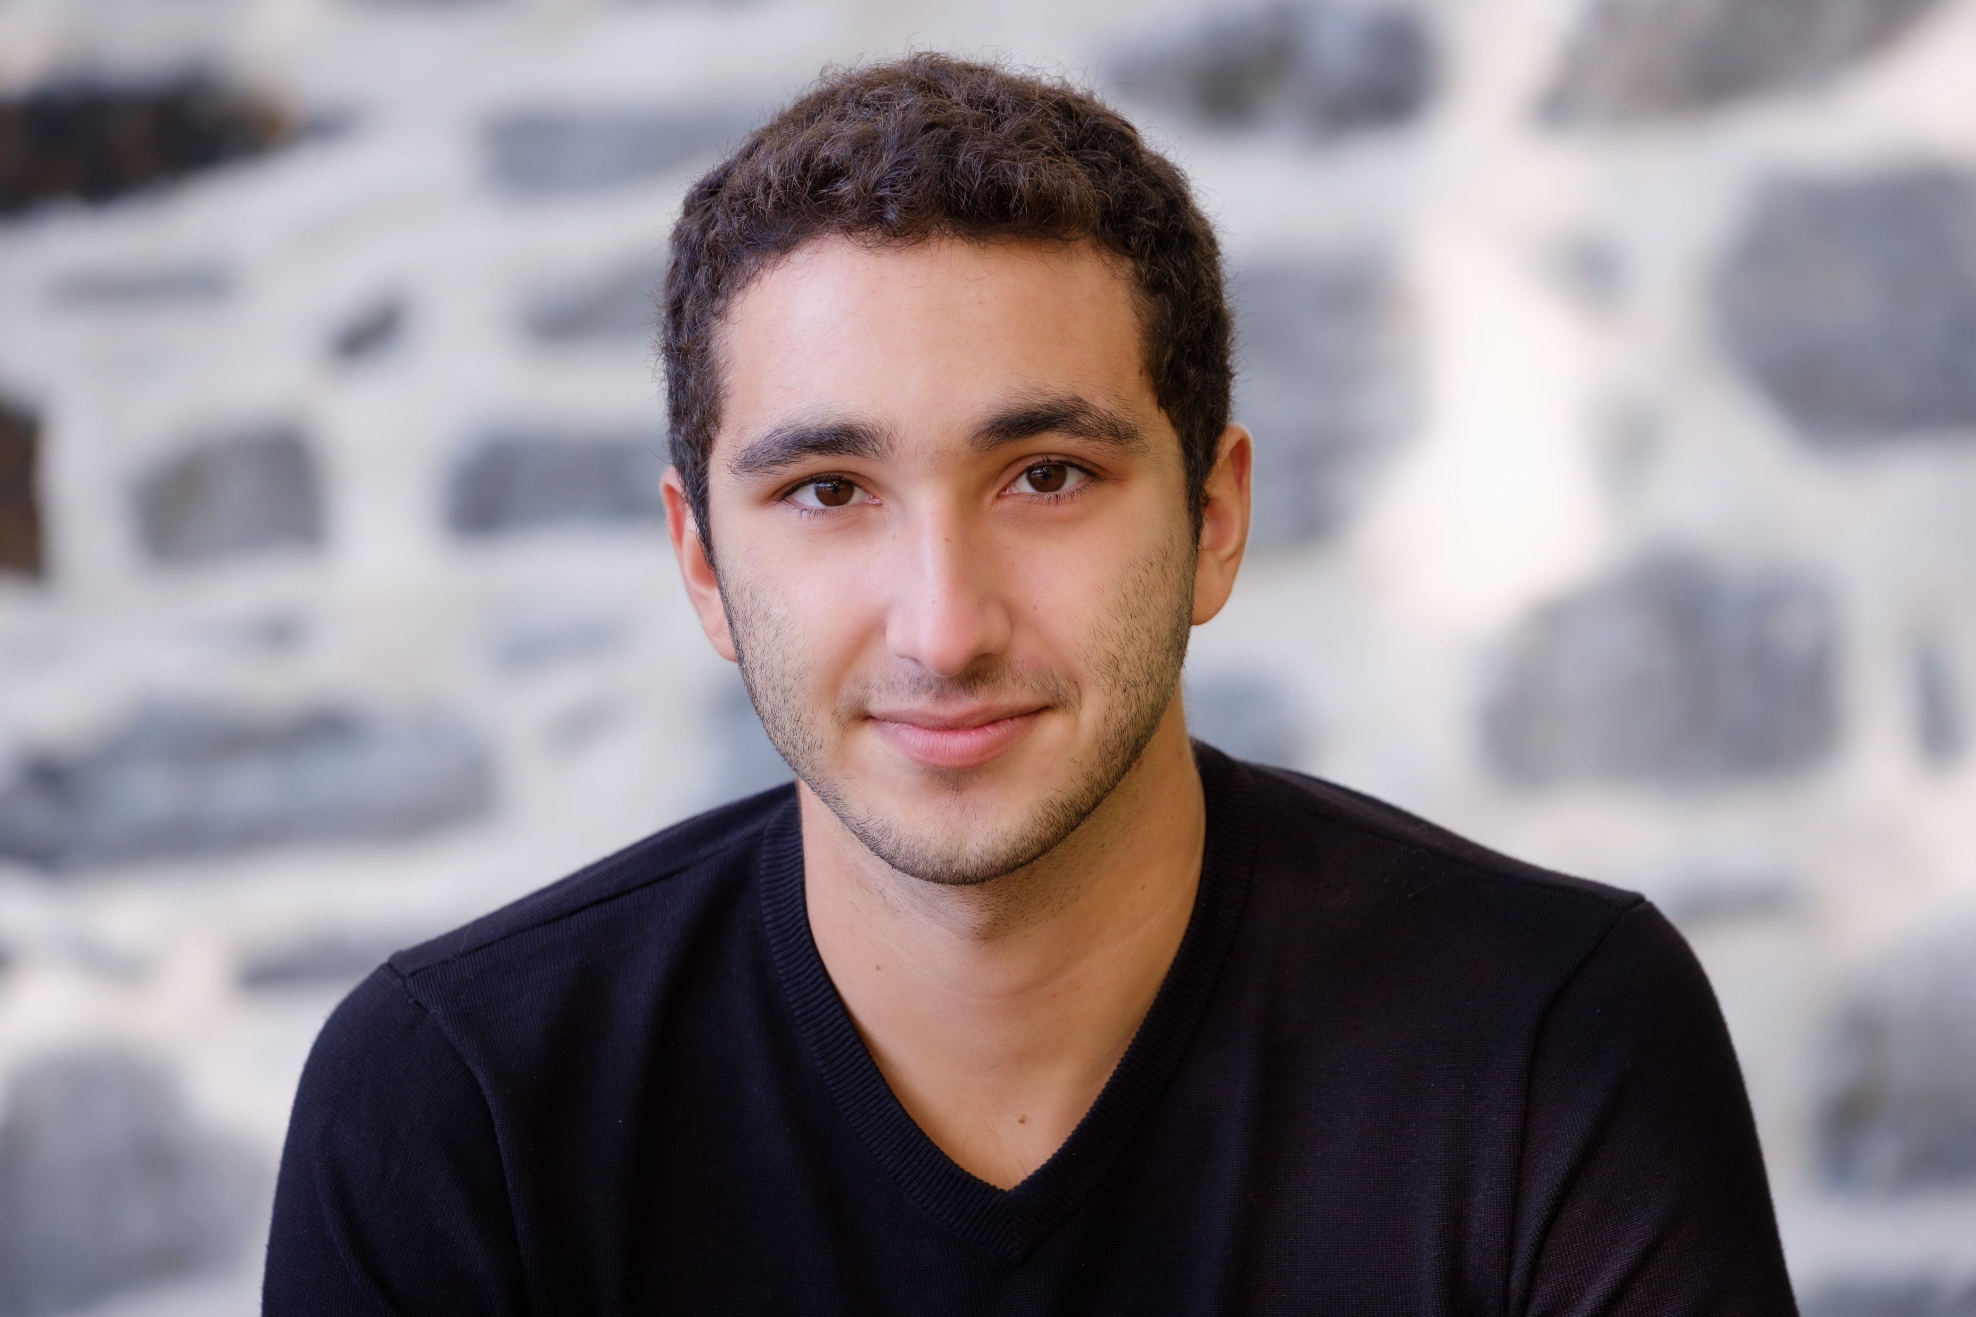
Jon Zlotnik
Software Engineering @ Concordia
Avionics and Embedded Systems
Information Security @ Genetec
Security Operations Center
Governance, Risk, and Compliance
Cloud Security and Identity
Notes:
No I didn’t learn any of this in school.
In school you mostly just learn how to deal with annoying overhead and bureaucracy.
Which is actually a very useful skill.

Slide 4
What is Cryptography?
You mean bitcoin?
Notes:
A head hunter from a consulting firm contacted me on LinkedIn and asked if I would be interested in a consulting position at their company.
I’m not one to close doors, so I said, sure!
We scheduled an interview.
Half way through interview, after I finish explaining what I do in my current employment, she tells me that she’s from HR admits that she doesn’t really know much about cryptography.
I ask if she understood what I was talking about.
She says that she thought cryptography was a digital currency like Bitcoin and didn’t really understand how anything I was saying made sense.
Sooooo, I now realize that I need to make the distinction between cryptocurrency and cryptography when introducing the topic.
For now, let’s forget about cryptocurrency. I may explain how cryptography is used in blockchains if time permits, but this is not the purpose of the workshop.
and it started well.
As expected, she described the hiring company and began with testing my soft skills (team work, communication, client management, etc.).
Then, she began asking me more technical questions about crypto and how I use it keep a company safe.
I can tell she has a written list of questions to go through, but

Slide 5
“the art of writing or solving codes”
- Oxford Dictionary
“secret writing”
- Miriam Webster
“the science or study of the techniques of secret writing, especially code and cipher systems, methods, and the like.”
- Dictionary.com
Notes:
Point is, there aren’t any great definitions on the internet.

Slide 6


Cryptography secures information
Notes:
What does it mean to secure information?
Confidentiality and Integrity
Hides things
Proves things

Slide 7
Confidentiality
Business secrets
Personal information
Sensitive messages or transactions
etc.

Slide 8
Integrity
Authentication
Non-repudiation in messaging
Proof of transactions
etc.
Notes:
Non-repudiation
- The sender of data is provided with proof of delivery and the recipient is provided with proof of the sender’s identity, so neither party can deny sending, receiving, or accessing the data.

Slide 9
How did it all start?
Let’s go back to ancient Greece!
Notes:
Throughout human history, we’ve made plenty of attempts at hiding information.

Slide 10
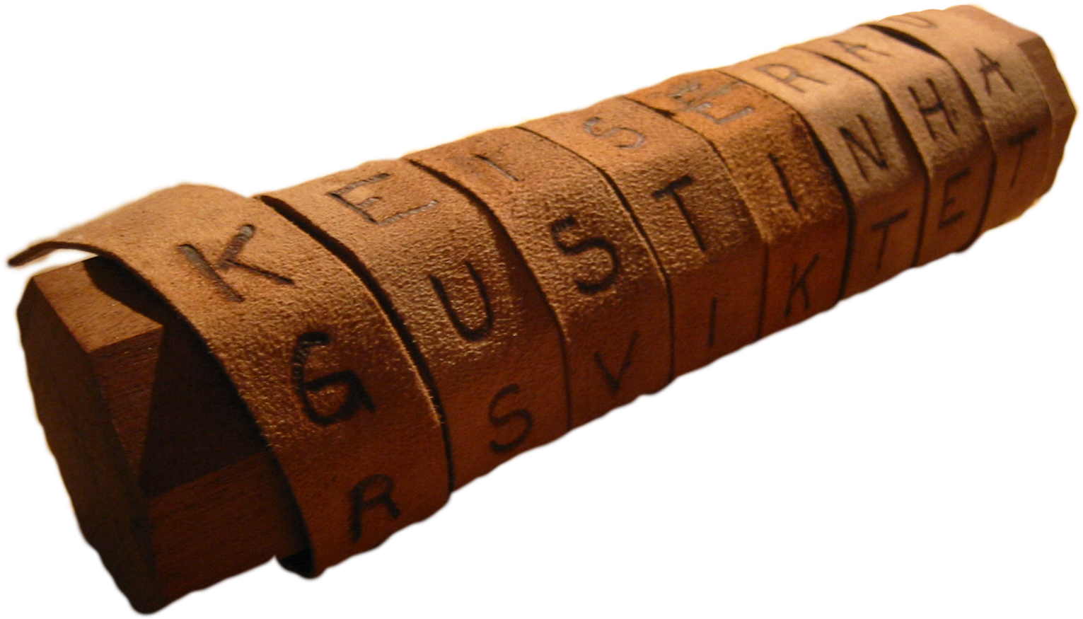
Scytale
A transposition cipher!
What was it used for?
How does it work?
Why is it insecure?
Notes:
Ask for guesses from the audience.
Used by ancient Greek army generals to communicate.
Minimize risk of their messages being intercepted and read.

Slide 11
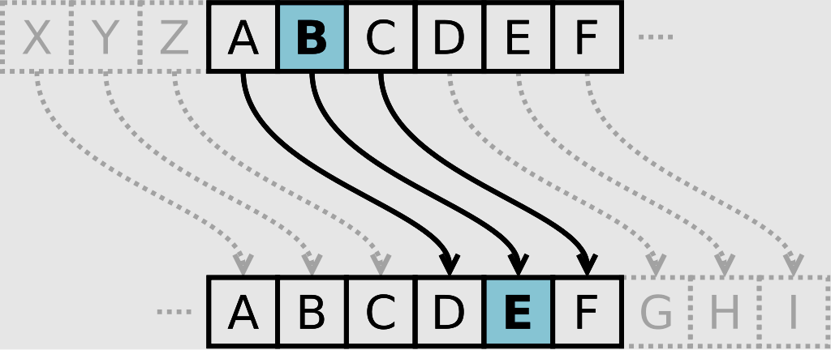
Caesar Cipher
A substitution cipher!
What was it used for?
How does it work?
Why is it insecure?

Slide 12
What are these ciphers doing wrong?
Notes:
Ask them!

Slide 13

What are these ciphers doing wrong?
Kerckoff’s Principle
Secrecy should depend only the secrecy of a cipher’s key, not the secrecy of the cipher’s algorithm.
Widely shared and long lived “secrets”
Only need one person to make a single careless mistake.
Notes:
It’s all about the key.
It’s easy to create reversable gibberish.
It’s extremely difficult to create gibberish that only the intended reader can understand.
Ask yourself: What is the key?
Once you figure out what the key is, it becomes simpler (not easier) to determine the strength of the cipher.
The scytale and the Caesar cipher both depended on the secrecy of the algorithm of the cipher as well as widely shared secrets.
We’ll see that the latter point isn’t remedied for another 500 or so years.

Slide 14
In the meantime.
Marry Queen of Scotts assassinated.
United states joins the allies.
1587
1917
1856
1945
Russia loses the Crimean War.
End of WW2
Notes:
1587 – Her monoalphabetic cipher failed her, releasing her plot to kill Elizabeth to the trial as evidence.
1856 – Charles Babbage’s cracking of the Vigenere cipher is rumoured to have given the UK the upper edge (9 years of a head start)
1917 – The Zimmerman telegram convinced the US to join the war and abandon their neutral “peacekeeper” mindset.
1945 – The Enigma traffic being read lead to major wins for the allies.

Slide 15
The key distribution problem
Runners
Trusted humans with USB keys that flew across the world to distribute keys every month.
Diffie-Helman Key Exchange
A way for two parties to agree on an encryption key over an insecure channel.
Public Key crypto
Let see how it works…
Notes:
Diffie – Hellman drawbacks
- Doesn’t establish identity so susceptible to MITM attacks

Slide 16
Where are we now?
Have Alice, Bob, and Eve figured it out?
Notes:
Alice, Bob, and Eve are the characters usually used to explain crypto.

Slide 17
Public Key Cryptography
RSA
Ron Rivest, Adi Shamir, and Leonard Adleman
Based on prime factorization
Elliptic curve cryptography
Public-key algorithm based on the algebraic structure of elliptic curves
Notes:
Does anybody know what this is?
Provides the ability to sign, verify, encrypt, and decrypt
The concept of public key infrastructure: Registration Authorities, Certificate Authorities, etc.
How does it help with confidentiality and integrity?
What are certificates, what do they look like?
Keystore explorer

Slide 18


Symmetric Key Cryptography
Block Ciphers
Like AES
Stream Ciphers
Like SNOW
Notes:
AES used for things like encrypting hard drives and large sets of data.
Used for encrypting communications like the up and coming 5G networks.
Only for encrypting and decrypting things.
How does it help with confidentiality and integrity?

Slide 19
The Hunt
Let’s go find crypto in the wild!
Notes:
The game is simple, I’ll display some technologies on the screen, and you need to screen shot as many examples of them as possible before the timer runs out.
Even if you don’t find anything, at least you’ll have explored the web a bit more than before.
After each hunt, I’ll show you some examples of the tech that I use in my personal projects and at work.
And then I’ll explain how cryptography plays a role in the technology.

Slide 20
Find me ssl/tls!
Let’s start easy.
YOU HAVE 60 SECONDS….
What does it do?
RSA for initial key exchange and verification of server.
Establishes a session.
AES for session encryption.
Rest of the data is encrypted symmetrically.

Slide 21
Authentication
F*ck passwords, find me some of these:
OpenID Connect
2FA/MFA
Time-based OTP
Hardware Tokens
FIDO2, PIV, or OpenPGP
YOU HAVE 3 MINUTES…
Notes:
Why are passwords bad?
They’re hard to remember and easy to guess.
Humans create easy to guess passwords because they’re hard to remember.
You need to use a different one for every service in case one service gets compromised.

Slide 22
Authorization
Slightly harder… find me some of this:
Role based access control (RBAC)
Hint: Look in Google’s Cloud or Firebase Console, or Azure’s Portal
OAuth2.0 protected API
Hint: No hint for this one. Find me some cool web APIs.
YOU HAVE 5 MINUTES…

Slide 23
The everyday app
As a developer, what do we do with crypto?
Notes:
The answer is as close to nothing as possible.
We should never try to implement anything in the previous slides ourselves cuz it WILL NOT be secure.
Even if you follow the best textbooks on cryptography to the letter, your implementation will still be lacking.
Actual implementations of cryptographic standards are done by large organizations and vetted by the open source community.
Like we talked about before, the key is what is kept secret. The algorithm/implementation can be, and should be reviewed by thousands of experts before being used in production.
99.9% of software developers merely consume cryptography.
Even my work at Genetec is mostly consumption. I may work a bit closer to the implemented standards when I’m building solutions to weird or very specific problems, but my first goal is always to see how little code I can get away with writing.
Questions before we write some code?

Slide 24
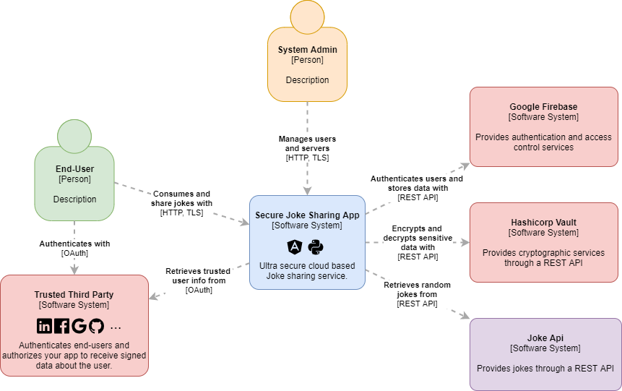

Slide 25
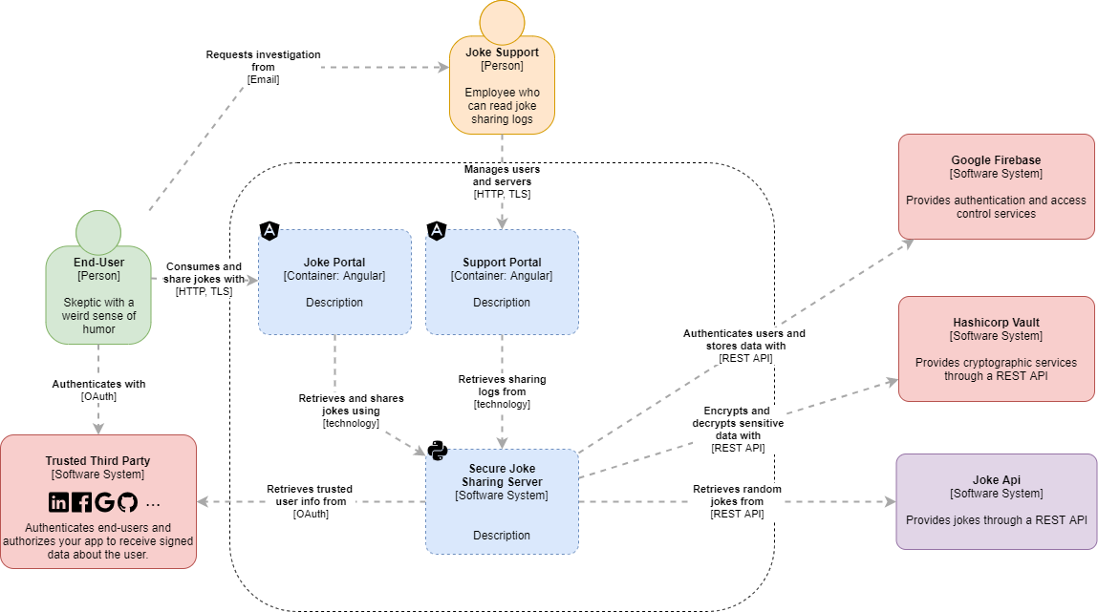

Slide 26
What do you want to try?
We’ll do OpenID Connect,
and will have time for one more…

Slide 27



Openid connect
...
Notes:
In my opinion, the platform that has done the best job of abstracting the OpenID Connect authentication process is Firebase!
If you don’t want to use firebase, every Oauth2.0 Provider has docs explaining how to do it with them.

Slide 28
Openid connect
The okta blog did a nice job of depicting OIDC.
I’ll walk you through it:
{okta} blog comic of OIDC
Notes:
In my opinion, the platform that has done the best job of abstracting the OpenID Connect authentication process is Firebase!
If you don’t want to use firebase, every Oauth2.0 Provider has docs explaining how to do it with them.

Slide 29
Get your fingers ready!
https://firebase.google.com/docs/auth/web/start
https://github.com/angular/angularfireZ
Notes:
You have 30 min to get your identities into my firebase authentication service!
At the 20min mark I’ll chime in and see how you are all doing!
Tell me when you get stuck and I’ll walk y’all through it!

Slide 30
API keys and other secrets
Try your best not to give them to your users.
Keep them in something like:
Google Cloud Credentials
Azure KeyVault
HashiCorp Vault
Notes:
Pro tip:
Often you’ll need to store and use an API key or Database connection string.
Keep it server side. (On a back channel)
Let the thousands of developers at Microsoft or Google handle them.
If you take advantage of these services, you’ll get entire teams working on securing your app.
If not, you’re on your own and your liable.

Slide 31
You wanna try something else?
If not, I’ll show you how to use Time-based OTP in Python.
And maybe introduce you to Hashicorp’s Vault.

Slide 32
Quantum & Questions

Slide 33
Post-Quantum Cryptography
The danger of general purpose quantum computers
We don’t have them yet.
Increase key sizes.
Use quantum safe algorithms.
What makes quantum computers so good at breaking cryptography ?
Shor’s algorithm

Slide 34
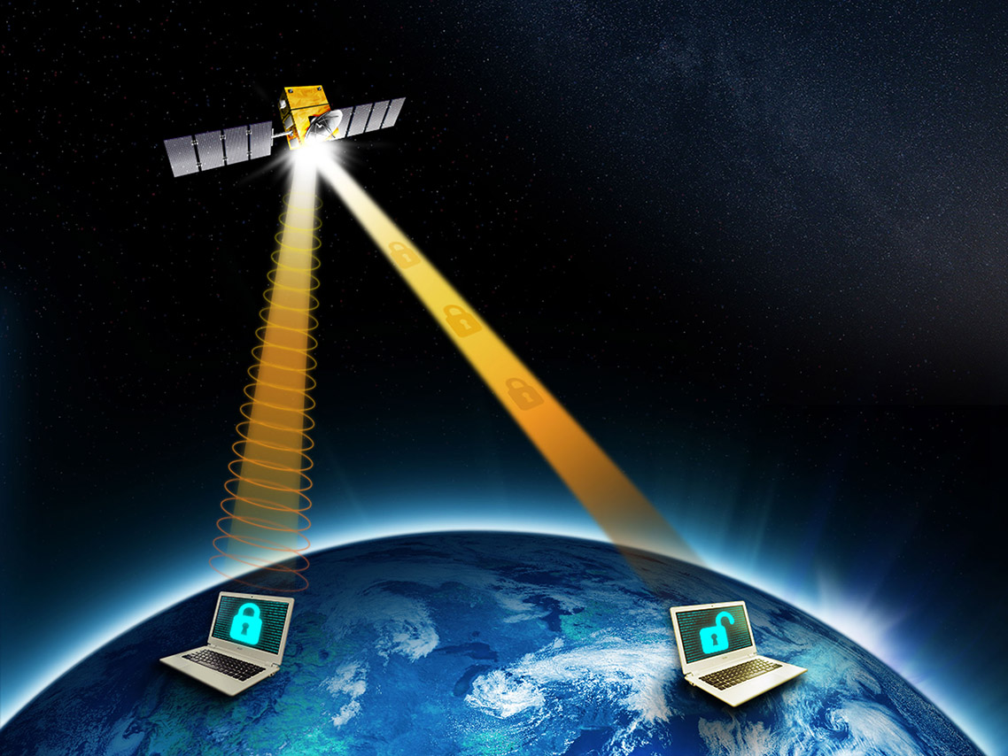
Quantum Key distribution
What is quantum key distribution?
Quantum Encryption and Science Satellite (QEYSSat)
Canadian space agency
Implementation is expected to extend until the end of 2022.
https://www.asc-csa.gc.ca/eng/sciences/qeyssat.asp

Slide 35
Q & A
Ask me anything.
If I don’t know the answer I’ll point you towards it.

