Slide 1

Python & Flask
From “Hello World!” to web api’s in 45min?
Notes:
Add mariHacks 2019 logo and shit

Slide 2
Your favorite mentor
I study…
I work…
I research…
I have been programming since…

Slide 3
Our goals for the hour:
Learn some python
Make something cool with it

Slide 4
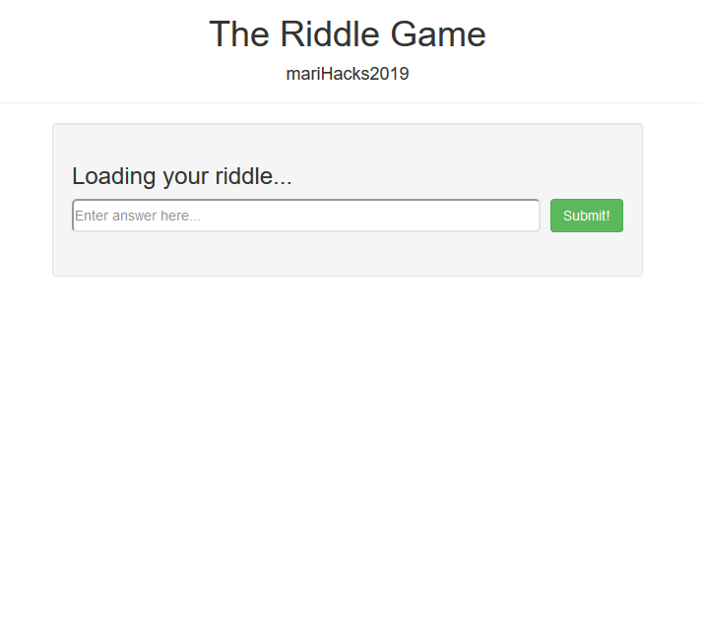
Learn by doing
If all goes well we should end up with something like this →

Slide 5


What do we need to build a web app?
Frontend
Backend

Slide 6
What do we need to build a web app?
Frontend
Backend
HTML
CSS
Javascript

Slide 7
What do we need to build a web app?
Frontend
Backend
Python 3
Flask
JSON

Slide 8
What do we need to build a web app?
Frontend
Backend
HTML5
CSS3
Javascript (ES5)
Python 3
Flask
JSON
Notes:
dip the versions

Slide 9
What do we need to build a web app?
Frontend
Backend
HTML
CSS
Javascript
Python 3
Flask
JSON

Slide 10
Python 101
Let’s write some code

Slide 11
A few things to knote:
We’ll be using Python 3 (not 2.7)
To follow along, clone my repo:
https://github.com/jonZlotnik/marihacks2019-python-flask
I was told to assume none of you know how to code.
I will go fast, but I will teach you how to learn.
The curse of the live demo.

Slide 12
Hello World
print(“Hello, world!”)
Everycoder’s first words…

Slide 13
Hello World
print(“Hello, world!”)
Hello, world!
Everycoder’s first words…

Slide 14
Languages around the world…
English
Hi, I’m Jon!
French
Salut, je m’appelle Jon!
Hebrew
היי, אני ג 'ון.
Russian
Привет, я Джон.
Notes:
Keep these slides on standby, make sure will have enough time (maybe do them at the end)

Slide 15
Languages around the world…
English
Hi, I’m Jon!
French
Salut, je m’appelle Jon!
Hebrew
היי, אני ג 'ון.
Russian
Привет, я Джон.
English
Where is the house?
French
Ou est la maison?
Hebrew
איפה הבית?
Russian
Где дом?

Slide 16
Programming languages are the same…
Python
Java
print(“Hello, world!”)
class HelloWorld {
public static void main(String[] args) {
System.out.println(“Hello, world!”);
}
}

Slide 17
Programming languages are the same…
Python
Java
print(“Hello, world!”)
class HelloWorld {
public static void main(String[] args) {
System.out.println(“Hello, world!”);
}
}
Hello, world!
Hello, world!

Slide 18



What is Python?
Python Interpreter
C API
Assembly & Binary
https://www.python.org/
Notes:
Find good place to explain the difference between the live console (remember name for it) and prewritten scripts.

Slide 19
Let’s build a riddle game!
Computer asks user a riddle.
User inputs an answer.
Computer saves user’s answer to a persistent file.
Computer checks answer against correct answer.
Computer responds with a message letting the user know how they did.
Computer shows past user attempts at the riddle.
Notes:
Figure out a way to write the code that sanitizes the input yet minimizes questions about xss and input sanitization.

Slide 20
1. Computer asks user a riddle.
We actually already know how to do this!

Slide 21
1. Computer asks user a riddle.
print(“How much wood would a woodchuck chuck if a woodchuck could chuck wood?”)
How much wood would a woodchuck chuck if a woodchuck could chuck wood?
We actually already know how to do this!

Slide 22

Okay, that’s great. Shall we ramp things up a bit?
I heard everybody uses Atom around here…

Slide 23
Web API
How is python gonna help with building a web api?

Slide 24

Here’s where Flask comes in!
But what is it?

Slide 25
What is programming?
API
https://www.python.org/

