Slide 1

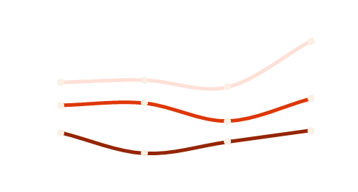

Who is disrupting fashion?
Shows 2 Sales
Shows to sales rates in the fashion industry have seen a significant rise of 30% in the last decade.
32
%
Increase
60
%
in sustainable fashion brands over the past five years.
Ethically sourced materials
Q1 20XX
60
%
1
in
3
Eco-friendly materials
fashion companies report an increase in sales after adopting inclusive sizing.
Q2 20XX
60
%
Customer return rate
Q3 20XX
1
2
3
Present
Past
Future
Progress
fashion companies report an increase in sales after adopting inclusive sizing.
In the past, fashion designers used to create garments exclusively by hand.
However, the production process has become 50% faster and more efficient.
$2Bn
20yy
20YY
Disclaimer: The following statement is a fictional disclaimer created for the purpose of this exercise and does not represent an actual company or its policies
Fabrikam does not guarantee specific results or outcomes from the use of its products. The information provided in this document is purely for entertainment purposes and should not be construed as professional advice. Fabrikam assumes no responsibility for any fashion choices made based on the content presented here. Any resemblance to real companies or statistics is purely coincidental.
www.fabrikam.com info@fabrikam.com
208 555 0100

Slide 2


Who is disrupting fashion?
Shows 2 sales
Shows to sales rates in the fashion industry have seen a significant rise of 30% in the last decade.
32
%
1
in
3
fashion companies report an increase in sales after adopting inclusive sizing.
Increase
in sustainable fashion brands over the past five years.
Shows
typically have an average attendance of 500 to 1,000 guests.
Online
65% of people shop online for clothing, highlighting the shift towards e-commerce in the industry.
$2Bn
20yy
20yy
60
%
45
%
24
%
Ethically sourced materials
Eco-friendly materials
Customer return rate
Q1 20XX
Q2 20XX
Q3 20XX
Disclaimer: The following statement is a fictional disclaimer created for the purpose of this exercise and does not represent an actual company or its policies
Fabrikam does not guarantee specific results or outcomes from the use of its products. The information provided in this document is purely for entertainment purposes and should not be construed as professional advice. Fabrikam assumes no responsibility for any fashion choices made based on the content presented here. Any resemblance to real companies or statistics is purely coincidental.
www.fabrikam.com info@fabrikam.com
208 555 0100

Slide 3


Who is disrupting fashion?
32
%
Increase
Highlights
65% of people shop online for clothing.
Fashion designers used to create garments by hand.
The production process has become faster and more efficient.
60
%
Progress
Ethically sourced materials
$2Bn
Q2 20xx
45
%
Eco-friendly materials
q20xx
20YY
20YY
Shows 2 sales
Shows to sales rates in the fashion industry have seen a significant rise of 30% in the last decade.
1
in
3
fashion companies report an increase in sales after adopting inclusive sizing.
Disclaimer: The following statement is a fictional disclaimer created for the purpose of this exercise and does not represent an actual company or its policies
Fabrikam does not guarantee specific results or outcomes from the use of its products. The information provided in this document is purely for entertainment purposes and should not be construed as professional advice. Fabrikam assumes no responsibility for any fashion choices made based on the content presented here. Any resemblance to real companies or statistics is purely coincidental.
www.fabrikam.com info@fabrikam.com
208 555 0100

