Slide 1
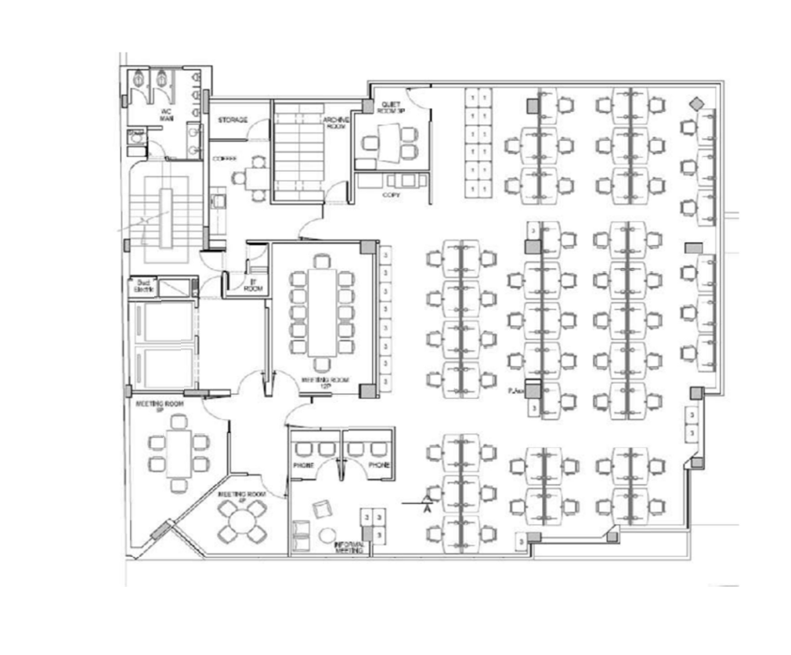
Sala Telecom
Access Point
AP
AP
AP
Core Router
Core Switch
Servidores
AP
AP

