Slide 1
MJ2505: PRO1 Presentation
Group 9
October 26, 20222

Slide 2
Step 1.1: Initial state of the network
Add picture of network + some facts (n_lines,…)
Colormap/bar plot to show loadings etc.

Slide 3
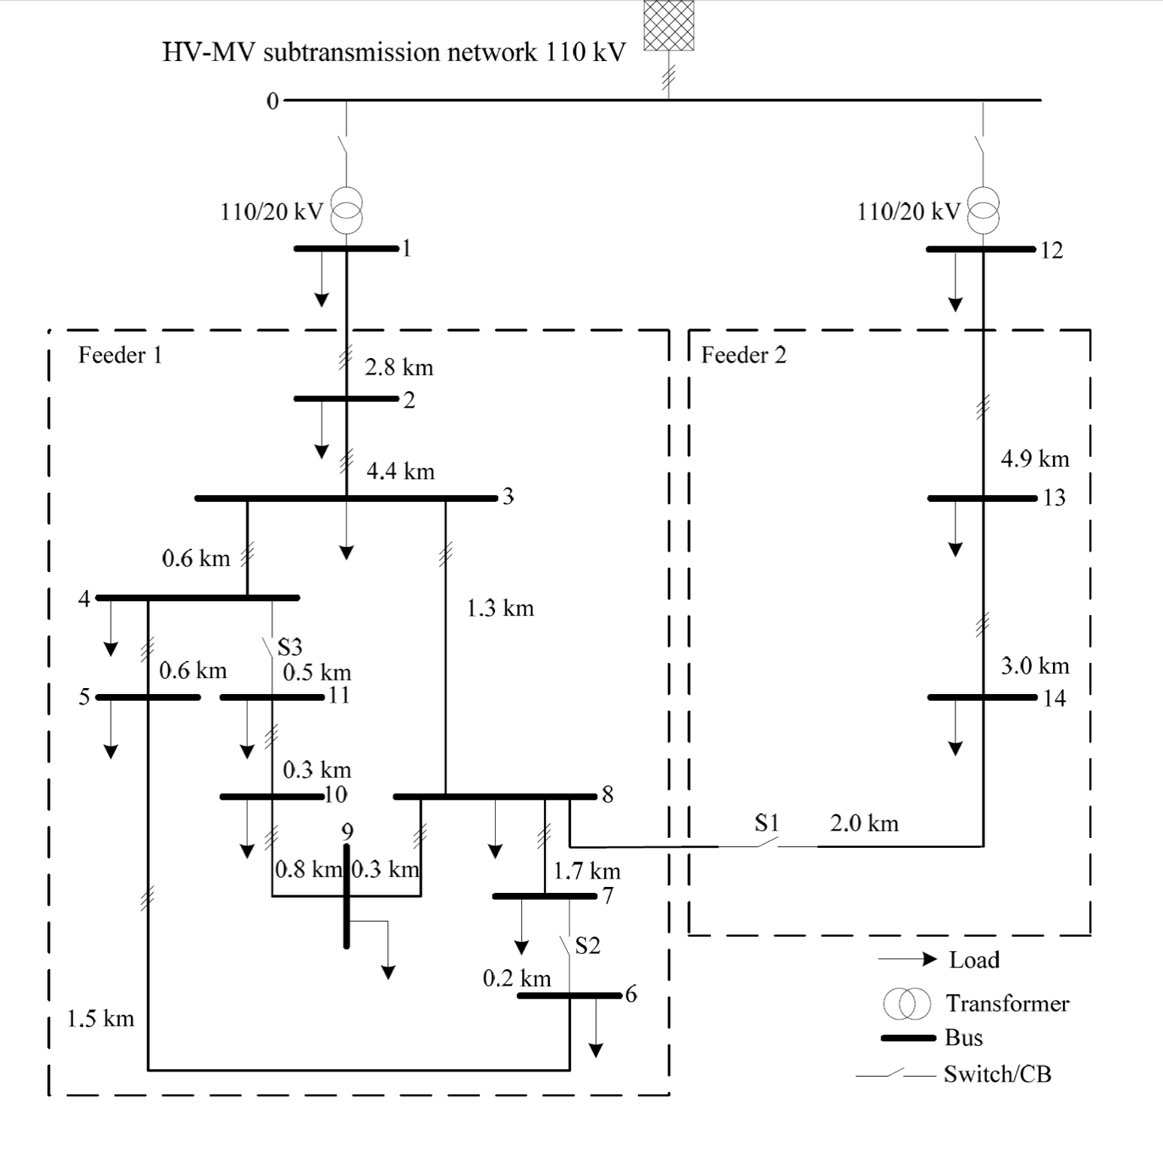
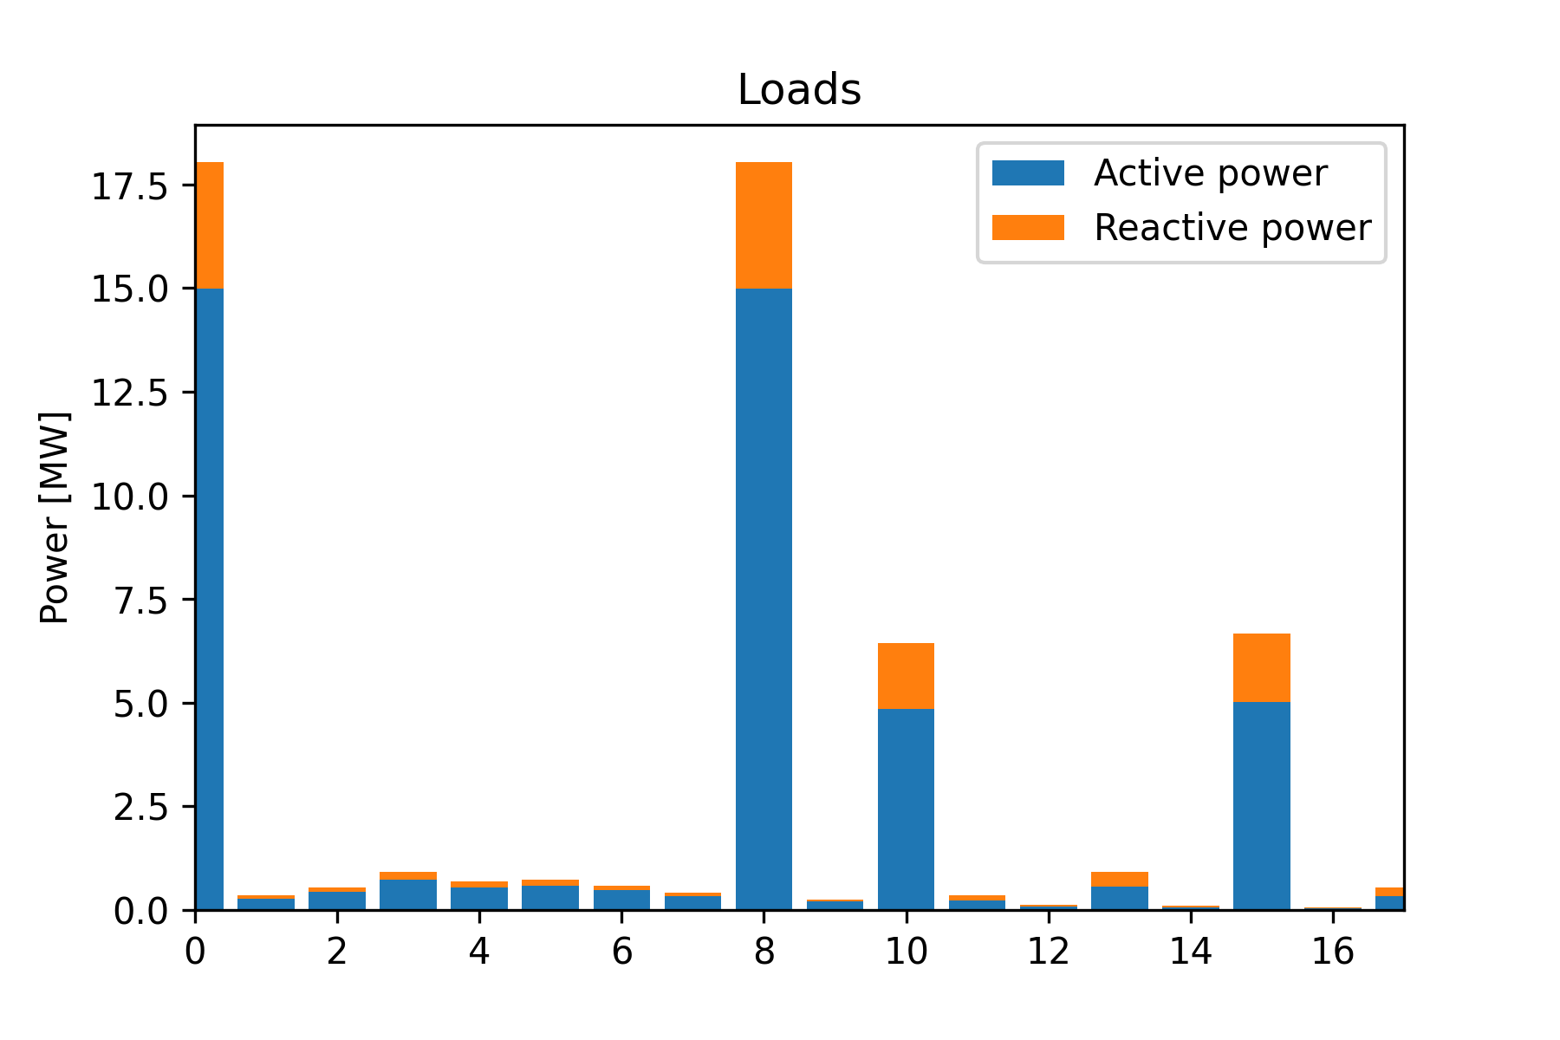
CIGRE Network
Initial configuration:
18 loads
load 0 and 10 connected to bus 1
load 8 and 15 connected to bus 12
8 switches (3 manual)
15 lines
2 trafos
15 buses

Slide 4
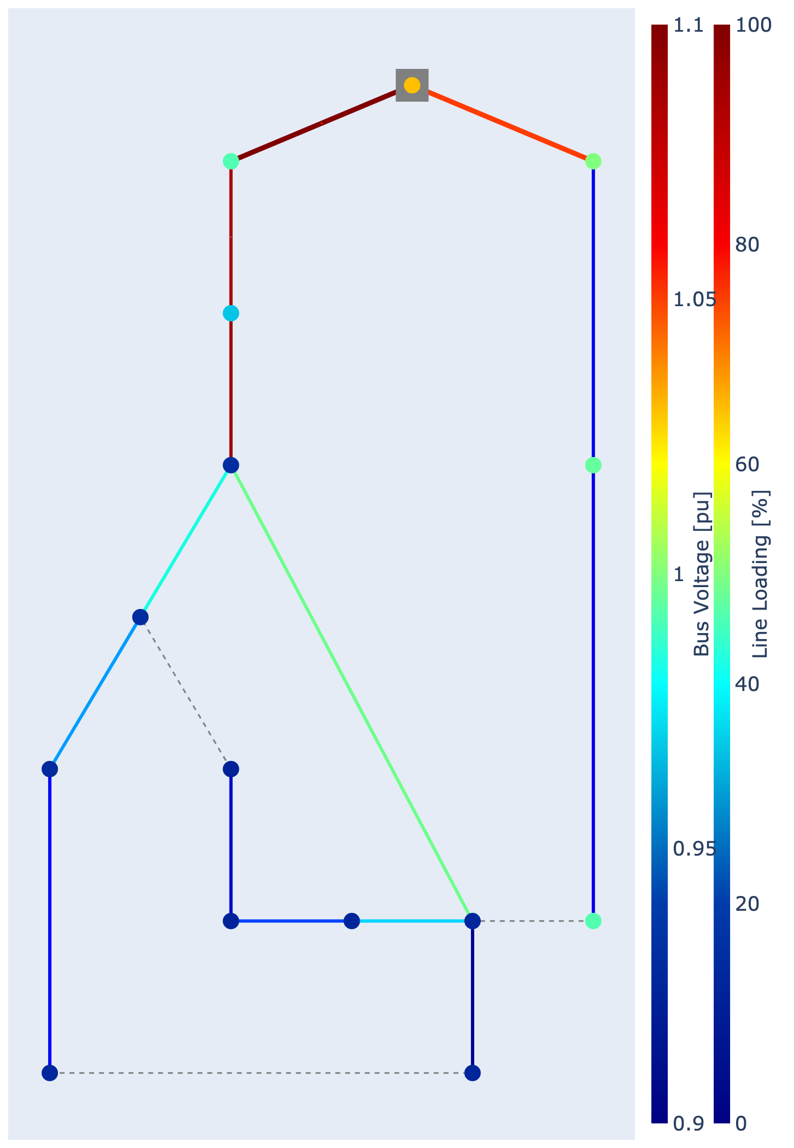
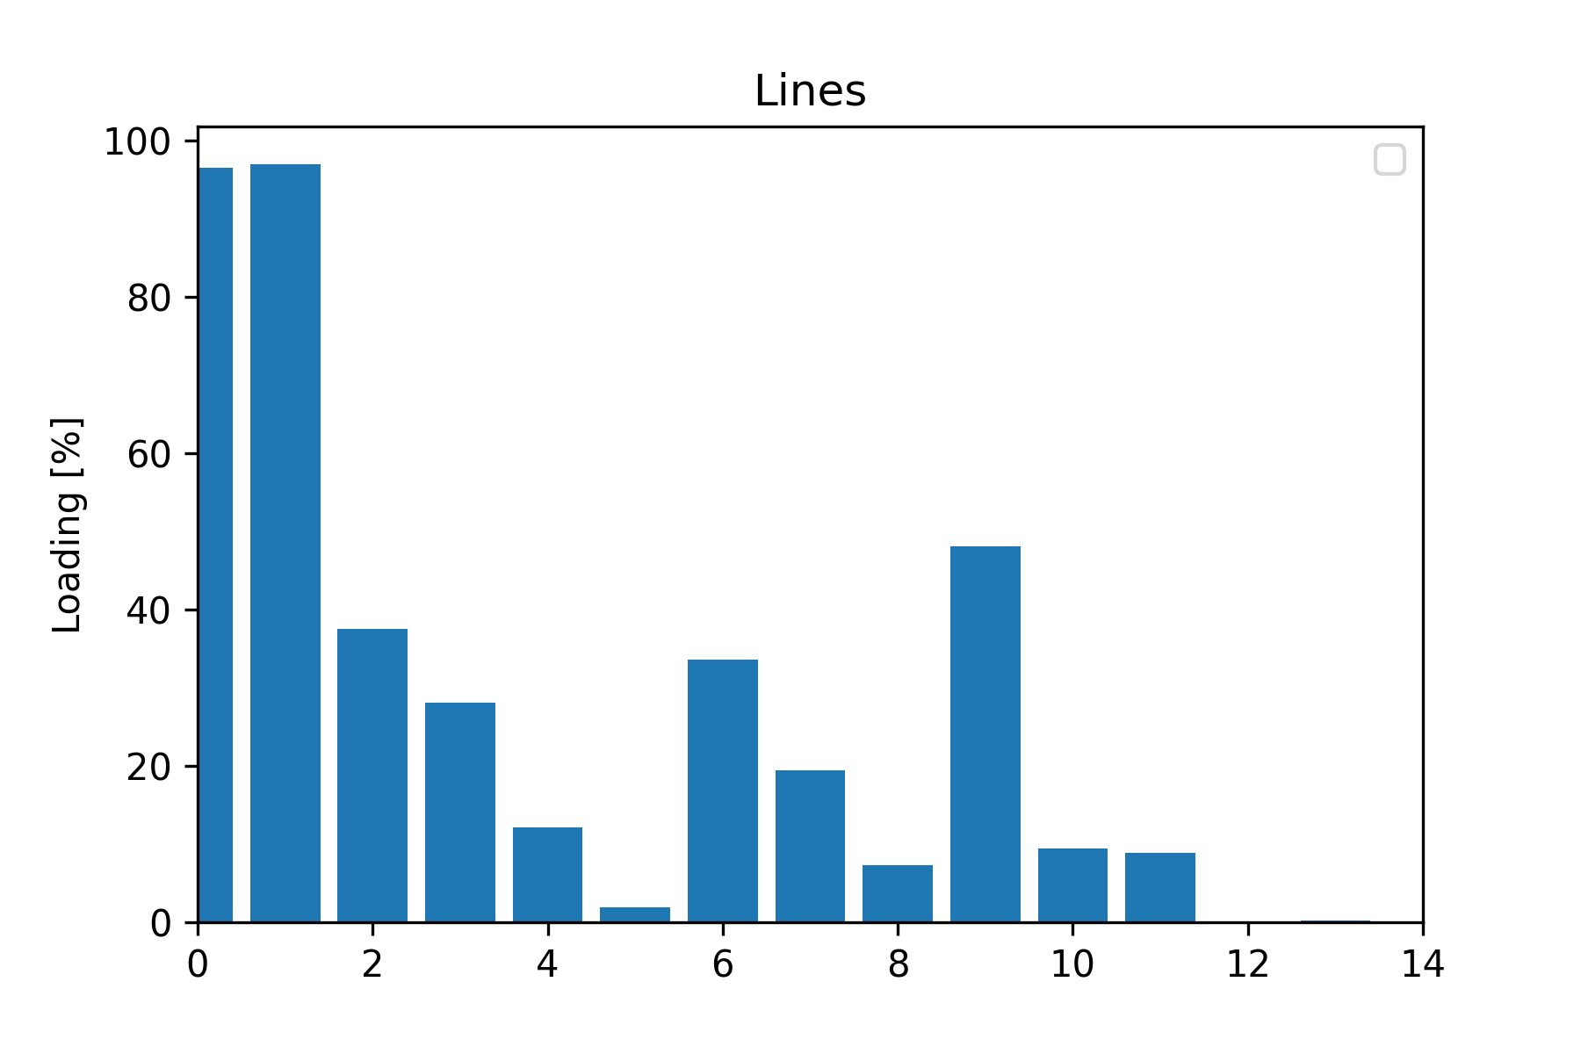
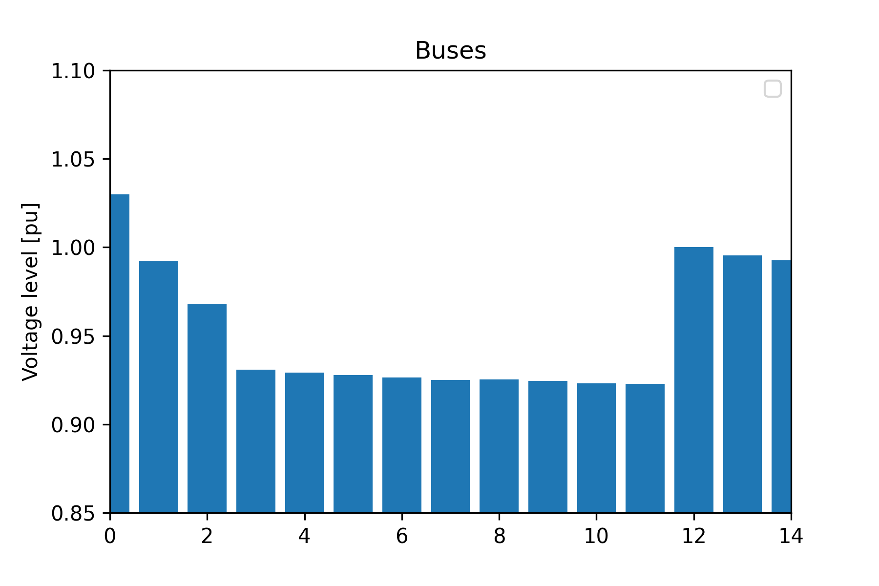
Running a power flow
Notes:
Lines bus 1-2, bus 2-3 are closest to 100% (96% max)
Trafo 1 is overloaded

Slide 5
Step 1.2: N-1 analysis
Explain procedure
Highlight critical cases and show results -> bar plot or colormap
Summarize results -> these are the cases we will consider in 3.3/3.4 -> also consider our „conclusion“ for the switches
for both: 5 and 10 % limits

Slide 6
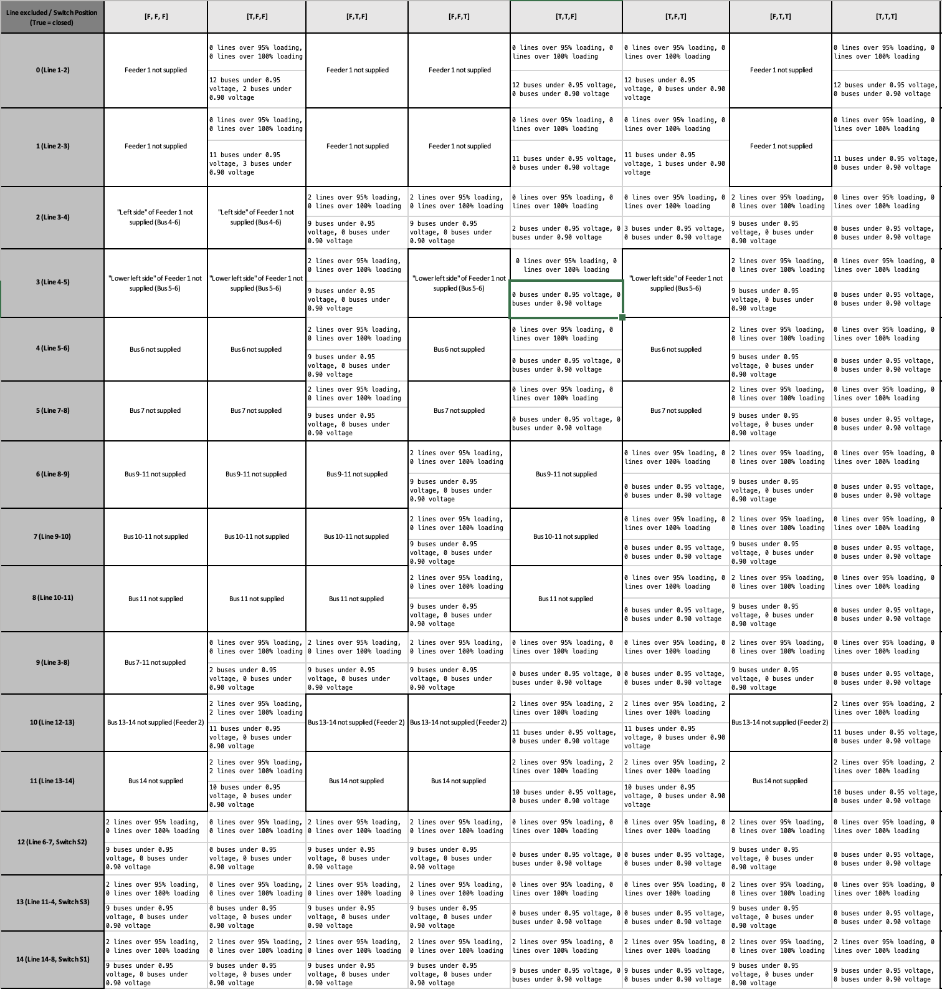
N-1 analysis
Went through all 120 scenarios (one line exluded + certain switch position)
Configuration reasonable?
Do some buses/lines exceed the limits?
If yes, which/how many?

Slide 7
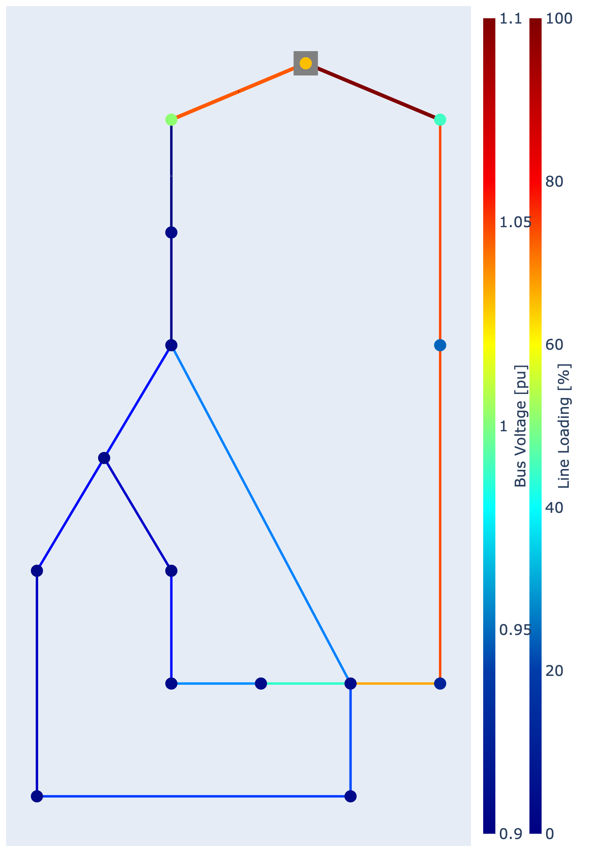
N-1 analysis: critical cases
Excluding line 0:
closing all switches
max line loading = 83%
overloaded trafo
12 buses below 0.95, all above 0.9

Slide 8
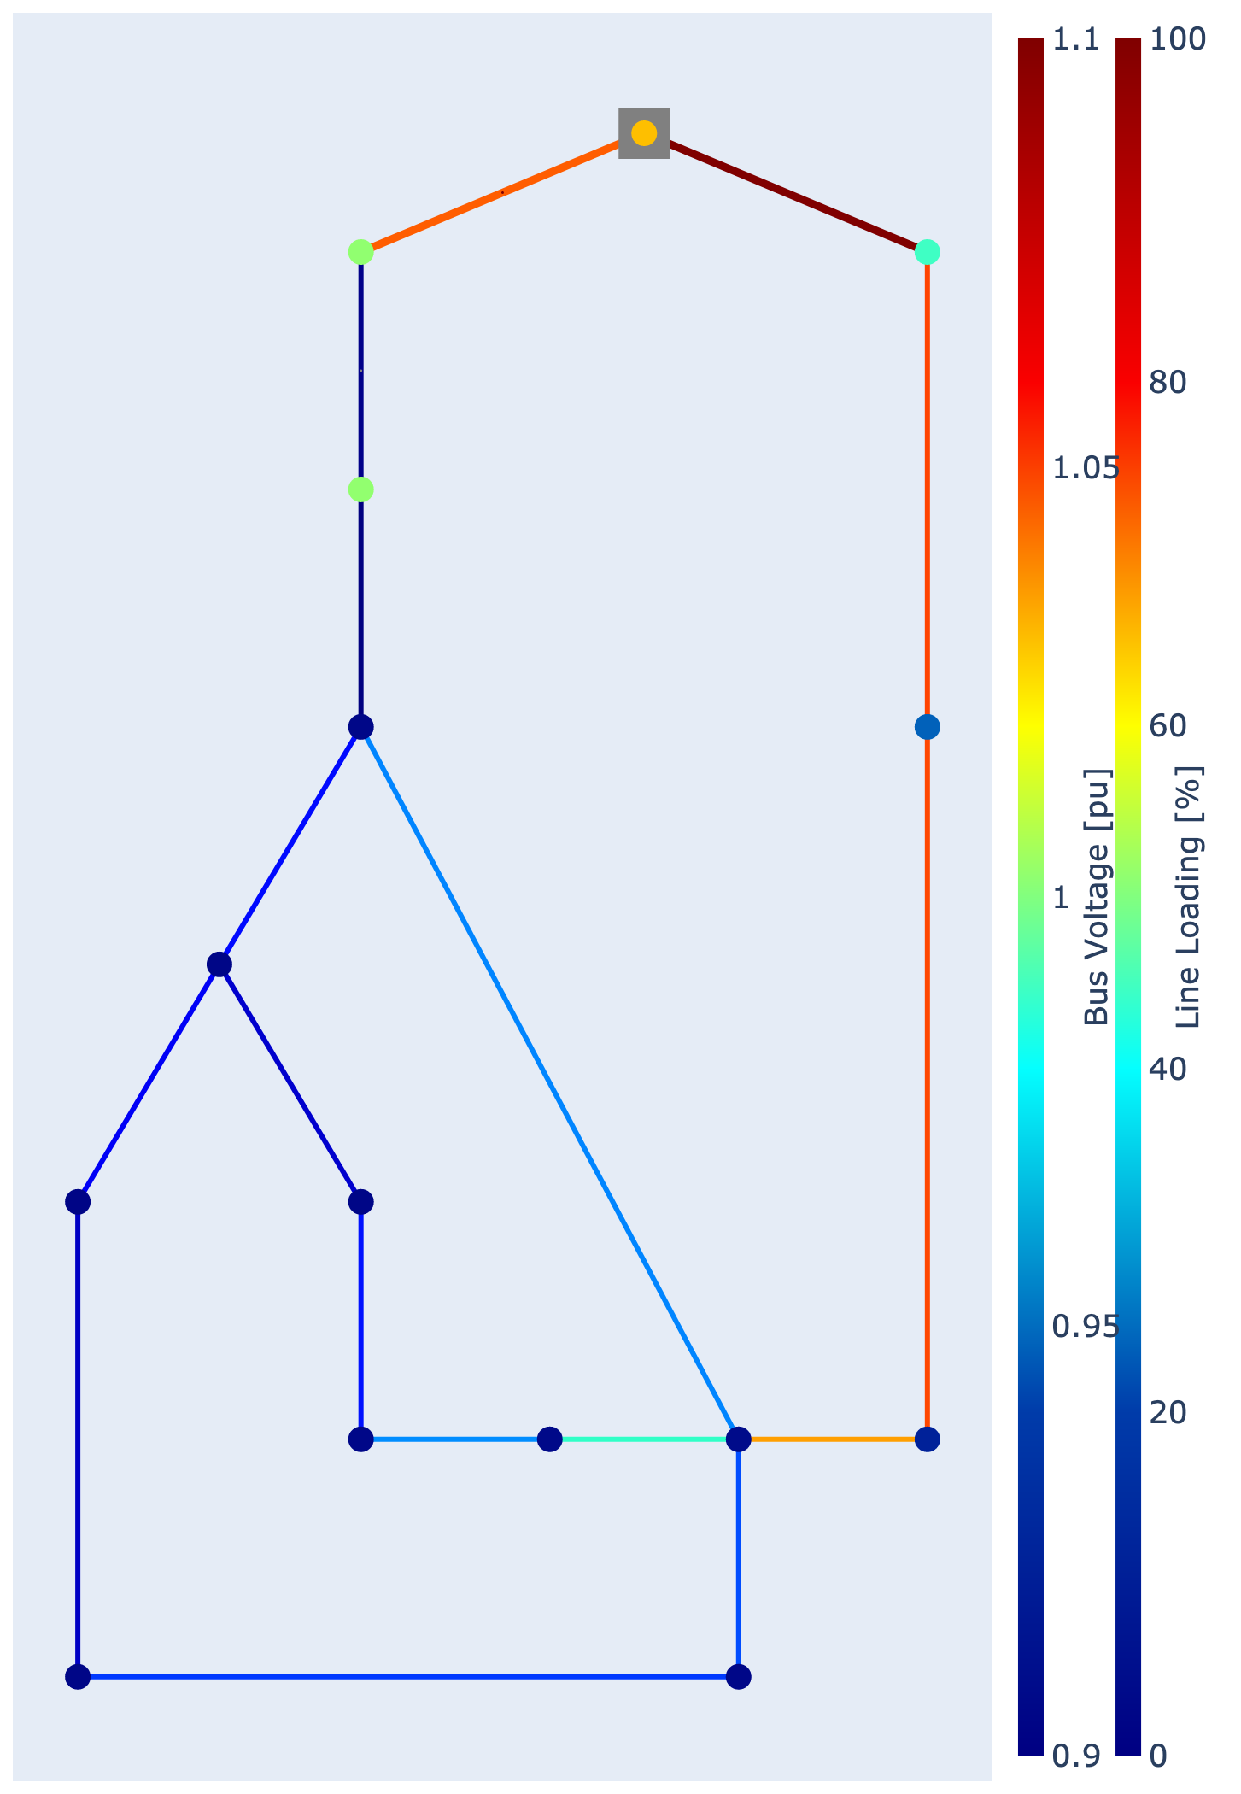
N-1 analysis: critical cases
Excluding line 1:
closing all switches
max line loading = 84%
overloaded trafo
11 buses below 0.95, all above 0.9

Slide 9
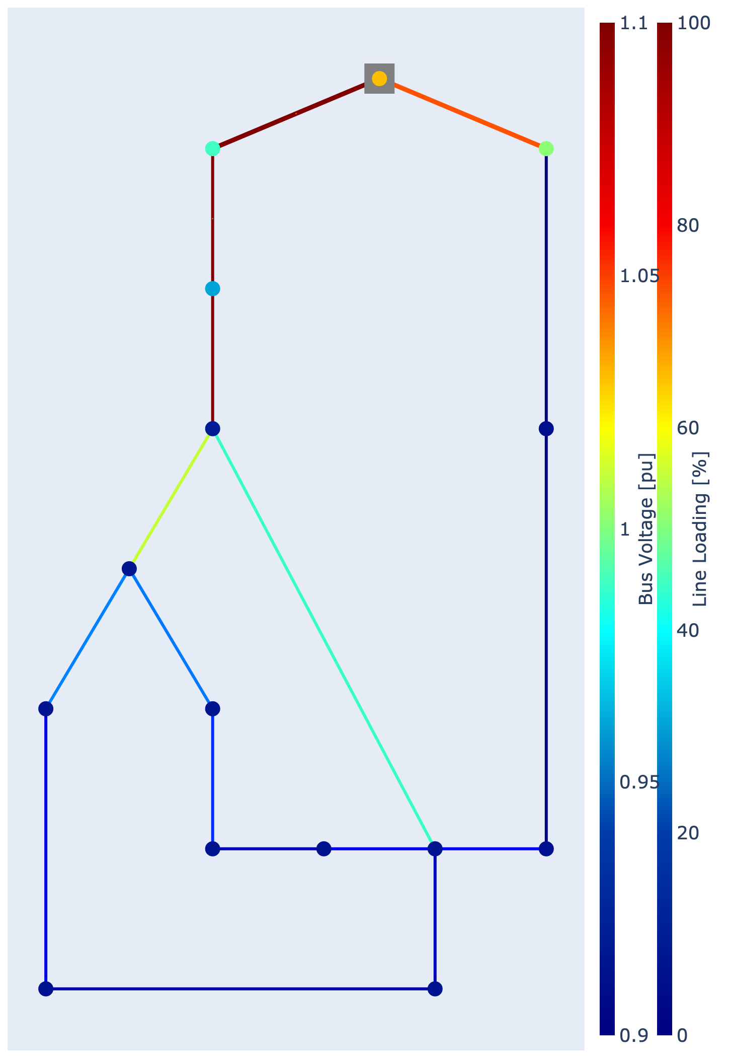
N-1 analysis: critical cases
Excluding line 10:
leads to overloaded lines and trafo for all switch configurations
11 buses are below 0.95, all above 0.9
need to close S1 to supply Feeder 2

Slide 10
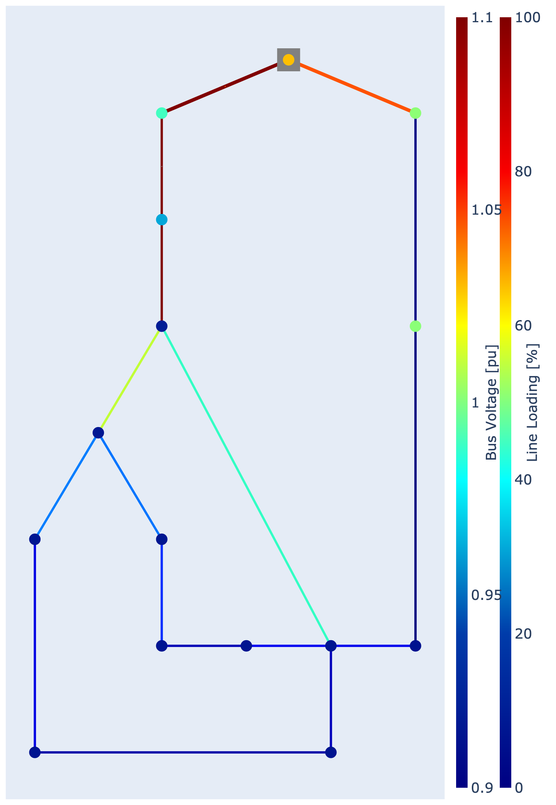
N-1 analysis: critical cases
Excluding line 11:
leads to overloaded lines and trafo for all switch configurations
10 buses below 0.95, all above 0.9
need to close S1 to supply Feeder 2

Slide 11
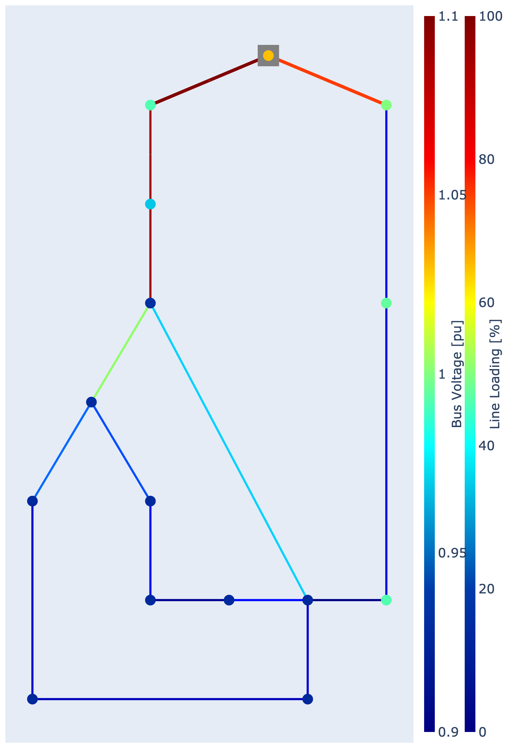
N-1 analysis: critical cases
Excluding line 14 (switch S1):
basically the same as the inital state of the network (overloaded trafo)
no critical lines
9 buses below 0.95, all above 0.9
switch configuration negligble

Slide 12
N-1 analysis: Summary
Focus on two very critical scenarios
Line 0 or 1 excluded -> Feeder 1 not supplied unless S1 is closed
Line 10 or 11 excluded -> Feeder 2 not supplied unless S1 is closed
Close all switches in these scenarios
Excluding line 14 not as big of a problem when considering timeseries
Notes:
0 and 1 are very similar
10 and 11 are very similar

Slide 13
Step 2: Adding CS
Add explanation for initial trafo placement and size
Show results of step 2 -> network picture, colormap of peak hour, subplot-plot
Add some conclusion

Slide 14
Different cases
Max case
Start with some location and highest power trafos
Go through steps 3 and 4
Iterate positions and power of the transformars based on results

Slide 15
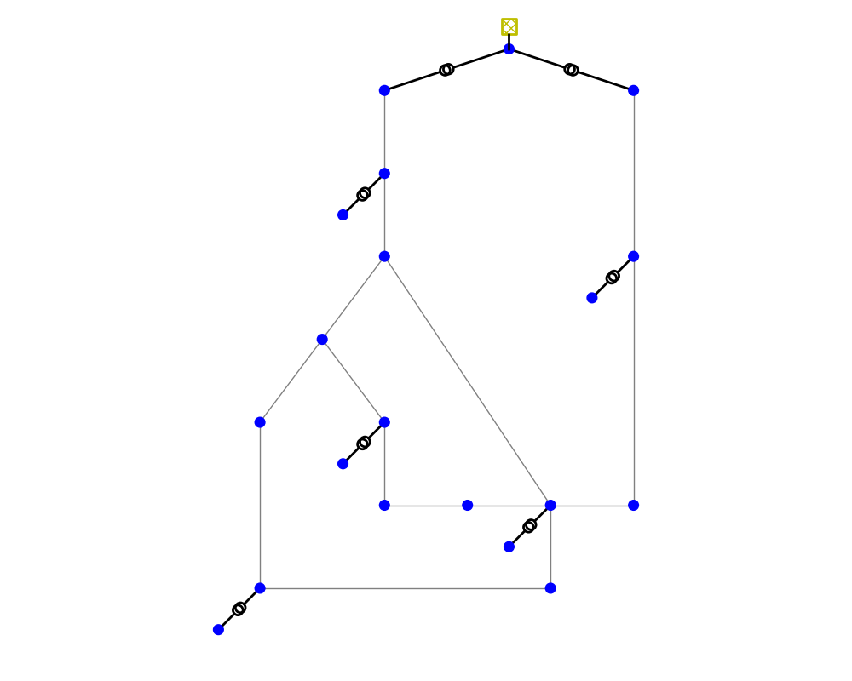
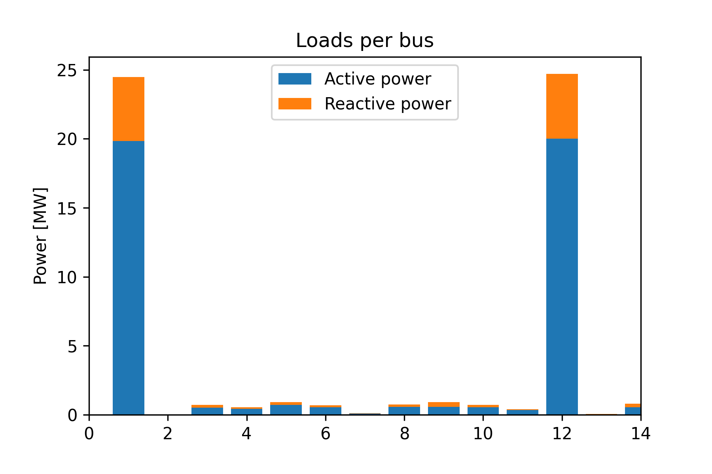
Adding CS
Connected to buses 2, 6, 8, 11, 13
Start with all at highest available power (0.63 MVA)
Notes:
2 instead of 3 due to critical case
Evenly distributed around the grid
6, 8, 11 are in residential areas

Slide 16
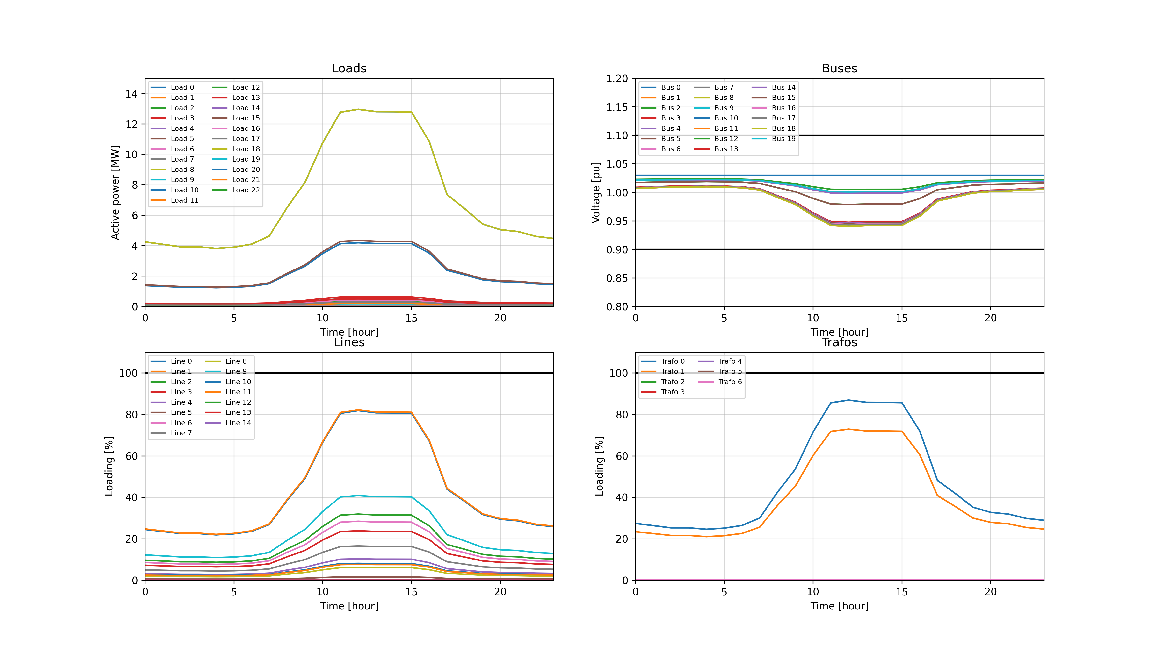
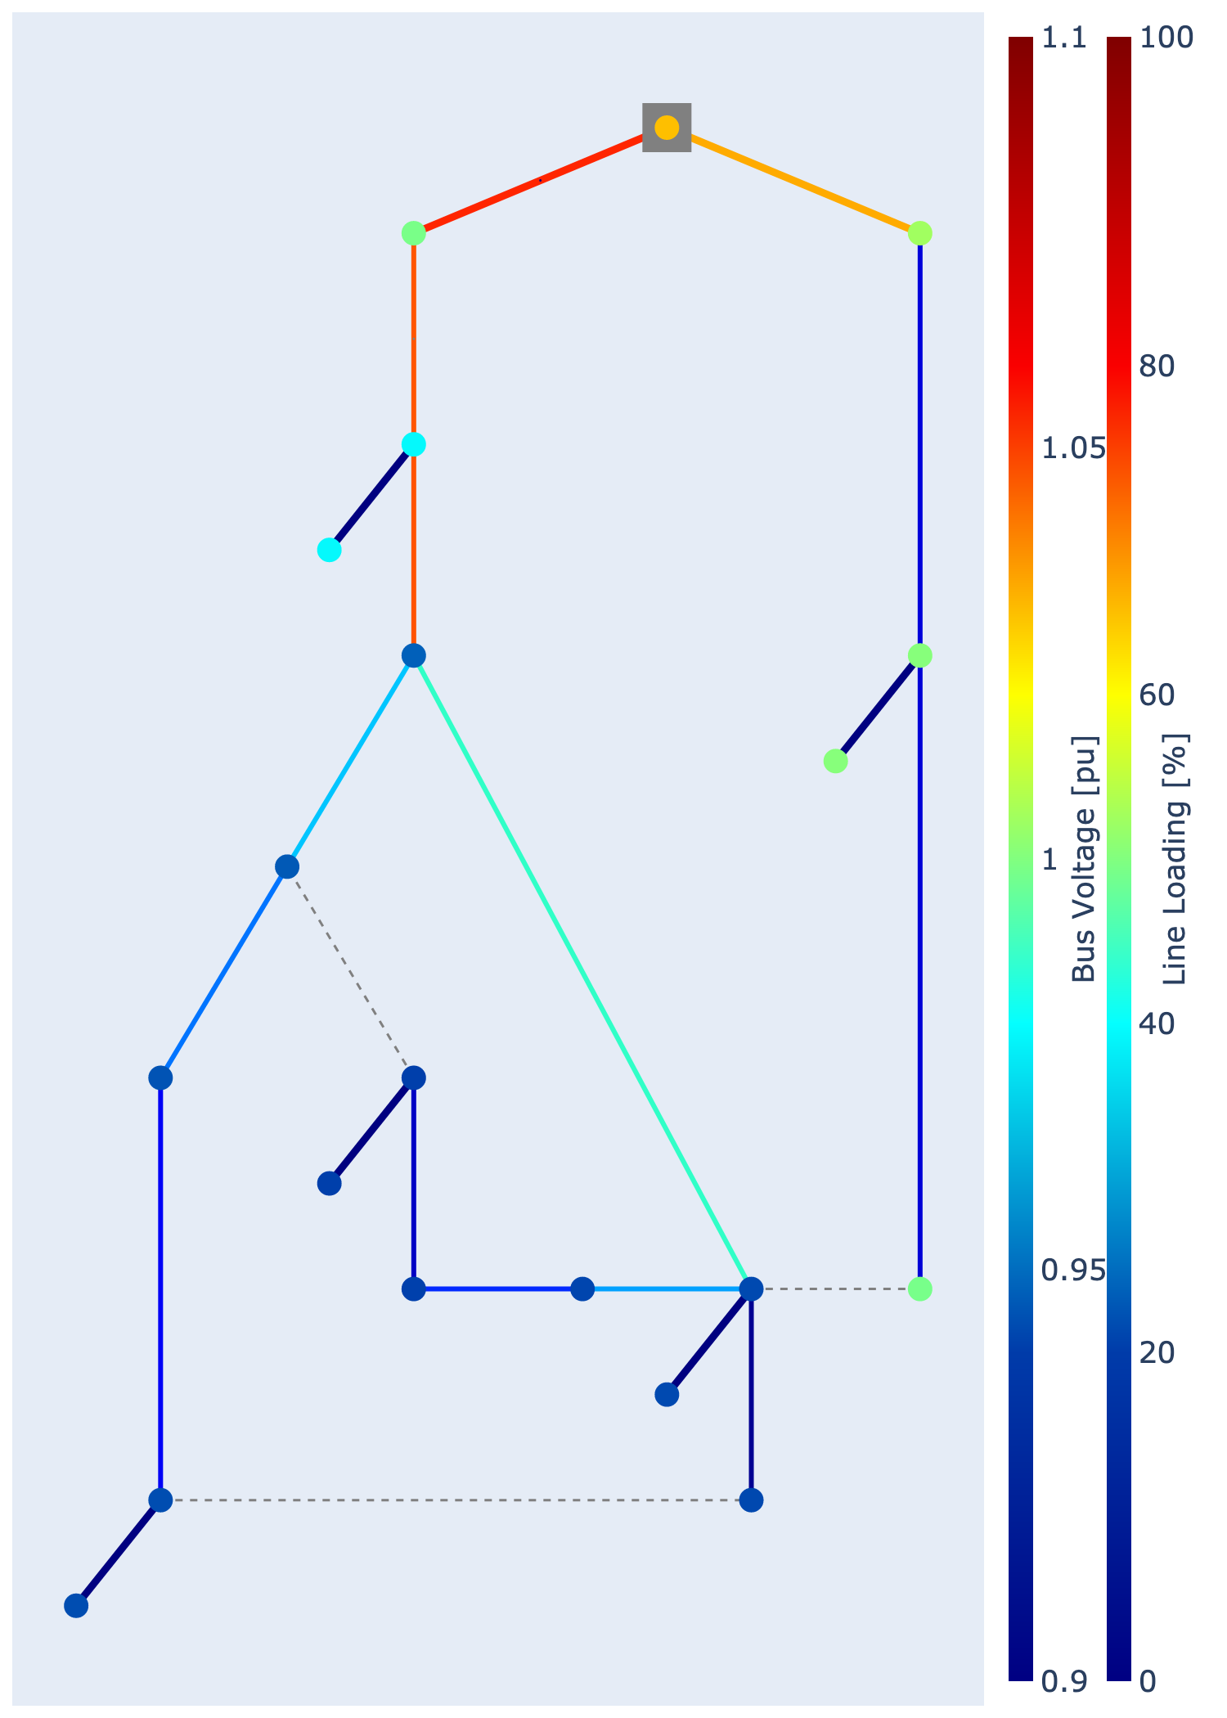
Adding CS
At peak hour = 12:
Notes:
Adding the CS without any load does not change anything for the existing buses/lines

Slide 17
Step 3: Adding EVs
Choose peak day and convert to hourly
Set number of EVs, randomly pick profiles and add them together based on given allocation
With all lines:
results for some n_ev
results for max n_ev
In N-1 case:
consider critical scenarios as in 1.2
results for max n_ev
results for max_n-1 case
Explain the results

Slide 18
Adding EVs: Preparation
10-minute interval charging profiles, full year
pick max value per hour
1-hour interval charging profiles, full year
pick day with max sum(all loads that day)
day_id = 199 => 19.07.
1-hour interval charging profiles, peak_day

Slide 19
Adding EVs: Allocation
Choose n_ev and n_ev_cs
e.g. n_ev = 100, n_ev_cs = [10,20,30,15,25]
Randomly pick n_ev profiles (without repetitions if n_ev < 349)
Allocate the first n_ev_cs[0] to CS1 and so on
Allocate = sum loadshapes of all profiles and a load with that loadshape to the low voltage bus of the corresponding CS

Slide 20
Adding EVs: Checking critical N-1 cases
For lines 0, 10
Remove line
Close all switches, n_ev = max n_ev
Run time series
Collect results and adjust n_ev

Slide 21
Adding 300 EVs

Slide 22
Adding max EVs
Case 1: increase and leave evenly distributed
Case 2: distributed oddly

Slide 23
N-1 for max n_ev

Slide 24
N-1 with decreased n_ev to stay within limits

Slide 25
Step 4: 115% case
Add 115% of Evs
Check results to find weak links (without any modification)
How can we improve the network? Why is that reasonable? What are the results after the improvement?
Choose different profiles / load optimization
Reinforce grid
Change transformers

