Slide 1
Visual Studio Code
“Full” Renesas Use Case
Heterogenous
Multiple Vendors
Single unified interface to all processes
Multi-context Debug Adaptor Protocol (DAP)
3rd Party Debug Adaptor Protocol (DAP)
3rd Party Debug Adaptor Protocol (DAP)
Renesas Debug Adaptor Protocol (DAP)
Renesas Debug Adaptor Protocol (DAP)
3rd Party Debug Adaptor Protocol (DAP)
ARM GDB
IMP-X GDB
RH850 GDB
We need to support 3rd party DAP components for IP used in Renesas parts.
The new multi-context DAP should also support loading 0, one or more DAP and using these too.
Renesas GDB Server
Renesas GDB Server
TCP/IP connection
TCP/IP connection
E2 emulator
USB
Linux GDB Server
SDB
SOC Target System

Slide 2
Visual Studio Code
“Simplified” Use Case
No hardware needed
Useful to explore problem space
Single unified interface to all processes
CDT Amalgamator (DAP)
CDT GDB Adapter (DAP)
CDT GDB Adapter (DAP)
Host GDB
Host GDB
Process 1
(empty1.exe)
Process 2
(empty2.exe)
SOC Target System
(Host Windows/Linux)

Slide 3
Visual Studio Code
Today’s State
Multiple independent debugs
Each needs to be launch/stopped independently
VS Code provides “compounds” to simplify launching
Single Process config using cdt-gdb-vscode
{
"type": "gdb",
"request": "launch",
"name": "proc1",
"program": "${workspaceFolder}/empty1.exe",
"verbose": true
} {
"type": "gdb",
"request": "launch",
"name": "proc2",
"program": "${workspaceFolder}/empty2.exe",
"verbose": true
}
"compounds": [
{
"name": "proc1 + proc2",
"configurations": [ "proc1", "proc2" ]
}
]
CDT GDB Adapter (DAP)
CDT GDB Adapter (DAP)
Host GDB
Host GDB
Process 1
(empty1.exe)
Process 2
(empty2.exe)
SOC Target System
(Host Windows/Linux)

Slide 4
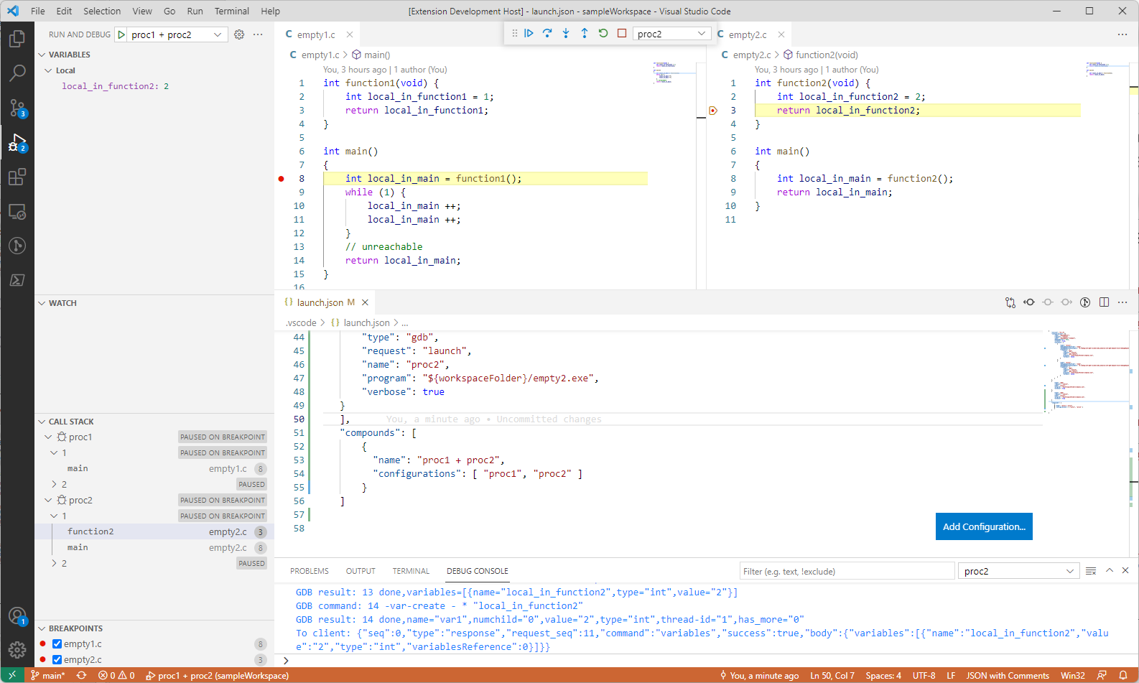
Visual Studio Code
Today’s State
Multiple independent debugs
Each needs to be launch/stopped independently
VS Code provides “compounds” to simplify launching
CDT GDB Adapter (DAP)
CDT GDB Adapter (DAP)
Host GDB
Host GDB
Process 1
(empty1.exe)
Process 2
(empty2.exe)
SOC Target System
(Host Windows/Linux)

Slide 5
Visual Studio Code
“Simplified” Use Case
No hardware needed
Useful to explore problem space
Single unified interface to all processes
CDT Amalgamator config
{
"type": "amalgamator",
"request": "launch",
"name": "Amalgamator Example",
"children": [
{
"name": "proc1",
"debugAdapterRuntime": "node",
"debugAdapterExecutable": "cdt-gdb-adapter.js",
"arguments": {
"program": "${workspaceFolder}/empty1.exe",
}
},
{
"name": "proc2",
"debugAdapterRuntime": "node",
"debugAdapterExecutable": "cdt-gdb-adapter.js",
"arguments": {
"program": "${workspaceFolder}/empty2.exe",
}
}
]
}
CDT Amalgamator (DAP)
CDT GDB Adapter (DAP)
CDT GDB Adapter (DAP)
Host GDB
Host GDB
Process 1
(empty1.exe)
Process 2
(empty2.exe)
SOC Target System
(Host Windows/Linux)

Slide 6
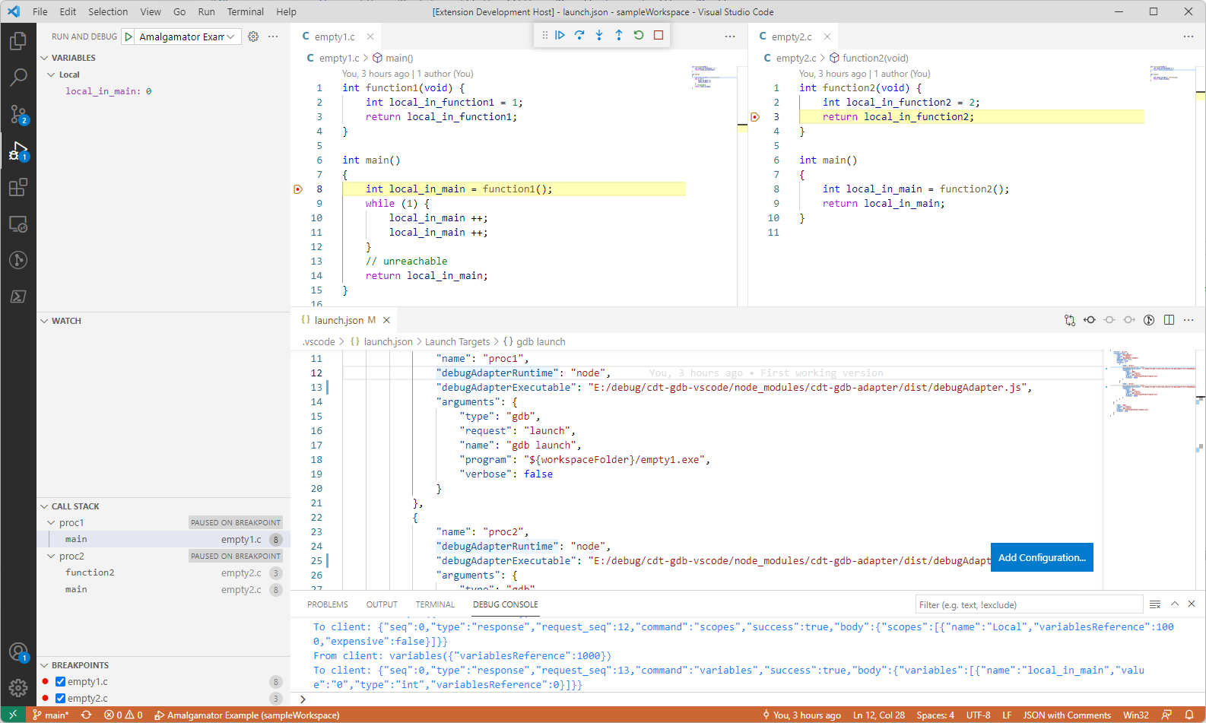
Visual Studio Code
“Simplified” Use Case
No hardware needed
Useful to explore problem space
Single unified interface to all processes
CDT Amalgamator (DAP)
CDT GDB Adapter (DAP)
CDT GDB Adapter (DAP)
Host GDB
Host GDB
Process 1
(empty1.exe)
Process 2
(empty2.exe)
SOC Target System
(Host Windows/Linux)

Slide 7
Visual Studio Code
“Full” Renesas Use Case
Heterogenous
Multiple Vendors
Single unified interface to all processes
Renesas Amalgamator (DAP)
Possible Rensas Amalgamator config
{
"type": "renesas-amalgamator",
"request": "launch",
"name": "Renesas SOC Launch",
"board": "SOC Target System",
"children": [
{
"deviceid": "arm1+imp",
"program": "${workspaceFolder}/main.elf",
"imp": "${workspaceFolder}/imageproc.elf",
},
{
"deviceid": "rh850",
"program": "${workspaceFolder}/rh.elf",
}
]
}
The Renesas Amalgamator knows which debug adapter + connection settings, gdb, gdbserver, etc to use based on combination of “board” and “deviceid” fields. Just like it does today in e2studio (Eclipse CDT).
Renesas Debug Adaptor Protocol (DAP)
Renesas Debug Adaptor Protocol (DAP)
ARM GDB
IMP-X GDB
RH850 GDB
Renesas GDB Server
Renesas GDB Server
TCP/IP connection
TCP/IP connection
E2 emulator
USB
Linux GDB Server
SDB
SOC Target System

Slide 8
Visual Studio Code
“Simplified” Use Case
No hardware needed
Useful to explore problem space
Single unified interface to all processes
CDT Amalgamator config
{
"type": "amalgamator",
"request": "launch",
"name": "Amalgamator Example",
"children": [
{
"name": "proc1",
"debugAdapterRuntime": "node",
"debugAdapterExecutable": "cdt-gdb-adapter.js",
"arguments": {
"program": "${workspaceFolder}/empty1.exe",
}
},
{
"name": "proc2",
"debugAdapterRuntime": "node",
"debugAdapterExecutable": "cdt-gdb-adapter.js",
"arguments": {
"program": "${workspaceFolder}/empty2.exe",
}
}
]
}
CDT Amalgamator (DAP)
CDT GDB Adapter (DAP)
CDT GDB Adapter (DAP)
CDT Amalgamator First Working Version:
https://github.com/jonahgraham/cdt-amalgamator
Host GDB
Host GDB
Process 1
(empty1.exe)
Process 2
(empty2.exe)
SOC Target System
(Host Windows/Linux)

Slide 9
Visual Studio Code
“Simplified” Use Case
No hardware needed
Useful to explore problem space
Demo Time!
CDT Amalgamator config
{
"type": "amalgamator",
"request": "launch",
"name": "Amalgamator Example",
"children": [
{
"name": "proc1",
"debugAdapterRuntime": "node",
"debugAdapterExecutable": "cdt-gdb-adapter.js",
"arguments": {
"program": "${workspaceFolder}/empty1.exe",
}
},
{
"name": "proc2",
"debugAdapterRuntime": "node",
"debugAdapterExecutable": "cdt-gdb-adapter.js",
"arguments": {
"program": "${workspaceFolder}/empty2.exe",
}
}
]
}
Single unified interface to all processes
CDT Amalgamator (DAP)
CDT GDB Adapter (DAP)
CDT GDB Adapter (DAP)
Host GDB
Host GDB
Process 1
(empty1.exe)
Process 2
(empty2.exe)
SOC Target System
(Host Windows/Linux)

