Slide 1
COLLEGE EVENT MANAGEMENT & QUIZ WEBSITE FOR CHESA
FIRST LEVEL REVIEW
PRESENTED BY:
JIJO.S. JOSE (2301150762)
AROMAL.BS (2301150758)
ABHAY KRISHNA SD (2301150877)
MANU M (2301150764)
MILAN S MANOJ ( 2301150765)

Slide 2
Project Abstract
A web-based platform to streamline the organization, participation, and management of college events and quizzes. It reduces manual work, enhances transparency, and ensures secure handling of student data, event records, and certificates.

Slide 3
Problem Statement & Motivation
Manual event handling causes delays and errors.
Certificates distributed manually are prone to loss or duplication.
Alumni and public engagement is limited.
Need for a centralized, secure, and transparent event/quiz management system.

Slide 4
Objectives
Provide a centralized system for event and quiz management
Enable secure student registrations and profile management
Auto-generate certificates with QR-based verification
Facilitate alumni and public engagement
Generate analytical reports for decision-making

Slide 5
Key Features
Event & Quiz Management (with real-time scoring)
Certificate Management (QR-based verification)
Student Dashboard (My Events, My Quizzes, Certificates)
Year-wise Gallery System
Role-based Feedback Collection
Responsive Design with Dark Mode

Slide 6
User Roles & Permissions
Students: Register, view certificates, give feedback, Attend Quiz and get certificates
Coordinators: Manage events, quizzes, and students
Public Visitors: View events, verify certificates
Alumni: Access past events, placements, give feedback

Slide 7
System Modules
Homepage & Navigation
Event Management
Quiz Management
Certificate Management
Gallery System
Feedback System
Reports & Analytics

Slide 8

Journal Review – Summary of Papers
10 research papers reviewed covering event systems, quiz automation, certificate verification, student portals, and cloud-based solutions.

Slide 9
Reviewed Research Papers
No. | Title / Contribution | Limitation
1 | Certificate Validation using Secure Computing (Blockchain-based certificates) | High computational cost
2 | Web-Based Student Info management System (UML-driven design, black-box testing) | Focus only on info management
3 | Performance Optimization using MERN (Scalable MERN stack web apps) | Focus on e-commerce
4 | Student Management System (Database-driven student records) | Limited online integration
5 | Certificate Verification System (Secure QR-based verification) | Single-module focus
6 | Student Information Portal (Online student accessibility) | Basic, lacks automation
7 | Academic Information System (Data storage & retrieval) | No event/quiz workflows
8 | Student Data Verification Portal (Verification and data mgmt) | Narrow scope
9 | Blockchain-Based Certificates (Tamper-proof academic records) | Prototype, low adoption
10 | Cloud-Based Event Mgmt Systems (Scalable event registration) | Doesn’t cover quizzes/certs

Slide 10
GAP IDENTIFIED
Existing works focus on individual modules.
Few integrate quizzes with event management.
Lack of automation in certificate generation & verification.
Limited alumni & public engagement.

Slide 11
System Architecture
Frontend: HTML5, CSS3, JavaScript, Bootstrap5
Backend : Django
Database: Sqlite3
Deployment : PythonAnywhere

Slide 12
Sample Code - Backend (Django)
from django.shortcuts import render,redirect
from django.contrib import messages
from django.contrib.auth import authenticate,login,logout
from django.contrib.auth.models import User
from Coordinator.models import Events,Gallery,Mcq,Question ,Profile
from django.db.models import Max
# Create your views here.
def index(request):
content = {
"events":Events.objects.all()[:10],
"galleries":Gallery.objects.filter(id__in=Gallery.objects.values('gallery_type').annotate(last_id=Max('id')).values('last_id'))
}
return render(request,"unauth/index.html",content)
def userlogin(request):
if request.method == "POST":
username = request.POST.get("username")
password = request.POST.get("password")
user = authenticate(request,username=username,password=password)
if user is not None:
if user.is_superuser:
if Profile.objects.filter(user=user).exists():
pass
else:
Profile.objects.create(user=user)
login(request,user)
messages.success(request,"You are logged in")
return redirect("coordinator:dashboard")
elif user.is_staff:
if Profile.objects.filter(user=user).exists():
pass
else:
Profile.objects.create(user=user)
login(request,user)
messages.success(request,"You are logged in")
return redirect("student:student")
else:
messages.error(request,"wait for admin approval")
return redirect("coordinator:userlogin")
else:
if User.objects.filter(username=username).exists():
messages.error(request,"Password is incorrect")
return redirect("coordinator:userlogin")
else:
messages.error(request,"Username does not exist")
return redirect("coordinator:userlogin")
return render(request,"unauth/login.html")

Slide 13
Sample Code - Registration Form
<form method="POST">
{% csrf_token %}
<!-- Full Name -->
<div class="mb-3">
<label for="name" class="form-label">Full Name</label>
<input type="text" class="form-control" name="name" id="name" placeholder="Enter your full name" required>
</div>
<!-- Email -->
<div class="mb-3">
<label for="email" class="form-label">Email Address</label>
<input type="email" class="form-control" name="email" id="email" placeholder="Enter your email" required>
</div>
<!-- Password -->
<div class="mb-3">
<label for="password" class="form-label">Password</label>
<div class="input-group">
<input type="password" class="form-control" name="password" id="password" placeholder="Enter password" required>
<span class="password-toggle" onclick="togglePassword('password')">
<i class="fas fa-eye"></i>
</span>
</div>
</div>
<!-- Confirm Password -->
<div class="mb-3">
<label for="confirmPassword" class="form-label">Confirm Password</label>
<div class="input-group">
<input type="password" class="form-control" name="confirmPassword" id="confirmPassword" placeholder="Confirm password" required>
<span class="password-toggle" onclick="togglePassword('confirmPassword')">
<i class="fas fa-eye"></i>
</span>
</div>
</div>
<!-- Submit Button -->
<div class="d-grid">
<button type="submit" class="btn btn-primary btn-lg">Register</button>
</div>
<!-- Link to Login -->
<p class="text-center mt-3">
Already have an account? <a href="{% url 'coordinator:userlogin' %}" style="color: #6a11cb; text-decoration: none;">Login here</a>
</p>
</form>

Slide 14
Sample Code - Login Form
<form method="POST">
{% csrf_token %}
<!-- Username -->
<div class="mb-3">
<label for="username" class="form-label">Username</label>
<input type="text" class="form-control" name="username" id="username" placeholder="Enter your username" required>
</div>
<!-- Password -->
<div class="mb-3">
<label for="password" class="form-label">Password</label>
<div class="input-group">
<input type="password" name="password" class="form-control" id="password" placeholder="Enter password" required>
<span class="password-toggle" onclick="togglePassword('password')">
<i class="fas fa-eye"></i>
</span>
</div>
</div>
<!-- Submit Button -->
<div class="d-grid">
<button type="submit" class="btn btn-primary">Login</button>
</div>
<!-- Link to Register -->
<p class="text-center mt-3">
Don’t have an account? <a href="{% url 'coordinator:userregister' %}" style="color: #6a11cb; text-decoration: none;"> Register</a>
</p>
</form>

Slide 15
Sample Code - Add Event Form
<form method="POST" enctype="multipart/form-data">
{% csrf_token %}
<input type="hidden" name="add_event" value="1">
<div class="modal-header">
<h5 class="modal-title"><i class="fas fa-plus-circle me-2"></i>Add New Event</h5>
<button type="button" class="btn-close btn-close-white" data-bs-dismiss="modal" aria-label="Close"></button>
</div>
<div class="modal-body">
<div class="mb-3">
<label class="form-label">Event Name</label>
<input type="text" class="form-control" name="event_name" required>
</div>
<div class="row">
<div class="col-md-6 mb-3">
<label class="form-label">Date</label>
<input type="datetime-local" class="form-control" name="event_date" required>
</div>
<div class="col-md-6 mb-3">
<label class="form-label">Location</label>
<input type="text" class="form-control" name="event_location" required>
</div>
</div>
<div class="mb-3">
<label class="form-label">Event Question</label>
<select class="form-select" name="event_type">
<option value="">-- Select Type --</option>
{% for i in MCQ %}
<option value="{{i.mcq_title}}">{{i.mcq_title}}</option>
{% endfor %}
</select>
</div>
<div class="mb-3">
<label class="form-label">Description</label>
<textarea class="form-control" rows="4" name="event_description" required></textarea>
</div>
<div class="mb-3">
<label class="form-label">Event Image</label>
<input type="file" class="form-control" name="event_image" required>
</div>
</div>
<div class="modal-footer">
<button type="button" class="btn btn-secondary" data-bs-dismiss="modal">Cancel</button>
<button type="submit" class="btn btn-primary">Save Event</button>
</div>
</form>

Slide 16
Expected Outcomes
Improved efficiency in event/quiz management
Secure and authentic certificate distribution
Increased alumni and public engagement
Accessible and user-friendly platform
Data-driven insights for future planning

Slide 17
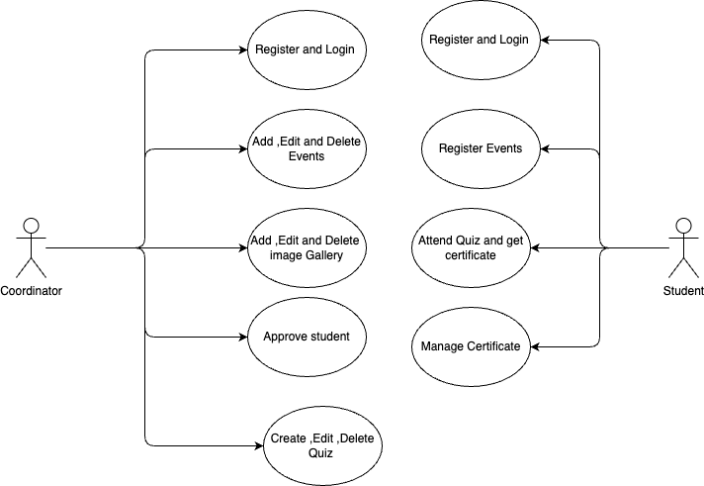
Use Case Diagram

Slide 18
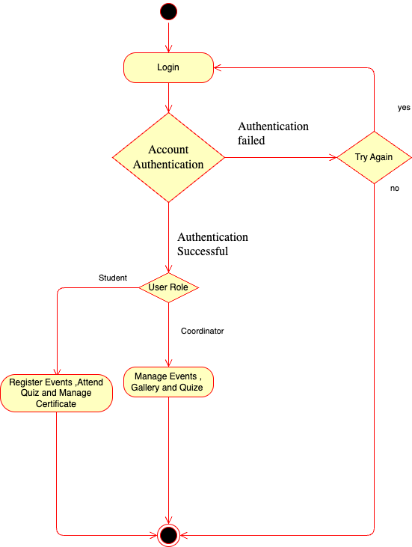
Activity Diagram

Slide 19
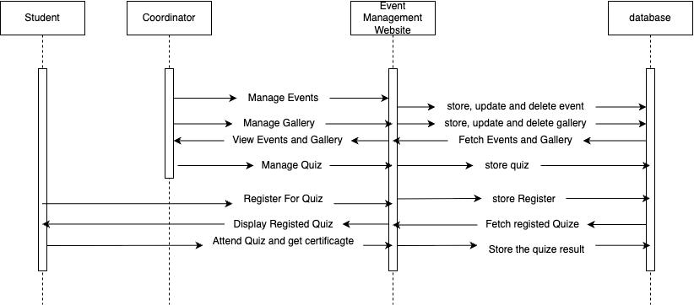
Sequence Diagram

Slide 20

Future Enhancements
Mobile application
AI-based quiz generation
Integration with placement & alumni database

Slide 21
Conclusion
The project provides a scalable, secure, and efficient solution for event & quiz management.
It addresses current limitations and is ready for next phase.

Slide 22
Thank you

