Slide 1

My Capstone Project
- Jonah Kelly

Slide 2
About the project
Webots is an application that is used for robot simulations before they get implemented in real life.
Programming Language that is high performance and reliable
The goal of the project is to have a drone that balances itself and to correctly implement the users' commands

Slide 3
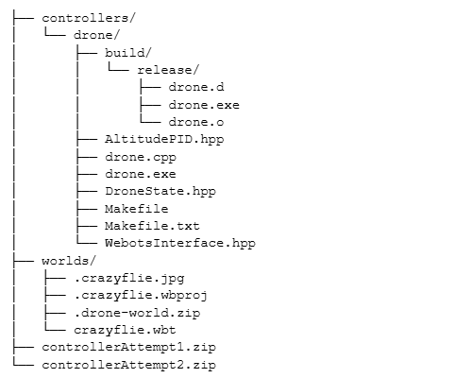
Code hierarchy
Main File

Slide 4
Thrust calculations, put the graphs from the data

Slide 5
Biggest Challenges

