Slide 1

CSCI E-96 Data Mining, Discovery and Exploration Online Algorithms and Steaming Analytics, Part 1
Steve Elston
Copyright 2021, 2022, 2023, 2024, 2025, 2026, Stephen F Elston. All rights reserved.

Slide 2
Main topics in this course
The main topics in this course are interconnected and build on each other
1. Hashing and K-V pair management
2. Distance and Similarity Metrics
3. Graph Algorithms
Foundations
Core Algorithms
2. Dimensionality Reduction
5. Similarity Search and NN Algorithms
4. Online Algorithms
3. Social Network Analysis
6. Web/Document ranking and search
7. Recommender Algorithms
8. Clustering Algorithms
Taks Speific Algorithms

Slide 3
Massive Scale and Online Analytics
Are analytics always computed in batch?
No!
Data often arrives in massive volume streams, requiring online processing
IOT/Sensor data – many applications
Capital markets data
E-commerce click streams and purchases
Emails, social media posts, etc.
Logistics information
Agricultural data
Internet packet streams for cybersecurity
Etc.
Analytics updated as data samples arrives
We call these online analytic algorithms

Slide 4
Streaming Analytics
Do we always apply online analytics to real-time data?
No!
We apply online algorithms for analytics on beyond core memory size datasets
Data is processed in ‘chunks’
Example, read files one or a few lines at a time
Example, use a series of limited data base queries
Analytics updated for each chuck
We will use the terms streaming and online interchangeably

Slide 5
Streaming Analytics
Difficulties with streaming analytics
Example – small scale
US Geological Survey maintains about 13,500 stream gauges
Average of 4 types of sensors per station
Each measurement is 4 bytes - 16 bytes total per sample
Each gauge collects data sample every 15 mins
Data uploaded every 4 hours – 6 sets of measurements per day – 1,536 bytes
Total of 5.4 M bytes per day for network
2 G bytes per year for archive
But, network bandwidth is limited
Sensors often connected by point-to-point wireless connections

Slide 6
Streaming Analytics
Difficulties with streaming analytics
Data volumes can be massive
2nd Example – Large scale
Power generation company with 10⁶ solar panels and inverters
5 sensors with 4 bytes per sensor every 10 ms per inverter
1,7 x 10⁹ bytes per inverter per day
1.7 x 10¹⁵ bytes total per day = 1700 petabytes
Network bandwidth is limited

Slide 7
Streaming Analytics
Difficulties with streaming analytics
Streams are infinite with unlimited data volume
Results must be updated as new values arrive
How to treat older values?
How much should older values weight in the analytic results?
How much storage capacity is required for the history?
We can filter massive streams
Reduce volume of stream data for processing
Use filtered values to update analytics
Idea: compute and store only summary statistics
Massive reduction in volume

Slide 8
Streaming Analytics
What are the key points to learn in this lesson?
Massive dataset and infinite streams include both real-valued and discrete-valued (event) data
We must use probabilistic sketch (hash) algorithms to filter massive online datasets
Sketches (hashes) are used to perform streaming analytics within computation and memory limits for both real valued and discrete streams

Slide 9
Streaming Analytics
This lesson is divided into several parts
Sampling methods for reducing volume of real-valued streams
We cannot process or store all of the values in a stream
Use sampling methods to reduce volume to manageable level
Basic sampling and averaging
Probabilistic sampling – the reservoir sampling algorithm for unbiased sampling
Probabilistic hash or sketch methods for reducing volume and summarizing discrete events
Filtering discrete events to reduce volume – Bloom and quotient filters
Estimating event frequency – count-min-sketch algorithm for counting events
Estimating event cardinality –Hyperloglog algorithm
Probabilistic hash or sketch methods for quantile estimation to summarize real-valued streams
The t-digest and relative error quantile (REQ) sketch algorithms

Slide 10

Streaming Analytics
Useful book on algorithms for massive scale streaming analytics
Algorithms for Massive Datasets, Medjedovic, Tahirovic, and Dedovic, Manning, 2022

Slide 11
Streaming Pipelines

Slide 12
Streaming Analytics
Components of stream analytics
Multiple input streams – potentially different data types
Network bandwidth often limited
Real-time stream processor
Real-time stream analytics output
Limited working storage for real-time processing
Ad-Hoc query capability – typically limited
Limited long-term archival storage
Ad-Hoc
Queries
Processor
. . . 1, 5, 2, 7, 0, 9, 3
. . . a, r, v, t, y, h, b
. . . 0, 0, 1, 0, 1, 1, 0
time
Streams Entering.
Each is stream is composed of elements/tuples
Standing
Queries
Output
Limited
Working
Storage
Archival
Storage

Slide 13
Processing of Stream Data
Push most processing to the periphery of network
Network bandwidth is major limitation for large networks
Consider IoT application with 100,000 sensors
At 1 sec sampling interval reporting rate is 360 M samples (messages) per hour
Statistic aggregated to 10 min reporting rate is 600 K samples (messages) per hour
Many peripheral devices have considerable processing power
We can take advantage of the idle capacity
Greatly reduce load on networks and central processing

Slide 14




Volume Reduction and Streaming Analytics
Reducing stream data volume is key to providing real-time analytics
Streams can be filtered and sampled near the source
Further filtering, sampling and sketching performed as preprocessing for analytics
Data Source
Filter/sample
Filter/sample/sketch
Stream analytic
Filter/sample/sketch
Stream analytic
Data Source
Filter/sample
$$⋮$$
$$⋮$$
$$⋮$$
$$⋮$$
Bandwidth limited network
Filter/sample/sketch
Stream analytic
Data Source
Filter/sample
Archival storage
Classical supervised and unsupervised ML
Server/Cloud
Minimum (filtered) data and analytics archived
Filtered streams and sketches used as input to classical ML

Slide 15
Case Study 1

Slide 16
Case Study 1: Telecom Fraud Detection
Goal: terminate calls from fraudulent accounts in real-time
Features
Call history
Phone characteristics
Payment history
Account types; individual, family, small business, corporate….
Etc.
Fraud detection algorithm
Train in batch
Terminate fraudulent calls in real time in < 1 sec - no billing record ‘residue’

Slide 17
Case Study 1: Telecom Fraud Detection
Model training
Ground truth is not known for 90-120 days
Must use delayed training data
Fraud patterns change quickly
Criminals constantly looking for greatest vulnerability
User behavior drifts with time

Slide 18
Case Study 1: Telecom Fraud Detection
Scaling
Training performed in batch – not time critical
Data size often larger than core memory
Realtime fraud detection
Move processing to edge – intercept communication between switch and billing system
Update blocked account/number list

Slide 19
Sketches as Approximate Representations

Slide 20
Sketches As Approximate Representations
For infinite streams we must accept a sketch as an approximate representation
Cannot store all history of streams in main memory!
At large scale infinite streams will fill any disk array!
Ideal sketch algorithms have three properties
Small memory footprint
Computationally efficient to construct
Approximation has bounded error
There is enviable tradeoff between the three dimensions of low memory use, computational efficiency and error
Example, we can usually improve accuracy at the expense of memory

Slide 21
Sketches As Approximate Representations
For infinite streams we must accept a sketch as an approximate representation
Sketches for real-valued streams
Reservoir sampling
Quantile estimation
Sketches for discrete valued streams
Occurrence
Counts
Cardinality

Slide 22
Sketch Software
Sketch algorithms can be found in several Python packages
The Apache DataSketches package is an enterprise-grade sketch package with Python, C++, and Java APIs
Integrated with enterprise platform, Google BigQuery, Apache SPARK
Python API is a bit incomplete and inconsistent
Packages that implement sketch algorithms specifically with a Python API
PyProbables
DataSketch
Numerous specialized or single algorithm packages

Slide 23
Basic Sampling and Filtering

Slide 24
Filtering and Sketching Real Valued Streams
Cannot store all history of streams in main memory!
Need a better approach
Some ideas:
Delta coding: Only update when there is substantial change
Moving window: Compute statistic for each window position
Decay window: compute statistic down-weighting older event values
Reservoir sampling: compute statistic from a random sample of the stream

Slide 25
Volume Reduction and Streaming Analytics
Event stream algorithms are both filters and analytics
Streams can be filtered and sampled near the source
Further filtering, sampling and sketching performed as preprocessing for analytics
Data Source
Filter/sample
Filter/sample/sketch
Stream analytic
Filter/sample/sketch
Stream analytic
Data Source
Filter/sample
$$⋮$$
$$⋮$$
$$⋮$$
$$⋮$$
Bandwidth limited network
Filter/sample/sketch
Stream analytic
Data Source
Filter/sample
Archival storage
Classical supervised and unsupervised ML
Server/Cloud
Minimum (filtered) data and analytics archived
Filtered streams and sketches used as input to classical ML

Slide 26
Delta Coding
Delta coding only transmits and processes values with significant differences
Example: consider a large network of sensors (IoT)
Values at most sensors do not change most of the time
Example: Temperature has not changed significantly
Example: Nothing moving in or out of image
Example: Current in transmission line has not changed
Etc.
Delta coding restricts transmission, processing and storage to significant changes (deltas)
A threshold determines significance of change
Threshold values are solution specific

Slide 27
Delta Coding
Delta coding moves filtering and initial processing to periphery of network
Example: Measuring flow in pipe network
100,000 flow sensors sampling every 1-sec with +/-3% standard error
Example: Set threshold and only report if change more than +/-3% of moving average
Can reduce network traffic and processing by orders of magnitude
Example: Security camera watching gate
Image transmission expensive at raw 50-60 frames per second
Threshold on object greater than some number of pixels moving in frame
Reduces transmission, processing and storage by many orders of magnitude

Slide 28
Moving Window Analytics
Compute and store summary statistics from moving window
Need to update the analytic as new values received
Must maintain samples in a window
Move window by a stride, number of samples
On update
Add new observations to the end of window
Remove old observations from beginning of window
Compute and store new estimate of statistic
Algorithm requires recomputing statistics using all observations in the window in main memory
May not scale well

Slide 29
Moving Window Analytics
Compute and store summary statistics from moving window
... t₀ t₁ t₂ t₃ t₃ t₄ t₅ t₆ t₇ t₈ t₉ t₁₀ t₁₁ t₁₂ t₁₃ t₁₄ t₁₅ …
Streaming data values
Window sample the stream
Compute statistic from samples
Move window by a Stride
Repeat steps 1-3 indefinitely
Span of time window = 8
Stride = 4
Statistic value
Statistic value

Slide 30
Reservoir Sampling

Slide 31
Reservoir Sampling
How can we randomly sample from infinite streams to compute an analytic?
Why do we need random samples or probabilistic sampling algorithms?
Moving window samples only hold information for a finite time
Loose history
Exponential smoothing methods only works for certain statistics
We cannot derive closed form recursions for many statistics, e.g. median
Idea: use a random samples to create a sketch of the observations
Build a sketch representative of the full infinite stream
Updated random sample as new observations arrive
Note: Reservoir sampling is implemented in the Apache DataSketches package

Slide 32
Volume Reduction and Streaming Analytics
Event stream algorithms are both filters and analytics
Streams can be filtered and sampled near the source
Further filtering, sampling and sketching performed as preprocessing for analytics
Data Source
Filter/sample
Filter/sample/sketch
Stream analytic
Filter/sample/sketch
Stream analytic
Data Source
Filter/sample
$$⋮$$
$$⋮$$
$$⋮$$
$$⋮$$
Bandwidth limited network
Filter/sample/sketch
Stream analytic
Data Source
Filter/sample
Archival storage
Classical supervised and unsupervised ML
Server/Cloud
Minimum (filtered) data and analytics archived
Filtered streams and sketches used as input to classical ML

Slide 33
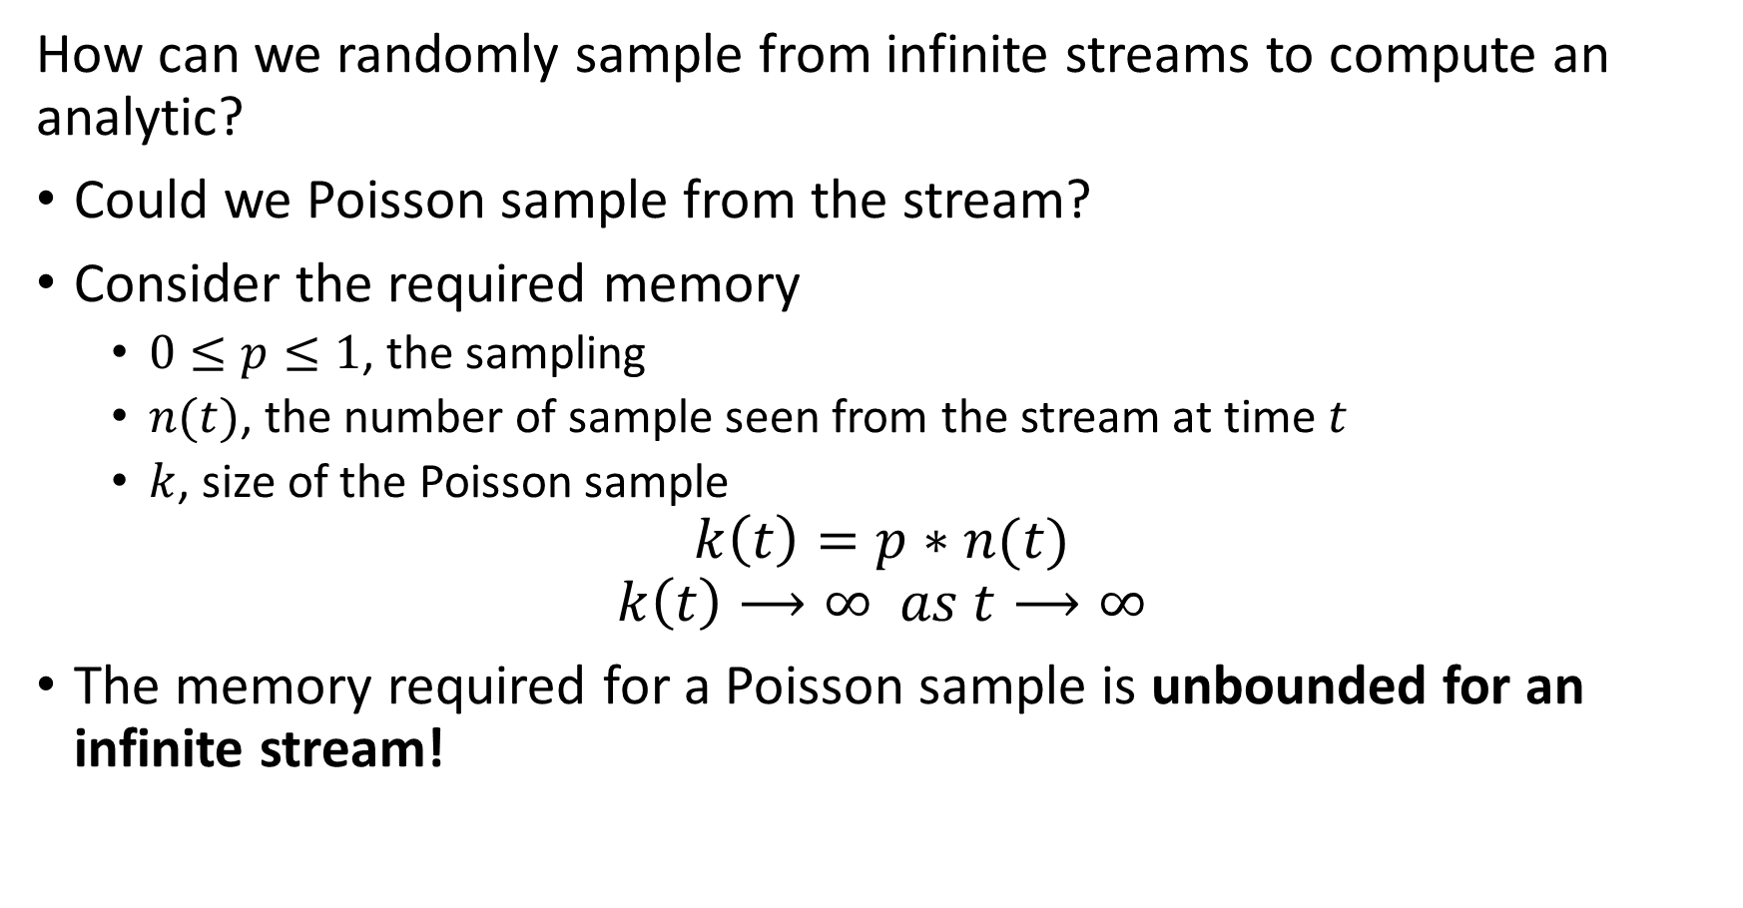
Reservoir Sampling
How can we randomly sample from infinite streams to compute an analytic?
Could we Poisson sample from the stream?
Consider the required memory
$0≤p≤1$, the sampling
$n(t)$, the number of sample seen from the stream at time $t$
$k$, size of the Poisson sample
$$k\left(t\right)=p∗n(t)$$
$$k\left(t\right)⟶∞ as t⟶∞$$
The memory required for a Poisson sample is unbounded for an infinite stream!

Slide 34
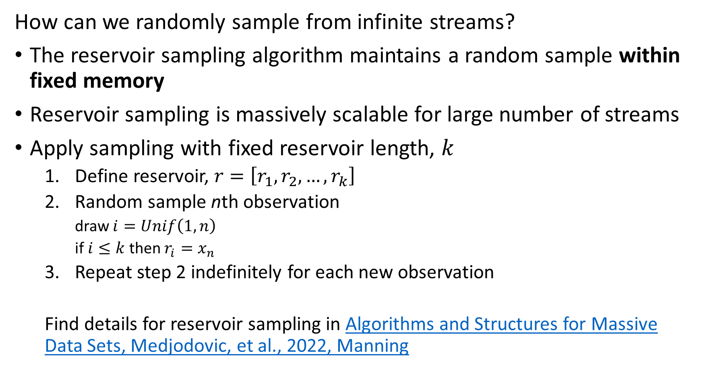
Reservoir Sampling
How can we randomly sample from infinite streams?
The reservoir sampling algorithm maintains a random sample within fixed memory
Reservoir sampling is massively scalable for large number of streams
Apply sampling with fixed reservoir length, $k$
Define reservoir, $r=\left[r_{1},r_{2},…,r_{k}\right]$
Random sample nth observation
draw $i=Unif\left(1,n\right)$
if $i≤k$ then $r_{i}=x_{n}$
Repeat step 2 indefinitely for each new observation
Find details for reservoir sampling in Algorithms and Structures for Massive Data Sets, Medjodovic, et al., 2022, Manning

Slide 35
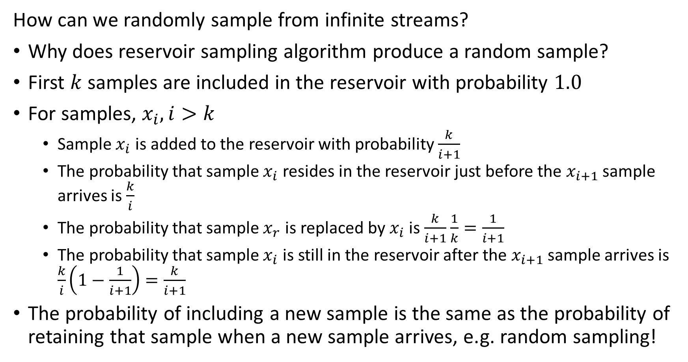
Reservoir Sampling
How can we randomly sample from infinite streams?
Why does reservoir sampling algorithm produce a random sample?
First $k$ samples are included in the reservoir with probability $1.0$
For samples, $x_{i}, i>k$
Sample $x_{i}$ is added to the reservoir with probability $\frac{k}{i+1}$
The probability that sample $x_{i}$ resides in the reservoir just before the $x_{i+1}$ sample arrives is $\frac{k}{i}$
The probability that sample $x_{r}$ is replaced by $x_{i}$ is $\frac{k}{i+1}$ $\frac{1}{k}=\frac{1}{i+1}$
The probability that sample $x_{i}$ is still in the reservoir after the $x_{i+1}$ sample arrives is $\frac{k}{i}\left(1−\frac{1}{i+1}\right)=\frac{k}{i+1}$
The probability of including a new sample is the same as the probability of retaining that sample when a new sample arrives, e.g. random sampling!

Slide 36
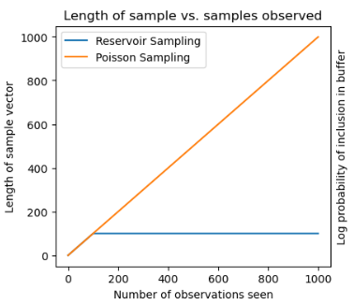
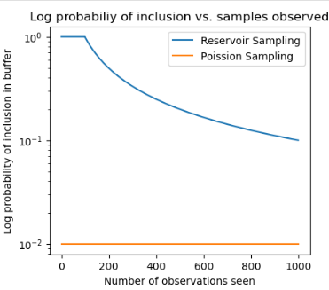
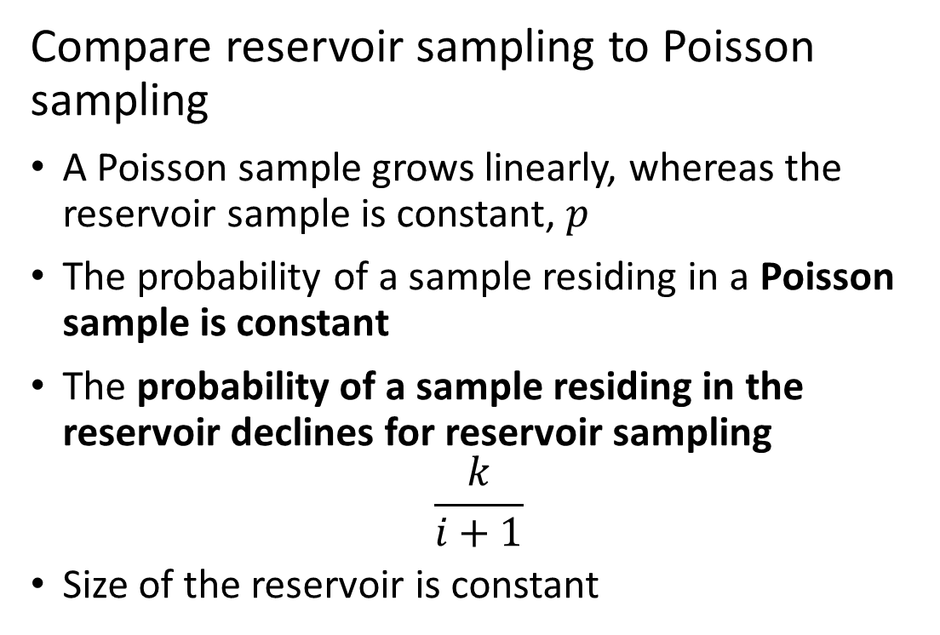
Reservoir Sampling
Compare reservoir sampling to Poisson sampling
A Poisson sample grows linearly, whereas the reservoir sample is constant, $p$
The probability of a sample residing in a Poisson sample is constant
The probability of a sample residing in the reservoir declines for reservoir sampling
$$\frac{k}{i+1}$$
Size of the reservoir is constant

Slide 37
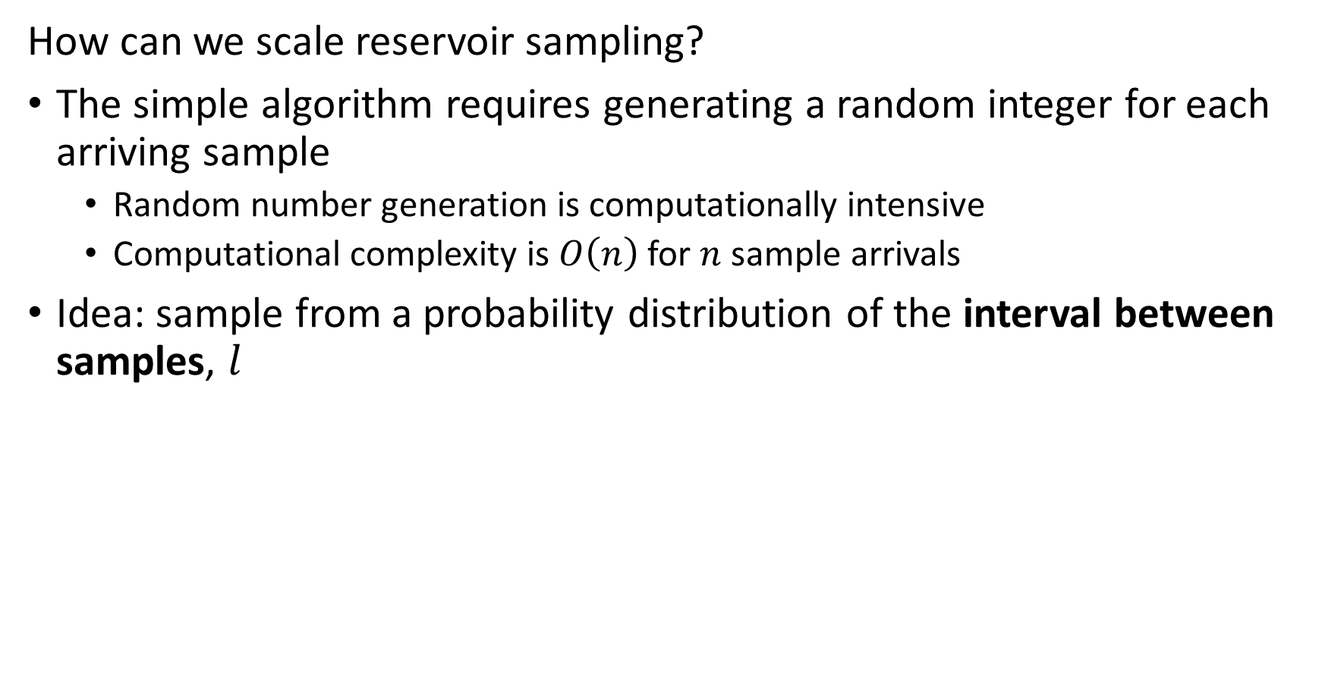
Reservoir Sampling
How can we scale reservoir sampling?
The simple algorithm requires generating a random integer for each arriving sample
Random number generation is computationally intensive
Computational complexity is $O\left(n\right)$ for $n$ sample arrivals
Idea: sample from a probability distribution of the interval between samples, $l$

Slide 38
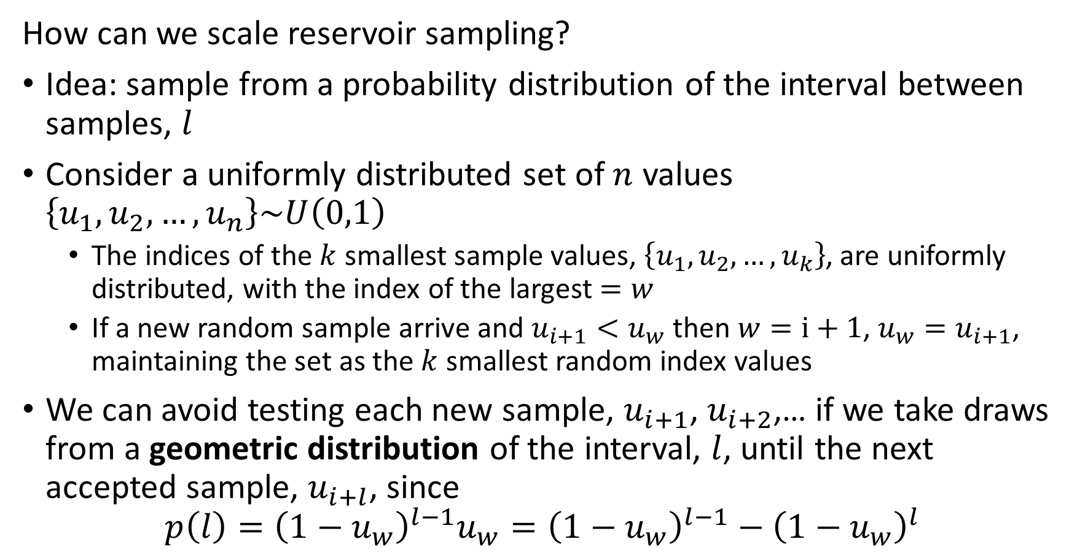
Reservoir Sampling
How can we scale reservoir sampling?
Idea: sample from a probability distribution of the interval between samples, $l$
Consider a uniformly distributed set of $n$ values $\left\{u_{1},u_{2},…,u_{n}\right\}\sim U\left(0,1\right)$
The indices of the $k$ smallest sample values, $\left\{u_{1},u_{2},…,u_{k}\right\}$, are uniformly distributed, with the index of the largest $=w$
If a new random sample arrive and $u_{i+1}<u_{w}$ then $w=i+1$, $u_{w}=u_{i+1}$, maintaining the set as the $k$ smallest random index values
We can avoid testing each new sample, $u_{i+1}$, $u_{i+2}$,… if we take draws from a geometric distribution of the interval, $l$, until the next accepted sample, $u_{i+l}$, since
$$p\left(l\right)={\left(1−u_{w}\right)}^{l−1}u_{w}={\left(1−u_{w}\right)}^{l−1}−{\left(1−u_{w}\right)}^{l}$$

Slide 39
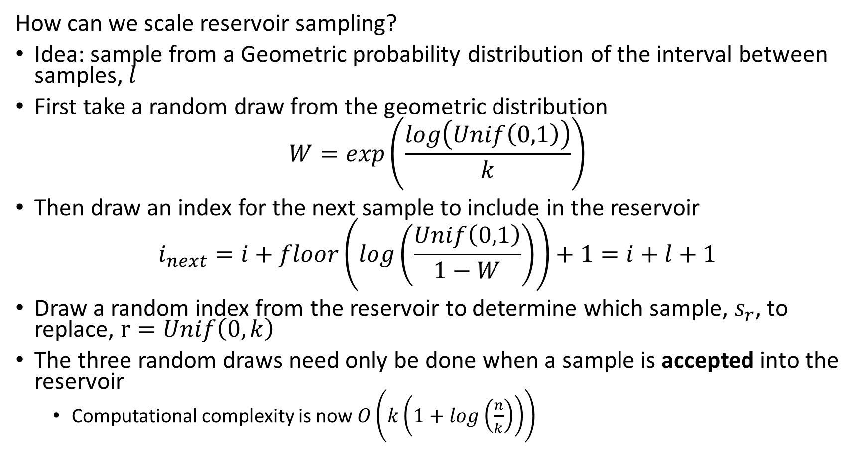
Reservoir Sampling
How can we scale reservoir sampling?
Idea: sample from a Geometric probability distribution of the interval between samples, $l$
First take a random draw from the geometric distribution
$$W=exp\left(\frac{log\left(Unif\left(0,1\right)\right)}{k}\right)$$
Then draw an index for the next sample to include in the reservoir
$$i_{next}=i+floor\left(log\left(\frac{Unif\left(0,1\right)}{1−W}\right)\right)+1=i+l+1$$
Draw a random index from the reservoir to determine which sample, $s_{r}$, to replace, $r=Unif\left(0,k\right)$
The three random draws need only be done when a sample is accepted into the reservoir
Computational complexity is now $O\left(k\left(1+log\left(\frac{n}{k}\right)\right)\right)$

Slide 40
Reservoir Sampling
How can we scale reservoir sampling?
Take an initial random draw from geometric distribution
Compute index of next sample to expect
Add sample to random location in reservoir buffer
Update random geometric distributed sample
W = math.exp(math.log(random.random())/k)
## Loop over the remianing samples in the stream
while i < n:
i = i + math.floor(math.log(random.random())/math.log(1 - W))
if i < n:
indx = random.randint(1, k) -1
reservoir_buffer[indx] = stream[i]
W = W * math.exp(math.log(random.random())/k)

Slide 41
Evaluating Stream Filtering

Slide 42
Evaluating Stream Filtering
How can we evaluate the effect of filtering and decimation of time series?
Evaluated the differences between original series and the filtered/decimated series
What does the difference series look like
How does the magnitude of the errors compare to original values?
Are the errors fairly uniformly distributed?
Error metrics
RMSE
MAE
Max deviation
Etc.

Slide 43
Discrete Streaming Events

Slide 44
Discrete Event Data
Discrete streaming data is common
Clicks on a web site
Counts of Key-value lookups
Counts of IP address pairs in internet traffic
Sensors count events
Vehicles passing
People entering a building
Wildlife sightings
…
And many more…

Slide 45
Discrete Event Data
What types of operations can we do with discrete event data?
Filter events to only process those of interest
Count events in a time window or in a reservoir sample
Unique types of events occurring in time window, or cardinality
Can concatenate operations, for example:
Filter events by type
Count events
Find cardinality of filtered stream
Query specific events
Etc.

Slide 46
Discrete Event Data
What limits discrete event data analytics?
Consider volume of events:
Storing all events is prohibitive
Want to push processing as far to periphery as possible
Use computationally and memory efficient approximate algorithms
Accept some error in exchange for orders of magnitude improvement in memory and computation
For large volume streams, approximations generally converge toward exact values
Many algorithms have been developed
Bloom filter and quotient filter for event history
Count-min-sketch algorithm for event counts
Flajolet-Martin and hyper-log-log algorithms for cardinality
Etc.
These algorithms can be applied in batch

Slide 47
Filtering Discrete Events Bloom Filters

Slide 48
Filtering Event Data
Often need to exclude events
Messages from IP addresses not on an authorized list
Is the originating phone one of our accounts?
Is this a sensor reading we need to process?
Has an event already occurred previously?
Etc.
The majority of traffic is often filtered in stream processing

Slide 49

Volume Reduction and Streaming Analytics
Event stream algorithms are both filters and analytics
Streams can be filtered and sampled near the source
Further filtering, sampling and sketching performed as preprocessing for analytics
Data Source
Filter/sample
Filter/sample/sketch
Stream analytic
Filter/sample/sketch
Stream analytic
Data Source
Filter/sample
$$⋮$$
$$⋮$$
$$⋮$$
$$⋮$$
Bandwidth limited network
Filter/sample/sketch
Stream analytic
Data Source
Filter/sample
Archival storage
Classical supervised and unsupervised ML
Server/Cloud
Minimum (filtered) data and analytics archived
Filtered streams and sketches used as input to classical ML

Slide 50

Filtering Event Data
0
0
0
0
How does a Bloom filter work?
Start with bit array or bitmap of length $m$ of all 0s
Use $k$ hash functions that address bit locations
0
0
0
0
0
0
0
0
0
0
0
0
…
0
0
0
0

Slide 51

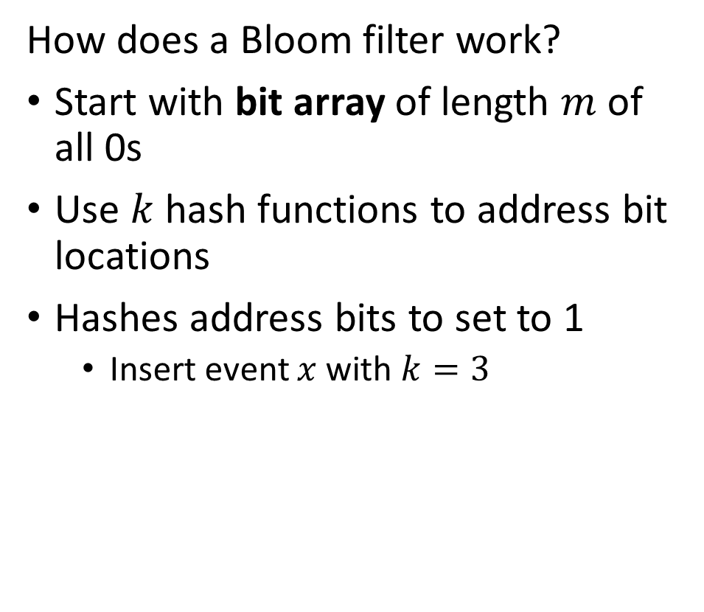


Filtering Event Data
0
1
$$f^{\left(1\right)}\left(x\right)$$
0
0
How does a Bloom filter work?
Start with bit array of length $m$ of all 0s
Use $k$ hash functions to address bit locations
Hashes address bits to set to 1
Insert event $x$ with $k=3$
0
$$f^{\left(2\right)}\left(x\right)$$
0
0
$$f^{\left(3\right)}\left(x\right)$$
1
0
0
0
0
0
0
0
1
…
0
0
0
0

Slide 52


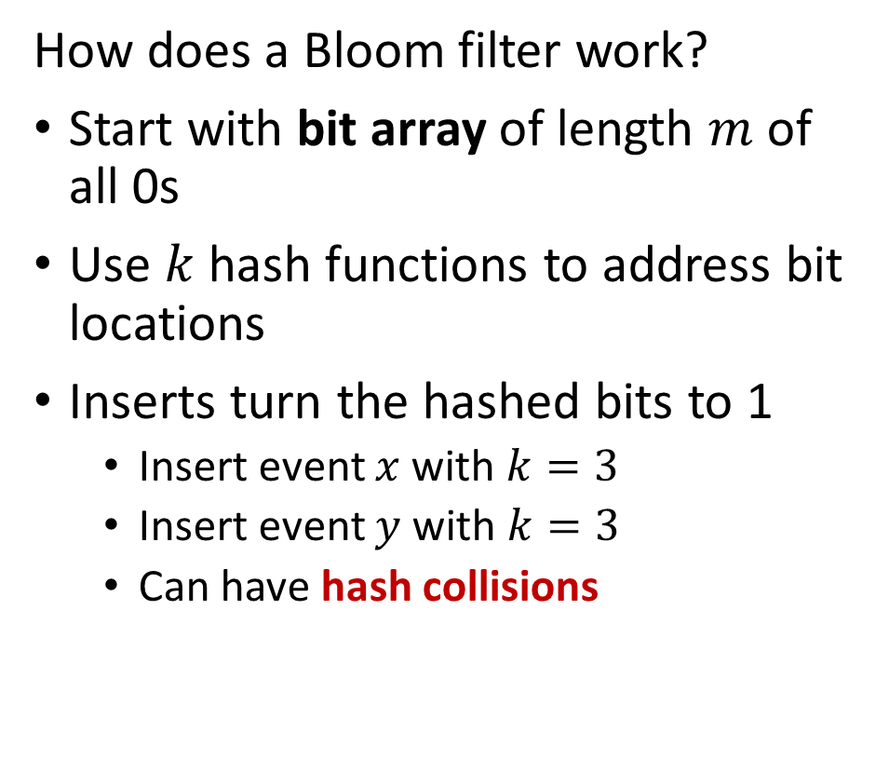

Filtering Event Data
0
1
$$f^{\left(1\right)}\left(x\right)$$
0
0
How does a Bloom filter work?
Start with bit array of length $m$ of all 0s
Use $k$ hash functions to address bit locations
Inserts turn the hashed bits to 1
Insert event $x$ with $k=3$
Insert event $y$ with $k=3$
Can have hash collisions
0
$$f^{\left(2\right)}\left(x\right)$$
0
0
$$f^{\left(3\right)}\left(x\right)$$
1
0
1
0
$$f^{\left(1\right)}\left(y\right)$$
1
0
$$f^{\left(2\right)}\left(y\right)$$
0
0
$$f^{\left(3\right)}\left(y\right)$$
1
…
0
0
0
0

Slide 53

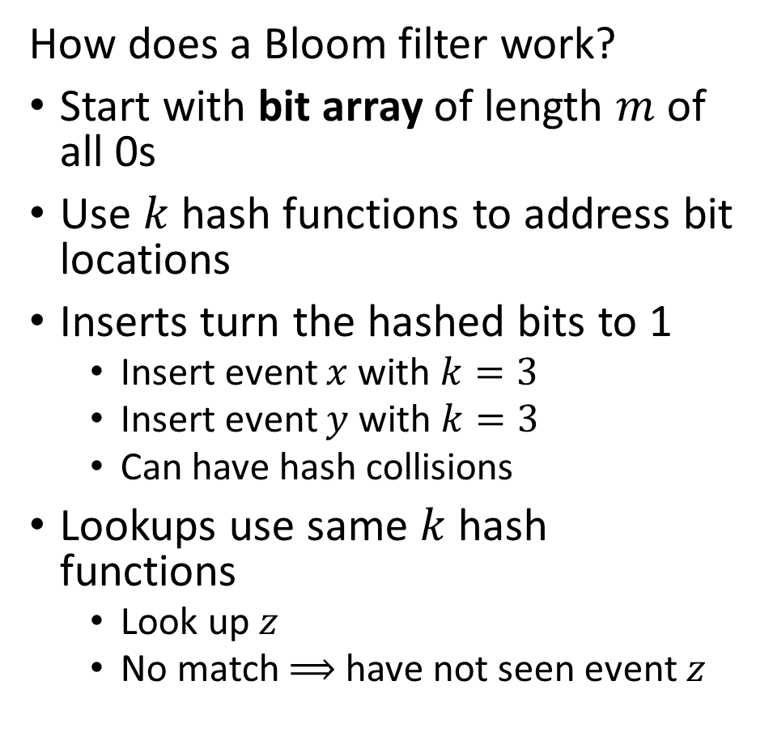


Filtering Event Data
0
1
$$f^{\left(1\right)}\left(z\right)$$
0
0
How does a Bloom filter work?
Start with bit array of length $m$ of all 0s
Use $k$ hash functions to address bit locations
Inserts turn the hashed bits to 1
Insert event $x$ with $k=3$
Insert event $y$ with $k=3$
Can have hash collisions
Lookups use same $k$ hash functions
Look up $z$
No match $⟹$ have not seen event $z$
0
$$f^{\left(2\right)}\left(z\right)$$
0
0
$$f^{\left(3\right)}\left(z\right)$$
1
0
1
0
1
0
0
0
1
…
0
0
0
0

Slide 54
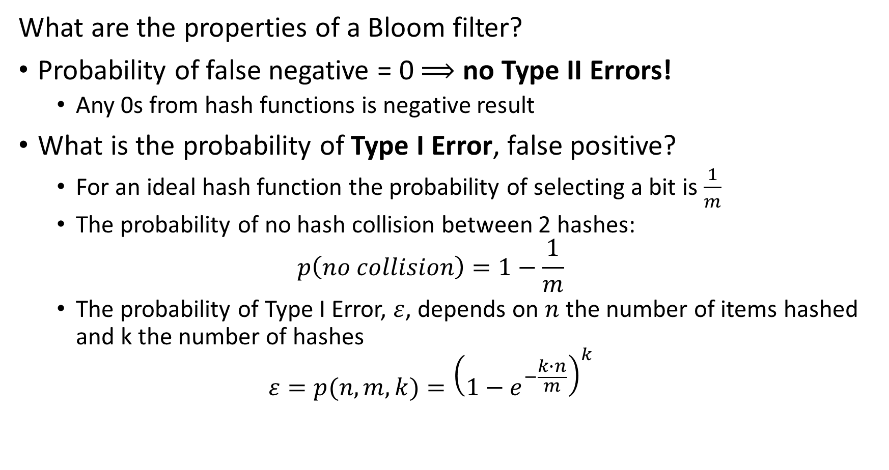
Filtering Event Data
What are the properties of a Bloom filter?
Probability of false negative = 0 $⟹$ no Type II Errors!
Any 0s from hash functions is negative result
What is the probability of Type I Error, false positive?
For an ideal hash function the probability of selecting a bit is $\frac{1}{m}$
The probability of no hash collision between 2 hashes:
$$p\left(no collision\right)=1−\frac{1}{m}$$
The probability of Type I Error, $ε$, depends on $n$ the number of items hashed and k the number of hashes
$$ε=p(n,m,k)={\left(1−e^{−\frac{k∙n}{m}}\right)}^{k}$$

Slide 55
Filtering Discrete Events Quotient Filters

Slide 56
Filtering Event Data
Alternatives to Bloom filter
Variation capable of deletes:
Each bit location has a counter
When event type is deleted, a count is decremented from each hash location
Quotient filter is a sketch using a more sophisticated hashing scheme
Memory efficient
Generally lower false positive rate
Manages counts in buckets
Better use of memory and computation compared to Bloom filter
Find details for quotient filter in Algorithms and Structures for Massive Data Sets, Medjodovic, et al., 2022, Manning

Slide 57



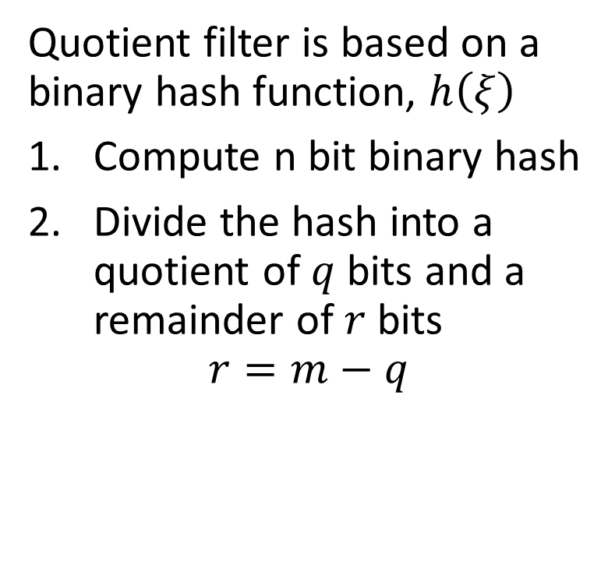















Filtering Event Data
Quotient filter is memory and computationally efficient
Quotient filter is based on a binary hash function, $h\left(ξ\right)$
Compute n bit binary hash
Divide the hash into a quotient of $q$ bits and a remainder of $r$ bits
$$r=m−q$$
Quotient
Remainder
$$h\left(w\right)=10001001010⇒$$
$$10001$$
$$001010$$
$$h\left(u\right)=10011000111⇒$$
$$10011$$
$$000111$$
$$h\left(v\right)=10011111111⇒$$
$$10011$$
$$111111$$
$$h\left(q\right)=10101101101⇒$$
$$10101$$
$$101101$$
$$h\left(x\right)=10110000111⇒$$
$$10110$$
$$000111$$
$$h\left(y\right)=00111111110⇒$$
$$00111$$
$$111110$$

Slide 58




Filtering Event Data
Quotient filter is memory and computationally efficient
The quotient defines a hash bucket
The remainder is the value
Notice the hash collision
Quotient
Remainder
$$h\left(w\right)=10001001010⇒$$
$$10001$$
$$001010$$
$$h\left(u\right)=10011000111⇒$$
$$10011$$
$$000111$$
$$h\left(v\right)=10011111111⇒$$
$$10011$$
$$111111$$
$$h\left(q\right)=10101101101⇒$$
$$10101$$
$$101101$$
$$h\left(x\right)=10110000111⇒$$
$$10110$$
$$000111$$
$$h\left(y\right)=00111111110⇒$$
$$00111$$
$$111110$$

Slide 59
Filtering Event Data
Quotient filter is memory and computationally efficient
Two key concepts used to manage hash collisions in quotient filters
A run is a consecutive sequence of slots occupied with remainders with the same quotient
A cluster is a continuous sequence of one or more runs
Performance of quotient filter relies on the empirical evidence for the prevalence of short clusters
Linear probing is used to find open slots for remainders
Stored consecutively
Stored in sort order to improve search efficiency

Slide 60






























Filtering Event Data
Quotient filter is memory and computationally efficient
Quotient filters use three bits to manage linear probing to resolve hash collisions
Run Continued bit is set when the slot is occupied but not the first element of the run
Is Occupied bit is set when the slot is occupied by a different hash from another location
Is Shifted bit is set to indicate the value in the slot is from another bucket
Bucket Occupied
Run Continued
Is Shifted
Quotient
Remainder
$$0$$
$$0$$
$$0$$
$$10001$$
$$001010$$
$$0$$
$$0$$
$$0$$
$$10011$$
$$000111$$
$$1$$
$$0$$
$$1$$
$10$011
$$111111$$
$$0$$
$$0$$
$$0$$
$$10101$$
$$101101$$
$$0$$
$$0$$
$$0$$
$$10110$$
$$000111$$
$$0$$
$$0$$
$$0$$
$$00111$$
$$111110$$

Slide 61
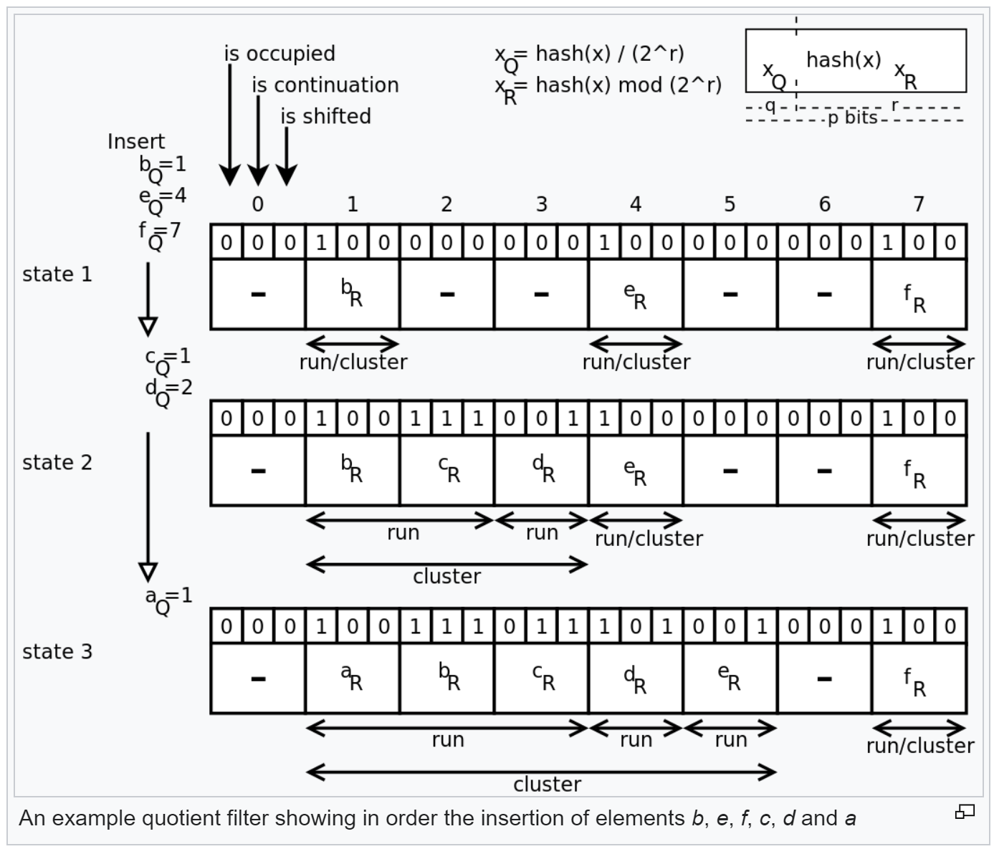
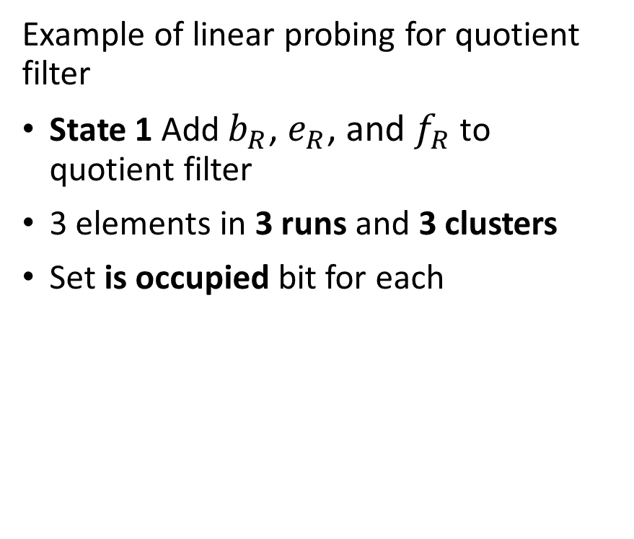
Filtering Event Data
Quotient filter is memory and computationally efficient
Example of linear probing for quotient filter
State 1 Add $b_{R}$, $e_{R}$, and $f_{R}$ to quotient filter
3 elements in 3 runs and 3 clusters
Set is occupied bit for each
Illustration from Wikipedia quotient filter article

Slide 62
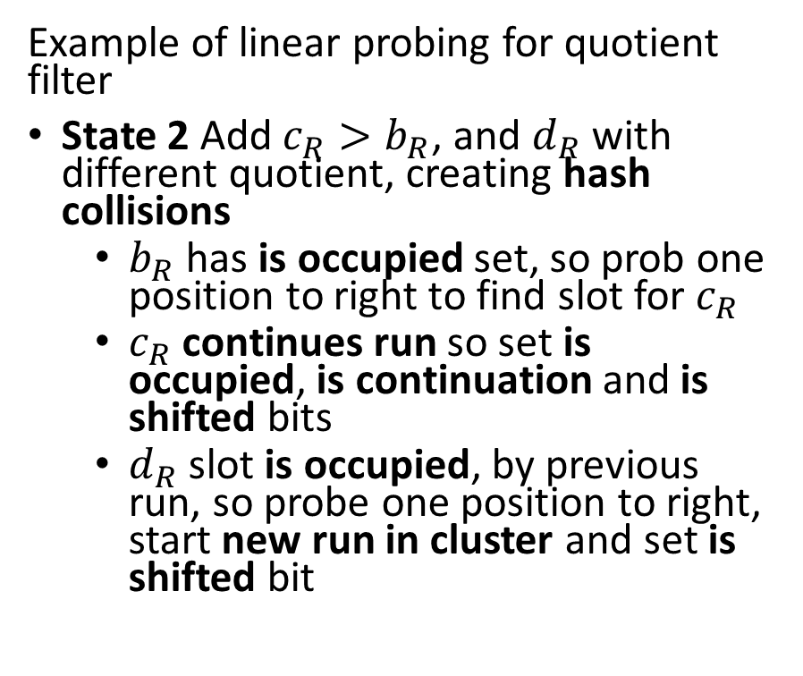
Filtering Event Data
Quotient filter is memory and computationally efficient
Example of linear probing for quotient filter
State 2 Add $c_{R}>b_{R}$, and $d_{R}$ with different quotient, creating hash collisions
$b_{R}$ has is occupied set, so prob one position to right to find slot for $c_{R}$
$c_{R}$ continues run so set is occupied, is continuation and is shifted bits
$d_{R}$ slot is occupied, by previous run, so probe one position to right, start new run in cluster and set is shifted bit
Illustration from Wikipedia quotient filter article

Slide 63
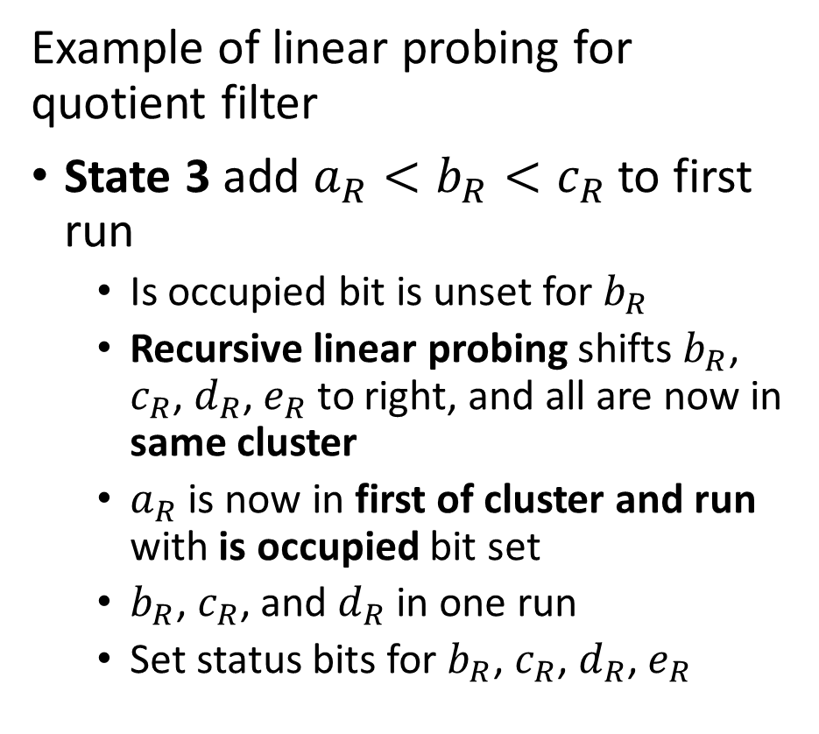
Filtering Event Data
Quotient filter is memory and computationally efficient
Example of linear probing for quotient filter
State 3 add $a_{R}<b_{R}<c_{R}$ to first run
Is occupied bit is unset for $b_{R}$
Recursive linear probing shifts $b_{R}$, $c_{R}$, $d_{R}$, $e_{R}$ to right, and all are now in same cluster
$a_{R}$ is now in first of cluster and run with is occupied bit set
$b_{R}$, $c_{R}$, and $d_{R}$ in one run
Set status bits for $b_{R}$, $c_{R}$, $d_{R}$, $e_{R}$
Illustration from Wikipedia quotient filter article

Slide 64
Filtering Event Data
Merging and resizing the quotient filter
Merging and resizing are important features of sketch hashes
Quotient filters can be merged by adding remainders of one filter to the bins defined by the quotients of another filter
Merging filters allows aggregation
Quotients must have same number of bits, or can resize, so quotients match
Need to ensure table is large enough to prevent quotient (hash) collisions.
Merging filters is useful for aggregation over multiple time periods
Can easily double the size of a quotient filter
Most significant bit of reminder becomes least significant bit of quotient
Adding a bit to the quotient doubles the size of the filter

Slide 65
Counting Discrete Events

Slide 66
Counting Events
Many applications of large-scale event counting
Events can be counted online or from streams
Counting events by scanning massive databases online
Counting events in streams in time windows
Applications
Count vehicles in highway sensors
Count trade volume in capital markets
Counts of packets to manage capacity or find suspicious activity in networks
Counts of transactions to find fraudulent activity
Counts from wearable technology
……

Slide 67
Volume Reduction and Streaming Analytics
Event stream algorithms are both filters and analytics
Streams can be filtered and sampled near the source
Further filtering, sampling and sketching performed as preprocessing for analytics
Data Source
Filter/sample
Filter/sample/sketch
Stream analytic
Filter/sample/sketch
Stream analytic
Data Source
Filter/sample
$$⋮$$
$$⋮$$
$$⋮$$
$$⋮$$
Bandwidth limited network
Filter/sample/sketch
Stream analytic
Data Source
Filter/sample
Archival storage
Classical supervised and unsupervised ML
Server/Cloud
Minimum (filtered) data and analytics archived
Filtered streams and sketches used as input to classical ML

Slide 68
Counting Events
Count-min-sketch algorithm efficiently counts events
A full count table needs an entry for every possible event identifier
Size is unbounded
Unmanageable for large event set
We need a better approach!
A sketch is a minimal (approximate) representation of a data structure
Use probabilistic sampling for approximate solution
Compact hash table as representation
Create a hash sketch of the counts using hash functions

Slide 69




Counting Events
Count-min-sketch employs a compact 2-dimensional data structure
Depth, d, hash functions, typically 10s
Width, w, buckets, typically 1000s
Compact data structure size leads to hash collisions
Width, w, buckets
1 | 2 | 3 | 4 | 5 | 6 | 7 | 8
0 | 0 | 0 | 0 | 0 | 0 | 0 | 0
0 | 0 | 0 | 0 | 0 | 0 | 0 | 0
0 | 0 | 0 | 0 | 0 | 0 | 0 | 0
0 | 0 | 0 | 0 | 0 | 0 | 0 | 0
$$h_{1}\left(\right)$$
Depth, d, hash functions
$$h_{2}\left(\right)$$
$$h_{3}\left(\right)$$
$$h_{4}\left(\right)$$

Slide 70
Counting Events
Count-min-sketch algorithm efficiently counts events
A sketch is a minimal (approximate) representation of a data structure
The count-min-sketch algorithm uses probabilistic sampling
Counts of events are added to the hash buckets in the sketch data structure
If no hash collisions, event counts in buckets for event identifier are exact
With inevitable hash collisions use minimum count in the hash buckets for the event identifier
Never get an under-count
Get over-count with some probability

Slide 71




Counting Events
Count-min-sketch employs a 2-dimensional data structure
Example, count events u, v, w, x, y
Event is tuple, (identifier, occurrences)
Event (u,1), add 1 to buckets indexed by hash functions for key u
1 | 2 | 3 | 4 | 5 | 6 | 7 | 8
0 | 0 | 1 | 0 | 0 | 0 | 0 | 0
0 | 0 | 0 | 0 | 0 | 0 | 1 | 0
1 | 0 | 0 | 0 | 0 | 0 | 0 | 0
0 | 0 | 0 | 0 | 1 | 0 | 0 | 0
$$h_{1}\left(u\right)=3$$
$$h_{2}\left(u\right)=7$$
$$h_{3}\left(u\right)=1$$
$$h_{4}\left(u\right)=5$$

Slide 72




Counting Events
Count-min-sketch employs a 2-dimensional data structure
Example, count events u, v, w, x, y
Event is tuple, (identifier, occurrences)
Event (v,2), add 2 to buckets indexed by hash functions, hash collision
1 | 2 | 3 | 4 | 5 | 6 | 7 | 8
2 | 0 | 1 | 0 | 0 | 0 | 0 | 0
0 | 0 | 0 | 0 | 0 | 2 | 1 | 0
1 | 0 | 0 | 2 | 0 | 0 | 0 | 0
0 | 0 | 0 | 0 | 3 | 0 | 0 | 0
$$h_{1}\left(v\right)=1$$
$$h_{2}\left(v\right)=6$$
$$h_{3}\left(v\right)=4$$
$$h_{4}\left(v\right)=5$$

Slide 73




Counting Events
Count-min-sketch employs a 2-dimensional data structure
Example, count events u, v, w, x, y
Event is tuple, (identifier, occurrences)
Event (w,1), add 1 to buckets, hash collision
1 | 2 | 3 | 4 | 5 | 6 | 7 | 8
3 | 0 | 1 | 0 | 0 | 0 | 0 | 0
0 | 0 | 0 | 0 | 1 | 2 | 1 | 0
1 | 0 | 1 | 2 | 0 | 0 | 0 | 0
0 | 0 | 0 | 0 | 3 | 1 | 0 | 0
$$h_{1}\left(w\right)=1$$
$$h_{2}\left(w\right)=5$$
$$h_{3}\left(w\right)=3$$
$$h_{4}\left(w\right)=6$$

Slide 74




Counting Events
Count-min-sketch employs a 2-dimensional data structure
Example, count events u, v, w, x, y
Event is tuple, (identifier, occurrences)
Event (x,3), add 3 to buckets, multiple hash collisions
1 | 2 | 3 | 4 | 5 | 6 | 7 | 8
3 | 0 | 4 | 0 | 0 | 0 | 0 | 0
0 | 0 | 0 | 3 | 1 | 2 | 1 | 0
3 | 0 | 1 | 2 | 0 | 0 | 0 | 0
0 | 3 | 0 | 0 | 3 | 1 | 0 | 0
$$h_{1}\left(x\right)=3$$
$$h_{2}\left(x\right)=4$$
$$h_{3}\left(x\right)=1$$
$$h_{4}\left(x\right)=2$$

Slide 75




Counting Events
Count-min-sketch employs a 2-dimensional data structure
Example, count events u, v, w, x, y
Event is tuple, (identifier, occurrences)
Event (y,2), add 2 to buckets, hash collision
1 | 2 | 3 | 4 | 5 | 6 | 7 | 8
3 | 2 | 4 | 0 | 0 | 0 | 0 | 0
0 | 0 | 0 | 5 | 1 | 2 | 1 | 0
3 | 0 | 1 | 2 | 2 | 0 | 0 | 0
0 | 3 | 0 | 0 | 3 | 1 | 0 | 2
$$h_{1}\left(y\right)=2$$
$$h_{2}\left(y\right)=4$$
$$h_{3}\left(y\right)=5$$
$$h_{4}\left(y\right)=8$$

Slide 76




Counting Events
Best estimate of count is minimum of counts in buckets of sketch data structure
Count-min-sketch algorithm finds upper bound on count
Estimate can be greater than actual count, never less!
u | v | w | x | y
4 | 3 | 3 | 4 | 2
1 | 2 | 1 | 5 | 5
3 | 2 | 1 | 3 | 2
3 | 3 | 3 | 3 | 3
1 | 2 | 1 | 3 | 2
1 | 2 | 1 | 3 | 2
$$h_{1}$$
$$h_{2}$$
$$h_{3}$$
$$h_{4}$$
Min count
Actual count

Slide 77
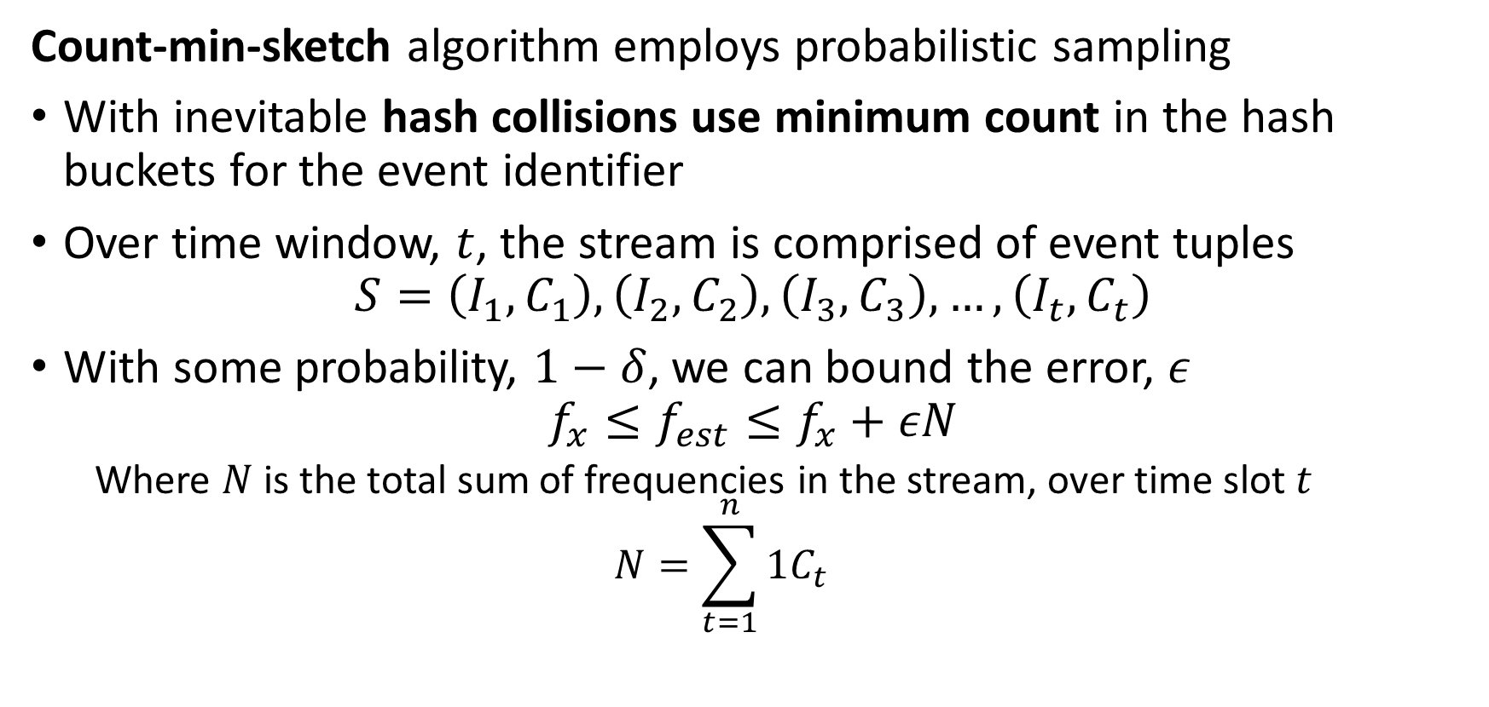
Counting Events
Count-min-sketch algorithm employs probabilistic sampling
With inevitable hash collisions use minimum count in the hash buckets for the event identifier
Over time window, $t$, the stream is comprised of event tuples
$$S=\left(I_{1},C_{1}\right),\left(I_{2},C_{2}\right),\left(I_{3},C_{3}\right),…,\left(I_{t},C_{t}\right)$$
With some probability, $1−δ$, we can bound the error, $ε$
$$f_{x}≤f_{est}≤f_{x}+εN$$
Where $N$ is the total sum of frequencies in the stream, over time slot $t$
$$N=\sum_{t=1}^{n}{1C_{t}}$$

Slide 78
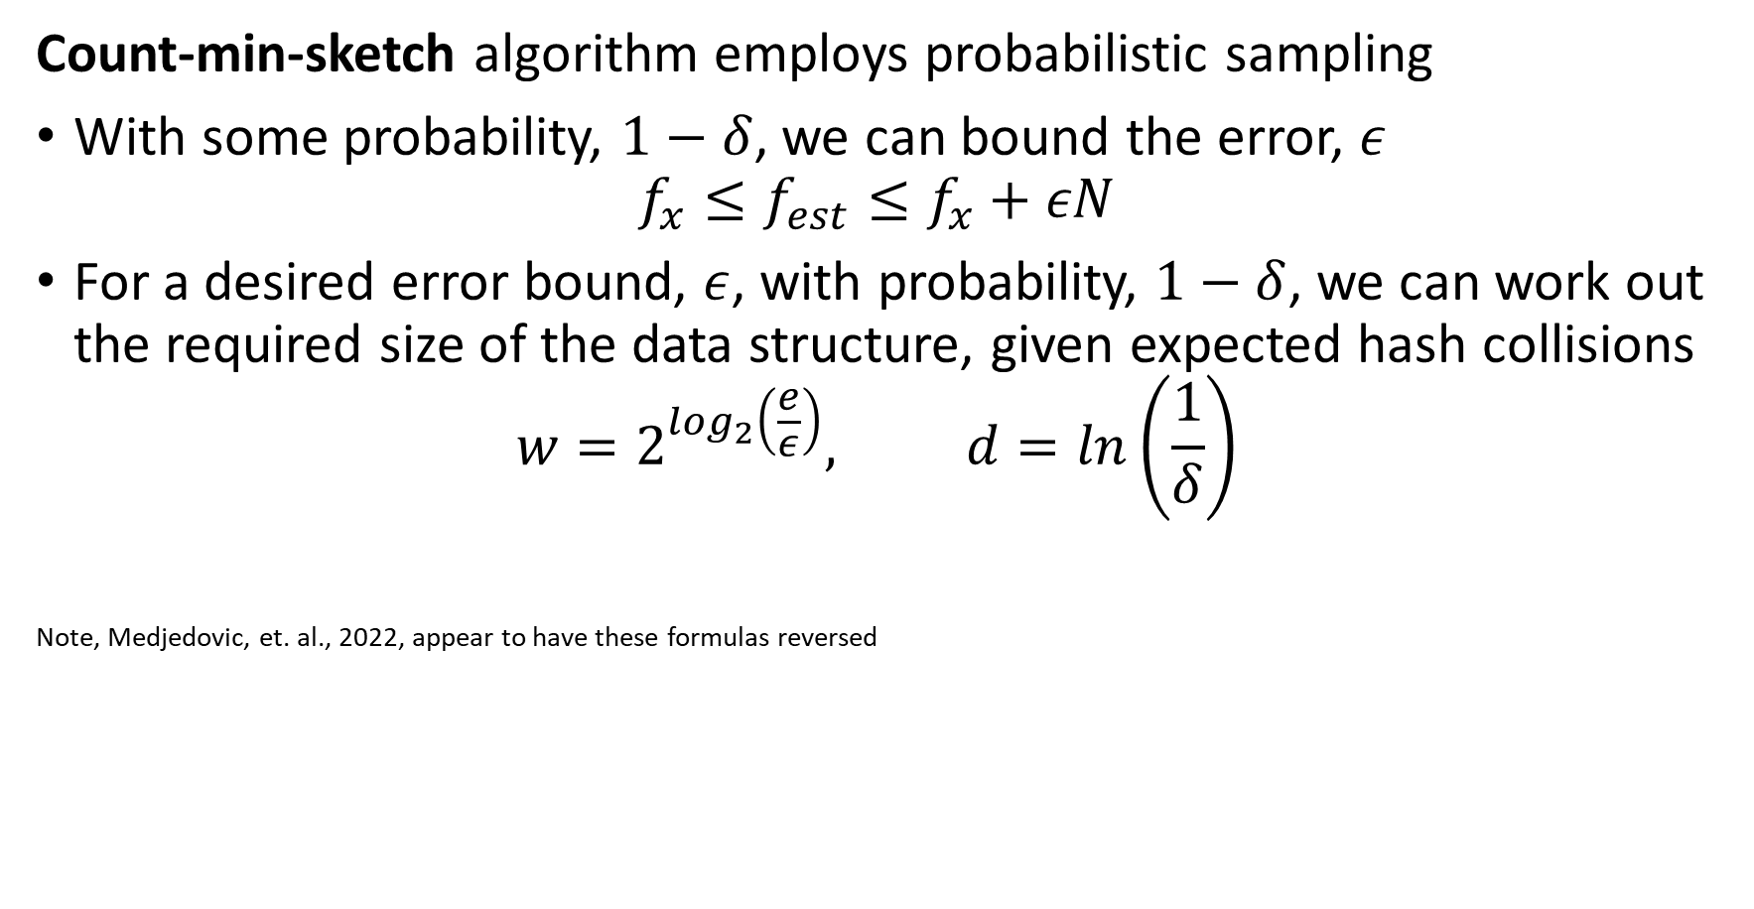
Counting Events
Count-min-sketch algorithm employs probabilistic sampling
With some probability, $1−δ$, we can bound the error, $ε$
$$f_{x}≤f_{est}≤f_{x}+εN$$
For a desired error bound, $ε$, with probability, $1−δ$, we can work out the required size of the data structure, given expected hash collisions
$$w=2^{\log_{2}\left(\frac{e}{ε}\right)}, d=ln\left(\frac{1}{δ}\right)$$
Note, Medjedovic, et. al., 2022, appear to have these formulas reversed

Slide 79
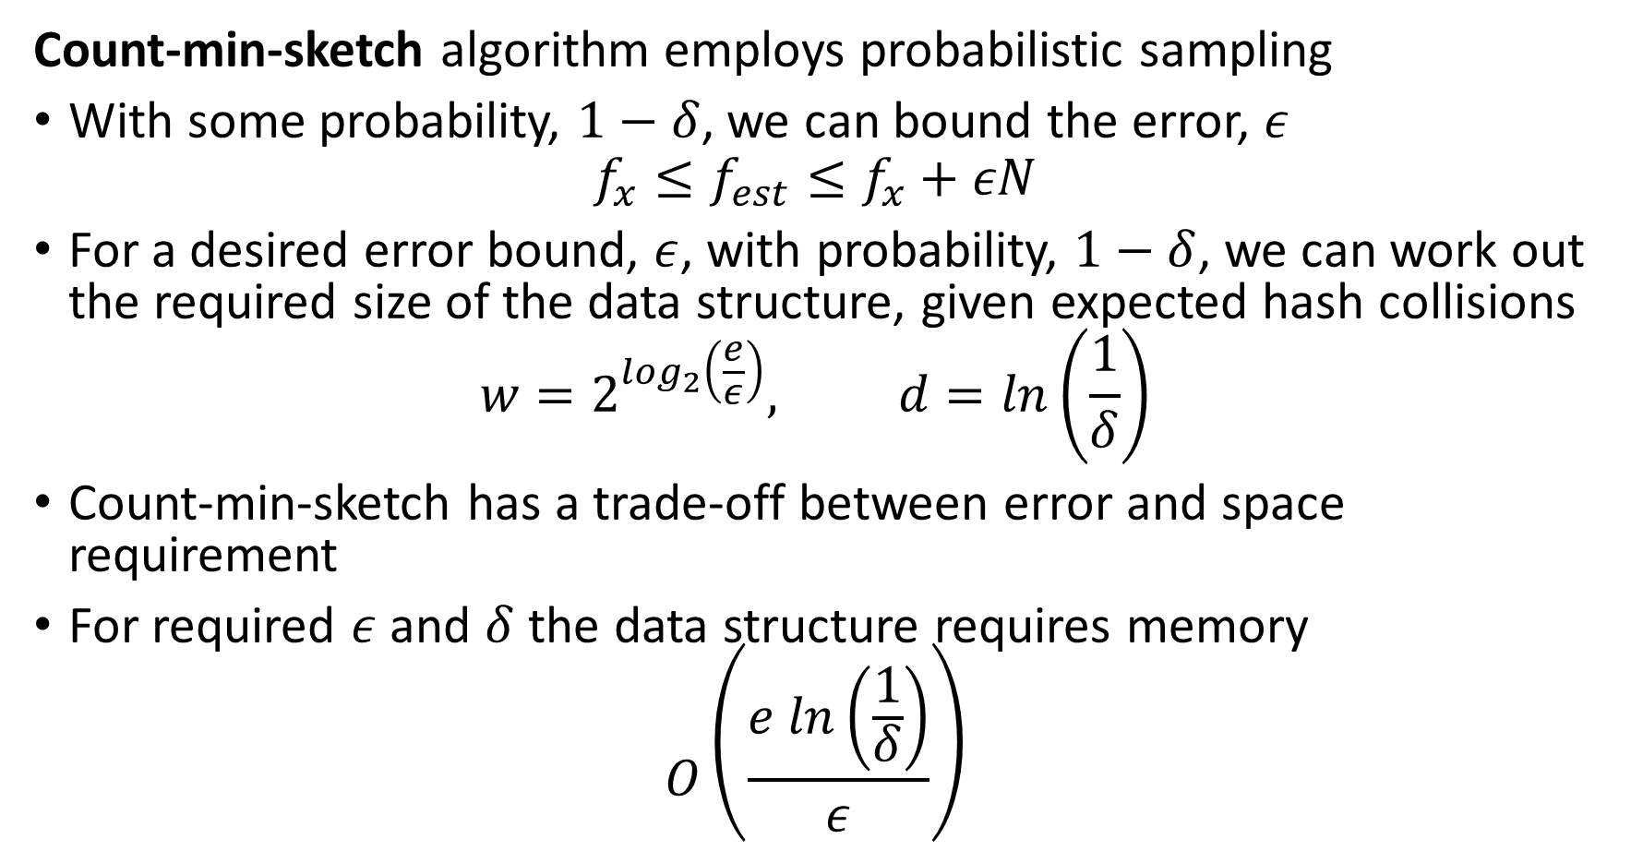
Counting Events
Count-min-sketch algorithm employs probabilistic sampling
With some probability, $1−δ$, we can bound the error, $ε$
$$f_{x}≤f_{est}≤f_{x}+εN$$
For a desired error bound, $ε$, with probability, $1−δ$, we can work out the required size of the data structure, given expected hash collisions
$$w=2^{\log_{2}\left(\frac{e}{ε}\right)}, d=ln\left(\frac{1}{δ}\right)$$
Count-min-sketch has a trade-off between error and space requirement
For required $ε$ and $δ$ the data structure requires memory
$$O\left(\frac{e ln\left(\frac{1}{δ}\right)}{ε}\right)$$

Slide 80
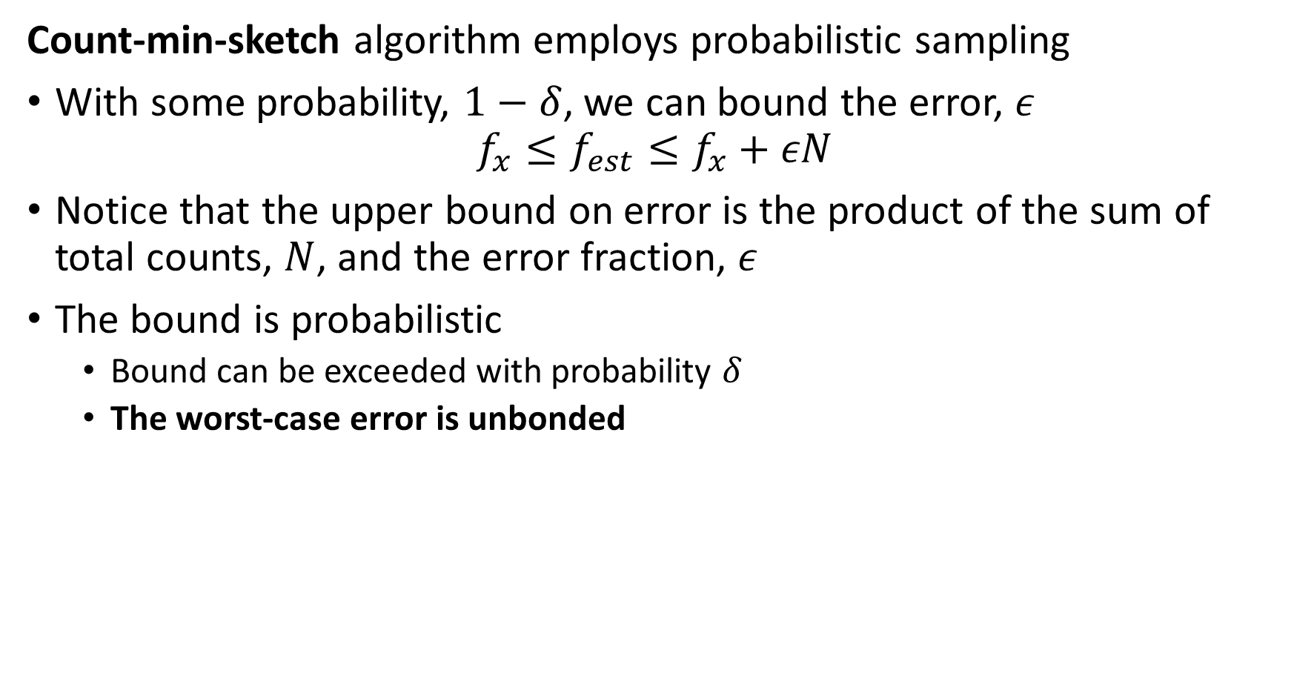
Counting Events
Count-min-sketch algorithm employs probabilistic sampling
With some probability, $1−δ$, we can bound the error, $ε$
$$f_{x}≤f_{est}≤f_{x}+εN$$
Notice that the upper bound on error is the product of the sum of total counts, $N$, and the error fraction, $ε$
The bound is probabilistic
Bound can be exceeded with probability $δ$
The worst-case error is unbonded

Slide 81
Counting Events
We can merge the sketches
Mergeability is a key property of sketches
Examples of merging count min sketches:
Merge multiple sketches to represent longer time periods
Merge sketches from several independent streams
Mergeable sketches allows parallel processing
Process each stream independently
Process multiple sub-queries from a database

Slide 82










Counting Events
We can merge the sketches
Mergeability is a key property of sketches
Sketches of same dimensions merged by summing elementwise
u | v | w | x | y
2 | 2 | 1 | 1 | 0
1 | 1 | 1 | 2 | 2
1 | 0 | 1 | 1 | 1
1 | 2 | 2 | 2 | 1
1 | 0 | 1 | 1 | 1
1 | 0 | 1 | 2 | 0
u | v | w | x | y
2 | 1 | 2 | 3 | 2
0 | 1 | 0 | 3 | 3
2 | 2 | 0 | 2 | 1
2 | 1 | 1 | 1 | 2
0 | 1 | 0 | 2 | 1
0 | 1 | 0 | 1 | 2
u | v | w | x | y
4 | 3 | 3 | 4 | 2
1 | 2 | 1 | 5 | 5
3 | 2 | 1 | 3 | 2
3 | 3 | 3 | 3 | 3
1 | 2 | 1 | 3 | 2
1 | 1 | 1 | 3 | 2
$$h_{1}$$
$$h_{1}$$
$$h_{2}$$
$$+$$
$$=$$
$$h_{2}$$
$$h_{3}$$
$$h_{3}$$
$$h_{4}$$
$$h_{4}$$
Min count
Actual count

Slide 83
Summary
Key points for this lesson
Streaming data often arrives at a massive scale
Down sample streams with real-number values
Moving averages
Delta coding
Reservoir sampling
….
Use probabilistic sketch algorithms for discrete event streams
Uniqueness – have we seen this event type before?
Counts – how many of these events in time interval?
…

