Slide 1

CSCI E-96
Data Mining, Discovery and Exploration
Steaming Analytics
Steve Elston
Copyright 2021, 2022, 2023, 2024, 2025, Stephen F Elston. All rights reserved.

Slide 2
Streaming Analytics
Are analytics always computed in batch?
No!
Data often arrives in streams
  IOT/Sensor data – many applications
  Capital markets data
  E-commerce click streams and purchases
  Emails, social media posts, etc.
  Logistics information
  Agricultural data
  Internet packet streams for cybersecurity
  Etc.
Analytics must be updated as data samples arrives
We call these online analytic algorithms

Slide 3
Streaming Analytics
Do we always apply online analytics to real-time data?
No!
We can use these algorithms for analytics on beyond core memory size
Data is processed in ‘chunks’
  Example, read files one or a few lines at a time
  Example, use a series of limited data base queries
Analytics updated for each chuck

Slide 4
Streaming Analytics
What are the key points to learn in this lesson?
Measures must be taken to reduce the massive volume of infinite stream data
Streams can be real-valued or discrete-valued
Stream data can be sampled and filtered to reduce volume
  Sampling methods used for filter real valued streams
  Hash methods used to filter discrete event streams
Sketches (hashes) are used to perform streaming analytics within computation and memory limits for both real valued and discrete streams

Slide 5

Streaming Analytics
Useful book on massive scale streaming analytics
Algorithms for Massive Datasets, Medjedovic, Tahirovic, and Dedovic, Manning, 2022

Slide 6
Streaming Analytics
Difficulties with streaming analytics
Example – small scale
  US Geological Survey maintains about 13,500 stream gauges
  Average of 4 types of sensors per station
  Each measurement is 4 bytes - 16 bytes total per sample
  Each gauge collects data sample every 15 mins
  Data uploaded every 4 hours – 6 sets of measurements per day – 1,536 bytes
  Total of 5.4 M bytes per day for network
  2 G bytes per year for archive
But, network bandwidth is limited
  Sensors often connected by point-to-point wireless connections

Slide 7
Streaming Analytics
Difficulties with streaming analytics
Data volumes can be massive
2nd Example – Large scale
  Power generation company with 10⁶ solar panels and inverters
  5 sensors with 4 bytes per sensor every 10 ms per inverter
  1,7 x 10⁹ bytes per inverter per day
  1.7 x 10¹⁵ bytes total per day = 1700 petabytes
Network bandwidth is limited

Slide 8
Streaming Analytics
Difficulties with streaming analytics
Streams are infinite with unlimited data volume
Results must be updated as new values arrive
How to treat older values?
  How much should older values weight in the analytic results?
  How much storage capacity is required for the history?
We can filter massive streams
  Reduce volume of stream data for processing
  Use filtered values to update analytics
Idea: compute and store only summary statistics?
  Massive reduction in volume

Slide 9
Streaming Pipelines

Slide 10
Streaming Analytics
Components of stream analytics
Multiple input streams – potentially different data types
Network bandwidth often limited
Real-time stream processor
Real-time stream analytics output
Limited working storage for real-time processing
Ad-Hoc query capability – typically limited
Long-term archival storage
Ad-Hoc
Queries
Processor
. . . 1, 5, 2, 7, 0, 9, 3
. . . a, r, v, t, y, h, b
. . . 0, 0, 1, 0, 1, 1, 0
time
Streams Entering.
Each is stream is
composed of
elements/tuples
Standing
Queries
Output
Limited
Working
Storage
Archival
Storage

Slide 11
Processing of Stream Data
Push most processing to the periphery of network
Network bandwidth is major limitation for large networks
  Consider IoT application with 100,000 sensors
  At 1 sec sampling interval reporting rate is 360 M samples (messages) per hour
  Statistic aggregated to 10 min reporting rate is 600 K samples (messages) per hour
Many peripheral devices have considerable processing power
  We can take advantage of the idle capacity
  Greatly reduce load on networks and central processing

Slide 12




Volume Reduction and Streaming Analytics
Reducing stream data volume is key to providing real-time analytics
Streams can be filtered and sampled near the source
Further filtering, sampling and sketching performed as preprocessing for analytics
Data Source
Filter/sample
Filter/sample/sketch
Stream analytic
Filter/sample/sketch
Stream analytic
Data Source
Filter/sample
$$⋮$$
$$⋮$$
$$⋮$$
$$⋮$$
Bandwidth limited network
Filter/sample/sketch
Stream analytic
Data Source
Filter/sample
Archival storage
Classical supervised and unsupervised ML
Server/Cloud
Minimum (filtered) data and analytics archived
Filtered streams and sketches used as input to classical ML

Slide 13
Case Study 1

Slide 14
Case Study 1: Telecom Fraud Detection
Goal: terminate calls from fraudulent accounts in real-time
Features
  Call history
  Phone characteristics
  Payment history
  Account types; individual, family, small business, corporate….
  Etc.
Fraud detection algorithm
  Train in batch
  Terminate fraudulent calls in real time in < 1 sec - no billing record ‘residue’

Slide 15
Case Study 1: Telecom Fraud Detection
Model training
Ground truth is not known for 90-120 days
  Must use delayed training data
Fraud patterns change quickly
  Criminals constantly looking for greatest vulnerability
User behavior drifts with time

Slide 16
Case Study 1: Telecom Fraud Detection
Scaling
Training performed in batch – not time critical
  Data size often larger than core memory
Realtime fraud detection
  Move processing to edge – intercept communication between switch and billing system
  Update blocked account/number list

Slide 17
Sketches as Approximate Representations

Slide 18
Sketches As Approximate Representations
For infinite streams we must accept a sketch as an approximate representation
Cannot store all history of streams in main memory!
  At large scale infinite streams will fill any disk array!
Ideal sketch algorithms have three properties
  Small memory footprint
  Computationally efficient to construct
  Bounded error
There is enviable tradeoff between these three dimensions of low memory, efficiency and error
  Example, we can usually improve accuracy at the expense of memory

Slide 19
Sketches As Approximate Representations
For infinite streams we must accept a sketch as an approximate representation
Sketches for real-valued streams
  Reservoir sampling
  Quantile estimation
Sketches for discrete valued streams
  Occurrence
  Counts
  Cardinality

Slide 20
Sketch Software
Sketch algorithms can be found in several Python packages
The Apache DataSketches package is an enterprise-grade sketch package with Python, C++, and Java APIs
  Integrated with enterprise platform, Google BigQuery, Apache SPARK
  Python API is a bit incomplete and inconsistent
Packages that implement sketch algorithms specifically with a Python API
  PyProbables
  DataSketch
Numerious specialized or single algorithm packages

Slide 21
Basic Sampling and Filtering

Slide 22
Filtering and Sketching Real Valued Streams
Cannot store all history of streams in main memory!
Need a better approach
Some ideas:
  Delta coding: Only update when there is substantial change
  Moving window: Compute statistic for each window position
  Decay window: compute statistic down-weighting older event values
  Reservoir sampling: compute statistic from a random sample of the stream

Slide 23
Volume Reduction and Streaming Analytics
Event stream algorithms are both filters and analytics
Streams can be filtered and sampled near the source
Further filtering, sampling and sketching performed as preprocessing for analytics
Data Source
Filter/sample
Filter/sample/sketch
Stream analytic
Filter/sample/sketch
Stream analytic
Data Source
Filter/sample
$$⋮$$
$$⋮$$
$$⋮$$
$$⋮$$
Bandwidth limited network
Filter/sample/sketch
Stream analytic
Data Source
Filter/sample
Archival storage
Classical supervised and unsupervised ML
Server/Cloud
Minimum (filtered) data and analytics archived
Filtered streams and sketches used as input to classical ML

Slide 24
Delta Coding
Delta coding only transmits and processes values with significant differences
Example: consider a large network of sensors (IoT)
  Values at most sensors do not change most of the time
  Example: Temperature has not changed significantly
  Example: Nothing moving in or out of image
  Example: Current in transmission line has not changed
  Etc.
Delta coding restricts transmission, processing and storage to significant changes (deltas)
  A threshold determines significance of change
  Threshold values are solution specific

Slide 25
Delta Coding
Delta coding moves filtering and initial processing to periphery of network
Example: Measuring flow in pipe network
  100,000 flow sensors sampling every 1-sec with +/-3% standard error
  Example: Set threshold and only report if change more than +/-3% of moving average
  Can reduce network traffic and processing by orders of magnitude
Example: Security camera watching gate
  Image transmission expensive at raw 50-60 frames per second
  Threshold on object greater than some number of pixels moving in frame
  Reduces transmission, processing and storage by many orders of magnitude

Slide 26
Moving Window Analytics
Compute and store summary statistics from moving window
Need to update the analytic as new values received
Must maintain samples in a window
Move window by a stride, number of samples
On update
  Add new observations to the end of window
  Remove old observations from beginning of window
  Compute and store new estimate of statistic
Algorithm requires recomputing statistics using all observations in the window in main memory
May not scale well

Slide 27
Moving Window Analytics
Compute and store summary statistics from moving window
... t₀ t₁ t₂ t₃ t₃ t₄ t₅ t₆ t₇ t₈ t₉ t₁₀ t₁₁ t₁₂ t₁₃ t₁₄ t₁₅ …
Streaming data values
Window sample the stream
Compute statistic from samples
Move window by a Stride
Repeat steps 1-3 indefinitely
Span of time window = 8
Stride = 4
Statistic value
Statistic value

Slide 28
Reservoir Sampling

Slide 29
Reservoir Sampling
How can we randomly sample from infinite streams to compute an analytic?
Why do we need random samples or probabilistic sampling algorithms?
Moving window samples only hold information for a finite time
  Loose history
Exponential smoothing methods only works for certain statistics
  We cannot derive closed form recursions for many statistics, e.g. median
Idea: use a random samples to create a sketch of the observations
  Build a sketch representative of the full infinite stream
  Updated random sample as new observations arrive
Note: Reservoir sampling is implemented in the Apache DataSketches package

Slide 30
Volume Reduction and Streaming Analytics
Event stream algorithms are both filters and analytics
Streams can be filtered and sampled near the source
Further filtering, sampling and sketching performed as preprocessing for analytics
Data Source
Filter/sample
Filter/sample/sketch
Stream analytic
Filter/sample/sketch
Stream analytic
Data Source
Filter/sample
$$⋮$$
$$⋮$$
$$⋮$$
$$⋮$$
Bandwidth limited network
Filter/sample/sketch
Stream analytic
Data Source
Filter/sample
Archival storage
Classical supervised and unsupervised ML
Server/Cloud
Minimum (filtered) data and analytics archived
Filtered streams and sketches used as input to classical ML

Slide 31
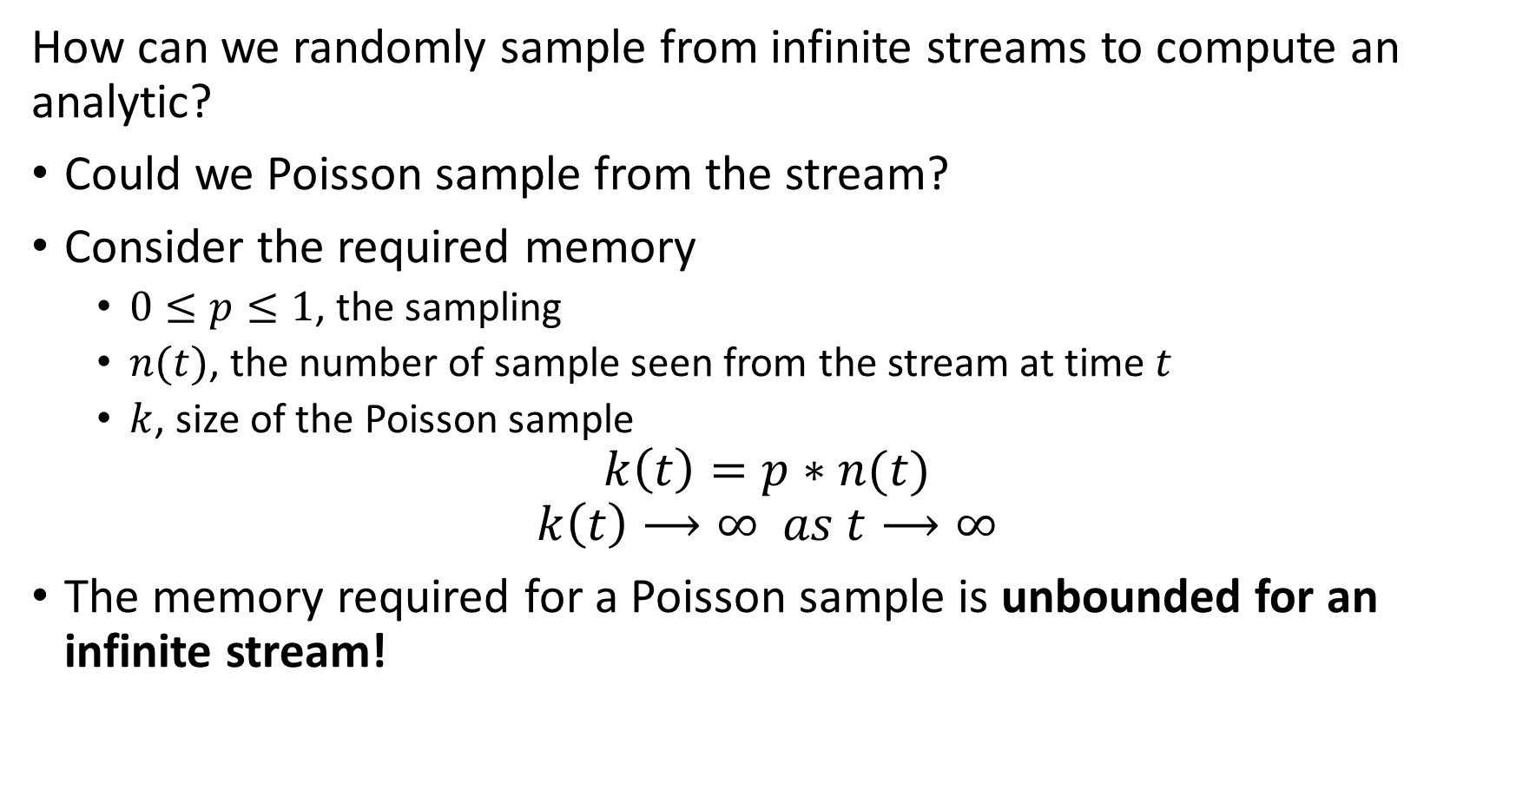
Reservoir Sampling
How can we randomly sample from infinite streams to compute an analytic?
Could we Poisson sample from the stream?
Consider the required memory
  $0≤p≤1$, the sampling
  $n(t)$, the number of sample seen from the stream at time $t$
  $k$, size of the Poisson sample
$$k\left(t\right)=p∗n(t)$$
$$k\left(t\right)⟶∞ as t⟶∞$$
The memory required for a Poisson sample is unbounded for an infinite stream!

Slide 32
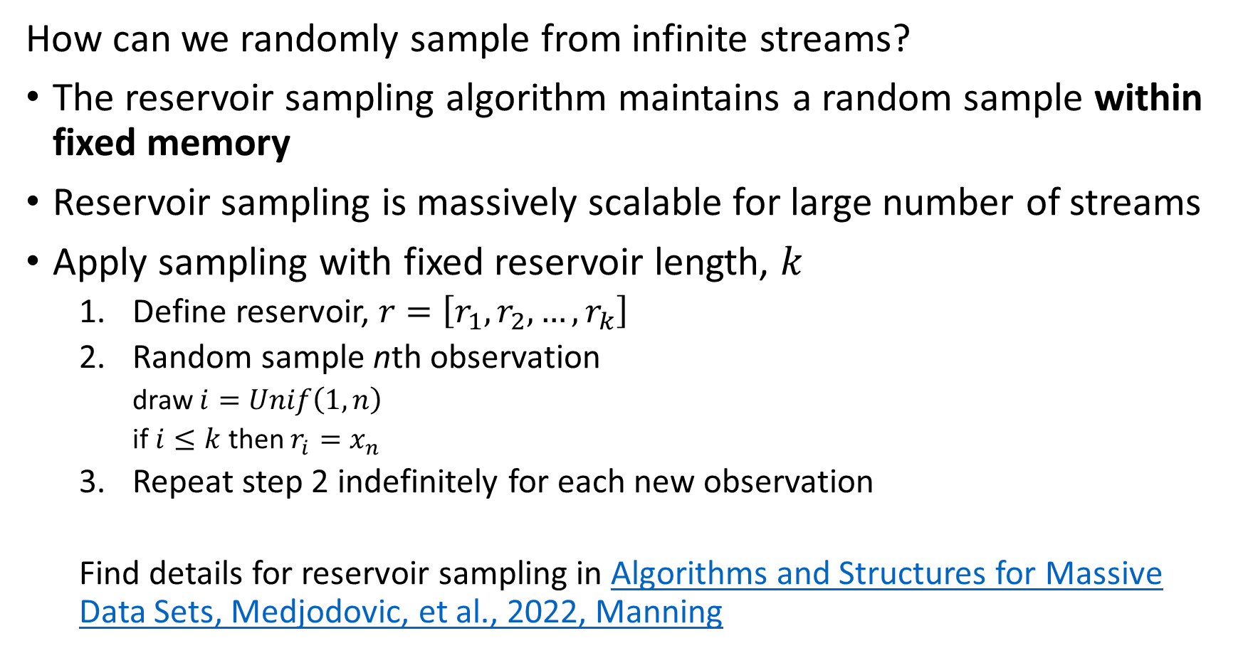
Reservoir Sampling
How can we randomly sample from infinite streams?
The reservoir sampling algorithm maintains a random sample within fixed memory
Reservoir sampling is massively scalable for large number of streams
Apply sampling with fixed reservoir length, $k$
  Define reservoir, $r=\left[r_{1},r_{2},…,r_{k}\right]$
  Random sample nth observation
    draw $i=Unif\left(1,n\right)$
    if $i≤k$ then $r_{i}=x_{n}$
  Repeat step 2 indefinitely for each new observation
  Find details for reservoir sampling in Algorithms and Structures for Massive Data Sets, Medjodovic, et al., 2022, Manning

Slide 33
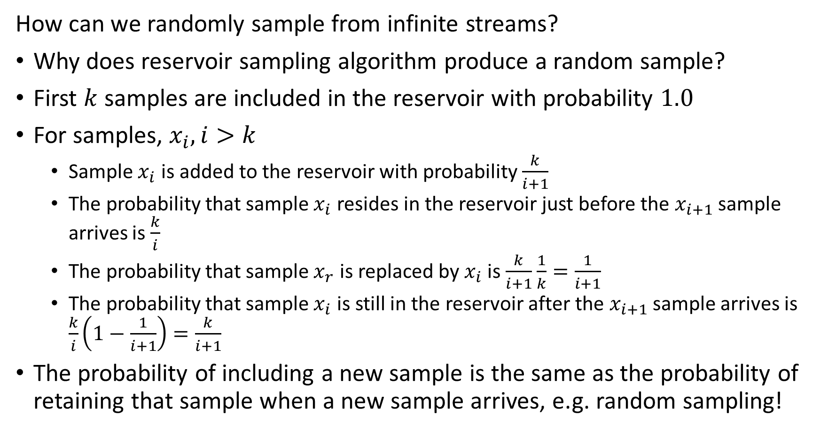
Reservoir Sampling
How can we randomly sample from infinite streams?
Why does reservoir sampling algorithm produce a random sample?
First $k$ samples are included in the reservoir with probability $1.0$
For samples, $x_{i}, i>k$
  Sample $x_{i}$ is added to the reservoir with probability $\frac{k}{i+1}$
  The probability that sample $x_{i}$ resides in the reservoir just before the $x_{i+1}$ sample arrives is $\frac{k}{i}$
  The probability that sample $x_{r}$ is replaced by $x_{i}$ is $\frac{k}{i+1}$ $\frac{1}{k}=\frac{1}{i+1}$
  The probability that sample $x_{i}$ is still in the reservoir after the $x_{i+1}$ sample arrives is $\frac{k}{i}\left(1−\frac{1}{i+1}\right)=\frac{k}{i+1}$
The probability of including a new sample is the same as the probability of retaining that sample when a new sample arrives, e.g. random sampling!

Slide 34
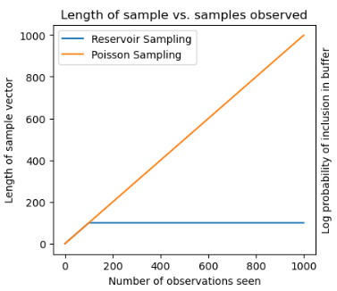
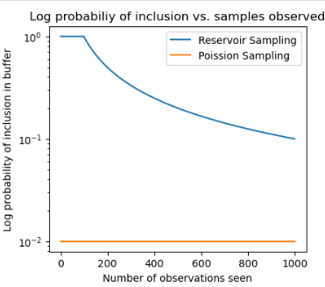
Reservoir Sampling
Compare reservoir sampling to Poisson sampling
A Poisson sample grows linearly, whereas the reservoir sample is constant
The probability of a sample residing in a Poisson sample is constant, whereas the probability declines for reservoir sampling

Slide 35
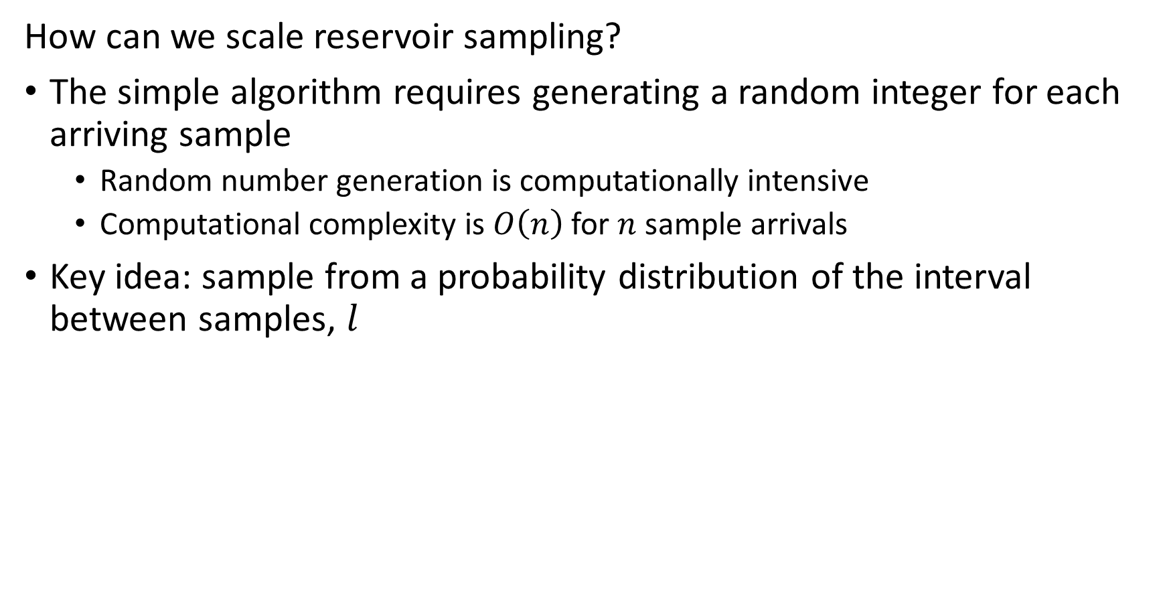
Reservoir Sampling
How can we scale reservoir sampling?
The simple algorithm requires generating a random integer for each arriving sample
  Random number generation is computationally intensive
  Computational complexity is $O\left(n\right)$ for $n$ sample arrivals
Key idea: sample from a probability distribution of the interval between samples, $l$

Slide 36
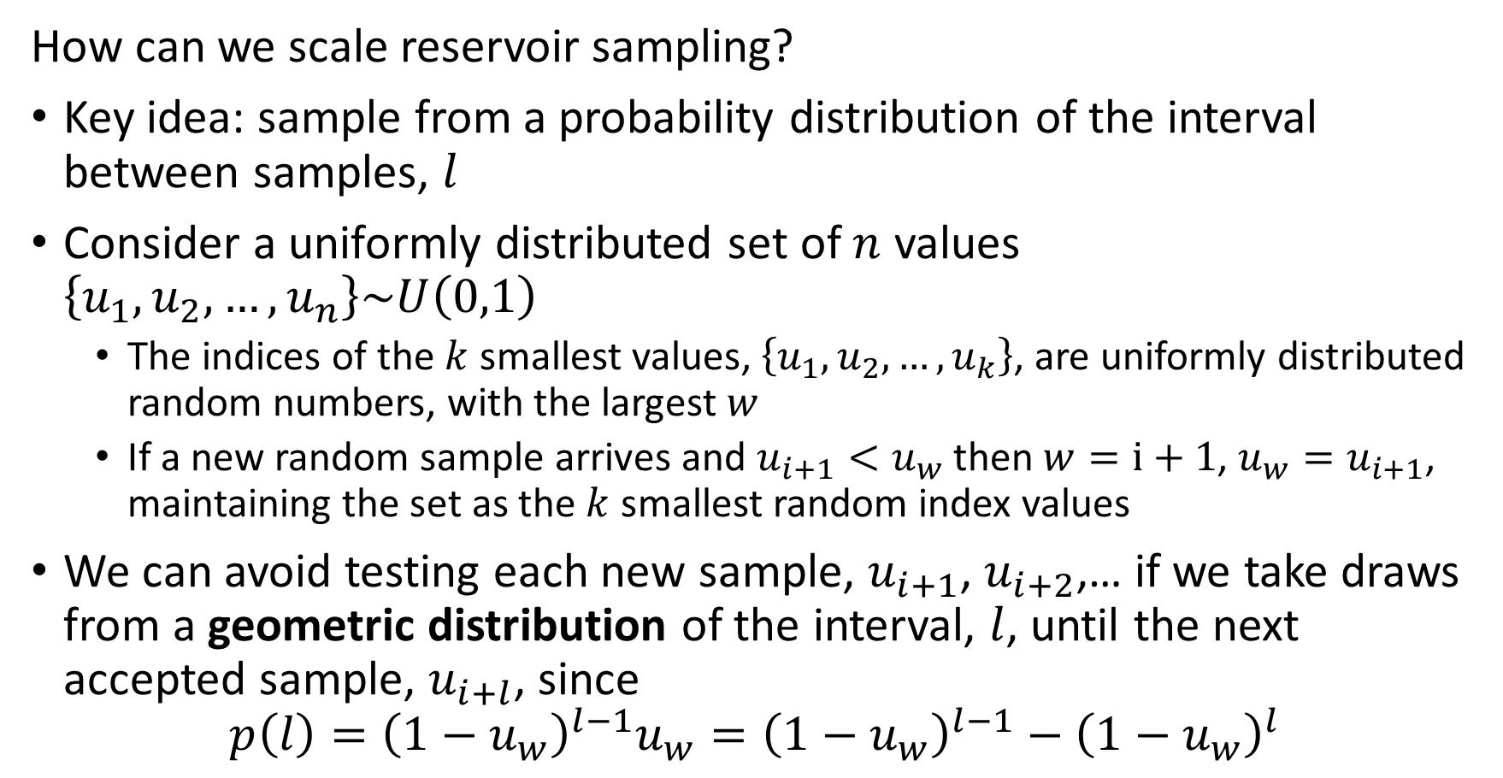
Reservoir Sampling
How can we scale reservoir sampling?
Key idea: sample from a probability distribution of the interval between samples, $l$
Consider a uniformly distributed set of $n$ values $\left\{u_{1},u_{2},…,u_{n}\right\}\sim U\left(0,1\right)$
  The indices of the $k$ smallest values, $\left\{u_{1},u_{2},…,u_{k}\right\}$, are uniformly distributed random numbers, with the largest $w$
  If a new random sample arrives and $u_{i+1}<u_{w}$ then $w=i+1$, $u_{w}=u_{i+1}$, maintaining the set as the $k$ smallest random index values
We can avoid testing each new sample, $u_{i+1}$, $u_{i+2}$,… if we take draws from a geometric distribution of the interval, $l$, until the next accepted sample, $u_{i+l}$, since
$$p\left(l\right)={\left(1−u_{w}\right)}^{l−1}u_{w}={\left(1−u_{w}\right)}^{l−1}−{\left(1−u_{w}\right)}^{l}$$

Slide 37
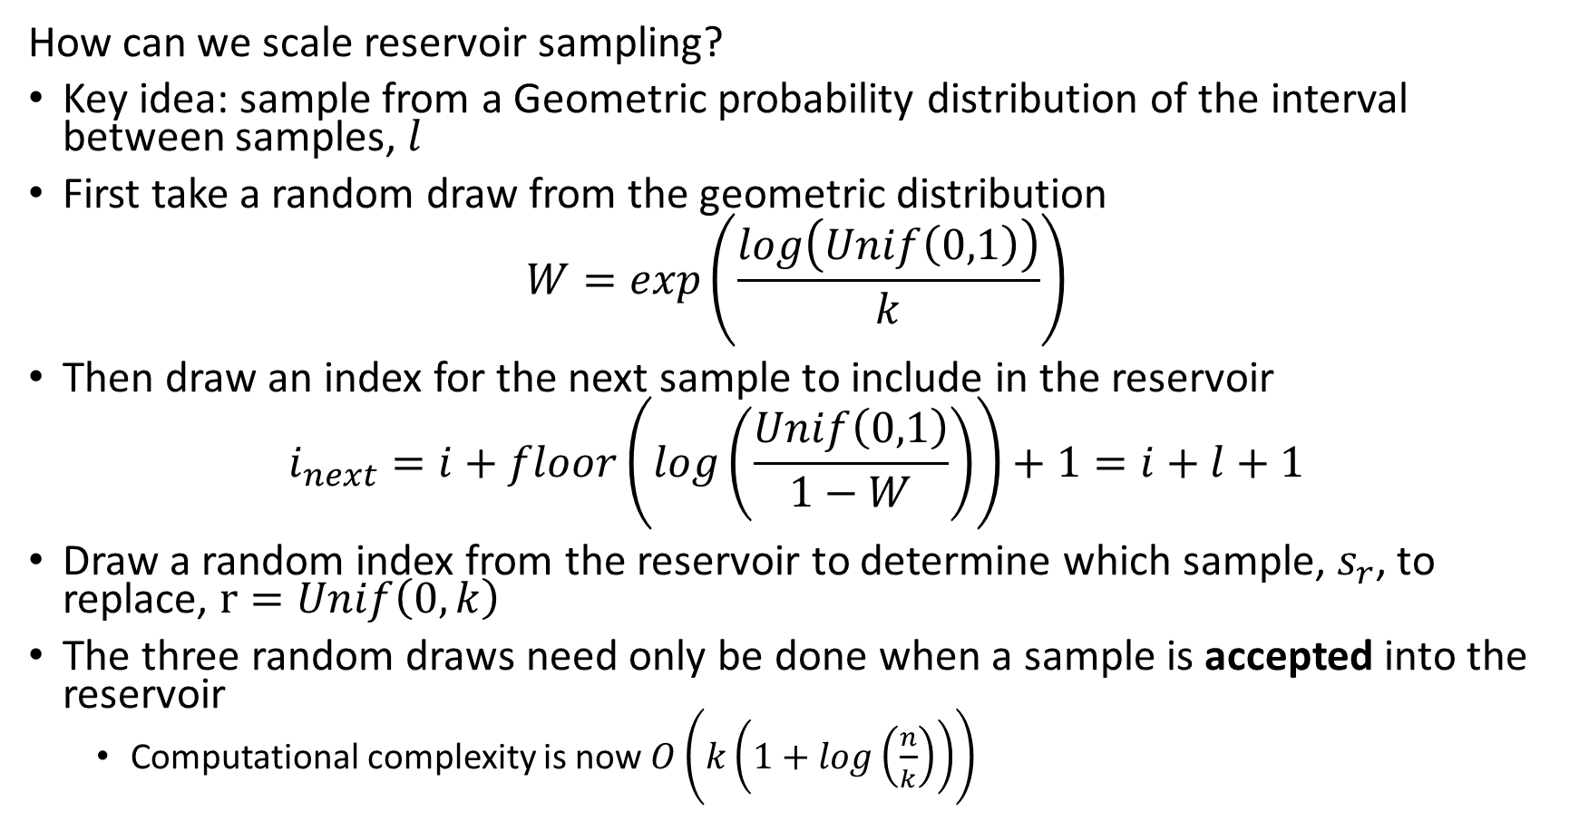
Reservoir Sampling
How can we scale reservoir sampling?
Key idea: sample from a Geometric probability distribution of the interval between samples, $l$
First take a random draw from the geometric distribution
$$W=exp\left(\frac{log\left(Unif\left(0,1\right)\right)}{k}\right)$$
Then draw an index for the next sample to include in the reservoir
$$i_{next}=i+floor\left(log\left(\frac{Unif\left(0,1\right)}{1−W}\right)\right)+1=i+l+1$$
Draw a random index from the reservoir to determine which sample, $s_{r}$, to replace, $r=Unif\left(0,k\right)$
The three random draws need only be done when a sample is accepted into the reservoir
  Computational complexity is now $O\left(k\left(1+log\left(\frac{n}{k}\right)\right)\right)$

Slide 38
Reservoir Sampling
How can we scale reservoir sampling?
Take an initial random draw from geometric distribution
Compute index of next sample to expect
Add sample to random location in reservoir buffer
Update random geometric distributed sample
W = math.exp(math.log(random.random())/k)
## Loop over the remianing samples in the stream
while i < n:
i = i + math.floor(math.log(random.random())/math.log(1 - W))
if i < n:
indx = random.randint(1, k) -1
reservoir_buffer[indx] = stream[i]
W = W * math.exp(math.log(random.random())/k)

Slide 39
Evaluating Stream Filtering

Slide 40
Evaluating Stream Filtering
How can we evaluate the effect of filtering and decimation of time series?
Evaluated the differences between original series and the filtered/decimated series
What does the difference series look like
  How does the magnitude of the errors compare to original values?
  Are the errors fairly uniformly distributed?
Error metrics
  RMSE
  MAE
  Max deviation
  Etc.

Slide 41
Discrete Streaming Events

Slide 42
Discrete Event Data
Discrete streaming data is common
Clicks on a web site
Counts of Key-value lookups
Counts of IP address pairs in internet traffic
Sensors count events
  Vehicles passing
  People entering a building
  Wildlife sightings
  …
And many more…

Slide 43
Discrete Event Data
What types of operations can we do with discrete event data?
Filter events to only process those of interest
Count events in a time window or in a reservoir sample
Unique types of events occurring in time window, or cardinality
Can concatenate operations, for example:
  Filter events by type
  Count events
  Find cardinality of filtered stream
  Query specific events
  Etc.

Slide 44
Discrete Event Data
What limits discrete event data analytics?
Consider volume of events:
  Storing all events is prohibitive
  Want to push processing as far to periphery as possible
Use computationally and memory efficient approximate algorithms
  Accept some error in exchange for orders of magnitude improvement in memory and computation
  For large volume streams, approximations generally converge toward exact values
Many algorithms have been developed
  Bloom filter and quotient filter for event history
  Count-min-sketch algorithm for event counts
  Flajolet-Martin and hyper-log-log algorithms for cardinality
  Etc.
These algorithms can be applied in batch

Slide 45
Filtering Discrete Events

Slide 46
Filtering Event Data
Often need to exclude events
Messages from IP addresses not on an authorized list
Is the originating phone one of our accounts?
Is this a sensor reading we need to process?
Has an event already occurred previously?
Etc.
The majority of traffic is often filtered in stream processing

Slide 47

Volume Reduction and Streaming Analytics
Event stream algorithms are both filters and analytics
Streams can be filtered and sampled near the source
Further filtering, sampling and sketching performed as preprocessing for analytics
Data Source
Filter/sample
Filter/sample/sketch
Stream analytic
Filter/sample/sketch
Stream analytic
Data Source
Filter/sample
$$⋮$$
$$⋮$$
$$⋮$$
$$⋮$$
Bandwidth limited network
Filter/sample/sketch
Stream analytic
Data Source
Filter/sample
Archival storage
Classical supervised and unsupervised ML
Server/Cloud
Minimum (filtered) data and analytics archived
Filtered streams and sketches used as input to classical ML

Slide 48

Filtering Event Data
0
0
0
0
How does a Bloom filter work?
Start with bit array or bitmap of length $m$
Use $k$ hash functions that output a bit location
0
0
0
0
0
0
0
0
0
0
0
0
…
0
0
0
0

Slide 49

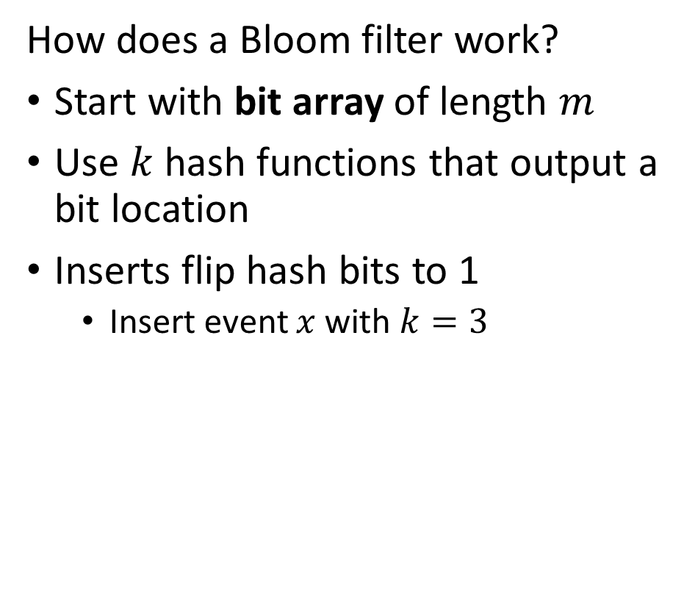


Filtering Event Data
0
1
$$f^{\left(1\right)}\left(x\right)$$
0
0
How does a Bloom filter work?
Start with bit array of length $m$
Use $k$ hash functions that output a bit location
Inserts flip hash bits to 1
  Insert event $x$ with $k=3$
0
$$f^{\left(2\right)}\left(x\right)$$
0
0
$$f^{\left(3\right)}\left(x\right)$$
1
0
0
0
0
0
0
0
1
…
0
0
0
0

Slide 50


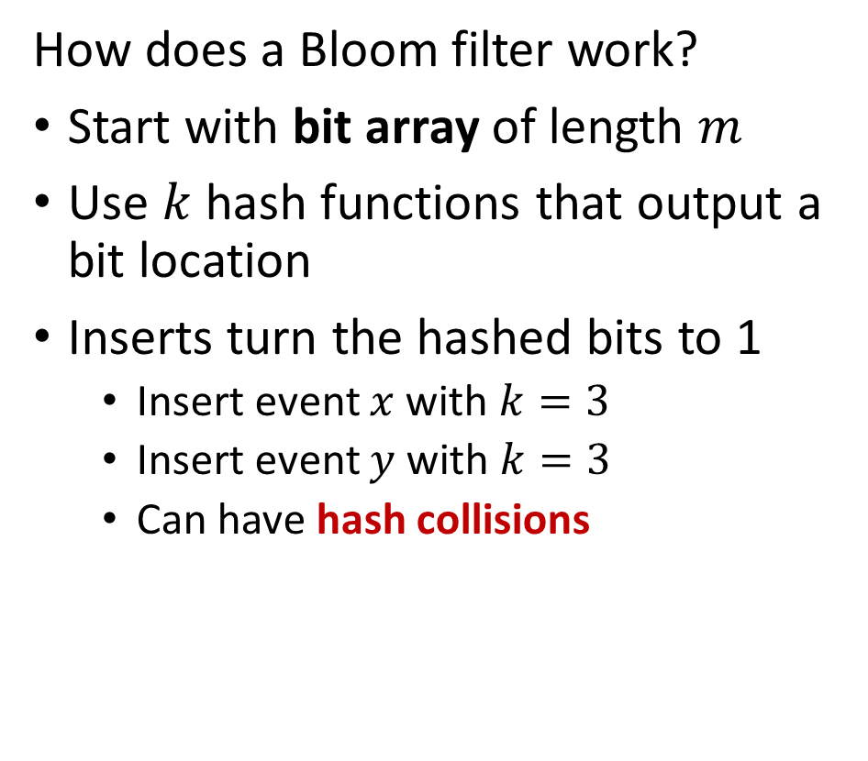

Filtering Event Data
0
1
$$f^{\left(1\right)}\left(x\right)$$
0
0
How does a Bloom filter work?
Start with bit array of length $m$
Use $k$ hash functions that output a bit location
Inserts turn the hashed bits to 1
  Insert event $x$ with $k=3$
  Insert event $y$ with $k=3$
  Can have hash collisions
0
$$f^{\left(2\right)}\left(x\right)$$
0
0
$$f^{\left(3\right)}\left(x\right)$$
1
0
1
0
$$f^{\left(1\right)}\left(y\right)$$
1
0
$$f^{\left(2\right)}\left(y\right)$$
0
0
$$f^{\left(3\right)}\left(y\right)$$
1
…
0
0
0
0

Slide 51

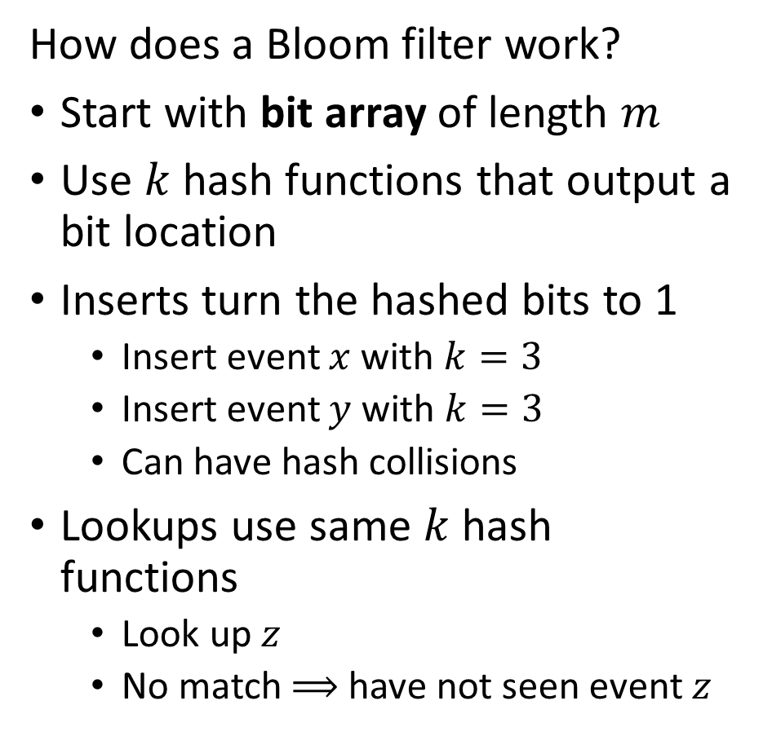


Filtering Event Data
0
1
$$f^{\left(1\right)}\left(z\right)$$
0
0
How does a Bloom filter work?
Start with bit array of length $m$
Use $k$ hash functions that output a bit location
Inserts turn the hashed bits to 1
  Insert event $x$ with $k=3$
  Insert event $y$ with $k=3$
  Can have hash collisions
Lookups use same $k$ hash functions
  Look up $z$
  No match $⟹$ have not seen event $z$
0
$$f^{\left(2\right)}\left(z\right)$$
0
0
$$f^{\left(3\right)}\left(z\right)$$
1
0
1
0
1
0
0
0
1
…
0
0
0
0

Slide 52
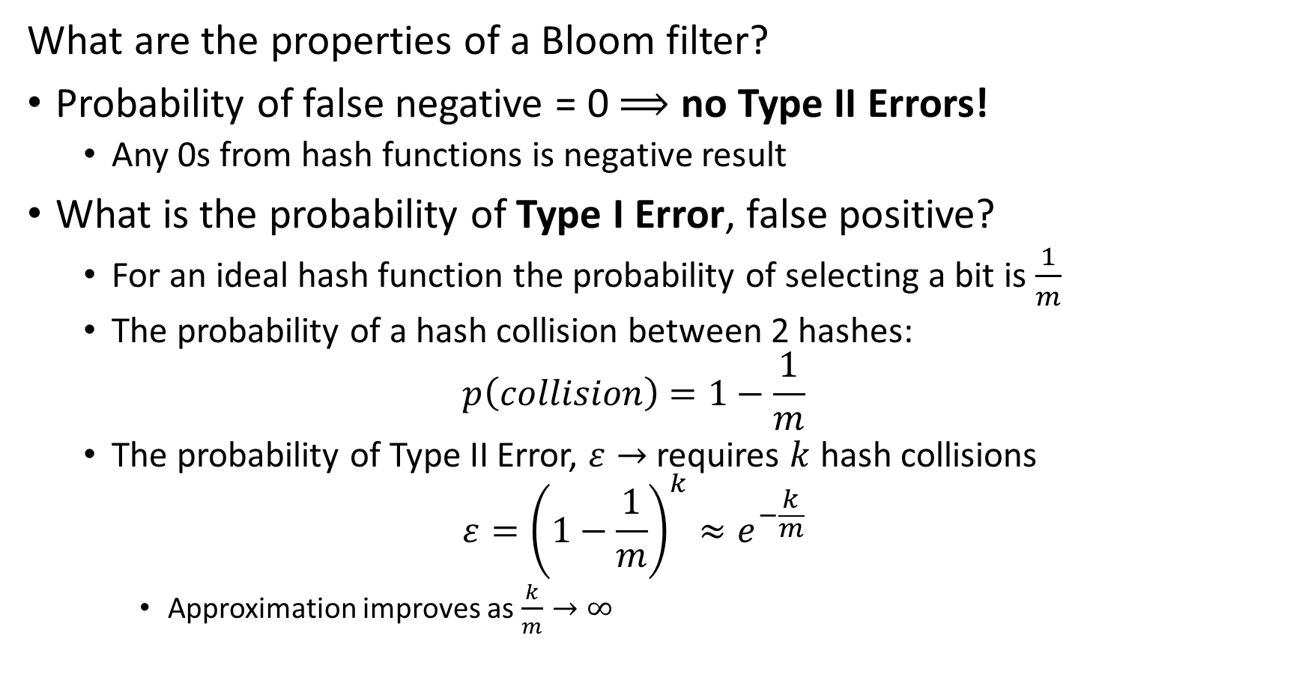
Filtering Event Data
What are the properties of a Bloom filter?
Probability of false negative = 0 $⟹$ no Type II Errors!
  Any 0s from hash functions is negative result
What is the probability of Type I Error, false positive?
  For an ideal hash function the probability of selecting a bit is $\frac{1}{m}$
  The probability of a hash collision between 2 hashes:
  $$p\left(collision\right)=1−\frac{1}{m}$$
  The probability of Type II Error, $ε→$ requires $k$ hash collisions
  $$ε={\left(1−\frac{1}{m}\right)}^{k}≈e^{−\frac{k}{m}}$$
    Approximation improves as $\frac{k}{m}→∞$

Slide 53
Filtering Event Data
Alternatives to Bloom filter
Variation capable of deletes:
  Each bit location has a counter
  When event type is deleted, a count is decremented from each hash location
Quotient filter is a sketch using a more sophisticated hashing scheme
  Memory efficient
  Generally lower false positive rate
  Manages counts in buckets
  Better use of memory and computation compared to Bloom filter
Find details for quotient filter in Algorithms and Structures for Massive Data Sets, Medjodovic, et al., 2022, Manning

Slide 54



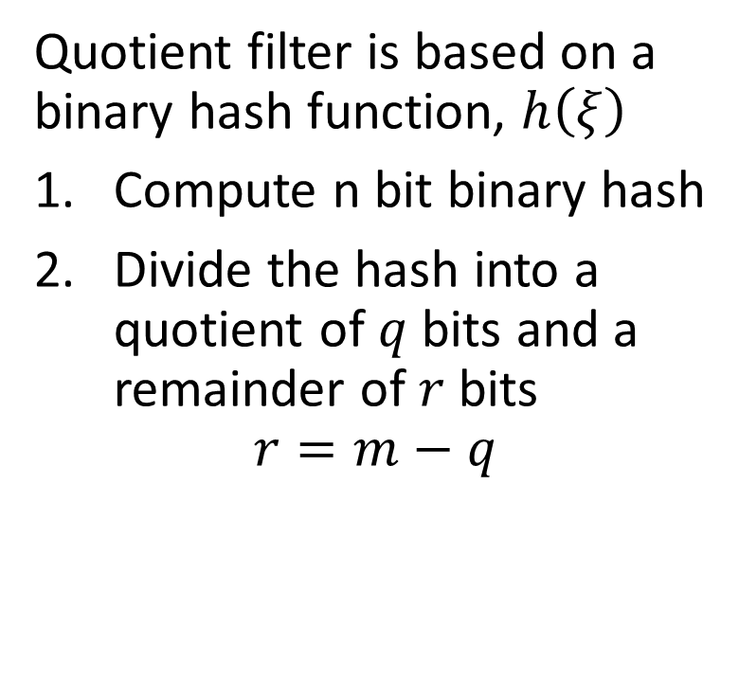















Filtering Event Data
Quotient filter is memory and computationally efficient
Quotient filter is based on a binary hash function, $h\left(ξ\right)$
Compute n bit binary hash
Divide the hash into a quotient of $q$ bits and a remainder of $r$ bits
$$r=m−q$$
Quotient
Remainder
$$h\left(w\right)=10001001010⇒$$
$$10001$$
$$001010$$
$$h\left(u\right)=10011000111⇒$$
$$10011$$
$$000111$$
$$h\left(v\right)=10011111111⇒$$
$$10011$$
$$111111$$
$$h\left(q\right)=10101101101⇒$$
$$10101$$
$$101101$$
$$h\left(x\right)=10110000111⇒$$
$$10110$$
$$000111$$
$$h\left(y\right)=00111111110⇒$$
$$00111$$
$$111110$$

Slide 55




Filtering Event Data
Quotient filter is memory and computationally efficient
The quotient defines a hash bucket
The remainder is the value
Notice the hash collision
Quotient
Remainder
$$h\left(w\right)=10001001010⇒$$
$$10001$$
$$001010$$
$$h\left(u\right)=10011000111⇒$$
$$10011$$
$$000111$$
$$h\left(v\right)=10011111111⇒$$
$$10011$$
$$111111$$
$$h\left(q\right)=10101101101⇒$$
$$10101$$
$$101101$$
$$h\left(x\right)=10110000111⇒$$
$$10110$$
$$000111$$
$$h\left(y\right)=00111111110⇒$$
$$00111$$
$$111110$$

Slide 56
Filtering Event Data
Quotient filter is memory and computationally efficient
Two key concepts used to manage hash collisions in quotient filters
A run is a consecutive sequence of slots occupied with remainders with the same quotient
A cluster is a continuous sequence of one or more runs
  Performance of quotient filter relies on the empirical evidence for the prevalence of short clusters
Linear probing is used to find open slots for remainders
  Stored consecutively
  Stored in sort order to improve search efficiency

Slide 57






























Filtering Event Data
Quotient filter is memory and computationally efficient
Quotient filters use three bits to manage linear probing to resolve hash collisions
Run Continued bit is set when the slot is occupied but not the first element of the run
Is Occupied bit is set when the slot is occupied by some other hash from another location
Is Shifted bit is set to indicate the value in the slot is from another bucket
Bucket Occupied
Run Continued
Is Shifted
Quotient
Remainder
$$0$$
$$0$$
$$0$$
$$10001$$
$$001010$$
$$1$$
$$0$$
$$0$$
$$10011$$
$$000111$$
$$1$$
$$0$$
$$1$$
$10$011
$$111111$$
$$0$$
$$0$$
$$0$$
$$10101$$
$$101101$$
$$0$$
$$0$$
$$0$$
$$10110$$
$$000111$$
$$0$$
$$0$$
$$0$$
$$00111$$
$$111110$$

Slide 58
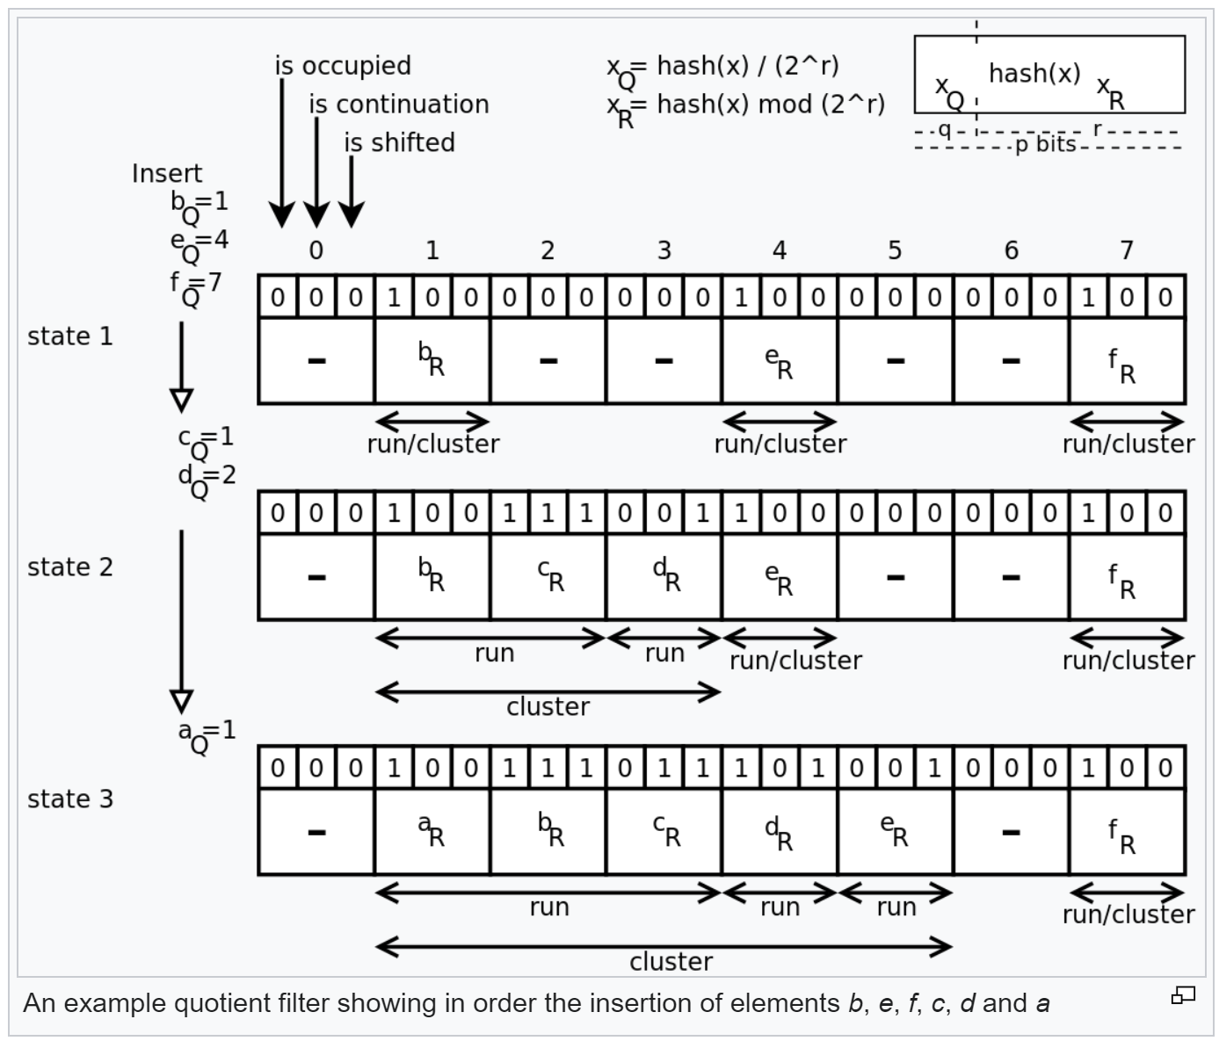
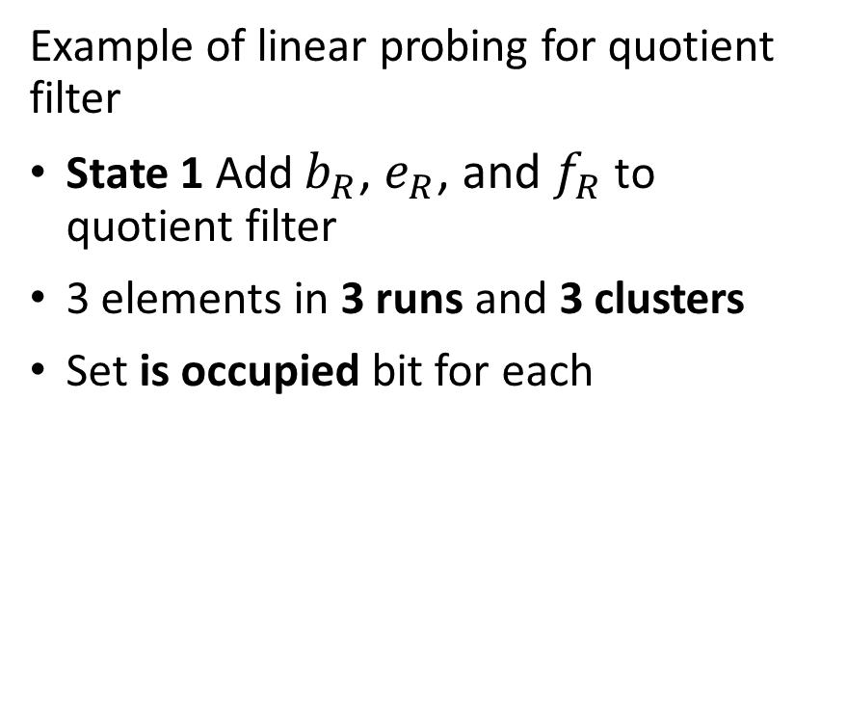
Filtering Event Data
Quotient filter is memory and computationally efficient
Example of linear probing for quotient filter
State 1 Add $b_{R}$, $e_{R}$, and $f_{R}$ to quotient filter
3 elements in 3 runs and 3 clusters
Set is occupied bit for each
Illustration from Wikipedia quotient filter article

Slide 59
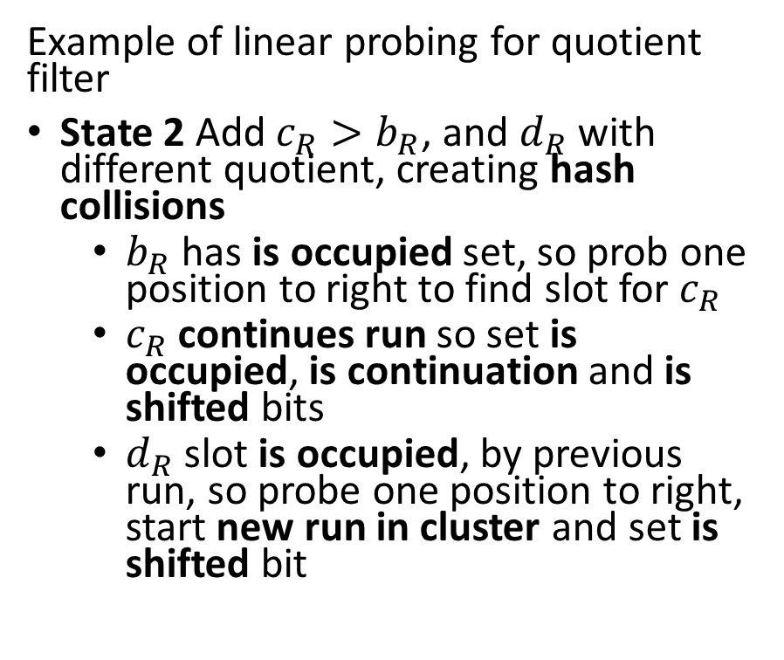
Filtering Event Data
Quotient filter is memory and computationally efficient
Example of linear probing for quotient filter
State 2 Add $c_{R}>b_{R}$, and $d_{R}$ with different quotient, creating hash collisions
  $b_{R}$ has is occupied set, so prob one position to right to find slot for $c_{R}$
  $c_{R}$ continues run so set is occupied, is continuation and is shifted bits
  $d_{R}$ slot is occupied, by previous run, so probe one position to right, start new run in cluster and set is shifted bit
Illustration from Wikipedia quotient filter article

Slide 60
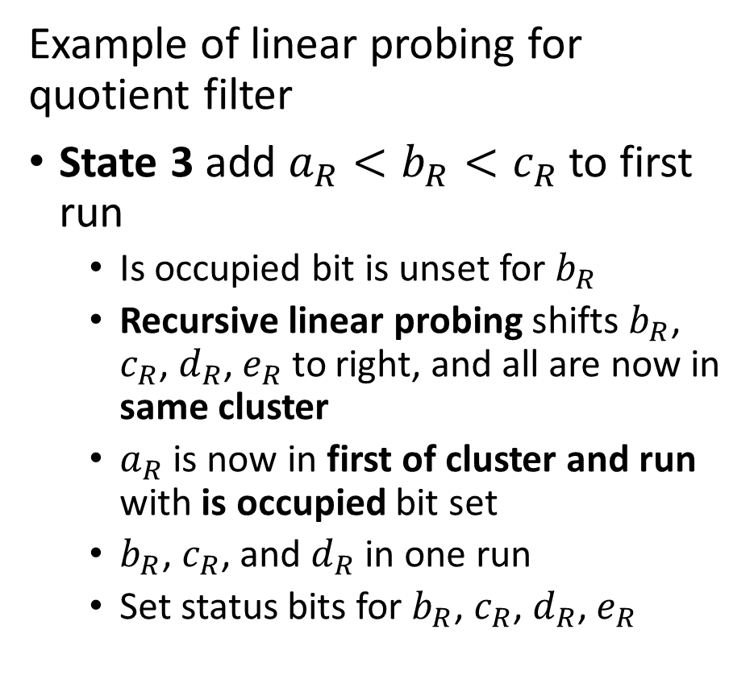
Filtering Event Data
Quotient filter is memory and computationally efficient
Example of linear probing for quotient filter
State 3 add $a_{R}<b_{R}<c_{R}$ to first run
  Is occupied bit is unset for $b_{R}$
  Recursive linear probing shifts $b_{R}$, $c_{R}$, $d_{R}$, $e_{R}$ to right, and all are now in same cluster
  $a_{R}$ is now in first of cluster and run with is occupied bit set
  $b_{R}$, $c_{R}$, and $d_{R}$ in one run
  Set status bits for $b_{R}$, $c_{R}$, $d_{R}$, $e_{R}$
Illustration from Wikipedia quotient filter article

Slide 61
Filtering Event Data
Merging and resizing the quotient filter
Quotient filters can be merged by adding remainders of one filter to the bins defined by the quotients of another filter
  Merging filters allows simple aggregation
  Quotients must have same number of bits, or can resize, so quotients match
  Need to ensure table is large enough to prevent quotient (hash) collisions.
Merging filters is useful for aggregation over multiple time periods
Can easily double the size of a quotient filter
  Most significant bit of reminder becomes least significant bit of quotient
  Adding a bit to the quotient doubles the size of the filter

Slide 62
Counting Discrete Events

Slide 63
Counting Events
Many applications of large-scale event counting
Events can be counted offline or online
  Counting events by scanning massive databases offline
  Counting events in streams in time windows
Applications
  Count vehicles in highway sensors
  Count trade volume in capital markets
  Counts of packets to manage capacity or find suspicious activity in networks
  Counts of transactions to find fraudulent activity
  Counts from wearable technology
  ……

Slide 64
Volume Reduction and Streaming Analytics
Event stream algorithms are both filters and analytics
Streams can be filtered and sampled near the source
Further filtering, sampling and sketching performed as preprocessing for analytics
Data Source
Filter/sample
Filter/sample/sketch
Stream analytic
Filter/sample/sketch
Stream analytic
Data Source
Filter/sample
$$⋮$$
$$⋮$$
$$⋮$$
$$⋮$$
Bandwidth limited network
Filter/sample/sketch
Stream analytic
Data Source
Filter/sample
Archival storage
Classical supervised and unsupervised ML
Server/Cloud
Minimum (filtered) data and analytics archived
Filtered streams and sketches used as input to classical ML

Slide 65
Counting Events
Count-min-sketch algorithm efficiently counts events
A full count table needs an entry for every possible event identifier
  Size is unbounded
  Unmanageable for large event set
We need a better approach!
A sketch is a minimal (approximate) representation of a data structure
Create a sketch of the counts using hash functions
  Count is approximated by the sketch
  Data structure is of fixed compact size!

Slide 66




Counting Events
Count-min-sketch employs a compact 2-dimensional data structure
Depth, d, hash functions, typically 10s
Width, w, buckets, typically 1000s
Compact data structure size leads to hash collisions
Width, w, buckets
1 | 2 | 3 | 4 | 5 | 6 | 7 | 8
0 | 0 | 0 | 0 | 0 | 0 | 0 | 0
0 | 0 | 0 | 0 | 0 | 0 | 0 | 0
0 | 0 | 0 | 0 | 0 | 0 | 0 | 0
0 | 0 | 0 | 0 | 0 | 0 | 0 | 0
$$h_{1}\left(\right)$$
Depth, d, hash functions
$$h_{2}\left(\right)$$
$$h_{3}\left(\right)$$
$$h_{4}\left(\right)$$

Slide 67
Counting Events
Count-min-sketch algorithm efficiently counts events
A sketch is a minimal (approximate) representation of a data structure
The count-min-sketch algorithm uses probabilistic sampling
Counts of events are added to the hash buckets in the sketch data structure
If no hash collisions, event counts in buckets for event identifier are exact
With inevitable hash collisions use minimum count in the hash buckets for the event identifier
  Never get an under-count
  Get over-count with some probability

Slide 68




Counting Events
Count-min-sketch employs a 2-dimensional data structure
Example, count events u, v, w, x, y
Event is tuple, (identifier, occurrences)
Event (u,1), add 1 to buckets indexed by hash functions for key u
1 | 2 | 3 | 4 | 5 | 6 | 7 | 8
0 | 0 | 1 | 0 | 0 | 0 | 0 | 0
0 | 0 | 0 | 0 | 0 | 0 | 1 | 0
1 | 0 | 0 | 0 | 0 | 0 | 0 | 0
0 | 0 | 0 | 0 | 1 | 0 | 0 | 0
$$h_{1}\left(u\right)=3$$
$$h_{2}\left(u\right)=7$$
$$h_{3}\left(u\right)=1$$
$$h_{4}\left(u\right)=5$$

Slide 69




Counting Events
Count-min-sketch employs a 2-dimensional data structure
Example, count events u, v, w, x, y
Event is tuple, (identifier, occurrences)
Event (v,2), add 2 to buckets indexed by hash functions, hash collision
1 | 2 | 3 | 4 | 5 | 6 | 7 | 8
2 | 0 | 1 | 0 | 0 | 0 | 0 | 0
0 | 0 | 0 | 0 | 0 | 2 | 1 | 0
1 | 0 | 0 | 2 | 0 | 0 | 0 | 0
0 | 0 | 0 | 0 | 3 | 0 | 0 | 0
$$h_{1}\left(v\right)=1$$
$$h_{2}\left(v\right)=6$$
$$h_{3}\left(v\right)=4$$
$$h_{4}\left(v\right)=5$$

Slide 70




Counting Events
Count-min-sketch employs a 2-dimensional data structure
Example, count events u, v, w, x, y
Event is tuple, (identifier, occurrences)
Event (w,1), add 1 to buckets, hash collision
1 | 2 | 3 | 4 | 5 | 6 | 7 | 8
3 | 0 | 1 | 0 | 0 | 0 | 0 | 0
0 | 0 | 0 | 0 | 1 | 2 | 1 | 0
1 | 0 | 1 | 2 | 0 | 0 | 0 | 0
0 | 0 | 0 | 0 | 3 | 1 | 0 | 0
$$h_{1}\left(w\right)=1$$
$$h_{2}\left(w\right)=5$$
$$h_{3}\left(w\right)=3$$
$$h_{4}\left(w\right)=6$$

Slide 71




Counting Events
Count-min-sketch employs a 2-dimensional data structure
Example, count events u, v, w, x, y
Event is tuple, (identifier, occurrences)
Event (x,3), add 3 to buckets, multiple hash collisions
1 | 2 | 3 | 4 | 5 | 6 | 7 | 8
3 | 0 | 4 | 0 | 0 | 0 | 0 | 0
0 | 0 | 0 | 3 | 1 | 2 | 1 | 0
3 | 0 | 1 | 2 | 0 | 0 | 0 | 0
0 | 3 | 0 | 0 | 3 | 1 | 0 | 0
$$h_{1}\left(x\right)=3$$
$$h_{2}\left(x\right)=4$$
$$h_{3}\left(x\right)=1$$
$$h_{4}\left(x\right)=2$$

Slide 72




Counting Events
Count-min-sketch employs a 2-dimensional data structure
Example, count events u, v, w, x, y
Event is tuple, (identifier, occurrences)
Event (y,2), add 2 to buckets, hash collision
1 | 2 | 3 | 4 | 5 | 6 | 7 | 8
3 | 2 | 4 | 0 | 0 | 0 | 0 | 0
0 | 0 | 0 | 5 | 1 | 2 | 1 | 0
3 | 0 | 1 | 2 | 2 | 0 | 0 | 0
0 | 3 | 0 | 0 | 3 | 1 | 0 | 2
$$h_{1}\left(y\right)=2$$
$$h_{2}\left(y\right)=4$$
$$h_{3}\left(y\right)=5$$
$$h_{4}\left(y\right)=8$$

Slide 73




Counting Events
Best estimate of count is minimum of counts in buckets of sketch data structure
Count-min-sketch algorithm finds upper bound on count
Actual count may be less than estimate, never greater
u | v | w | x | y
4 | 3 | 3 | 4 | 2
1 | 2 | 1 | 5 | 5
3 | 2 | 1 | 3 | 2
3 | 3 | 3 | 3 | 3
1 | 2 | 1 | 3 | 2
1 | 2 | 1 | 3 | 2
$$h_{1}$$
$$h_{2}$$
$$h_{3}$$
$$h_{4}$$
Min count
Actual count

Slide 74
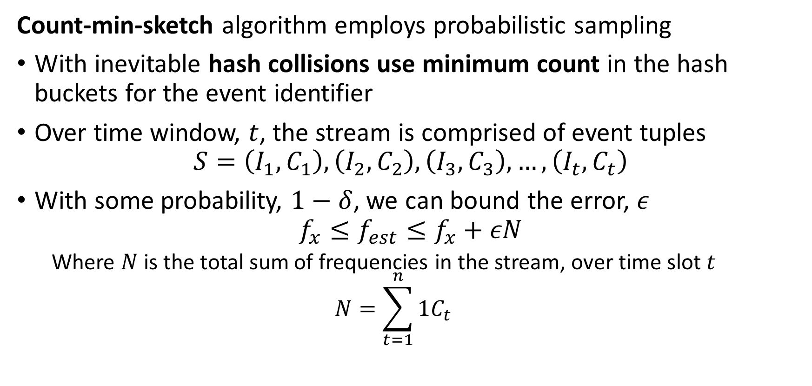
Counting Events
Count-min-sketch algorithm employs probabilistic sampling
With inevitable hash collisions use minimum count in the hash buckets for the event identifier
Over time window, $t$, the stream is comprised of event tuples
$$S=\left(I_{1},C_{1}\right),\left(I_{2},C_{2}\right),\left(I_{3},C_{3}\right),…,\left(I_{t},C_{t}\right)$$
With some probability, $1−δ$, we can bound the error, $ε$
$$f_{x}≤f_{est}≤f_{x}+εN$$
  Where $N$ is the total sum of frequencies in the stream, over time slot $t$
  $$N=\sum_{t=1}^{n}{1C_{t}}$$

Slide 75
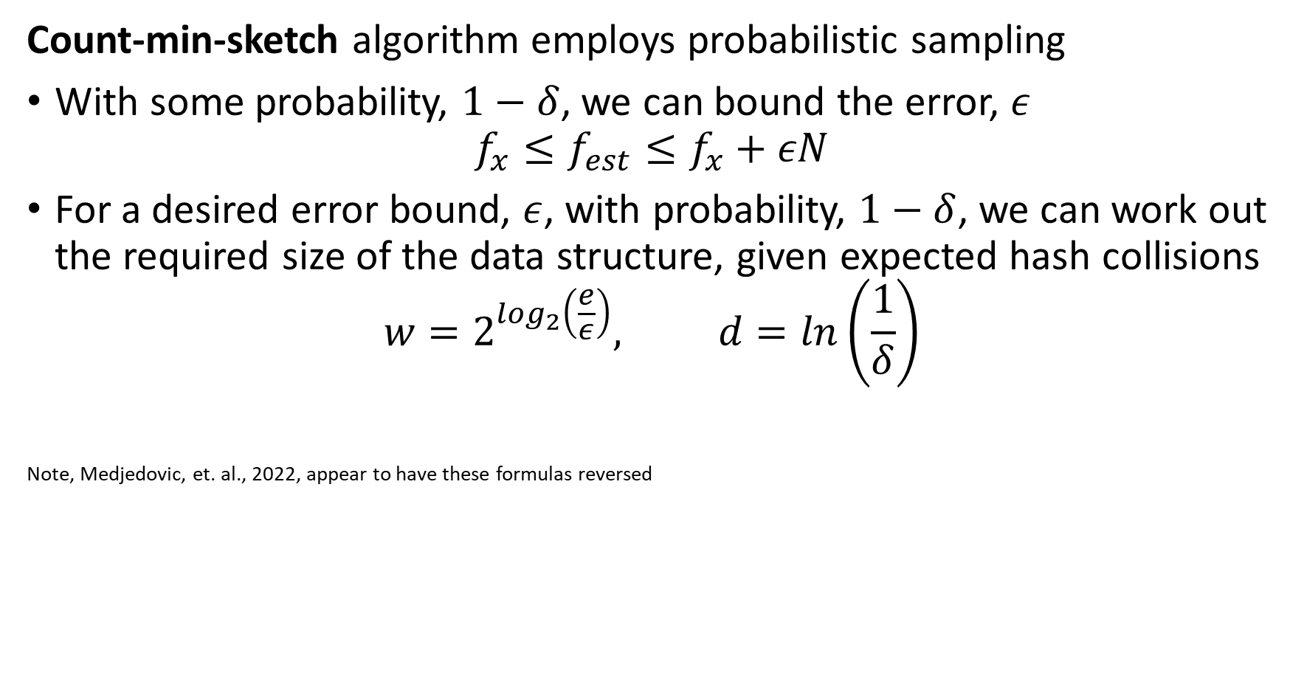
Counting Events
Count-min-sketch algorithm employs probabilistic sampling
With some probability, $1−δ$, we can bound the error, $ε$
$$f_{x}≤f_{est}≤f_{x}+εN$$
For a desired error bound, $ε$, with probability, $1−δ$, we can work out the required size of the data structure, given expected hash collisions
$$w=2^{\log_{2}\left(\frac{e}{ε}\right)}, d=ln\left(\frac{1}{δ}\right)$$
Note, Medjedovic, et. al., 2022, appear to have these formulas reversed

Slide 76
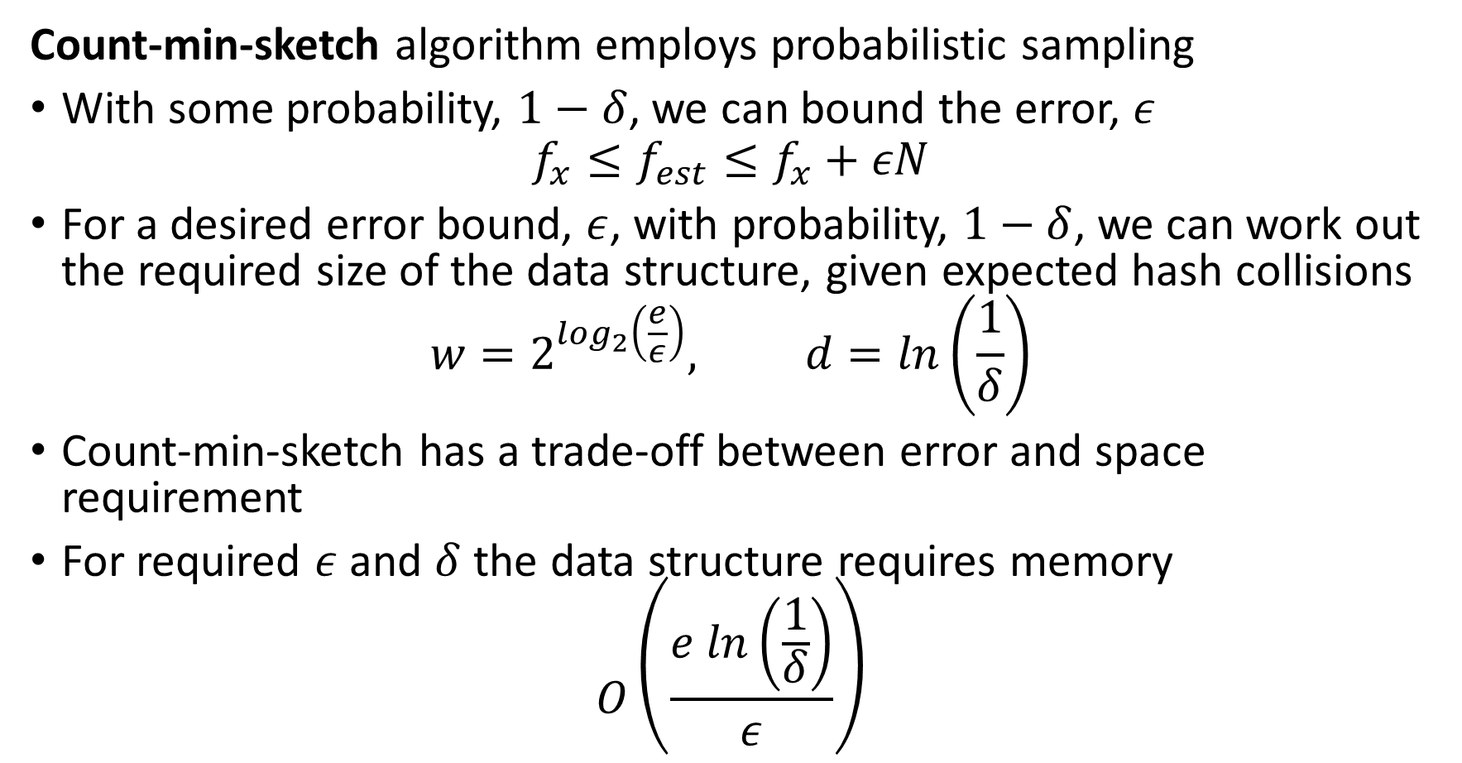
Counting Events
Count-min-sketch algorithm employs probabilistic sampling
With some probability, $1−δ$, we can bound the error, $ε$
$$f_{x}≤f_{est}≤f_{x}+εN$$
For a desired error bound, $ε$, with probability, $1−δ$, we can work out the required size of the data structure, given expected hash collisions
$$w=2^{\log_{2}\left(\frac{e}{ε}\right)}, d=ln\left(\frac{1}{δ}\right)$$
Count-min-sketch has a trade-off between error and space requirement
For required $ε$ and $δ$ the data structure requires memory
$$O\left(\frac{e ln\left(\frac{1}{δ}\right)}{ε}\right)$$

Slide 77
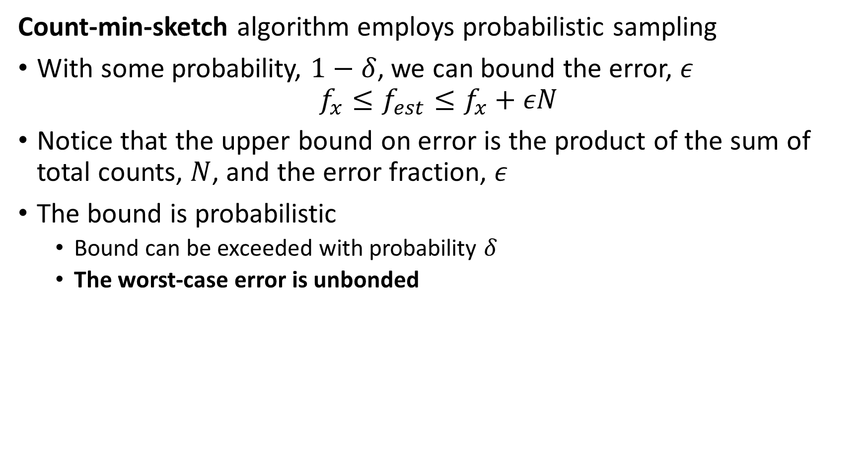
Counting Events
Count-min-sketch algorithm employs probabilistic sampling
With some probability, $1−δ$, we can bound the error, $ε$
$$f_{x}≤f_{est}≤f_{x}+εN$$
Notice that the upper bound on error is the product of the sum of total counts, $N$, and the error fraction, $ε$
The bound is probabilistic
  Bound can be exceeded with probability $δ$
  The worst-case error is unbonded

Slide 78
Counting Events
We can merge the sketches
Mergeability is a key property of sketches
Examples of merging count min sketches:
  Merge multiple sketches to represent longer time periods
  Merge sketches from several independent streams
Mergeable sketches allows parallel processing
  Process each stream independently
  Process multiple sub-queries from a database

Slide 79










Counting Events
We can merge the sketches
Mergeability is a key property of sketches
Sketches of same dimensions merged by summing elementwise
u | v | w | x | y
2 | 2 | 1 | 1 | 0
1 | 1 | 1 | 2 | 2
1 | 0 | 1 | 1 | 1
1 | 2 | 2 | 2 | 1
1 | 0 | 1 | 1 | 1
1 | 1 | 1 | 2 | 0
u | v | w | x | y
2 | 1 | 2 | 3 | 2
0 | 1 | 0 | 3 | 3
2 | 2 | 0 | 2 | 1
2 | 1 | 1 | 1 | 2
0 | 2 | 0 | 2 | 1
0 | 1 | 0 | 1 | 2
u | v | w | x | y
4 | 3 | 3 | 4 | 2
1 | 2 | 1 | 5 | 5
3 | 2 | 1 | 3 | 2
3 | 3 | 3 | 3 | 3
1 | 2 | 1 | 3 | 2
1 | 2 | 1 | 3 | 2
$$h_{1}$$
$$h_{1}$$
$$h_{2}$$
$$+$$
$$=$$
$$h_{2}$$
$$h_{3}$$
$$h_{3}$$
$$h_{4}$$
$$h_{4}$$
Min count
Actual count

Slide 80
Summary
Key points for this lesson
Streaming data often arrives at a massive scale
Down sample streams with real-number values
  Moving averages
  Delta coding
  Exponential weighting
  Reservoir sampling
  ….
Use probabilistic sketch algorithms for discrete event streams
  Uniqueness – have we seen this event type before?
  Counts – how many of these events in time interval?
  Cardinality – how many event types?
  Quantiles – what is the density of the distribution?
  …

