Slide 1
Doing a race thing
Daisy Intelligence Hackathon 2019
Jonah and Leon

Slide 2
Strategy
First solve unconstrained problem. Assume we have an infinite supply of gas and tire.
What’s the best acceleration/breaking strategy?
We then modify the strategy to satisfy gas and tire constraints
Do this for every car configuration and pick the best

Slide 3
Greedy Smoothing
Given the unconstrained acceleration plan, we iteratively reduce speeds to not run out of gas/tire
From a given solution, we look locally at how shifting down each velocity affects gas/tire usage and time
Decrease the velocities that have a good ratio until we make it to the end without running out

Slide 4
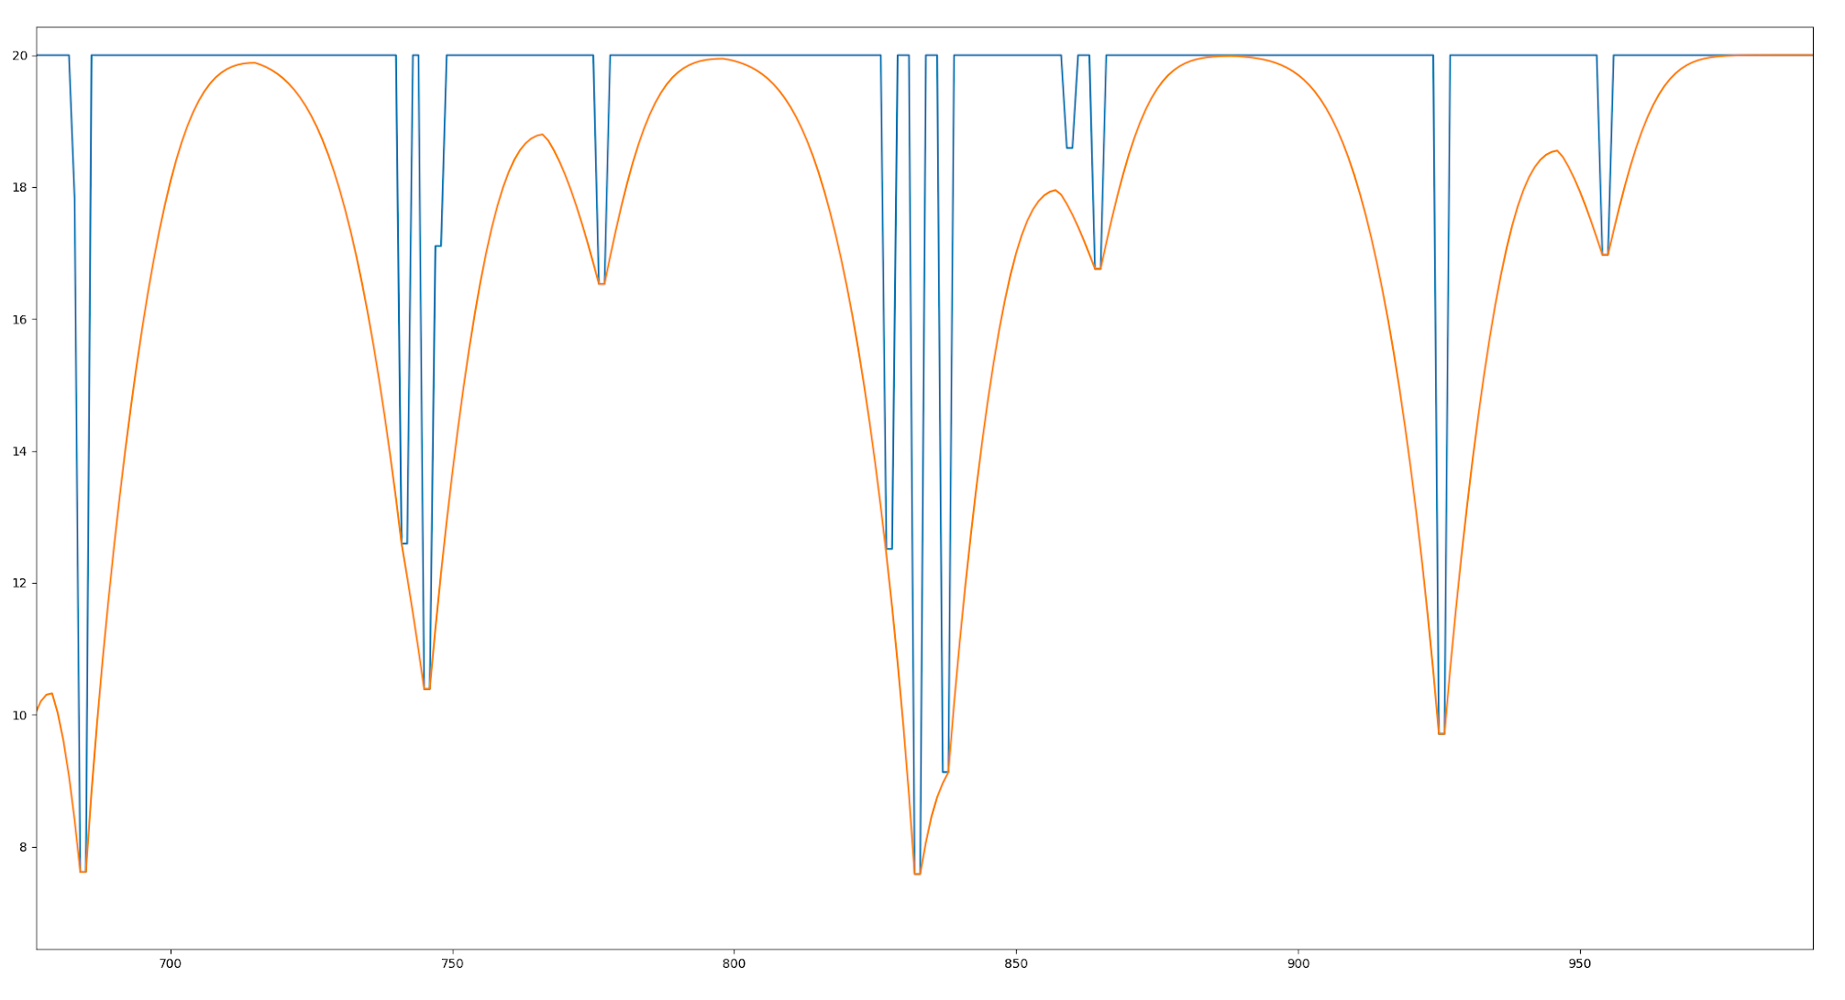
Reduction Strategy
Where is the least time-costly place to save fuel/tire?

Slide 5
Adding Pit stops
First, we tried spreading the stops uniformly over the total track
Next, we tried placing stops based on gas consumption in the unconstrained strategy.
It turns out our algorithm doesn’t like pit stops anyways.

