Slide 1

BIG BIRD AND XLNET
Jonah Winninghoff

Slide 2



THESIS
Two text summarizations are compared using specific metrics and a timer.
Transferred Learnings: Big Bird and XLNet Transformers
Metrics: Recall-Oriented Understudy for Gisting Evaluation (ROUGE)
Timer with CPU 1.6 GHZ

Slide 3
BUT SO WHAT?
The Transformers has self-attention expensive to compute especially for longer sequence.
The Google Research team attempts to solve this using block sparsity.
Their mathematical assessment shows that this approach reduces this quadratic dependency to linear dependency in time or memory term, which is skeptical.
THESIS
Two text summarizations are compared using specific metrics and a timer.
Transferred Learnings: Big Bird and XLNet Transformers
Metrics: Recall-Oriented Understudy for Gisting Evaluation (ROUGE)
Timer with CPU 1.6 GHZ

Slide 4
OUTLINE
Describe Transformers and Big Bird architectures
Explain method, dataset, and research questions
Share actionable insights and future research ideas
THESIS
Two text summarizations are compared using specific metrics and a timer.
Transferred Learnings: Big Bird and XLNet Transformers
Metrics: Recall-Oriented Understudy for Gisting Evaluation (ROUGE)
Timer with CPU 1.6 GHZ

Slide 5
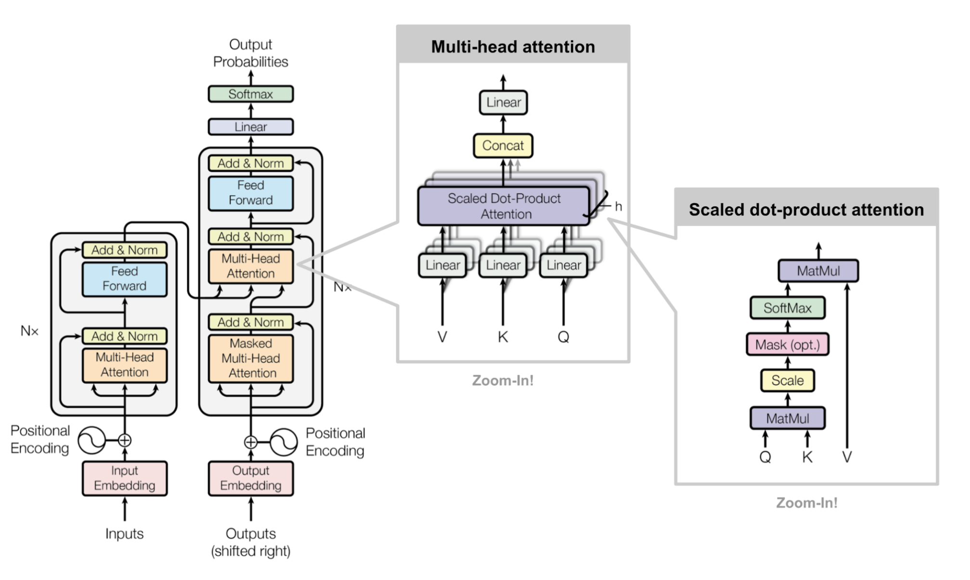
(Vaswani et al., 2017)

Slide 6
TRANSFORMERS ARCHITECTURE
The representation of encoder is the word embedding of X (x₁, …, x_{n}), such as article text.
The representation of decoder is the word embedding of Z (z₁, …, z_{n}), such as ground-truth summary.
Multi-head attention contains head_{i} that contains attention.

Slide 7

FORMULAS:
$$Attention\left(Q,K,V\right)=softmax\left(\frac{QK^{T}}{\sqrt{d_{k}}}\right)V$$
$${head}_{i}=Attention\left(QW_{i}^{Q},KW_{i}^{K},VW_{i}^{V}\right)$$
$MultiHead(Q,K,V)=Concat({head}_{i}$,…, ${head}_{h}$)
Q = a matrix of queries
K = a matrix of keys
V = a matrix of values (or weights)
W = a matrix of weights
d_{k} = dimensionality of key

Slide 8
XLNET
For this research, the XLNet is in use. This model is different by maximum log likelihood of the sequence wrt permutation being in used.
The fundamental of the model remains same.

Slide 10
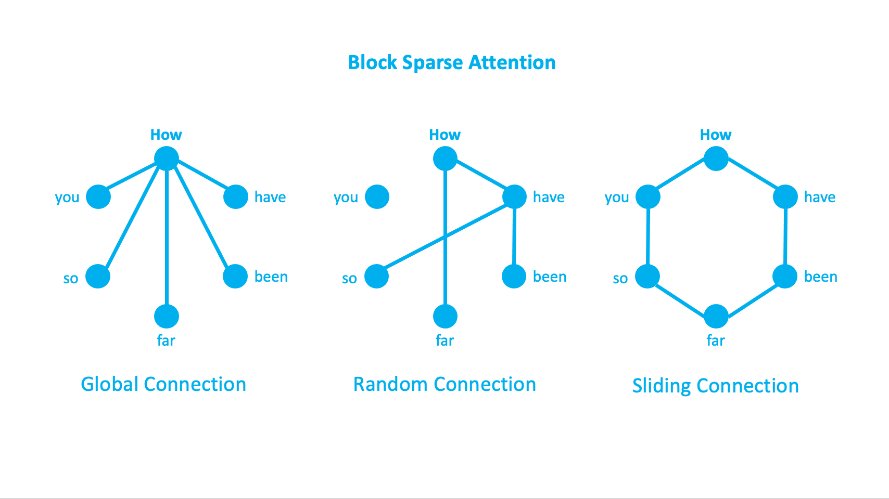
BIG BIRD ARCHITECTURE

Slide 11
BLOCK SPARSITY
The concept of sliding and global connections is not novel but what is new is random connection.
Perhaps, the Google Research team develops the random connection based on CLT and LLN.
For example, predicted summaries become more consistent when sequence length is longer.
But this comes with the price of no theoretical guarantees.

Slide 12



METHOD
Partial NLP data science pipeline and Randomized Controlled Trials (RCTs)
Variables: article, actual abstract, predicted abstract, word counts for each, and type of model.
Target variables: time per predicted abstract (in seconds), ROUGE-1 F1 score, ROUGE-2 F1 score, and ROUGE-L F1 score

Slide 13
ROUGE-N
ROUGE-N F1-score is a measure of model accuracy based on a number of matching n-grams between predicted and ground-truth summaries.
For example, ROUGE-1 means a number of matching unigram.
ROUGE-1 means a number of matching the longest common subsequence (LCS).
METHOD
Partial NLP data science pipeline and Randomized Controlled Trials (RCTs)
Variables: article, actual abstract, predicted abstract, word counts for each, and type of model.
Target variables: time per predicted abstract (in seconds), ROUGE-1 F1 score, ROUGE-2 F1 score, and ROUGE-L F1 score

Slide 14
DATASET
The arXiv journals prepared by TensorFlow is in use, which contains article_id, article_text, and actual abstract text.
Three subsets: testing (6,658 entities), training (119,924 entities), and validation (6,633 entities) sets.
70.8% of tokens in article texts matches NLTK dictionaries while 62.05% in abstract text matches these dictionaries
METHOD
Partial NLP data science pipeline and Randomized Controlled Trials (RCTs)
Variables: article, actual abstract, predicted abstract, word counts for each, and type of model.
Target variables: time per predicted abstract (in seconds), ROUGE-1 F1 score, ROUGE-2 F1 score, and ROUGE-L F1 score

Slide 15
DATASET
For this research, validation set is in use. This set is unseen, technically.
Why?
Big Bird model is pretrained with Wikipedia dataset.
XLNet model is pretrained with several datasets other than arXiv.
METHOD
Partial NLP data science pipeline and Randomized Controlled Trials (RCTs)
Variables: article, actual abstract, predicted abstract, word counts for each, and type of model.
Target variables: time per predicted abstract (in seconds), ROUGE-1 F1 score, ROUGE-2 F1 score, and ROUGE-L F1 score
Random sampling for this set to predict is 110 in total for each model. This data collection takes two days.

Slide 16
RESEARCH QUESTIONS
?
Does the Big Bird model outperform XLNet model?
?
Being compared with XLNet model, how fast Big Bird can produce each predicted summary?
?
Does the Big Bird successfully reduce this quadratic dependency to linear dependency in sequence term?

Slide 17
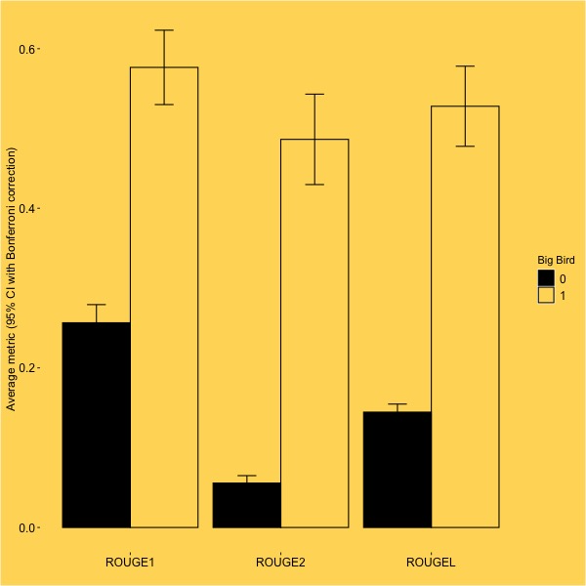
Average metric (95% CI with Bonferroni correction)
ROUGE-1
ROUGE-2
ROUGE-L

Slide 18
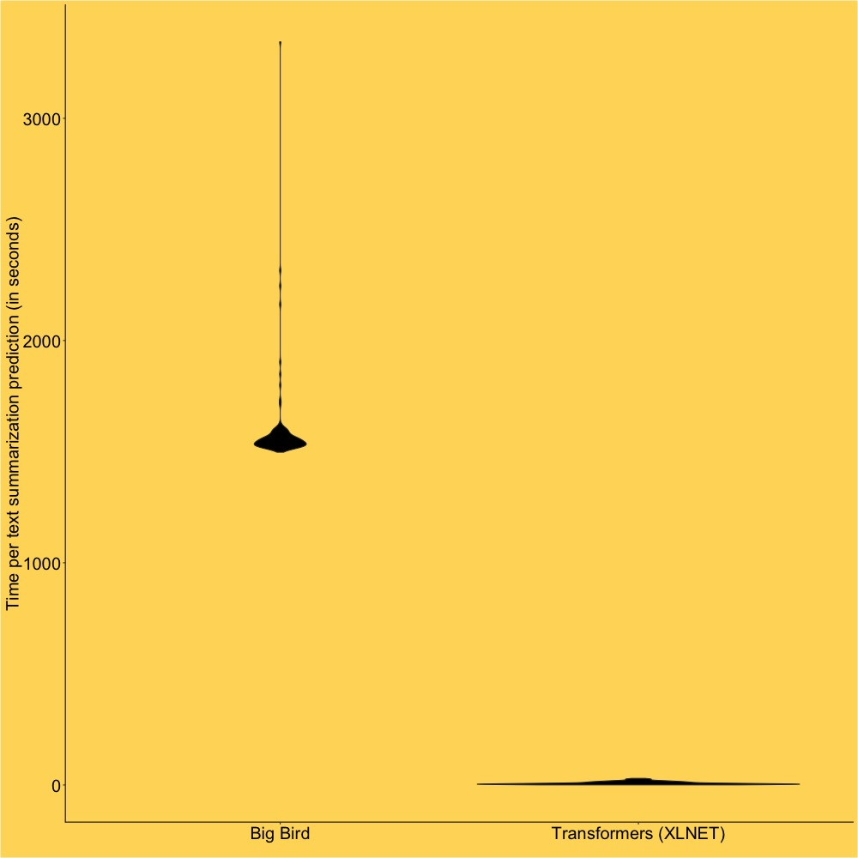
Time per predicted summary (in seconds)
Big Bird
Transformers (XLNET)

Slide 19
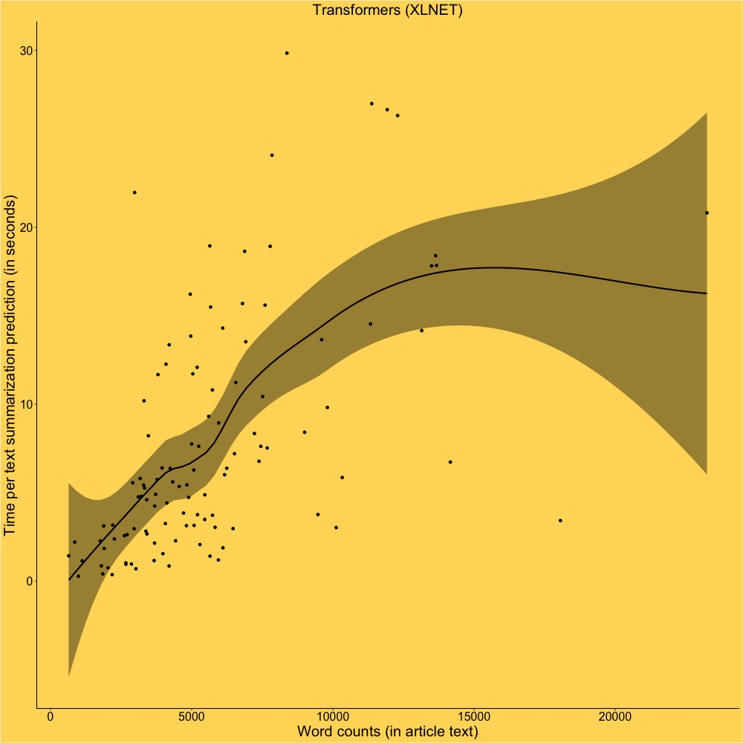
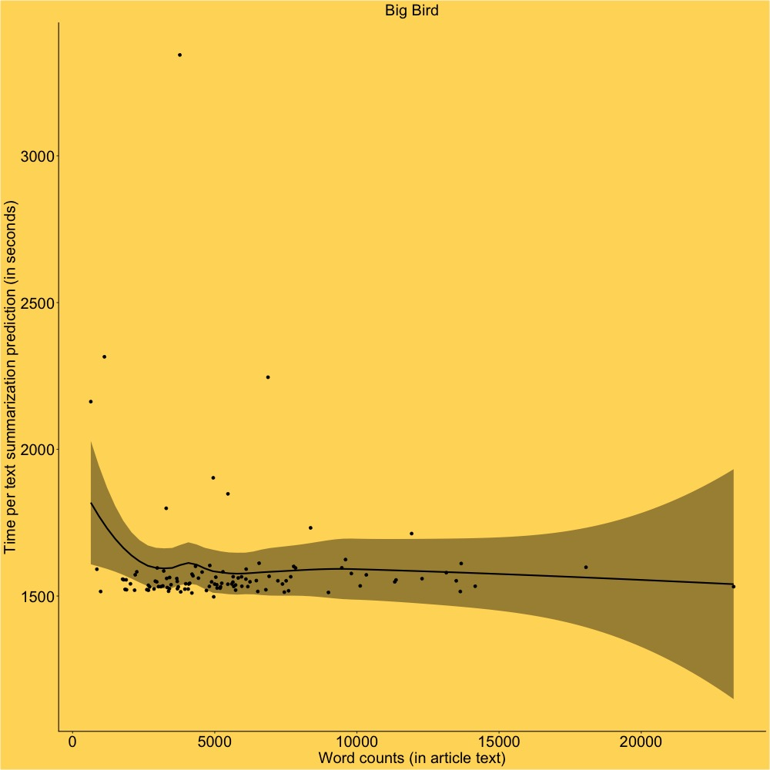
Transformers (XLNET)
Big Bird
Time per predicted summary (in seconds)
Time per predicted summary (in seconds)
Word counts (in article text)
Word counts (in article text)

Slide 20
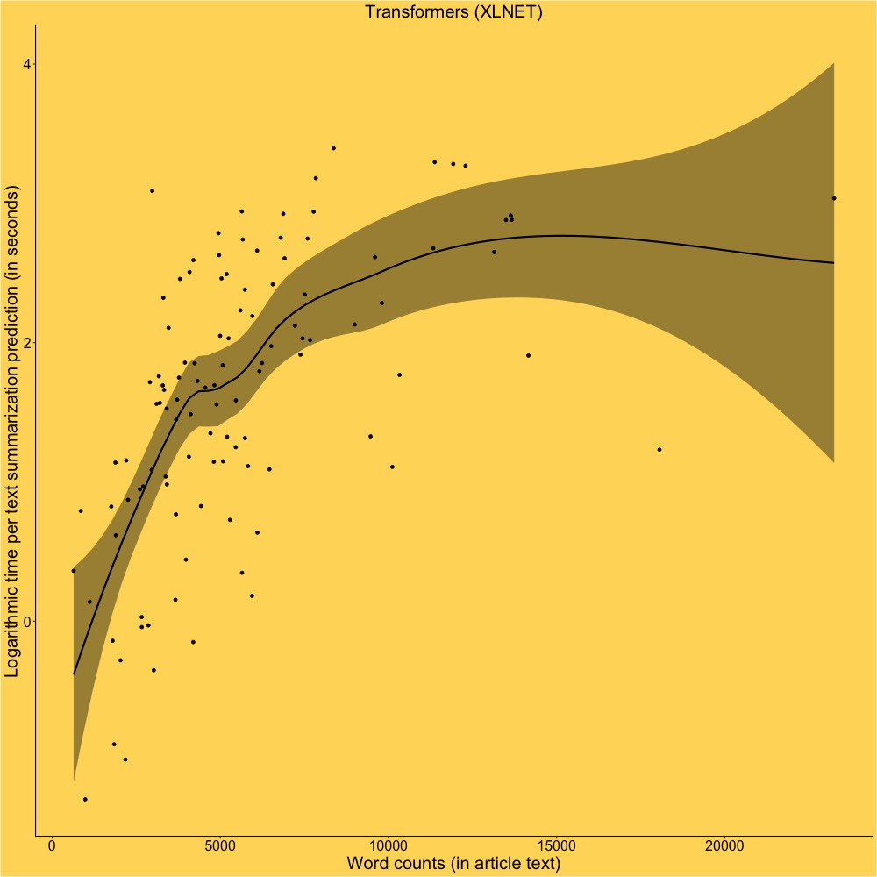
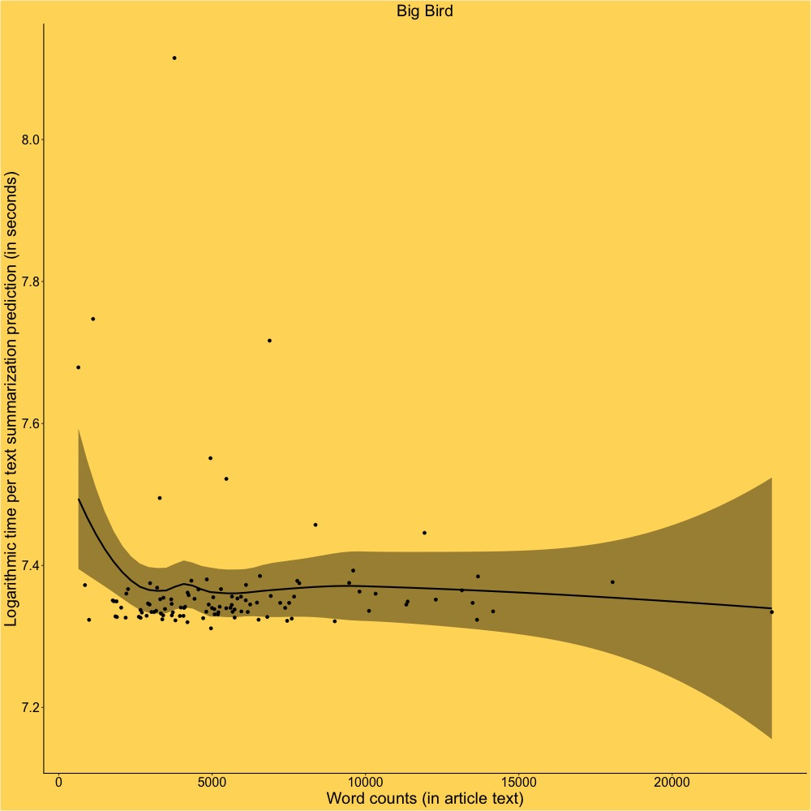
Transformers (XLNET)
Big Bird
Logarithmic time per predicted summary (in seconds)
Logarithmic time per predicted summary (in seconds)
Word counts (in article text)
Word counts (in article text)

Slide 21



CONCLUSION AND FUTURE WORK
Big Bird model does better with predicting summary and successfully linearize self-attention. However, the speed of this model is 193.04 wpm by median.
The Big Bird algorithm is highly recommended for producing summaries as long as if the cloud environment is in use.
To address scalability and redundancy problems, Attention Free Transformer and Bayesian connection need to be tested with block sparsity.

Slide 22
REFERENCES
Brochu, E., Cora, VM., and Freitas, N. “A Tutorial on Bayesian Optimization of Expensive Cost Functions, With Application to Active User Modeling and Hierarchical Reinforcement Learning.” arXiv, Dec. 2020. https://www.math.umd.edu/~slud/RITF17/Tutorial_on_Bayesian_Optimization.pdf
Child, R., Gray, S., Radford, A., and Sutskever, I. “Generating Long Sequences with Sparse Transformers.” arXiv, 2019. https://arxiv.org/pdf/1904.10509.pdf
Rayner, K., Slattery, TJ., and Bélanger, NN. “Eye movements, the perceptual span, and reading speed.” Psychon Bull Rev., Dec. 2010. doi: 10.3758/PBR.17.6.834
Gupta, V. “Understanding BigBird’s Block Sparse Attention.” Huggingface, Mar. 2021. https://huggingface.co/blog/big-bird
Vaswani, A., Shazeer, N., Parmar, N., Uszkoreit, J., Jones, Ł., Gomez, AN., Kaiser, L., and Polosukhin, I. “Attention is All You Need.” Advances in Neural Information Processing Systems 30. NIPS, 2017. https://proceedings.neurips.cc/paper/2017/file/3f5ee243547dee91fbd053c1c4a845aa-Paper.pdf
Yang, Z., Dai, Z., Yang, Y., Carbonell, J., Salakhutdinov, R., and Le., QV. “XLNet: Generalized Autoregressive Pretraining for Language Understanding.” arXiv, Jan. 2020.https://arxiv.org/pdf/1906.08237v2.pdf
Zaheer, M., Guruganesh, G., Dubey, A., Ainslie, J., Alberti, C., Ontanon, S., Philip, P., Ravula, A., Wang, Q., Yang, L., and Amr Ahmed, A. “Big Bird: Transformers for Longer Sequences.” Advances in Neural Information Processing Systems 33, NeurIPS, 2020. https://papers.nips.cc/paper/2020/file/c8512d142a2d849725f31a9a7a361ab9-Paper.pdf
Zhai, S., Talbott, W., Srivastava, N., Huang, C., Goh, H., Zhang, R., and Susskind, J. “An Attention Free Transformer.” arXiv, Sep. 2021. https://arxiv.org/pdf/2105.14103.pdf

