Slide 1
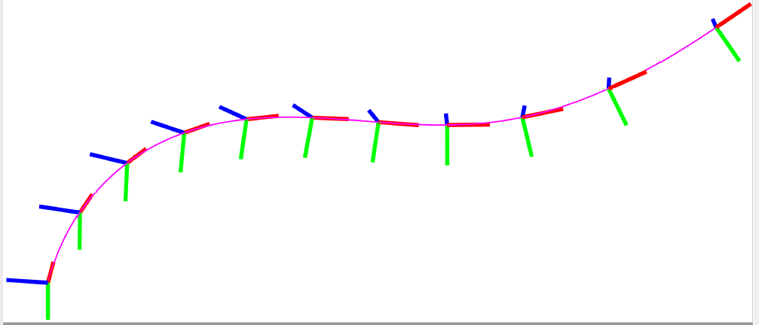
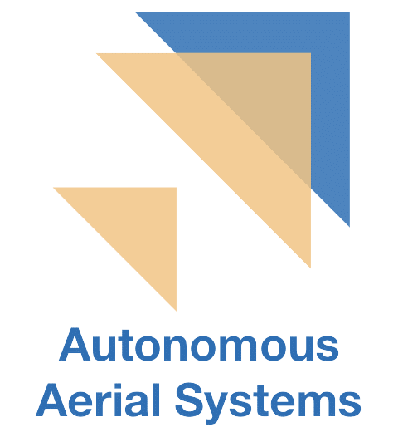
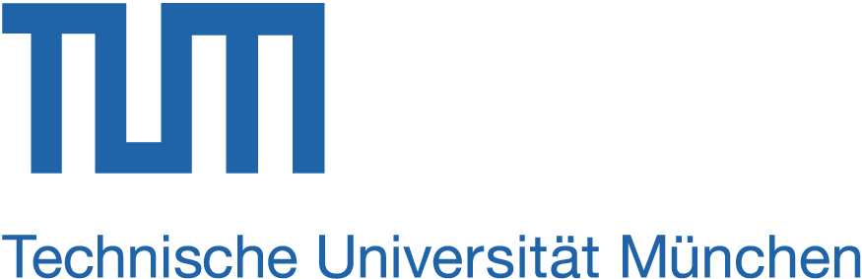
Pose-Following
with
Dual Quaternions
Jon Arrizabalaga, Markus Ryll
jon.arrizabalaga@tum.de, markus.ryll@tum.de
Technical University Munich, Autonomous Aerial Systems
Notes:
Hi everyone! My name is Jon Arrizabalaga and I am a PhD student at the Technical University of Munich. Today I will be presenting our work on “Pose-Following with Dual Quaternions”. This is a joint project with my supervisor Prof. Markus Ryll.

Slide 2

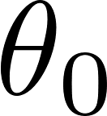
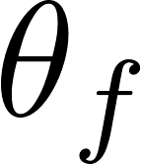

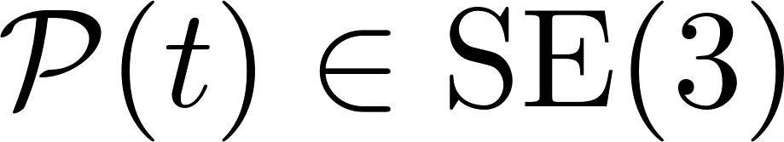
Motivation
Which problem are we tackling?
Simultaneous position and attitude control pose-control
1
2
Dynamic system
2
1
2
Geometric reference
Notes:
Our motivation comes from simultaneous position and attitude control. Given a * rigid body and a * geometric reference parametrized by a variable, theta in this case, we aim to design a control method that to not only converges in * position, but also in * orientation.

Slide 3
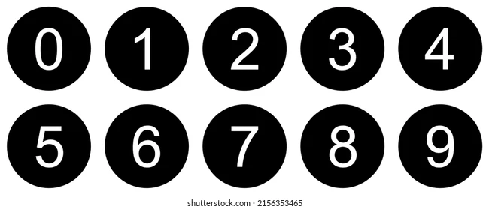

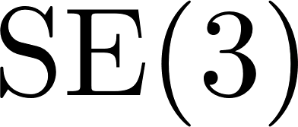

Motivation
What is state-of-the-art?
Decoupled
Position Control → Translations
Attitude Control → Rotations
Agnostic to interdependence between rotational and translational dynamics
Globally expressed
Special Euclidean Group
Singularity-free
Extend PD control design to pose-control
Leverage group structure
Very well-stablished across a wide range of applications [ 1, 2, 3, 4]
[1] Geometric tracking control of a quadrotor UAV on SE(3), T. Lee, M. Leok, and N. H. McClamro, CDC, 2010
[2] Robust kinematic control of manipulator robots using dual quaternion, L. Figueredo, B. V. Adorno, J. Y. Ishihara, and G. A. Borges, ICRA, 2013
[3] MIT Cheetah 3: Design and control of a robust, dynamic quadruped robot, G. Bledt, M. J. Powell, B. Katz, J. Di Carlo, P. M. Wensing, and S. Kim, IROS, 2018
[4] Adaptive position and attitude-tracking controller for satellite proximity operations using dual quaternions, N. Filipe et. al. , Journal of Guidance, Control, and Dynamics, 2015
Notes:
The simplest approach to address the pose control problem is * decoupling it into two separate subproblems. On the one hand, a position controller drives the translational motions, and on the other hand, an attitude controller regulates the rotational behavior. This separation relates to the de facto representation of the rigid body dynamics, in which the translational and angular motions are expressed separately. * However, such partitioning poses a challenge to effectively control the interdependence between the rotational and translational dynamics.
An alternative to this decoupling is * representing the system dynamics globally on the configuration manifold of the special Euclidean group SE(3). Doing so allows for * leveraging the group structure to first avoid singularities and, second design proportional derivative (PD) feedback pose-controllers. Such control methods have * shown very promising results within a wide range of applications. Despite these achievements, even the controllers designed within the SE3 group have their own limitations.

Slide 4

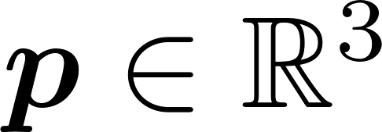
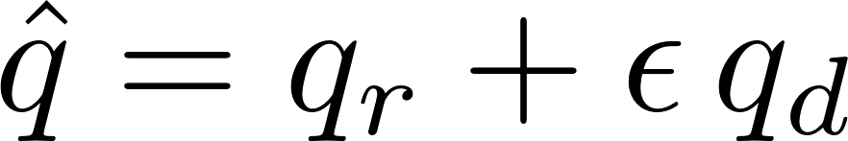
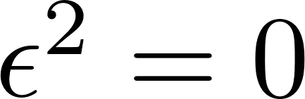
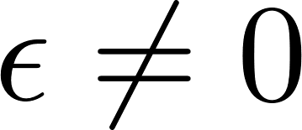
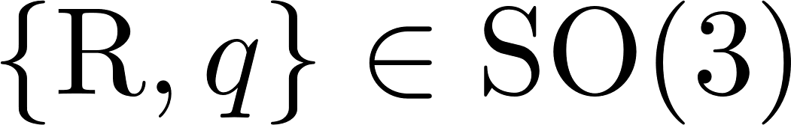
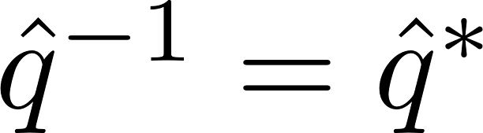
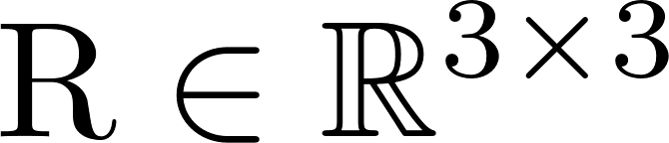
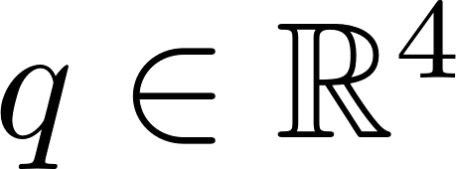
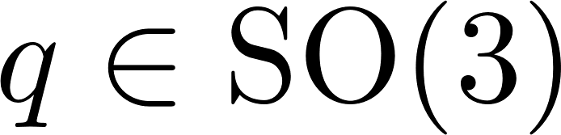
Motivation
→ Quaternion multiplication
Limitations of state-of-the-art
What do we propose?
Pose representation
Unit Dual Quaternions (UDQ)
Position
Orientation
Rotation matrices
Unit quaternions
with and
Unit
where,
Translation vector
Rotation quaternion
Not compact
Inefficient “pose” operations
Multiple equilibrium points
Two separate “pose-error” functions
Compact
Efficient “pose” operations
Two equilibrium points
Unique (coupled) “pose-error” function
UDQ Control methods
Reference-tracking
Rely on predefined time-varying reference
“… when to be where …”
Notes:
To represent the pose * of a rigid body in SE3 , it is customary to combine a three-dimensional vector of the Cartesian coordinates with either a rotation matrix or a unit quaternion. Starting with the rotation matrix, one of its drawbacks is * that it is not a compact representation, since it is given by a 3 by 3 matrix, resulting in a total of 9 parameters. An alternative solution is to use unit quaternions, which only rely on 4 values. Other than that, * with such representations the computation of rotation and position is performed independently, making it more difficult and inefficient to operate with poses. When it comes to control design, there are two shortcomings that are worth highlighting: First, * both the rotation matrices and unit quaternions contain multiple equilibrium points. Second, rather than relying on a single pose-error function, rotation matrices and unit quaternions require two separate functions: one for the position-error and another one for the attitude-error.
To overcome these limitations *, we propose to use a less popular –yet full of potential– SE3 parameterization: * Unit Dual Quaternions. A dual quaternion consists of a standard quaternion whose components are given by dual numbers. For a dual quaternion to be * unit, its inverse needs to be equal to the conjugate. Just as unit quaternions represent rotations, unit dual quaternions describe three-dimensional pose-transformations. In other words, * translations and rotations. More specifically, a unit dual quaternion consisting of a translation vector p and a rotation quaternion q corresponds to a screw motion and is given by the equation highlighted in yellow. Due to the time constraints of this presentation, I will not provide further details on formally defining this screw motion. If interested, please check the paper.
When compared to the more conventional pose representations, unit dual quaternions overcome most of the aforementioned limitations. First, * their parameterization is compact since it only relies on 8 numbers. Second, their utilization is * simple and efficient, because a series of rigid movements can be expressed as a sequence of dual quaternion multiplications. Third, due to their quaternion-based nature, * unit dual quaternions inherit the double coverage of SO3, and thus, have two equilibrium points. Last but not least, * unit dual quaternions allow to represent the pose-error with a single function.
Due to these appealing properties, unit dual quaternions have received considerable attention in the literature. Despite this recent raise in interest, the majority of the existing methods exclusively focus on reference-tracking. To properly emphasize this limitation, lets take a tangent and clearly state the differences between reference-tracking and reference-following.

Slide 5
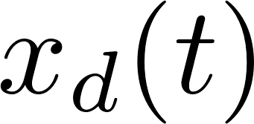
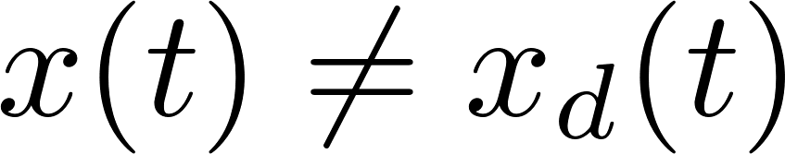
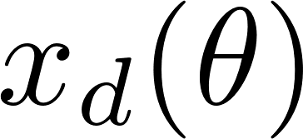
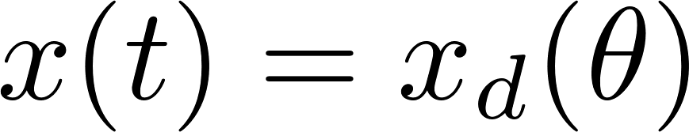
Motivation
Tracking vs Following
Path-Tracking
“ … when to where … “
Path-Following
Notes:
In path-tracking the desired state evolves with time and is agnostic to the system’s states. This might lead to an undesired system performance. To understand this, lets focus on the following illustrative example * . Let's assume that a dynamical system, shown in red, is accurately tracking a desired state, depicted in blue. This desired state depends on time and moves along the black geometric reference. If at any point an * external disturbance hinders the progress of the system, the time-based reference will * keep moving, while the dynamical system remains stuck. Once the disturbance * disappears, it will try to catch up, resulting in an increased tracking-error. In literature * this is commonly summarized as a method that imposes “when to be where”.
In response to this undesired behavior *, path-following does not rely on a predefined reference but leverages the progress along the path as an additional degree of freedom. More intuitively, in the previous illustrative example, when the dynamical system * gets blocked by the external disturbance, the desired state * is dependent on the progress along the path, and therefore, does not keep moving forward. As a consequence, * once the system is set free, the dynamical system proceeds to follow the path without any deviations..
Having clarified the benefits of path-following, lets get back to the previous slide.

Slide 6
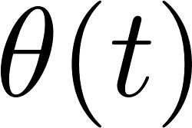
Motivation
→ Quaternion multiplication
Limitations of state-of-the-art
What do we propose?
Pose representation
Unit Dual Quaternions (UDQ)
Position
Orientation
Rotation matrices
Unit quaternions
with and
Unit
where,
Translation vector
Rotation quaternion
Not compact
Inefficient “pose” operations
Multiple equilibrium points
Two separate “pose-error” functions
Compact
Efficient “pose” operations
Two equilibrium points
Unique (coupled) “pose-error” function
UDQ Control methods
Reference-tracking
UDQ Pose-Following
Reference-following
Rely on predefined time-varying reference
“… when to be where …”
Additional DoF - - to self-regulate
progress along the path
Notes:
As mentioned before, the appealing attributes associated to unit dual quaternions have caused an increase in their popularity as a pose-parametrization for designing control methods. However, the existing literature limits their applicability to reference-tracking scenarios. Therefore, following the explanations in the previous slide *, we suggest to formulate a unit-dual-quaternion based pose-following method, allowing us to overcome the fundamental limitations of tracking.
The analysis conducted in this slide brings us to the research questions that we are trying to answer in this work.

Slide 7
Motivation
Research question
“ How can we formulate a
pose-following control method
based on
unit dual quaternions ? ”
Notes:
The question says as follows: * How can we formulate a * pose-following control method * based on unit dual quaternions? This question naturally extends the concept of path-following to pose-following. In the upcoming two slides we will reformulate this research question into two different problems.

Slide 8
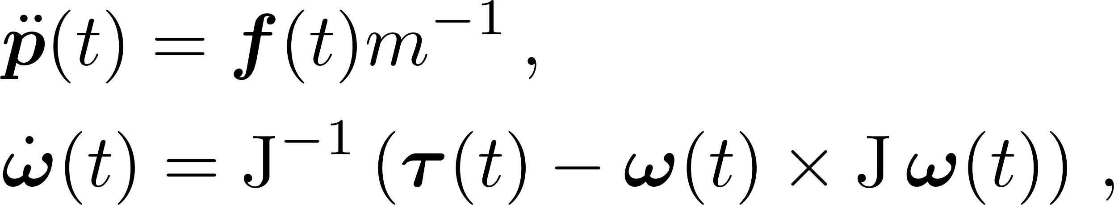
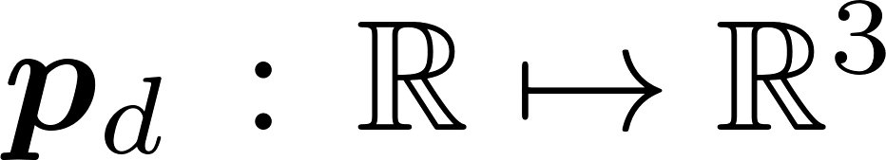
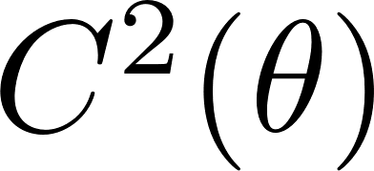
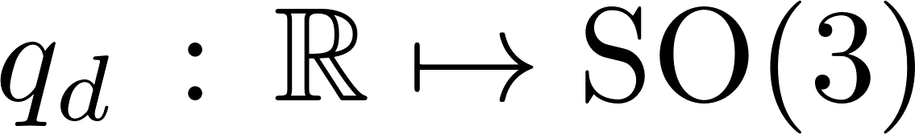
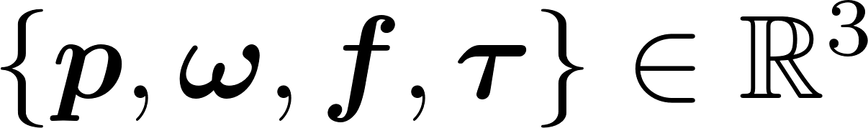
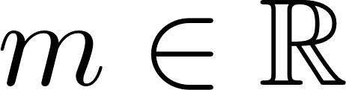
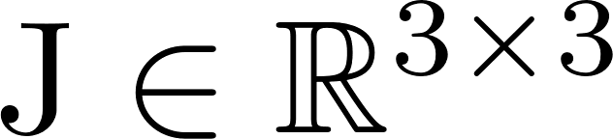
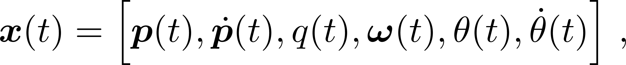
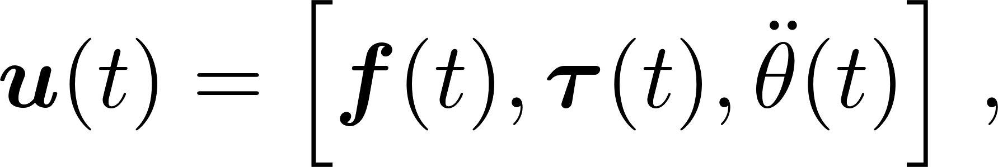
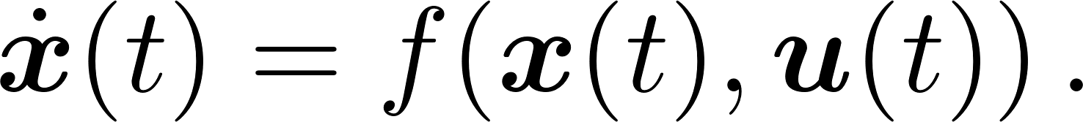
Methodology
Problem statement (preliminaries)
Rigid body dynamics
Geometric reference representation
Three-dimensional rigid body dynamics in body-frame:
where
is the desired parametric position
is the desired parametric attitude
where , and .
Augmented rigid body dynamics
Pose-following error
Defining and choosing
where is a function that outputs the deviation between the rigid body's pose and desired pose.
we can express the augmented body dynamics as
Notes:
Before doing so, there are some preliminaries that need to be covered.
First * , we consider that the system dynamics are given by the standard three-dimensional rigid-body translational and rotational equations of motion.
Second * , we define the geometric reference, denoted by gamma, as a path with a moving frame attached to it. Both the cartesian coordinates and the moving frame are given by two functions parameterized by theta.
Third *, we define the augmented rigid body dynamics. For this purpose, we choose * the ordinary system states --position, velocity, unit quaternion attitude and angular velocity --, and augment them by the parametric variable and its first derivative. In a similar way, the parametric variable’s acceleration is added to the nominal control commands, the force and torque applied in the rigid body. Combining the rigid body dynamics with the augmented states and inputs allow us to write the dynamics in the standard nonlinear form.
Fourth *, we define the pose-following error by a yet to be defined function that outputs the deviation between the rigid body’s pose and the desired pose, denoted by pd and qd. Due to the structure of SE3, this function is dependent on the control design approach, and thus, will be defined in the upcoming slides.
Having settled the preliminaries, lets move on to the formal definition of the problems that we solve in this work.

Slide 9
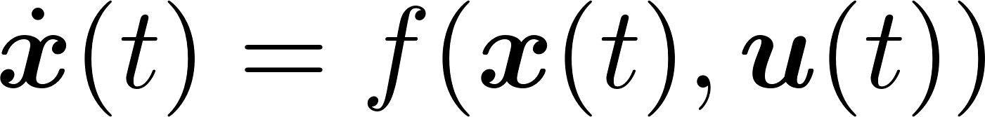

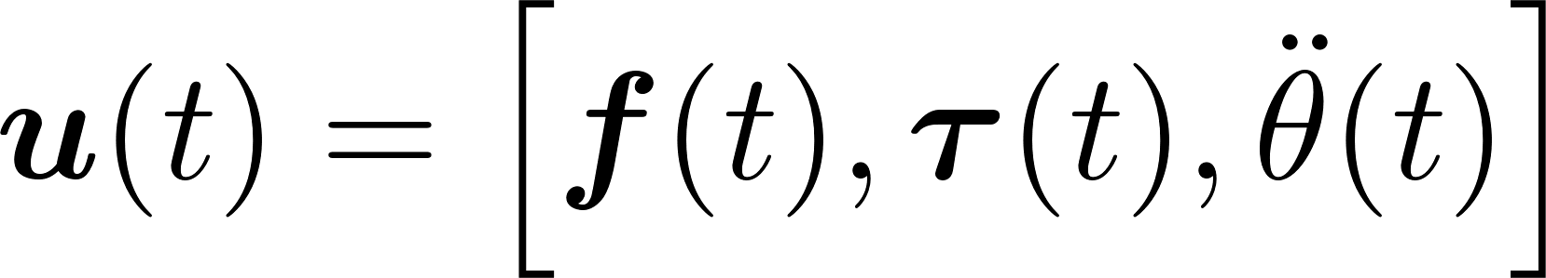
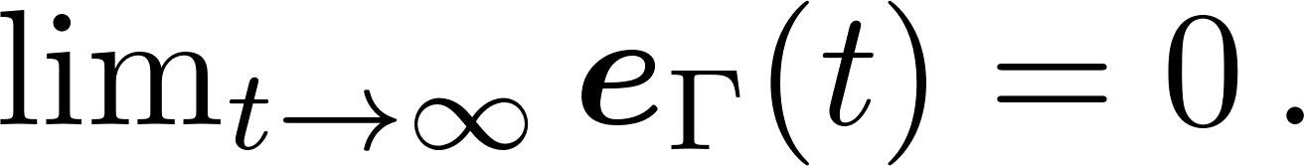
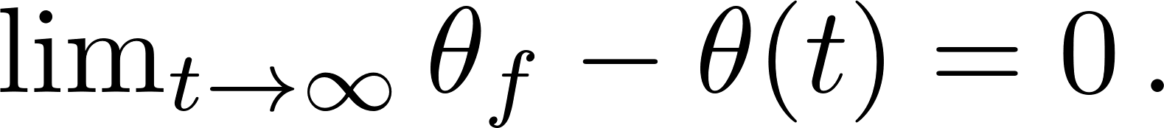
Methodology
Body dynamics ( 1 )
Geom. reference ( 2 )
Pose error function ( 3 )
Problem formulations
Problem : Pose-Following
Given the geometric reference in (2) and the augmented rigid body dynamics in (1), formulate a controller
that fulfills:
Pose Convergence: The pose-following error vanishes asymptotically
Convergence on parametric variable: The system converges to the end of the geom. ref.
Problem : Pose-Following with velocity assignment
Given the geometric reference in (2) and the augmented rigid body dynamics in (1), formulate a controller
that fulfills:
Pose Convergence: From Problem 1 .
Velocity convergence: The parametric speed converges to a desired velocity profile
Notes:
Having motivated the problem and defined the preliminaries, which are summarized in the upper-left part of the slide, we will now formally state the two specific problems addressed in our work:
First, * we define the “Pose-Following” problem, which states as follows : Given the geometric reference gamma in (2) and the augmented rigid body dynamics (1), formulate a controller that fulfills “Pose-Convergence” and “Convergence on parametric variable”. The former ensures that the pose error vanishes asymptotically, while the latter guarantees that the system reaches the end of the geometric reference.
Second, * we extend the first problem to a second one, denoted as “Pose-Following with velocity assignment”. The key distinction is that it replaces the “Convergence on parametric variable” with “Velocity Convergence”. The aim of this modification is to make the parametric speed converge to a predetermined velocity profile.

Slide 10
Methodology
“ How can we formulate a
pose-following control method
based on
unit dual quaternions ? ”
Contributions
Extend the ODEs from well-stablished dual-quaternion based pose-tracking to pose-following.
Derive two alternative control methods to
ensure convergence to a desired velocity profile.
incite a desired behavior around the reference.
Prove almost global asymptotic stability for the pose-following (with velocity assignment) problem.
Notes:
To solve these problems and ultimately answer the previously stated research question, our contributions are threefold:
First, * we extend the unit dual quaternion based ODEs from pose-tracking to pose-following
Second, * we derive a unit dual quaternion based pose-following control framework that can be tailored either to ensure convergence to a desired velocity profile, or to incite a desired behavior around the reference.,
Third, * we prove almost global asymptotic stability for the previously derived control law.
Now we will proceed to look into each contribution in more detail.

Slide 11
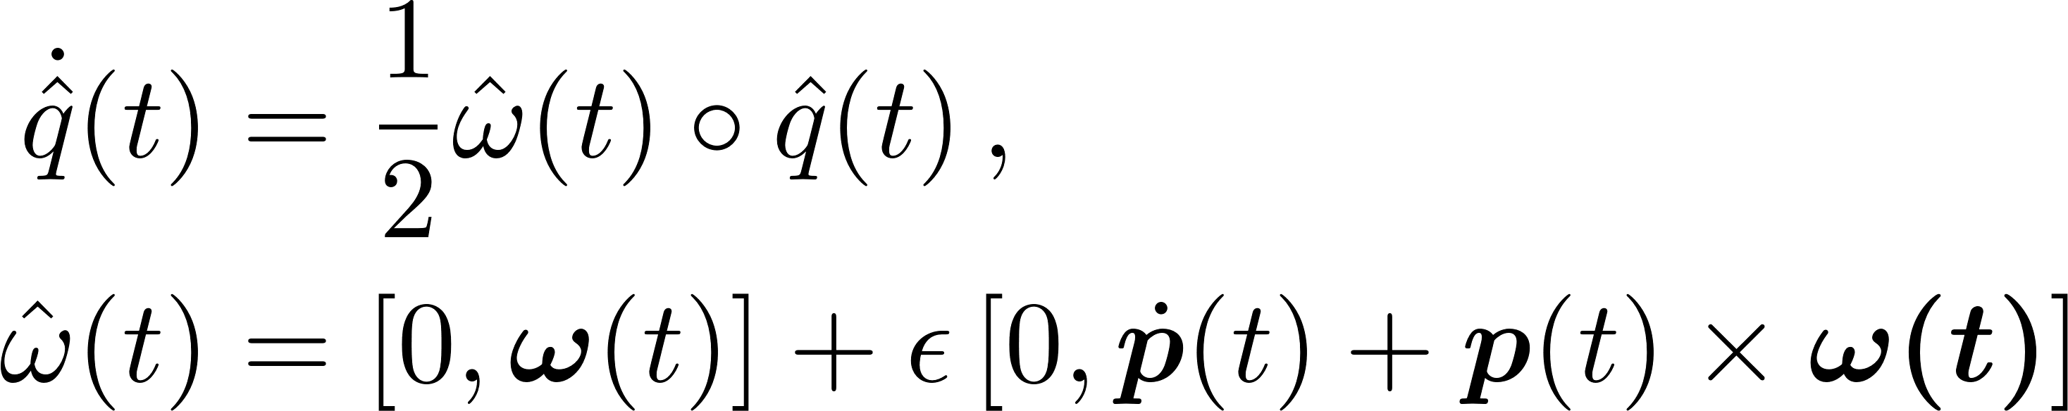
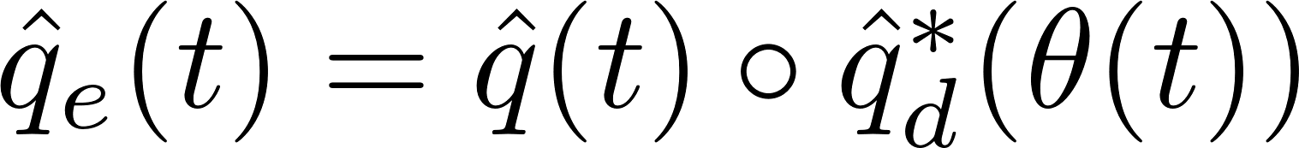
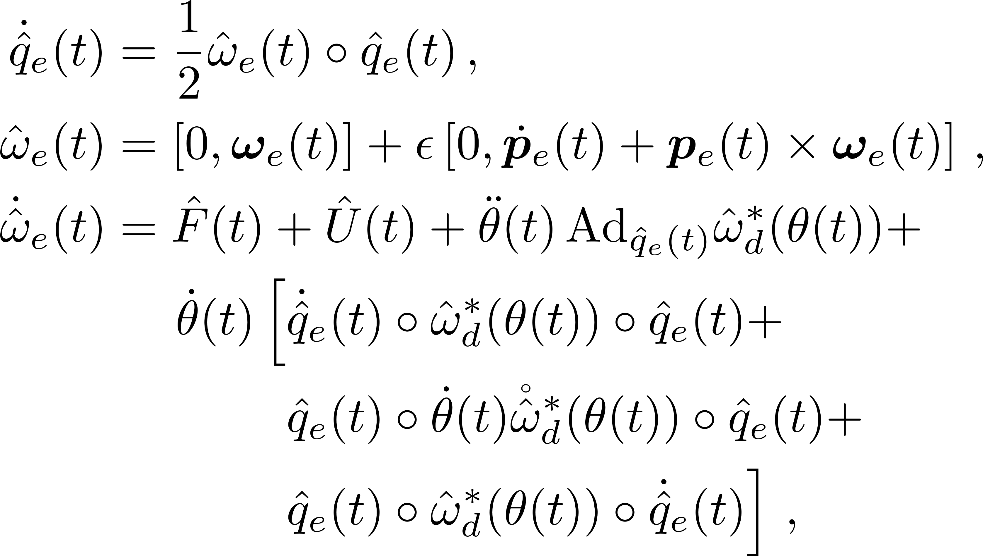
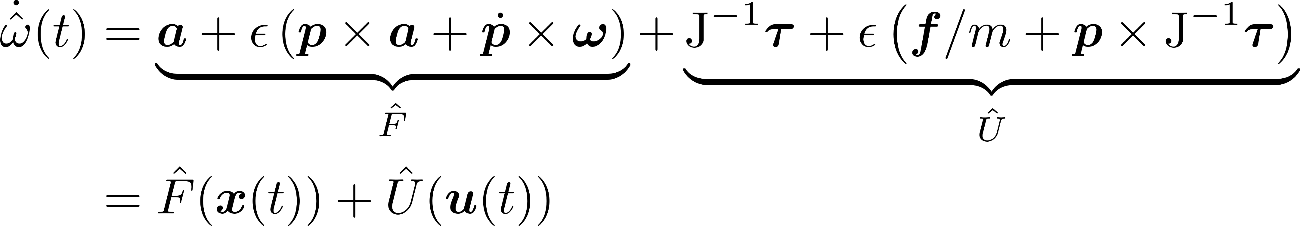
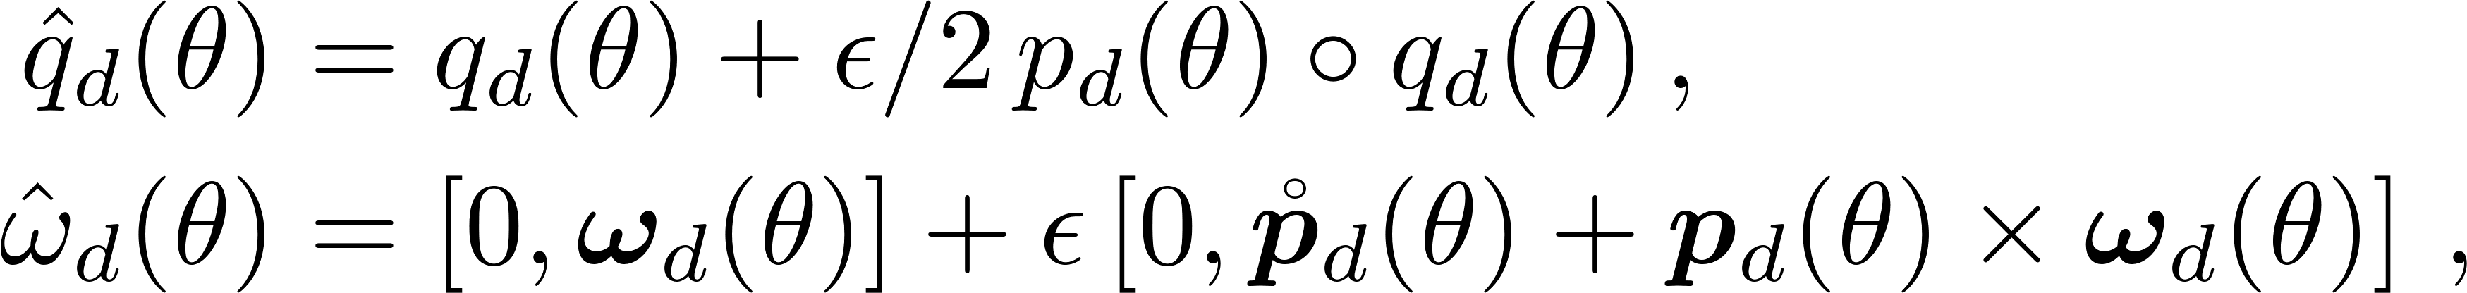
Methodology
Body dynamics ( 1 )
Geom. reference ( 2 )
Contribution 1: Error dynamics for UDQ-Pose-Following
Unit Dual Quaternion system dynamics
Unit Dual Quaternion error dynamics
Taking the time-derivative of :
Defining the dual quaternion error as
After some derivations we get
Further time-derivations on the latter, combined with the augmented rigid body dynamics (1) results in
Unit Dual Quaternion geom. reference
different to pose-tracking
Expressing the geom. reference in (2) with dual quaternions:
Notes:
In the first contribution, we derive the error dynamics required for Unit Dual Quaternion based Pose-Following. We start * by converting the augmented system dynamics in (1) to a dual quaternion representation. To do so, we derivate the dual quaternion’s definition on time. Besides obtaining the dual quaternion’s equation of motion, we also get the dual twist. To derive its equation of motion *, we combine it with augmented rigid body dynamics in (1) and differentiate it with respect to time. The resulting equation can be rearranged into two variables: F for terms that rely solely on the states and U for terms that rely solely on the inputs.
In a similar way, * we can represent the parametric geometric reference in (2) with unit dual quaternions.
Despite having successfully transformed the rigid body dynamics and the geometric reference from the standard pose-representation to the dual quaternion representation, in order to design the control law, we are interested in the error dynamics.
For this purpose, * we define the dual quaternion error by the formula within the red box. Combining it with the unit dual quaternion based system dynamics and geometric reference, after some derivations *, we finally get the unit-dual-quaternion based error dynamics. When compared to the tracking counterpart, * additional terms arise.
As we will see in the following slide, these differences will play a significant role in the design of the control law.

Slide 12
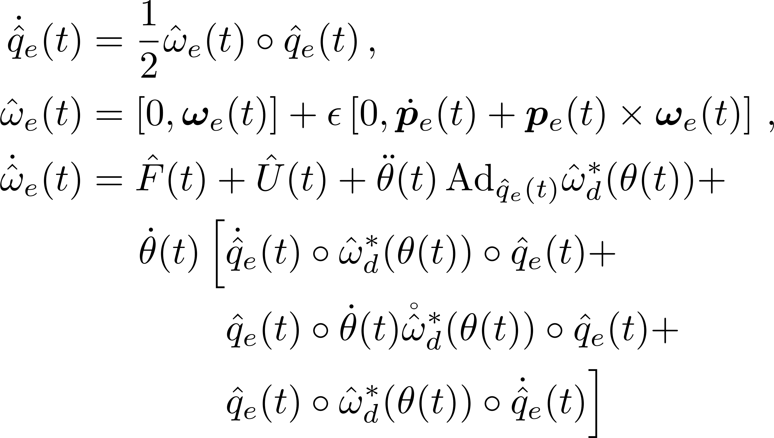
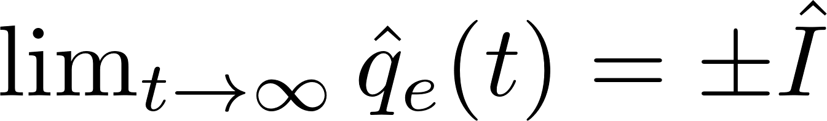
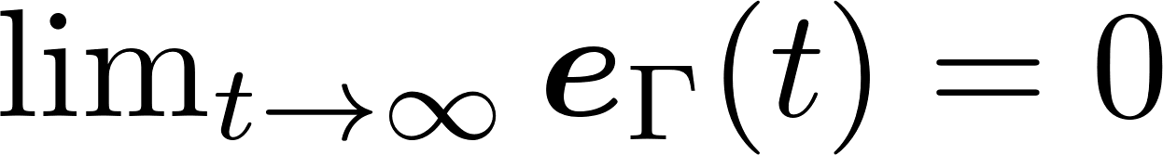
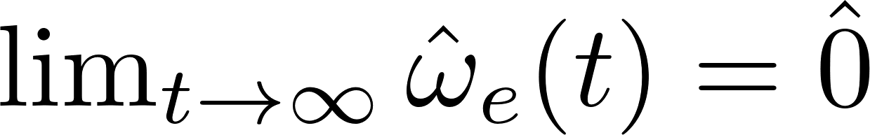
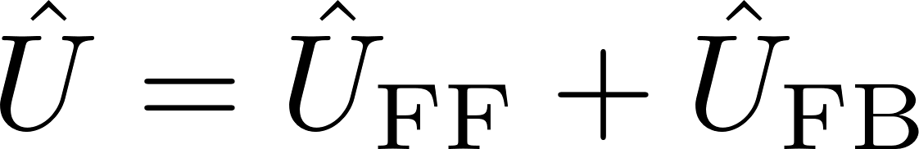

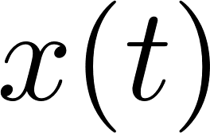
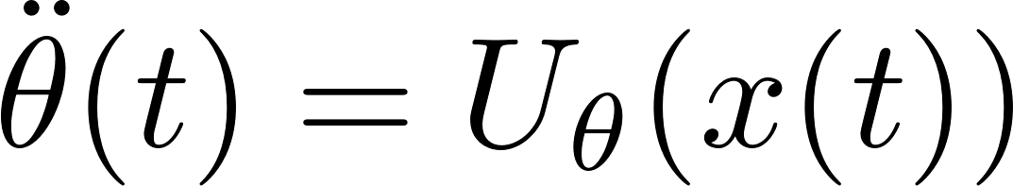

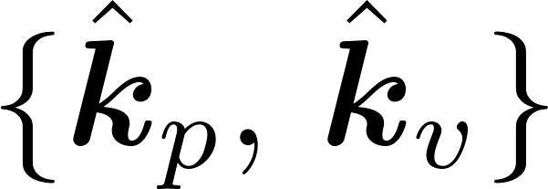
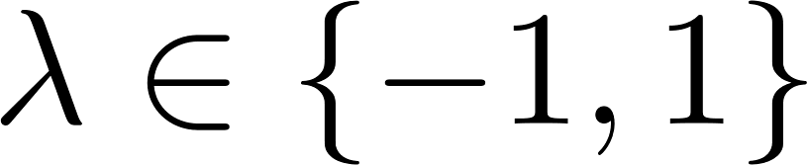

Methodology
Contribution 2: Control law
Pose Convergence:
Feedforward ( )
Cancel feedback nonlinearities
Feedback ( )
Leverage Lie Group associated to dual quaternions
where are vector dual quaternions and is a switching parameter for both equilibrium points
Notes:
Before formulating the control law, we need to * take a step back and bring up the definition of pose convergence. This is equivalent to ensuring that the dual quaternion error converges to the equilibrium points of the error dynamics. Taking this into account we proceed to formulate a control law that regulates the stable equilibrium point. To do so, * we decouple the control law into a feedforward and feedback term.
The goal of the feedforward term is to * cancel the feedback nonlinearities. When doing so, it is apparent that the first and last term can readily be cancelled out. However, this is not true for the third term, which is multiplied by the virtual input. To account for this, we choose * the virtual input to be feedback-dependent, allowing us to also get rid of it with the feedforward component.
Regarding the feedback term *, we leverage the logarithmic mapping associated to the Lie group of unit dual quaternions to design a proportional derivative feedback. Notice that the lambda term is a switching term that guarantees convergence to the stable equilibrium point.
Putting both the feedback and the feedforward terms together, we obtain the control law used in this work. Notice that the feedback term introduced in the feedforward component – the one highlighted in yellow -- still needs to be defined. To do so, we proceed to the third contribution, where we layout the conditions to ensure stability.

Slide 13





Methodology
Contribution 3.1 : Stability of pose-following
Body dynamics ( 1 ) Control law ( 4 )
Geom. reference ( 2 ) ( 4.1 )
Pose - error ( 3 ) ( 4.2 )
Theorem : Stability of pose-following
Consider the augmented rigid body dynamics in (1), the geometric reference in (2), the control law in (4) with the feedforward and feedback terms in (4.1 ~ 4.2), and assume that the following conditions are satisfied:
(i) The dual quaternion control gains are chosen as with , , and
(ii) The pose-parameter control law ensures that the velocity of the pose-parameter is positive, i.e.,
Then the closed-loop control scheme defined by system (2) and control law (4) solves the pose-following problem.
Notes:
The stability guarantees are given by two different theorems, each of them being associated to the two problems formulated earlier. For the sake of time, we will only state the theorems. If you are interested in the proofs, please check the paper.
The theorem tackling the first problem * says as follows: Consider the augmented rigid body dynamics in (1), the geometric reference in (2), the control law in (4) with the feedforward and feedback terms in (4.1 ~ 4.2), and assume that the following conditions are satisfied: First, the dual quaternions control gains are chosen to be positive, and the dual components of kp equal to each other. Second, the pose-parameter control law ensures that the velocity of the pose-parameter is positive. Then the closed-loop control scheme defined by system (2) and control law (4) solves the pose-following problem.
That is the first theorem, lets move on to the second one.

Slide 14


Methodology
Contribution 3.2 : Stability of pose-following with vel. assignment
Body dynamics ( 1 ) Control law ( 4 )
Geom. reference ( 2 ) ( 4.1 )
Pose - error ( 3 ) ( 4.2 )
Theorem : Stability of pose-following with velocity assignment
Consider the augmented rigid body dynamics in (1), the geometric reference in (2), the control law in (4) with the feedforward and feedback terms in (4.1 ~ 4.2), and assume that the following conditions are satisfied:
(i) The dual quaternion control gains are chosen as with , , i.e., equivalent terms in the dual part of , and
(ii) The pose-parameter control law is given by , where
Then the closed-loop control scheme defined by system (2) and control law (3) solves the pose-following with velocity assignment problem.
Notes:
The theorem ensuring stability for the “pose-following with velocity assignment” problem is the same as the first one except for the second condition. In this case * , the feedback term is required to have the form of the equation highlighted in yellow. This will ensure that the parametric variable’s speed will converge to the desired velocity profile.

Slide 15


Results
Validate Theorem 2:
almost global asymptotic stability for pose-following with vel. assignment
Experiment 1
Almost global asymptotic stability
*
Pose
Vel. profile
Convergence in
Implemented with
4 initial states
2 cte. vel. profiles / initial state
*
A more detailed view
Convergence to non-constant vel. profiles
Notes:
To evaluate our approach we conduct two simulated experiments. In the first experiment *, we validate the second theorem. For this purpose, * we analyze the pose and parametric speed convergence for different initial states and velocity profiles. The * obtained trajectories are depicted in the four figures at the upper-right side of the slide. The black thick line with the moving frame refers to the geometric reference. The rest of the colored lines are the trajectories obtained when initializing from different states. Each starting point is evaluated according to two different constant velocity profiles. The motions associated to the fast profiles are depicted by a continuous line, while the motions related to the slow profiles are given by dashed lines. These motions manifest two noteworthy characteristics. The first one being that all of them demonstrate asymptotic convergence towards the geometric reference. The second characteristic, which aligns with common intuition, is that motions corresponding to the slower velocity profiles attain convergence at an earlier stage.
To further observe the convergence of the velocity profile, we can take a closer look to * the starting point circled in red. The figure at the lower part shows that, for three different cases, the parametric speed (depicted by the continuous line) converges to the desired velocity profile (represented as the dashed line).

Slide 16






Results
Compare against dual quaternion-based pose-tracking [ 1 ]
Experiment 2
where is the transverse distance to the geometric reference
Analyze convergence in the presence of a disturbance
Desired pose
Pose-tracking
[ 1 ]
Pose-following:
Ours
End
Start
[1] Unit dual quaternion-based feedback linearization tracking problem for attitude and position dynamics, Systems & Control Letters, 2013
16
Notes:
In the second experiment, * we compare the performance of the proposed pose-following approach against unit-dual-quaternion based pose-tracking. To do so, * the desired velocity profile function is chosen to be dependent on the distance to the geometric reference. Intuitively, if the system is far away from the reference, it slows down until it is close enough to increase the speed.
This mapping is regarded as a tuning parameter that the user can tailor. In an illustrative manner, we design three variants: progressive (red), medium (orange) and conservative (blue).
To conduct the experiment, we pick a planar sinusoidal curve with a moving frame attached to it as a
geometric reference. The task at hand consists of traversing the geometric reference from a zero-velocity pose. However,
at the middle of the navigation a longitudinal and angular disturbance is introduced. To ensure a fair comparison, both
the pose-tracking and pose-following have been tuned to ensure that the navigation time is the same if no disturbance
occurs. The computed trajectories are depicted at the bottom right part of the slide.
When compared to pose-tracking (in magenta), two differences can be spotted. First, at the very beginning of the trajectory, the tracking method shows a small deviation from the reference. This is due to the fact that the rigid body initially is standing still and needs to catch up with the moving time-reference. In contrast the presented pose-following is aware of its initial state and progressively increases its velocity along the reference. Second, as soon as the disturbance is over, the additional degree of freedom inherited from augmenting the system allows all three variants to slow down and converge back to the geometric reference. As expected, the convergence rate directly correlates to how conservative the desired velocity profile mapping is. On the other hand,
pose-tracking lacks this additional degree of freedom and has no choice but to catch up with the time-based reference, causing a large deviation error.

Slide 17
Conclusion
What have we done?
Formulated a unit dual quaternion-based pose-following control approach
Derived equations of motion for the pose-following error
Extended the control law to account for nonlinearities arising from the augmented states
Designed the additional DoF inherited from reference-following
either to achieve convergence to a desired velocity profile
or as a feedback mechanism
Established conditions for almost global asymptotic stability of the pose-error
Numerically validated our findings with two simulated experiments
17
Notes:
This brings us to the end of our presentation. To sum up in this paper we * have formulated a unit dual quaternion-based pose-following control approach for rigid body dynamics. Initially, * we have derived the equations of motion for the full pose error between the rigid body and the geometric reference in the form of a dual quaternion and dual twist. Subsequently, * we have extended the original control law to account for nonlinearities arising from the introduction of auxiliary states associated with pose-following and designed the additional degree of freedom either to achieve convergence to a desired velocity profile or as a feedback
mechanism. When doing so, * we have also established almost global asymptotic stability. Lastly, * we have numerically validated our findings with two illustrative simulations.

Slide 18

Code available in Github !
Contact me !
Pose-Following with Dual Quaternions
Jon Arrizabalaga, Markus Ryll
jon.arrizabalaga@tum.de, markus.ryll@tum.de

Slide 19
Motivation
Limitations of state-of-the-art
What do we seek?
Pose representation Position + Orientation
Rotation matrices / Unit quaternions
?
Not compact
Inefficient “pose” operations
Multiple equilibrium points
Two separate “pose-error” functions
Compact
Efficient “pose” operations
Single equilibrium point
Unique “pose-error” function
Control methods
Reference-tracking
Reference-following → Pose-following
Rely on predefined time-varying reference
“… when to be where …”
Self-regulate progress along the path
Notes:
To represent * the pose of a rigid body in SE3 , it is customary to combine a three-dimensional vector of the Cartesian coordinates with either a rotation matrix or a unit quaternion. Starting with the rotation matrix, one of its drawbacks is * that it is not a compact representation, since it is given by a 3 by 3 matrix, resulting in a total of 9 parameters. An alternative solution is to use unit quaternions, which only rely on 4 values. Other than that, * with such representations the computation of rotation and position is performed independently, making it more difficult and inefficient to operate with poses. When it comes to control design, there are two shortcomings that are worth highlighting: First, * both the rotation matrices and unit quaternions contain multiple equilibrium points. Second, rather than relying on a single pose-error function, rotation matrices and unit quaternions require two separate functions: one for the position-error and another one for the attitude-error.
---------------------
More specifically, unit quaternions yield two closed-loop equilibrium points associated to a double coverage of SO(3), both of which represent the identity rotation matrix, while rotation matrices generate a minimum of four closed-loop equilibrium points, with only one of them relating to the identity

Slide 20
Motivation
Limitations of state-of-the-art
What do we propose?
Pose representation
Unit Dual Quaternions (UDQ)
Position
Orientation
Rotation matrices
Unit quaternions
with and
Unit
where,
Translation vector
Rotation quaternion
Not compact
Inefficient “pose” operations
Multiple equilibrium points
Two separate “pose-error” functions
Compact
Efficient “pose” operations
Two equilibrium points
Unique (coupled) “pose-error” function
UDQ Control methods
Reference-tracking
UDQ Pose-Following
Reference-following
Rely on predefined time-varying reference
“… when to be where …”
Additional DoF - - to self-regulate
progress along the path
Notes:
To represent the pose * of a rigid body in SE3 , it is customary to combine a three-dimensional vector of the Cartesian coordinates with either a rotation matrix or a unit quaternion. Starting with the rotation matrix, one of its drawbacks is * that it is not a compact representation, since it is given by a 3 by 3 matrix, resulting in a total of 9 parameters. An alternative solution is to use unit quaternions, which only rely on 4 values. Other than that, * with such representations the computation of rotation and position is performed independently, making it more difficult and inefficient to operate with poses. When it comes to control design, there are two shortcomings that are worth highlighting: First, * both the rotation matrices and unit quaternions contain multiple equilibrium points. Second, rather than relying on a single pose-error function, rotation matrices and unit quaternions require two separate functions: one for the position-error and another one for the attitude-error.
To overcome these limitations *, we propose to use a less popular –yet full of potential– SE3 parameterization: * Unit Dual Quaternions. A dual quaternion consists of a standard quaternion whose components are given by dual numbers. For a dual quaternion to be * unit, its inverse needs to be equal to the conjugate. Just as unit quaternions represent rotations, unit dual quaternions describe three-dimensional pose-transformations. In other words, * translations and rotations. More specifically, a unit dual quaternion consisting of a translation vector p and a rotation quaternion q corresponds to a screw motion and is given by the equation highlighted in yellow. Due to the time constraints of this presentation, I will not provide further details on formally defining this screw motion. If interested, please check the paper.
When compared to the more conventional pose representations, unit dual quaternions overcome most of the aforementioned limitations. First, * their parameterization is compact since it only relies on 8 numbers. Second, their utilization is * simple and efficient, because a series of rigid movements can be expressed as a sequence of dual quaternion multiplications. Third, due to their quaternion-based nature, * unit dual quaternions inherit the double coverage of SO3, and thus, have two equilibrium points. Last but not least, * unit dual quaternions allow to represent the pose-error with a single function.
Due to these appealing properties, unit dual quaternions have received considerable attention in the literature. Despite this recent raise in interest, the majority of the existing methods exclusively focus on reference-tracking. This implies that the reference evolves with time and is agnostic to the system’s states. However, not all problems fit in such a description.
where the reference is agnostic from the system’s states and evolves with time

Slide 21
Potential questions
ToDo
R and q, multiple equilibrium points?
Why “almost” global asymptotic stability?
Proves for theorems

Slide 22

Methodology
→ Quaternion multiplication
Ingredients and Contributions
Ingredients
Contributions
Dual Quaternions
Pose-Following with Dual Quaternions
where,
Translation vector
Rotation quaternion
Extend the ODEs from well-stablished dual-quaternion based pose-tracking to pose-following.
Prove almost global asymptotic stability for the pose-following (with velocity assignment) problem.
Derive two alternative control methods to
ensure convergence to a desired velocity profile.
incite a desired behavior around the reference.
Compact
Efficient “pose” operations
Unique (coupled) “pose-error” function
Two-equilibrium points
Pose-Following
Additional DoF - - to self-regulate progress
Notes:
This leads us to the research question that we answer in this paper: Is it possible to derive a control method capable of following a desired position and orientation reference? This question naturally extends the concept of path-following to pose-following. To tackle this problem, our main ingredient is to parameterize the pose with dual quaternions. This choice relies on the multiple benefits associated to dual quaternions, most of which have already been discussed over this workshop. To answer the presented question, our contributions are threefold:
1- We extend the ODE’s from well-known dual quaternion based pose-tracking methods to pose-following.
2- We derive two alternative control methods for the additional degree of freedom
3- Prove almost global asymptotic stability.
In order to validate the presented approach, we conduct two simulated experiments, one for each control method:

Slide 23

Results
Validate Theorem 2:
almost global asymptotic stability for pose-following with vel. assignment
Experiment 1
Almost global asymptotic stability
*
Pose
Vel. profile
Convergence in
Implemented with
4 initial states
2 cte. vel. profiles / initial state
*
A more detailed view
Switching parameter
Convergence to non-constant vel. profiles
Notes:
To evaluate our approach we conduct two simulated experiments. In the first experiment *, we validate the second theorem. For this purpose, * we analyze the pose and parametric speed convergence for different initial states and velocity profiles. The * obtained trajectories are depicted in the four figures at the upper-right side of the slide. The black thick line with the moving frame refers to the geometric reference. The rest of the colored lines are the trajectories obtained when initializing from different states. Each starting point is evaluated according to two different constant velocity profiles. The motions associated to the fast profiles are depicted by a continuous line, while the motions related to the slow profiles are given by dashed lines. These motions manifest two noteworthy characteristics. The first one being that all of them demonstrate asymptotic
convergence towards the geometric reference. The second characteristic, which aligns with common intuition, is that motions corresponding to the slower velocity profiles attain convergence at an earlier stage

Slide 24
Desired pose
Pose-tracking
[ 1 ]
Pose-following:
Ours

Slide 25


Experiments – E1
Almost global asymptotic stability
Convergence to velocity profile
Notes:
The goal of the first experiment is to validate the almost global asymptotic stability with velocity assignment. In the left figure, we see that regardless of the initial state, the pose of the rigid body converges to the geometric reference. In the right side, we also show that convergence with respect to the velocity profile is achieved.

Slide 26
Experiments – E2
Comparison to pose-tracking
Desired pose
Pose-tracking
[ 1 ]
Pose-following:
Ours
[1] Unit dual quaternion-based feedback linearization tracking problem for attitude and position dynamics,” Systems & Control Letters, vol. 62, no. 3, pp. 225–233, 2013
Notes:
In the second case-study we compare the performance of the proposed pose-following approach (red, orange and blue) against pose-tracking (magenta). For this purpose, we pick a planar sinusoidal curve and the task at hand consists of traversing the geometric reference from a zero-velocity pose. However, at the middle of the navigation a longitudinal and angular disturbance is introduced. In this comparison, it becomes apparent that pose-tracking lacks this additional degree of freedom of pose-following and has no choice but to catch up with the time-based reference, causing larger deviation errors.

Slide 27
Methodology
Research Question
Contributions
How to derive a control method capable of
following a desired reference?
position
Pose-Following with Dual Quaternions
orientation
Extend the ODEs from well-stablished dual-quaternion based pose-tracking to pose-following.
Derive two alternative control methods to
ensure convergence to a desired velocity profile.
incite a desired behavior around the reference.
Prove almost global asymptotic stability for the presented pose-following control method.
Pose-following
Ingredients
Dual Quaternions
Singularity-free
Compact
Efficient
Lie Algebra
…
E1
E2
Notes:
This leads us to the research question that we answer in this paper: Is it possible to derive a control method capable of following a desired position and orientation reference? This question naturally extends the concept of path-following to pose-following. To tackle this problem, our main ingredient is to parameterize the pose with dual quaternions. This choice relies on the multiple benefits associated to dual quaternions, most of which have already been discussed over this workshop. To answer the presented question, our contributions are threefold:
1- We extend the ODE’s from well-known dual quaternion based pose-tracking methods to pose-following.
2- We derive two alternative control methods for the additional degree of freedom
3- Prove almost global asymptotic stability.
In order to validate the presented approach, we conduct two simulated experiments, one for each control method:

Slide 28


Motivation
Ingredients
Limitations of state-of-the-art
Dual Quaternions
Singularity-free
Compact
Efficient
Lie Algebra
…
Frenet-Serret
frame
Euler coordinates
Spatial coordinates
[1] N. van Duijkeren, R. Verschueren, G. Pipeleers, M. Diehl, and J. Swevers, “Path-following NMPC for serial-link robot manipulators using a path-parametric system reformulation”, IEEE European Control Conference (ECC), 2016
[2] R. Verschueren, N. van Duijkeren, J. Swevers, and M. Diehl, “Time-optimal motion planning for n-dof robot manipulators using a path-parametric system reformulation”, American Control Conference (ACC), 2016
[3] S. Kumar and R. Gill, “Path following for quadrotors”, IEEE Conference on Control Technology and Applications (CCTA), 2017
[4] S. Spedicato and G. Notarstefano, “Minimum-time trajectory generation for quadrotors in constrained environments”, IEEE Transactions on Control Systems Technology, 2017
[5] J. Arrizabalaga and M. Ryll, “Towards time-optimal tunnel-following for quadrotors”, IEEE International Conference on Robotics and Automation (ICRA), 2022
Notes:
To conduct this spatial reformulation, state-of-the-art methods rely on the Frenet-Serret frame.
Parameterization:
- Inefficient
- Diffiicult to operate
Control: - Tracking sucks
Our suggestion:
- Dual quaternions
- Reference following
When doing so *, we overcome the limitations of reference-tracking by focusing on reference-following, which allows the rigid body to self-regulate the progress along the path.

