Slide 1
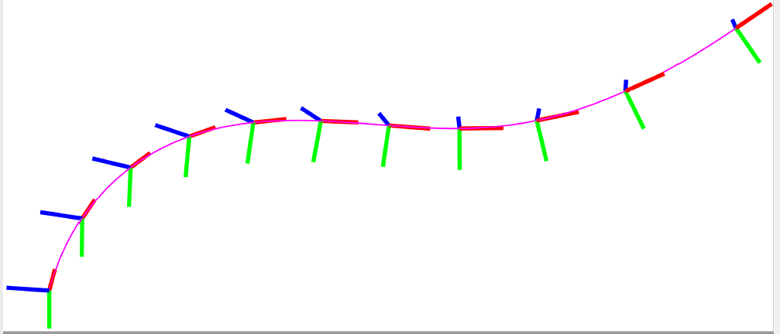
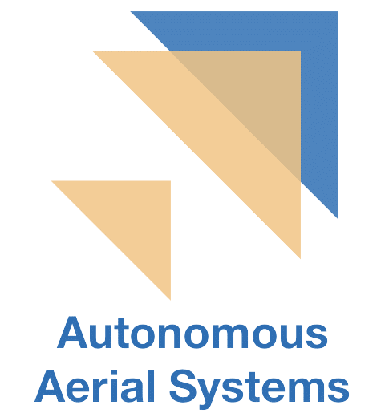
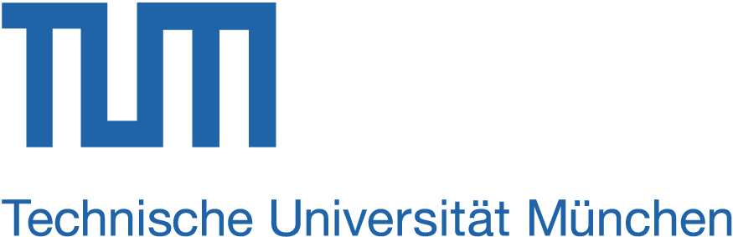
Pose-Following
with
Dual Quaternions
Jon Arrizabalaga, Markus Ryll
jon.arrizabalaga@tum.de, markus.ryll@tum.de
Technical University Munich, Autonomous Aerial Systems

Slide 2
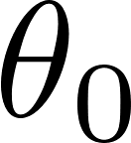

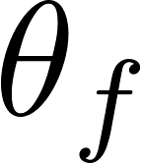
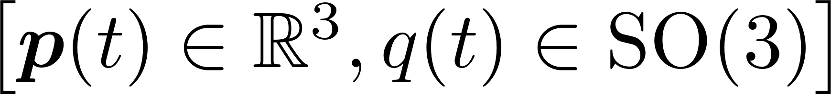
Motivation
State-of-the-art
Reference-tracking
Ours
Reference-following
Dynamic system
Geometric reference
Notes:
Our motivation comes from simultaneous position and attitude control. Given a rigid body and a parametric geometric reference, we aim to design a control method to concurrently converge in position, as well as orientation. When doing so *, we overcome the limitations of reference-tracking by focusing on reference-following, which allows the rigid body to self-regulate the progress along the path.

Slide 3
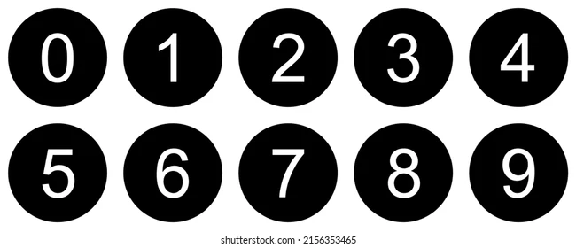
Methodology
Research Question
Contributions
How to derive a control method capable of
following a desired reference?
position
Pose-Following with Dual Quaternions
orientation
Extend the ODEs from well-stablished dual-quaternion based pose-tracking to pose-following.
Derive two alternative control methods to
ensure convergence to a desired velocity profile.
incite a desired behavior around the reference.
Prove almost global asymptotic stability for the presented pose-following control method.
Pose-following
Ingredients
Dual Quaternions
Singularity-free
Compact
Efficient
Lie Algebra
…
E1
E2
Notes:
This leads us to the research question that we answer in this paper: Is it possible to derive a control method capable of following a desired position and orientation reference? This question naturally extends the concept of path-following to pose-following. To tackle this problem, our main ingredient is to parameterize the pose with dual quaternions. This choice relies on the multiple benefits associated to dual quaternions, most of which have already been discussed over this workshop. To answer the presented question, our contributions are threefold:
1- We extend the ODE’s from well-known dual quaternion based pose-tracking methods to pose-following.
2- We derive two alternative control methods for the additional degree of freedom
3- Prove almost global asymptotic stability.
In order to validate the presented approach, we conduct two simulated experiments, one for each control method:

Slide 4
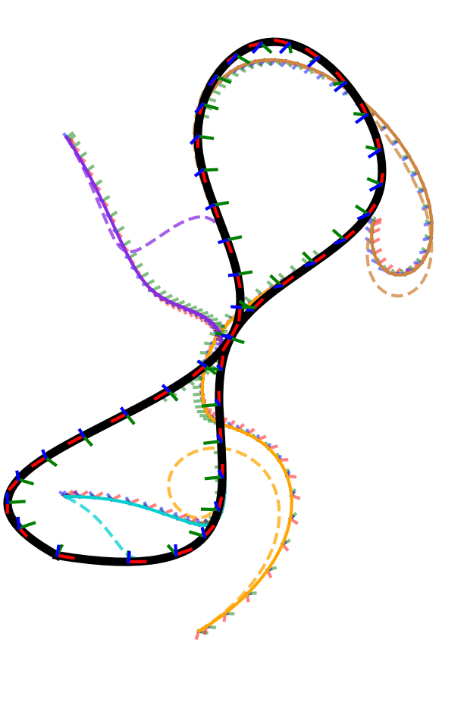
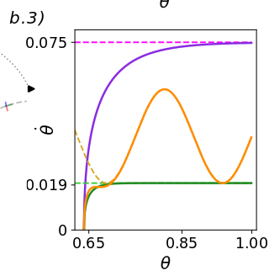
Experiments – E1
Almost global asymptotic stability
Convergence to velocity profile
Notes:
The goal of the first experiment is to validate the almost global asymptotic stability with velocity assignment. In the left figure, we see that regardless of the initial state, the pose of the rigid body converges to the geometric reference. In the right side, we also show that convergence with respect to the velocity profile is achieved.

Slide 5
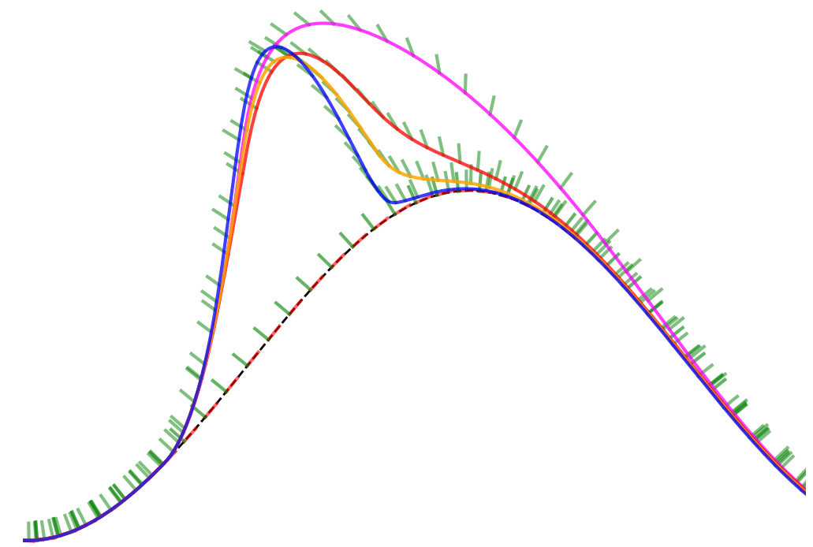
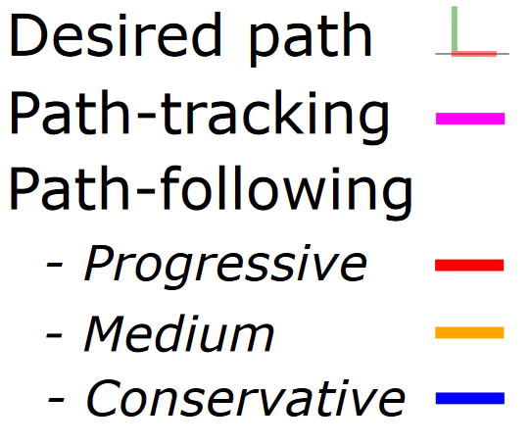
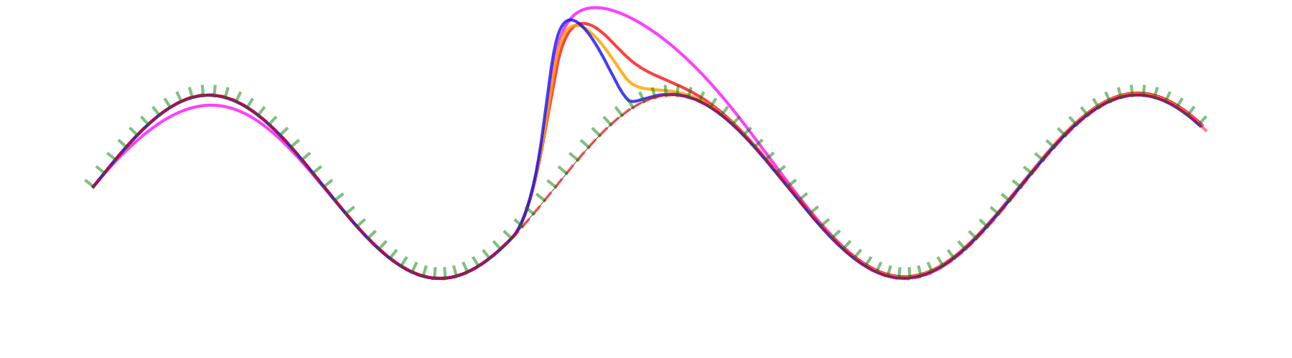
Experiments – E2
Comparison to pose-tracking
Desired pose
Pose-tracking
[ 1 ]
Pose-following:
Ours
[1] Unit dual quaternion-based feedback linearization tracking problem for attitude and position dynamics,” Systems & Control Letters, vol. 62, no. 3, pp. 225–233, 2013
Notes:
In the second case-study we compare the performance of the proposed pose-following approach (red, orange and blue) against pose-tracking (magenta). For this purpose, we pick a planar sinusoidal curve and the task at hand consists of traversing the geometric reference from a zero-velocity pose. However, at the middle of the navigation a longitudinal and angular disturbance is introduced. In this comparison, it becomes apparent that pose-tracking lacks this additional degree of freedom of pose-following and has no choice but to catch up with the time-based reference, causing larger deviation errors.

Slide 6
Pose-Following
with
Dual Quaternions
Jon Arrizabalaga, Markus Ryll
jon.arrizabalaga@tum.de, markus.ryll@tum.de
Technical University Munich, Autonomous Aerial Systems

