Slide 1
Group 51 – Data Mining I Project
Analysis of Social Circles and Anomalous Users in the Friendfeed Network
Jonas Blum
Sanjatul Islam
Xin Tian
Riccardo Rebecchi

Slide 2
Topics
Research Questions
Data Preprocessing
Initial Data Exploration
Social Circle Detection and Characterization
Anomaly Detection and Characterization

Slide 3
Research Questions
RQ 1: Is it possible to identify distinct social circles within the Friendfeed network based on user connections, and characterize them in terms of activity, service usage and interaction patterns?
RQ 2: Is it possible to detect anomalous users in the Friendfeed network (e.g., bots, spammers) based on posting, following, and interaction patterns (commenting/liking) and characerize them in terms of activity and interactions patterns?

Slide 4
Data – Friendfeed Social Network
Number of users: 665’382
Number of posts: 12’450’658
Number of comments: 3’749’891
Number of people following: 19’547’158
Number of likes: 798’112

Slide 5
Preprocessing
Dataset has already been preprocessed before
Remove “dead” accounts (without any posts, likes and comments) Users removed: 160’792 (504’590 users remaining)
Connect users following each other (via FollowedID and FollowerID)
Connect users and their posts via UserID
Connect posts, users and likes + comments via PostId and UserID

Slide 6
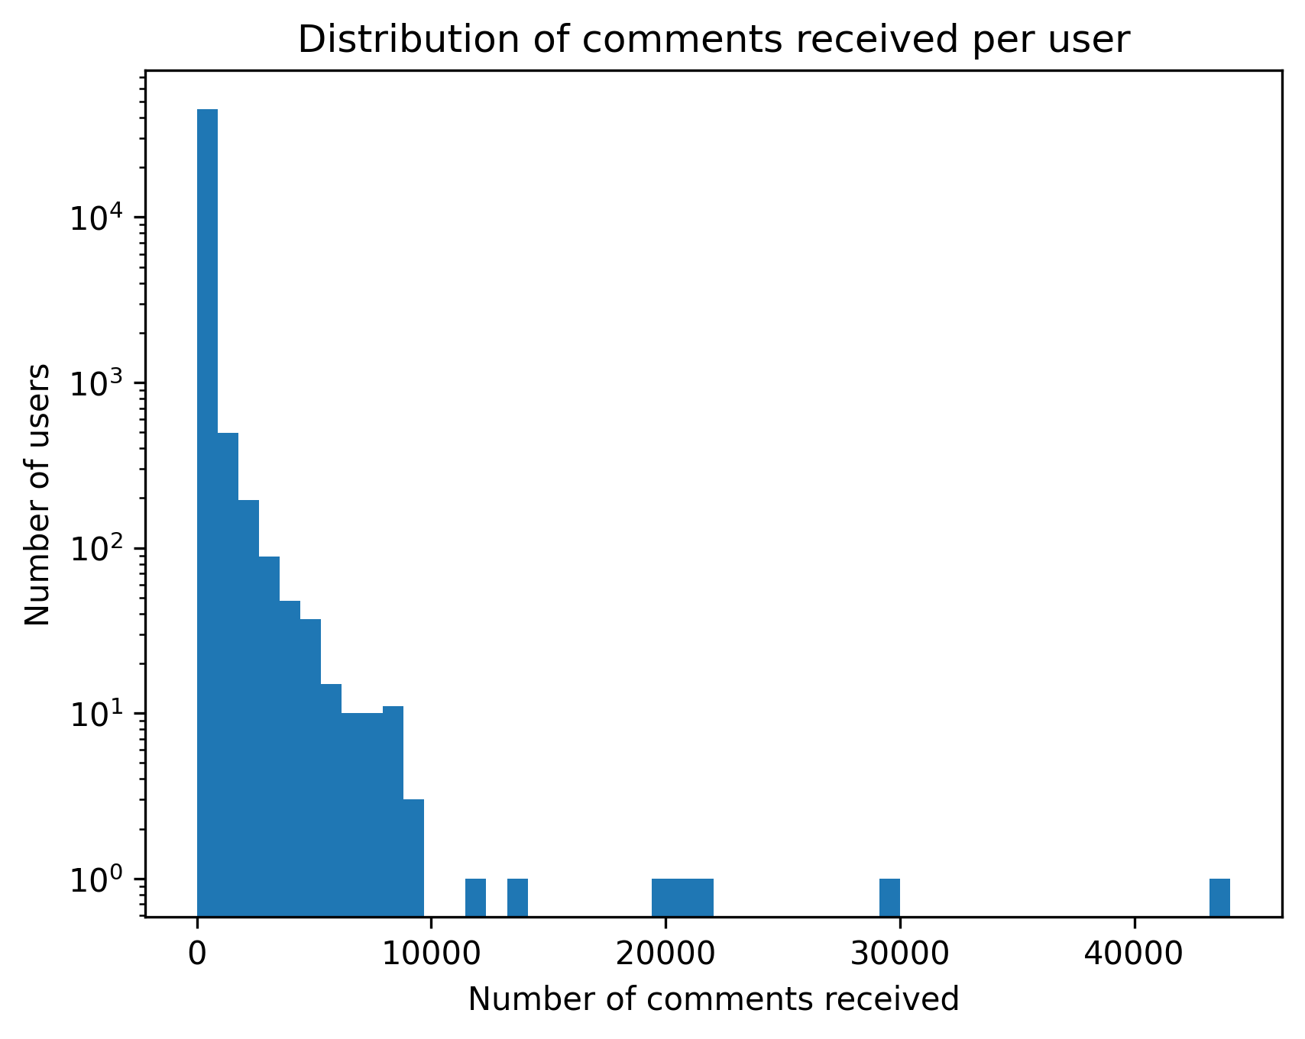
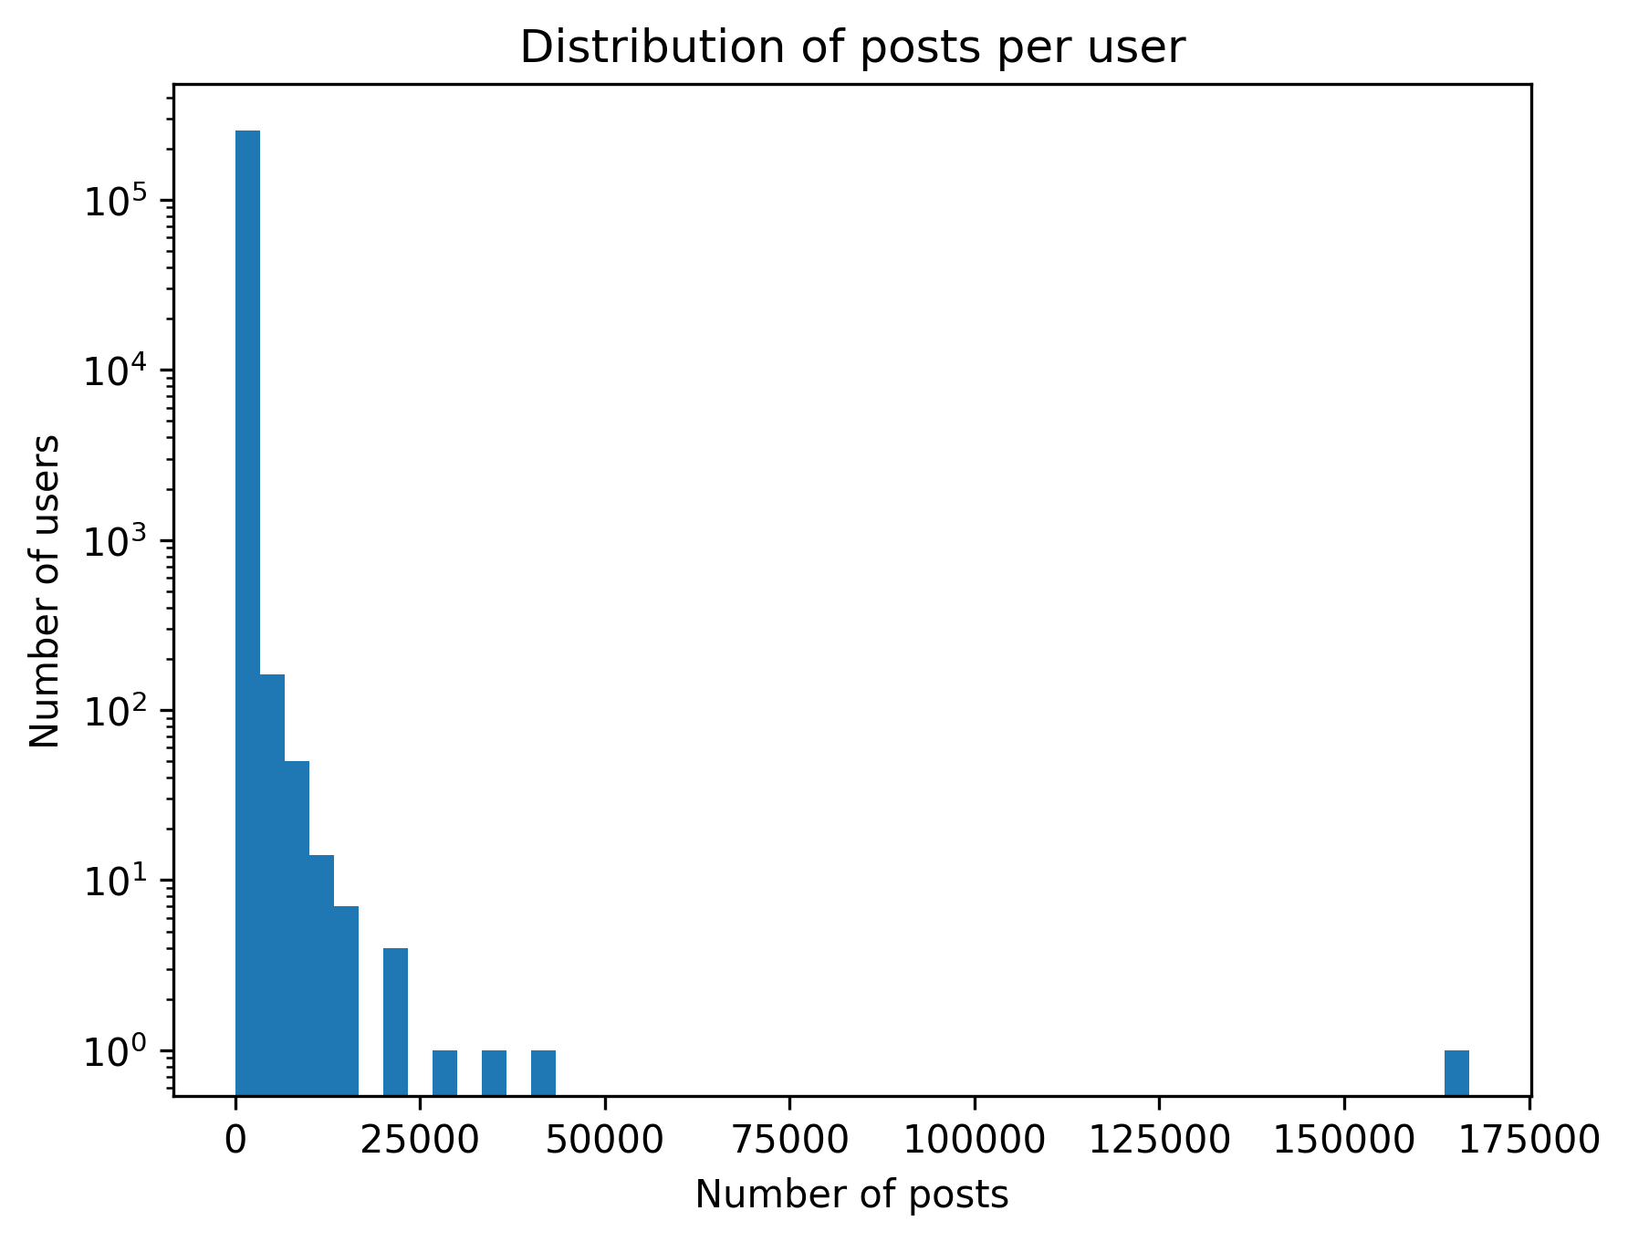
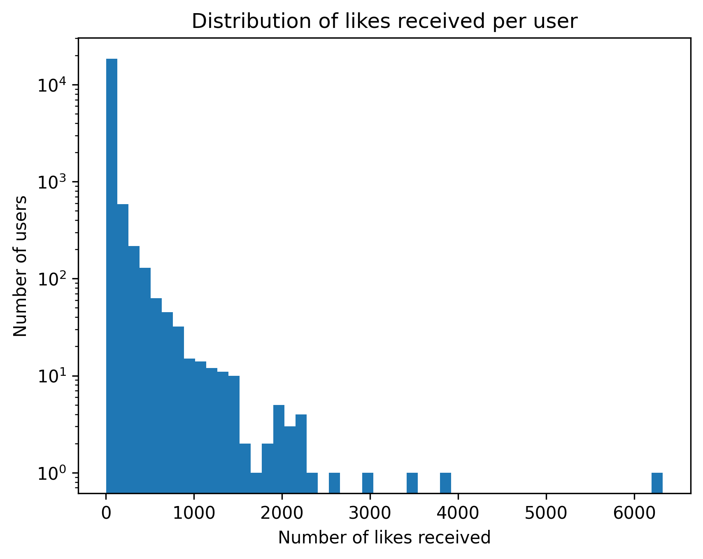
Initial Data Exploration

Slide 7
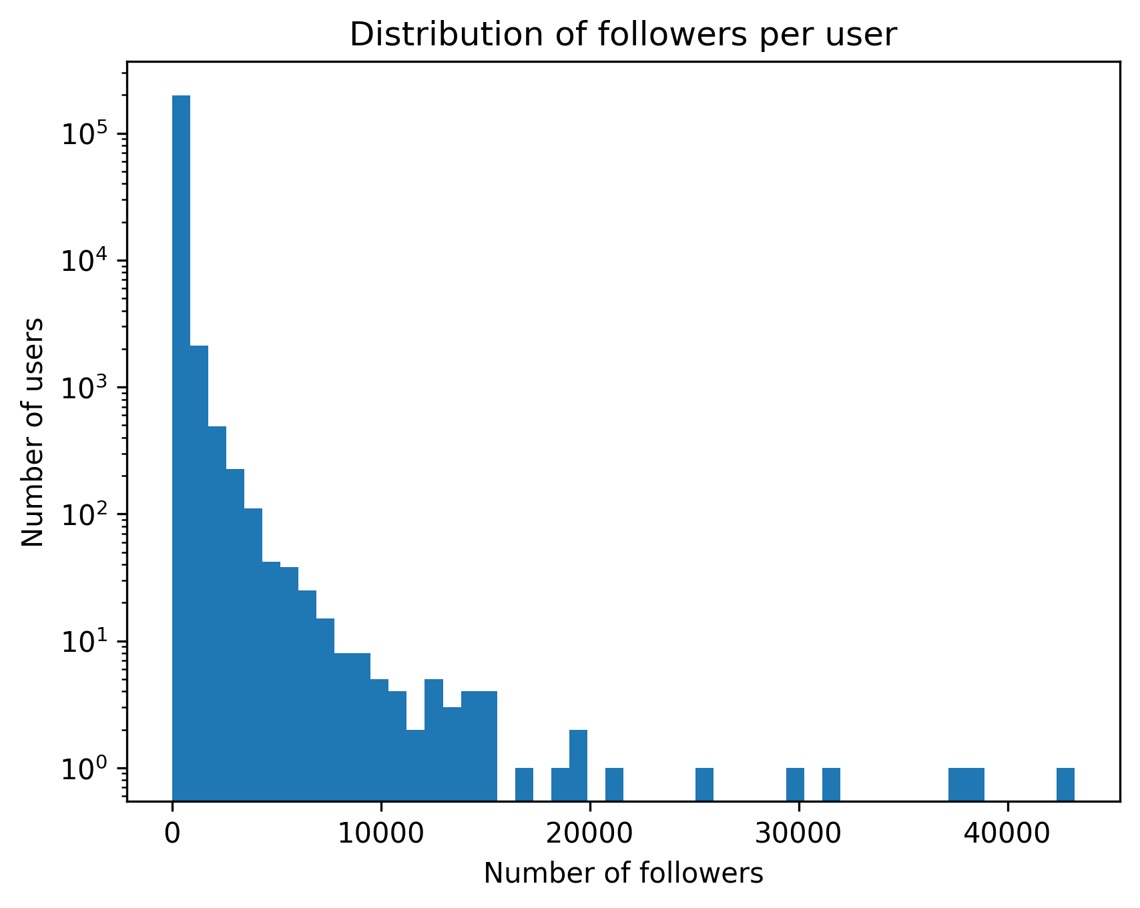
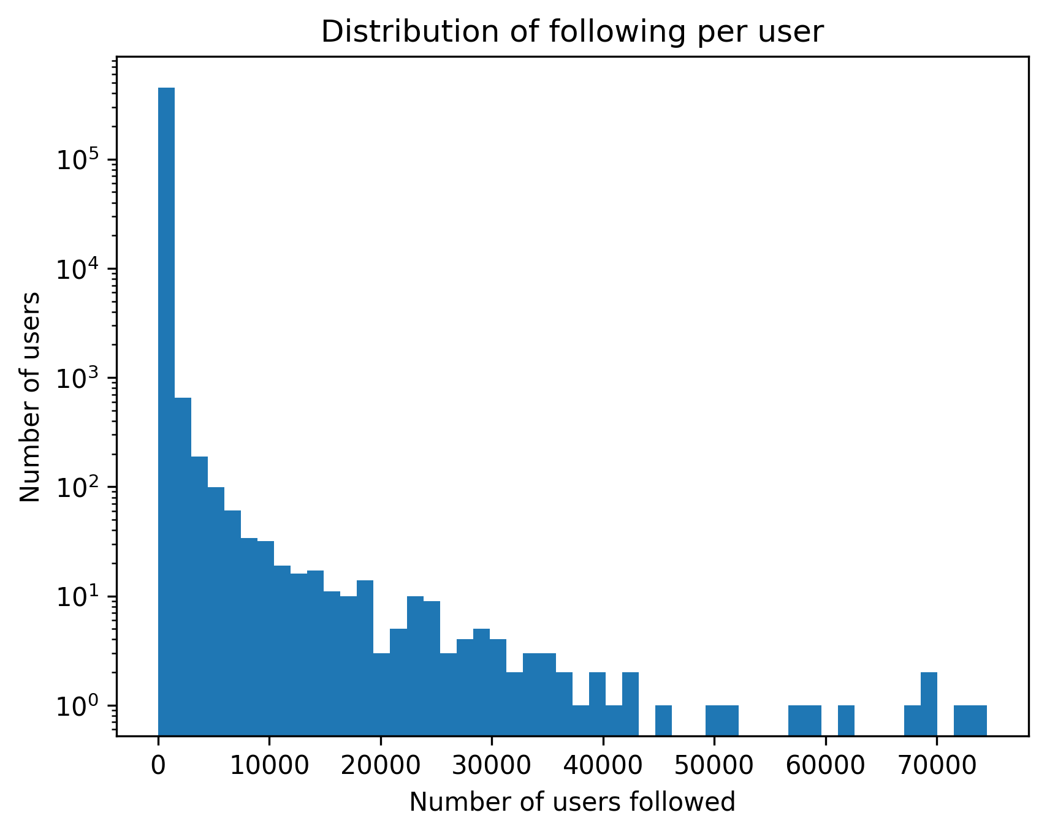
Initial Data Exploration

Slide 8
Initial Data Exploration – per User Statistics
Type | Average | Median | Standard Deviation | Maximum
Follower Count per User | 96.7 | 20 | 380.44 | 43’222
Following Count per User | 43.04 | 4 | 534.28 | 74’522
Posts Created per User | 48.53 | 8 | 433.89 | 166’965
Likes Received per Post per User | 0.04 | 0 | 0.63 | 180.7
Likes Given per User | 34.89 | 3 | 213.05 | 25’224
Comments Received per Post per User | 0.2 | 0 | 1.69 | 279.15
Comments Given per User | 69.38 | 4 | 339.45 | 29’348

Slide 9
Algorithm for Social Circle Detection (Louvian and Leiden)
504’590 users/vertices
19’547’158 followings/edges
Louvian: undirected, invented in 2015, O(|V| + |E|), similar to agglomerative clustering: bottom-up, hierarchical and greedy
Leiden: ....
Notes:
We are using Leiden because of the following reasons:

Slide 10
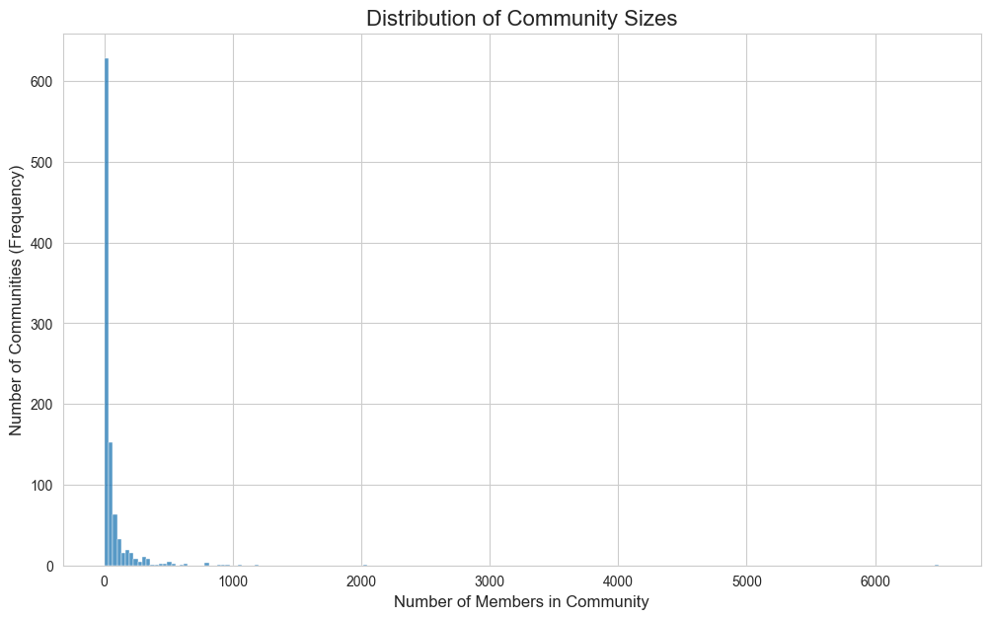
Outcome of Social Circle Detection
Number of communities: 2098
Average community size: 239.3 users
Max community size: 157’643 users
Modularity: ....
Density: ....
Concudance: ....
Notes:
Modularity: ...
Density: How well are the nodes connected
Conductance: ....

Slide 11
Community 6 (157’643 Users)
Type | Average | Median | Standard Deviation | Maximum
Follower Count per User | 109.66 | 36 | 491.91 | 42487
Following Count per User | 38.76 | 4 | 570.49 | 58349
Posts Created per User | 31.86 | 8 | 191.34 | 22375
Likes Received per Post per User | 0.01 | 0 | 0.13 | 16
Likes Given per User | 33.95 | 2 | 165.45 | 3948
Comments Received per Post per User | 0.07 | 0 | 0.34 | 34
Comments Given per User | 24.76 | 3 | 138.02 | 4365

Slide 12
Community 1 (84’830 Users)
Type | Average | Median | Standard Deviation | Maximum
Follower Count per User | 44.16 | 12 | 364.06 | 36765
Following Count per User | 25.48 | 3 | 681.91 | 73103
Posts Created per User | 59.5 | 9 | 326.26 | 16258
Likes Received per Post per User | 0 | 0 | 0.06 | 5
Likes Given per User | 9.65 | 1 | 43.66 | 666
Comments Received per Post per User | 0.05 | 0 | 0.21 | 14
Comments Given per User | 48.15 | 3 | 307.91 | 12197

Slide 13
Community 0 (48’550 Users)
Type | Average | Median | Standard Deviation | Maximum
Follower Count per User | 304.79 | 135 | 566.65 | 10232
Following Count per User | 143.47 | 13 | 645.94 | 26764
Posts Created per User | 65.25 | 10 | 410.25 | 40377
Likes Received per Post per User | 0 | 0 | 0.06 | 3
Likes Given per User | 7.23 | 1 | 34.45 | 419
Comments Received per Post per User | 0.04 | 0 | 0.18 | 7
Comments Given per User | 27.52 | 3 | 162.12 | 4644

Slide 14
Answer to Research Question 1
We were able to identify distinct social circles based on user connections (using the Leiden community detection algorithm)
We characterized three interesting social circles based on their activity, service usage and interaction patterns
Notes:
RQ 1: Is it possible to identify distinct social circles within the Friendfeed network based on user connections, and characterize them in terms of shared interests and activity patterns?

Slide 15
Algorithms used for Anomaly Detection
Statistical Approach (Multivariate Gaussian)
Clustering-based Approach (k-Means)
Distance-based Approach (k-NN)
Density-based Approach (LOF)
Isolation-based Approach (iForest)
One-Class SVM
Reconstruction-based Approach (PCA)
Notes:
1. Statistical Approach
Identifies points that have a low probability of belonging to an assumed data distribution (e.g., Gaussian).
2. Clustering-based Approach
Flags data points that are the furthest from the center of their assigned cluster.
3. Distance-based Approach (k-NN -> k nearest neighbots)
Considers points with the largest distances to their nearest neighbors as outliers.
4. Density-based Approach (LOF -> Local Outlier Factor))
Finds outliers in areas of significantly lower point density compared to their local neighborhood.
5. Isolation-based Approach (iForest)
Based on the principle that anomalies are easier to separate (isolate) from the main data.
6. One-Class SVM
Learns a boundary that encloses the majority of the data; points falling outside are flagged as outliers.
7. Reconstruction-based Approach (PCA)
Flags points with a high error when being reconstructed from a compressed, lower-dimensional version of the data.

Slide 16
Features used for Anomaly Detection
Follower Count per User
Following Count per User
Posts Created per User
Likes Received per Post per User
Likes Given per User
Comments Received per Post per User
Comments Given per User

Slide 17
Preprocessing for Anomaly Detection
Create a new dataframe -> rows = users -> columns = 7 features
Normalization -> mean of every feauture = 0 -> std of every feature = 1
Setting an appropriate contamination rate -> in our case: 0.05% -> 0.0005 * 504’590 users ~ 250 outlier users

Slide 18
Outlier User ” itblogger” Influencer: is in the top 1 % in all categories
Type | Value | Rank | Top in %
Follower Count | 2,135.0 | 688 | 0.14
Following Count | 1,282.0 | 1371 | 0.28
Posts Created | 329 | 4851 | 1
Likes Received per Post (on average) | 0.72 | 2646 | 0.54
Likes Given | 1,868.0 | 12 | 0
Comments Received per Post (on average) | 7.8 | 481 | 0.1
Comments Given | 2,201.0 | 184 | 0.04
Algorithms that detected outlier: Multivariate Gaussian, k-Means, kNN, iForest, PCA

Slide 19
Outlier User ” golaqa” Like and Comment Spammer Bot (no Followers)
Type | Value | Rank | Top in %
Follower Count | 0 | 196437 | 70.13
Following Count | 63 | 42306 | 8.72
Posts Created | 215 | 8210 | 1.69
Likes Received per Post (on average) | 1.67 | 467 | 0.1
Likes Given | 3,439.0 | 4 | 0
Comments Received per Post (on average) | 14.07 | 129 | 0.03
Comments Given | 4,259.0 | 38 | 0.01
Algorithms that detected outlier: Multivariate Gaussian, k-Means, kNN, iForest, PCA

Slide 20
Outlier User ” falob” - Very active User: likes a lot of posts but doesn’t comment much
Type | Value | Rank | Top in %
Follower Count | 507 | 6455 | 1.32
Following Count | 940 | 1926 | 0.39
Posts Created | 2 | 163603 | 35.32
Likes Received per Post (on average) | 78.5 | 1 | 0
Likes Given | 25,224.0 | 1 | 0
Comments Received per Post (on average) | 26 | 25 | 0.01
Comments Given | 2 | 25251 | 5.69
Algorithms that detected outlier: Multivariate Gaussian, k-Means, kNN, iForest, PCA

Slide 21
Answer to Research Question 2
We were able to detect anomalous users using seven different anomaly detection algorithms
We were able to characterize three interesting anomalous users based on their activity and interaction pattern
Notes:
RQ 2:
Is it possible to detect anomalous users in the Friendfeed network (e.g., bots, spammers) based on posting, following, and interaction patterns (commenting/liking) and characerize them in terms of activity and interactions patterns?

Slide 22
Future Work
Characterize more social circles and anomalous users based on their activity and interaction patterns
Create more attributes of the users (e.g.: gender, political view and academic level based on profile and post descriptions)
Create association rules within the friendfeed network and social circles (e.g. if the users are using facebook, they are likely to also use twitter)

