Slide 1
Group 51 – Data Mining I Project
Analysis of Social Circles and Anomalous Users in the Friendfeed Network
Jonas Blum
Sanjatul Islam
Xin Tian
Riccardo Rebecchi

Slide 2
Topics
Research Questions
Data Preprocessing
Initial Data Exploration
Social Circle Detection
Anomaly Detection

Slide 3
Research Questions
RQ 1: Is it possible to identify distinct social circles within the Friendfeed network based on user connections, and characterize them in terms of activity and interaction patterns?
RQ 2: Is it possible to detect anomalous users in the Friendfeed network (e.g., bots, spammers) based on posting, following, and interaction patterns (commenting/liking) and characerize them in terms of activity and interactions patterns?

Slide 4
Data – Friendfeed Social Network
Number of users: 665’382
Number of posts: 12’450’658
Number of comments: 3’749’891
Number of people following: 19’547’158
Number of likes: 798’112

Slide 5
Preprocessing
Dataset has already been preprocessed before
Remove “dead” accounts (without any posts, likes and comments) Users removed: 160’792 (504’590 users remaining)
Connect users following each other (via FollowedID and FollowerID)
Connect users and their posts via UserID
Connect posts, users and likes + comments via PostId and UserID

Slide 6
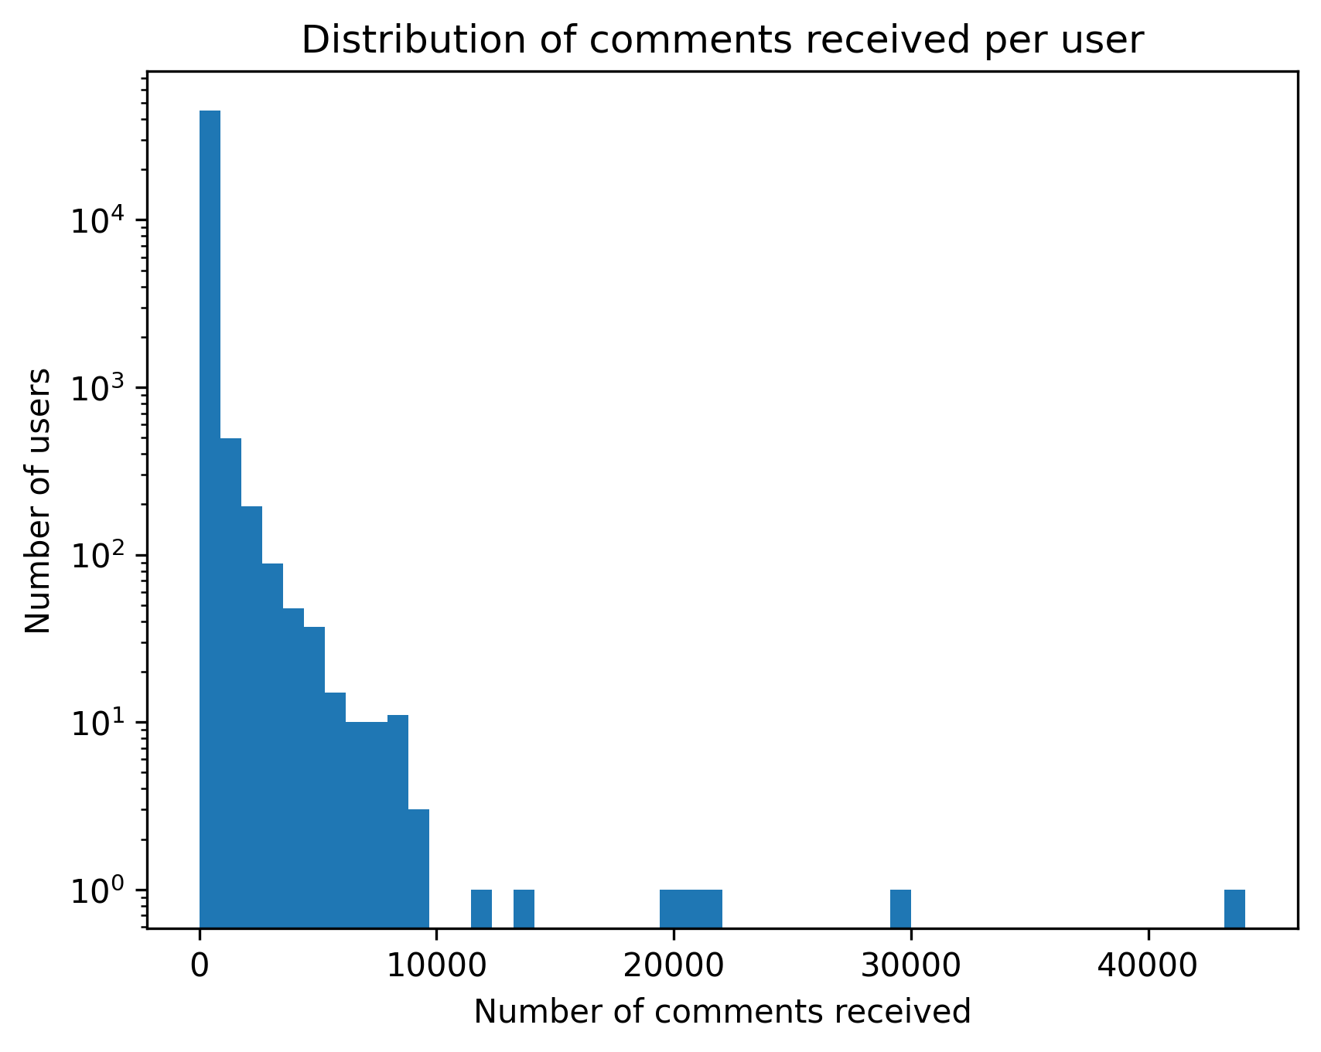
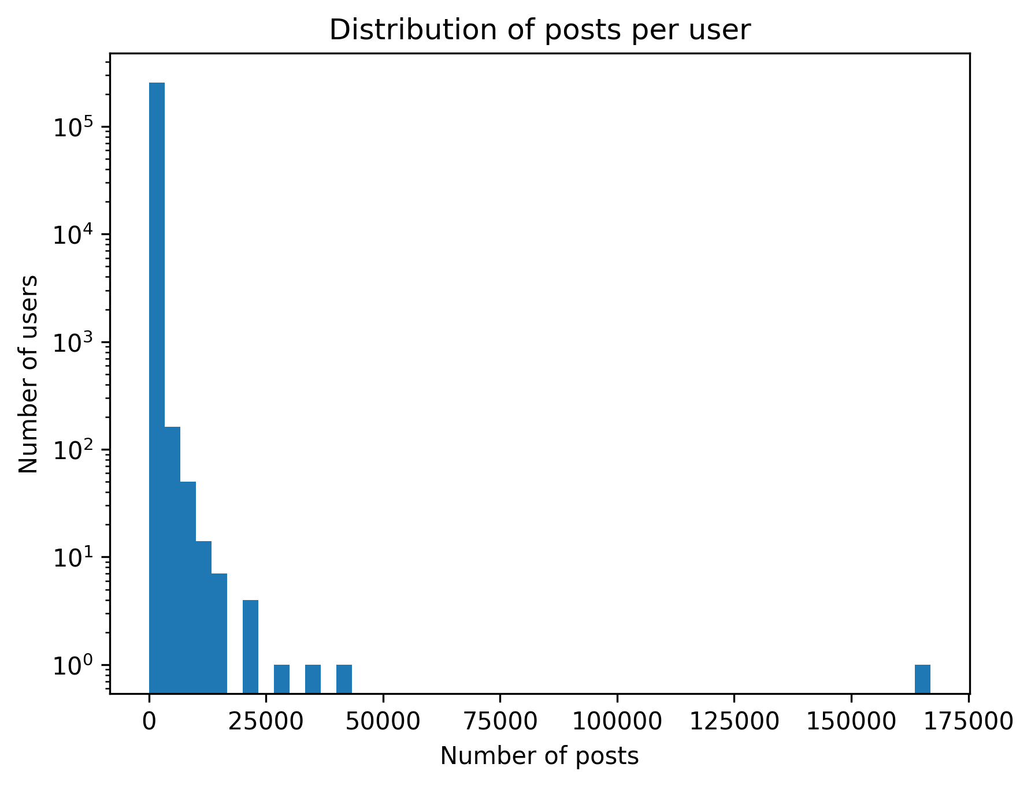
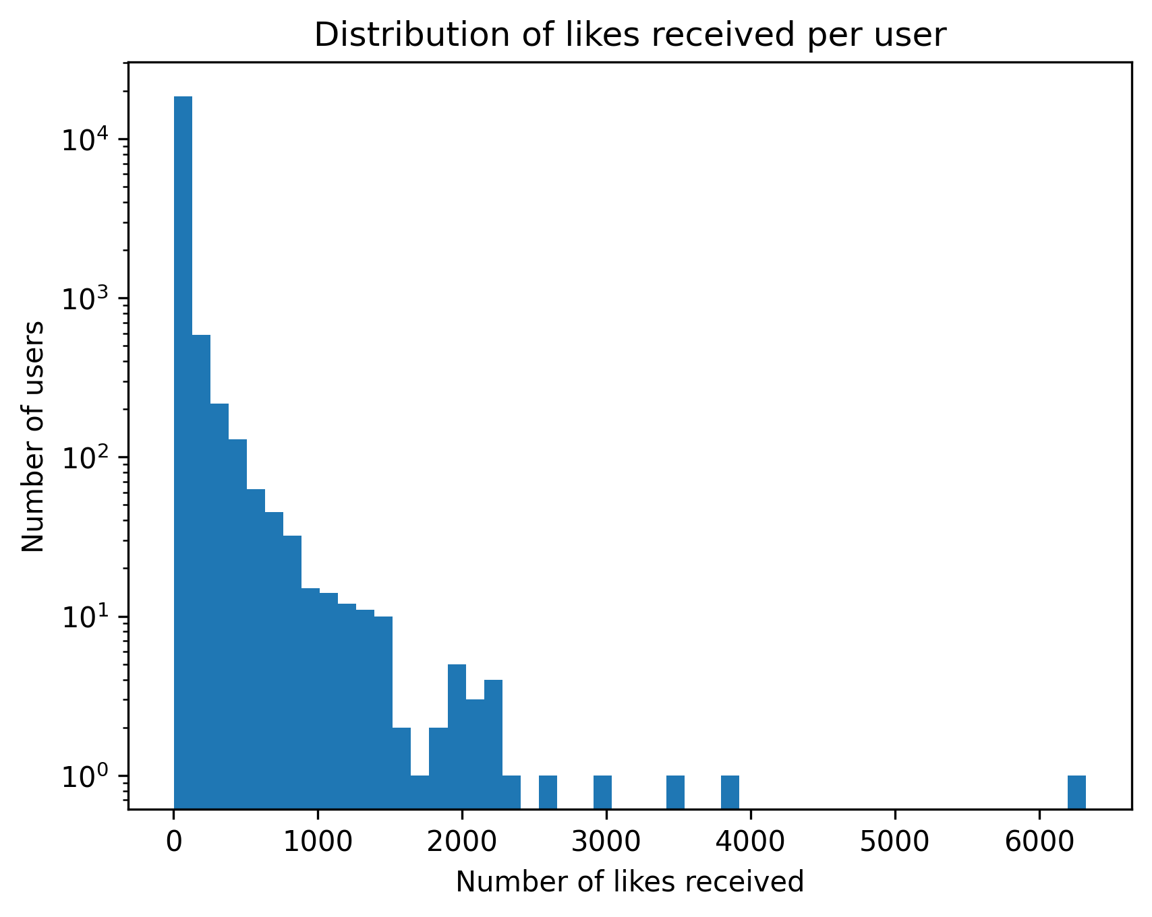
Initial Data Exploration

Slide 7
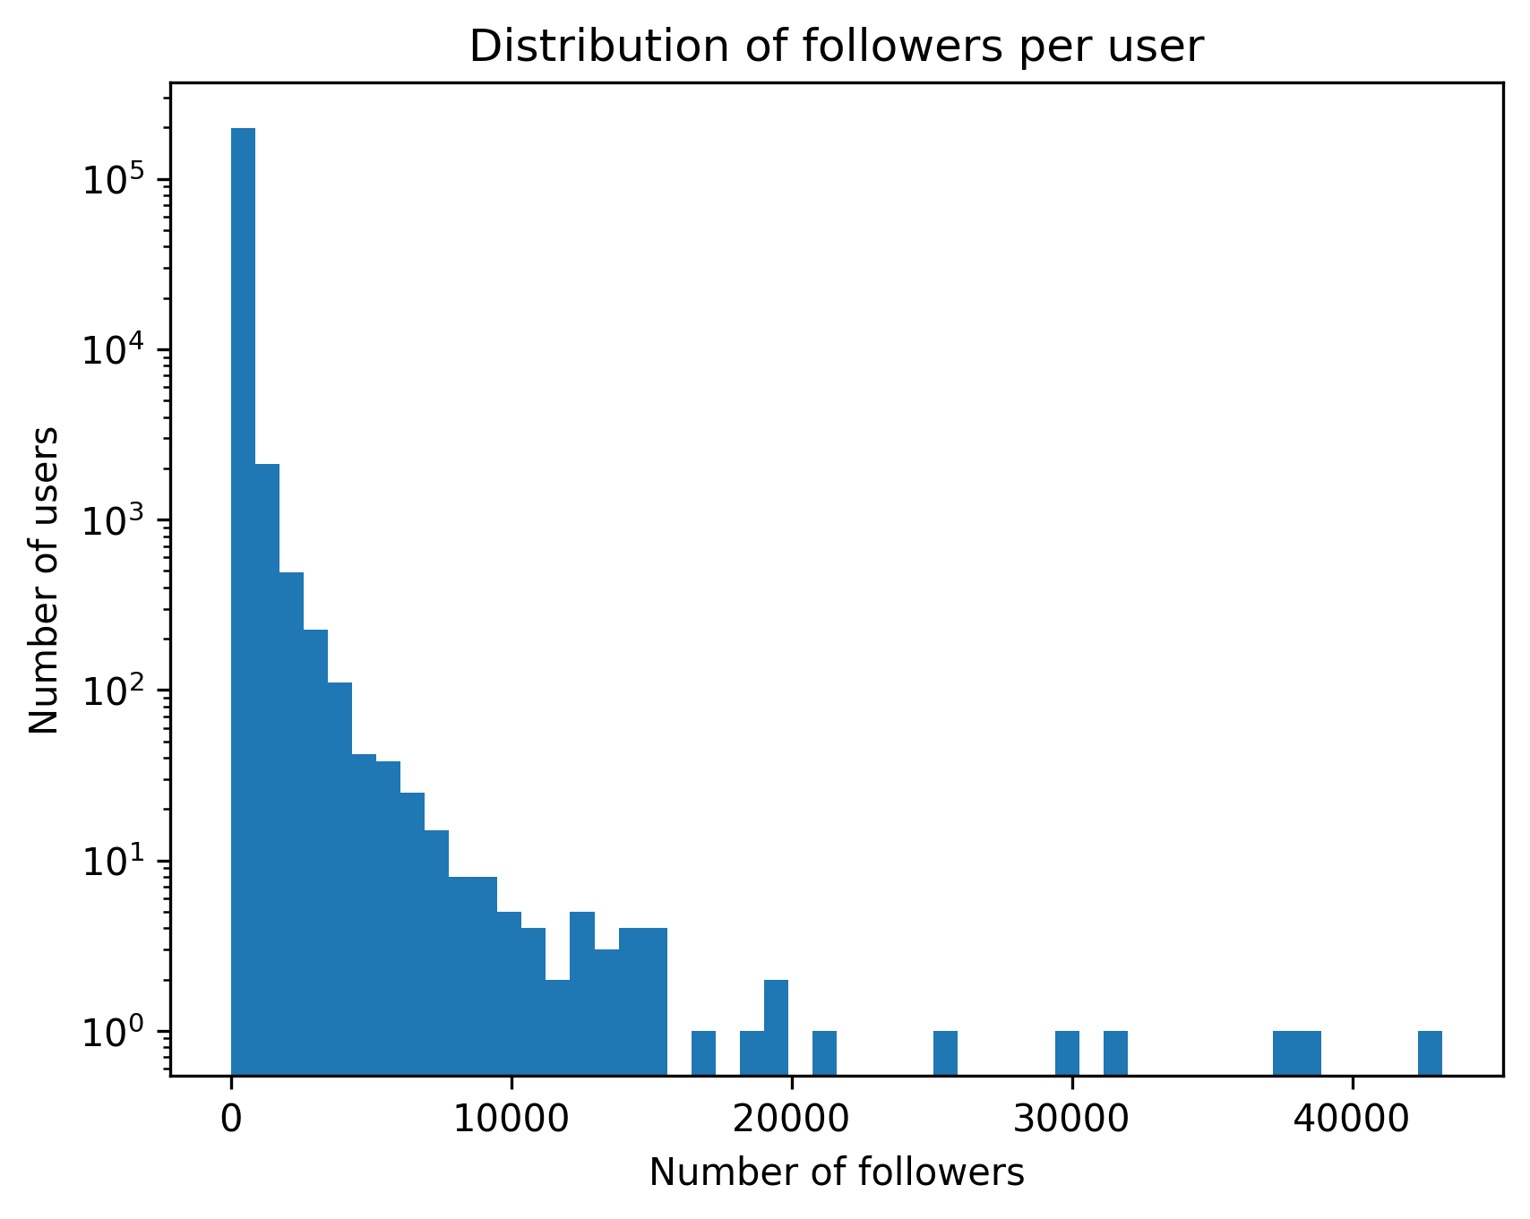
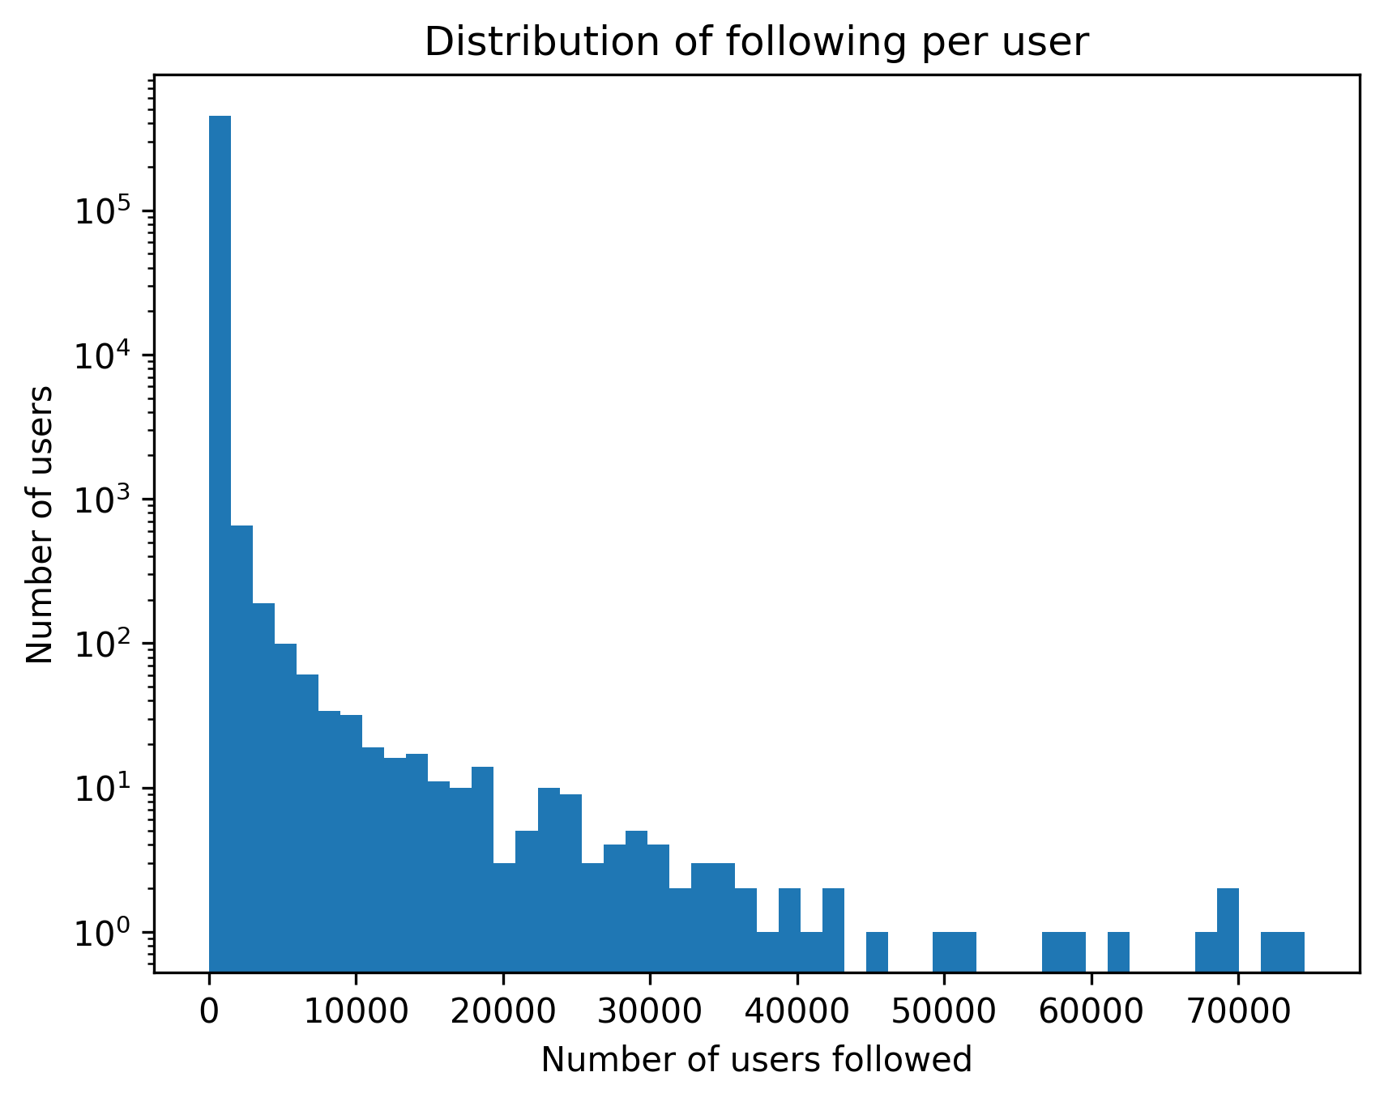
Initial Data Exploration

Slide 8
Initial Data Exploration – per User Statistics
Type | Average | Median | Standard Deviation | Maximum
Follower Count per User | 96.7 | 20 | 380.44 | 43’222
Following Count per User | 43.04 | 4 | 534.28 | 74’522
Posts Created per User | 48.53 | 8 | 433.89 | 166’965
Likes Received per Post per User | 0.04 | 0 | 0.63 | 180.7
Likes Given per User | 34.89 | 3 | 213.05 | 25’224
Comments Received per Post per User | 0.2 | 0 | 1.69 | 279.15
Comments Given per User | 69.38 | 4 | 339.45 | 29’348

Slide 9
Louvain Algorithm for Social Circle Detection
504’590 users/vertices
19’547’158 followings/edges
Invented in 2015
Space and time complexity: O(|V| + |E|)
Similar to agglomerative clustering: bottom-up, hierarchical and greedy
Notes:
1. Starts with individual vertices 2. Merges vertices into neighboring communities 3. Creates a new hierarchy after each pass of merging

Slide 10
Outcome of Social Circle Detection
Number of communities:
Average community size:

Slide 11
Community 6 (157’643 Users)
Type | Average | Median | Standard Deviation | Maximum
Follower Count per User | 109.66 | 36 | 491.91 | 42487
Following Count per User | 38.76 | 4 | 570.49 | 58349
Posts Created per User | 31.86 | 8 | 191.34 | 22375
Likes Received per Post per User | 0.01 | 0 | 0.13 | 16
Likes Given per User | 33.95 | 2 | 165.45 | 3948
Comments Received per Post per User | 0.07 | 0 | 0.34 | 34
Comments Given per User | 24.76 | 3 | 138.02 | 4365

Slide 12
Community 1 (84’830 Users)
Type | Average | Median | Standard Deviation | Maximum
Follower Count per User | 44.16 | 12 | 364.06 | 36765
Following Count per User | 25.48 | 3 | 681.91 | 73103
Posts Created per User | 59.5 | 9 | 326.26 | 16258
Likes Received per Post per User | 0 | 0 | 0.06 | 5
Likes Given per User | 9.65 | 1 | 43.66 | 666
Comments Received per Post per User | 0.05 | 0 | 0.21 | 14
Comments Given per User | 48.15 | 3 | 307.91 | 12197

Slide 13
Community 0 (48’550 Users)
Type | Average | Median | Standard Deviation | Maximum
Follower Count per User | 304.79 | 135 | 566.65 | 10232
Following Count per User | 143.47 | 13 | 645.94 | 26764
Posts Created per User | 65.25 | 10 | 410.25 | 40377
Likes Received per Post per User | 0 | 0 | 0.06 | 3
Likes Given per User | 7.23 | 1 | 34.45 | 419
Comments Received per Post per User | 0.04 | 0 | 0.18 | 7
Comments Given per User | 27.52 | 3 | 162.12 | 4644

Slide 14
Community 9 (46’322 Users)
Type | Average | Median | Standard Deviation | Maximum
Follower Count per User | 88.18 | 19 | 237.63 | 7997
Following Count per User | 26.37 | 3 | 150.25 | 18364
Posts Created per User | 61.65 | 7 | 1472.32 | 166965
Likes Received per Post per User | 0.23 | 0 | 1.08 | 78
Likes Given per User | 34.89 | 4 | 328.76 | 25224
Comments Received per Post per User | 0.87 | 0 | 2.24 | 49
Comments Given per User | 141.22 | 8 | 574.59 | 29348

Slide 15
Community 5 (25’606 Users)
Type | Average | Median | Standard Deviation | Maximum
Follower Count per User | 40.75 | 13 | 121.29 | 7044
Following Count per User | 29.61 | 8 | 89.54 | 7098
Posts Created per User | 58.23 | 23 | 140.39 | 6949
Likes Received per Post per User | 0 | 0 | 0.02 | 1
Likes Given per User | 8.96 | 2 | 18.98 | 133
Comments Received per Post per User | 0.01 | 0 | 0.1 | 2
Comments Given per User | 23.29 | 4 | 126.62 | 3773

Slide 16
Answer to Research Question 1
We were able to identify distinct social circles based on user connections (users following each other)
We characterized five interesting social circles based on their activity and interaction patterns
Notes:
RQ 1: Is it possible to identify distinct social circles within the Friendfeed network based on user connections, and characterize them in terms of shared interests and activity patterns?

Slide 17
Algorithms used for Anomaly Detection
Statistical Approach (Multivariate Gaussian)
Clustering-based Approach (k-Means)
Distance-based Approach (k-NN)
Density-based Approach (LOF)
Isolation-based Approach (iForest)
One-Class SVM
Reconstruction-based Approach (PCA)
Notes:
1. Statistical Approach
Identifies points that have a low probability of belonging to an assumed data distribution (e.g., Gaussian).
2. Clustering-based Approach
Flags data points that are the furthest from the center of their assigned cluster.
3. Distance-based Approach
Considers points with the largest distances to their nearest neighbors as outliers.
4. Density-based Approach (LOF)
Finds outliers in areas of significantly lower point density compared to their local neighborhood.
5. Isolation-based Approach (iForest)
Based on the principle that anomalies are easier to separate (isolate) from the main data.
6. One-Class SVM
Learns a boundary that encloses the majority of the data; points falling outside are flagged as outliers.
7. Reconstruction-based Approach (PCA)
Flags points with a high error when being reconstructed from a compressed, lower-dimensional version of the data.

Slide 18
Features used for Anomaly Detection
Follower Count per User
Following Count per User
Posts Created per User
Likes Received per Post per User
Likes Given per User
Comments Received per Post per User
Comments Given per User

Slide 19
Outlier User ”pattonroberta”
Type | Value | Rank | Top in %
Follower Count | 1,453 | 1280 | 0.26
Following Count | 147 | 19283 | 3.97
Posts Created | 1,389 | 793 | 0.16
Likes Received per Post (on average) | 0.66 | 2992 | 0.61
Likes Given | 2,707.0 | 5 | 0.00
Comments Received per Post (on average) | 3.28 | 2013 | 0.41
Comments Given | 4,365.0 | 36 | 0.01
Algorithms that detected outlier: Multivariate Gaussian, kNN, iForest, PCA Reconstruction

Slide 20
Outlier User ”golaqa”
Type | Value | Rank | Top in %
Follower Count | 0 | 196437 | 70.13
Following Count | 63 | 42306 | 8.72
Posts Created | 215 | 8210 | 1.69
Likes Received per Post (on average) | 1.67 | 467 | 0.1
Likes Given | 3,439.0 | 4 | 0
Comments Received per Post (on average) | 14.07 | 129 | 0.03
Comments Given | 4,259.0 | 38 | 0.01
Algorithms that detected outlier: Multivariate Gaussian, kMeans, kNN, PCA Reconstruction

Slide 21
Outlier User ”jluvisions”
Type | Value | Rank | Top in %
Follower Count | 110 | 36065 | 7.42
Following Count | 0 | 443553 | 95.45
Posts Created | 8,297.0 | 38 | 0.01
Likes Received per Post (on average) | 0 | 15716 | 3.22
Likes Given | 0 | 15739 | 51.61
Comments Received per Post (on average) | 0.99 | 8591 | 1.76
Comments Given | 8,205.0 | 5 | 0
Algorithms that detected outlier: Multivariate Gaussian, kMeans, kNN, PCA Reconstruction

Slide 22
Outlier User ”romanussum”
Type | Value | Rank | Top in %
Follower Count | 53 | 60294 | 12.42
Following Count | 2 | 263137 | 59
Posts Created | 12,198.0 | 16 | 0
Likes Received per Post (on average) | 0 | 15915 | 51.63
Likes Given | 0 | 15739 | 51.61
Comments Received per Post (on average) | 1 | 8494 | 1.74
Comments Given | 12,197.0 | 2 | 0
Algorithms that detected outlier: Multivariate Gaussian, kMeans, kNN, PCA Reconstruction

Slide 23
Outlier User ”tahaakcakaya”
Type | Value | Rank | Top in %
Follower Count | 287 | 13630 | 2.8
Following Count | 263 | 9830 | 2.02
Posts Created | 186 | 9842 | 2.02
Likes Received per Post (on average) | 0.61 | 3200 | 0.66
Likes Given | 1,447.0 | 21 | 0
Comments Received per Post (on average) | 25.62 | 28 | 0.01
Comments Given | 11,546.0 | 3 | 0
Algorithms that detected outlier: Multivariate Gaussian, kMeans, kNN, PCA Reconstruction

Slide 24
Answer to Research Question 2
We were able to detect anomalous users using seven different anomaly detection algorithms
We were able to characterize five interesting anomalous users based on their activity and interaction pattern
Notes:
RQ 2:
Is it possible to detect anomalous users in the Friendfeed network (e.g., bots, spammers) based on posting, following, and interaction patterns (commenting/liking) and characerize them in terms of activity and interactions patterns?

Slide 25
Future Work
Characterize more social circles and anomalous users based on their activity and interaction patterns
Create more attributes of the users (e.g.: political view based on profile and post descriptions)
Characterize the social circles and anomalous users based on the external services they are using (e.g.: work, entertainment, social media)

