Slide 1
Group 51 – Data Mining I Project
Analysis of Social Circles and Anomalous Users in the Friendfeed Network
Jonas Blum
Sanjatul Islam
Xin Tian
Riccardo Rebecchi

Slide 2
Topics
Research Questions
Data Preprocessing
Initial Data Exploration
Social Circle Detection and Characterization
Anomaly Detection and Characterization

Slide 3
Research Questions
RQ 1: Is it possible to identify distinct social circles within the Friendfeed network based on user connections, and characterize them in terms of activity, service usage and interaction patterns?
RQ 2: Is it possible to detect anomalous users in the Friendfeed network (e.g., bots, spammers) based on posting, following, and interaction patterns (commenting/liking) and characerize them in terms of activity and interactions patterns?

Slide 4
Data – Friendfeed Social Network
Number of users: 665’384
Number of people following: 19’547’158
Number of services: 1’587’334
Number of posts: 12’450’658
Number of comments: 3’749’891
Number of likes: 798’112

Slide 5
Data – Preprocessing
1. Users Table
Removed duplicate records.
Converted all user_id values to lowercase to maintain consistency and avoid mismatches due to case differences.
2. Following Table
Removed duplicate records.
Filtered out any follow relationships where either the follower or followed user does not exist in the users table.
Standardized follower_id and followed_id by converting them to lowercase.

Slide 6
Data – Preprocessing
3. Services Table
Removed duplicate records.
Removed rows containing null values in key fields such as user_id and service_id.
Converted all user_id and service_id values to lowercase for consistency.
Retained only service records for users that exist in the followings table, as these users are relevant for community detection.
4. Posts Table
Removed posts that did not contain any text, image, or video content.
Dropped rows with null values in key fields such as user_id and post_id.
Converted all user_id and post_id values to lowercase to ensure consistency and accurate matching.

Slide 7
Data – Preprocessing
Retained only posts from users present in the followings table, as these users are relevant for community detection.
5. Likes Table
Removed duplicate records.
Converted all user_id and post_id values to lowercase for consistency and accurate matching.
Retained only likes from users present in the followings table, as these users are relevant for community detection.
5. Comments Table
Removed duplicate records.
Dropped rows with null values in key fields such as posted_by.

Slide 8
Data – Preprocessing
Converted all posted_by values to lowercase for consistency and accurate matching.
Retained only comments made by users present in the followings table, as these users are relevant for community detection.

Slide 9
Data - After Preprocessing -
Number of users: 645’416
Number of people following: 18’477’147
Number of services: 136’6407
Number of posts: 10’864’613
Number of comments: 3’749’891
Number of likes: 797’290

Slide 10
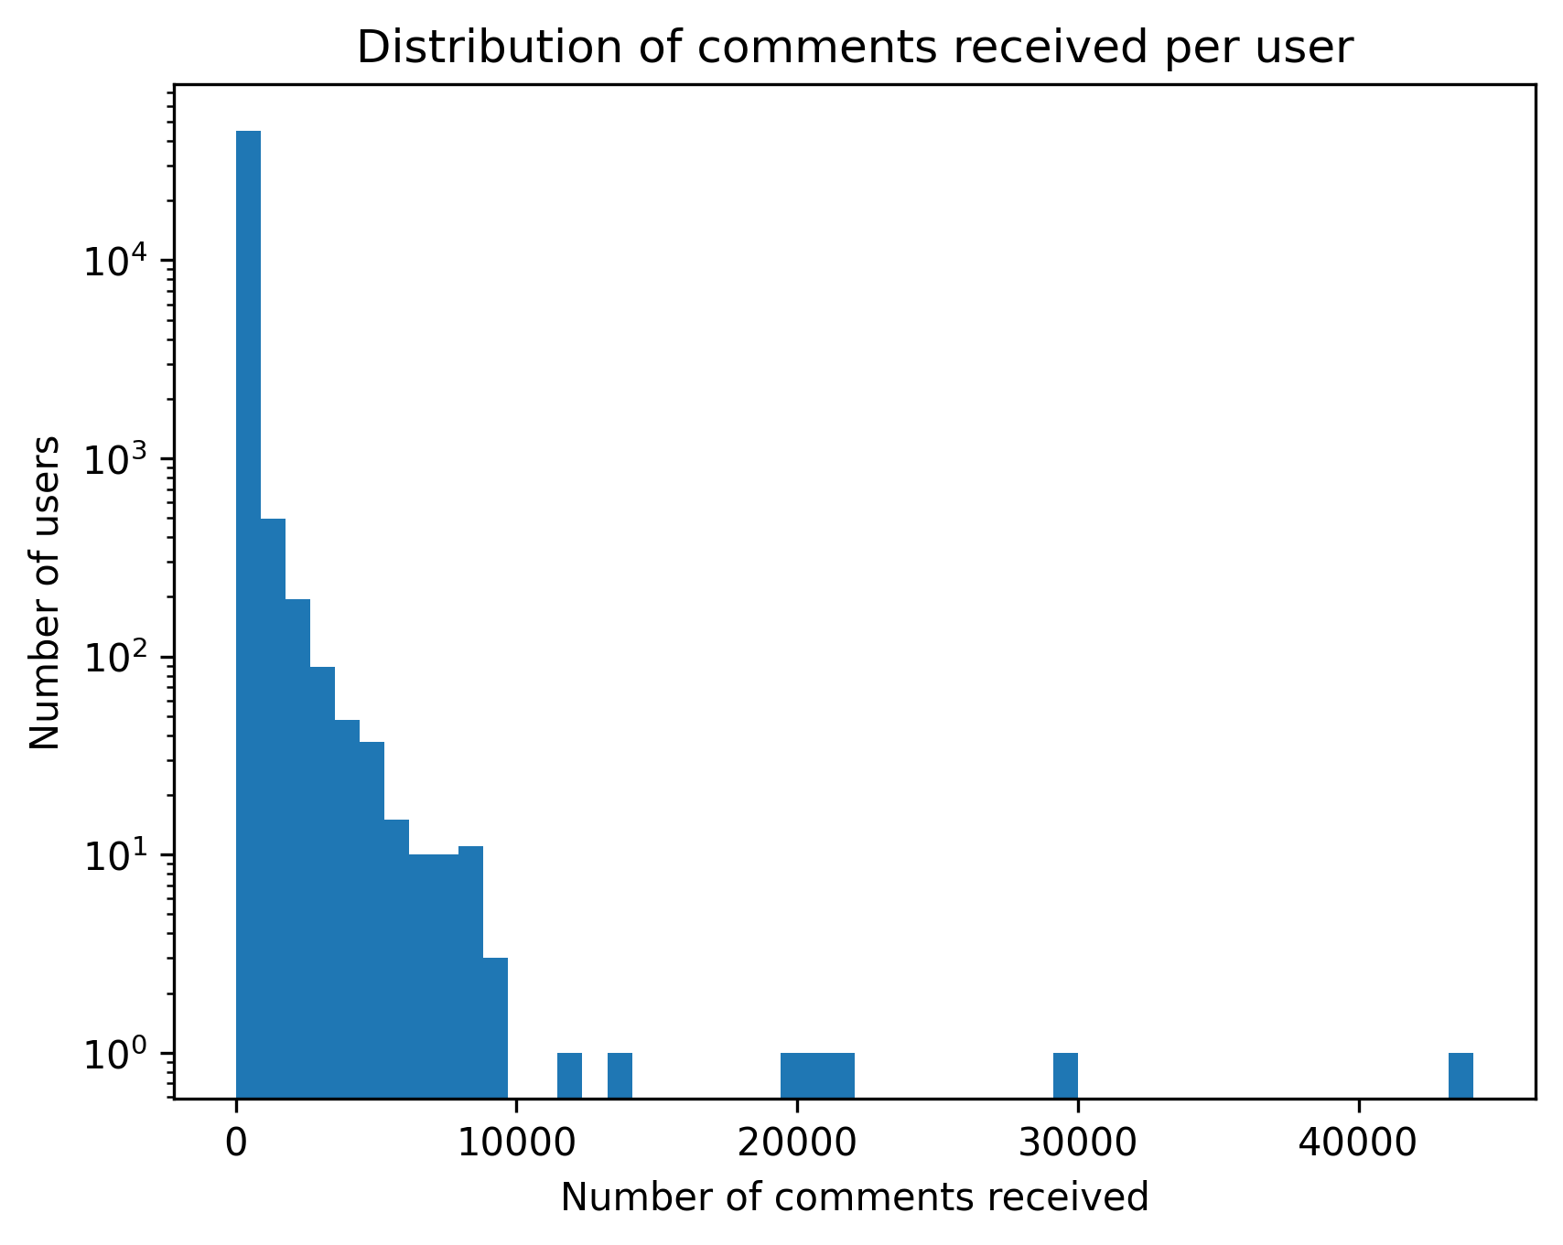
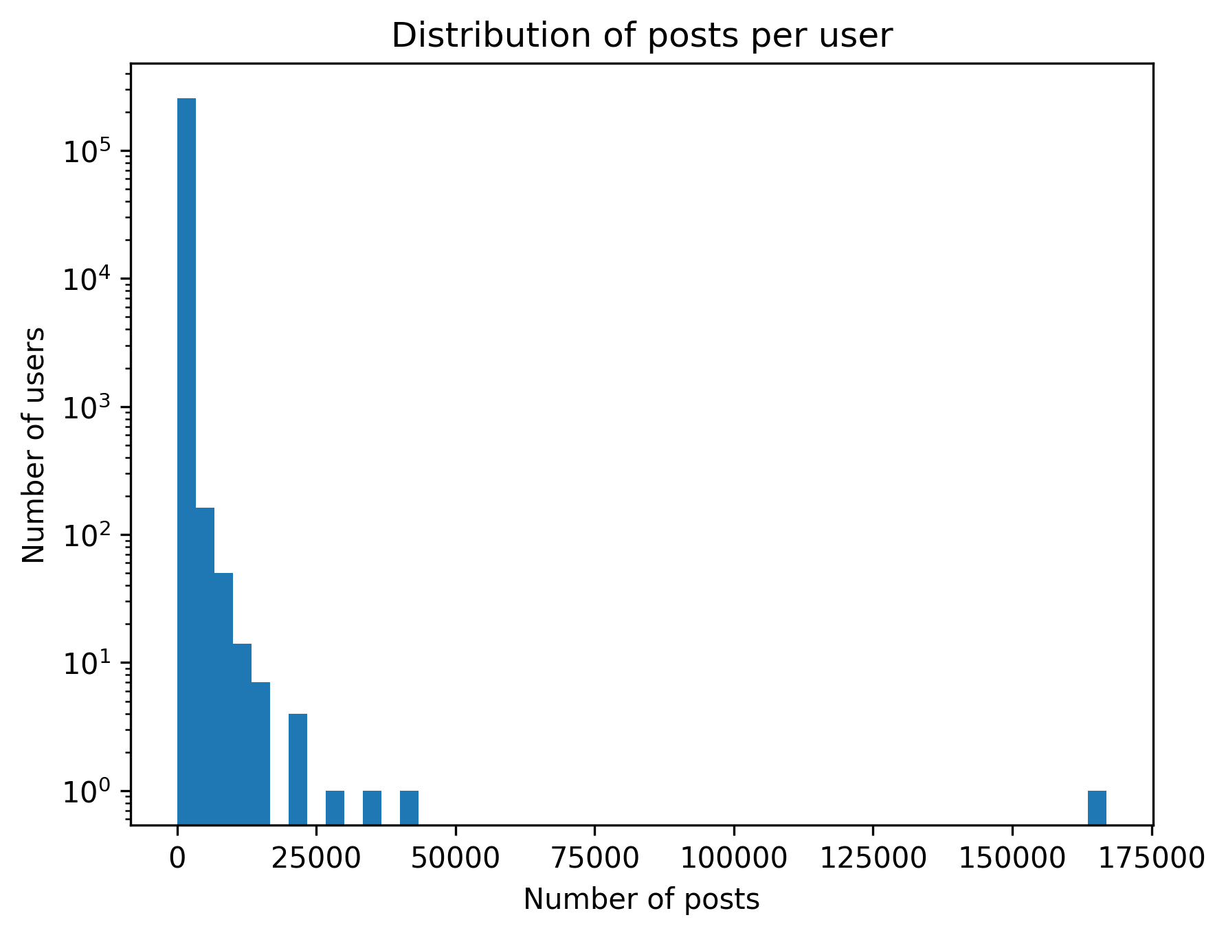
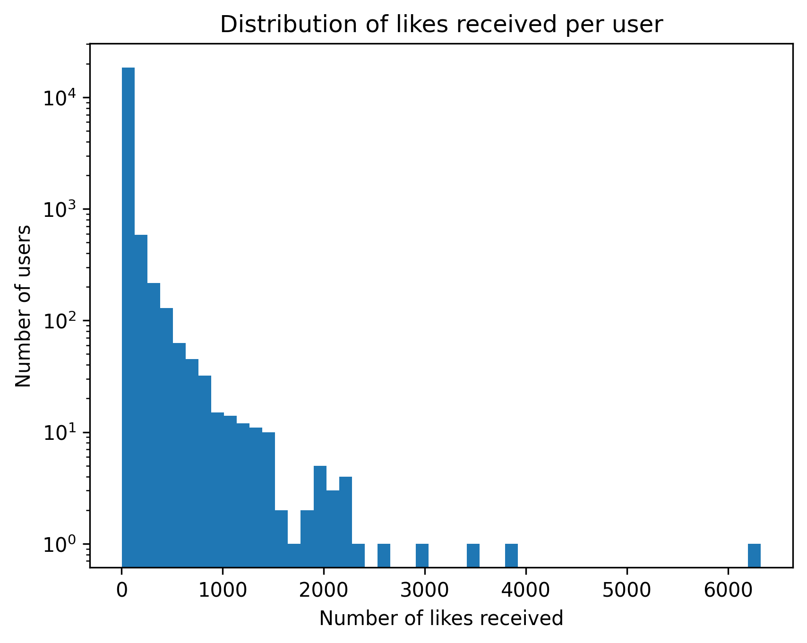
Initial Data Exploration

Slide 11
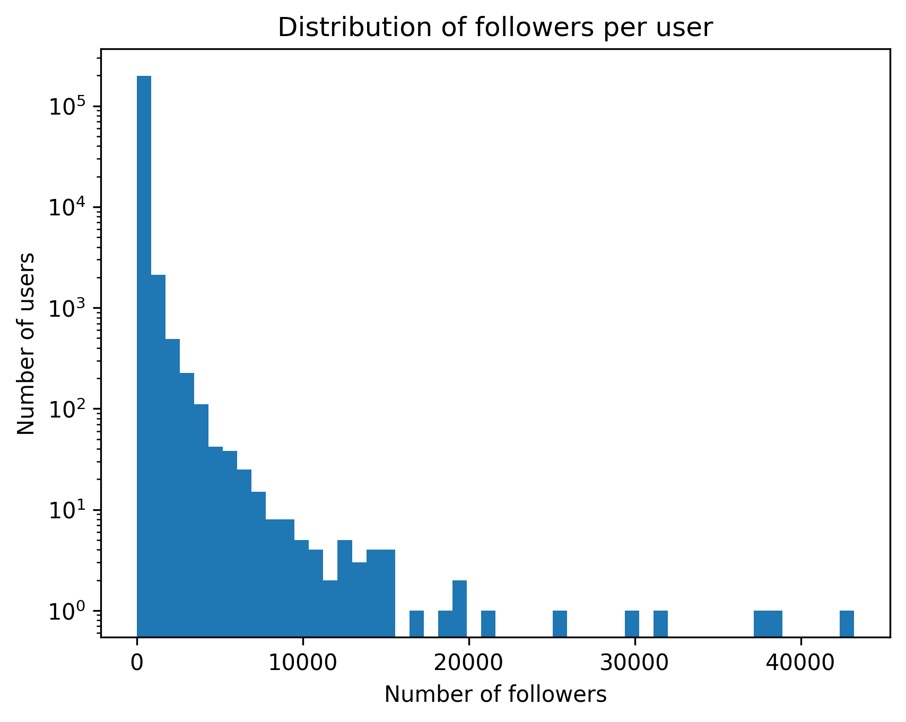
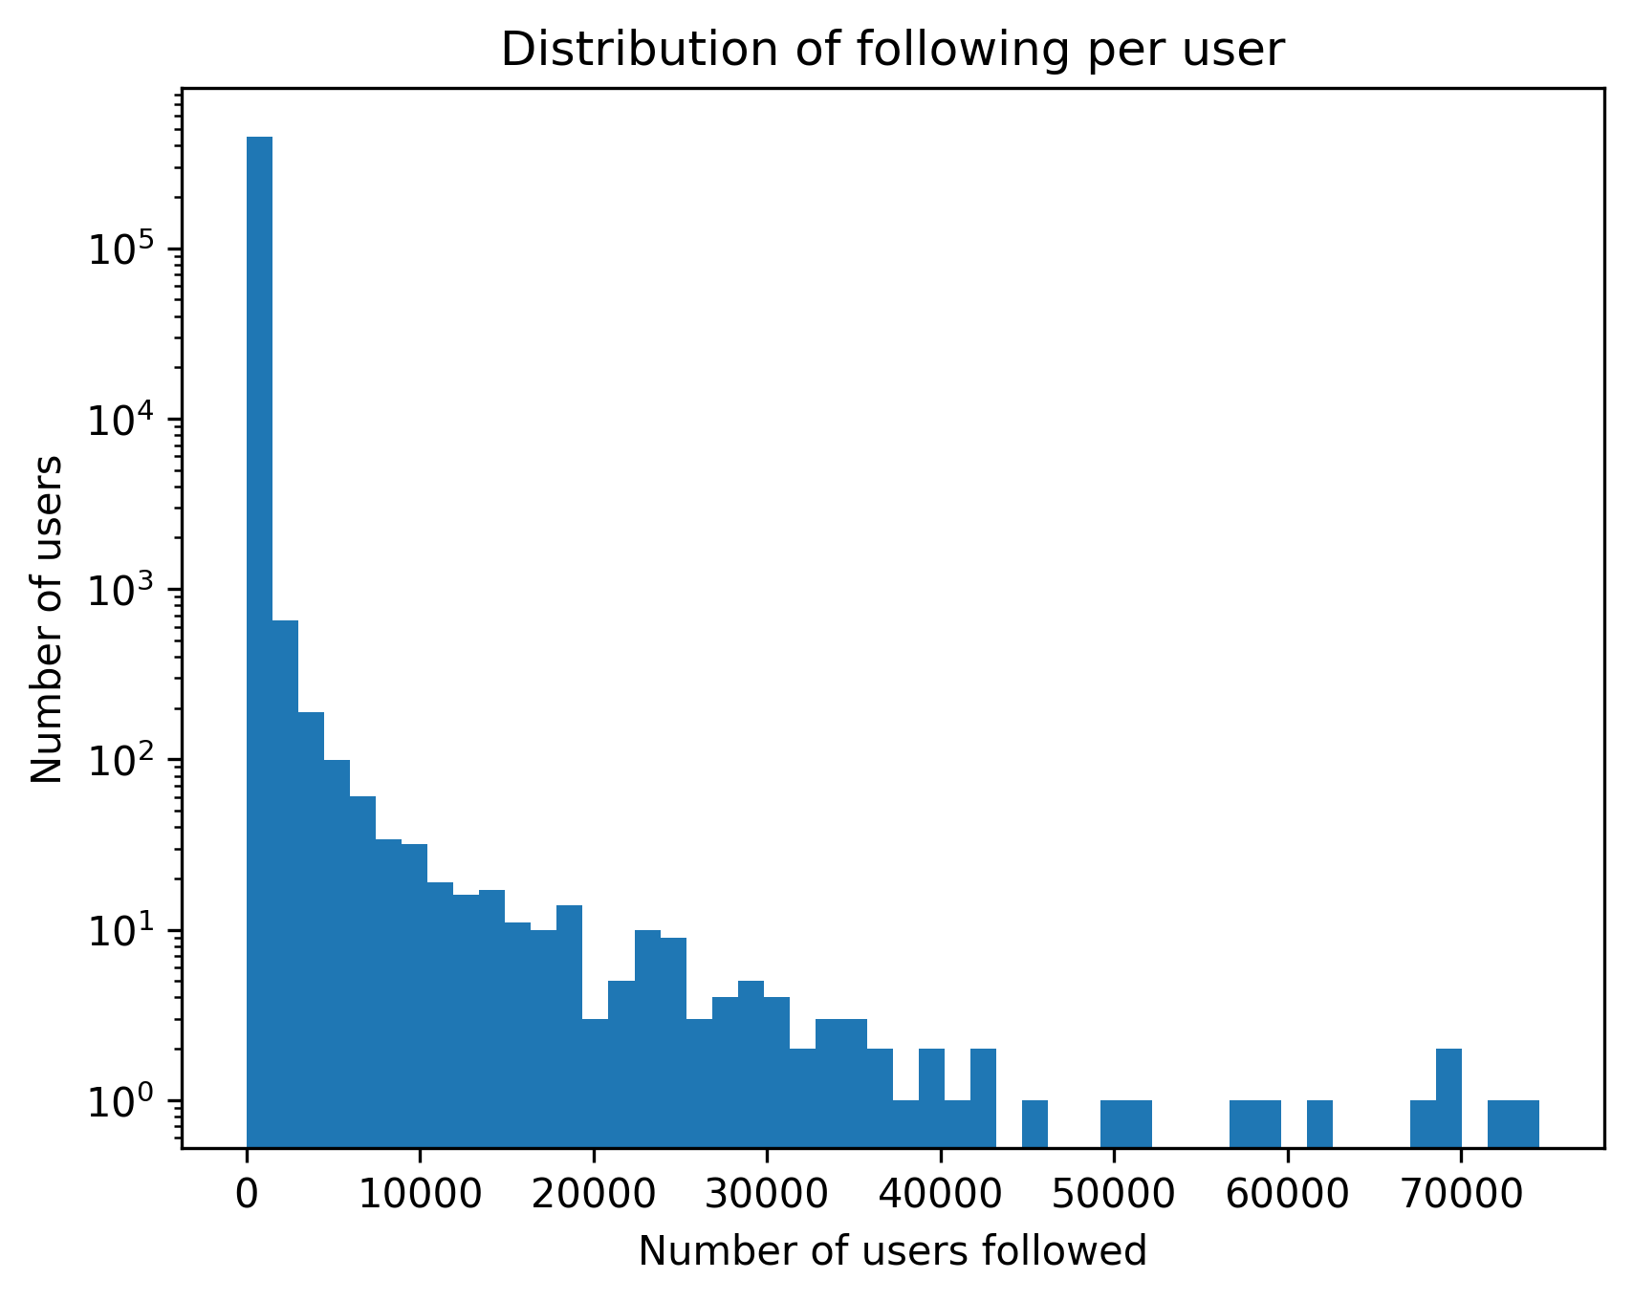
Initial Data Exploration

Slide 12
Initial Data Exploration – per User Statistics
Type | Average | Median | Standard Deviation | Maximum
Follower Count per User | 96.7 | 20 | 380.44 | 43’222
Following Count per User | 43.04 | 4 | 534.28 | 74’522
Posts Created per User | 48.53 | 8 | 433.89 | 166’965
Likes Received per Post per User | 0.04 | 0 | 0.63 | 180.7
Likes Given per User | 34.89 | 3 | 213.05 | 25’224
Comments Received per Post per User | 0.2 | 0 | 1.69 | 279.15
Comments Given per User | 69.38 | 4 | 339.45 | 29’348

Slide 13
Community Detection Methods Analyzed
1. Louvain Algorithm
Works on undirected graphs
Optimizes modularity to find communities
Can handle large datasets
Limitation: May produce disconnected or poorly connected communities
2. Leiden Algorithm
Works on directed and undirected graphs
Based on modularity optimization like Louvian
Can handle large datasets
Improved version of Louvain — ensures well-connected communities
Notes:
We are using Leiden because of the following reasons:

Slide 14
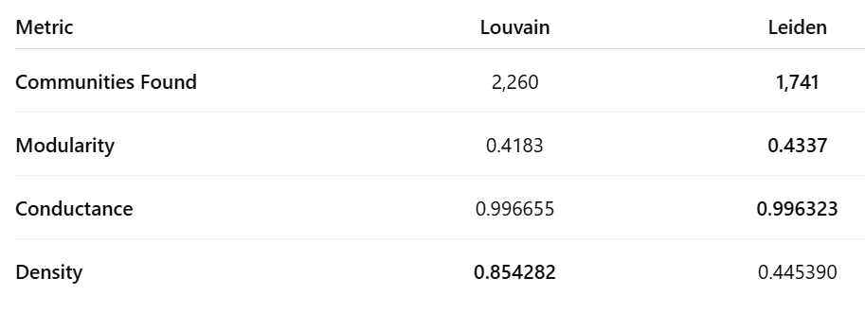
Community Detection Methods Analyzed
Insights from Our Analysis
Leiden achieves a higher modularity, indicating stronger and more distinct community structure.
Conductance values are high for both methods due to the nature of the data, but Leiden performs slightly better.
Density appears higher for Louvain, primarily because it operates on undirected graphs, which naturally produce denser connections.
Notes:
We are using Leiden because of the following reasons:

Slide 15
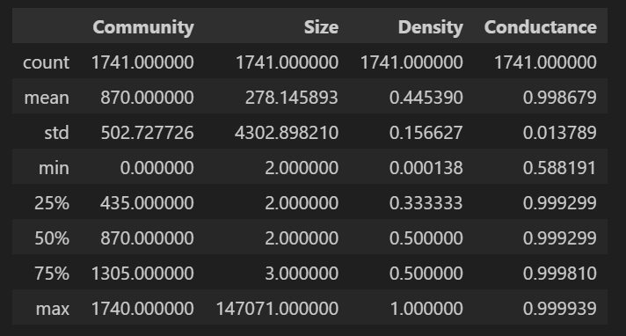
Louvian - Social Circle Detection
The following results show the outcomes of social circle detection applied to our dataset:

Slide 16
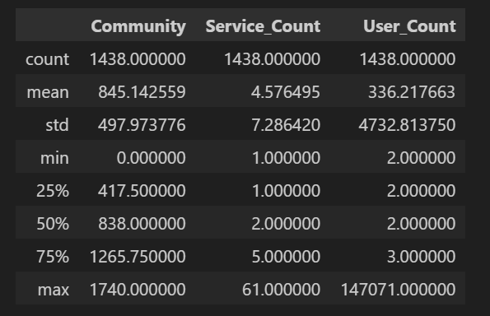
Characterize social circles based on services
Total Communities Detected using Services: 1,438
Highest Service Count: 61 (Community 0, User Count: 147,071)
Lowest Service Count: 1 (Community 1704, User Count: 2)
Notes:
RQ 1: Is it possible to identify distinct social circles within the Friendfeed network based on user connections, and characterize them in terms of shared interests and activity patterns?

Slide 17
Approach for Characterizing Users (Based on Top 3 Services)
Agglomerative approach (Complete Linkage) –
It is well-suited for detecting nested or naturally forming user communities based on their top services.
Complete Linkage to add maximum distance between members to ensure compact clusters and avoid chaining.
Steps for Clustering User Communities -
Removed communities with fewer than 4 users to reduce noise
Computed Jaccard distance matrix for categorical (service-type) data
Applied Z-linkage to determine the optimal distance threshold and number of clusters
Performed Agglomerative Clustering using Complete Linkage to group similar communities
Evaluated clustering using the Silhouette Score

Slide 18
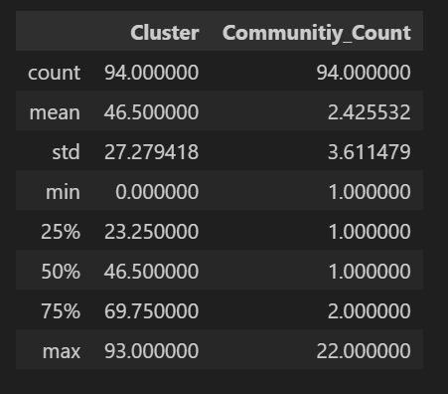
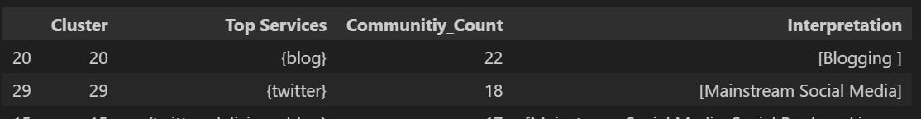
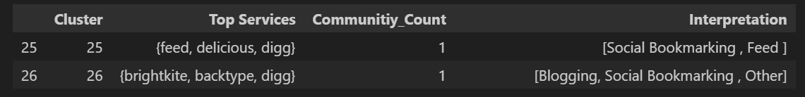
Agglomerative Clustering Results (Complete Linkage)
Observation: Most clusters contain very few communities, but a few clusters have a much higher number of communities (up to 22), indicating some highly connected social circles.

Slide 19
Approach for Characterizing Users (Based on activites)
User activity features used for characterization
Post rate per user in each community
Likes given per user in each community
Comments given per user in each community
DBSCAN approach
Used raw data without filtering communities, as DBSCAN automatically detects noise.
Determined optimal ε (epsilon) using the Davies-Bouldin Index.
Selected min point parameters based on the number of features (3).

Slide 20
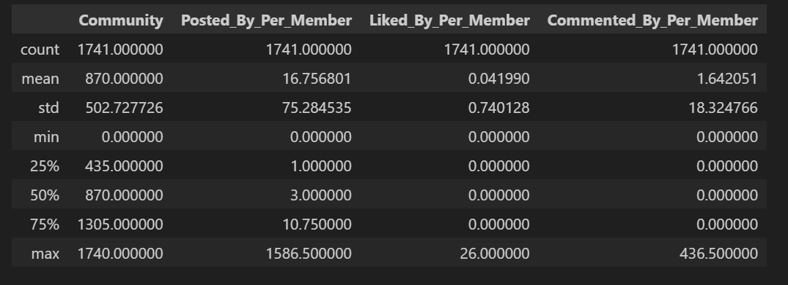
DBSCAN approach
Features for DBSCAN clustering

Slide 21
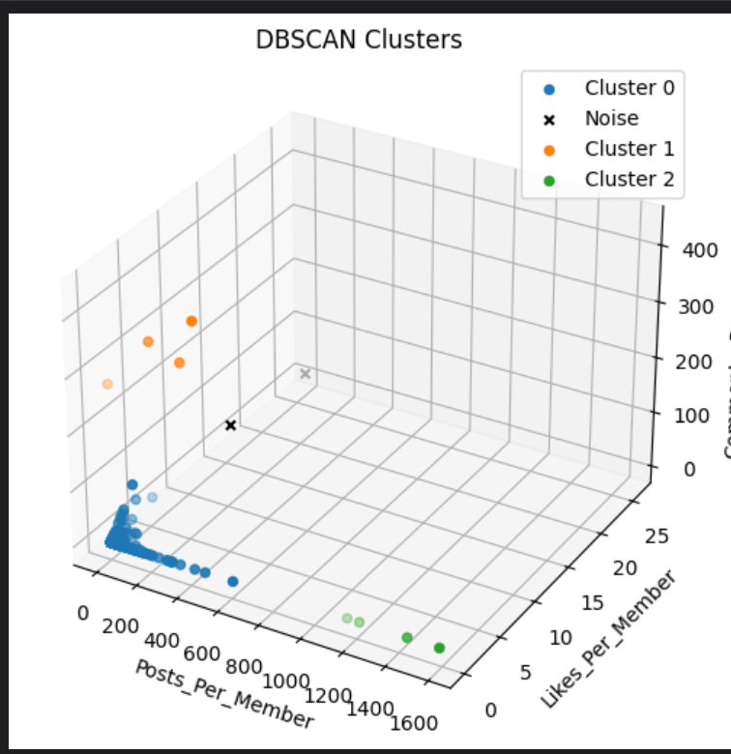
DBSCAN Clustering Results
Observation:
Total clusters detected: 4
Noise: 2 communities were identified as noise (assigned to cluster -1)
Major cluster: 1,731 communities grouped together, indicating a large, highly similar group
Smaller clusters: 4 communities distributed across the remaining 2 clusters, representing small, distinct activity patterns

Slide 22
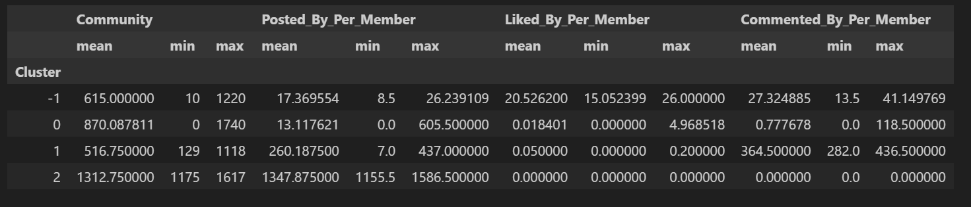
DBSCAN Clustering Results
DBSCAN clustering summary

Slide 23
Answer to Research Question 2
We were able to identify distinct social circles within the Friendfeed network using three different algorithms (Louvian, Leiden and DBSCAN)
We were able to characterize the social circles based on the activity, serivce usage and interaction patterns
Notes:
RQ 2:
Is it possible to detect anomalous users in the Friendfeed network (e.g., bots, spammers) based on posting, following, and interaction patterns (commenting/liking) and characerize them in terms of activity and interactions patterns?

Slide 24
Algorithms used for Anomaly Detection
Statistical Approach (Multivariate Gaussian)
Clustering-based Approach (k-Means)
Distance-based Approach (k-NN)
Density-based Approach (LOF)
Isolation-based Approach (iForest)
One-Class SVM
Reconstruction-based Approach (PCA)
Notes:
1. Statistical Approach
Identifies points that have a low probability of belonging to an assumed data distribution (e.g., Gaussian).
2. Clustering-based Approach
Flags data points that are the furthest from the center of their assigned cluster.
3. Distance-based Approach (k-NN -> k nearest neighbots)
Considers points with the largest distances to their nearest neighbors as outliers.
4. Density-based Approach (LOF -> Local Outlier Factor))
Finds outliers in areas of significantly lower point density compared to their local neighborhood.
5. Isolation-based Approach (iForest)
Based on the principle that anomalies are easier to separate (isolate) from the main data.
6. One-Class SVM
Learns a boundary that encloses the majority of the data; points falling outside are flagged as outliers.
7. Reconstruction-based Approach (PCA)
Flags points with a high error when being reconstructed from a compressed, lower-dimensional version of the data.

Slide 25
Features used for Anomaly Detection
Follower Count per User
Following Count per User
Posts Created per User
Likes Received per Post per User
Likes Given per User
Comments Received per Post per User
Comments Given per User

Slide 26
Preprocessing for Anomaly Detection
Create a new dataframe -> rows = users -> columns = 7 features
Normalization -> mean of every feauture = 0 -> std of every feature = 1
Setting an appropriate contamination rate -> in our case: 0.02% -> 0.0002 * 504’590 users ~ 150 outlier users

Slide 27
Outlier User ”pattonroberta” Influencer: is in the top 1 % in almost all categories
Type | Value | Rank | Top in %
Follower Count | 1,453.0 | 1280 | 0.26
Following Count | 147 | 19283 | 3.97
Posts Created | 1,389.0 | 793 | 0.16
Likes Received per Post (on average) | 0.66 | 2992 | 0.61
Likes Given | 2,707.0 | 5 | 0
Comments Received per Post (on average) | 3.28 | 2013 | 0.41
Comments Given | 4,365.0 | 36 | 0.01
Algorithms that detected outlier: Multivariate Gaussian, k-Means, kNN, iForest, PCA

Slide 28
Outlier User ”musiclion” Post Spammer Bot
Type | Value | Rank | Top in %
Follower Count | 22 | 92419 | 19.11
Following Count | 0 | 443553 | 95.45
Posts Created | 166,965.0 | 1 | 0
Likes Received per Post (on average) | 0 | 15913 | 3.26
Likes Given | 0 | 15739 | 51.61
Comments Received per Post (on average) | 0 | 37392 | 7.66
Comments Given | 29 | 8512 | 1.76
Algorithms that detected outlier: Multivariate Gaussian, k-Means, kNN, PCA

Slide 29
Outlier User ”lolbot” Post and Comment Spammer Bot
Type | Value | Rank | Top in %
Follower Count | 8 | 128155 | 26.7
Following Count | 2 | 263137 | 59
Posts Created | 7,231.0 | 51 | 0.01
Likes Received per Post (on average) | 0 | 15915 | 51.63
Likes Given | 0 | 15739 | 51.61
Comments Received per Post (on average) | 1 | 5365 | 1.42
Comments Given | 7,225.0 | 8 | 0
Algorithms that detected outlier: Multivariate Gaussian, k-Means, kNN, PCA

Slide 30
Answer to Research Question 2
We were able to detect anomalous users using seven different anomaly detection algorithms
We were able to characterize three interesting anomalous users based on their activity and interaction pattern
Notes:
RQ 2:
Is it possible to detect anomalous users in the Friendfeed network (e.g., bots, spammers) based on posting, following, and interaction patterns (commenting/liking) and characerize them in terms of activity and interactions patterns?

Slide 31
Future Work
Characterize more social circles and anomalous users based on their activity and interaction patterns
Create more attributes of the users (e.g.: gender, political view and academic level based on profile and post descriptions)
Create association rules within the friendfeed network and social circles (e.g. if the users are using facebook, they are likely to also use twitter)

