Slide 1
Group 51 - Project

Slide 2
Research Questions
Is it possible to identify distinct social circles within the Friendfeed network based on user connections, and characterize them in terms of shared interests and activity patterns?
Is it possible to detect anomalous users in the Friendfeed network (e.g., bots, spammers) based on posting, following, and interaction patterns (commenting/liking)?

Slide 3
Data – Friendfeed Social Network
Number of users: 665’382
Number of posts: 12’450’658
Number of comments: 3’749’891
Number of people following: 19’547’158
Number of likes: 798’112

Slide 4
Preprocessing
Dataset has already been preprocessed before
Remove “dead” accounts (without any posts, likes and comments) Users removed: 160’792 (504’590 users remaining)
Connect users following each other (via FollowedID and FollowerID)
Connect users and their posts via UserID
Connect posts, users and likes + comments via PostId and UserID

Slide 5
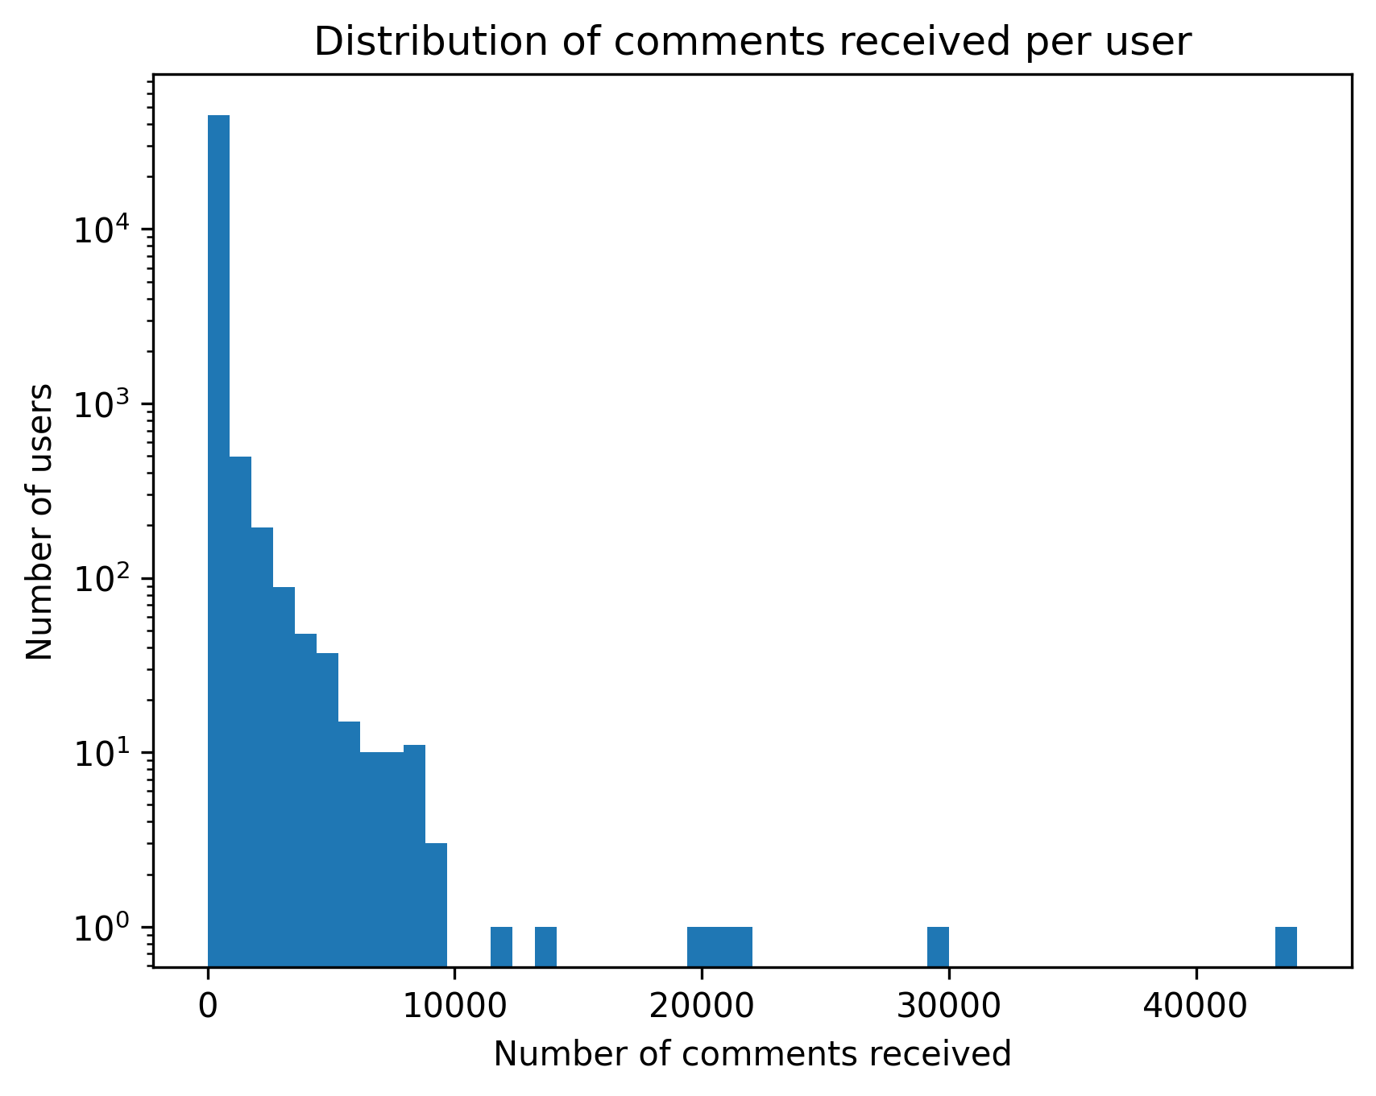
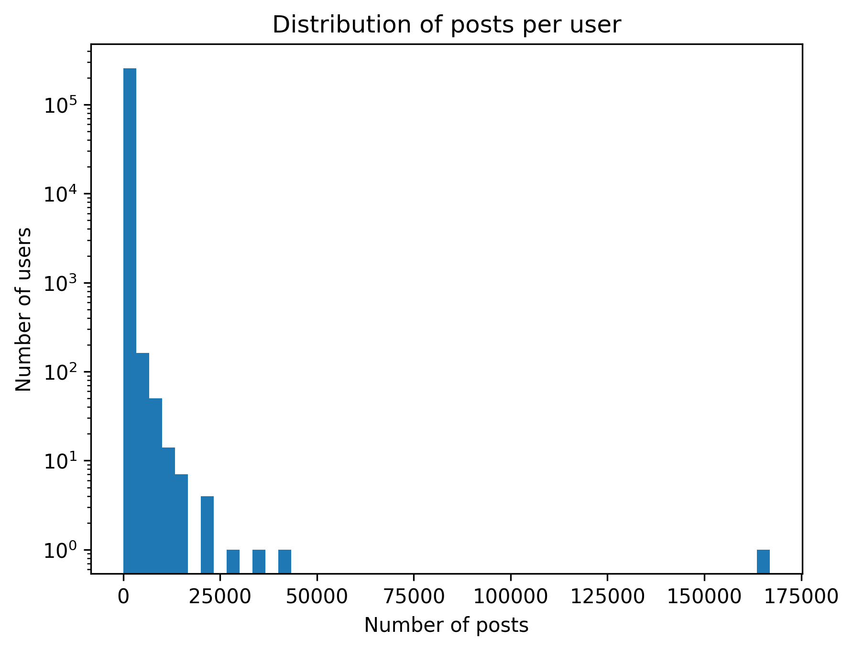
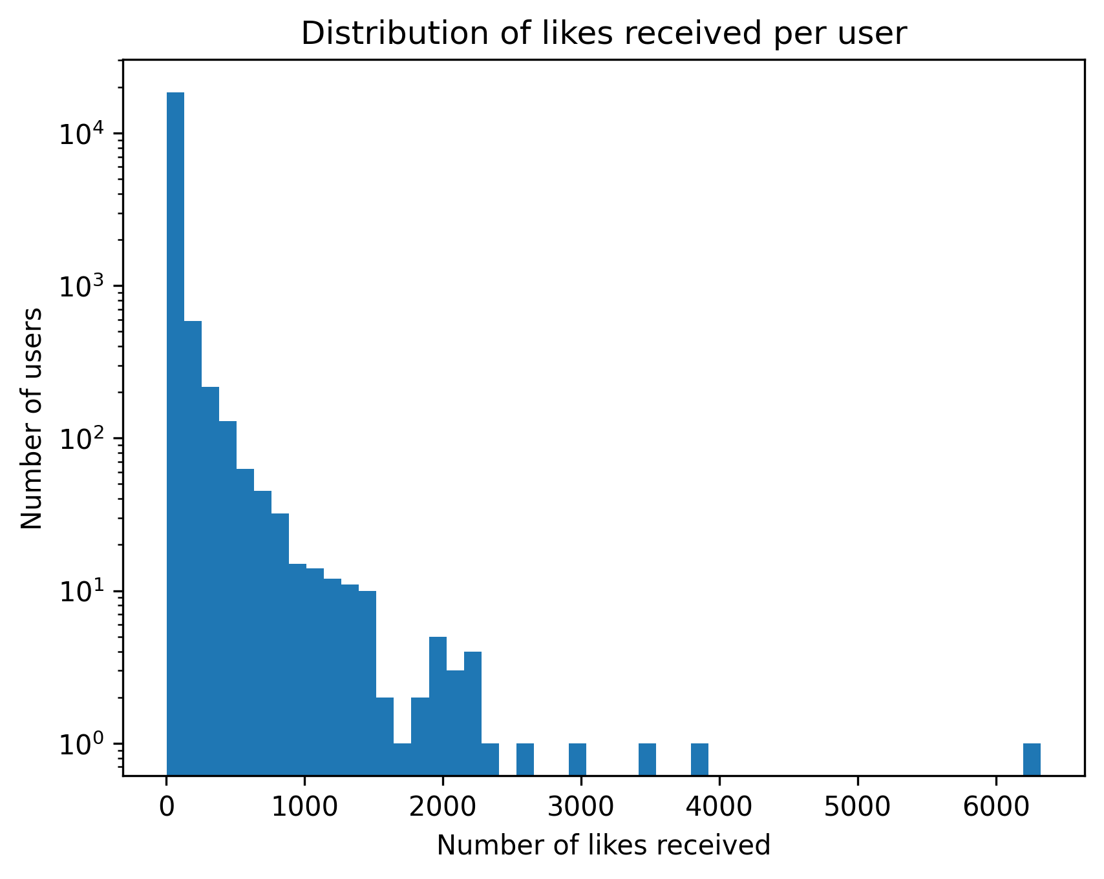
Initial Data Exploration

Slide 6
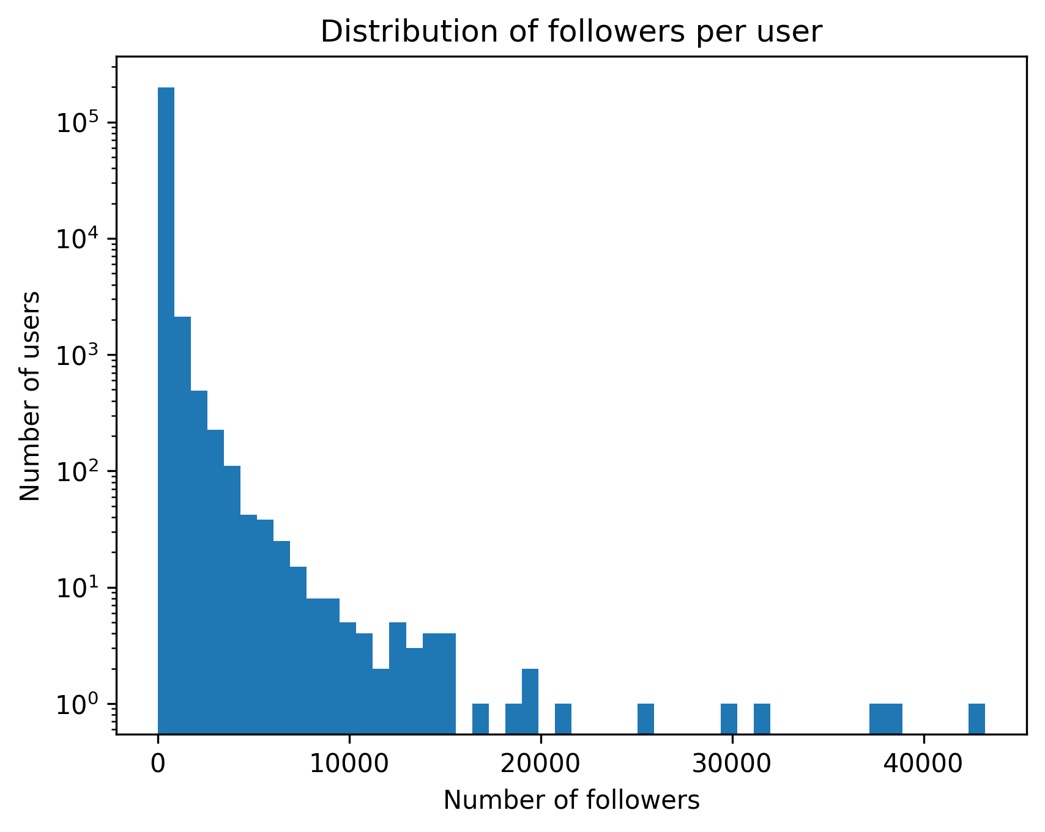
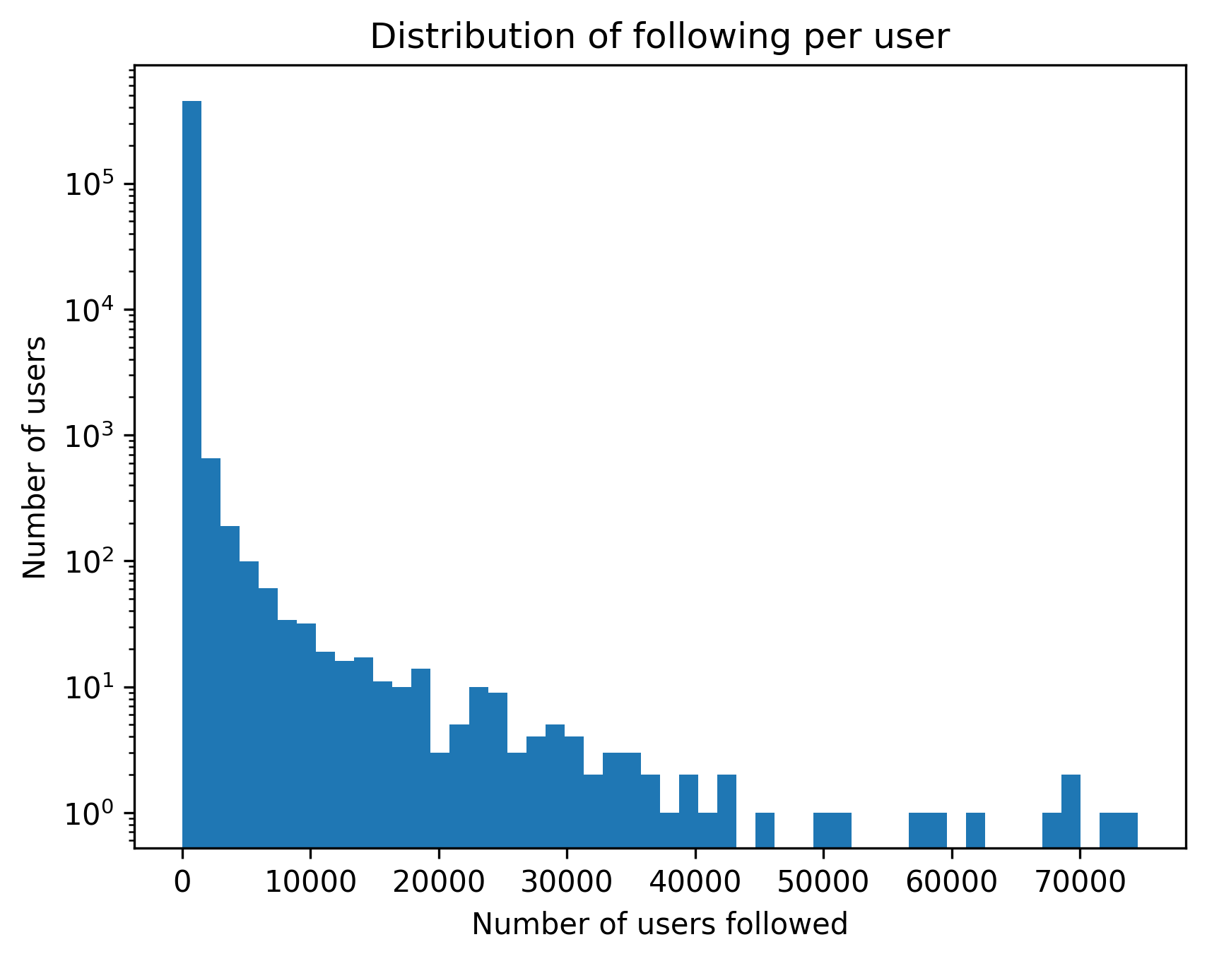
Initial Data Exploration

Slide 7
Initial Data Exploration – per User Statistics
Type | Average | Median | Standard Deviation | Maximum
Follower Count per User | 96.7 | 20 | 380.44 | 43’222
Following Count per User | 43.04 | 4 | 534.28 | 74’522
Posts Created per User | 48.53 | 8 | 433.89 | 166’965
Likes Received per Post per User | 0.04 | 0 | 0.63 | 180.7
Likes Given per User | 34.89 | 3 | 213.05 | 25’224
Comments Received per Post per User | 0.2 | 0 | 1.69 | 279.15
Comments Given per User | 69.38 | 4 | 339.45 | 29’348

Slide 8
Louvain Algorithm for Social Circle Detection
504’590 users/vertices
19’547’158 followings/edges
Invented in 2015
Space and time complexity: O(|V| + |E|)
Similar to agglomerative clustering: bottom-up, hierarchical and greedy
Notes:
1. Starts with individual vertices 2. Merges vertices into neighboring communities 3. Creates a new hierarchy after each pass of merging

Slide 9
Community 6 (157’643 Users)
Type | Average | Median | Standard Deviation | Maximum
Follower Count per User | 109.66 | 36 | 491.91 | 42487
Following Count per User | 38.76 | 4 | 570.49 | 58349
Posts Created per User | 31.86 | 8 | 191.34 | 22375
Likes Received per Post per User | 0.01 | 0 | 0.13 | 16
Likes Given per User | 33.95 | 2 | 165.45 | 3948
Comments Received per Post per User | 0.07 | 0 | 0.34 | 34
Comments Given per User | 24.76 | 3 | 138.02 | 4365

Slide 10
Community 1 (84’830 Users)
Type | Average | Median | Standard Deviation | Maximum
Follower Count per User | 44.16 | 12 | 364.06 | 36765
Following Count per User | 25.48 | 3 | 681.91 | 73103
Posts Created per User | 59.5 | 9 | 326.26 | 16258
Likes Received per Post per User | 0 | 0 | 0.06 | 5
Likes Given per User | 9.65 | 1 | 43.66 | 666
Comments Received per Post per User | 0.05 | 0 | 0.21 | 14
Comments Given per User | 48.15 | 3 | 307.91 | 12197

Slide 11
Community 0 (48’550 Users)
Type | Average | Median | Standard Deviation | Maximum
Follower Count per User | 304.79 | 135 | 566.65 | 10232
Following Count per User | 143.47 | 13 | 645.94 | 26764
Posts Created per User | 65.25 | 10 | 410.25 | 40377
Likes Received per Post per User | 0 | 0 | 0.06 | 3
Likes Given per User | 7.23 | 1 | 34.45 | 419
Comments Received per Post per User | 0.04 | 0 | 0.18 | 7
Comments Given per User | 27.52 | 3 | 162.12 | 4644

Slide 12
Community 9 (46’322 Users)
Type | Average | Median | Standard Deviation | Maximum
Follower Count per User | 88.18 | 19 | 237.63 | 7997
Following Count per User | 26.37 | 3 | 150.25 | 18364
Posts Created per User | 61.65 | 7 | 1472.32 | 166965
Likes Received per Post per User | 0.23 | 0 | 1.08 | 78
Likes Given per User | 34.89 | 4 | 328.76 | 25224
Comments Received per Post per User | 0.87 | 0 | 2.24 | 49
Comments Given per User | 141.22 | 8 | 574.59 | 29348

Slide 13
Community 5 (25’606 Users)
Type | Average | Median | Standard Deviation | Maximum
Follower Count per User | 40.75 | 13 | 121.29 | 7044
Following Count per User | 29.61 | 8 | 89.54 | 7098
Posts Created per User | 58.23 | 23 | 140.39 | 6949
Likes Received per Post per User | 0 | 0 | 0.02 | 1
Likes Given per User | 8.96 | 2 | 18.98 | 133
Comments Received per Post per User | 0.01 | 0 | 0.1 | 2
Comments Given per User | 23.29 | 4 | 126.62 | 3773

Slide 14
Identified and Characterized Social Circles
-> present statistics such as average follower/following count of the users in the group
->present statistics such as average number of posts/likes received+given/comments received+given of the users in the group

Slide 15
Algorithms used for Anomaly Detection
Statistical based Approach: Multivariate Gaussian distribution + Likelihood
Clustering-based: small clusters = outliers
Distance-based Approach: largest distances = outliers
Density-based Approach: LOF
Isolation-based Approach: iForest
One Class SVM
Reconstruction Error

Slide 16
Features used for Anomaly Detection
Follower Count per User
Following Count per User
Posts Created per User
Likes Received per Post per User
Likes Given per User
Comments Received per Post per User
Comments Given per User

Slide 17
Outlier User ”pattonroberta”
pattonroberta
Type | Value | Rank | Top in %
Follower Count | 53 | 60294 | 12.42
Following Count | 2 | 263137 | 59
Posts Created | 12,198.0 | 16 | 0
Likes Received per Post (on average) | 0 | 15915 | 51.63
Likes Given | 0 | 15739 | 51.61
Comments Received per Post (on average) | 1 | 8494 | 1.74
Comments Given | 12,197.0 | 2 | 0

Slide 18
Outlier User ”golaqa”
Type | Value | Rank | Top in %
Follower Count | 0 | 196437 | 70.13
Following Count | 63 | 42306 | 8.72
Posts Created | 215 | 8210 | 1.69
Likes Received per Post (on average) | 1.67 | 467 | 0.1
Likes Given | 3,439.0 | 4 | 0
Comments Received per Post (on average) | 14.07 | 129 | 0.03
Comments Given | 4,259.0 | 38 | 0.01

Slide 19
Outlier User ”jluvisions”
Type | Value | Rank | Top in %
Follower Count | 110 | 36065 | 7.42
Following Count | 0 | 443553 | 95.45
Posts Created | 8,297.0 | 38 | 0.01
Likes Received per Post (on average) | 0 | 15716 | 3.22
Likes Given | 0 | 15739 | 51.61
Comments Received per Post (on average) | 0.99 | 8591 | 1.76
Comments Given | 8,205.0 | 5 | 0

Slide 20
Outlier User ”romanussum”
Type | Value | Rank | Top in %
Follower Count | 53 | 60294 | 12.42
Following Count | 2 | 263137 | 59
Posts Created | 12,198.0 | 16 | 0
Likes Received per Post (on average) | 0 | 15915 | 51.63
Likes Given | 0 | 15739 | 51.61
Comments Received per Post (on average) | 1 | 8494 | 1.74
Comments Given | 12,197.0 | 2 | 0

Slide 21
Outlier User ”tahaakcakaya”
Type | Value | Rank | Top in %
Follower Count | 287 | 13630 | 2.8
Following Count | 263 | 9830 | 2.02
Posts Created | 186 | 9842 | 2.02
Likes Received per Post (on average) | 0.61 | 3200 | 0.66
Likes Given | 1,447.0 | 21 | 0
Comments Received per Post (on average) | 25.62 | 28 | 0.01
Comments Given | 11,546.0 | 3 | 0

Slide 22
Future Work
Characterize the different social circles based on the data
Characterize the outlier users based on the data
Highlight why the characterization of the social circle/outlier user was done

