Slide 1
Group 51 - Project

Slide 2
Research Questions
“Is it possible to identify distinct social circles within the Friendfeed network based on user connections, and characterize them in terms of shared interests and activity patterns?
“Is it possible to detect anomalous users in the Friendfeed network (e.g., bots, spammers) based on posting, following, and interaction patterns (commenting/liking)?”

Slide 3
Data – Friendfeed Social Network
Number of users: 665’382
Number of posts: 12’000’000
Number of comments: 3’749’891
Number of people following: 19’547’158
Number of likes: 798’112

Slide 4
Preprocessing
Dataset has already been preprocessed before
Remove “dead” accounts (accounts without any posts) -> Users removed: 160’792 (504’590 users remaining)
Connect users following each other (via FollowedID and FollowerID)
Connect users and their posts via UserID
Connect posts, users and likes + comments via PostId and UserID

Slide 5
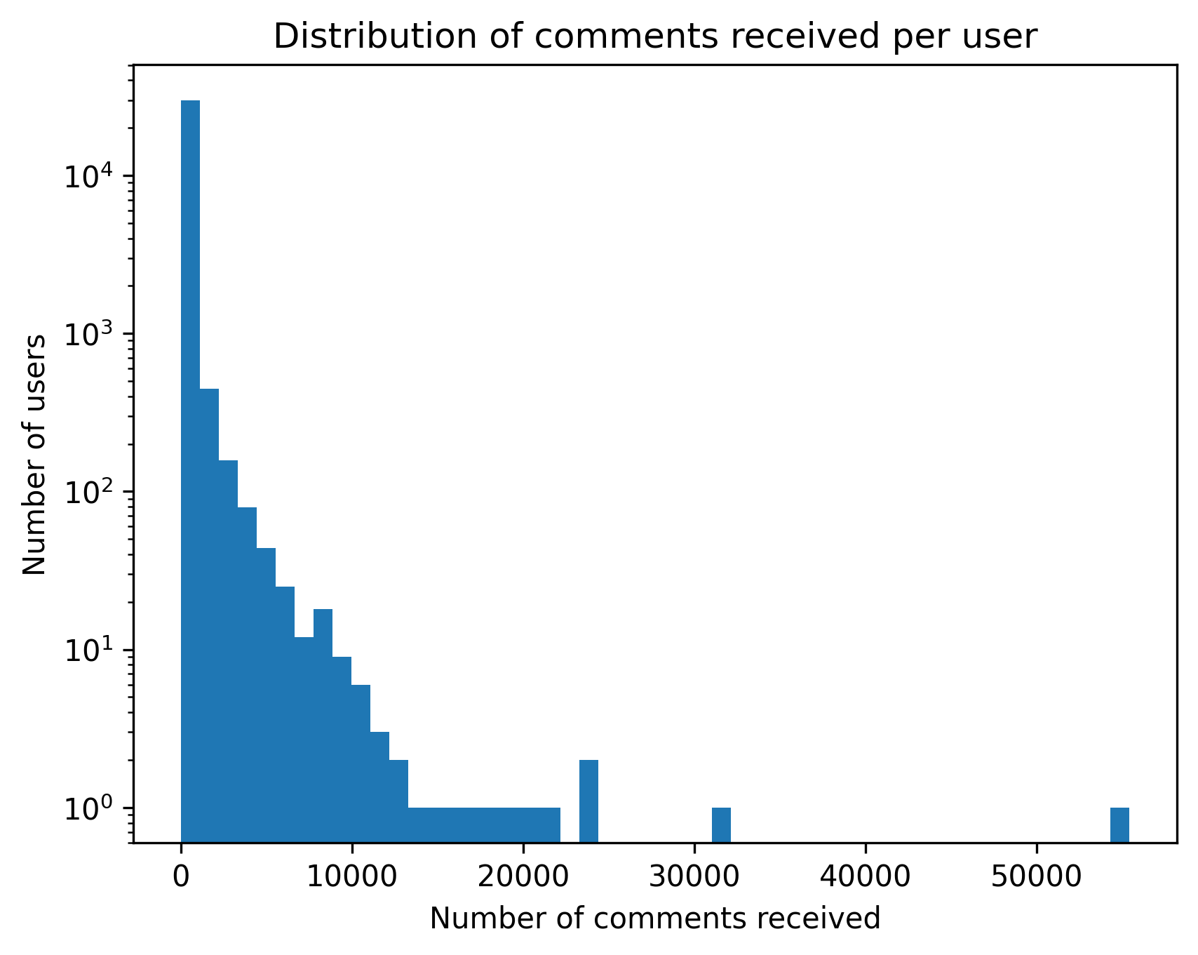
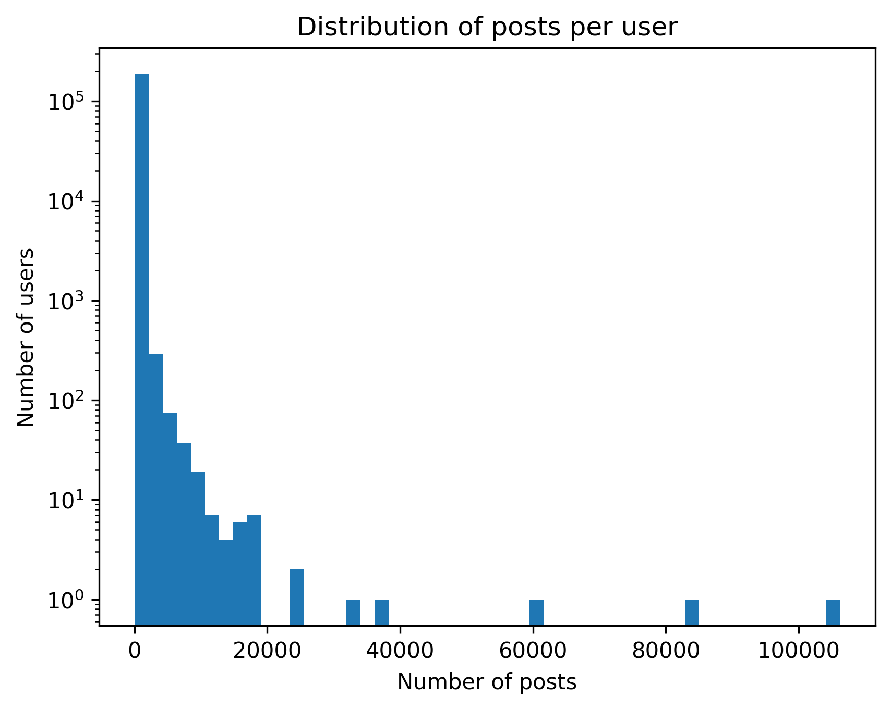
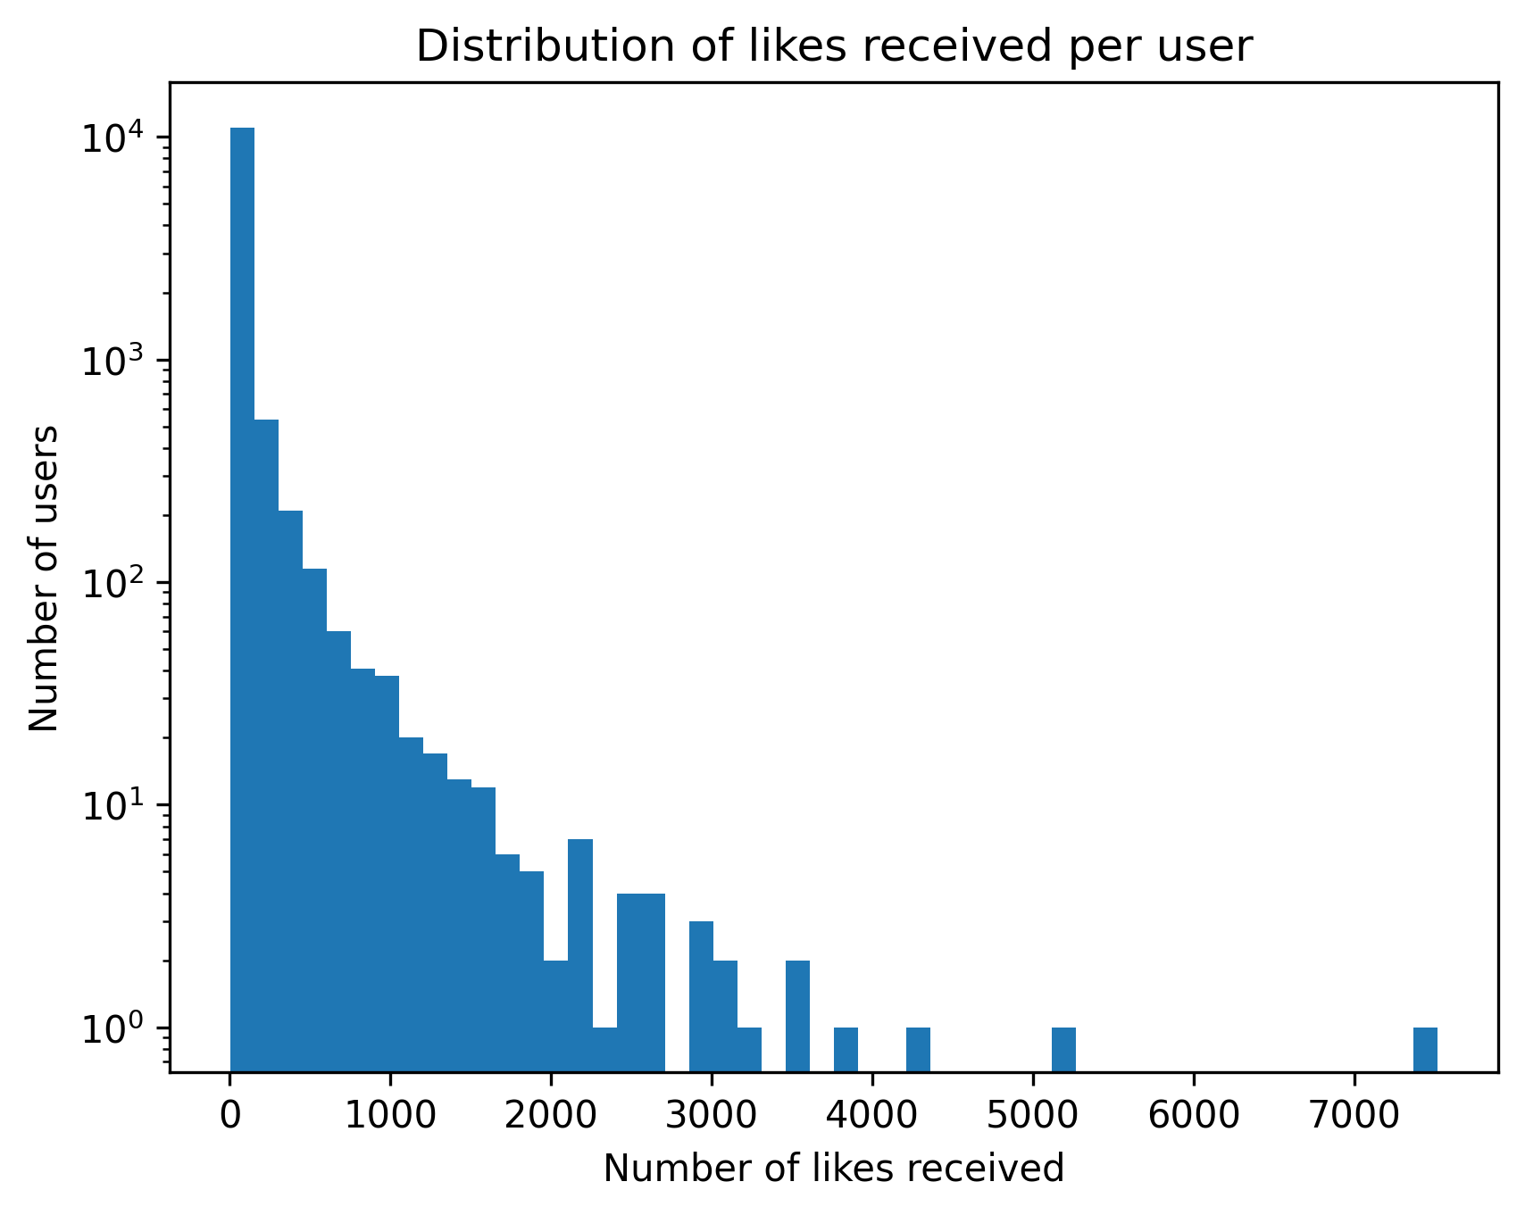
Initial Data Exploration

Slide 6
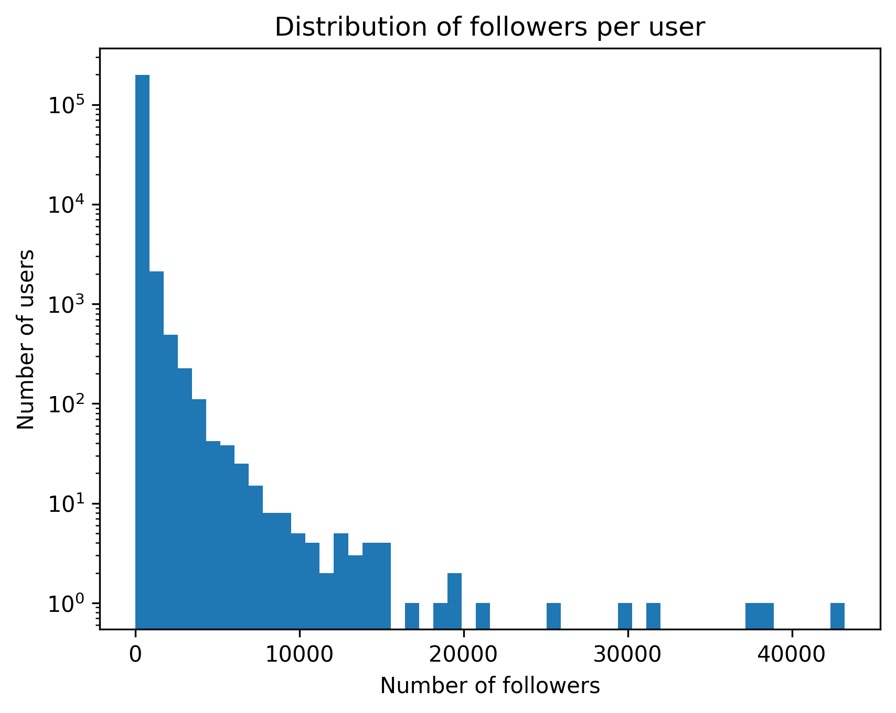
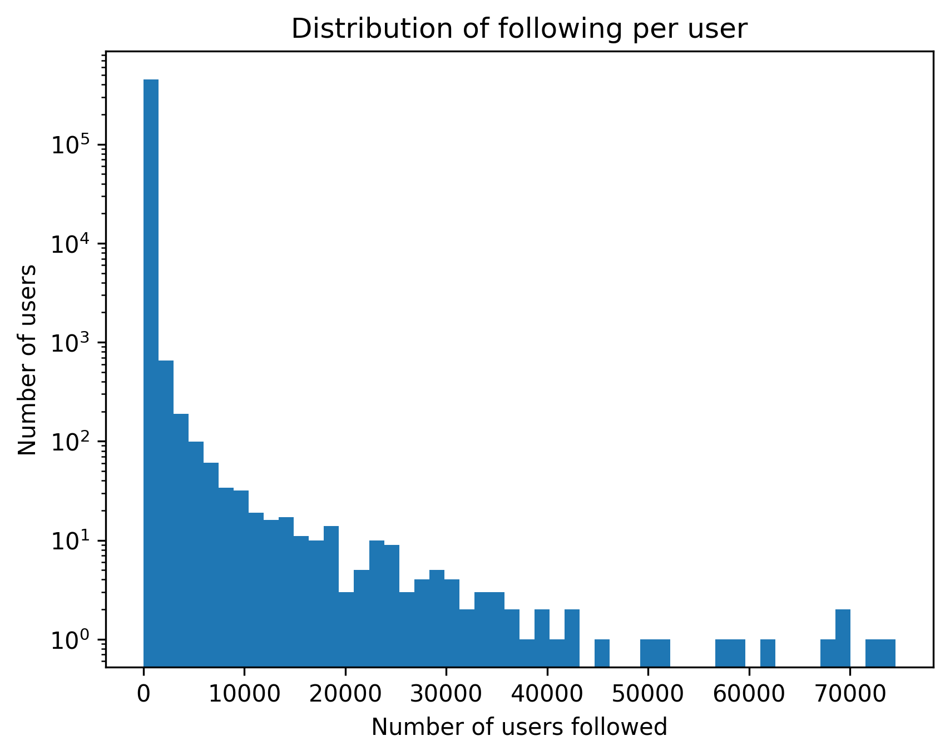
Initial Data Exploration

Slide 7
Data After Prepocessing
-> show histograms of the “connected” data
-> maybe also show a graph of following network

Slide 8
Louvain Algorithm for community detection
504’590 users/vertices
19’547’158 followings/edges
Invented in 2015
Space and time complexity: O(|V| + |E|)
Similar to agglomerative clustering: bottom-up, hierarchical and greedy
Notes:
1. Starts with individual vertices 2. Merges vertices into neighboring communities 3. Creates a new hierarchy after each pass of merging

Slide 9
Identified and Characterized Social Circles
-> present statistics such as average follower/following count of the users in the group
->present statistics such as average number of posts/likes received+given/comments received+given of the users in the group

Slide 10
Identified and Characterized Social Circles
-> present statistics such as average follower/following count of the users in the group
->present statistics such as average number of posts/likes received+given/comments received+given of the users in the group

Slide 11
Algoithms used anomaly detection
-> we can use multiple algorithms and see if all of them detect the same outlier users
-> do the outlier detection based on the 7 columns: - Follower count - Following count - Posts created - Likes received on average per post - Likes given - Comments received on average per post - Comments given

Slide 12
Outlier users
-> present the top 5 outlier users and why they are outliers -> which characteristic/s makes those users outliers

