Slide 1
Computing 101
Introduction to Python
Rafael Silva Coutinho

Slide 2
Installing Python
Recommended: use anaconda/miniconda,
always with environments
  Package installer that can handle way more:
    Have multiple Python and package versions
Attention:
can grow big (~GB)! Install to "data" folder with still fast I/O rate, not home
Disable base environment (see installer)
Add conda-forge to channels

Slide 3
Let's dive in!

Slide 4
Python
Interpreted language
  Every line gets compiled, then executed
  → no need for pre-compilation
  Very dynamic, a lot of user-friendly features
#1 language in Data Analysis,
most popular language in general
General purpose programming language

Slide 5
Python in short
Python is easy
Python is slow

Slide 6
Python in short
Python is easy
  Simple to learn, just use it
Python is slow
  Unfortunately, therefore C++ must be used for large data

Slide 7
Python in short
Python is easy
  Simple to learn, just use it
"Driving a car is easy. Just push the power. Any 5 year old can do…"

Slide 8
Python in short
Python is easy
  Simple to learn, just use it
"Driving a car is easy. Just push the power. Any 5 year old can do…"
(Which is "true" compared to e.g. a bicycle)

Slide 9
Python in short
Python is easy
  Simple to learn, just use it
"Driving a car is easy. Just push the power. Any 5 year old can do…"
Problem: accidents <=> bugs
(see e.g. this talk)

Slide 10
Python in short
Python is beautiful!
  Clean, powerful and well designed
  … and yes, less to care about

Slide 11
Python in short
Python is slow
  Unfortunately, therefore C++ must be used for large data

Slide 12
Python in short
Python is slow
  Unfortunately, therefore C++ must be used for large data

Slide 13
Python in short
Python is slow
  Unfortunately, therefore C++ must be used for large data
A Ferrari is slow…

Slide 14
Python in short
Python is slow
  Unfortunately, therefore C++ must be used for large data
A Ferrari is slow…
True, if you transport goods, compared to a truck

Slide 15
Python in short
Python is slow
  Unfortunately, therefore C++ must be used for large data
"Writing C++ code, that does heavy number crunching, with Python syntax and executing it with a Python interpreter is slow"
True!

Slide 16
Python in short
Python is slow
  Unfortunately, therefore C++ must be used for large data
Python
C++
Compiler and more
Python is a high level language

Slide 17
Python in short
Python is a fast, high level language
  It uses C++/Fortran code for computations
  No need for manual implementation
  e.g. just add vectors

Slide 18
Python in short
Python is beautiful!
  Clean, powerful and well designed
  … and yes, less to care about
Python is a fast, high level language
  It uses C++/Fortran code for computations
  No need for manual implementation
  e.g. for vector operations

Slide 19
Python for data analysis
Strong in data analysis
  Large open-source community
  Big data boom in recent years strong driver

Slide 20
This lecture
Ideal: fully planned lectures, well designed, perfect pace...

Slide 21
This lecture
Ideal: fully planned lectures, well designed, perfect pace…
Everyone has a different Python level (and it's spread usually)
average level of Python increases every year
Python ecosystem changes rapidly

Slide 22
This lecture
Ideal: fully planned lectures, well designed, perfect pace…
Everyone has a different Python level (and it's spread usually)
average level of Python increases every year
Python ecosystem changes rapidly
Focus is on HEP in Python, there are some tutorials, but…
let's find out together!

Slide 23
This lecture is...
...dynamic. Depending on you.
  More material available than time
  Follows somewhat online course
…not just an overview
  You will spend a lot of time with Python
  Some deeper understanding of critical parts
...interactive.
  Solve small problems and ask about the libraries
  Ask questions about concepts and code

Slide 24
This lecture is...
(Introduction to classes?)
Medium Python concepts
  *, **; context manager, exceptions,…
  (numpy, math libraries?)
Basics of data handling and plotting
  Uproot, pandas, cuts, plots…
Multivariate analysis (machine learning)
  BDT, uniformity, training and test
Histograms and reweighting
Likelihood fits and inference
  Building models, fitting, significance
Scikit-HEP diverse tools

Slide 25
Who are you?
Who has ever coded something?

Slide 26
Who are you?
Who has ever coded something?
  In C++?
  In Python?
  In Java?
  Something else?

Slide 27
Who are you?
Who does NOT know:
  Float, integer, string, boolean
  Difference between float, double
  resp. float32, float64

Slide 28
Who are you?
Who does NOT know:
  Arrays and indexing
  Hash table/dict (key-value pairs)

Slide 29
What do you want?
Classes and objects
  Introduction
  Can write a simple class with a single method
  Inheritance, getter/setter, constructor
  Magical methods
  OOP patterns, interface
  MRO, __new__, metaclass

Slide 30
Who are you?
Classes and objects
  Ever heard of?
  Can write a simple class with a single method
  Inheritance, getter/setter, constructor
  Magical methods
  OOP patterns, interface
  MRO, __new__, metaclass

Slide 31
Editors
Vim or Emacs
Simple editors like nano, gedit
IDE (Integrated Development Environment)
  Offers great support for so many things
  Basically two (similar) options (try them out)
    PyCharm
    VSCode

Slide 32
Learning a language

Slide 33
Languages
Programming similar to natural language
How to learn:
  Grammar/Syntax + Rules
  Practice
  Time
Be curious!
  Ask yourself: what exactly is happening?
  Try out: what if I do this?

Slide 34
Conventions
Can I write…
  Hel lo, i havearri ved
  Хелло, и хаве арривед.
  Hallo, ich bin angekommen.
  … if I wanna say "Hello, I have arrived."?

Slide 35
Conventions
Can I write…
  Hel lo, i havearri ved
  Хелло, и хаве арривед.
  Hallo, ich bin angekommen.
  … if I wanna say "Hello, I have arrived."
No!

Slide 36
Conventions
Can I write…
  Hel lo, i havearri ved
  Хелло, и хаве арривед.
  Hallo, ich bin angekommen.
  … if I wanna say "Hello, I have arrived."
Conventions:
  When there are several ways, we agree on one
  Make life easier for everyone!
There should be one – and preferably only one – obvious way to do it.

Slide 37
Python conventions
We are very picky…
  Hello, i have arrived.

Slide 38
Python conventions
We are very picky…
  Hello, i have arrived.
Python lives from conventions
  Because it is so powerful and let's you do a lot
  "We are all adults here"
  PEP8: style-guide (many auto checkers)
  Google for the "best" (most pythonic) solution

Slide 39
Python conventions
We are very picky…
  Hello, i have arrived.
Python lives from conventions
  Because it is so powerful and let's you do a lot
  "We are all adults here"
  PEP8: style-guide (many auto checkers)
  Google for the "best" (most pythonic) solution
>>> import this

Slide 40
writing code is more than writing code

Slide 41
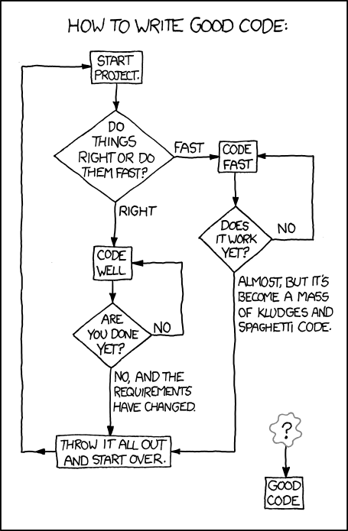

Slide 42
I am not a book author...
...(although I speak English!)
A book needs a story…
  … and a language to "implement it"

Slide 43
I am not a book author...
...(although I speak English!)
A book needs a story…
  … and a language to "implement it"
Book author ↔ software engineer
  Knowing how to program ≠knowing the language

Slide 44
I am not a book author...
...(although I speak English!)
A book needs a story…
  … and a language to "implement it"
Book author ↔ software engineer
  Knowing how to program ≠knowing the language
OOP, composition, interfaces, protocols, CI/CD, unittests, responsibilities, stateful, VCS, code review, legacy, open-close, forward/backwards compatibility, DRY, etc.

Slide 45
I am not a book author...
...(although I speak English!)
OOP, coupling, interfaces, protocols, CI/CD, unittests, responsibilities, stateful, VCS, code review, legacy, forward/backwards compatibility, DRY, etc.
We do not need to know that all, but
Be aware of your limits
We do not need (and should not!)
reinvent programming
… it's invented, let's learn from the right people.

Slide 46
Vectorization

Slide 47
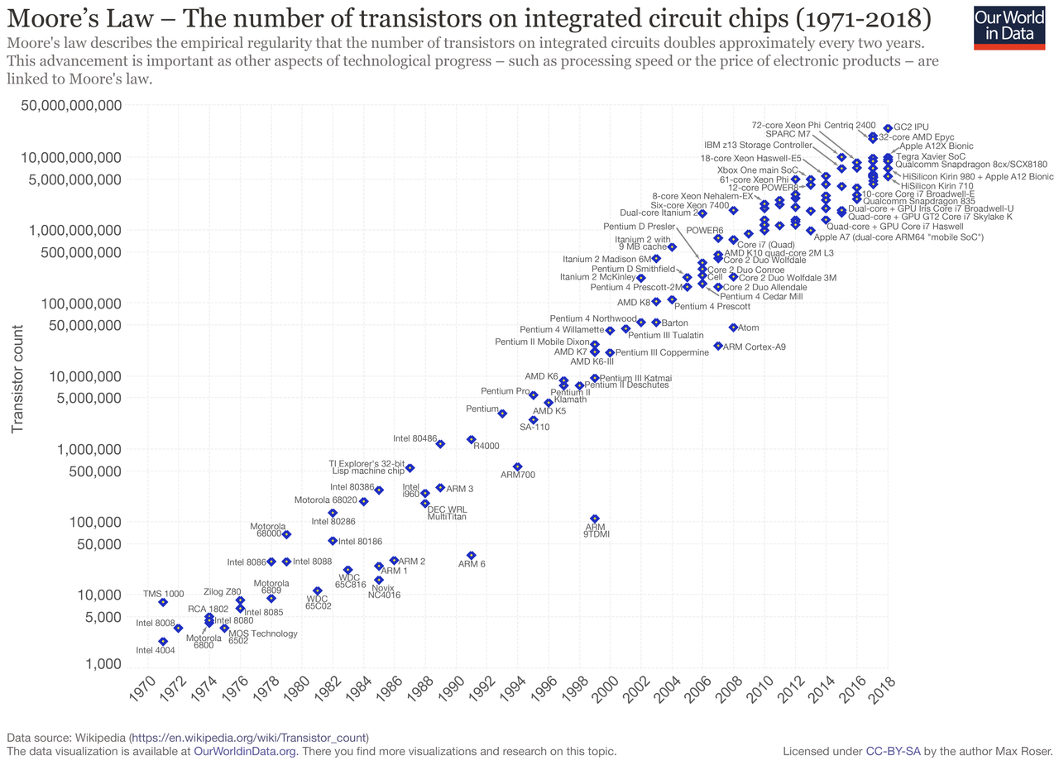
Moore's law
every 1.5 year, the CPU power doubles
Stated in the 70s → just holds

Slide 48
Well, actually...
It states that the clock frequency doubles
One problem: heat dissipation prop. frequency³
  Not a problem until 2000's
  Now a problem: frequency/speed stuck at GHz
But: parallelization helps
(Moore's law still basically true)

Slide 49
Paralellization
You need many exercises to split amongt students
100 students but giving them 1 exercise (serial) after the other is useless
Idea: think vectorized
  Vector operations automatically include multiple operations at once
  Hardware like GPU built for massively parallel execution of the same operation on points

Slide 50
Sometimes we can cheat
Some libraries can (sometimes) convert for-loops to vectors
Learn to think vectorized!
  (not so easy if used to for-loops)
Code vectorized
  Pandas, numpy, TensorFlow etcetcetc.
Key to speed

Slide 51
Number crunching!

