Slide 1
Applied Data Science with R Capstone project
Jonas Fortner
11.03.2024

Slide 2

Outline
Executive Summary
Introduction
Methodology
Results
Conclusion
Appendix

Slide 3

Executive Summary
Point1
Point2
Sub Point 1
Sub Point 2
Sub Point 3
Point3
Point4
Point5

Slide 4

Introduction
Point1
Point2
Point3
Point4
Sub Point1
Sub Point2

Slide 5

Methodology
Perform data collection
Perform data wrangling
Perform exploratory data analysis (EDA) using SQL and visualization
Perform predictive analysis using regression models
How to build the baseline model
How to improve the baseline model
Build a R Shiny dashboard app

Slide 6
Methodology

Slide 7
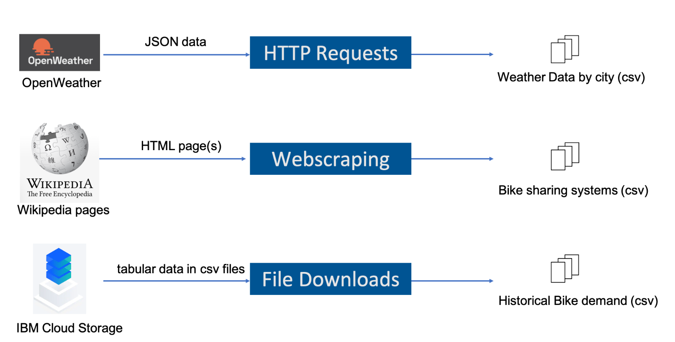
Data collection
The four datasets that were used were collected from several different sources, namely OpenWeather, Wikipedia and IBM Cloud Storage, using Webscraping, which was completed with help of the “rvest” and “httr” package in R. These datasets were then saved as four separate CSV files.
Add screenshots of Notebook code cell and cell output used for OpenWeatherAPI and Webscraping to the Appendix section for peer-review

Slide 8
Data wrangling
Data wrangling process:
Standardized all off the column names across the collected datasets
Use of “for-loop” to standardize column names (change all to upper case, replace spaces with underscores)
2. Removed unwanted appendages from the values in the datasets (specifically the reference links from the table from Wikipedia)
remove unwanted reference links using regular expressions (set a specific reference pattern to find the reference links and replace it with blank space)
3. Extract only the numeric values from the values with unwanted annotations
→ Extract wanted values using a loop, where the pattern is extracted and the result is saved as a numeric value
Add the screenshots of data wrangling code cell and output for regular expressions, missing values handling, generating indicator columns to the Appendix section for peer-review

Slide 9
EDA with SQL
Exploratory data analysis using SQL:
Determined the number of records present in the data
Determined the number of records where no bikes were rented
Determined the weather forecast in Seoul for the next 3 hours
Determined which seasons were included in the dataset
Determined the first and last dates in the Seoul Bike Sharing dataset
Determined on what day and hour the most bike rentals took place
Determined the average hourly temperature and the average number of bike rentals per hour over each season
Determined the average hourly bike count, the minimum, maximum, and standard deviation of the rented bike count during each season
Determined the average of the columns RENTED_BIKE_ COUNT, TEMPERATURE, HUMIDITY, WIND_SPEED, VISIBILITY, DEW_POINT_TEMPERATURE, SOLAR_RADIATION, RAINFALL, and SNOWFALL per season
Performed an implicit join across the WORLD_CITIES and the BIKE_SHARING_SYSTEMS tables to combine the number of bikes available in Seoul with the columns CITY, COUNTRY, LAT, LON, POPULATION
Filtered all cities with total bike counts between 15000 and 20000, which is a comparable count to Seoul
Add screenshots of all required SQL queries to the Appendix section

Slide 10
EDA with data visualization
Charts plotted:
Scatter plot of RENTED_BIKE_COUNT vs DATE
Scatter plot of RENTED_BIKE_COUNT vs DATE with HOUR displayed by colors
Histogram overlaid with a kernel density curve, showing the density of RENTED_BIKE_COUNT
Add the screenshots of your ggplot code snippets to the Appendix section

Slide 11
Predictive analysis
Summarize how you built, evaluated, improved and found the best performing model
Building the model:
Split the data into a training and testing dataset
Built a model with only weather variables
Built a model using all variables
Comparison of models with rsq and rmse values
Sorted the coefficients of the model and plotted them with a bar chart
Improving the model:
→ Added polynomial terms to the model, due to the relationship between RENTED_BIKE_COUNT vs TEMPERATURE being non-linear
Plotted a scatter plot and tested different polynomials by altering the formula in geom_smooth
Applied the most fitting to the linear model
Tested the linear model with the test data
Converted all negative prediction results to 0 (there are no negative rented bike counts)
Calculated R-squared and RMSE from the test results
Added interaction terms for variables that interact (such as “TEMPERATURE * HUMIDITY“ and “WIND_SPEED * HUMIDITY”)
Tested performance of model after adding these features
Determining the best model:
Experimentation with polynomial terms, interaction terms and regularization
You need present your model development process using key phrases and flowchart

Slide 12
Build a R Shiny dashboard
Plots and interactions in the dashboard:
→ A map displaying several different cities, the level of bike rentals predicted as different colors (green, yellow and red) and a detailed label for each city, containing information on the weather
A line plot displaying the predicted temperature in the selected city in the near future , with the time of day on the x-axis and the temperature on the y-axis
A line plot displaying the predicted number of bike rentals in the near future, with the time of day on the x-axis and the bike rental count on the y-axis
→ A text render when the user interacts with the plot, displaying the x-value and y-value of the point the user clicks on in the plot.
→ A correlation scatterplot of humidity vs bike rental prediction in the selected city combined with a geom_smooth line to display if correlation is present

Slide 13
Results
Exploratory data analysis results
Predictive analysis results
A dashboard demo in screenshots

Slide 14
EDA with SQL

Slide 15
Busiest bike rental times
Find dates and hours which had the most bike rentals
Present your query result with a short explanation here

Slide 16
Hourly popularity and temperature by seasons
Find hourly popularity and temperature by season
Present your query result with a short explanation here

Slide 17
Rental Seasonality
Rental Seasonality
Present your query result with a short explanation here

Slide 18
Weather Seasonality
Weather Seasonality
Present your query result with a short explanation here

Slide 19
Bike-sharing info in Seoul
Find the total Bike count and city info for Seoul
Present your query result with a short explanation here

Slide 20
Cities similar to Seoul
Find all city names and coordinates with comparable bike scale to Seoul's bike sharing system
Present your query result with a short explanation here

Slide 21
EDA with Visualization

Slide 22
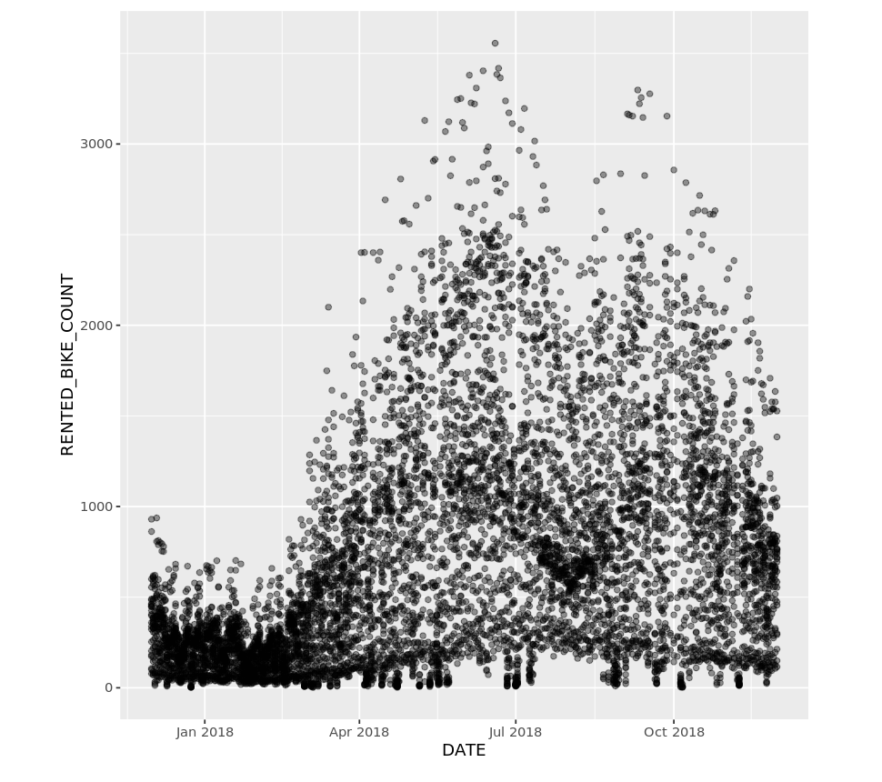
Bike rental vs. Date
Show a scatter plot of RENTED_BIKE_COUNT vs. DATE
Show the screenshot of the scatter plot with explanations

Slide 23
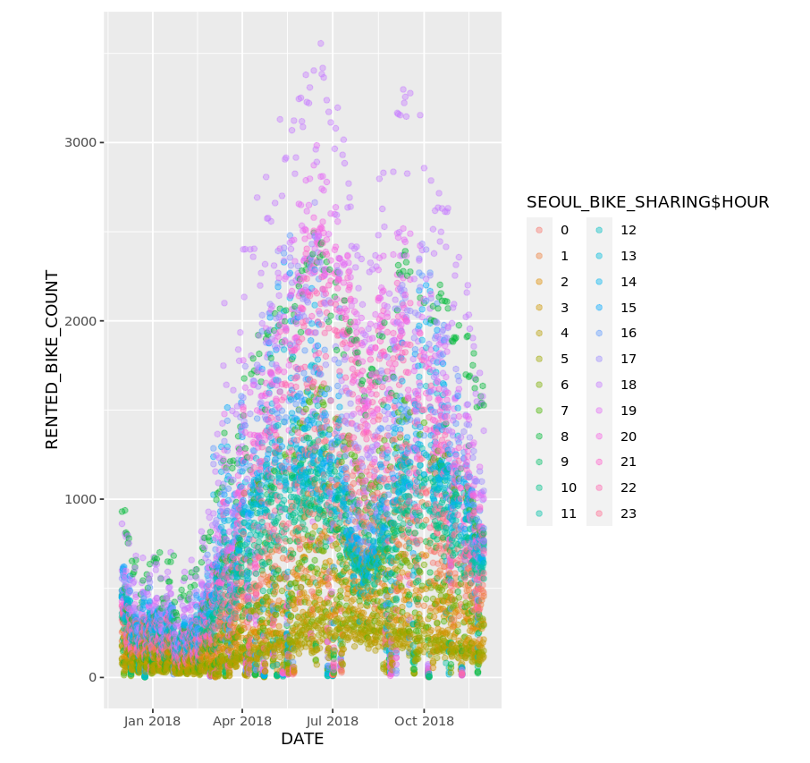
Bike rental vs. Datetime
Show the same plot of the RENTED_BIKE_COUNT time series, but now add HOURS as the colour
Show the screenshot of the scatter plot with explanations

Slide 24
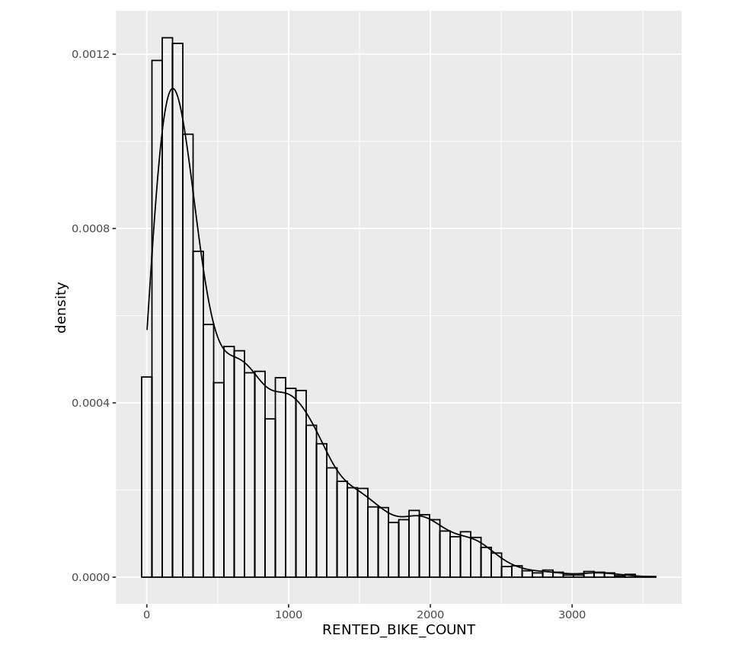
Bike rental histogram
Show a histogram overlaid with a kernel density curve
Show the screenshot of the histogram with explanations

Slide 25

Daily total rainfall and snowfall
Show a barchart calculating the daily total rainfall and snowfall
Show the screenshot of the box plot with explanations

Slide 26
Predictive analysis

Slide 27
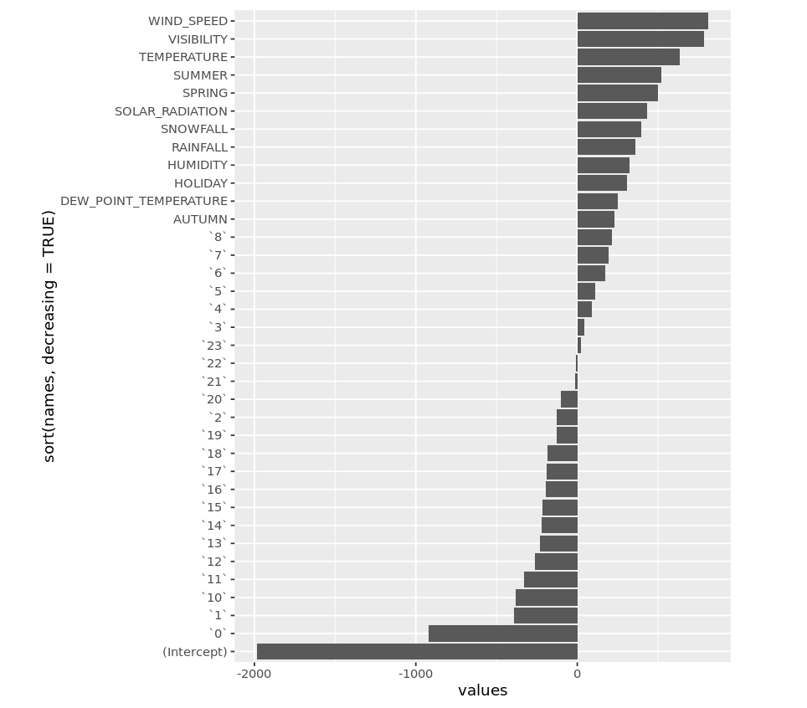
Ranked coefficients
Show a screenshot of the ranked coefficients bar chart for the baseline model
Try to tell a story why some variables are important while some are not for predicting bike-sharing demand

Slide 28
Model evaluation
Built at least 5 different models using polynomial terms, interaction terms, and regularizations
Visualize the refined models’ RMSE and R-squared using grouped bar chart

Slide 29
Find the best performing model
Select the best performing model with:
RMSE must be less than 330
R-squared must be larger than 0.72
Shown a screenshot of the model performance
Show its model formula here (RENTED_BIKE_COUNT ~ x1 + x2 + x3 ….)
You could optionally present their final coefficients here

Slide 30
Q-Q plot of the best model
Plot the Q-Q plot of the best model’s test results vs the truths

Slide 31
Dashboard

Slide 32
<Dashboard screenshot 1>
Replace <Dashboard screenshot 1> title with an appropriate title
Show the screenshot for cities’ max bike-sharing prediction on a map
Explain the important elements on the screenshot

Slide 33
<Dashboard screenshot 2>
Replace <Dashboard screenshot 2> title with an appropriate title
Show the screenshot when one specific city is selected
Explain the important elements on the screenshot

Slide 34
<Dashboard screenshot 3>
Replace <Dashboard screenshot 3> title with an appropriate title
Show the screenshot when another specific city is selected
Explain the important elements on the screenshot

Slide 35

CONCLUSION
Point 1
Point 2
Point 3
Point 4
…

Slide 36

APPENDIX
Include any relevant assets like R code snippets, SQL queries, charts, Notebook outputs, or data sets that you may have created during this project

