Slide 1
Visualization of rare event and importance sampling proposal in high-dimensional space
Tianyu ZHANG, Hanzhe CUI, Wenxi QIU, Erjia FU
Department of Civil and Environmental Engineering
Department of Industrial Engineering and Decision Analytics
HKUST
Notes:
Hi everyone, today we will talk about how to visualize high-dimensional rare event and importance sampling.

Slide 2
Outline
Problem formulation
Methodology
Datasets
Conclusions
Notes:
We will first talk about problem formulation, then our methodology.
Next, we will show our work on two datasets.
And the last one is our conclusions.

Slide 3
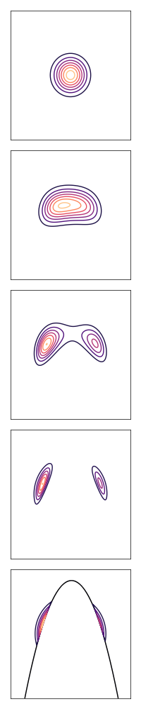
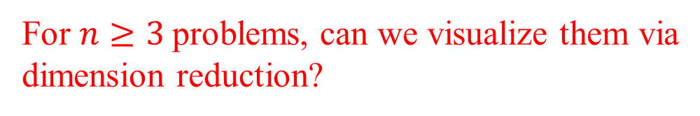
Problem Formulation
Adaptive Importance Sampling (AIS)
Intermediate Density
Approximation
Sampling
Optimal IS density
Sampling
Sampling
For $n≥3$problems, can we visualize them via
dimension reduction?
Sampling
Notes:
A core problem in reliability analysis is to estimate a small failure probability. And Importance sampling is a major method to solve this problem. According to theory of IS, there is one optimal IS density that leads to 0 estimation variance. Unfortunately, the optimal IS density is unknown in practice since the denominator is the quantity of interest.
AIS provides an feasible way to approximate the optimal IS density. For n=2 problems, we can easily visualize the importance distribution, just like this one shown in the below. But for problems with dimensionality greater than 3, that’s not very straightforward. In this presentation, we will show you how to visualize the failure domain and the importance distribution generated by AIS.

Slide 4
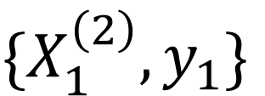
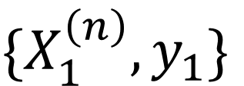

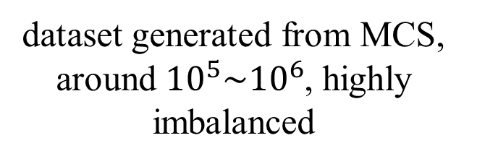
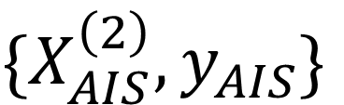

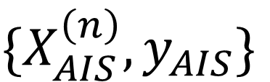

Methodology
dataset generated from MCS, around ${10}^{5}\sim {10}^{6}$, highly imbalanced
$$\{X^{(n)},y\}$$
$$\{X_{AIS}^{\left(n\right)},y_{AIS}\}$$
reduced dataset for training, keeping all positive samples
$$\hat{h}$$
$$\{X_{1}^{\left(n\right)},y_{1}\}$$
$$\{X_{AIS}^{\left(2\right)},y_{AIS}\}$$
$$\hat{h}$$
fitted embedder
can be visualized on 2D plane!
$$\{X_{1}^{\left(2\right)},y_{1}\}$$
training set mapped into 2D plane
Notes:
Here is our idea. First we generate dataset with crude Monte Carlo. This is our original high dimensional dataset. We would like to train an embedder to project this data into 2D plane.
But our data is highly imbalanced which means that positive class is far smaller than the negative class.
Therefore, we form a reduced dataset by keeping all the positive class and part of the negative class.
Then we train an embedder h on this reduced dataset X_1^n and y_1.
After we have a good embedder, we project the data sampled from AIS importance distribution to the 2D plane to check whether the distribution match the failure domain.
Now let’s see some example.

Slide 5
Methodology
Model selection: unsupervised UMAP, supervised UMAP and parametric UMAP.
AIS dataset: samples from ICE-SG, ICE-GM and ICE-vMFNM
ICE: Improved Cross Entropy
SG: single Gaussian
GM: gaussian mixture
vMFNM: von Mises–Fisher–Nakagami mixture
Notes:
We will consider three dimensional reduction algorithm, unsupervised UMAP, supervised UMAP and parametric UMAP, among which parametric UMAP is the most powerful one since it utilizes neural network.
We will consider samples from importance distribution generated by three AIS method: ICE-SG, ICE-GM and ICE-vMFNM.

Slide 6
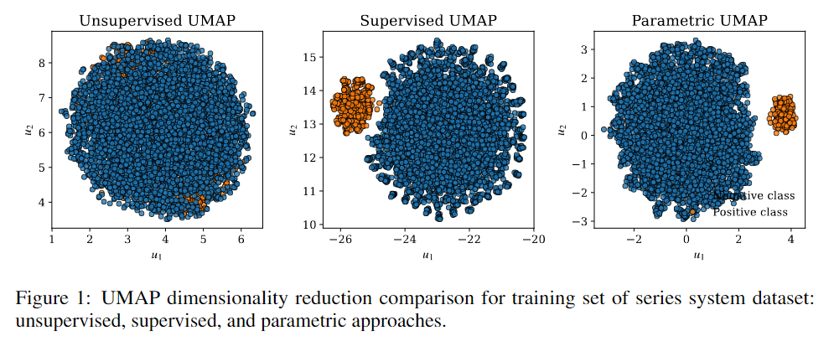
Datasets: Series system dataset
100-dimensional dataset, original dataset of size $10^{6}$, reduced dataset of size 5500.
Notes:
Here is the first dataset, series system dataset, it’s a 100-dimensional dataset, the original size is 10^6, and the reduced dataset for training is 1400.
The training results are shown in fig 1, as you can see, the unsupervised cannot separate the positive class and negative class while the supervised and parametric one did it.
This indicates that the label information is useful in this example.

Slide 7
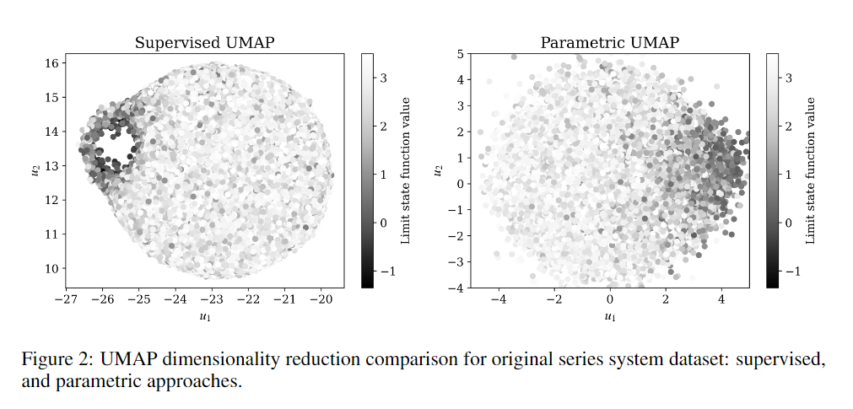
Datasets: Series system dataset
Embedder applied on the original dataset:
Notes:
Next, we apply our trained embedder on the original MCS dataset. Since the unsupervised version is not applicable. We ignore it.
From the results ,we can see that both results show a continuous change of the limit state function value, which means that both algorithms successfully preserve the high-dimensional structure of the original dataset.
And we can safely apply our embedder to ICE dataset. We choose parametric UMAP to proceed.

Slide 8
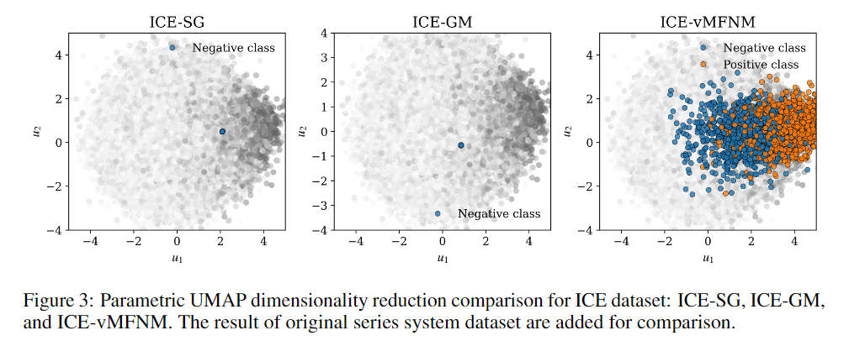
Datasets: Series system dataset
Embedder applied on the ICE dataset:
Notes:
Here is the result, we can see that both SG and GM failed in this example since they generate samples around one single point. And ICE-vMFNM does quite well since it generates a large portion of failure sample.
By using dimension reduction and visualization, we can easily compare the quality of an importance distribution. Just like what we did for 2D problems.

Slide 9
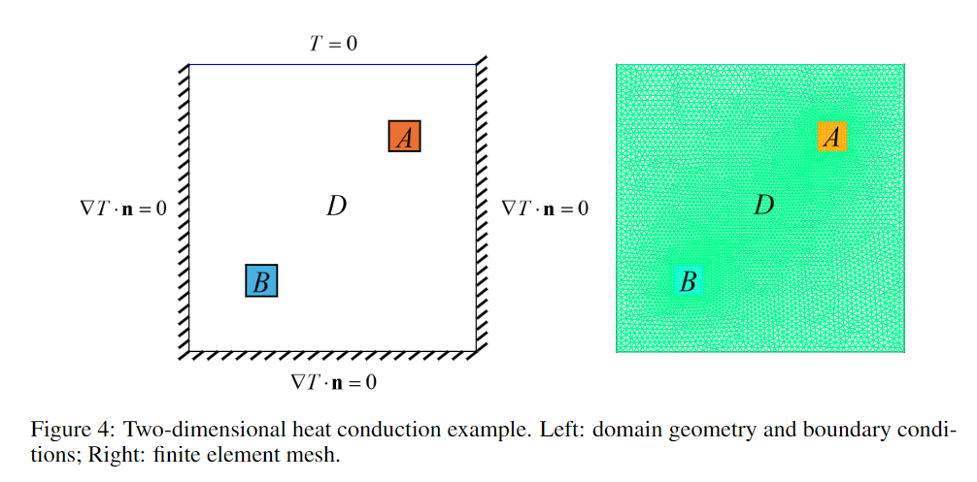
Datasets: Heat diffusion dataset
53-dimensional dataset, original dataset of size ${10}^{5}$, reduced dataset of size 1400.
Notes:
This is the second dataset, which is generated through the following finite element model. This dataset has 53 dimensions.

Slide 10
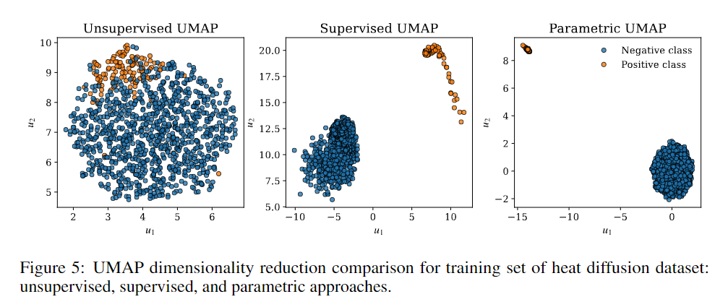
Datasets: Heat diffusion dataset
Embedder applied on the training dataset:
Notes:
Here is the training results. We can see that both unsupervised and supervised UMAP achieves good results, which means that the dataset is easy to separate in the high dimensional space.
However, the supervised version is clearly better since it incorporates label information.

Slide 11
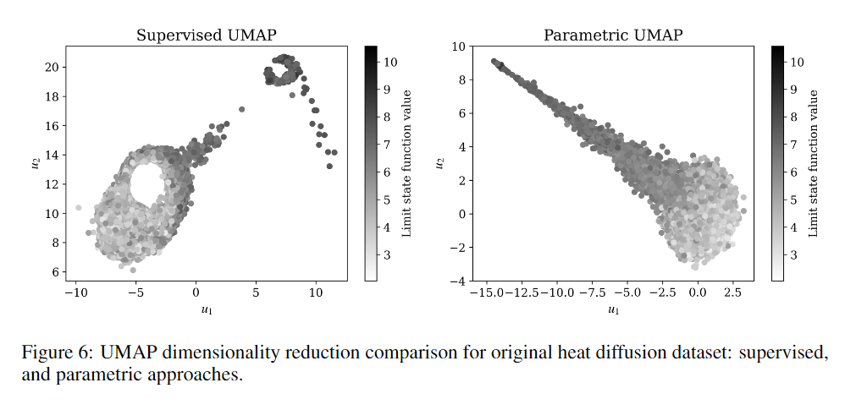
Datasets: Heat diffusion dataset
Embedder applied on the original dataset:
Notes:
We apply both embedder to the original dataset and we can see that the results of parametric UMAP is much better since it displays the continuous change of the g(x) value.
We will proceed with parametric UMAP.

Slide 12
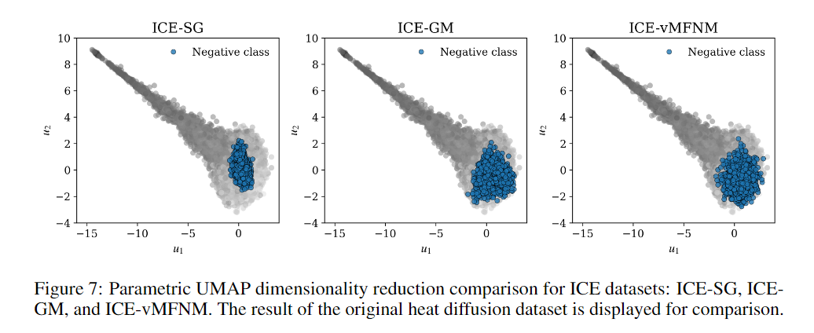
Datasets: Heat diffusion dataset
Embedder applied on the ICE dataset:
Notes:
For this example, we can see that all of three method failed since they can’t generate failure sample.

Slide 13
Conclusions
Dimension reduction algorithms, e.g. UMAP are useful tools to visualize high-dimensional rare event and importance distribution.

Slide 14
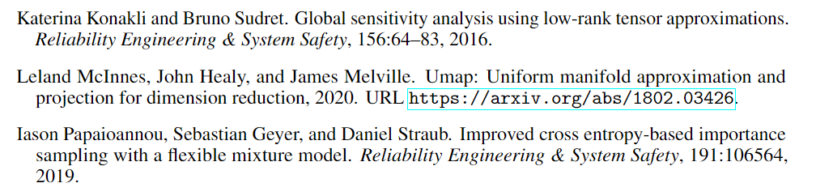
Reference

Slide 15
Thank you!

