Slide 1
GERMAN PENSION REFORM | SATELLITE SECTOR ALLOCATION
Keep, Review, or Switch?
How Quantum Computing Supports Safe Pension Investment Decisions
Decision Date: 31 Dec 2019 | Fiduciary Mandate: Alterssicherungskommission & KENFO Fund Governance
TUM Quantum Hackathon 2026 (QuantWorld) | 10-Minute Executive Pitch

Slide 2
TEAM FINANCE BROSITOS AND BROSITAS
KEEP, REVIEW, or SWITCH?
AN APPROACH TO OPTIMISE PORTFOLIOS USING QUANTUM METHODS
TUM Quantum Hackathon 2026 (QuantWorld) | Final pitch, 30 October 2026 |
Ahmed Mahmoud | Ivan . | Jonas Sandelmann | Manyu . | Mingzhi . | Samarth Seth

Slide 3


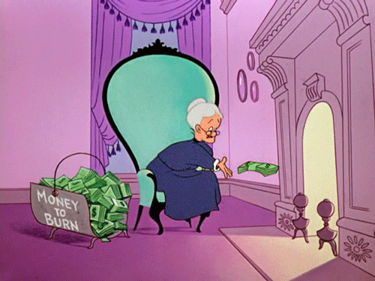

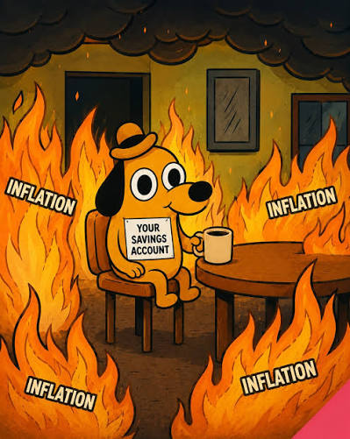







MEME SLIDE

Slide 4
THE CHALLENGE
THE BURNING PENSION GAP (QUITE LITERALLY) DUE TO INFLATION

Slide 5

INFLATION
MY SAVINGS
INFLATION
INFLATION

Slide 6
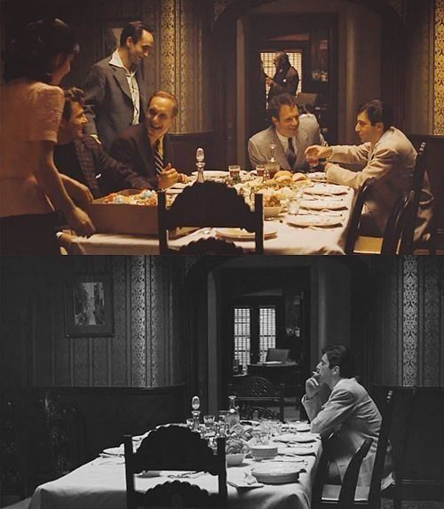
THE DÖNER INDEX
Inflation reality:
€100 kept at 0% interest from 2026 buys only about €76 of goods in 2035
and about €48 in 2050, if prices rise 3% a year. Savings alone cannot
fund a pension.
With 20€ in 2016
With 20€ in 2026

Slide 7


WE SAW AN OPPORTUNITY
WE SAW AN OPPORTUNITY

Slide 8
DISCLAIMER
⚠️⚠️ We are students, not your financial advisers:
this is a teaching model, not financial advice. If it were, our own portfolios wouldn't be this red⚠️⚠️

Slide 9
THE ADVISEE:
THE COMMITTEE OF GERMANY'S NEW PENSION FUND
From 2028, 2% of gross wages go into a public pension fund (the Kapitalrente, no guarantees).
Its independent committee decides how the money is invested.

Slide 10


Slide 11
1. THE CHALLENGE
Savers need growth, but cannot afford big losses
The problem
Inflation eats savings
From 2028, 2% of wages go into a public pension fund
No guarantees: losses hit savers directly
Our questions
Is tech worth the extra risk?
Do losses stay within each saver's limit?
Who protects people who never choose?
KEY TAKEAWAY: Change a pension portfolio only when the evidence is strong.
Source: Alterssicherungskommission (June 2026)

Slide 12
2. THE SETUP
We decide one small slice: 3 of 6 sectors
90%
Core: a broad global index
We don't touch it.
10%
Satellite: 3 of 6 US sectors
Equal thirds: 20 possible baskets.
20
baskets a laptop checks in milliseconds
This exact answer grades our quantum circuit.
KEY TAKEAWAY: A small, checkable decision. We claim no quantum advantage.
Source: our canonical run (results/canonical/summary.json) · data: Kenneth French, 6 US industries, 2015–2019

Slide 13



3. THE SAVERS
Three savers, three different loss limits
LENA | Growth
“I can handle big swings.”
Loss limit
Losses above 8% in at most 6 of 60 months
THOMAS | Balanced
“I never chose a profile.”
Loss limit
Losses above 5% in at most 6 of 60 months
ANNA | Risk-sensitive
“I can't afford big losses.”
Loss limit
Losses above 3% in at most 6 of 60 months
KEY TAKEAWAY: Thomas never chose a profile, so he deserves extra care.
Source: our canonical run (results/canonical/summary.json) · data: Kenneth French, 6 US industries, 2015–2019

Slide 14
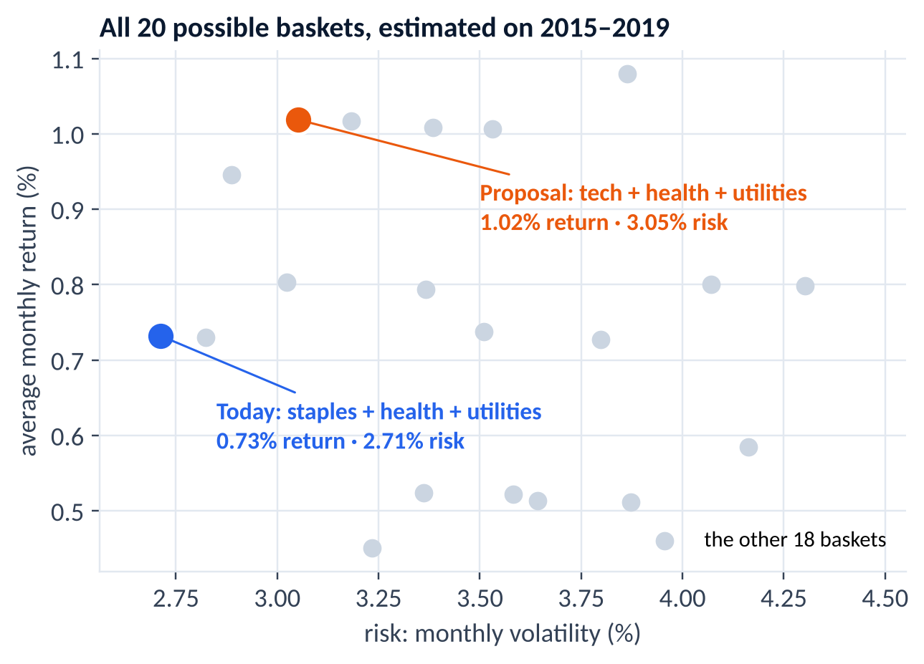
4. THE PROPOSAL | GRANDMA'S BASKET OR NVIDIA'S?
Swap staples for tech: more return, but more risk
The proposal
Sell consumer staples, buy tech
Return: 0.73% → 1.02% a month
Risk: 2.71% → 3.05% a month
No return can buy a breach of the loss limit
KEY TAKEAWAY: Is the extra return worth the extra risk? It depends on the saver.
Source: our canonical run (results/canonical/summary.json) · data: Kenneth French, 6 US industries, 2015–2019

Slide 15
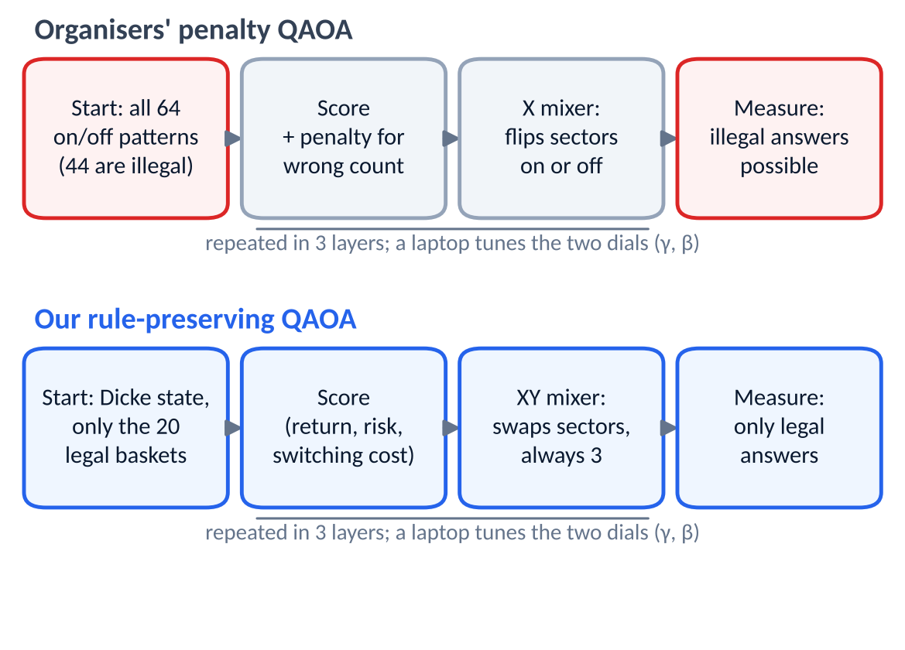
5. THE QUANTUM CIRCUIT
Our quantum circuit can only suggest legal baskets
Our idea
Start with the 20 legal baskets only
Mix by swapping sectors: always exactly 3
Illegal baskets never appear
KEY TAKEAWAY: The rule is built into the circuit, not punished afterwards.
Method: Hadfield et al. (2019), QAOA with Dicke start and XY mixer · code: src/qhf/circuits.py

Slide 16
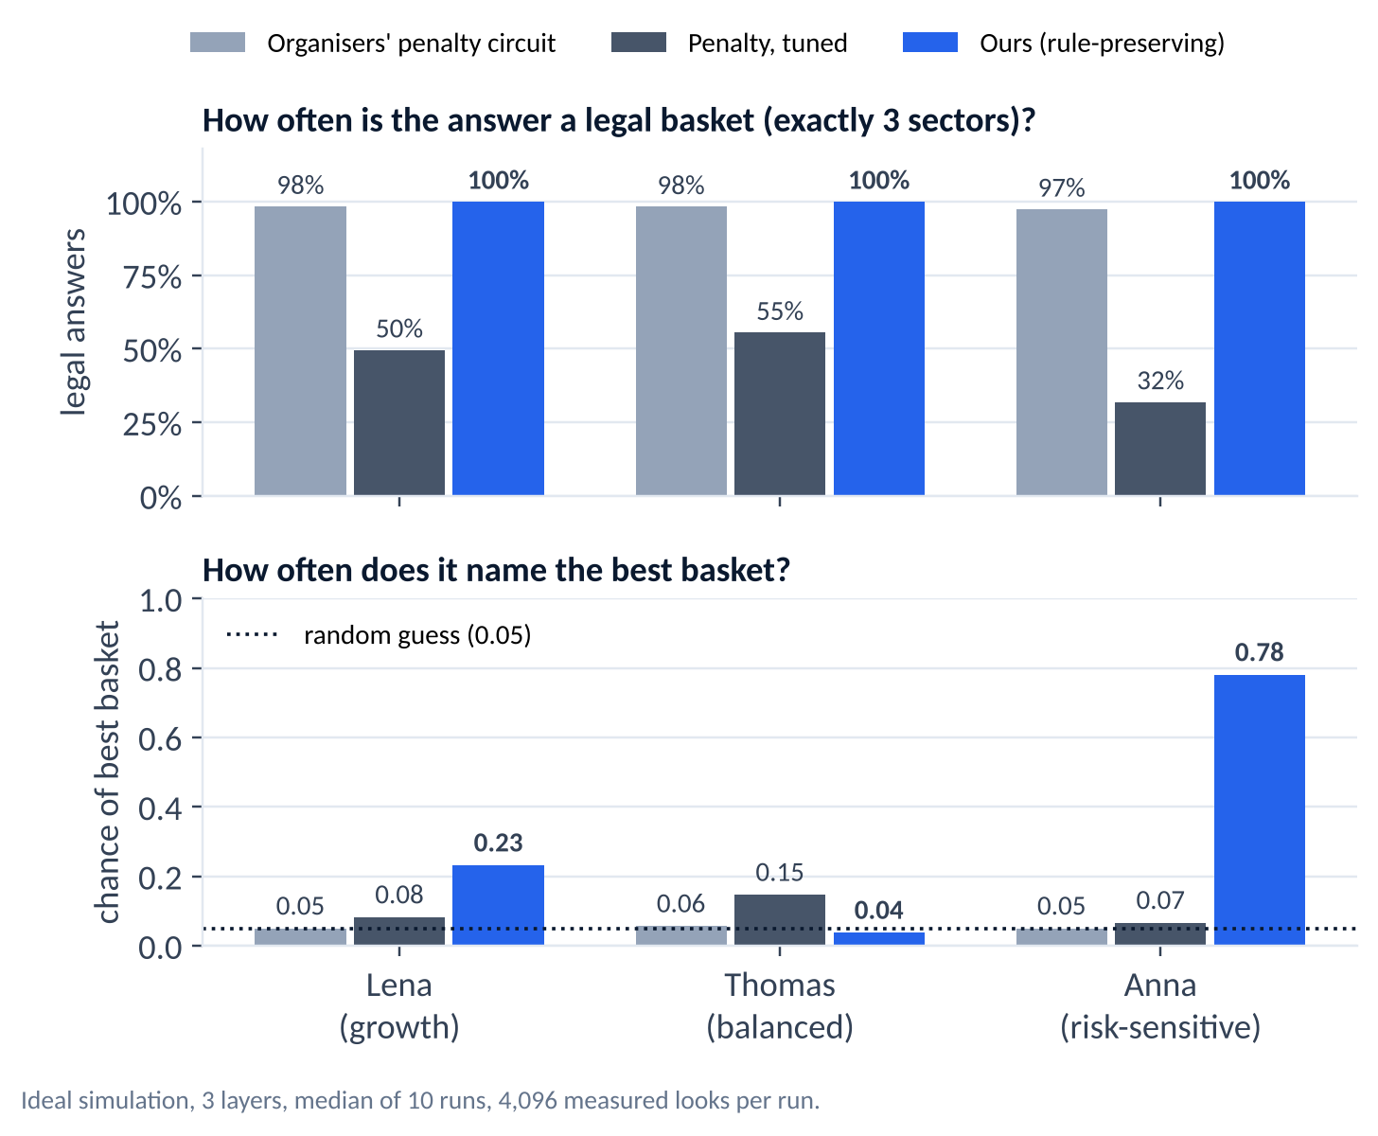
6. QUANTUM RESULTS
Always legal, and far more accurate for Anna
100%
legal answers
Ours, in every run
78%
Anna's best basket found
Organisers' circuit: 5%, the same as guessing
4%
for Thomas
A near-tie: no better than guessing
KEY TAKEAWAY: A clear win where the answer is clear. No magic on a near-tie.
Source: results/canonical/quantum_summary.csv · ideal simulation, 3 layers, 10 runs, 4,096 looks each

Slide 17
7. RESULTS
One proposal, three answers
LENA | Growth
SWITCH
Better in 89% of 500 replays
Wins every stress test
THOMAS | Balanced
REVIEW
Near-tie: flips under stress
Hold until the committee decides
ANNA | Risk-sensitive
KEEP
Lowest risk of all 20 baskets
Tech sits right on her loss limit
KEY TAKEAWAY: “Review” is a valid answer, not a failure.
Source: our canonical run (results/canonical/summary.json) · data: Kenneth French, 6 US industries, 2015–2019

Slide 18
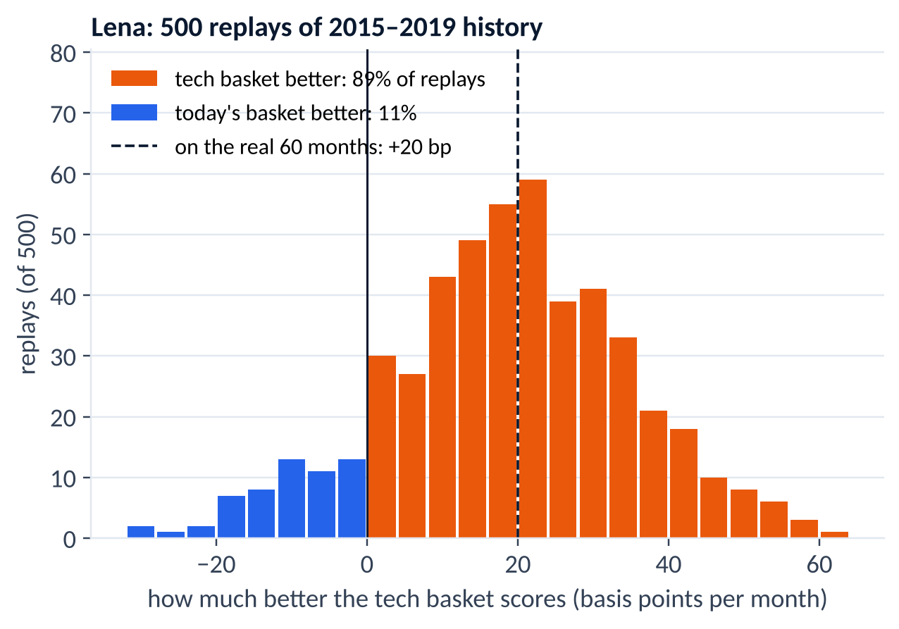
8. LENA
Lena: switching to tech wins every test
LENA: SWITCH
+0.29 points return a month
Better in 89% of 500 replays
Wins every stress test
Switching cost earned back in month 1
KEY TAKEAWAY: Strong evidence → switch.
Source: our canonical run (results/canonical/summary.json) · data: Kenneth French, 6 US industries, 2015–2019

Slide 19
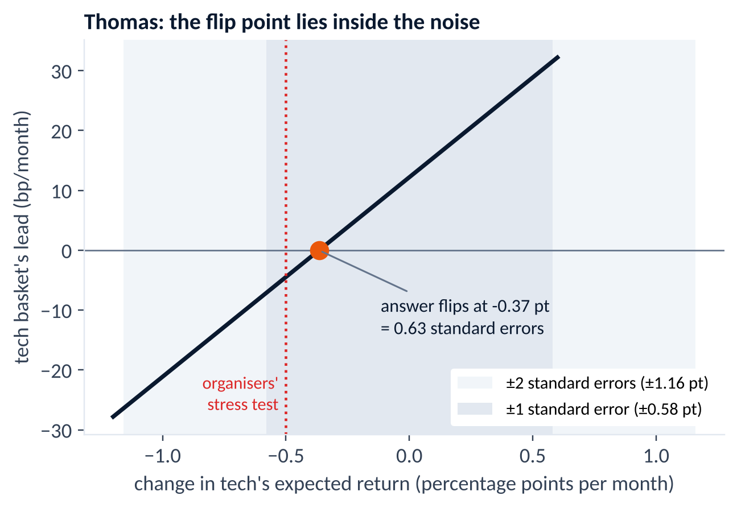
9. THOMAS
Thomas: the data cannot tell the two baskets apart
THOMAS: REVIEW
Tech's lead is tiny: 12 bp a month
It flips if tech earns 0.37 points less
The data's noise is bigger: ±0.58
So: hold, the committee decides
KEY TAKEAWAY: Too close to call → hold.
Source: our canonical run (results/canonical/summary.json) · data: Kenneth French, 6 US industries, 2015–2019

Slide 20
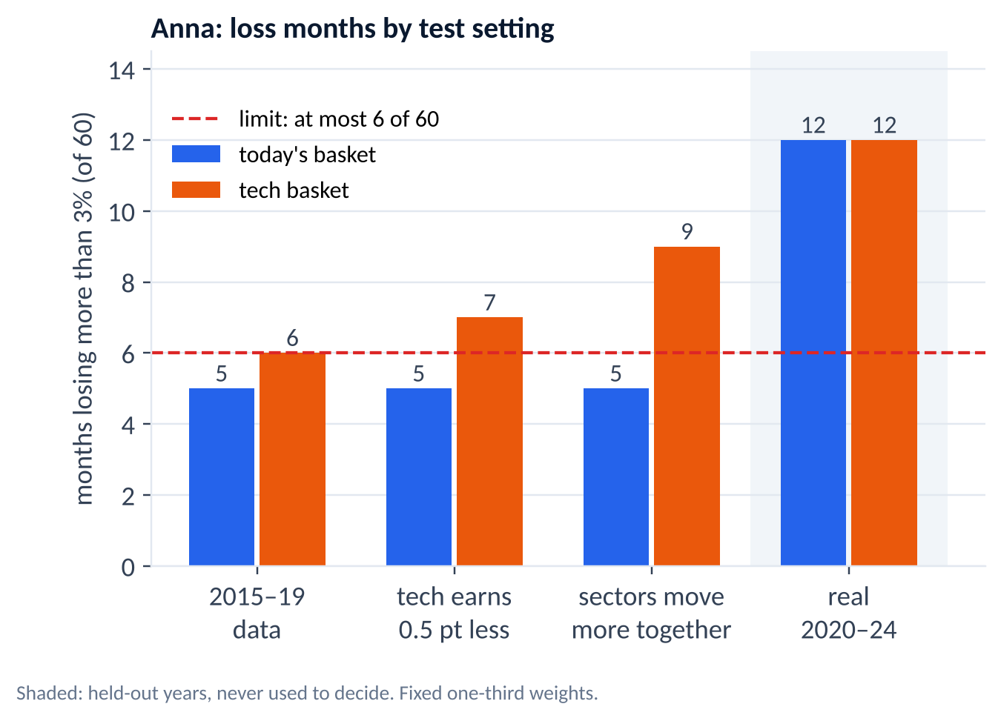
10. ANNA
Anna: today's basket is the safer choice
ANNA: KEEP
Lowest risk of all 20 baskets
Tech basket sits exactly on her limit
Tech fails both stress tests
KEY TAKEAWAY: Safety first → keep.
Source: our canonical run (results/canonical/summary.json) · data: Kenneth French, 6 US industries, 2015–2019

Slide 21
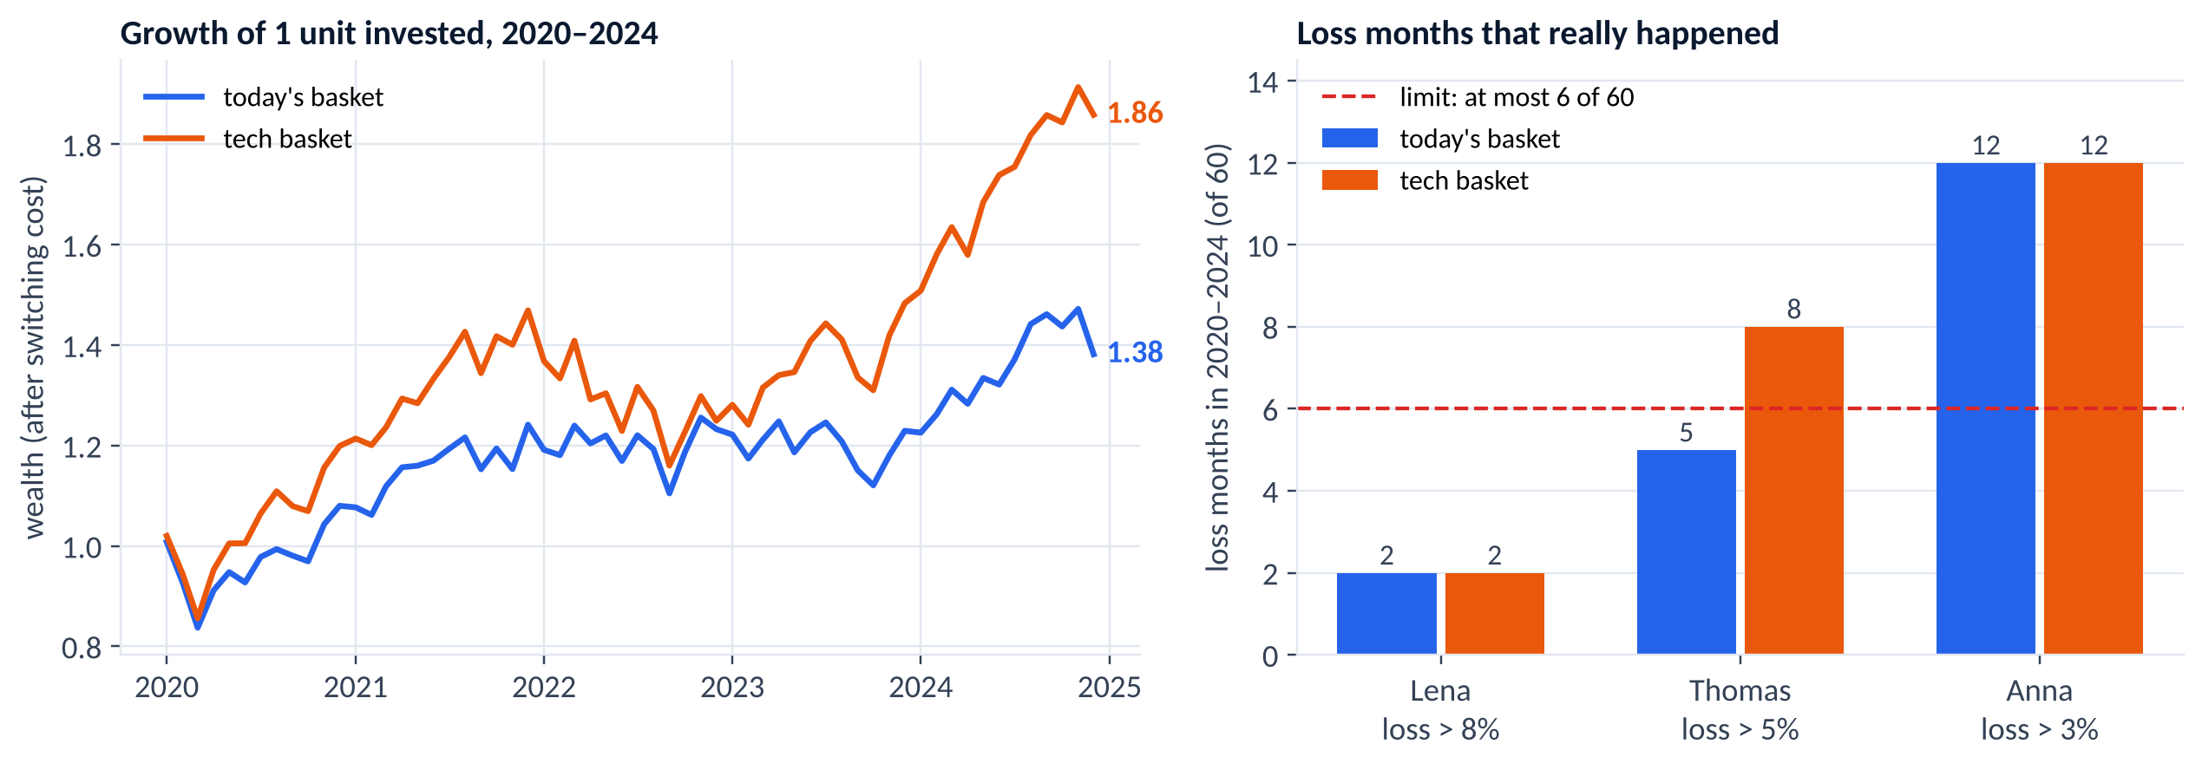
11. REALITY CHECK 2020–2024
Tech grew more, but losses came more often
KEY TAKEAWAY: Hindsight only: Anna's limit broke for both baskets. Our loss model was too optimistic.
Source: results/canonical/loss_limits.csv, holdout.csv · Jan 2020–Dec 2024, never used to decide

Slide 22
12. POLICY
Three rules for using this responsibly
RECOMMENDATION 1 | REVISED
Protect the default
Savers choose a profile. Those who don't get balanced and need protection from fragile bets.
RECOMMENDATION 2 | ADOPTED
Law sets limits, committee sets the mix
Limits are checked exactly and never traded for return.
RECOMMENDATION 3 | ADOPTED
Burden of proof
Switch only with the same winner in every test and at least 70% support.
KEY TAKEAWAY: Policy sets the limits; people make the final call.
Sources: Alterssicherungskommission (June 2026); team policy brief

Slide 23
13. CONCLUSION
Clear answers, from a circuit that keeps the rules
Our answers
Lena: SWITCH
Thomas: REVIEW
Anna: KEEP
From one reproducible run
What quantum added
A circuit that can't break the 3-sector rule
Anna: 0.78 vs 0.05 (organisers')
No quantum advantage claimed
Next: bigger problems, real hardware
KEY TAKEAWAY: Small, honest, reproducible: one command reruns everything.
Source: our canonical run (results/canonical/summary.json) · data: Kenneth French, 6 US industries, 2015–2019

