Slide 1

TUM Quantum Hackathon · Finance track
Keep, review, or switch?
One proposal for Germany’s planned public pension fund, and what it means for Lena, Thomas and Anna
Team Finance · 30 October 2026
Notes:
OPENING (about 30 seconds). We did not build a bigger optimiser. We built a small, checkable decision tool, and we show what would change its answer. The question in our title is the whole talk: should a pension fund keep its portfolio, review it, or switch? And we will answer it for three people. All numbers in this deck come from one reproducible run of our code (results/canonical/summary.json).

Slide 2
Our savers: Lena, Thomas and Anna
Three savers in Germany’s planned public pension fund. The names are labels for the three profiles, not real people.
Lena
Thomas
Anna
Chose: growth
Made no choice: placed in balanced
Chose: risk-sensitive
Accepts big swings.
The default for non-choosers (an open assumption).
Dislikes swings.
The fund’s investment committee decides. The core is a broad index. We decide only the satellite tilt (10%): which 3 of 6 sectors to hold.
Each insured person chooses a profile actively.
Fund: 2% of gross wage, from 2028, no guarantees (Alterssicherungskommission, 2026) · Setting: README.md, docs/decisions.md
2
Notes:
Answers Eden’s question 1: a concrete problem and a concrete user. Germany plans a public fund for a new funded pension, the gesetzliche Kapitalrente: an extra 2 percent of gross wage, phased in from 2028, with no guarantees. Its investment committee decides how the money is invested. Every insured person chooses one of three profiles: growth, balanced or risk-sensitive. It is an active choice, not set by age. People who make no choice are placed in balanced; our team marks this as an open assumption. To make this easy to follow, we give the three profiles names: Lena chose growth and accepts big swings; Anna chose risk-sensitive and dislikes swings; Thomas made no choice, so he is in balanced. The core of the fund stays a broad index. We decide only the satellite tilt, 10 percent in our configuration: which three of six US industry sectors to hold. Sources: README.md, docs/decisions.md, docs/client_germany.md, src/qhf/config.py.

Slide 3
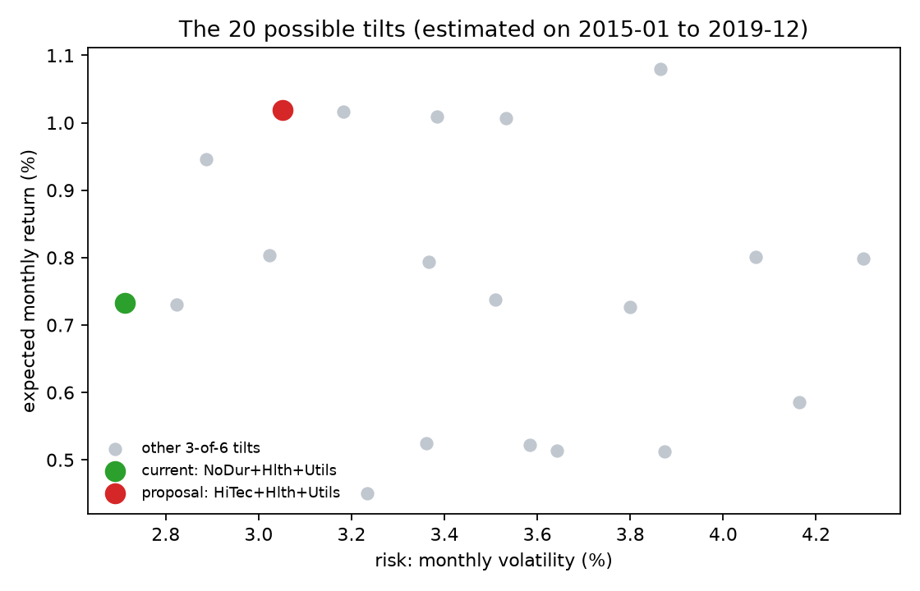
Sell consumer staples, buy technology?
31 December 2019 · estimated on Jan 2015–Dec 2019 only
NoDur
Manuf
Enrgy
HiTec
Hlth
Utils
Current basket: consumer staples (NoDur: food, tobacco, textiles, apparel), healthcare (Hlth), utilities (Utils), one third each.
Proposal: replace NoDur with technology (HiTec).
2015–19, per month | Today | Proposal
Average return | 0.73% | 1.02%
Volatility | 2.71% | 3.05%
Worst month | −8.11% | −7.08%
Months losing over 3% | 8.3% | 10.0%
Green dot: today · red dot: proposal · Data: Kenneth French, 10 Industry Portfolios · docs/problem.md, exact_rankings.csv
3
Notes:
It is 31 December 2019, the decision date. The tilt holds three US industry portfolios in equal thirds: consumer staples, called NoDur in the data (food, tobacco, textiles and apparel), healthcare and utilities. Of all 20 possible baskets, it has the lowest volatility: the green dot in the chart. Someone proposes to sell consumer staples and buy technology, the red dot, because tech had a great five years: about 0.29 points more return per month. But it also swings more, and the risk measures disagree: the worst month was milder, yet months losing more than 3 percent were more frequent. Which measure counts is a mandate choice, not a fact. So: is the higher average worth it for Lena, Thomas and Anna? Numbers: docs/problem.md and results/canonical/exact_rankings.csv.

Slide 4
Each profile has a loss limit that no return can buy
Binding
Preferences
Break one and the basket is out. No amount of return buys it back.
Weighed against each other in one score.
Exactly 3 sectors, equal weight
A loss month means losing more than 8% (Lena), 5% (Thomas) or 3% (Anna)
At most 10% of the 60 months may be loss months
Higher return
Risk, weighted 1 / 5 / 20
Small switching cost (0.002 × turnover)
Tech share limit 100% / 35% / 20% (soft)
Checked exactly, outside the score.
All values: assumptions from the organiser configuration.
Source: src/qhf/config.py (profiles) · docs/decisions.md (tech limit made a preference on 16 Oct)
4
Notes:
Each profile comes with rules, taken from our configuration file. Binding rules cannot be traded for return: exactly three sectors in equal weights, and a loss limit. For Lena, a loss month means losing more than 8 percent; for Thomas 5 percent; for Anna 3 percent. At most 10 percent of the 60 scenario months may be loss months, so at most 6. Preferences are weighed against each other in one score: return, risk with a weight of 1, 5 or 20, a soft tech-share limit and a small switching cost of 0.002 times turnover, which stands for reluctance to trade, not a real fee model. The tech limit was binding at first; the team made it a preference on 16 October, and the verdicts are identical without it. All values are labelled as assumptions from the organiser configuration, not official fund parameters. Sources: src/qhf/config.py, docs/decisions.md.

Slide 5
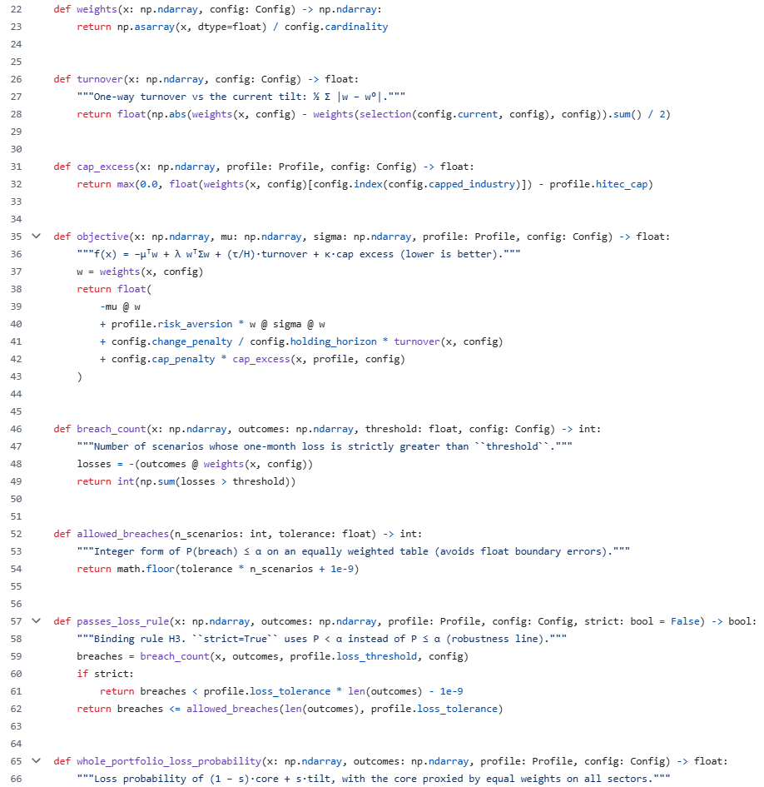
Score every basket; check the loss limit separately
In our code: the scorecard (block 02)
① Reward
② Risk, per saver
③ Loss limit: yes or no
Higher average return lowers the score.
Swings count 1× for Lena, 20× for Anna.
Counts loss months. Not in the score, so return can never buy it.
Shortened from src/qhf/portfolio.py (holding-horizon factor omitted); comments added for this slide
5
Notes:
This is our code, block one, in plain words. Every possible basket gets a score, like a school grade where lower is better. Part one: a higher average return makes the score better. Part two: risk, the swings, makes it worse, and how much depends on the saver: times one for Lena, times twenty for Anna. Then a small cost for every change, and the tech preference. Part three is the important design choice: the loss limit is NOT in the score. It is a separate yes-or-no check that counts the bad months. That way, no amount of return can buy a breach. Our laptop runs these two functions on all 20 baskets: that is the answer key. Full code: src/qhf/portfolio.py and src/qhf/exact.py.

Slide 6
Only Thomas’s best basket changes under stress
Result 1 · the exact answer key: all 20 baskets scored in 3 test settings
Best basket | Base case | Sectors move together | Tech earns 0.5 pts less
Lena · growth | Tech basket | Tech basket | Tech basket
Thomas · balanced | Tech basket | Tech basket | Current basket
Anna · risk-sensitive | Current basket | Current basket | Current basket
Baskets within Anna’s loss limit | 7 of 20 | 5 of 20 | 5 of 20
What the baskets are
For Anna, tech sits right on her limit
Tech basket = tech, healthcare, utilities.
Current basket = consumer staples, healthcare, utilities.
6 loss months of 60 in the base case (6 allowed); 9 and 7 under the two stress tests.
Source: results/canonical/summary.json, “exact” · exact.py ranks every basket in milliseconds
6
Notes:
This is our first real result, straight from the exact answer key. The laptop scores all 20 baskets for each saver, in three test settings: the base case, a stress where sectors move more together, and a stress where tech earns half a point less per month. Lena’s winner is the tech basket every time. Anna’s winner is Current basket every time; only 7 of 20 baskets even pass her loss limit, and under stress only 5. The tech basket sits exactly on her limit: 6 bad months out of 60, with 6 allowed, and it breaks the limit under both stresses. Thomas is the only one whose winner changes: the tech basket in two settings, Current basket when tech earns a bit less. Remember that row; it decides his answer on the next slides.

Slide 7
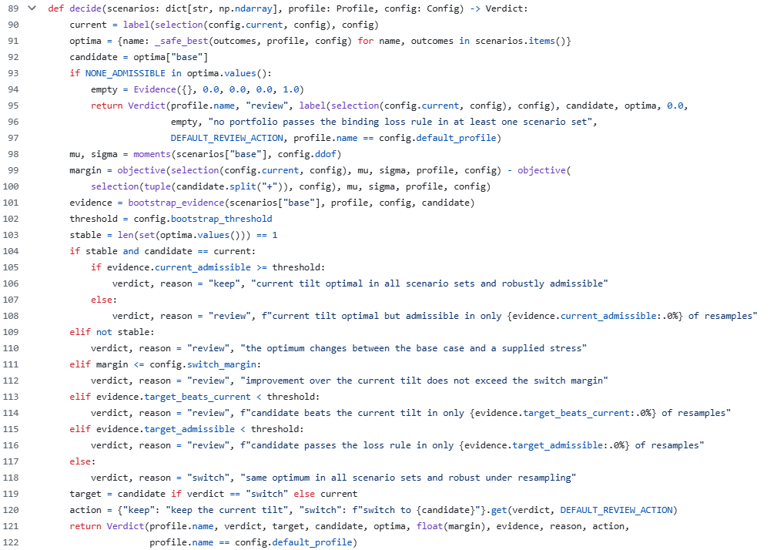
Switching must pass every check; otherwise, hold
In our code: the burden of proof (block 03)
Switch only if the same basket wins in all 3 test settings, beats Current basket in at least 70% of 500 replays, and stays within the loss limit in at least 70%. Otherwise: review, and nothing changes.
Shortened from src/qhf/decision.py, decide(): the real code also checks a minimum margin and records a reason
7
Notes:
Block three of our code: how a verdict is reached. This is the burden of proof, written as code. First: is the winner the same in all three test settings? If the current basket wins everywhere and stays within the loss limit in at least 70 percent of replays, we keep: that is Anna. If the winner changes between settings, it is review: that is Thomas. A switch must pass every further check, better in at least 70 percent of replays and within the loss limit in at least 70 percent; only then switch: that is Lena. Because the rule was written before anyone saw the result, nobody can bend it afterwards. Our first version of this rule was tightened after an AI code review; that is logged in docs/decisions.md.

Slide 8
One proposal, three answers
Result 2 · Lena switches, Thomas waits, Anna keeps
LENA · GROWTH
THOMAS · BALANCED
ANNA · RISK-SENSITIVE
Switch
Review
Keep
We replayed history 500 times. The switch won in 89% of them, in every test setting.
Wins 74% of replays, but a stress test flips it. The committee decides; until then, nothing changes.
Her basket stays within her loss limit in 76% of replays. Tech sits on the line and fails under stress.
Changing must earn it: the same winner in all 3 test settings, and better in at least 70% of 500 replays. Otherwise: review, and hold.
Source: summary.json, “verdicts” (growth 0.886 · balanced 0.74 · risk-sensitive 0.764)
8
Notes:
This is the slide to remember: one proposal, three answers, like a traffic light. We replayed history 500 times by reshuffling the 60 past months. For Lena the switch wins in 89 percent of replays and in every test setting: green, switch. For Anna, the tech basket sits exactly on her loss limit and breaks it under both stress tests; her current basket is best in every setting and stays within the limit in 76 percent of replays: red, keep. For Thomas it is amber: the switch wins 74 percent of replays, but when we lower tech’s return by the organisers’ stress value, the answer turns around. So it fails our burden of proof: the committee has to decide, and until then nothing changes. The three test settings are the base case, a covariance stress (sectors move more together) and a return stress (tech 0.5 points a month lower). If asked about Anna: the tech basket breaks her limit in exactly 6 of 60 months, right on the line, and fails under a strict reading. Figures match results/canonical/summary.json (0.886, 0.74, 0.764).

Slide 9
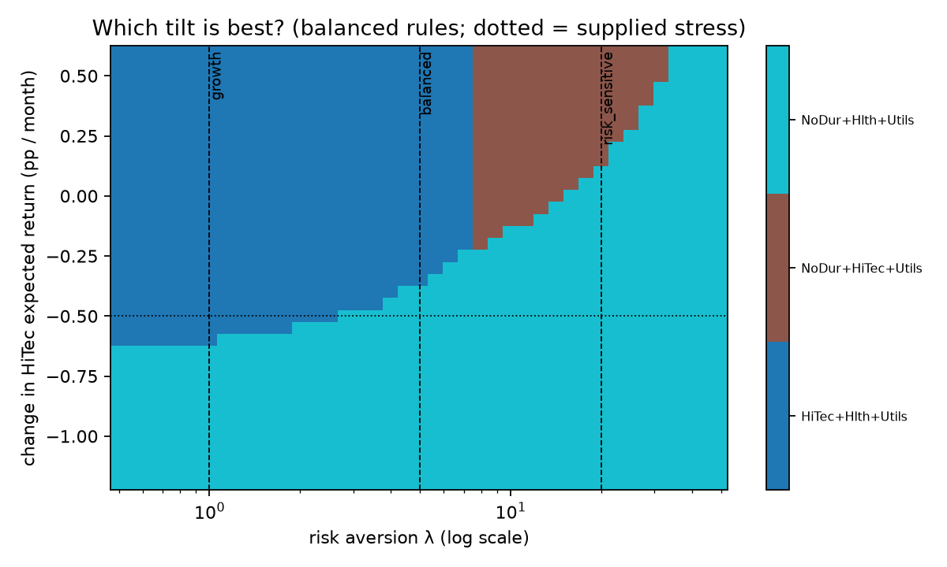
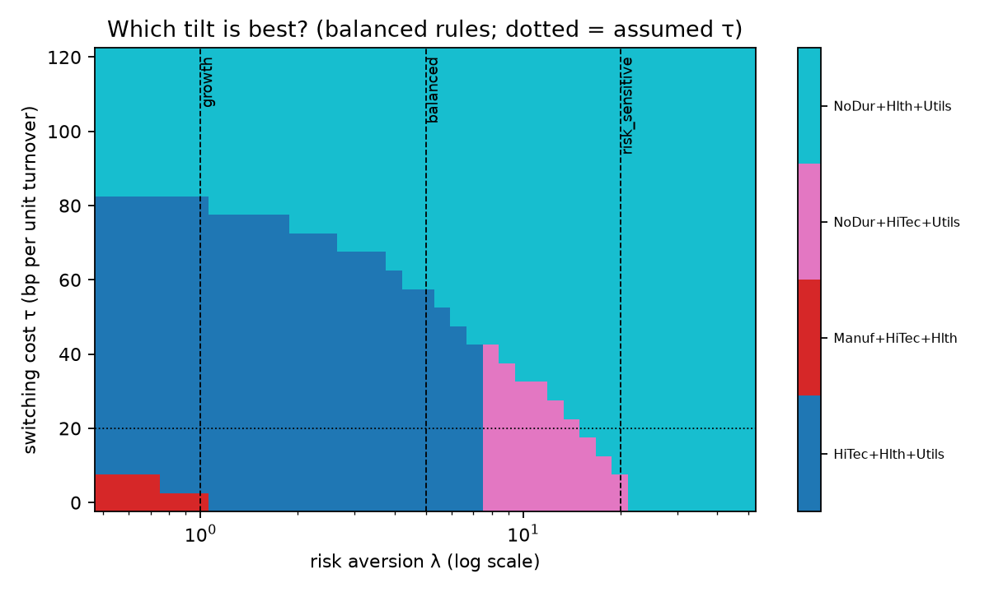
Balanced sits right on the edge
Result 3 · Thomas’s three tipping points, from our sensitivity code
Tech edge −0.37 pts
Switching cost 0.0057
Risk weight 7.5 / 14.9
Tech earns 0.37 pts less per month (supplied stress: −0.50)
about 3× the base 0.002
to NoDur+HiTec+Utils / to current (base 5)
Thomas changes his mind if tech earns just 0.37 points less, and the organisers’ own stress test is already at minus 0.50. Lena would only change her mind if tech earned 0.60 points less, so her answer is more stable. And Anna never flips, because she doesn’t hold tech in the first place.
9
Notes:
Thomas sits right on the edge. Our sensitivity code changes one assumption at a time and finds where his best basket flips. One: if tech earns just 0.37 points less per month, today’s basket wins; the organisers’ own stress test is minus 0.50, already beyond that. Two: if switching cost about three times our base value, he should not switch. Three: if risk counted 7.5 instead of 5, staples, tech and utilities would win; at 14.9, today’s basket. On the left map, the colour on his dashed line changes at about minus 0.37. For comparison, Lena flips only at minus 0.60, and Anna never flips with tech. So the data cannot settle Thomas’s answer: review. Source: summary.json, break_even (sensitivity.py).

Slide 10
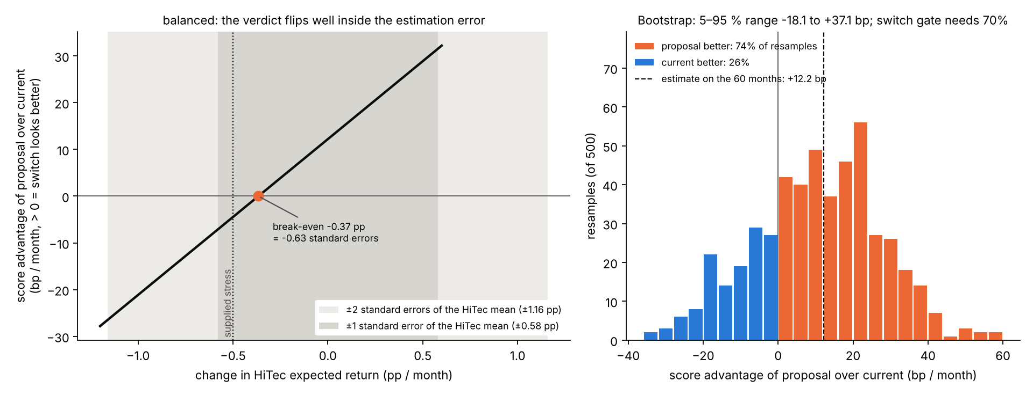
Thomas’s flip point is inside the noise
Result 3 · tech’s 1.51% a month is only an estimate (± 0.58 points); Thomas flips at −0.37
Source: results/canonical/estimation_error.csv, bootstrap_advantage.csv (sensitivity.py) · grey bands: ±1 and ±2 standard errors · 500 replays
10
Notes:
In plain words: the tech basket looks 12 basis points a month better for Thomas. But that rests on one number, tech’s average return of 1.51 percent a month, and 60 months cannot pin it down: it could easily be 0.58 points higher or lower. That is one standard error, the dark grey band. Thomas’s answer flips if tech earns just 0.37 points less, well inside the dark band; the organisers’ stress of minus 0.5 is already beyond it. Right side: we replayed the 60 months 500 times, drawing months at random with repeats. The switch was better in 74 percent of replays (orange) and worse in 26 percent (blue). So the data cannot tell the two baskets apart for Thomas, and our rule says review. For comparison, Lena’s flip point is minus 0.60, about a full standard error away; Anna would need tech to do better, not worse. Source: results/canonical/estimation_error.csv and bootstrap_advantage.csv, made by src/qhf/sensitivity.py.

Slide 11
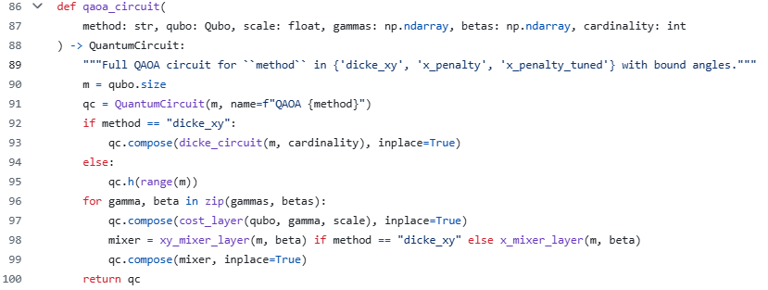
A circuit that can only suggest a legal basket
In our code: the quantum step (block 04)
Result (ideal simulation, 3 layers)
Legal baskets: 100% · organisers’ 97–98% (tuned: 32–55%)
Anna’s best basket found: 0.78 · organisers’ 0.05, no better than a random guess (1 in 20)
So the rule is never broken, and for Anna it finds the right answer far more often. For Lena and Thomas the gain is smaller, and there is no quantum advantage at this size.
STEP 1 · START
STEP 2 · TILT
STEP 3 · STIR
THEN · MEASURE
A “cloud” over all 20 legal baskets. Illegal ones never appear.
Push the cloud towards baskets with a better score.
Let it drift to neighbouring baskets, always with 3 sectors.
A laptop tunes the two dials; we look 4,096 times and take the most frequent basket.
From src/qhf/circuits.py, qaoa_circuit(); comments added for this slide · Method: Hadfield et al. (2019) · circuit diagram: appendix
11
Notes:
Answers Eden’s question 5: the technical part through a concrete example. These eight lines are the heart of our quantum code. Six qubits, one per sector. The organisers’ version, the else-branch, starts with all 64 on-off patterns, including illegal ones with two or five sectors. Ours starts with a cloud that sits only on the 20 legal baskets. Then, in each round, we tilt the cloud towards baskets with a better score from the previous slide, and stir it with a special mixer, the XY mixer, that swaps sectors but always keeps exactly three. A normal computer tunes the two dials, called gamma and beta. At the end we look 4,096 times; the basket that appears most often is the suggestion. Technically: QAOA with a Dicke-state start and an XY mixer, run on a laptop simulator. Circuit diagram: appendix, or ask our technical team member.

Slide 12
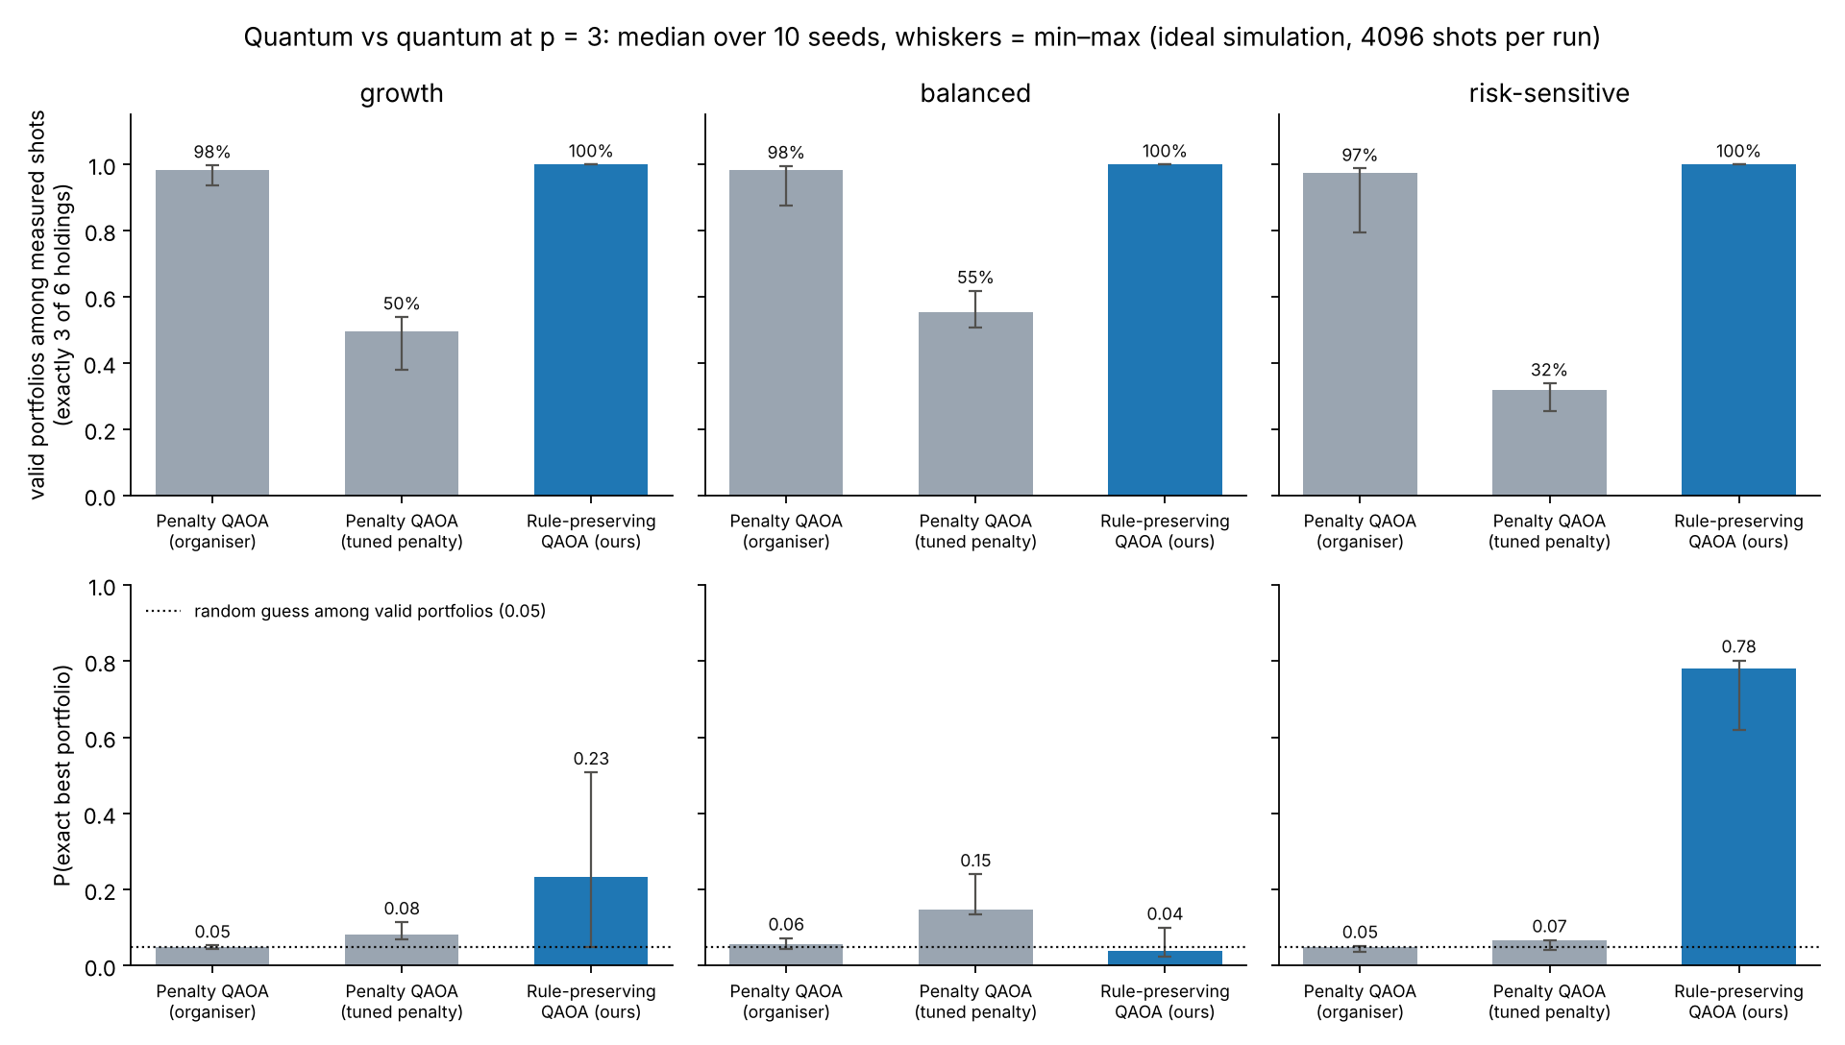
Always a legal basket; far better only for Anna
Result 4 · our circuit vs the organisers’ · ideal simulation, 3 layers, 10 runs, 4,096 looks each
Top row: legal baskets. Ours: 100% of looks, in every run. Organisers’: 97 to 98%. With a tuned penalty: only 32 to 55%.
Bottom row: best basket found. Anna: 0.78 vs 0.05. Lena: 0.23. Thomas: 0.04, a near-tie where ours is no better than a guess (0.05).
No quantum advantage: a laptop checks all 20 baskets in milliseconds.
Source: results/canonical/quantum_summary.csv (qaoa.py) · median of 10 runs · blue = ours, grey = organisers’ circuits
12
Notes:
Does the circuit from the last slide work? Top row: what share of the 4,096 looks are legal baskets, with exactly three sectors. Ours: all of them, every time, because the rule is built into the circuit. The organisers’ circuit instead adds a penalty for illegal baskets. With their large penalty, 97 to 98 percent of looks are legal, but then, bottom row, it finds Anna’s best basket only 5 percent of the time, which is what a blind guess among 20 baskets gives. With a smaller, tuned penalty it finds better baskets but wastes half or more of its looks on illegal ones. Ours finds Anna’s best basket 78 percent of the time and Lena’s 23 percent. For Thomas, the near-tie, ours is no better than a guess; a variant with a different objective (CVaR) reaches 25 percent. Numbers are medians over 10 random starts; the whiskers show the lowest and highest run. This is an ideal simulation; with simulated measurement noise during tuning, ours drops to 0.36 for Anna. A re-run on a second laptop gave the same verdicts, with quantum numbers within 0.01. No quantum advantage: a laptop checks all 20 baskets in milliseconds. Source: results/canonical/quantum_summary.csv, src/qhf/qaoa.py.

Slide 13
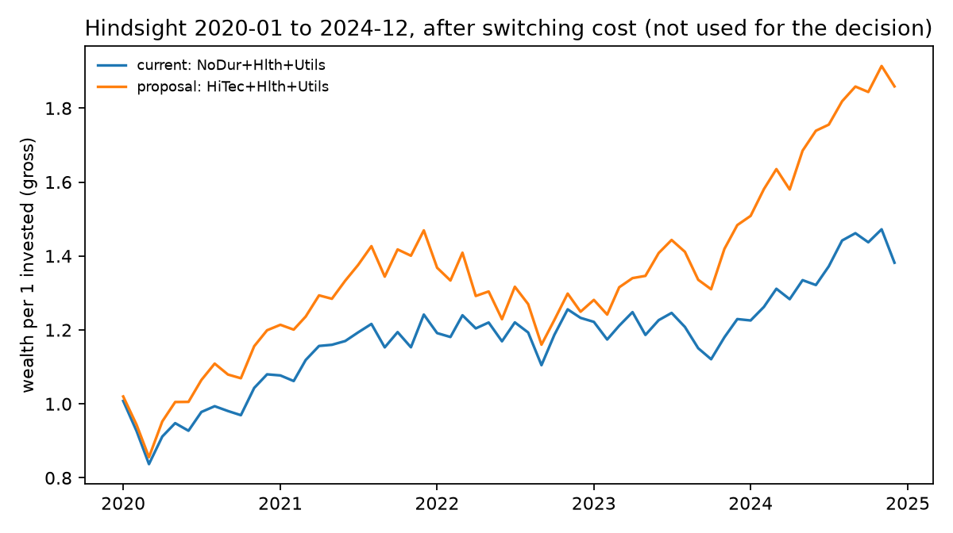
Tech grew more; loss months came more often
Result 5 · 2020–2024 is a check, never a decision input
2020–24 | Today | Proposal
Wealth per 1 invested | 1.38 | 1.86
Deepest fall | −17% | −21%
Thomas’s loss months (limit 10%) | 8% | 13%
Anna’s loss months (limit 10%) | 20% | 20%
Feb–Mar 2020: Current basket lost 17% in two months. In 2022, tech fell 32%.
One path cannot prove the 2019 decision right or wrong. It shows our loss model was too optimistic.
Source: summary.json, “holdout” (evaluation.py), incl. switching cost · 2020 and 2022 figures computed from the organisers’ data
13
Notes:
Now we watch the replay, but we do not change the referee’s call: 2020 to 2024 is held back and never used for the decision. From 2020 to 2024, one unit invested in Current basket grew to 1.38; in the proposal to 1.86, after the switching cost. So Lena’s switch paid off. But the proposal also fell deeper, minus 21 percent against minus 17. And loss months came more often than our 2015–2019 data said: under Thomas’s rules the proposal broke the 10 percent limit with 13 percent of months; under Anna’s rules Current basket had loss months in one month out of five. In February and March 2020 it lost 17 percent in two months, and in 2022 tech fell 32 percent; we computed these two figures from the organisers’ data. One path cannot prove the 2019 decision right or wrong, but it shows our loss model, built on calm years, was too optimistic. Rebalancing at 2 or 5 percent drift did not beat simply holding the proposal. Source: results/canonical/summary.json and holdout.csv.

Slide 14
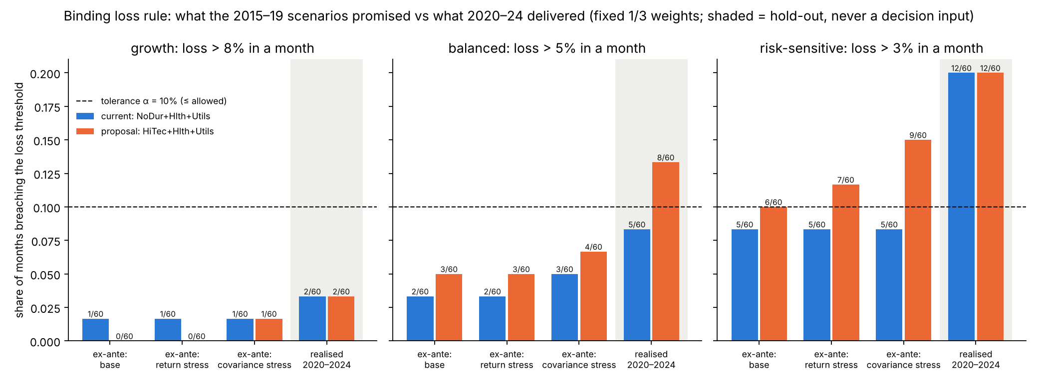
The loss limit held for Lena, not for Anna
Result 6 · loss months that 2015–19 promised vs what 2020–24 delivered (at most 6 of 60 allowed)
Source: results/canonical/loss_limits.csv (evaluation.py) · fixed one-third weights · shaded = 2020–24, never a decision input
14
Notes:
Here we check the binding rule itself. Each bar counts loss months out of 60; the dashed line is the limit, at most 6 months. The first three pairs of bars are what our 2015–2019 data and the two stress tests said; the shaded pair is what really happened in 2020–2024. Lena, left: 2 of 60 for both baskets, so the limit held. Thomas, middle: his current basket stayed within the limit with 5, the tech basket would have broken it with 8; holding, our review verdict, was the safer call. Anna, right: every 2015–2019 test said her current basket was fine with 5 bad months; in reality it had 12, twice the limit, and so did the tech basket. Our loss model, built on 60 calm months, was too optimistic. That is why the decision card says: do not rely on the model’s loss estimate alone. Source: results/canonical/loss_limits.csv, src/qhf/evaluation.py.

Slide 15
No quantum advantage, and we say so
What we showed
What we assumed
Next steps
An encoding that keeps the rules: 100% legal samples
Every result graded against the exact answer
A map of what flips the answer
Same verdicts on a second laptop, one command
Mandate numbers are ours, not the fund’s
Equal weights, exactly 3 of 6 sectors
Switching cost is a proxy, not a fee model
60 months of US sectors, in dollars
Loss rule applied to the tilt; whole portfolio only as a side view
Noisy simulation, then real hardware
Strong classical solvers on larger problems
Global data, in euros
A tail-risk model beyond 60 calm months
The profile choice tested with real savers
Already known, not claimed by us: optimisers amplify estimation error (Michaud, 1989); quantum optimisation has no established advantage; claims should stay proportionate to evidence (Kop et al., 2024).
15
Notes:
Answers Eden’s questions 4 and 6: what did we show, what is assumed or untested, what limits it, and what comes next. Say this before the jury does. Twenty options are trivial for a laptop, so quantum is not faster here. What we did show is a correct, rule-keeping encoding, graded against the exact answer, a map of what changes the result, and a run anyone can reproduce in about 22 minutes. What we assumed: our own mandate numbers, equal weights, a simple switching cost, 60 months of US data. Next steps: noisy simulation and hardware, comparison with strong classical solvers on larger problems, global data in euros, and testing the profile sheet with real savers. The binding loss rule is applied to the satellite tilt; the code also reports a whole-portfolio view (tilt at 10 percent, core approximated by equal weights on all sectors), but only as a side view. Results come from ideal simulation; a shot-noise check exists in the results folder. Some points come from the literature and we do not claim them as our findings.

Slide 16
Decision card: use the optimiser as advice
Switch growth · review balanced (hold until the committee decides) · keep risk-sensitive
WHO GAINS
WHO LOSES
HOW CONFIDENT
Growth savers: more expected return. All savers: decisions that are recorded and checkable.
Growth savers carry more concentration and deeper falls (−21% vs −17%). Cautious savers give up return if tech keeps winning.
Growth: fairly high. Risk-sensitive: moderate to high. Balanced: low, a near-tie that flips under stress.
DO NOT FOLLOW IT IF
WHAT AI SUGGESTED, AND WHAT WE DID
tech’s 2015–19 edge came from a rally you do not expect to continue.
AI suggested the risk route, a robo-advisor client, age-based profiles and a binding tech cap. We chose the allocation route, the public fund, profiles chosen by savers, and the tech cap as a preference.
Same content as docs/decision_card.md · printed as the A5 Decision Card
16
Notes:
This slide mirrors the printed A5 Decision Card the brief asks for. Recommendation in one sentence: use the optimiser as advice, switch the growth profile, send balanced to committee review and hold, keep risk-sensitive. Could the committee act tomorrow? Only on growth and risk-sensitive, and only as advice to a human decision. The strongest argument against us: 60 calm months cannot settle the balanced case, and our loss model proved too optimistic in 2020–2024, so a committee may simply prefer to hold everywhere. Do not follow the switch if tech’s 2015–2019 edge came from a rally you do not expect to continue; and do not rely on the model’s loss estimate alone, because 2020–2024 broke it more often than estimated. Risk-sensitive is only moderately certain: it passes its loss rule in 76 percent of replays, and in 12.6 percent no portfolio passes at all. Two more AI points from the decision log: the organisers’ notebook, which looks AI-written, missed the risk-sensitive optimum in all three seeds; and our first verdict rule was tightened after an AI code review, because “best of all 20” almost never passes with near-ties, so we ask the pairwise question instead. This slide follows the team’s docs/decision_card.md; all AI deviations are logged in docs/decisions.md.

Slide 17
Policy Recommendations
01
02
03
Codify model governance in the guidelines
Define the default profile in law
Require a supervised pilot phase
Optimiser output is treated as a proposal for the committee to approve. Binding limits are verified outside the model; results within estimation uncertainty are referred for review.
The implementing law should specify and justify the profile for savers who make no active choice, with standardised disclosure of each profile’s loss limit and record.
Any optimiser runs in shadow mode for the first twelve months under independent validation. Use of external quantum providers requires a prior classical benchmark.
Who: Investment committee
When: Before investment begins in 2028
Who: BMAS and the fund
When: Implementing law, early 2027
Who: Committee; BMAS for the statute
When: First year of operation
17
Notes:
[Presented by the policy team. These are recommendations from the team’s policy brief; the code shows the problem, it did not test these remedies.] Our code showed one thing we did not expect: people who never choose are placed in balanced, the only profile that ends in review. Thomas never chose and got the shakiest answer. That leads to three rules. One: codify model governance in the fund’s guidelines. Optimiser output is only a proposal for the committee to approve; binding limits are verified outside the model; results within estimation uncertainty are referred for review. Who: the investment committee, before investment begins in 2028. Two: define the default profile in law. The implementing law should specify and justify the profile for savers who make no active choice, with a standard disclosure of each profile’s loss limit and record. Who: BMAS and the fund, early 2027. Three: require a supervised pilot. Any optimiser runs twelve months in shadow mode under independent validation, and external quantum providers must first pass a classical benchmark. Who: the committee, with BMAS for the statute, in the first year of operation.

Slide 18
References
FINANCE AND METHODS
POLICY AND RESPONSIBILITY
French, K. R. (2026). 10 Industry Portfolios [Data set]. Kenneth R. French Data Library.
Markowitz, H. (1952). Portfolio selection. The Journal of Finance, 7(1), 77–91.
Michaud, R. O. (1989). The Markowitz optimization enigma: Is “optimized” optimal? Financial Analysts Journal, 45(1), 31–42.
Ledoit, O., & Wolf, M. (2004). Honey, I shrunk the sample covariance matrix. The Journal of Portfolio Management, 30(4), 110–119.
Lucas, A. (2014). Ising formulations of many NP problems. Frontiers in Physics, 2, 5.
Hadfield, S., et al. (2019). From the quantum approximate optimization algorithm to a quantum alternating operator ansatz. Algorithms, 12(2), 34.
Alterssicherungskommission. (2026). Empfehlungen der Alterssicherungskommission. Die Bundesregierung.
BaFin. (2021). Big data and artificial intelligence: Principles for the use of algorithms in decision-making processes.
Directive (EU) 2016/2341 (IORP II). (2016). Official Journal of the EU, L 354.
Regulation (EU) 2022/2554 (DORA). (2022). Official Journal of the EU, L 333.
Kop, M., et al. (2024). Ten principles for responsible quantum innovation. Quantum Science and Technology, 9(3), 035013.
TUM Quantum Hackathon Finance Team. (2026). Model governance for Germany’s planned Kapitalrente fund [Policy brief].
Code, decision log and full results: github.com/jonas221101/quantum-hackathon-finance
18
Notes:
Leave this slide up during questions. Every claim we did not prove ourselves is backed here: data, finance theory, the QUBO and mixer methods, and the policy sources. The full legal references are in the policy brief; code, the decision log and the canonical results are in our GitHub repository.

