Slide 1
TUM QUANTUM HACKATHON · FINANCE TRACK
Keep, switch or review?
Choosing three of six industries for the German Kapitalrente fund, checked with two quantum algorithms
Decision date 31 Dec 2019 · Estimates from 2015–19 · Allocation route
No quantum advantage is claimed. 20 options can be solved exactly in an instant.
Notes:
Opening: we did not build a bigger optimiser. We built a small, checkable decision tool and show what would change the answer. All numbers come from the canonical run (results/canonical/summary.json).

Slide 2
1 · THE PROBLEM
Swap calm sectors for technology?
Holding today
Proposal
Consumer staples (NoDur), healthcare (Hlth), utilities (Utils). One third each.
Sell NoDur, buy technology (HiTec). Tech had a great 2015–19.
Lowest swings of all 20 possible portfolios.
About +0.29 points more return per month, but more swings.
Not “find the best portfolio”
Why it is hard
Build a case that lets people decide, with clear rules, honest uncertainty and a way to see what flips it.
Only 60 months of data, a tech rally inside it, and a cost for every switch.
Source: supplied data, 2015–19; figures from the canonical run
Notes:
Set the scene: 31 December 2019. Three calm sectors, one proposal to move into tech. The point of the task is a decision a committee can defend, not a single best portfolio.

Slide 3
2 · THE CLIENT
The German government’s public pension fund
Planned “gesetzliche Kapitalrente”: 2 % of wages invested by a public fund modelled on KENFO. The commission asks for broad diversification, costs up to 0.1 % a year and no guarantees.
Core
Satellite tilt
Broad index. Most of the money. Not our decision.
Three of six sectors, equal weight. This is what we decide.
Who | Role
Investment committee | Decides
Portfolio managers | Use the result
Insured people | Bear the losses. Each chooses a profile actively, not by age
Source: Alterssicherungskommission, June 2026 (not yet law). Mandate numbers are our assumptions.
Notes:
Client is the German government via the planned public fund. The 3-of-6 decision is a small satellite tilt; the core stays a broad index, as the commission demands. Profiles are chosen actively by each insured person, because age-based tilts would treat generations unequally. Default for people who do not choose: balanced (open assumption).

Slide 4
3 · THE DECISION
Which three sectors, for which profile?
Each insured person picks one profile. We give the committee one of three answers for each.
Growth
Balanced
Risk-sensitive
Accepts big swings. A monthly loss above 8 % must be rare.
Middle way. Loss above 5 %. Also the assumed default.
Dislikes swings. Loss above 3 % must be rare.
Keep
Switch
Review: not enough evidence
“Review” is a real result, not a failure. All profile numbers are assumptions from the organiser config.
Notes:
Three profiles, three possible answers. Review means: the evidence does not settle it and the committee must state a belief. Default action in that case is to hold.

Slide 5
4 · THE RULES
Binding rules are never for sale
Binding
Preferences
Break one and the portfolio is not allowed. No amount of return buys it back.
Weighed against each other in one score.
Higher return
Lower risk (weight 1 / 5 / 20)
Fewer changes (small switching cost)
Tech weight limit 100 % / 35 % / 20 %
Exactly 3 holdings, equal weight
Chance of a big monthly loss at most 10 %. Loss size: 8 % / 5 % / 3 %
Checked exactly, not guessed.
The tech limit is a preference, by team decision.
If everything sat in one score, enough return could “buy” a violation. Values are organiser assumptions.
Notes:
Key design choice. The cardinality rule is built into the quantum circuit; the loss tolerance is an exact check after the choice, because a probability over scenarios is not a simple formula in the variables. The HiTec limit was binding at first and was changed to a preference (penalty 0.01) by the team on 16 October; verdicts are identical without it.

Slide 6
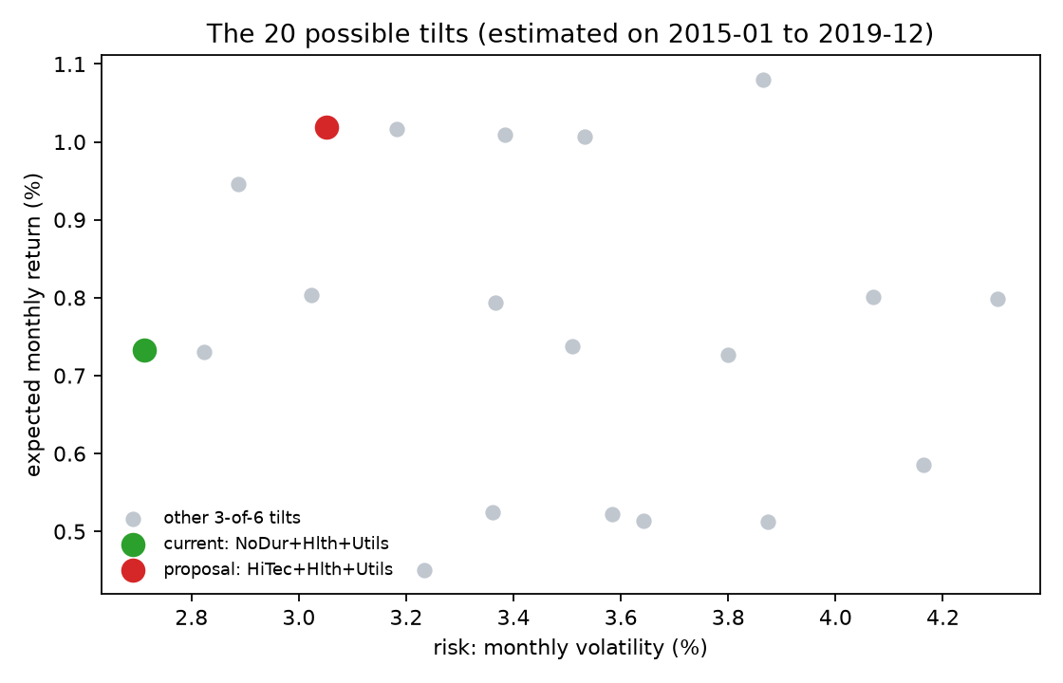
5 · THE 20 OPTIONS
Six switches, twenty legal settings
Each industry is a switch (on = held). 64 settings, only 20 with exactly three on. A normal computer checks all 20 instantly: our answer key.
2015–19 monthly | Current | Proposal
Average return | 0.73 % | 1.02 %
Volatility | 2.71 % | 3.05 %
Worst month | −8.11 % | −7.08 %
Loss above 3 % | 8.3 % | 10.0 %
Risk measures disagree. Which one counts is a choice, not a fact.
Source: supplied data 2015–19, canonical run (fig_risk_return)
Notes:
Six switches, 64 settings, only 20 with exactly three holdings. That is why enumeration is trivial and why we never say quantum is needed here. The chart shows the tension: return versus swings, and the table shows risk measures that disagree. For the risk-sensitive profile only 7 of the 20 pass the loss rule.

Slide 7
6 · THE QUANTUM IDEA
A cloud of guesses that learns where the cheap portfolios are
NoDur
Manuf
Enrgy
HiTec
Hlth
Utils
One qubit per industry. Light = held. This is today’s holding.
STEP 1 · START
STEP 2 · COST
STEP 3 · MIX
REPEAT · LEARN
Spread evenly over all legal portfolios
Tilt: cheap portfolios become more likely
Stir: let the cloud move to neighbours
A normal computer tunes two knobs, tries again, then we measure
This is QAOA. We run it on a laptop simulator, many times with different seeds.
Quantum is one component. The loss rule and the verdict stay classical.
Notes:
Plain analogy: a cloud sitting on all legal portfolios at once. Step 2 tilts the cloud toward cheap portfolios, step 3 stirs it so it can reach neighbouring portfolios. A classical optimiser adjusts how hard to tilt and stir. At the end we measure many times; the most frequent answer is the suggestion. QAOA is a heuristic; it does not guarantee the best answer.

Slide 8
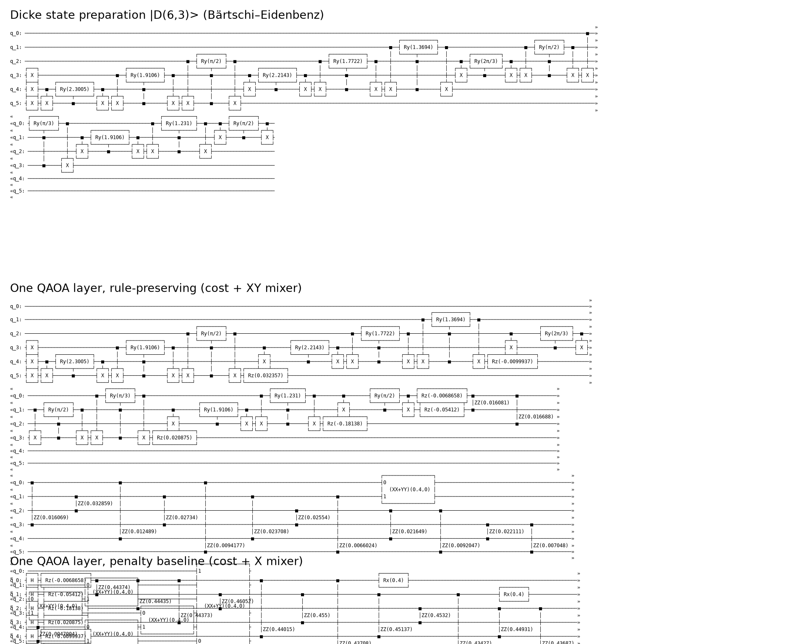
7 · TWO QUANTUM VERSIONS
Fence around the road, or no road at all
 | Organiser: penalty | Ours: Dicke + XY
Start | All 64 settings | Only the 20 legal ones
Stirring | Flips single switches | Swaps on and off, count stays 3
3 holdings | Big punishment in the cost | Cannot be broken
Illegal samples | Yes, 2–68 % | None
Penalty: a fence around a field, and the sheep still wander into the road.
Ours: a field where the road does not exist.
Quantum against quantum. Our circuit is deeper but never leaves the legal set. Exact enumeration is only the answer key.
Notes:
The organiser notebook adds penalties; we move the rule into the circuit. Reference: Hadfield et al. 2019. Our circuit is deeper (depth about 392 at three layers versus 81), a real cost. The loss rule stays an exact check after sampling because it is not cheaply encodable.

Slide 9
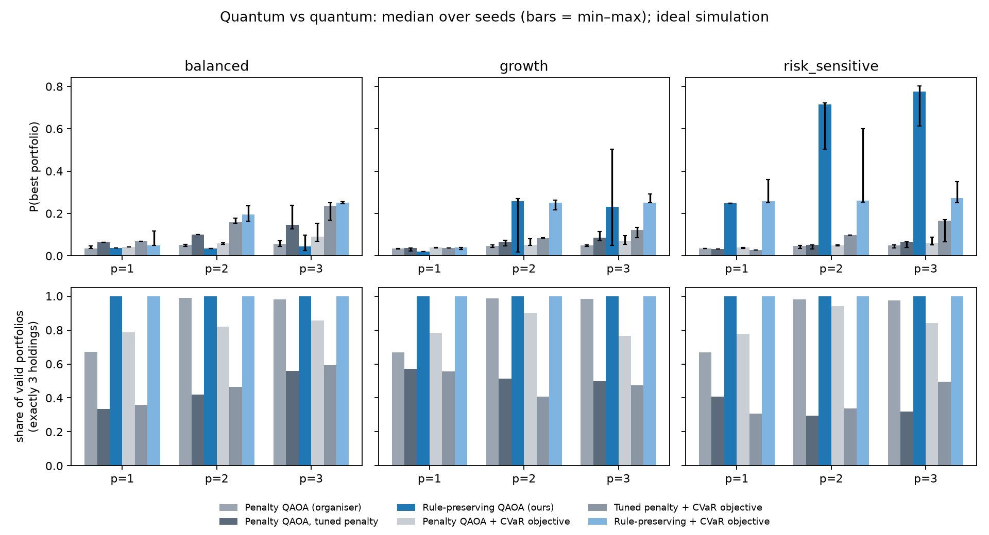
8 · QUANTUM AGAINST QUANTUM
Chance of sampling the exact best portfolio
Six variants: organiser penalty, tuned penalty, ours (rule-preserving), each also with a CVaR objective. Median of 10 seeds, 3 layers. Guessing: 0.05.
Risk-sensitive: ours 0.77 vs 0.05 (organiser), 0.07 (tuned)
Growth: ours 0.23 (CVaR 0.25) vs 0.05, 0.09
Balanced: near-tie. Ours 0.04, with CVaR 0.25
Valid portfolios: 100 % ours, 32–98 % penalty versions
Ideal simulation. Seeds vary a lot (min–max bars). Exact enumeration is the answer key. No quantum advantage.
Notes:
Quantum against quantum, ideal simulation, 10 seeds. Our design wins clearly for risk-sensitive and is better for growth. Balanced is a near-tie: the mean objective fails (0.04), the CVaR objective helps (0.25; the right answer is decoded in 90 percent of runs). Be honest: the tuned penalty also does well at the tie (0.15), but only about half of its samples are valid portfolios. Mean-cost optimisation does not maximise the probability of the best portfolio, and results vary between seeds.

Slide 10
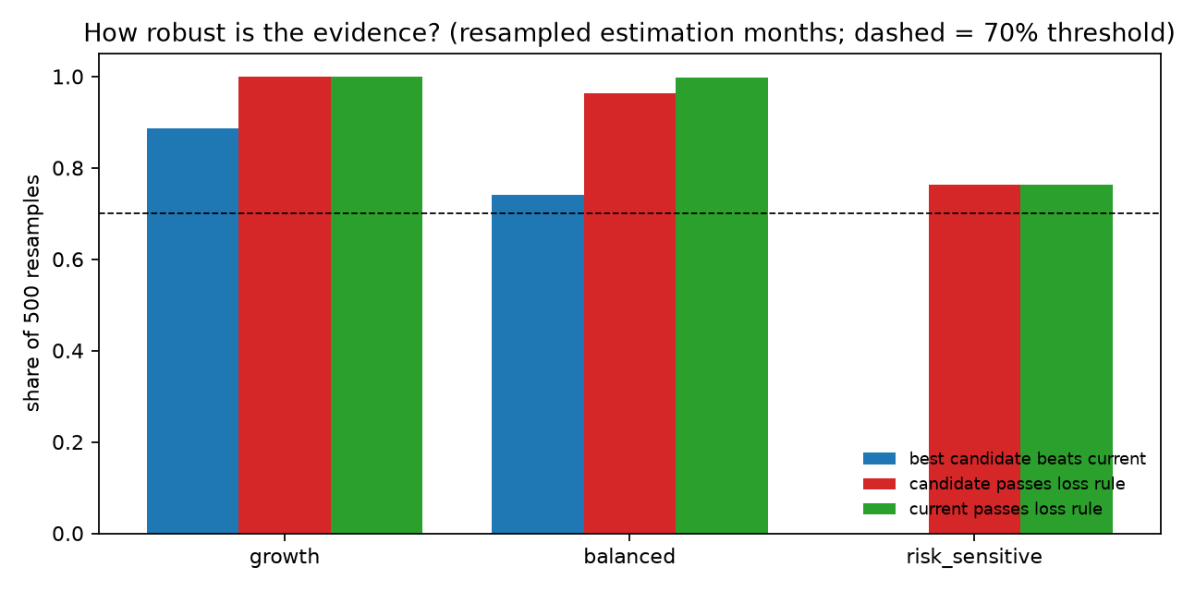
9 · THE VERDICTS
The change must prove itself
Profile | Verdict | Portfolio | Evidence
Growth | Switch | HiTec + Hlth + Utils | Same winner in 3 scenarios; beats current in 89 % of resamples
Balanced | Review | Hold; committee decides | Return stress flips it; beats current in 74 %
Risk-sensitive | Keep | NoDur + Hlth + Utils | Winner in 3 scenarios; passes loss rule in 76 %
Switch needs the same winner everywhere and at least 70 % of 500 resamples in favour. Keep needs the current tilt best and admissible in 70 %.
Balanced is the assumed default, so the fragile answer lands on people who did not choose.
Canonical run. Bootstrap = resampling the 60 months (fig_bootstrap). Tech limit is a preference; same verdicts without it.
Notes:
Verdict rule tightened after code review: burden of proof on the change. Growth switches. Balanced is review because the optimum flips under the supplied return stress and the proposal beats current in only 74 percent of resamples; default action is to hold. Risk-sensitive keeps; it passes the loss rule in 76 percent of resamples and in 12.6 percent no portfolio passes. With the tech limit penalty at zero the verdicts are identical.

Slide 11
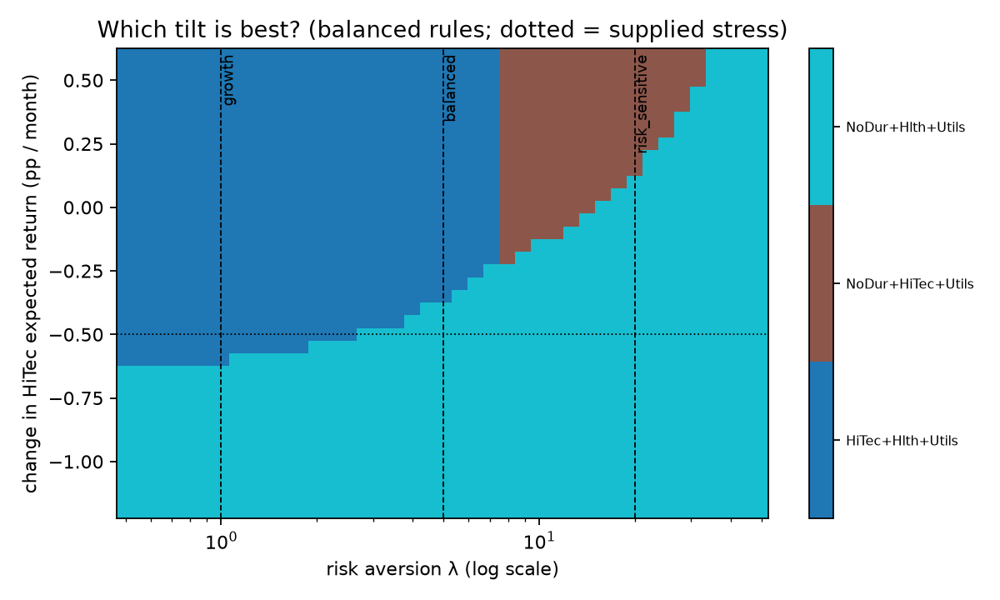
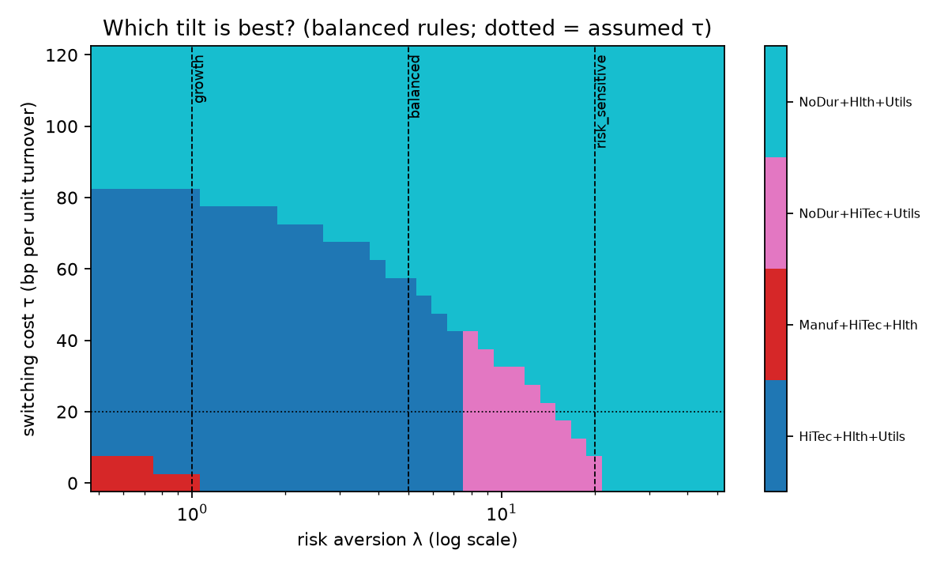
10 · WHAT FLIPS THE BALANCED PROFILE
Three tipping points, close to today
Tech edge −0.37 pp
Switching cost 0.0057
Risk weight 7.5 / 14.9
per month (supplied stress: −0.50)
about 3× the base 0.002
to NoDur+HiTec+Utils / to current (base 5)
Score margin is only 0.0012 per month. Switch only if you believe tech’s edge stays above about 0.37 points.
Notes:
Break-even: the value of an assumption at which the best choice flips. Balanced has three, all close. The pairwise proposal-versus-current break-even is not the whole picture: with risk weight the proposal first gives way to NoDur+HiTec+Utils at 7.5, then to current at 14.9. The risk-sensitive profile uses a risk weight of 20, so it keeps. The tech limit is a preference with penalty 0.01; verdicts are identical without it.

Slide 12
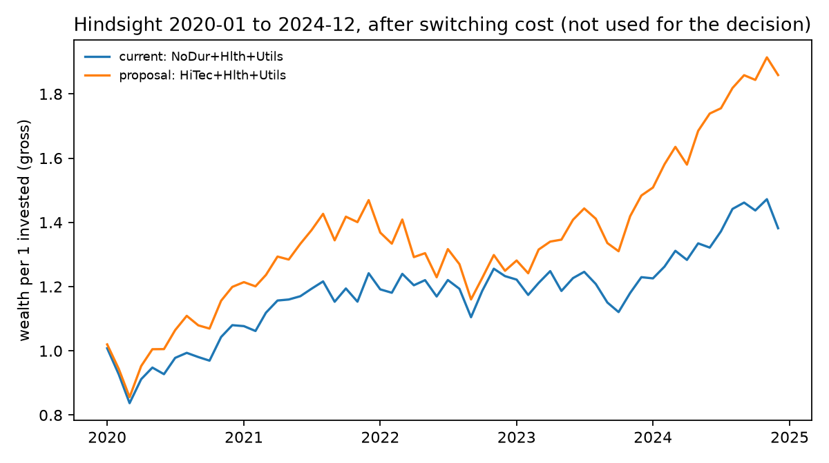
11 · HINDSIGHT, 2020–24
Tech won, and losses came more often
Wealth (incl. switch cost): 1.86 proposal vs 1.38 current
Drawdown: −21 % vs −17 %
Months above each profile’s loss threshold: growth 5 % vs 3 %, balanced 13 % vs 8 %, risk-sensitive 20 % both
Rebalancing at 2 % or 5 % drift did not beat holding the proposal.
Evaluation only, never a decision input. One path does not prove the 2019 decision right or wrong.
Notes:
Hold-out check using the canonical holdout values, including the one-off switching cost. The proposal grew more with a deeper drawdown. Loss frequencies are higher than the 2015-19 scenario model implied, so the loss rule understates tail risk. We use the period to test decision rules and our risk model, not to pick winners after the fact.

Slide 13
12 · RESPONSIBILITY
Is the difference in the world, or in our computer?
Estimation uncertainty
Computational variation
Only 60 months. Measured by resampling the months at least 500 times.
Random seeds, shots, depth. Measured by repeating the quantum run.
Decides Review vs Switch.
Never decides: the exact optimum is always computed.
Active choice: each insured person picks a profile, so it must be explained in plain words.
Default effect: non-choosers get balanced, the most fragile answer. A default needs a justification.
Outside the model: tilt size, the core, liquidity, tax, global universe, politics.
Supervision and DORA applicability are our reading and still to be confirmed. Details: docs/responsibility.md
Notes:
The responsibility issue built into the model: keep estimation uncertainty and computational variation apart, so a committee knows what it is looking at. Before a real institution relies on it: written committee beliefs, independent validation, longer and global data, tail-risk model, fairness check for defaults, local compute only (DORA/sovereignty). KENFO is the template; supervision of the new fund is not fixed by law yet.

Slide 14
13 · LIMITS
No quantum advantage, and we say so
What we do show
What we do not show
A checked encoding that keeps the rules
Every result graded against the exact answer
A map of what flips the answer
Same numbers on a second laptop
That quantum beats classical: 20 options are trivial
Hardware results: simulator only, no noise
Real-fund fit: 60 months, US sectors, no liquidity, tax or ESG
Real mandate numbers: ours are assumptions
Equal weights and exactly 3 holdings are simplifications. The switching cost is a proxy, not a fee model.
A small, transparent result beats a big unexplained one.
Notes:
Say these before the jury does. The value is correct, rule-preserving encoding and verification, and a path to larger problems where enumeration is no longer possible. Even there, advantage is not established.

Slide 15
14 · NEXT STEPS
Before the final pitch on 30 October
NUMBERS
STRESS
POLICY
PITCH
More seeds, more shot-noise runs, final reruns
Ledoit–Wolf, shrunk means, exclusion of Enrgy, the mid-hackathon change
Confirm supervision and DORA reading with the policy advisers
Decision Card, findings note, everyone can explain their part
Do not follow the switch if tech’s edge came from a rally you do not expect to continue.
The one condition on the Decision Card. Code and docs: GitHub repository, README.
Thank you. Questions?
Notes:
Close with the one condition under which the recommendation should not be followed, and with what we will add before 30 October: more seeds, shot-noise runs, more stress tests, confirmation of the policy reading.

