Slide 1

in
Action

Slide 2
Learning Goals
Lectures
Create Database (syntax, character set, collation).
Create Table (syntax, storage engine).
Derived Table
Sub Query
Triggers
Views
Stored Function
Stored Procedures
Temporary Table
Transactions
Code Demo
eLoading Backend App
Use Cases
11 actual transactions from the Code Demo.

Slide 3
https://github.com/jonasalberttan/mysql-in-action

Slide 4

Tools Needed
A database management software
https://dbeaver.io/download/

Slide 5
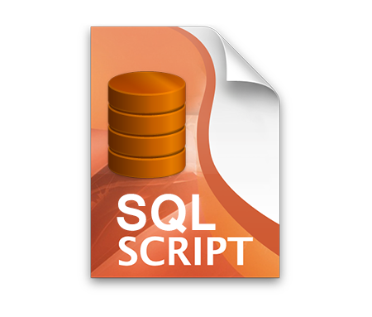
Tools Needed
mysqlsampledatabase.sql

Slide 6

Tools Needed

Slide 7

Tools Needed
open-source software, open-standards, and services for interactive computing across dozens of programming languages.
https://jupyterlab.readthedocs.io/en/stable/getting_started/installation.html

Slide 8
Lectures

Slide 9
Database (classicmodels)
Extract the mysqlsampledatabase.zip
Execute the SQL Script (mysqlsampledatabase.sql) using DBeaver.

Slide 10
Create Database
Syntax

