Slide 1

in
Action

Slide 2
Learning Goals
Lectures
Create Database (syntax, character set, collation).
Create Table (syntax, storage engine).
Derived Table
Sub Query
Triggers
Views
Stored Function
Stored Procedures
Temporary Table
Transactions
Code Demo
eLoading Backend App
Use Cases
11 actual transactions from the Code Demo.

Slide 3

Tools Needed
A database management software

Slide 4
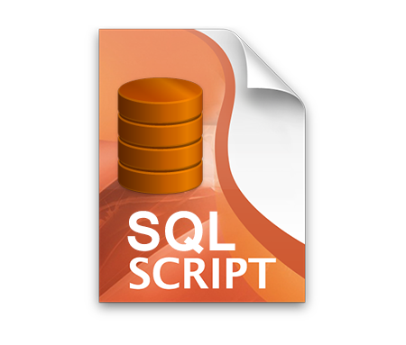
Tools Needed
Mysqlsampledatabase.sql

Slide 5

Tools Needed

Slide 6

Tools Needed
open-source software, open-standards, and services for interactive computing across dozens of programming languages.

Slide 7
Lectures

Slide 8
Database (classicmodels)

