Slide 1
My First MOJO Plugin
Tibor Digaňa
Github repository
https://github.com/Tibor17/maven/tree/master/plugins/firstMojo

Slide 2
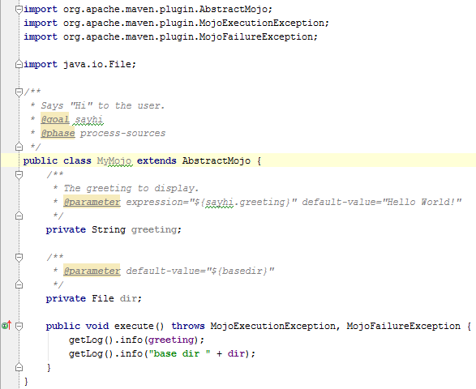
My Mojo Plugin sample.plugin.MyMojo

Slide 3
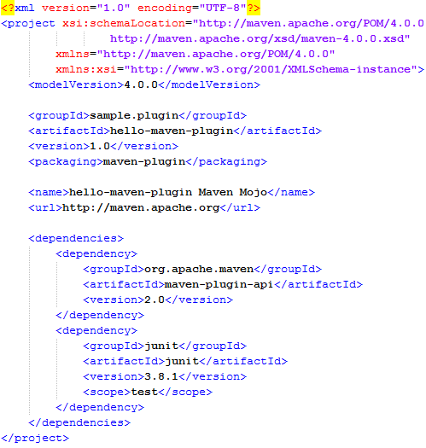
Plugin Project pom.xml

Slide 4
Locations of files
If your plugin pom.xml is located in ${basedir}, then place the java source class sample.plugin.MyMojo in to ${basedir}/src/main/java

Slide 5
Install plugin
cd ${basedir}
mvn install

Slide 6
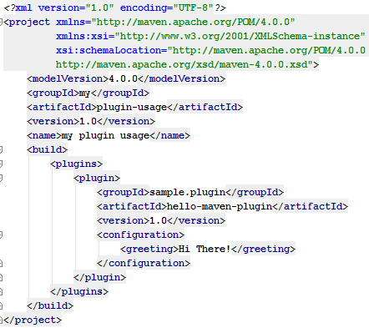
Plugin usage in another pom.xml

Slide 7
Running the plugin’s goal sayhi on another pom.xml
mvn sample.plugin:hello-maven-plugin:1.0:sayhi

Slide 8
Running the plugin’s goal sayhi on another pom.xml
[INFO] Scanning for projects...
[INFO] -------------------------------------------------------------
[INFO] Building my plugin usage
[INFO] task-segment: [sample.plugin:hello-maven-plugin:1.0:sayhi]
[INFO] -------------------------------------------------------------
[INFO] [hello:sayhi {execution: default-cli}]
[INFO] Hi There!
[INFO] base dir c:\Users\tibor17\IdeaProjects\firstMojo\pluginUsage
[INFO] -------------------------------------------------------------
[INFO] BUILD SUCCESSFUL
[INFO] -------------------------------------------------------------
[INFO] Total time: < 1 second
[INFO] Finished at: Fri Jun 15 13:47:40 CEST 2012
[INFO] Final Memory: 2M/15M
[INFO] -------------------------------------------------------------

Slide 9
Running the plugin’s goal sayhi on another pom.xml
Logger printed “Hi There!”
instead of default-value "Hello World!“
See the field “greeting” in MyMojo class

