Slide 1
Enterprise Architecture with Maven Modularity
Tibor Digaňa
Github repository
https://github.com/Tibor17/maven/tree/master/architecture/modularity

Slide 2
Goal
To split product modularity to 3 logical parts
Dependencies Management
Run out of the hell of duplicate versions

Slide 3
Agenda
Explanatory picture
Dependency Management in Maven
Product’s projects (Maven)
Internal projects (Maven)
External artifacts (Maven)

Slide 4
Three Parts of Architecture
Maven projects of a product
Maven artifacts of internal projects
Maven external artifacts - repository

Slide 5
Maven Dependency Management splits to three Build Of Material POMs
Product’s dependencyManagement located in com.xyz:product-bom:pom:1.0.0
Internal projects dependencyManagement located in com.xyz:internal-bundles-bom:pom:1.0.0
External artifacts (in a repository) dependencyManagement located in com.xyz:external-bundles-bom:pom:1.0.0

Slide 6
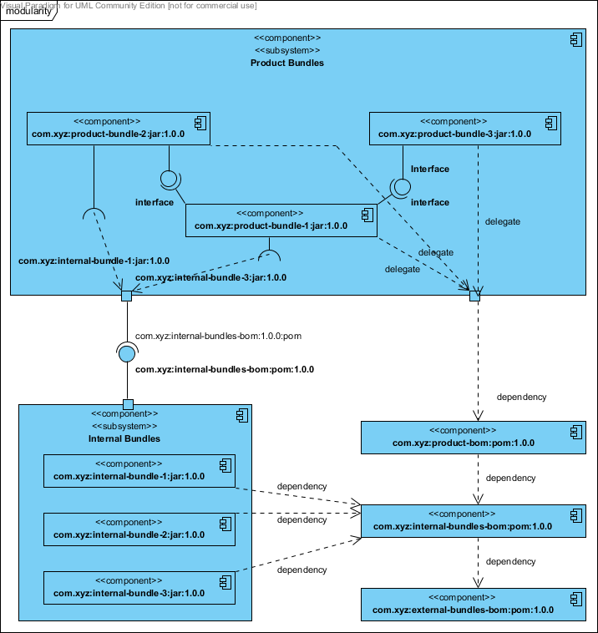
Explanatory Picture

Slide 7
Product’s Projects
See the previous picture, artifacts namely: com.xyz:product-bundle-3:jar:1.0.0 com.xyz:product-bundle-2:jar:1.0.0 com.xyz:product-bundle-1:jar:1.0.0
extend from POM com.xyz:product-bom:pom:1.0.0 which has only dependencyManagement and specifies product Maven modules namely product-bundle-3 product-bundle-2 product-bundle-1

Slide 8
Internal Projects
See the previous picture, artifacts namely: com.xyz: internal-bundle-1:jar:1.0.0 com.xyz: internal-bundle-2:jar:1.0.0 com.xyz: internal-bundle-3:jar:1.0.0
extend from POM com.xyz: internal-bundles-bom:pom:1.0.0 which has only dependencyManagement and specifies product Maven modules namely internal-bundle-1 internal-bundle-2 internal-bundle-1

Slide 9
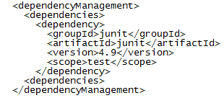
External Artifacts
No projects with sources
Only repositories with deployed open source artifacts
Only POM with dependencyManagement e.g.:

Slide 10
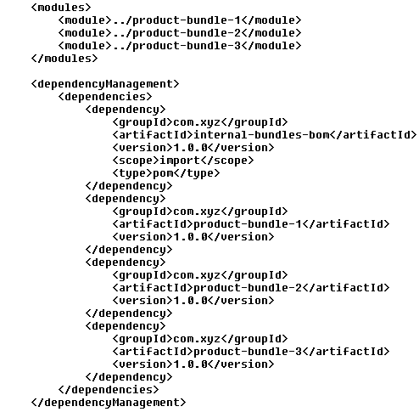
com.xyz:product-bom:pom:1.0.0

Slide 11
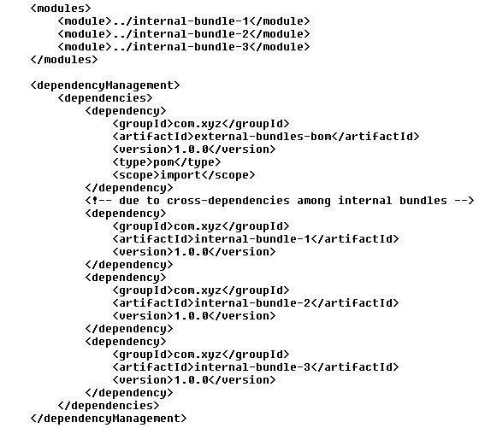
com.xyz:internal-bundles-bom:pom:1.0.0

