Slide 1
System Architecture using Maven Modularity
Tibor Digaňa
Github repository
https://github.com/Tibor17/maven/tree/master/architecture/modularity

Slide 2
Goal
To split product modularity to 3 logical parts
Dependencies Management
Run out of the hell of duplicate and conflicting versions

Slide 3
Agenda
Explanatory picture
Dependency Management in Maven
Product’s projects (Maven)
Internal projects (Maven)
External artifacts (Maven)

Slide 4
Three Parts of Architecture
Maven projects of a product
Maven artifacts of internal projects
Maven external artifacts - repository

Slide 5
Maven Dependency Management splits to three Build Of Material POMs
Product’s dependencyManagement located in com.xyz:product-bom:pom:1.0.0
Internal projects dependencyManagement located in com.xyz:internal-bundles-bom:pom:1.0.0
External artifacts (in a repository) dependencyManagement located in com.xyz:external-bundles-bom:pom:1.0.0

Slide 6
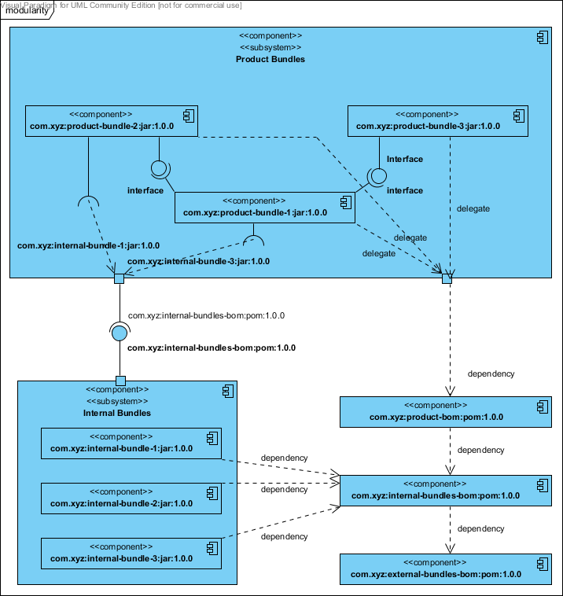
Explanatory Picture

Slide 7
Product’s Projects
See the previous picture, artifacts namely: com.xyz:product-bundle-3:jar:1.0.0 com.xyz:product-bundle-2:jar:1.0.0 com.xyz:product-bundle-1:jar:1.0.0
extend from POM com.xyz:product-bom:pom:1.0.0 which has only dependencyManagement and specifies product Maven modules namely product-bundle-3 product-bundle-2 product-bundle-1

Slide 8
Internal Projects
See the previous picture, artifacts namely: com.xyz:internal-bundle-1:jar:1.0.0 com.xyz:internal-bundle-2:jar:1.0.0 com.xyz:internal-bundle-3:jar:1.0.0
extend from POM com.xyz:internal-bundles-bom:pom:1.0.0 which has only dependencyManagement and specifies product Maven modules namely internal-bundle-1 internal-bundle-2 internal-bundle-3

Slide 9
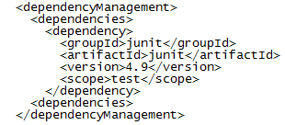
External Artifacts
No projects with sources
Only repositories with deployed open source artifacts
Only POM with dependencyManagement e.g.:

Slide 10
Common BOM’s parent
All three BOM projects have common parent; e.g.:
<parent>
<groupId>com.xyz</groupId>
<artifactId>modularity</artifactId>
<version>1.0.0</version>
</parent>
The parent is important to compile all from scratch.

Slide 11
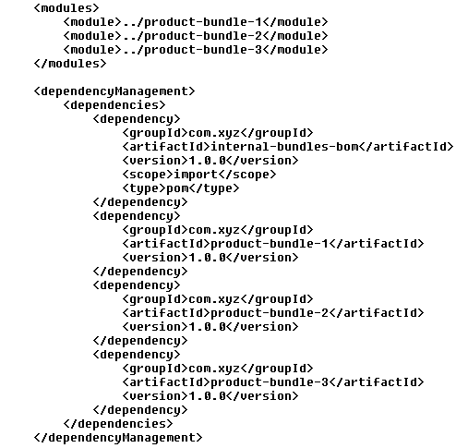
com.xyz:product-bom:pom:1.0.0

Slide 12
com.xyz:product-bom:pom:1.0.0
The project does not validate by itself because new
internal-bundles-bom does not exist in repository.
Therefore deploy with new expected versions:
First alternative
Physically deploy external bundles to your repository
Using external-bundles-bom: mvn deploy
Using internal-bundles-bom: mvn deploy
Deploy product using product-bom: mvn deploy
Second alternative, use the top parent with new children versions:
Simply deploy using top parent com.xyz:modularity:1.0.0

Slide 13
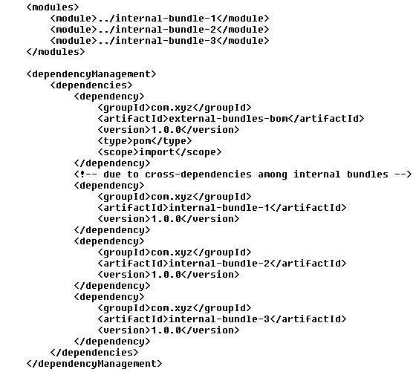
com.xyz:internal-bundles-bom:pom:1.0.0

Slide 14
com.xyz:internal-bundles-bom:pom:1.0.0
In order to deploy internal bundles:
Prepare repository with external artifacts
Resolve conflicts on external artifacts

Slide 15
Resolve conflicting versions
Exclusions applied only to external artifacts.
Conflicts are resolved by increased version (except for major version)

Slide 16
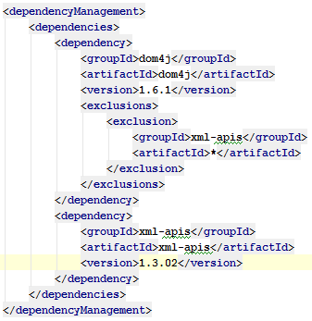
Example of resolving conflicts on external bundles
com.xyz:external-bundles-bom:pom:1.0.0

Slide 17
Dependency Management Violation
</dependencyManagement> declares dependencies by POM packaging project
</dependencies> uses artifacts in children
Properties specifying artifacts versions violate the whole idea of dependencyManagement
See the link (project with <artifactId>bom</artifactId>)
http://maven.apache.org/guides/introduction/introduction-to-dependency-mechanism.html#Importing_Dependencies

Slide 18
Thank you!
Download Sources
https://github.com/Tibor17/maven/tree/master/architecture/modularity

